Slide 1


A Logic-in-memory Computer
HAROLD STONE
1970
Report person：Kejun Liu
Time：2021-12-09

Slide 2

01
Introduction
02
High-speed Buffer Memory
C O N T E N T
03
Summary

Slide 3

1
P A R T O N E
Introduction

Slide 4
Introduction
1
2
3
The cost of microelectronic
arrays in the future will tend to reflect the number of pins on the array.The logic-in-memory array is an extremely attractive computer component.
Used as a cache, a logic-in-
memory array performs as a high-speed buffer between a
conventional CPU and a conventional memory.
Because of the high-speed, highly parallel sector operati ons, the logic-in-memory computer points to a new
direction for achieving orders
of magnitude increase in computer performance.

Slide 5

2
P A R T T W O
High-speed Buffer Memory

Slide 6
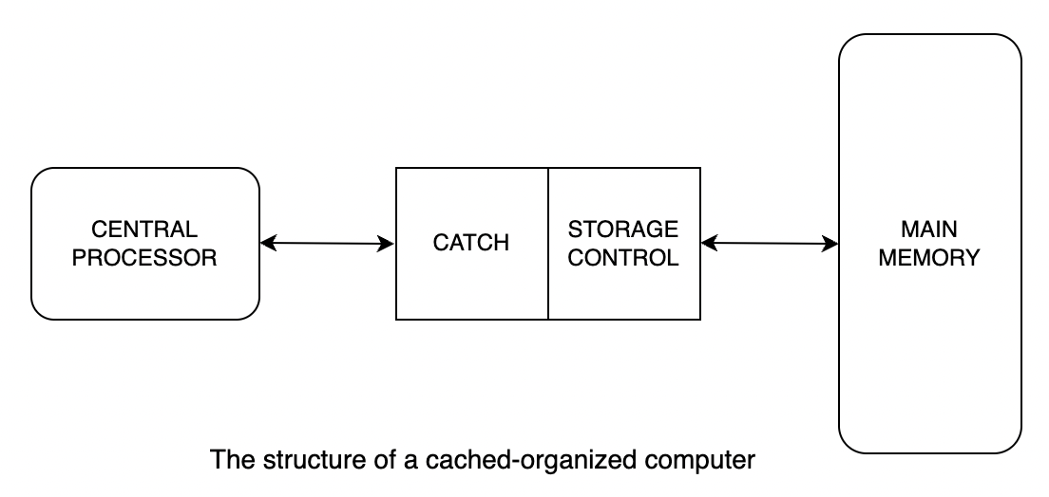
A Computer Organization Containing a High-speed Buffer Memory
what？
logic-in-memory array
a high-speed microelectronic
memory
Why？
fast

Slide 7
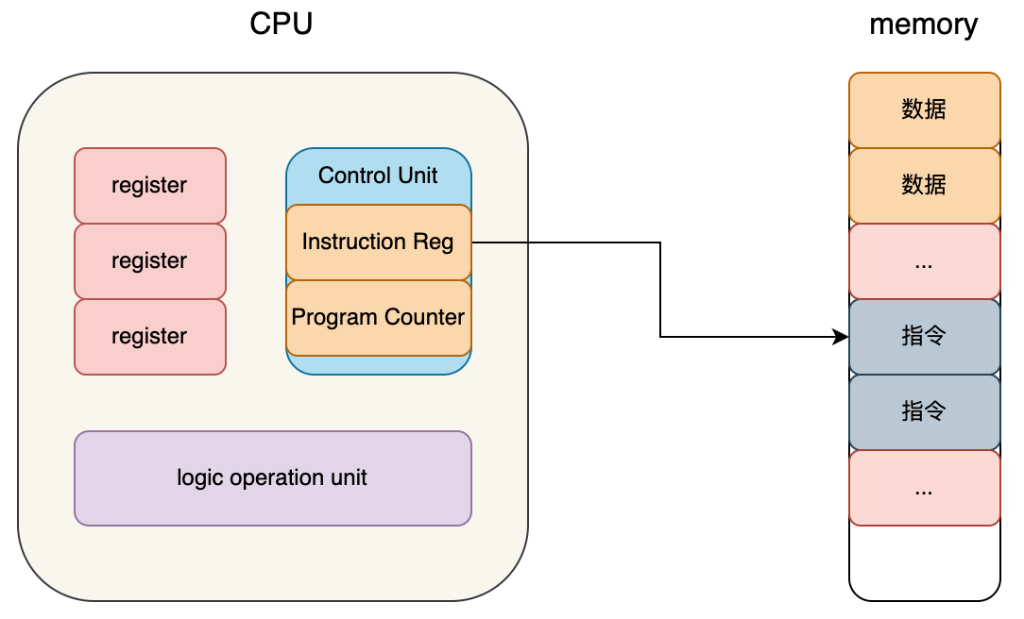
A Computer Organization Containing a High-speed Buffer Memory
How？
cache hit
c = a + b
d = a + c
Extension
LRU(Least Recently Used) Argorithm
Page Replacement Argorithm

Slide 8
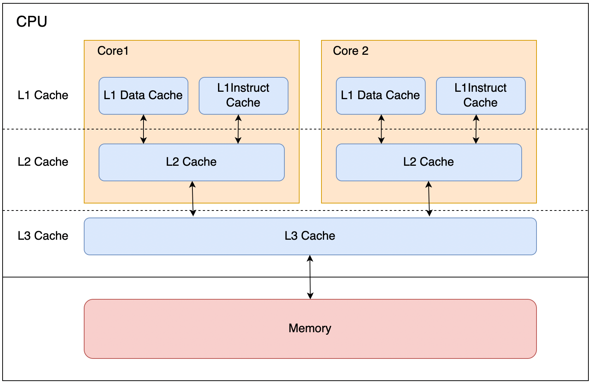
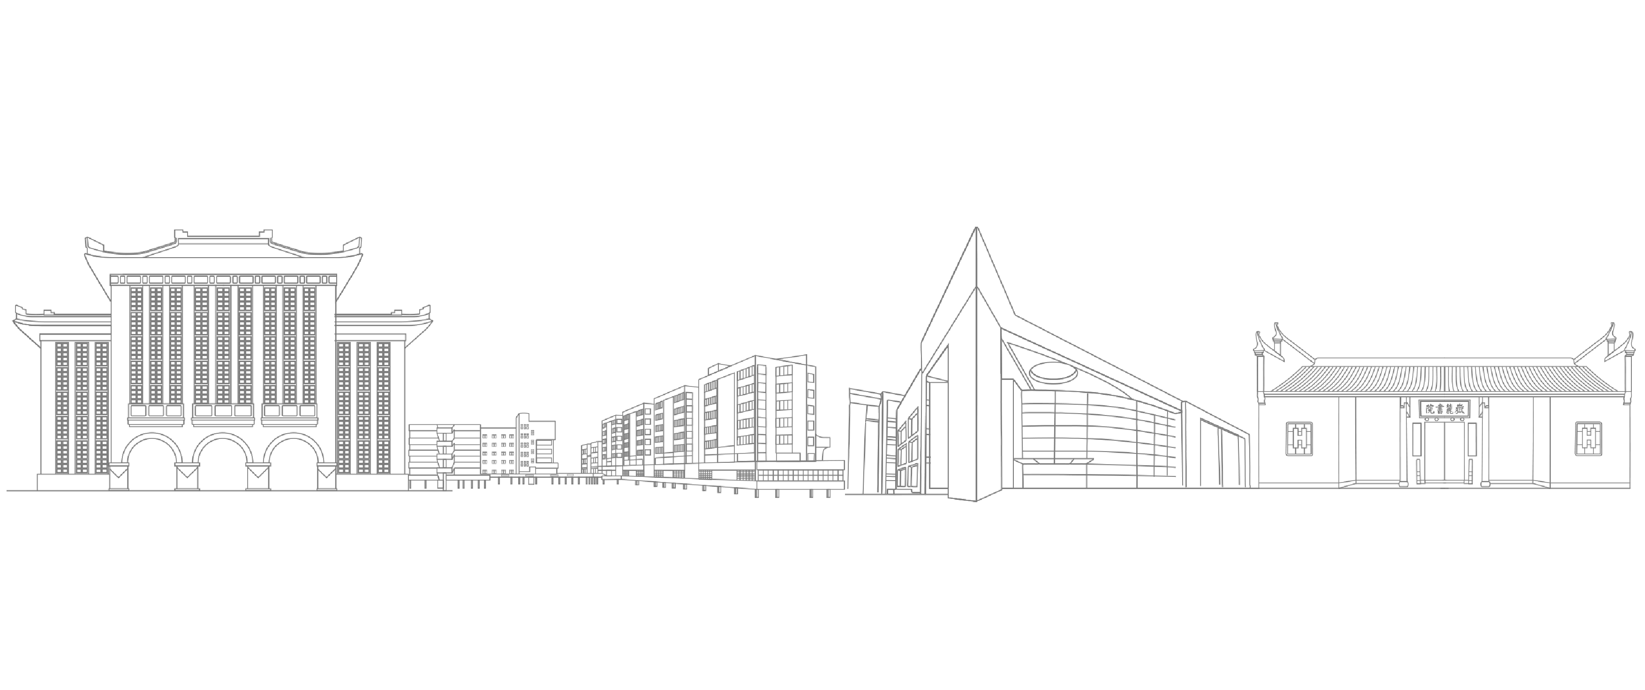
CPU Cache
L1 Cache
Data Cache
Instruct Cache
L2 Cache
Linux Look L1 Data Cache
opacity
L3 Cache
$ cat /sys/devices/system/cpu/cpu0/cache/index0/size
32K

Slide 9
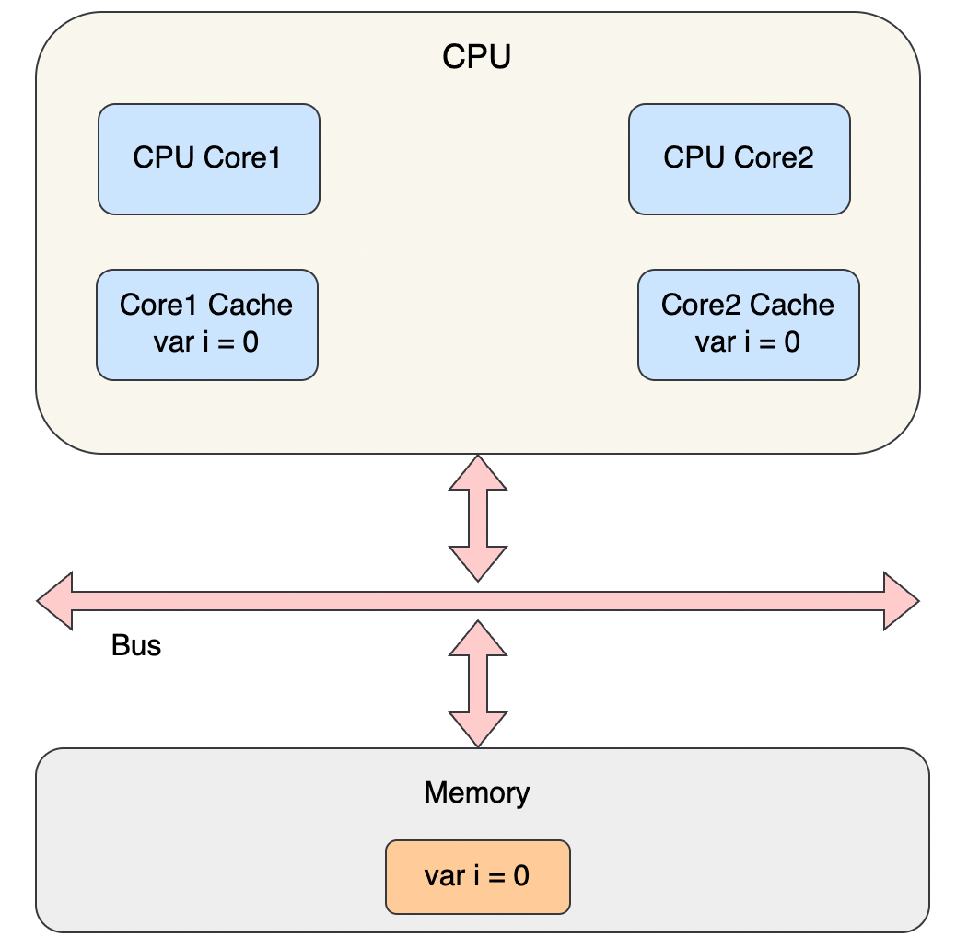
CPU Cache
Problem
Cache Coherence
Solution
Write Propagation
Transaction Serialization

Slide 10
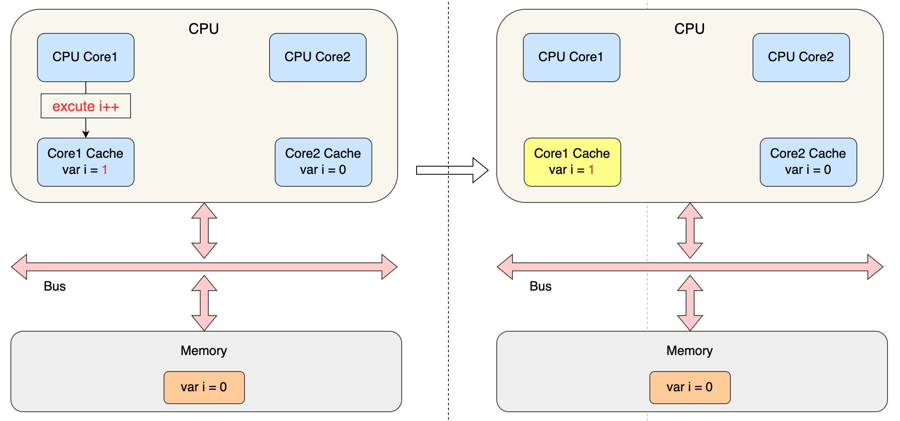
CPU Cache
Problem
Cache Coherence

Slide 11
CPU Cache
Solution
Write Propagation
When data is updated in the Cache of one CPU core,
it must be propagated to the Cache of another CPU core
Transaction Serialization
The order in which data is processed in one CPU core
must appear to be the same in all other cores

Slide 12
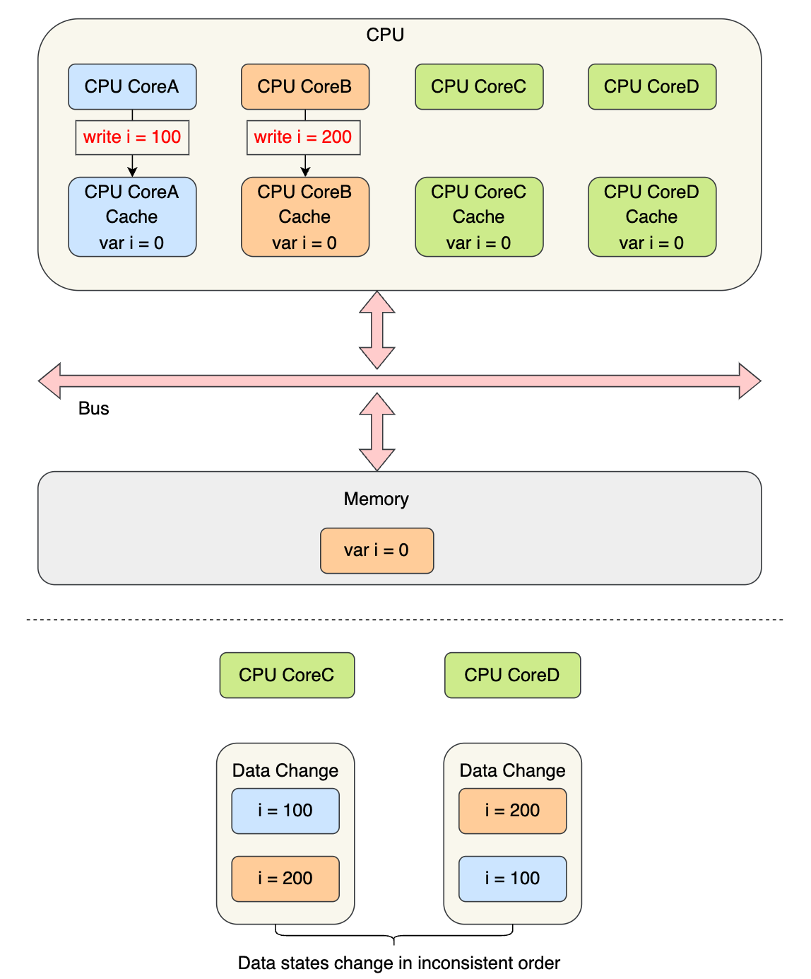
CPU Cache
Transaction Serialization
Example

Slide 13
3
P A R T T H R E E
Summary

Slide 14
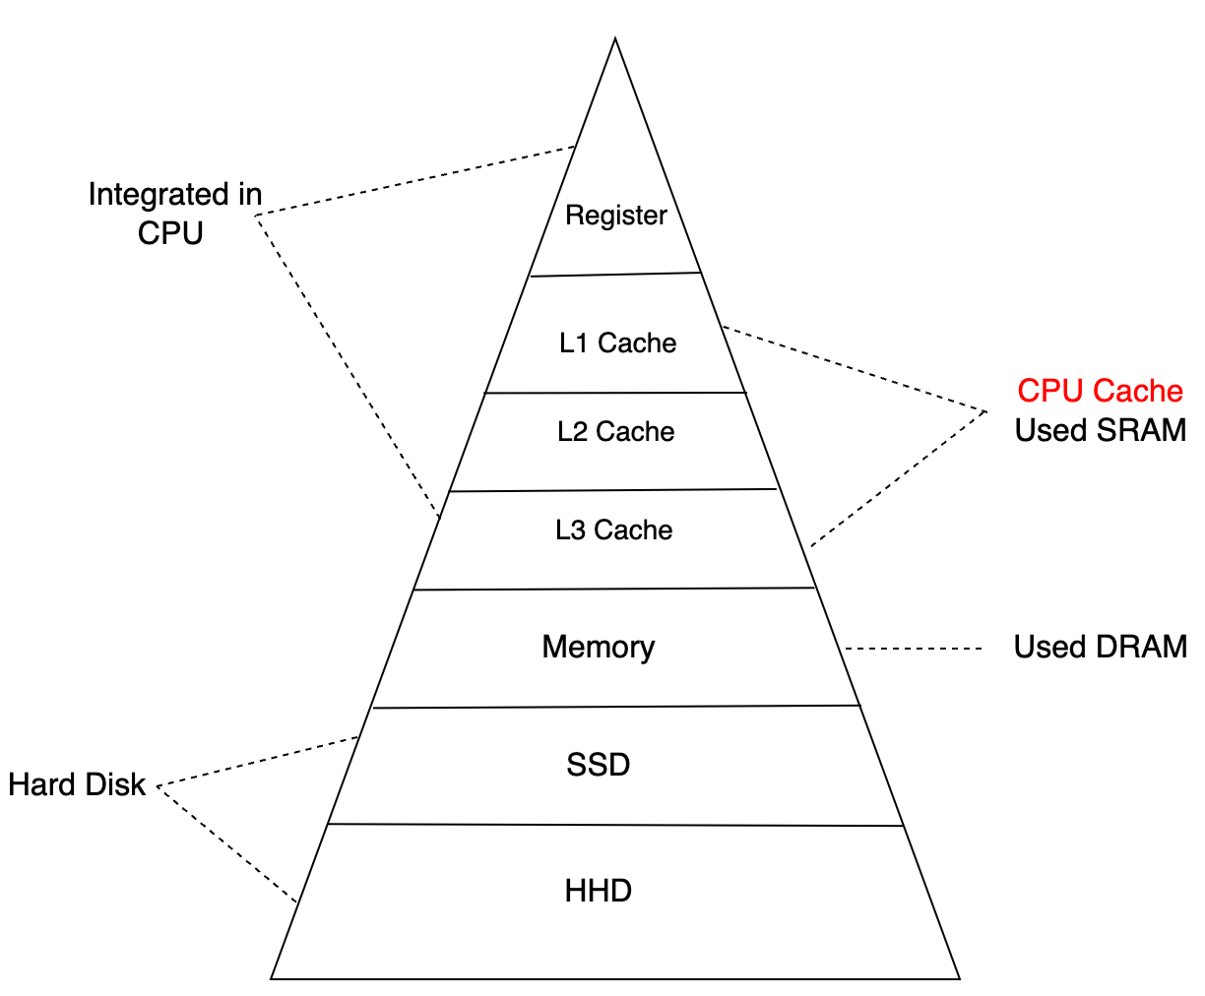
Memory Construction of Computer
More and more capacity
but slower and slower

Slide 15
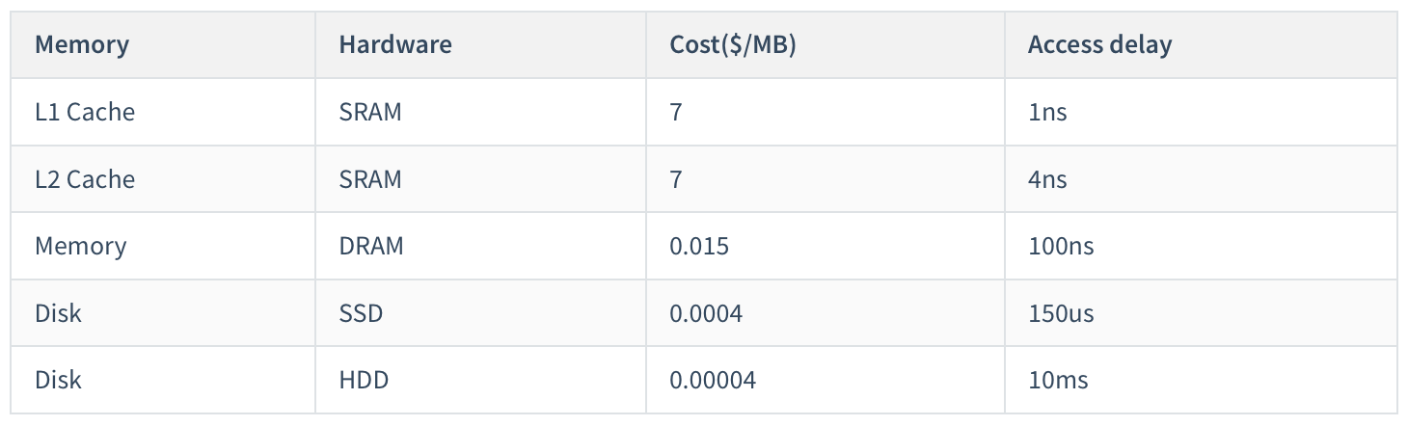
Cost comparisons between different levels of storage

Slide 16
THANKS FOR YOUR WATCHING

