Slide 1
Cellular Logic-in-Memory Arrays
Author: William H, Kautz
Publication: IEEE Transactions on Computers
Pulished date: August 1969
刘学建 S211000844

Slide 2
Contents
Problem of Large-Scale Integration
CLIM Arrays
A Cellular Sorting Array

Slide 3
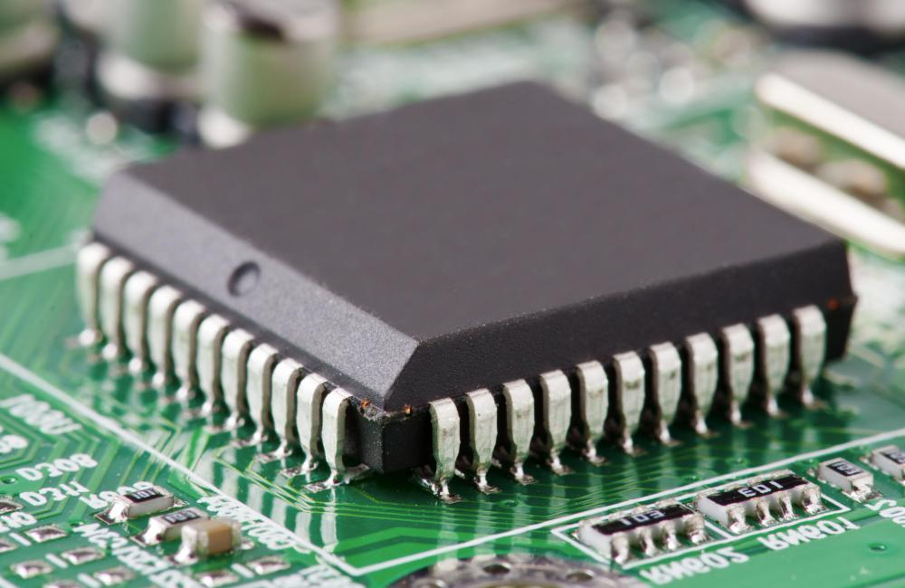
Problem of Large-Scale Integration
Background(1969)
the development of integrated semiconductor electronics.
the availability of inexpensive and reliable circuit chips, each of which may contain hundreds or thousands of circuit element.
Problem
the outstanding problem is that of deciding just what kinds of large but useful networks should be designed.

Slide 4
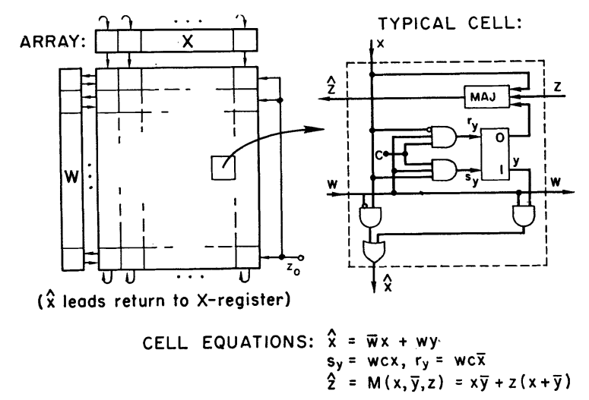
CLIM Arrays
What is CLIM Arrays(Cellular Logic-in-Memory Arrays)?
A two-dimensional iterative configuration of identical cells.
Each of cells contains both logic and storage and is connected mainly to its immediate neighbors.

Slide 5
CLIM Arrays
Features of CLIM Arrays
Functional Flexibility
Testability
Fault Accommodation
Isolated faulty cells in an array may often be bypassed by programming the adjacent cells to avoid active connection to the faulty cell.
Subarray Interconnectability
High Logical Performance
Ease of Logical Design
Low Power Level and High Speed

Slide 6
A Cellular Sorting Array
Function
Keeps in sorted order all data words that are fed into it.
Words that are read out are obtained in order of size, with the largest word first (or alternatively, with the smallest first, as desired).

Slide 7
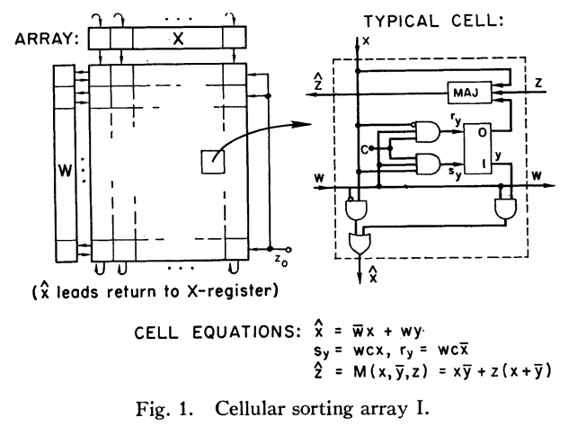
A Cellular Sorting Array
Overview

Slide 8
A Cellular Sorting Array
Overview
Input-Output Register

Slide 9
A Cellular Sorting Array
Overview
Input-Output Register
Word Selected Register

Slide 10
A Cellular Sorting Array
Overview
Input-Output Register
Word Selected Register

Slide 11
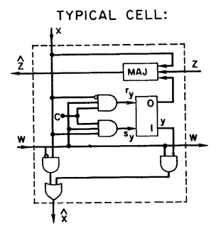
A Cellular Sorting Array
Cell

Slide 12
A Cellular Sorting Array
Cell
Selector

Slide 13
A Cellular Sorting Array
Cell
Flip-Flop
Selector

Slide 14
A Cellular Sorting Array
Cell
Comparator
Flip-Flop
Selector

Slide 15
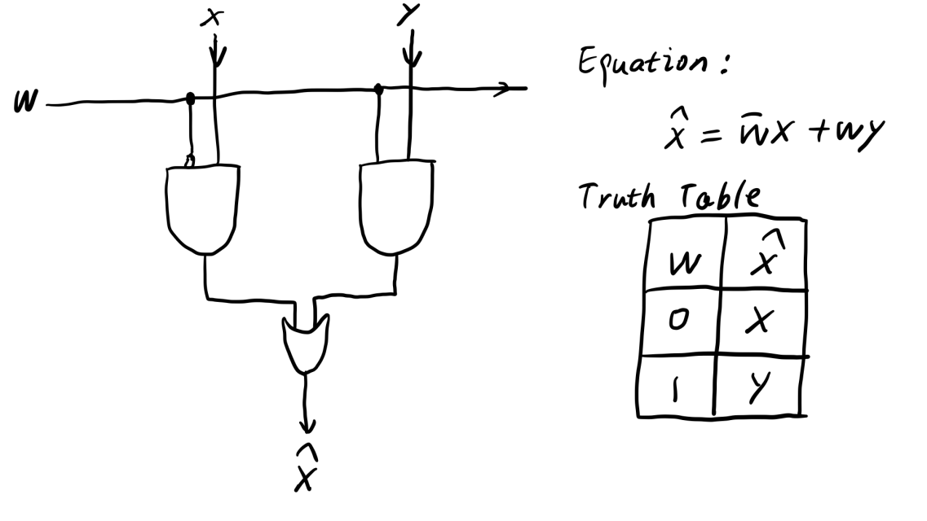
A Cellular Sorting Array
Selector
Selector

Slide 16
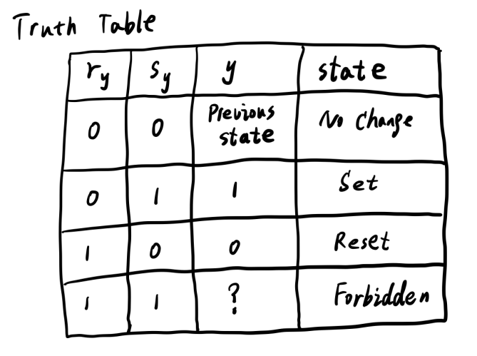
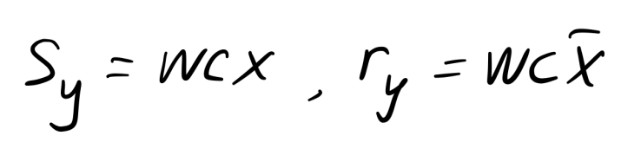
A Cellular Sorting Array
Flip-Flop
Flip-Flop

Slide 17
A Cellular Sorting Array
Comparator
Comparator

Slide 18
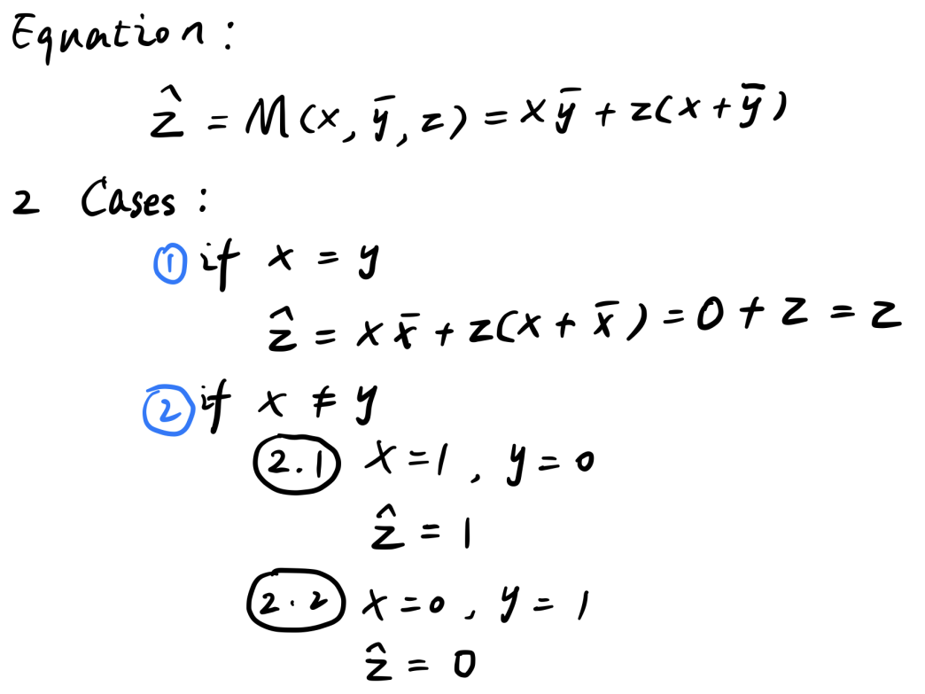
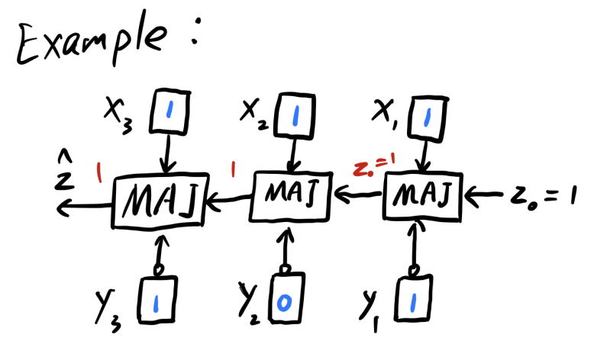
A Cellular Sorting Array
Comparator
Comparator

Slide 19
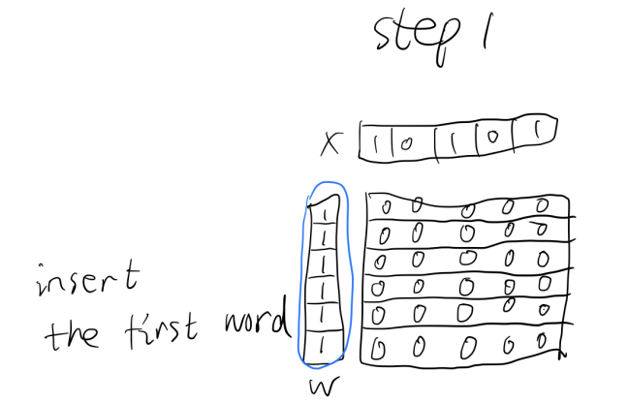
A Cellular Sorting Array
One cycle of operation that inserts a word
Step1. A comparison step
The word X in the X-register is simultaneously compared with all N words stored in rows of the array.
a 1 is injected into the W-register in those rows whose words (including blank words) are smaller than or equal to the word X, and a 0 is injected into the W-register in those rows whose words are larger than the word X.

Slide 20
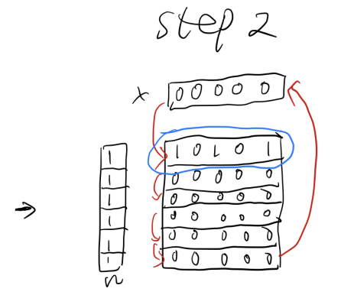
A Cellular Sorting Array
One cycle of operation that inserts a word
Step2. An execution step
a) The set of all words that are stored in the subset of rows having a 1 in the W-register are collectively moved downward one row within the set, while the word in the X-register is copied into the uppermost such row;
b) The lowermost such word is copied into the X-register.

Slide 21
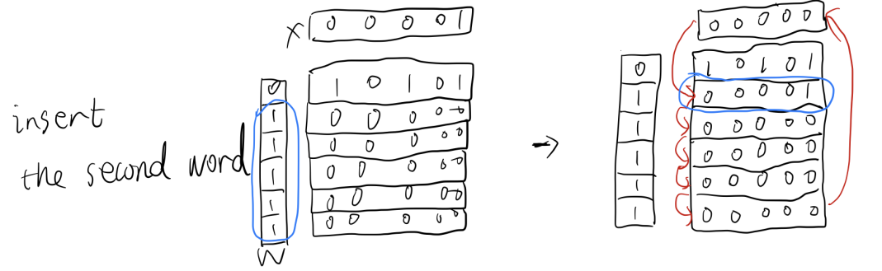
A Cellular Sorting Array
One cycle of operation that inserts a word

Slide 22
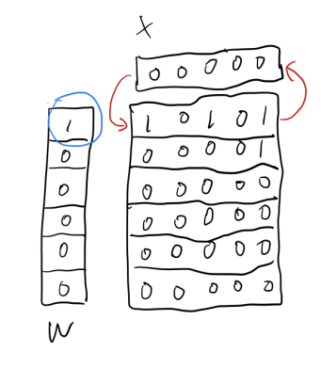
A Cellular Sorting Array
One cycle of operation that reads out a word

Slide 23
A Cellular Sorting Array
Other uses of the cellular sorting array
Switching Function
Pushdown and Buffer memories
Content-Addressed Memory

Slide 24
^_^

