Slide 1
Fairness via Source Throttling: A configurable and high-performance fairness substrate for multi-core memory systems
ASPLOS’10,March 13–17, 2010
Reporter：周大为 S211000824
Time：2021.12.2
Notes:
体系结构方面的顶尖会议

Slide 2

Eiman Ebrahimi
a member of the system architecture research group at NVIDIA Research
achieving efficient scale-out performance of multi-GPU systems for deep learning.
Notes:
NVIDIA Research 系统架构研究组成员
实现用于深度学习的多 GPU 系统的高效横向扩展性能。

Slide 3
Outline
Background and Problem
Motivation for Source Throttling
Fairness via Source Throttling (FST)
Evaluation
Conclusion

Slide 4
Background and Problem
Core 0
Core 1
Core 2
...
Core N
Shared Memory
Resources
Shared Cache
Memory Controller
On-chip
Chip Boundary
Off-chip
DRAM
Bank 0
DRAM
Bank 1
DRAM Bank 2
...
DRAMBank K
Notes:
主内存和共享缓存是共享资源的两个例子。
在共享内存子系统中，来自在一个CMP的不同内核上执行的不同应用程序的内存请求可能会相互干扰和延迟。
共享内存系统资源对不同应用程序执行的影响非常不同，因为在共享资源中使用的资源管理算法是不公平的。

Slide 5
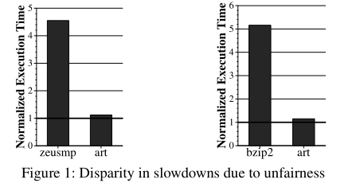
Background and Problem
Magnitude of each application’s slowdown depends on concurrently running applications’ memory behavior
Large disparities in slowdowns are unacceptable
Low system performance
Vulnerability to denial of service attacks
Difficult for system software to enforce priorities
Notes:
1.每个应用程序的减速程度取决于并发运行的应用程序的内存行为
图的解释：当bzip2和art以相同的优先级同时运行时，由共享内存系统资源引起的核间干扰使bzip2比单独运行时慢了5.2倍，而art只慢了1.15倍。
在同时运行的具有相同优先级的应用程序之间共享内存系统资源而导致的减速差异是不可接受的。
2.放缓的巨大差异是不可接受的
2.1系统性能低
2.2拒绝服务攻击的漏洞
2.3系统软件难以强制执行优先级

Slide 6
Outline
Background and Problem
Motivation for Source Throttling
Fairness via Source Throttling (FST)
Evaluation
Conclusion

Slide 7
Prior Approaches
Primarily focused on partitioning a particular shared resource
Shared Cache, Memory Controller, Interconnect, etc.
Combining techniques for the different resources can result in negative interaction
Approaches that coordinate interaction among techniques for different resources require complex implementations
Goal: Enable fair sharing of the entire memory system by dynamically detecting and controlling interference in a coordinated manner
Notes:
1.主要侧重于对特定共享资源进行分区
1.1共享缓存、内存控制器、互连
1.2针对不同资源的组合技术可能会导致负面交互
2.协调不同资源技术之间交互的方法需要复杂的实现
目标：通过动态检测和协同控制干扰，实现整个内存系统的公平共享

Slide 8
Author's Approach
Manage inter-application interference at the cores, not at the shared resources
Dynamically estimate unfairness in the memory system
If unfairness > system-software-specified target then throttle down core causing unfairness & throttle up core that was unfairly treated
Notes:
1.在核心而非共享资源上管理应用程序间干扰
2.动态估计内存系统中的不公平性
3.如果不公平 > 系统软件指定的目标，则限制导致不公平的核心并限制受到不公平对待的核心

Slide 9
Outline
Background and Problem
Motivation for Source Throttling
Fairness via Source Throttling (FST)
Evaluation
Conclusion

Slide 10
Fairness via Source Throttling (FST)
Runtime Unfairness Evaluation
Dynamically estimates the unfairness in the memory system
Dynamic Request Throttling
Adjusts how aggressively each core makes requests to the shared resources
Notes:
1.运行时不公平评估
1.1动态估计内存系统中的不公平性
2.动态请求限制
2.1调整每个核心向共享资源发出请求的积极程度

Slide 11
Fairness via Source Throttling (FST)
Interval 1
Interval 2
Interval 3
Time
⎪
⎨
⎪
⎧
⎩
Slowdown Estimation
FST
Unfairness Estimate
Runtime Unfairness
Evaluation
Runtime Unfairness
Evaluation
Dynamic
Request Throttling
Dynamic
Request Throttling
App-slowest
App-interfering
1- Estimating system unfairness
2- Find app. with the highest slowdown (App-slowest)
3- Find app. causing most interference for App-slowest (App-interfering)
if (Unfairness Estimate >Target)
{
1-Throttle down App-interfering
2-Throttle up App-slowest
}

Slide 12
Estimating System Unfairness
Max{Slowdown i} over all applications i
Unfairness =
Min{Slowdown i} over all applications i
Ti
Shared
Slowdown of application i =
Ti
Alone
Alone
How can be estimated in shared mode?
Ti
Excess
is the number of extra cycles it takes application i to execute due to interference
Ti
Alone
Shared
Excess
Ti
=
Ti
-
Ti
Notes:
3.Talone在共享模式下如何估计？
4.Texcess是应用程序 i 由于干扰而执行的额外周期数

Slide 13
Tracking Inter-Core Interference
Core 0
Core 1
Core 2
Core 3
FST hardware
0
0
0
0
Core #
0
1
2
3
Shared Cache
Interference per core
bit vector
Memory Controller
Three interference sources:
1. Shared Cache
2. DRAM bus and bank
3. DRAM row-buffers
Bank 0
Bank 1
Bank 2
Bank 2
Row
...
Bank 7
Notes:
跟踪核心间干扰
bank：内存库
DRAM行缓冲区

Slide 14
Tracking DRAM Row-Buffer Interference
Core 0
Core 1
FST additions
Row B
Shadow Row Address Register
(SRAR) Core 1 :
Row A
Shadow Row Address Register
(SRAR) Core 0 :
Row B
Interference induced
row conflict
Row A
Core #
0
1
Row A
0
Row B
queue of requests to bank 2
1
0
Interference
per core
bit vector
Row Conflict
Row Hit
Row Hit
Row Conflict
Row Buffer:
Row B
Bank 0
Bank 1
Bank 2
Bank 7
...

Slide 15
Dynamic Request Throttling
Goal: Adjust how aggressively each core makes requests to the shared resources
Mechanisms:
Miss Status Holding Register (MSHR) quota
Controls the number of concurrent requests accessing shared resources from each application
Request injection frequency
Controls how often memory requests are issued to the last level cache from the MSHRs
Notes:
动态请求限制
目标：调整每个核心向共享资源发出请求的积极程度
机制：
Miss Status Holding Register (MSHR) 配额
控制从每个应用程序访问共享资源的并发请求数
请求注入频率
控制从 MSHR 向最后一级缓存发出内存请求的频率

Slide 16
Dynamic Request Throttling
Throttling level assigned to each core determines both MSHR quota and request injection rate
Throttling level | MSHR quota | Request Injection Rate
100% | 128 | Every cycle
50% | 64 | Every other cycle
25% | 32 | Once every 4 cycles
10% | 12 | Once every 10 cycles
5% | 6 | Once every 20 cycles
4% | 5 | Once every 25 cycles
3% | 3 | Once every 30 cycles
2% | 2 | Once every 50 cycles
Total # of
MSHRs: 128
Notes:
分配给每个核心的节流级别决定了 MSHR 配额和请求注入率

Slide 17
System Software Support
Different fairness objectives can be configured by system software
Estimated Unfairness > Target Unfairness
Estimated Max Slowdown > Target Max Slowdown
Estimated Slowdown(i) > Target Slowdown(i)
Support for thread priorities
Weighted Slowdown(i) = Estimated Slowdown(i) x Weight(i)
Notes:
系统软件支持
1.系统软件可配置不同的公平目标
1.1估计不公平 > 目标不公平
1.2估计最大减速 > 目标最大减速
1.3估计减速(i) > 目标减速(i)
2.支持线程优先级
2.1加权减速(i) = 估计减速(i) x 权重(i)

Slide 18
Hardware Cost
Total storage cost required for 4 cores is ∼ 12KB
FST does not require any structures or logic that are on the processor’s critical path
Notes:
硬件成本
4 核所需的总存储成本约为 12KB
FST 不需要处理器关键路径上的任何结构或逻辑

Slide 19
Outline
Background and Problem
Motivation for Source Throttling
Fairness via Source Throttling (FST)
Evaluation
Conclusion

Slide 20
Evaluation Methodology
x86 cycle accurate simulator
Baseline processor configuration
Per-core
4-wide issue, out-of-order, 256 entry ROB
Shared (4-core system)
128 MSHRs
2 MB, 16-way L2 cache
Main Memory
DDR3 1333 MHz
Latency of 15ns per command (tRP, tRCD, CL)
8B wide core to memory bus
Notes:
评估方法
1.x86 周期精确模拟器
2.基准处理器配置
2.1每个核
2.1.1 4-wide 问题，乱序，256 个条目 ROB
2.2 4核系统的共享
2.2.1 128个MSHR的配额
2.2.2 2 MB，16 路二级缓存
2.3 主存
2.3.1 DDR3 1333HZ
2.3.2 每个命令的延迟为 15ns（tRP、tRCD、CL）
2.3.3 8B 宽内核到内存总线

Slide 21
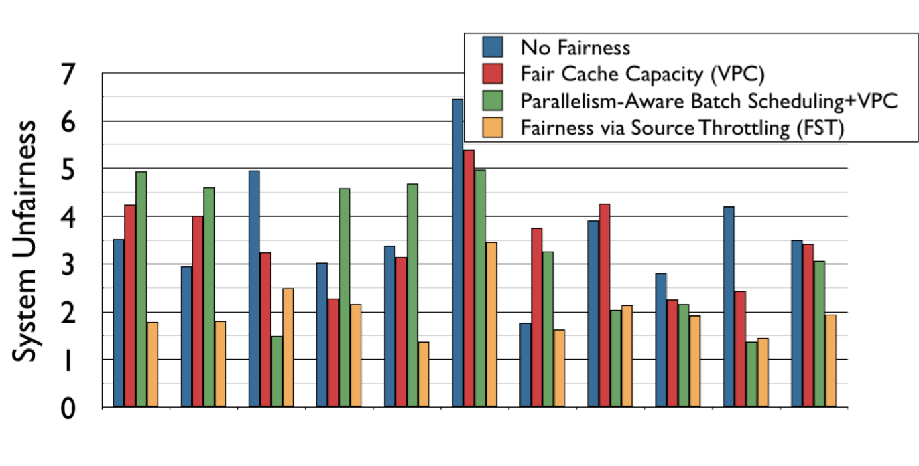
System Unfairness Results
44.4%
36%
gmean
lbm+omnet+apsi+vortex
art+leslie+games+grom
grom+art+astar+h264
art+astar+leslie+crafty
lbm+Gems+astar+mesa
art+games+Gems+h264
art+milc+vortex+calculix
gcc06+xalanc+lbm+cactus
lucas+ammp+xalanc+grom
mgrid+parser+soplex+perlb
Notes:
fair cache capacity：一个仅使用虚拟私有缓存技术进行公平缓存容量管理的系统
parallelism-aware batch scheduling+VPC：具有并行性感知批量调度的公平内存调度程序和公平缓存容量管理的系统，

Slide 22
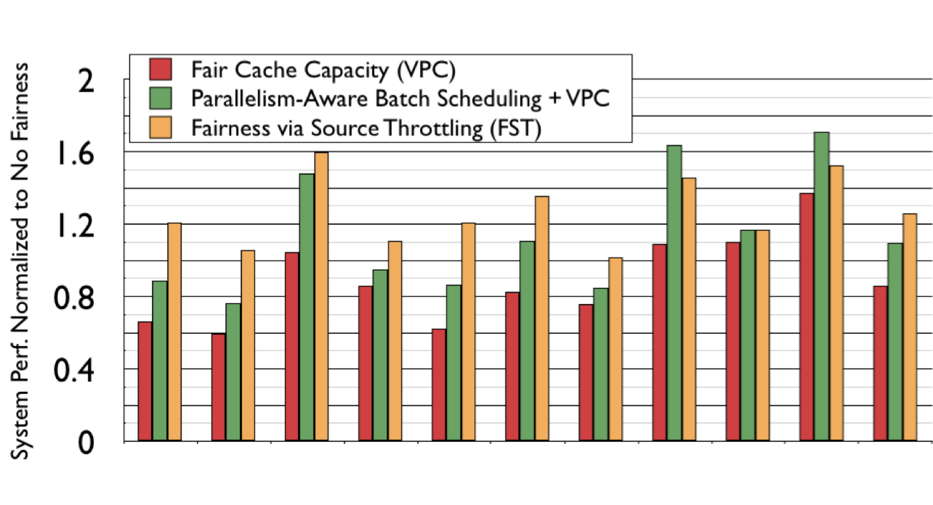
System Performance Results
14%
25.6%
gmean
lbm+omnet+apsi+vortex
art+leslie+games+grom
grom+art+astar+h264
art+astar+leslie+crafty
lbm+Gems+astar+mesa
art+games+Gems+h264
art+milc+vortex+calculix
gcc06+xalanc+lbm+cactus
lucas+ammp+xalanc+grom
mgrid+parser+soplex+perlb

Slide 23
Outline
Background and Problem
Motivation for Source Throttling
Fairness via Source Throttling (FST)
Evaluation
Conclusion

Slide 24
Conclusion
Fairness via Source Throttling (FST) is a new fair and high-performance shared resource management approach for CMPs
Dynamically monitors unfairness and throttles down sources of interfering memory requests
Eliminates the need for and complexity of multiple per-resource fairness techniques
Improves both system fairness and performance
Incorporates thread weights and enables different fairness objectives
Notes:
通过源节流 (FST) 实现公平是 CMP 的一种新的公平和高性能共享资源管理方法
动态监控不公平性并减少干扰内存请求的来源
消除了对多种资源公平技术的需求和复杂性
提高系统公平性和性能
结合线程权重并实现不同的公平目标

Slide 25
Thanks!
Q&A

