Slide 1
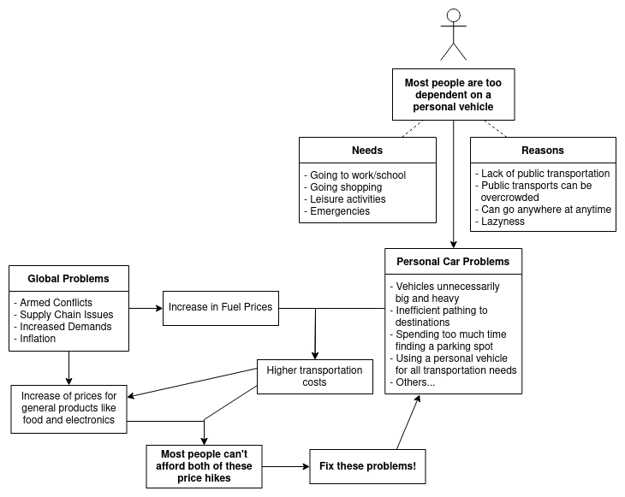

Slide 2
Empathy Map
Save Gas to Save Cash
09/11/2022
Thinking
If public transports services were better provided, more people would use them.
Personal vehicles can
be too big an expense
Going to university
by car would be too
expensive
Public transports are
inconvenient
“More buses per route
would make them less full”
“Waiting times are
too high, especially
during strikes”
Feeling
Delays in public transportation
cause stress
Saying
18-25 years old
Personal cars are
much more comfortable
“Time between buses
should be at most
20 minutes”
Goes to university
by subway
Goes to most places
by car
Drives as efficiently
as possible
Doing
Pains
-Feels claustrophobic when forced to stand in overcrowded buses or the subway.
Gains
-Would like if buses had better schedules, with more destinations and workers weren’t
forced to strike.
-Would like an app to help budget fuel.
-Would like a way to know the exact locations of transports to know if they are late and by how much.

Slide 3
Empathy Map
Save Gas to Save Cash
09/11/2022
Believes public transportation should find a way to give each person more privacy
Thinking
Preference between public transports or a personal vehicle is also cultural
Environmentalism has a huge impact on the preference of public transports
“Even if I can easily access public transports I prefer the privacy of my car”
Lack of safety and schedules on public transports
“I always use the car when I need to go somewhere”
Feeling
Saying
Enjoys the privacy of car riding
26-32 years old
“People with worse financial status have a tendency to prefer the use of public transports”
Uses the car once or twice a week due to working online
Rarely used public transportation even with easy access
Uses the car on leisure activities
Doing
Pains
-The price increase of groceries and other necessary goods
Gains
-An app with a car pooling system in it
-An app that gives the trajectory that would save the most fuel, not necessarily being the fastest

Slide 4
Empathy Map
Save Gas to Save Cash
09/11/2022
Thinking
The government should motivate people to use public transports
Government should expand public transports to more areas and increase their frequency
Financial status influences a lot in the decision of whether to use your personal vehicle or not
Sad about the high gas prices, that are causing many problems in all areas
“My area is not well connected by public transport”
Feeling
Thankful for his situation, that allows him not to stop driving his personal vehicle
“Driving my own vehicle gives me a lot of comfort and freedom to moving around”
Saying
18-25 years old
Uses his car every day
Uses Bolt, Uber and others before public transports due to the facilities and competitive price they present when traveling in a group
Doing
Pains
-Being limited to using your personal vehicle
Gains
-Improving public transportation and the connectivity between areas

Slide 5
Empathy Map
Save Gas to Save Cash
09/12/2022
Thinking
Poorer people are more reliant on public transports because a personal vehicle is too expensive
Believes he could be using his fuel in a more efficient way
Rich people would always use their car outside big cities but would still use public transportation in the city
“Gas prices are too high to go to university by car”
Loses too much time on public transportation
“Public transports should be more frequent, at least once every 20 minutes”
Feeling
The subway is less safe
Saying
18-25 years old
Gas prices increasing causes stress
“Buses are currently too overcrowded”
Uses the bike instead of the car when possible
Uses public transport when going to the university
Uses the car when going to the gym
Doing
Pains
-With the increase of gas prices might not have enough money for the entire month
Gains
-An app to help him find parking quicker
-A way to know exactly how much money he spends on gas to help budget better

Slide 6
Affinity Map
Save Gas to Save Cash
09/12/2022
Goverment Responsability
Public transport problems
Financial Status
The goverment should motivate people to use public transports
Government should expand public transports to more areas and increase their frequency
Personal vehicle preferences
Loses too much time on public transportation
Public transports are inconvenient
Lack of safety and schedules on public transports
“My area is not well connected by public transportation”
Delays in public transportation cause stress
“Public transports should be more frequent, at least once every 20 minutes”
The financial status influences a lot in the decision of going in your personal vehicle or not
Richer people always use their car outside the big cities but would still use public transportation in the city
Poorer people are more reliant on public transports because a personal vehicle is too expensive
People with worse finacial status have a tendency to prefer the use of public transports
Goes to most places by car
Personal cars are much more comfortable
Uses the car once or twice a week due to working online
“Driving my own vehicle gives me a lot of comfort and freedom to moving around”
Uses his car every day
Enjoys the privacy of car riding
High Prices
Going to university by car would be too expensive
Gas prices increasing causes stress
Sad about the high gas prices, that are causing many problems in all areas
With the increase of gas prices might not have enough money for the entire month

Slide 7
