Slide 1
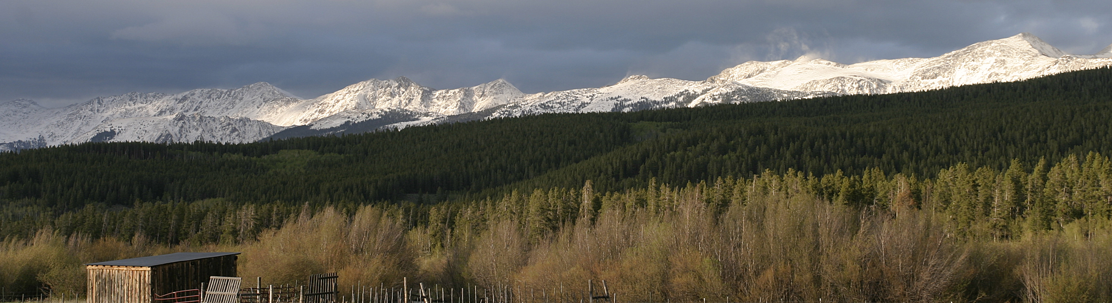
Rawah Wilderness / refractor / CC BY 2.0 / cropped
Forest Cover Type Classification
A dense neural network case study in northern Colorado
Beomarc Andrew D. Cartoneros
Matthew R. Lopez
Axiel Achia M. Escabal
Alon U. Villanueva
Notes:
Suggested speaker: Beomarc Andrew D. Cartoneros (25 seconds)
Our case asks whether we can classify the dominant forest cover of a land cell from its measured land attributes. We compared dense networks on the UCI Covertype dataset. This photograph shows Rawah Wilderness, one of the four study areas. It is geographic context.
Sources
https://doi.org/10.24432/C50K5N
https://archive.ics.uci.edu/ml/machine-learning-databases/covtype/covtype.info
Rawah Wilderness / refractor / CC BY 2.0 / cropped
https://commons.wikimedia.org/wiki/File:Rawah_Wilderness.jpg
https://creativecommons.org/licenses/by/2.0/

Slide 2
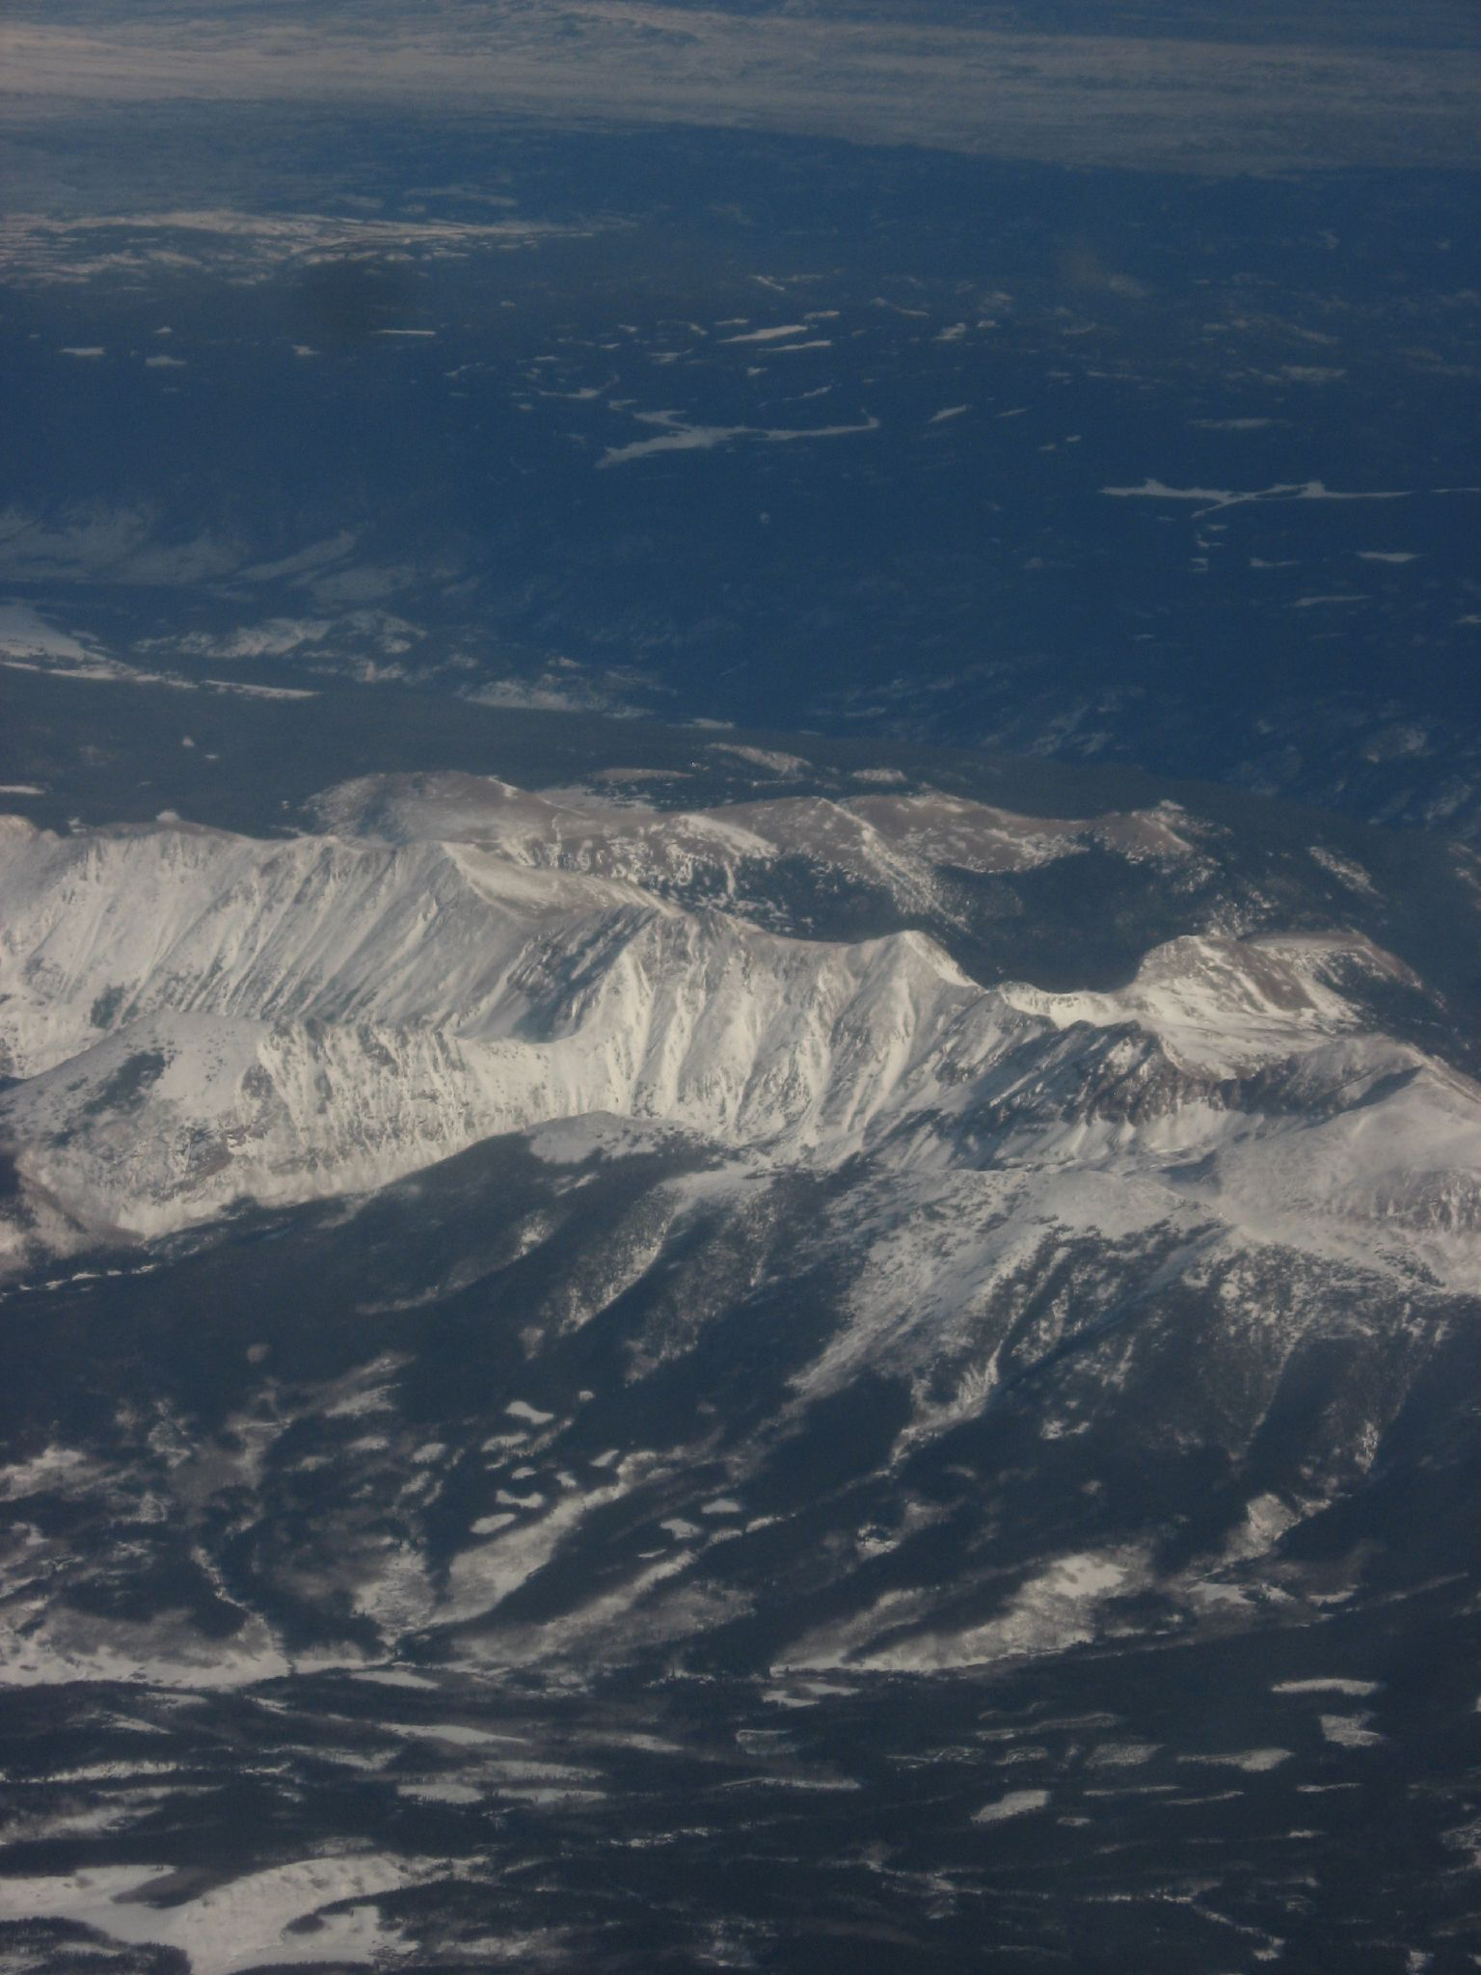
The classification task
Four wilderness areas in Roosevelt National Forest, Colorado
581,012 land records
Each record represents one 30 × 30 metre cell.
54 inputs
10 numeric land measures, 4 wilderness indicators
and 40 soil indicators.
7 possible forest cover types
Medicine Bow Mountains, Colorado
Ken Lund / CC BY-SA 2.0 / context photo
02
Notes:
Suggested speaker: Beomarc Andrew D. Cartoneros (50 seconds)
Examples of numeric features include elevation, slope, hillshade and horizontal distance to water. The seven output labels are shown on slide 3. The labels came from U.S. Forest Service records. The photo shows the broader regional landscape. The dataset consists of tabular records.
Sources
https://doi.org/10.24432/C50K5N
https://archive.ics.uci.edu/ml/machine-learning-databases/covtype/covtype.info
Medicine Bow Mountains at Jackson–Larimer County Border / Ken Lund / CC BY-SA 2.0
https://commons.wikimedia.org/wiki/File:Medicine_Bow_Mountains_at_Jackson-Larimer_County_Border_in_Colorado_(2520238260).jpg
https://creativecommons.org/licenses/by-sa/2.0/

Slide 3
Two classes account for 85.22% of all cells
Share of 581,012 records by true cover type
Cottonwood/Willow is the smallest class, with 2,747 cells.
03
Notes:
Suggested speaker: Beomarc Andrew D. Cartoneros (45 seconds)
Lodgepole Pine has 283,301 records and Spruce/Fir has 211,840. An overall accuracy score can therefore conceal weak results for smaller classes. We use macro-F1 for model selection because every class contributes equally. Hand off to Matthew for the split and training design.
Sources
https://doi.org/10.24432/C50K5N
Saved evidence: artifacts/class_counts.csv

Slide 4
Data split and preprocessing
The three partitions retain the original class proportions.
Partition | Rows | Used for
Training | 464,809 | Fit the scaler and model
Validation | 58,101 | Stop training and choose a run
Test | 58,102 | Evaluate the frozen winner
Standardize the first 10 columns using training statistics.
Keep the 44 indicators as 0/1. Map class labels 1–7 to 0–6.
04
Notes:
Suggested speaker: Matthew R. Lopez (45 seconds)
Explain why fitting the scaler on validation or test leaks information. We used stratified splits with fixed seeds 42 and 43. Checks found no missing or nonfinite values, no shared row IDs and no repeated feature hashes. Random splitting does not measure geographic transfer.
Sources
https://scikit-learn.org/stable/common_pitfalls.html
Saved evidence: artifacts/study_manifest.json and artifacts/data_quality.json

Slide 5
Baseline and wider model
R1 doubled the width of both hidden layers.
Run | Inputs | Hidden layers | Outputs | Parameters
R0 baseline | 54 | 50 ReLU, 50 ReLU | 7 softmax | 5,657
R1 wider | 54 | 100 ReLU, 100 ReLU | 7 softmax | 16,307
Shared training setup
Adam at 0.001, batch 100, sparse categorical cross-entropy
Early stopping on validation loss, patience 2, cap 50 epochs
05
Notes:
Suggested speaker: Matthew R. Lopez (45 seconds)
ReLU introduces nonlinearity and softmax yields a score for each class. Sparse cross-entropy accepts integer class labels. The parameter counts include all weights and biases. Both runs used the same optimization settings and data. Each experiment began with fresh model, optimizer and callback state.
Sources
https://keras.io/api/callbacks/early_stopping/
https://keras.io/api/models/model_training_apis/
Saved evidence: artifacts/Group8_Experiment_Log.csv

Slide 6
R1 led on validation macro-F1
Each run changed one setting from R0.
Run | Change | Epochs¹ | Val. loss | Val. acc. | Macro-F1
R0 | Baseline | 16 / 14 | 0.3417 | 85.75% | 0.7827
R1 | Wider layers (100, 100) | 13 / 11 | 0.2793 | 88.66% | 0.8272
R2 | Three hidden layers | 20 / 18 | 0.2889 | 88.38% | 0.8163
R3 | Tanh activation | 34 / 32 | 0.2682 | 89.31% | 0.8254
R4 | Batch size 500 | 22 / 20 | 0.3611 | 85.26% | 0.7628
R5 | Learning rate 0.0003 | 42 / 40 | 0.3433 | 85.87% | 0.7753
R6 | Patience 5 | 50 / 46 | 0.2901 | 88.21% | 0.8270
R7 | Balanced class weights | 15 / 13 | 0.4965 | 79.59% | 0.7353
R8 | Dropout 0.2 | 24 / 22 | 0.4185 | 82.51% | 0.7114
¹ Epochs executed / restored. R3 led on accuracy. R6 trailed R1 by 0.0002 macro-F1.
06
Notes:
Suggested speaker: Matthew R. Lopez (60 seconds)
We declared validation macro-F1 first, then accuracy, lower loss, fewer parameters and run ID as tiebreakers. R1 improved from 0.7827 to 0.8272 against R0. R6 was close, and one seed cannot establish a stable ranking. R7 raised mean class recall from 75.15% to 87.35% while reducing macro-F1. R8 used dropout during training and scored 0.7114. Hand off to Axiel for the selected checkpoint and held-out results.
Sources
https://keras.io/api/layers/regularization_layers/dropout/
Saved evidence: artifacts/selection.json and artifacts/Group8_Experiment_Log.csv

Slide 7
R1 restored the weights from epoch 11
Training and validation cross-entropy for the selected run
Epoch 11
Lowest validation loss
0.2793
Training ended after two more epochs without improvement.
07
Notes:
Suggested speaker: Axiel Achia M. Escabal (50 seconds)
The line with round markers is validation loss. It reaches 0.279338 at epoch 11. Epochs 12 and 13 did not beat it, so patience 2 stopped the run and restored epoch 11. Early stopping uses validation loss to choose weights within a run. Macro-F1 compares the restored checkpoints across runs.
Sources
https://keras.io/api/callbacks/early_stopping/
Saved evidence: artifacts/runs/R1/history.csv

Slide 8
The frozen model reached 88.75% test accuracy
One final evaluation on 58,102 held-out cells
Partition | Accuracy | Macro-F1 | Balanced accuracy
Training | 89.29% | 0.8368 | 83.66%
Validation | 88.66% | 0.8272 | 82.50%
Test | 88.75% | 0.8315 | 83.24%
0.64 percentage points between training and validation accuracy
08
Notes:
Suggested speaker: Axiel Achia M. Escabal (45 seconds)
The held-out test was scored after the model, preprocessing and class mapping were frozen. A single model.evaluate call recorded loss and accuracy. Saved predictions provide class metrics and mistakes. The train–validation gap is 0.635 percentage points. This is a descriptive result on the chosen split. Always predicting the largest class would yield 48.76% accuracy.
Sources
Saved evidence: artifacts/final_test_metrics.json and artifacts/Group8_Split_Metrics.csv

Slide 9
Douglas-fir had the lowest recall
Correct predictions as a share of each true class
Douglas-fir: 1,119 of 1,737 cells correctly classified (64.42%).
09
Notes:
Suggested speaker: Axiel Achia M. Escabal (60 seconds)
Recall answers how often a true class is detected. Precision asks how often a prediction of the class is correct. Cottonwood/Willow had 91.24% recall on 274 cases and 73.10% precision. The full report includes precision, F1 and the confusion matrix. Hand off to Alon to explain five example errors.
Sources
https://scikit-learn.org/stable/modules/generated/sklearn.metrics.classification_report.html
Saved evidence: artifacts/Group8_Per_Class_Test_Metrics.csv

Slide 10
Five misclassified test cells
Examples selected by a rule fixed before test analysis
Row | True cover | Predicted cover | Area | Soil
115 | Spruce/Fir | Lodgepole Pine | Rawah | 29
444 | Lodgepole Pine | Spruce/Fir | Rawah | 29
2844 | Ponderosa Pine | Douglas-fir | Cache la Poudre | 10
2180 | Cottonwood/Willow | Ponderosa Pine | Cache la Poudre | 10
45 | Aspen | Lodgepole Pine | Rawah | 18
The first two cells share Rawah and soil indicator 29.
Shared land conditions are one possible explanation for the errors.
10
Notes:
Suggested speaker: Alon U. Villanueva (85 seconds)
The model made 6,534 errors. We chose the lowest row ID per true class until we had five examples. Focus on the two Rawah rows, which produced opposite Spruce/Fir and Lodgepole errors. Rows 2844 and 2180 share Cache la Poudre and soil indicator 10. Class imbalance may contribute to the Aspen and Cottonwood/Willow errors. Treat these explanations as hypotheses. Scores are uncalibrated.
Row 115 was Spruce/Fir and was predicted as Lodgepole Pine. Elevation 3,195 m, slope 15°, horizontal water distance 469 m, maximum softmax 67.65%.
Row 444 was Lodgepole Pine and was predicted as Spruce/Fir. Elevation 3,004 m, slope 6°, horizontal water distance 180 m, maximum softmax 70.27%.
Row 2844 was Ponderosa Pine and was predicted as Douglas-fir. Elevation 2,329 m, slope 24°, horizontal water distance 0 m, maximum softmax 69.95%.
Row 2180 was Cottonwood/Willow and was predicted as Ponderosa Pine. Elevation 2,030 m, slope 18°, horizontal water distance 42 m, maximum softmax 46.81%.
Row 45 was Aspen and was predicted as Lodgepole Pine. Elevation 2,529 m, slope 8°, horizontal water distance 210 m, maximum softmax 55.42%.
Sources
https://archive.ics.uci.edu/ml/machine-learning-databases/covtype/covtype.info
Saved evidence: artifacts/Group8_Five_Errors.csv

Slide 11
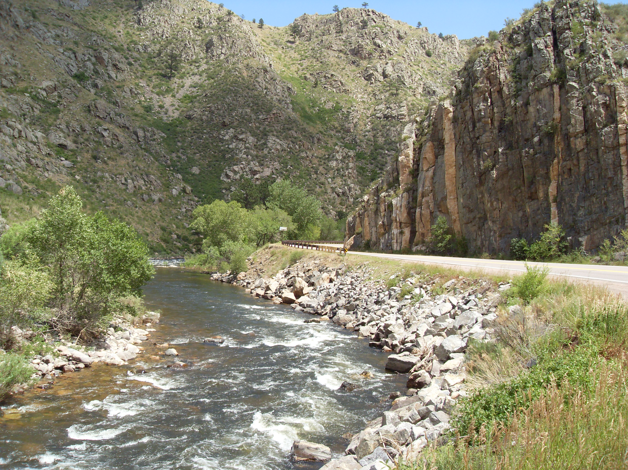
Screening similar forest records
Client recommendation
Use predictions to prioritize records for review.
Give Douglas-fir predictions and likely omissions extra scrutiny.
Test on a separate geographic area before expanding use.
Cache la Poudre River, Colorado
Wusel007 / CC BY-SA 3.0 / context photo
11
Notes:
Suggested speaker: Alon U. Villanueva (75 seconds)
Our evidence comes from a random split within one dataset from four Colorado wilderness areas. Nearby cells may share ecological characteristics across partitions. A new-region evaluation and confidence calibration would answer separate deployment questions. The Poudre Canyon photo provides landscape context and is not a verified image of a sampled cell.
Sources
https://doi.org/10.24432/C50K5N
https://archive.ics.uci.edu/ml/machine-learning-databases/covtype/covtype.info
Cache la Poudre River in Poudre Canyon / Wusel007 / CC BY-SA 3.0
https://commons.wikimedia.org/wiki/File:Cache_la_Poudre_River_in_Poudre_Canyon_high_walls.JPG
https://creativecommons.org/licenses/by-sa/3.0/

Slide 12
References and photo credits
Study sources
Photographs
Blackard, J. A. (1998). Covertype [Data set]. UCI Machine Learning Repository.
doi.org/10.24432/C50K5N
Rawah Wilderness
refractor, CC BY 2.0 (cropped)
Medicine Bow Mountains
Ken Lund, CC BY-SA 2.0
Blackard, J. A. (1999). The Forest CoverType dataset [Data set documentation]. UCI Machine Learning Repository.
Cache la Poudre River in Poudre Canyon
Wusel007, CC BY-SA 3.0
Keras and scikit-learn documentation
Full APA 7 references appear in the report.
Photo and license links in speaker notes.
AI assistance included research, coding, execution, analysis, writing and slide preparation.
12
Notes:
Suggested speaker: Alon U. Villanueva (15 seconds)
Invite questions. Use the report for full experiment results and APA 7 references. The photo links below go to the original Commons records and license terms.
Sources
https://doi.org/10.24432/C50K5N
https://archive.ics.uci.edu/ml/machine-learning-databases/covtype/covtype.info
https://keras.io/api/callbacks/early_stopping/
https://keras.io/api/layers/regularization_layers/dropout/
https://keras.io/api/models/model_training_apis/
https://scikit-learn.org/stable/common_pitfalls.html
https://scikit-learn.org/stable/modules/generated/sklearn.metrics.classification_report.html
Rawah Wilderness / refractor / CC BY 2.0 / cropped
https://commons.wikimedia.org/wiki/File:Rawah_Wilderness.jpg
https://creativecommons.org/licenses/by/2.0/
Medicine Bow Mountains at Jackson–Larimer County Border / Ken Lund / CC BY-SA 2.0
https://commons.wikimedia.org/wiki/File:Medicine_Bow_Mountains_at_Jackson-Larimer_County_Border_in_Colorado_(2520238260).jpg
https://creativecommons.org/licenses/by-sa/2.0/
Cache la Poudre River in Poudre Canyon / Wusel007 / CC BY-SA 3.0
https://commons.wikimedia.org/wiki/File:Cache_la_Poudre_River_in_Poudre_Canyon_high_walls.JPG
https://creativecommons.org/licenses/by-sa/3.0/

