Slide 1


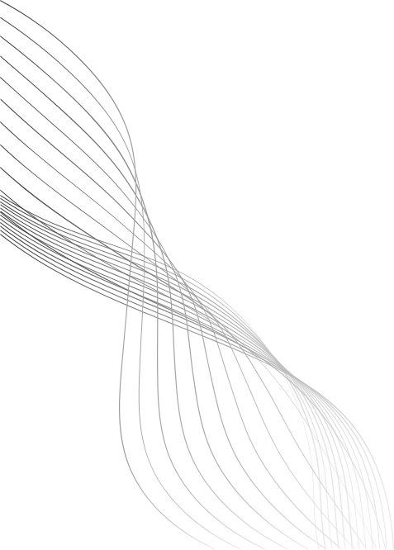
OMR MCQ GRADING
By
Mohamed ashraf
Mohamed hany
yousef nada

Slide 2
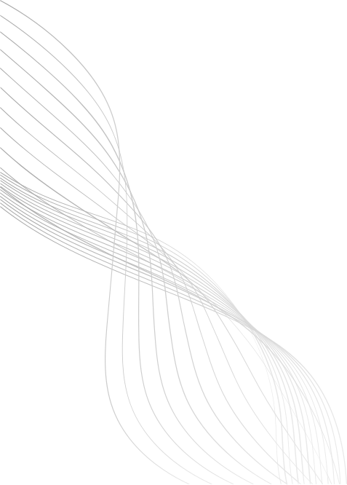
INTRODUCTION
This project presents an Automated Optical Mark Recognition (OMR) system designed to efficiently and accurately grade bubble sheet tests. using computer vision techniques
01

Slide 3
PROJECT GOALS
Accurately identify marked answers on scanned bubble sheets.
Automate the comparison of student responses with a predefined answer key.
Instantly calculate and display scores for completed tests.
Provide visual feedback on correct and incorrect answers directly on the sheet.
02

Slide 4
how the project works
Image Preprocessing
Contour Detection and Isolation
Perspective Transformation (Warping)
Answer Bubble Analysis
Grading and Feedback
Result Presentation
03

Slide 5
Image Preprocessing
The input image of the bubble sheet is converted to grayscale to simplify subsequent processing.
Gaussian blur is applied to reduce noise, which helps in more accurate edge detection.
Canny edge detection is then used to find prominent edges within the image, which are crucial for identifying the contours of the bubble sheet and answer sections.
03

Slide 6
Contour Detection and Isolation
The system identifies all contours in the edge-detected image.
These contours are then filtered to specifically find rectangular shapes, as bubble sheets and their main sections are typically rectangular.
The two largest rectangular contours are identified: one representing the entire bubble sheet and another representing the dedicated "grading" or "score" area.
03

Slide 7
Perspective Transformation (Warping)
Once the main rectangular contours are found, perspective transformation is applied. This rectifies the image, effectively "unskewing" it so that the bubble sheet appears as if viewed directly from above, regardless of the original angle it was captured at. This is performed for both the main sheet and the grading area.
03

Slide 8
Answer Bubble Analysis:
The warped image of the bubble sheet is converted back to grayscale and then subjected to an inverse binary thresholding. This makes the marked bubbles stand out as dark regions against a white background.
The system then divides the main answer area into individual "boxes," each corresponding to a single bubble option for a question.
For each box, the number of non-zero pixels (representing the dark, filled-in areas) is counted.
By comparing the pixel counts within each row of answer choices, the algorithm determines which bubble in each question row has the highest pixel density, indicating it's the marked answer.
03

Slide 9
Grading and Feedback
The identified user answers are then compared against a predefined answer key.
For each question, the answer is marked as correct or incorrect.
A final score is calculated based on the number of correct answers.
Visual feedback is generated: correct answers are typically highlighted in green, and incorrect user answers are marked in red, with the correct answer for that question also shown in green.
03

Slide 10
RESULT PRESENTATION
The final graded image, along with the calculated score, is displayed. The system also shows a visual breakdown of the processing steps, from the original image to the final graded sheet, for debugging and demonstration purposes.
09

Slide 11
problems we faced
1 - contour detection doesnt work on all bubble sheets so we solved this with another approach
2 - it works only with 1 column bubble sheets
03

Slide 12
2nd version of the project
instead of using contours on the bubble sheet because it may not work on all types of bubble sheets
we made another version that prompts the user to put points that specify the bubble sheet columns that work on most types
03

Slide 13
THANK YOU
10

