Slide 1

Online Book Store(PustakBindu)
Project II
Course Code: CAPJ356
Semester: 6th sem.
Prepared by:
Anil Shrestha, 6-2-355-4-2021
Sachin Magar, 6-2-355-22-2021

Slide 2
Table of Contents
Introduction
Problem Statement
Objectives
Scope
Limitation
Methodology
Algorithm Details
Use Case Diagram
Conclusion

Slide 3
Introduction
PustakBindu provides a simple, responsive, and personalized platform for book lovers
Web-based platform for organizing and accessing books online.
Supports dynamic search and filtering by category and price.
Secure authentication with JWT.

Slide 4
Problem Statement
Challenges Faced by Online Book Buyers
Inefficient discovery of books
Poor ui/ux
No recommendation system based purchase
Solution
Provides smooth user interface and design
Smart filters (genre, price)

Slide 5
Objectives
Following are the objectives of our Online Book Store:
To provide centralized platform for buying books.
To enhance the book discovery using recommendation algorithm
To ensure efficient content management with role-based access, content moderation and user friendly interface.

Slide 6
Scope
A React frontend that delivers a smooth and responsive user interface
Dynamic search and filtering functionality based on categories and price
A backend API for managing book data, user requests, and order processing

Slide 7
Limitation
The platform does not support multiple sellers or user-generated listings; all books are managed and sold directly by the store.
Inventory management features are basic and may not handle complex stock scenarios like backorders or multiple warehouses.
The system assumes users have a stable internet connection for real-time search and filtering; offline access is not supported
The project does not include features such as user accounts with extensive profiles or social features like reviews and comments.

Slide 8
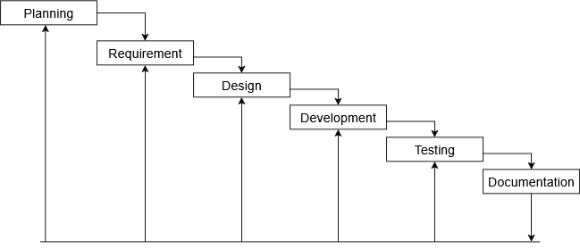
Methodology
Figure: Waterfall Methodology of Online Book Store

Slide 9
Algorithm Details
Order based algorithm
The Order-Based Popular Books Algorithm ranks and retrieves books according to how many times they have been ordered.
Pseudo code:
function getOrderBasedPopularBooks(limit):
books = getAllBooksFromDatabase()
sort books by orderCount in descending order
popularBooks = take first 'limit' books
return popularBooks

Slide 10
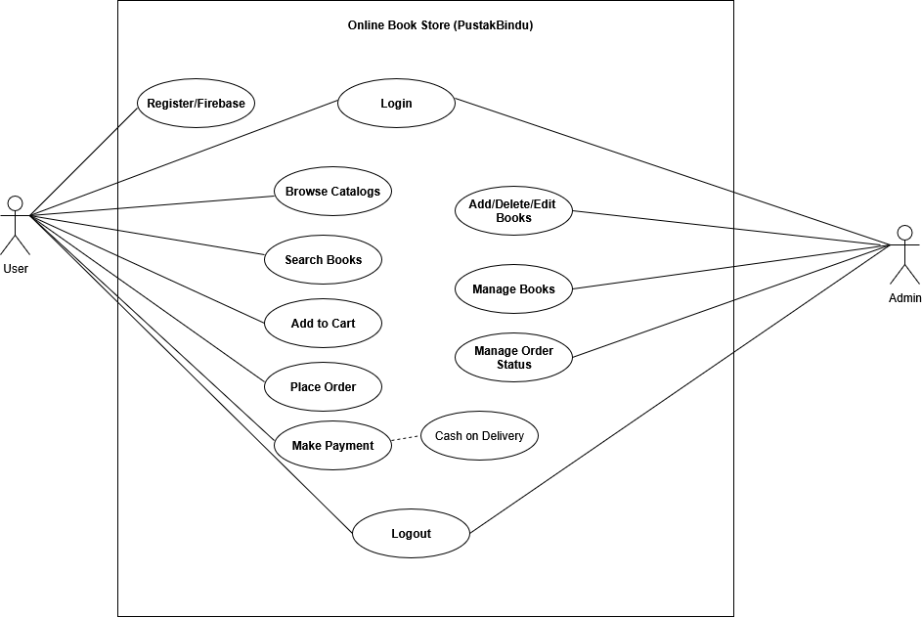
Use Case
Diagram

Slide 11
Conclusion
Improved process of discovering, purchasing of books.
User friendly features for Users for purchase
Decision to implement waterfall method was a correct one.
Future improvements in personalization, recommendation algorithms, and system performance will ensure that PustakBindu continues to be a preferred platform for book lovers.

Slide 12
Any Questions?

Slide 13
Thank
You
Thank You!

