Slide 1
CSC 101 – Introduction to Computing
Lecture 01

Slide 2
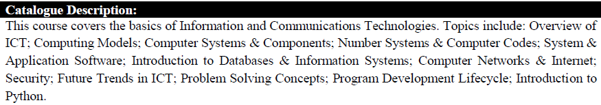
Course Information

Slide 3
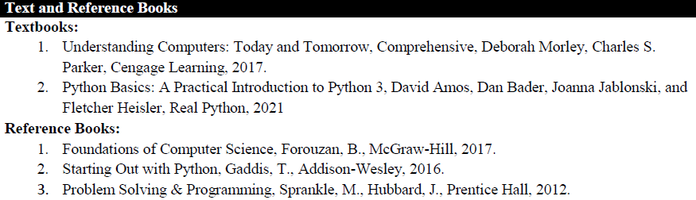
Books

Slide 4
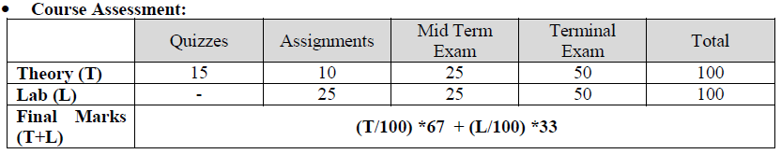
Assessment Plan for the Course:

Slide 5
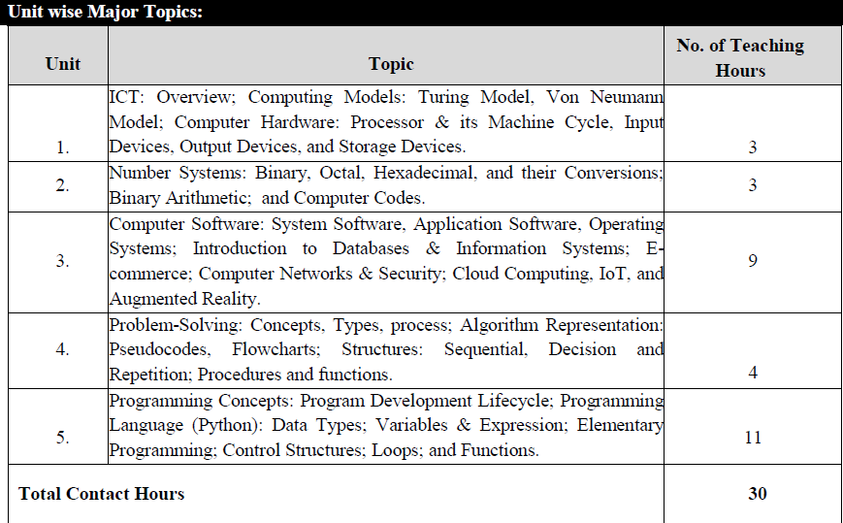
Major Topics Covered in the Course

Slide 6
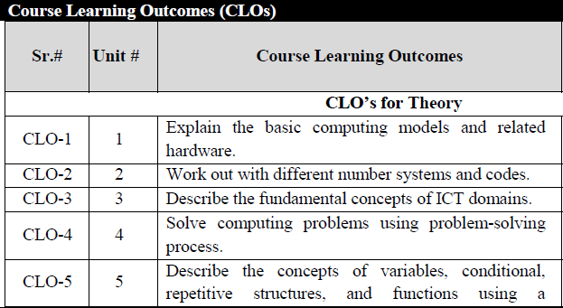
Course Learning Outcomes

Slide 7
Plagiarism Policy
Any assignment found 20% or more copied from the internet will be marked 0 (ZERO).
Any assignment copied from the class mate will also be marked 0 (ZERO).
Both for the source and the copied one.
No consideration will be made regarding plagiarized assignments.

Slide 8
Attendance Policy
Any student late in class by 5 min shall be marked absent.

Slide 9
Contact
Office
First Floor, CS Dept, Academic Block II
Email
umariqbal@comsats.edu.pk

Slide 10
Lecture 01

Slide 11
Outline
Definition of IT
Computer Technology
Communication Technology
Role of IT in Society
Models:
Turing Model,
Von Neumann Model;
Input Devices:
Keyboard,
Pointing & Touch Devices,
Game Controllers,
Optical Input Devices, Audio Visual Devices;
Output Devices:
Monitors,
Audio Output,
Printers & Plotters.

Slide 12

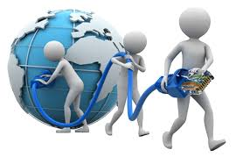
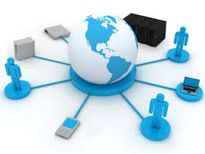

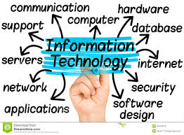
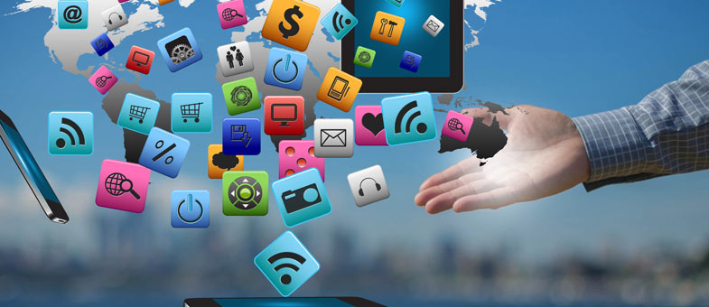
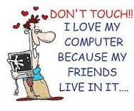
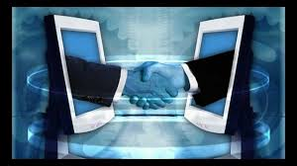

Slide 13
What is Information Technology
Fusion of computer and communication technology
Computer Technology
programmable, multiuse machine that accepts data and processes it into usable information
summaries, totals, or reports
used to speed up problem solving and increase productivity.

Slide 14
What is Information Technology
Communication Technology
consists of electromagnetic/optical devices and systems for communicating over long distances
InfoTech or IT is any technology that helps to produce, manipulate, store, communicate, and/or disseminate information
merges computing with high-speed communications links carrying data, sound, and video

Slide 15
Exercise
How have you been using communication Technology in your life?

Slide 16
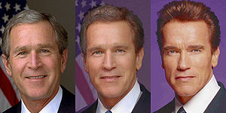
Some examples of IT
Image Morphing
changing (or morphing) one image into another through a seamless transition
Image Courtesy: http://en.wikipedia.org/wiki/Morphing
Notes:
3 Frames form a morph from George W. Bush to Arnold Schwarzenegger showing also the mid-point between the two extremes

Slide 17
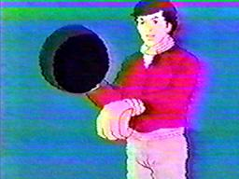
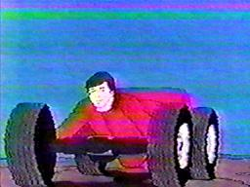
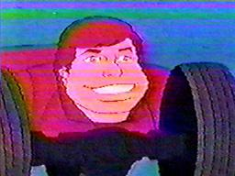
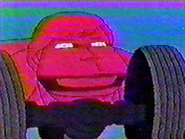
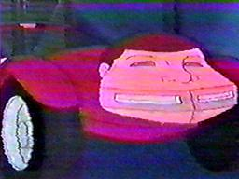
Image Morphing?
Turbo Teen
/

Slide 18
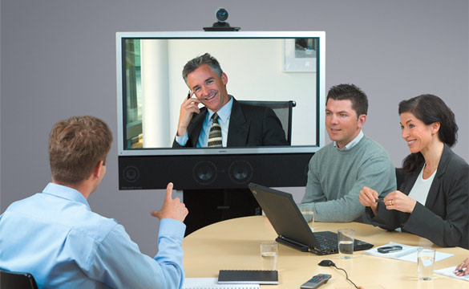
Some examples of IT
Video Conferencing

Slide 19
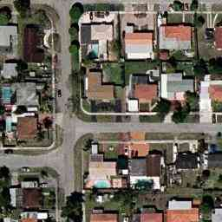
Some examples of IT
GPS Tracking
Track your vehicles, wherever they go, using GPS.

Slide 20
What is a Computer and What Does it Do?
Computer
A programmable, electronic device that accepts data, performs operations on that data, and stores the data
Follows instructions, called programs, which determine the tasks the computer will perform
Basic Operations
Input: Entering data into the computer
Processing: Performing operations on the data
Output: Presenting the results
Storage: Saving data, programs, or output for future use
Communications: Sending or receiving data

Slide 21
Communication Defined
Communication: To transfer data/information from one point to another
Using Wires
Electrical Signals
Optical Signals (Light)
Wirelessly
ElectroMagnetic Waves
Acoustic Waves (Sound) ….?
Using Analog Signals
Using Digital Signals

Slide 22
Related IT terms
What is a Network?
communications system connecting two or more computers with/without wires
What does being online mean?
using a computer or other information device, connected through a voice or data network, to access information and services from another computer or information device

Slide 23

Related IT terms
Cyberspace
encompasses the whole wired and wireless world of communications
The Internet
the “network of all networks”
Multimedia
technology that presents information in more than one medium, such as text, still images, moving images, and sound
World Wide Web
“graphical side of the Internet”
global network of linked documents on the Internet

Slide 24
Related IT terms
The E-word ; E Stands for Electronic
E-mail
E-learning
E-business
E-commerce
E-government

Slide 25
Exercise
Generate a list of ways the computer/IT has impacted the world.
Include both positive changes and negative changes.
think creatively.

Slide 26
Who Uses Computers?
Military
Doctors
Educators
Engineers
Architects
Musicians
Filmmakers
Attorneys
Bankers
Architects

Slide 27
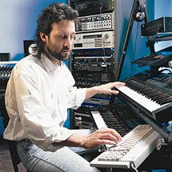
Computers In Society
Computers at home
Business
Entertainment
Communication
Education
Notes:
Insider information
The 2000 Census determined that 51% of American households had computers. Over 42% of these households also had Internet access. This can be contrasted to 36% and 18% in 1997. See www.census.gov/prod/2001pubs/p23-207.pdf for more information.

Slide 28
Computers In Society
Computers in education
Computer literacy required at all levels
Computers in small business
Makes businesses more profitable
Allows owners to manage
Computers in industry
Computers are used to design products
Assembly lines are automated
Notes:
Insider information
Specialized mountain bikes are designed on Sun workstations.

Slide 29
Computers In Society
Computers in government
Necessary to track data for population
Police officers
Tax calculation and collection
Governments were the first computer users
Notes:
Most state departments of motor vehicles rely on a mainframe computer. Officers access the mainframe from a remote intelligent terminal.

Slide 30
Computers in the Home
Computers used for a variety of tasks:
Looking up information and news
Exchanging e-mail
Shopping and paying bills
Watching TV and videos
Downloading music and movies
Organizing digital photographs
Playing games
Making vacation plans

Slide 31
Computers in the Home
Used for reference, productivity, and entertainment
Wireless networking
Computers can be used in nearly any location
Smart appliances
Traditional appliances with built-in computer or communication technology
Smart homes
Household tasks are monitored and controlled by a main computer in the house

Slide 32
Computers in Education
Youth today: the computing generation
Computer labs and classrooms
Most students today have access to computers at school
Some schools integrate e-books into the curriculum
Wireless hotspots
Colleges and universities are even more integrated
Some have computer requirements for enrollment
Supplied or Bring Your Own Device (BYOD)
Distance learning
Students participate from locations other than the traditional classroom setting using computers and Internet access

Slide 33
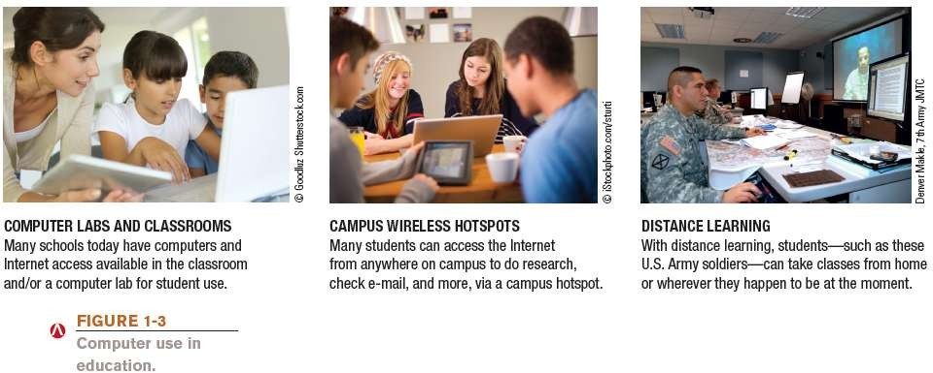
Computers in Education

Slide 34
Computers on the Job
Computers have become a universal on-the-job tool for decision-making, productivity, and communication
By all types of employees
For access control and other security measures
For service professional use
Extensively by the military
Requires continually refreshing computer skills
– Common uses:
– Decision making, productivity, off-site communications, and authentication

Slide 35
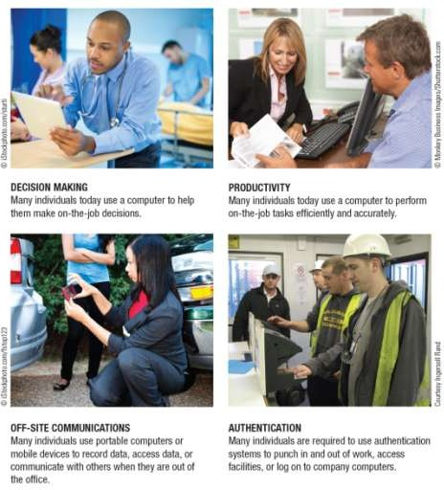

Computers on the Job

Slide 36
Computers on the Go
Computers are encountered in nearly every aspect of daily life
Consumer kiosks
ATM transactions
POS systems at retail stores
Self-checkout systems
Consumer authentication systems
Portable computers or mobile devices
GPS systems

Slide 37
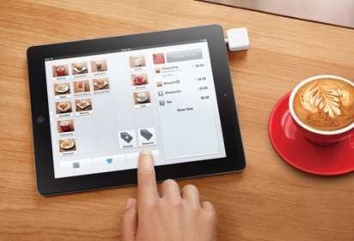
Technology and You
Restaurant iPad Ordering Systems
Used in conjunction with e-menus
Customers can place and pay for orders
Can provide more resources to customers

Slide 38
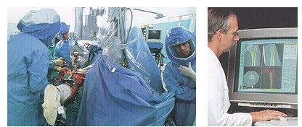
Computers In Health Care
Computers in health care
Revolutionized health care
New treatments possible
Scheduling of patients has improved
Delivery of medicine is safer
Notes:
Page 19 of the text introduces the first Norton Notebook, the Merging of Media and Meaning. The author draws an analogy between electricity and computers in our lives. Discuss how difficult live would be without either of these devices. Remember that computers exist in nearly all of our modern devices, including cars, phones, kitchen appliances and entertainment devices.

Slide 39
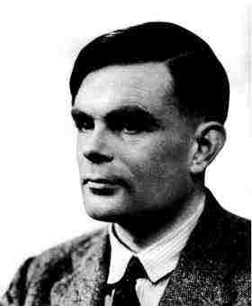
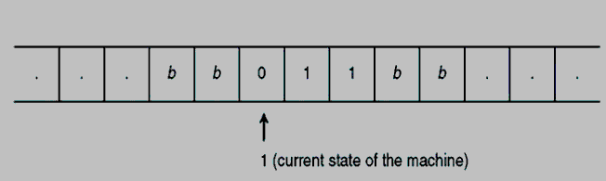
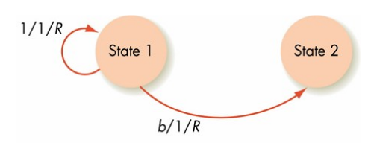
Allen Turing (1912-1954)
The Turing Machine Aka The Universal Machine (1936) includes
A conceptual Tape that extends infinitely to both directions
Holds the input to the turing machine
Serves as memory
The tape is divided in cells
A unit that reads one cell of the tape and writes a symbol in that cell
Notes:
The story of modern electronic digital computing should start with Alan Turing who published a paper in 1936 On Computable Numbers, with an application to the Entscheidungs problem. The paper proved that a machine capable of processing a stream of 1s and 0s according to programmed instructions would be capable of solving any problem that would count as a 'definite method.' As it happens, the set of problems included in this definition is the universe of mechanically solvable problems. Hence, the Turing Machine is also known as the Universal Machine, the theoretical precursor to the electronic digital computer which Atanasoff was soon to invent.

Slide 40
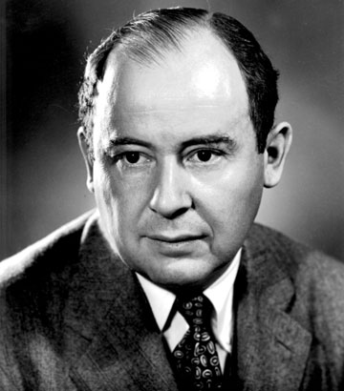
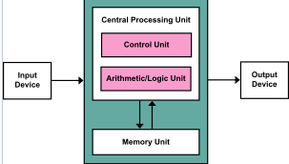
John von Neumann
A processing unit with both an arithmetic logic unit and processor registers
A control unit that includes an instruction register and a program counter
Memory that stores data and instructions
External mass storage
Input and output mechanisms

Slide 41
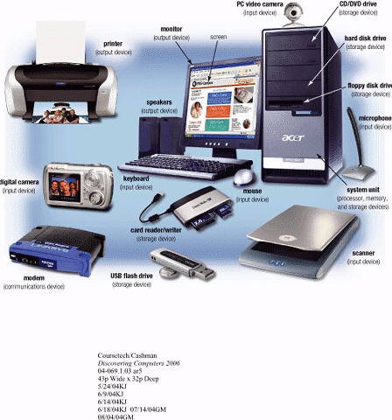
Input Devices
Hardware used to enter data and instructions

Slide 42
Two Common Input Devices
Keyboard
Mouse

Slide 43
The Keyboard
First peripheral to be used with computers
The most common input device for inputting text and numbers
About 100 keys
Must be proficient with keyboard
Skill is called keyboarding

Slide 44
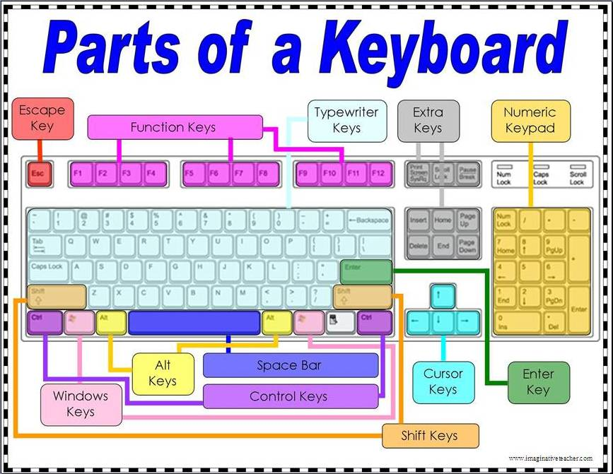

Slide 45
The Mouse
All modern computers have a variant
Allows users to select objects
Pointer moved by the mouse
Mechanical mouse
Rubber ball determines direction and speed
The ball often requires cleaning
Optical mouse
Light shown onto mouse pad
Reflection determines speed and direction
Requires little maintenance

Slide 46
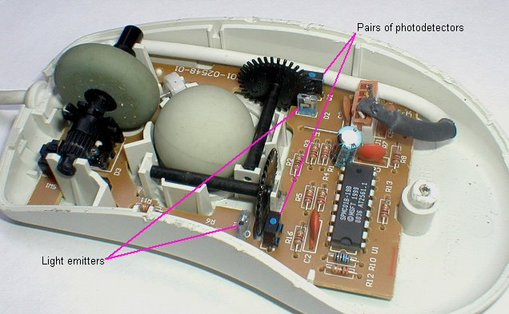
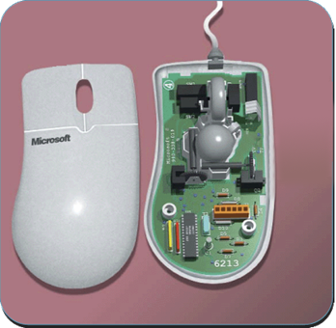
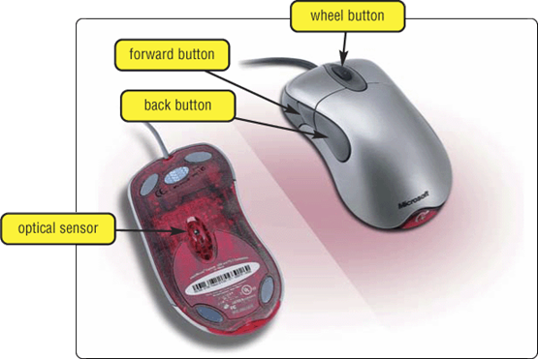
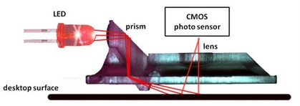
The Mouse
mouse buttons
wheel button
ball

Slide 47
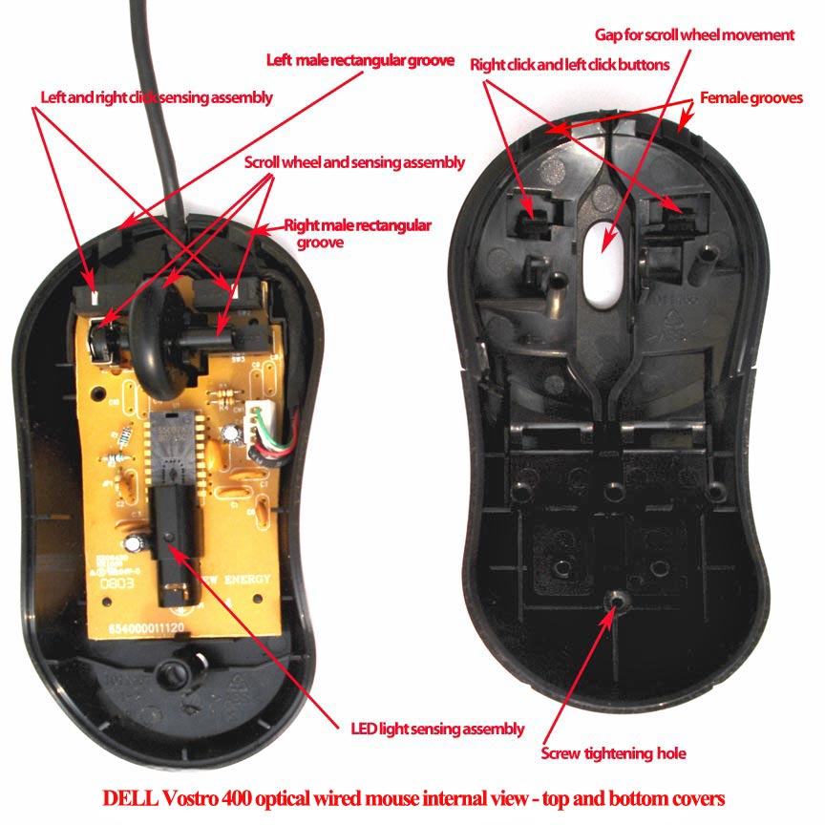
Optical Mouse

Slide 48
Benefits of Using Mouse
Pointer positioning is fast
Menu interaction is easy
Users can draw electronically

Slide 49
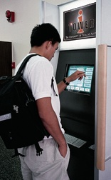
Touch Screens
accept input by allowing the user to place a fingertip directly on the computer screen
Use sensors to detect touch
Well suited for simple applications
ATM
Public information kiosk
Notes:
Discussion point
Discuss the information kiosks at local malls. Many offer limited Internet access. Have students discuss what could happen to the computers if the malls were to provide keyboards to the mall shoppers.

Slide 50
Touch Screens
work well in environments where dirt or weather would render keyboards and pointing devices useless, and
where a simple, intuitive interface is important.
Touch screens have become common in
fast-food restaurants,
department stores,
drugstores, and supermarkets,
where they are used for all kinds of purposes, from creating personalized greeting cards to selling lottery tickets.
Notes:
Discussion point
Discuss the information kiosks at local malls. Many offer limited Internet access. Have students discuss what could happen to the computers if the malls were to provide keyboards to the mall shoppers.

Slide 51
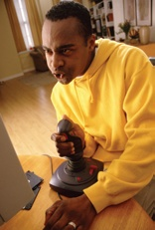
Game Controllers
Enhances gaming experience
Provide custom input to the game
Modern controllers offer feedback
Two broad Categories
Joystick
Game pad
Notes:
Teaching tip
Microsoft’s Force Feedback joysticks vibrate. In driving games, when the player hits another car, the joystick will vibrate.

Slide 52
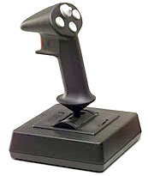
Joystick
Around for long time
Can be used other than games
enable the user to “ fly” or “ drive” through a game, directing a vehicle or character
popular in racing and flying games
One variant is the racing game controller, which includes an actual steering wheel
some racing game controllers even include foot pedals and gearshifts
Notes:
Teaching tip
Microsoft’s Force Feedback joysticks vibrate. In driving games, when the player hits another car, the joystick will vibrate.

Slide 53
Game Pad
is a small, flat device that usually provides two sets of controls— one for each hand.
extremely flexible and are used to control many kinds of games
If you do not have a joystick, you can use a game pad to control most racing and flying games.
Many computer games still provide support for a mouse or keyboard, so a dedicated game controller is not always required
Notes:
Teaching tip
Microsoft’s Force Feedback joysticks vibrate. In driving games, when the player hits another car, the joystick will vibrate.

Slide 54
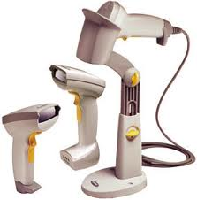
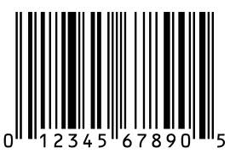
Optical Input Devices
Allows the computer to see input
Bar code readers
Converts bar codes to numbers
UPC Universal Product Code
Computer find number in a database
Works by reflecting light
Amount of reflected light indicates number
Notes:
Insider information
For more information on the UPC code and a searchable database, visit http://www.upcdatabase.com/. A working UPC is 071662000240, which represents a 24 count box of Crayola Crayons.

Slide 55
Bar Code Reading Process
reader emits a beam of that is reflected by the bar code image
light-sensitive detector identifies the bar code image by recognizing special bars at both ends of the image
special bars are different, so the reader can tell whether the bar code has been read right-side up or upside down
After detector has identified the bar code, it converts the individual bar patterns into numeric digits code the computer can understand
reader then feeds the data into the computer
Notes:
Insider information
For more information on the UPC code and a searchable database, visit http://www.upcdatabase.com/. A working UPC is 071662000240, which represents a 24 count box of Crayola Crayons.

Slide 56
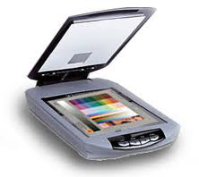
Image Scanners
Converts printed media into electronic
Reflects light on the image
Sensors read the intensity
Filters determine color depths
Notes:
Teaching tip
Spend a few minutes here discussing computer screen colors. A good website to look at colors is http://www.radok.com/web-safe-colors_rgb.html. To demonstrate how computers generate color, use the custom color creator in Paint.

Slide 57
How an Image is Scanned
A light source is moved across a printed page
The light bounces off the page and is passed through a lens
And onto the light sensitive diodes which converts light to electricity. There are usually 300-600 diodes per inch.
A circuit board converts the electricity to numbers and send the information to the computers
Notes:
Teaching tip
Spend a few minutes here discussing computer screen colors. A good website to look at colors is http://www.radok.com/web-safe-colors_rgb.html. To demonstrate how computers generate color, use the custom color creator in Paint.

Slide 58
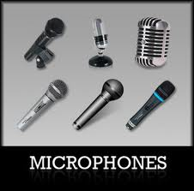
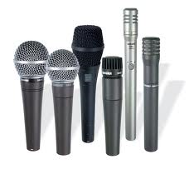
Audiovisual Input Devices
Microphones
Used to record speech
Speech recognition
“Understands” human speech
Allows dictation or control of computer
Matches spoken sound to known phonemes
Enters best match into document
Notes:
Insider information
Two common products are IBM’s Via Voice and Scansoft Dragon NaturallySpeaking. More information for ViaVoice can be found at http://www-306.ibm.com/software/voice/viavoice/. More information regarding Dragon is located at http://www.scansoft.com/naturallyspeaking/.

Slide 59
Speech Recognition
demand for translating spoken words into text
Translating voice to text is a capability known as speech recognition (or voice recognition).
With it, you can dictate to the computer instead of typing, and you can control the computer with simple commands
translates Phonemes into text or commands
Notes:
Insider information
Two common products are IBM’s Via Voice and Scansoft Dragon NaturallySpeaking. More information for ViaVoice can be found at http://www-306.ibm.com/software/voice/viavoice/. More information regarding Dragon is located at http://www.scansoft.com/naturallyspeaking/.

Slide 60
Other type of Audio Input
Computers can accept many kinds of audio input
Sound card with the appropriate plugs
a compact disc
a tape player
a radio or
even a record player
If the audio source outputs sounds in the form of analog, sound card must convert the analog signals into digital code so the computer can store and use it.
Notes:
Insider information
Two common products are IBM’s Via Voice and Scansoft Dragon NaturallySpeaking. More information for ViaVoice can be found at http://www-306.ibm.com/software/voice/viavoice/. More information regarding Dragon is located at http://www.scansoft.com/naturallyspeaking/.

Slide 61
Video Input
With growth of multimedia and the Internet, computer users are adding video input capabilities to their systems in great numbers
Applications such as video conferencing enable people to use full-motion video images
Videos are commonly used in presentations and on Web pages

Slide 62

Video Camera and Webcam
video cameras used with computers digitize images by breaking them into individual pixels
pixel is one or more dots that express a portion of an image
Each pixel’s color and other characteristics are stored as digital code
With Webcam the user can “capture” images of himself or herself while working at the computer

Slide 63
Digital Cameras
portable, handheld devices that capture still images
digitizes the image
compresses it, and
stores it on a special memory card.
user can then copy the information to a PC, where the image can be edited, copied, printed, embedded in a document, or transmitted to another user

Slide 64
Digital Cameras
Digital cameras have become standard equipment for designers of all kinds.
In Web page design, digital cameras enable designers to shoot a subject and quickly load the images onto their computers.
This process saves the step of acquiring existing photographs or developing and printing film-based photos—which must be scanned into the computer.
Designers can update a Web site’s illustrations quickly and regularly using digital cameras.
Graphic designers can edit and enhance digital photographs in innumerable ways, using photo-editing software

Slide 65
Monitors
Most common output device
Connects to the video card or controller
Two types
Cathode Ray Tube (CRT)
Flat-panel
Categorized by color output
Monochrome
One color with black background
Grayscale
Varying degrees of gray
Color
Display 4 to 16 million colors

Slide 66
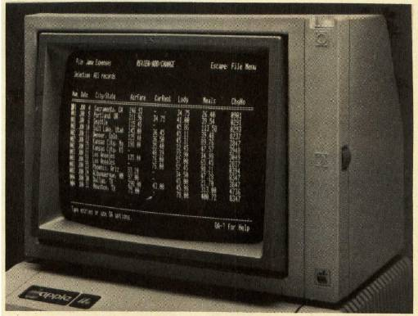
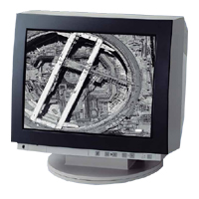
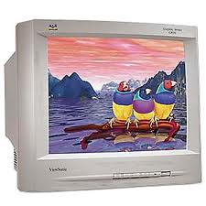
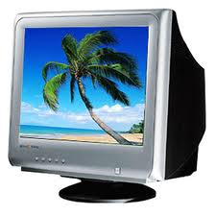
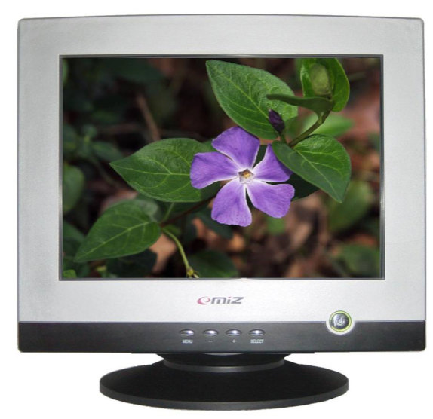
Cathode Ray Tube (CRT)
Most common type of monitor

Slide 67
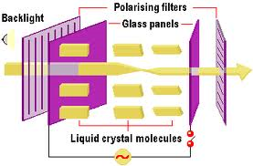

Liquid Crystal Display (LCD)
Commonly found on laptops
Desktop versions exist
Solve the problems of CRT
Fluorescent lights provide illumination

Slide 68
Plasma Display Panel (PDP)
Utilizes small cells containing electrically charged ionized gases called fluorescent lamps
Advantages
Better picture quality
Wider viewing angles
Less visible motion blur
Disadvantages
Screen burn-in
Uses more electricity than LCDs

Slide 69
Light Emitting Diodes (LED)
uses light-emitting diodes as a video display
produce images with greater dynamic contrast;
can be extremely slim, some screens less than half an inch (0.92 cm) thick;[6]
produce less environmental pollution on disposal;
are more expensive;
have typically 20 to 30% lower power consumption

Slide 70

Sound Systems
Integral part of the computer experience
Capable of recording and playback

Slide 71

Sound Cards
Device between the CPU and speakers
Converts digital sounds to analog
Can be connected to several devices
Modern cards support Dolby Surround Sound
Notes:
Insider Information
Sound Blaster is the primary manufacturer of sound cards. Exceptional models start at around $30.00.

Slide 72


Headphones and Headsets
Replacement for speakers and microphones
Offer privacy
Does not annoy other people
Outside noise is not a factor
Headsets have speakers and a microphone
Notes:
Insider information
The PS2 game SOCOM II Navy Seals includes a USB headset to allow verbal communication with other team members.

Slide 73
Commonly Used Printers
Impact printers
Generate output by striking the paper
Uses an inked ribbon
Most common
Dot Matrix
Line Printer and Band Printers
Non-impact printers
Use methods other than force
Tend to be quiet and fast
Most Common
Ink jet and Laser

Slide 74


Dot Matrix Printer
Can produce sheets of plain text very quickly
Used to print to multi-sheet pages
Printing on wide-sheet paper
Print head strikes inked ribbon
Speed measured in characters per second (CPS)
Notes:
Teaching Tip
Figure 4B.5 on page 163 provides an excellent rendering of how the print head works. Be sure to refer to the image as you teach.

Slide 75

Dot Matrix Printer Parts

Slide 76

Dot Matrix Printhead Mechanism
Print head Mechanism
which contains a cluster (or matrix) of short pins arranged in one or more columns.
Printer can push any of the pins out in any combination.
By pushing out pins in various combinations, the print head can create alphanumeric characters
Forms a character by creating a series of dots.
Notes:
Teaching Tip
Figure 4B.5 on page 163 provides an excellent rendering of how the print head works. Be sure to refer to the image as you teach.

Slide 77
How Image is created?
When pushed out from the duster, the protruding pins’ ends strike a ribbon
which is held in place between the print head and the paper.
When the pins strike the ribbon, they press ink from the ribbon onto the paper.
More pins that a print head contains, the higher the printer’s resolution
Slowest dot matrix printers create 50 to 70 cps
Fastest more than 500 cps

Slide 78
Laser Printer
Non-impact printer
Works on a similar process as photocopier
Laser is at the heart of these printers.
Produces high quality documents
Color or black and white
Speed measured in pages per minute
Quality expressed as dots per inch
Notes:
Insider information
The laser printer works on a similar process to a photocopier. The first photocopier as we know it today was invented in Astoria NY in 1938 by Chester Carlson and Otto Kornei.

Slide 79

How Laser Creates an Image

Slide 80



Laser Printer Technology

Slide 81


Plotters
Large high quality blueprints
Older models draw with pens
Operational costs are low
Output is very slow

Slide 82
Summary
Definition of IT
Computer Technology
Communication Technology
Role of IT in Society
Models:
Turing Model,
Von Neumann Model;
Input Devices:
Keyboard,
Pointing & Touch Devices,
Game Controllers,
Optical Input Devices, Audio Visual Devices;
Output Devices:
Monitors,
Audio Output,
Printers & Plotters.

