Slide 1
CSC 101 – Introduction to ICT
Lecture 02 (Morley Ch 02)

Slide 2
Outline
How Computer Process Data
Central Processing Unit
Control Unit
Arithmetic & Logic Unit
System Clock & Machine Cycle
Memory
Volatile & Non-Volatile, Flash Memory, Registers, Cache Memory
Bus & Types, and Ports

Slide 3
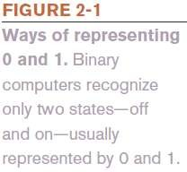
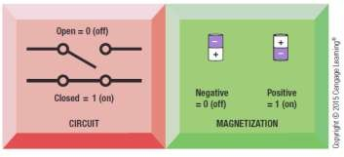
Data and Program Representation
Digital Data Representation
Coding Systems
Used to represent data and programs in a manner
understood by the computer
Digital Computers
Can only understand two states, off and on
(0 and 1)
Digital Data Representation
The process of representing data in digital form so it can be understood by a computer

Slide 4

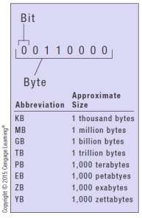
Digital Data Representation
Bit
The smallest unit of data that a binary computer can recognize (a single 1 or 0)
Byte = 8 bits
Byte terminology used to express the size of documents and other files, programs, etc.
Prefixes are often used to express larger quantities of bytes: kilobyte (KB), megabyte (MB), gigabyte (GB), terabyte (TB), petabyte (PB), exabyte (EB), zettabyte (ZB), yottabyte (YB).

Slide 5
Representing Numerical Data
The Binary Numbering System
Numbering system
A way of representing numbers
Decimal numbering system
Uses 10 symbols (0-9)
Binary numbering system
Uses only two symbols (1 and 0) to represent all possible numbers
In both systems, the position of the digits determines the
power to which the base number (such as 10 or 2) is raised

Slide 6
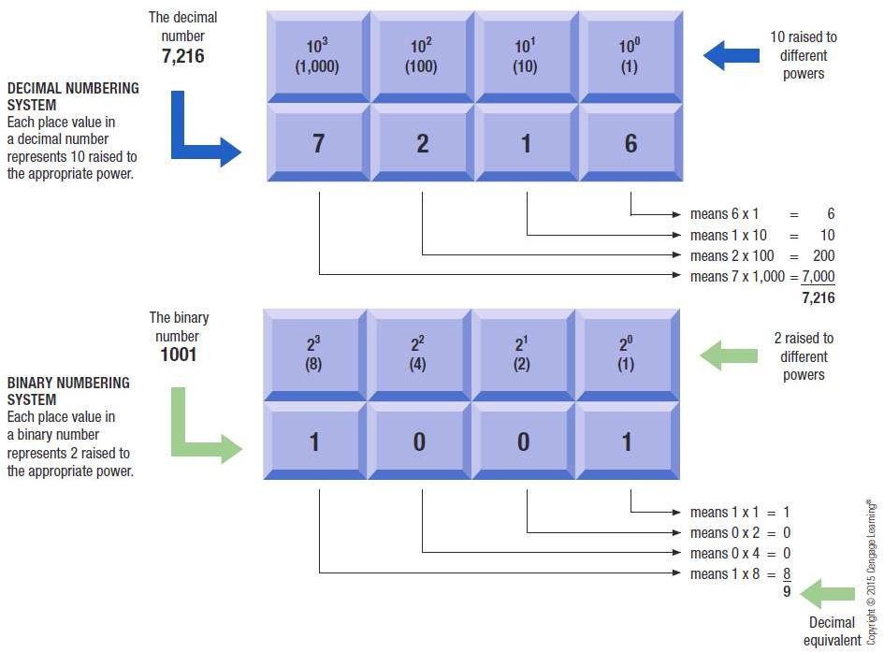
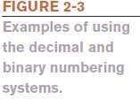
Representing Numerical Data

Slide 7
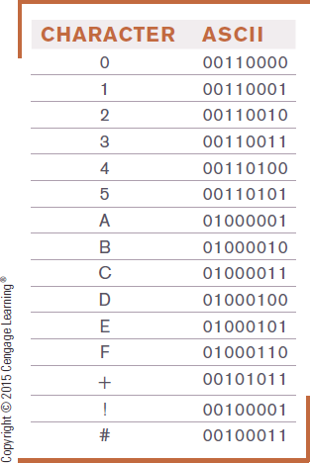

Coding Systems for Text-Based Data
ASCII (American Standard Code for Information Interchange)
Coding system traditionally used with personal computers
EBCDIC (Extended Binary-Coded Decimal Interchange Code)
Developed by IBM, primarily for
mainframes

Slide 8
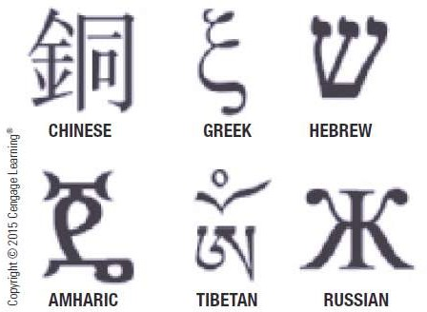
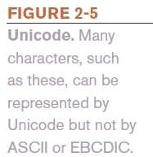
Coding Systems for Text-Based Data
Unicode
Newer code (32 bits per character is common)
Universal coding standard designed to represent text-
based data written in any ancient or modern language
Replacing ASCII as the primary text-coding system

Slide 9
Coding Systems for Other Types of Data
Graphics Data (still images such as photos or drawings)
Bitmapped images
Image made of up of a grid of small dots called pixels
Monochrome graphic can only be one of two colors
Requires just one bit for color storage
Images with more than two colors
Can use 4, 8, or 24 bits to store the color data for each pixel
More bits = more colors

Slide 10
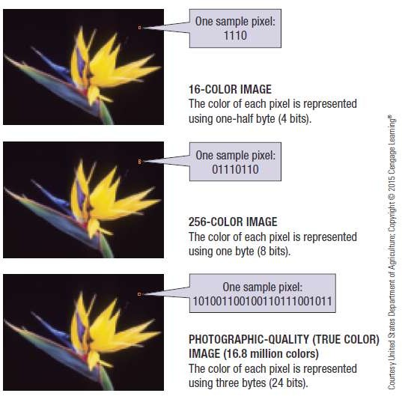
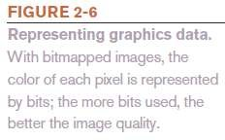
Coding Systems for Other Types of Data

Slide 11
Coding Systems for Other Types of Data
Audio Data
Must be in digital form in order to be stored on or processed by a computer
Often compressed when sent over the Internet
MP3 files are 10 times smaller than their uncompressed digital versions
Download more quickly and take up less storage space
Video Data
Displayed using a collection of frames, each frame contains a still image
Amount of data can be substantial, but can be compressed

Slide 12
Representing Software Programs
Machine language
Binary-based language for representing computer programs the computer can execute directly
Early programs were written in machine language
Today’s programs still need to be translated into machine language in order to be understood by the computer

Slide 13
Inside the System Unit
System Unit
The main case of a computer
Houses the processing hardware for a computer
Also contains storage devices, the power supply, and cooling fans
Houses processor, memory, interfaces to connect to
peripheral devices (printers, etc), and other components
With a desktop computer, usually looks like a rectangular box

Slide 14
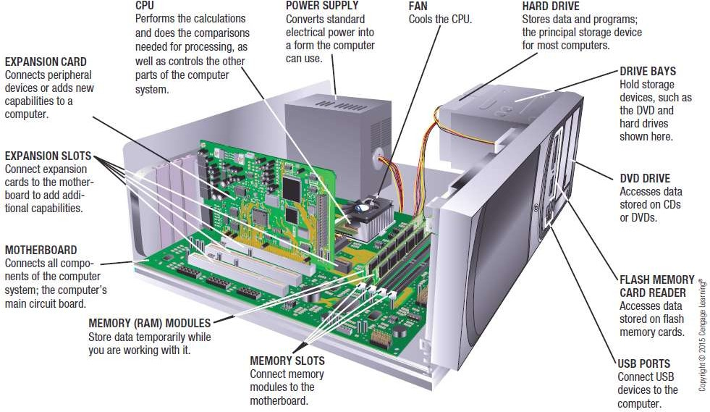
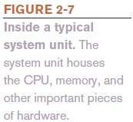
Inside the System Unit

Slide 15
Inside the System Unit
The Motherboard
Computer Chip
Very small pieces of silicon or other semi-conducting
material onto which integrated circuits are embedded
Circuit Board
A thin board containing computer chips and other
electronic components
System Board
The main circuit board inside the system unit to which
all devices must connect

Slide 16
Inside the System Unit
External devices (monitors, keyboards, mice, printers)
Wireless devices (e.g., Bluetooth)
Power Supply
Connects to the motherboard to deliver electricity (personal computer)
Portable computers use rechargeable battery pack
Nonremovable batteries more difficult and expensive to replace

Slide 17
Inside the System Unit
Drive Bays
Rectangular metal racks inside the system unit that house storage devices
Hard drive, CD/DVD drive, flash memory card reader
Connected to the motherboard with a cable
Processors
The CPU (Central Processing Unit)
Circuitry and components packaged together and connected directly to the motherboard
Does the vast majority of processing for a computer
Also called a processor; called a microprocessor when talking about personal computers

Slide 18
Inside the System Unit
Dual-core CPU
Contains the processing components (cores) of two separate processors on a single CPU
Quad-core CPU
Contains four cores
Multi-core processors allow computers to work on more than one task at a time
Typically different CPUs for desktop computers, portable computers, servers, mobile devices, consumer devices, etc.
Personal computer CPU often made by Intel or AMD
Media tablets and mobile phones use processors made by other companies such as ARM

Slide 19
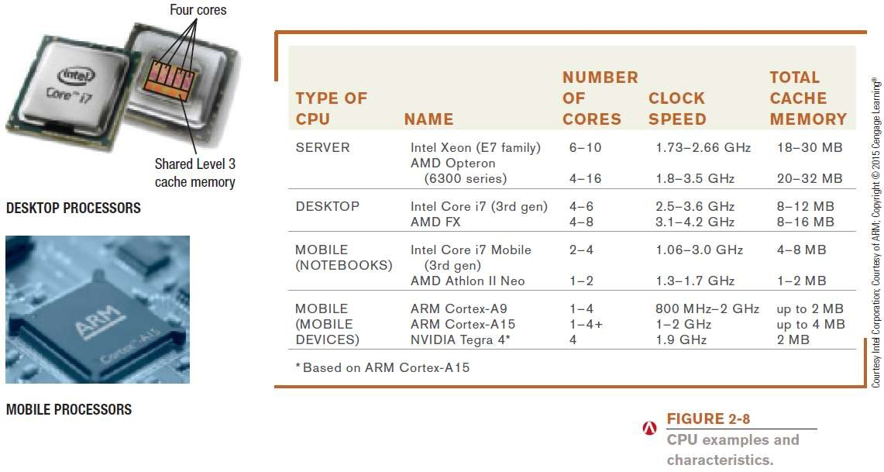
Inside the System Unit

Slide 20
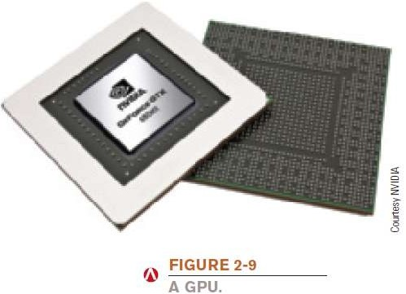
Inside the System Unit
The GPU (graphics processing unit)
Takes care of the processing needed to display images (including still images, animations) on the screen
Can be located on the motherboard, on a video graphics board, on in the CPU package

Slide 21
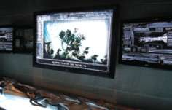
How It Works Box
GPUs and Transformers: The Ride 3D at Universal Studios
Uses a 2,000 foot-long track, 14 huge screens, and 34 projectors
Motion is synchronized with the action
Images are 3D, 4K
Used GPUs to see 3D animations in real time as they were being developed

Slide 22
Inside the System Unit
Processing Speed
CPU clock speed is one measurement of processing speed
Rated in megahertz (MHz) or gigahertz (GHz)
Higher CPU clock speed = more instructions processed per second
Alternate measure of processing speed is the number of
instructions a CPU can process per second
Megaflops (millions), gigaflops (billions), teraflops (trillions)
Benchmark tests can be used to evaluate overall processing speed

Slide 23
Inside the System Unit
Word Size
The amount of data that a CPU can manipulate at one time
Typically 32 or 64 bits
Cache Memory
Special group of very fast memory chips located on or close to the CPU
Level 1 is fastest, then Level 2, then Level 3
More cache memory typically means faster processing
Usually internal cache (built into the CPU)

Slide 24
Inside the System Unit
Bus Width, Bus Speed, and Bandwidth
A bus is an electronic path over which data can travel
Found inside the CPU and on the motherboard
Bus width is the number of wires in the bus over which data can travel
A wider bus allows more data to be transferred at one time

Slide 25
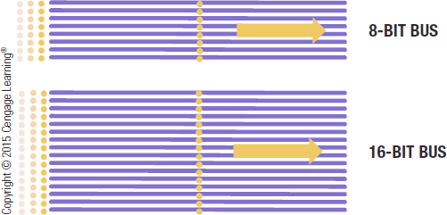
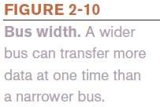
Inside the System Unit
Bus width and speed determine the throughput or bandwidth of the bus
– The amount of data that can be transferred by the bus in a given time period

Slide 26
Memory
Memory
Refers to chip-based storage located inside the system unit
Storage refers to the amount of long-term storage
available to a computer
Random Access Memory (RAM)
Computer’s main memory
Consists of chips arranged on a circuit board called a memory module which are plugged into the motherboard
Stores essential parts of operating system, programs, and data the computer is currently using

Slide 27
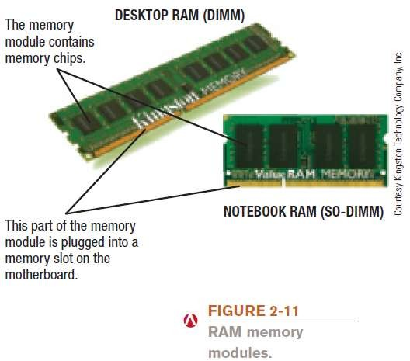
Memory

Slide 28
Memory
Volatile
RAM content lost when the computer is shut off
ROM and flash memory are non-volatile
Measured in bytes
Amount installed depends on the CPU and operating system being used
Most personal computers use SD-RAM
MRAM and PRAM - non-volatile RAM under development

Slide 29

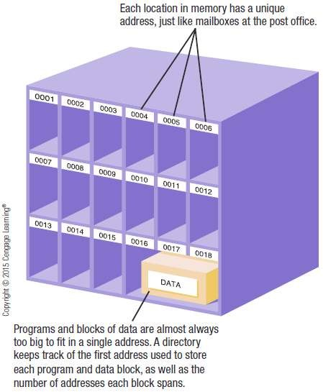
Memory
Each location in memory has an address
Each location typically holds one byte
Computer system sets up and maintains directory tables to facilitate retrieval of the data

Slide 30
Memory
Registers
High-speed memory built into the CPU
Used to store data and intermediary results during
processing
Fastest type of memory
ROM (read-only memory)
Non-volatile chips located on the motherboard into which data or programs have been permanently stored
Retrieved by the computer when needed
Being replaced with flash memory

Slide 31
Memory
Flash Memory
Nonvolatile memory chips that can be used for storage
Have begun to replace ROM for storing system
information
Now stores firmware for personal computers and other devices
Built into many types of devices (media tablets, mobile phones, and digital cameras) for user storage

Slide 32
Cooling Components
Fans
Fans used on most personal computers to help cool the CPU and system unit
Heat is an ongoing problem for CPU and computer manufacturers
Can damage components
Cooler chips run faster
Heat Sinks
Small components typically made out of aluminum with
fins that help to dissipate heat

Slide 33
Cooling Components
Cooling Systems
Liquid cooling systems
Cool the computer with liquid-filled tubes
Immersion cooling
Hardware is actually submerged into units filled with a liquid cooling solution
Notebook cooling stand
Cools the underside of a notebook computer
Other cooling methods, such as ion pump cooling systems,
are under development

Slide 34
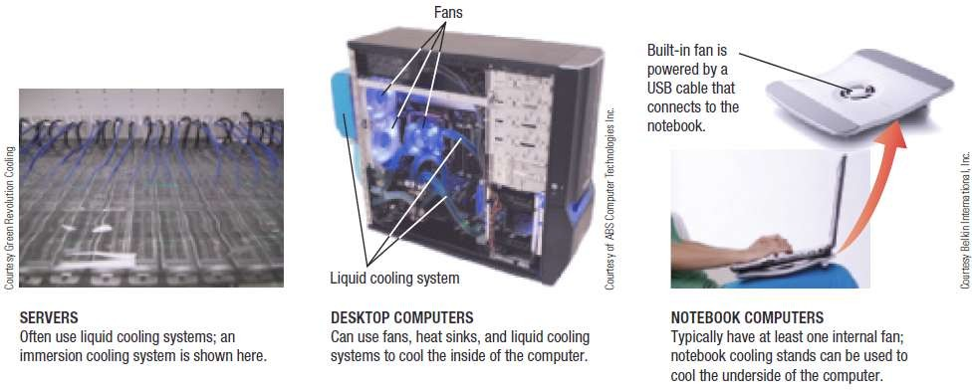

Cooling Components

Slide 35
Expansion
Expansion Slots, Expansion Cards, and ExpressCard Modules
Expansion Slot
A location on the motherboard into which expansion
cards are inserted
Expansion Card
A circuit board inserted into an expansion slot
Used to add additional functionality or to attach a peripheral device
ExpressCard Modules
Designed to add additional functionality to notebooks

Slide 36
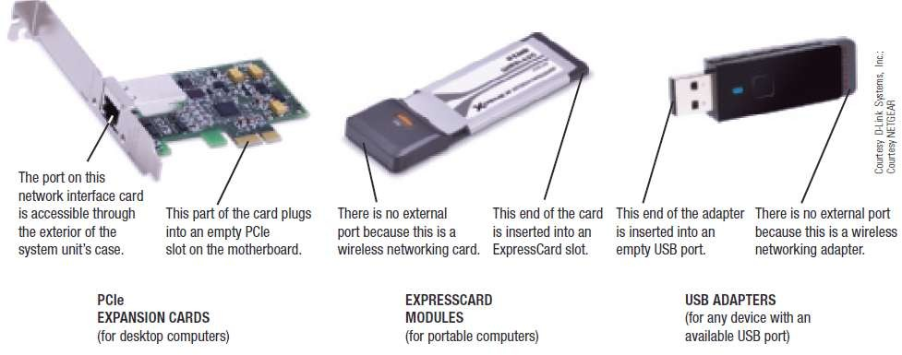

Expansion

Slide 37
Buses
Bus
An electronic path within a computer over which data travels
Located within the CPU and etched onto the motherboard
Expansion Bus
Connects the CPU to peripheral (typically input and output)
devices
Memory Bus
Connects CPU directly to RAM
Frontside Bus (FSB)
Connects CPU to the chipset that connects the CPU to the rest of the bus architecture

Slide 38
Buses
PCI and PCI Express (PCIe) Bus
PCI has been one of the most common types
Today, PCI Express bus, which is extremely fast, has
replaced the PCI bus
Universal Serial Bus (USB)
Extremely versatile
Allows 127 different devices to connect to a computer via a single USB port
FireWire Bus
Developed by Apple to connect multimedia devices to a computer

Slide 39
Ports and Connectors
Port
A connector on the exterior of a computer’s system unit to which a device may be attached
Typical desktop computer ports include:
Power connector, Firewire, VGA monitor, Network, USB, Audio, and HDMI
Others include IrDA and Bluetooth ports, eSATA ports, Thunderbolt ports (Apple devices)
Most computers support the Plug and Play standard

Slide 40
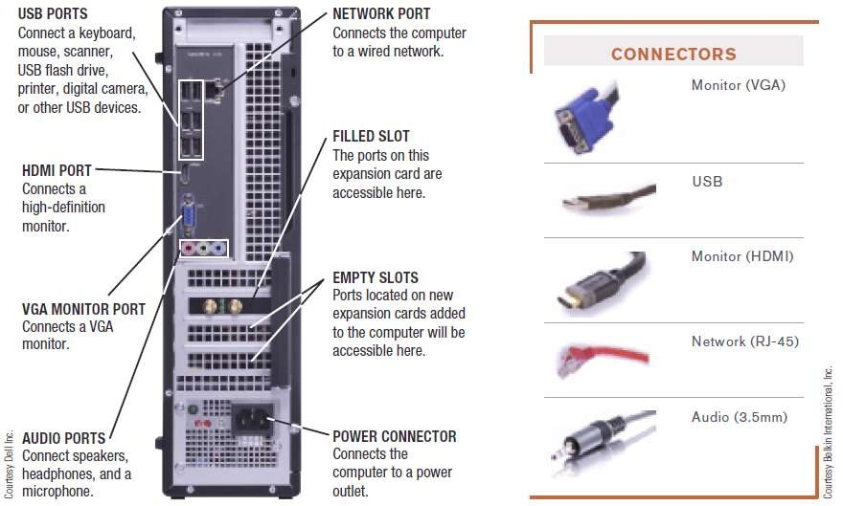
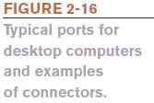
Ports and Connectors

Slide 41
Ports and Connectors
Portable computers have ports similar to desktop computers, but often not as many
Smartphones and mobile devices have more limited
expansion capabilities
Usually have a USB port, HDMI port, and/or flash memory card slot
Flash memory cards often use the Secure Digital (SD) format
MiniSD and microSD cars are smaller than regular SD
cards

Slide 42
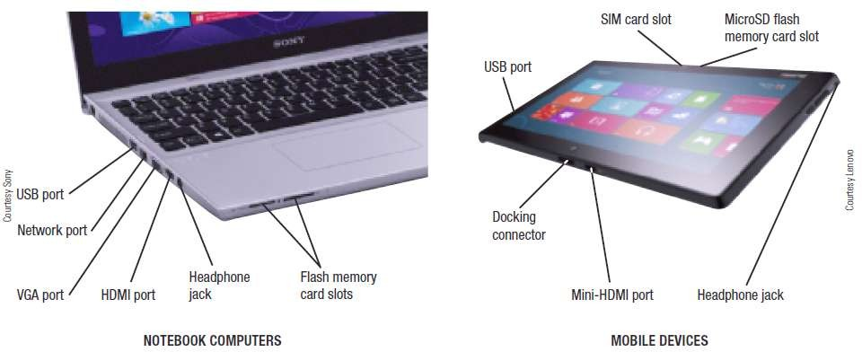

Ports and Connectors

Slide 43
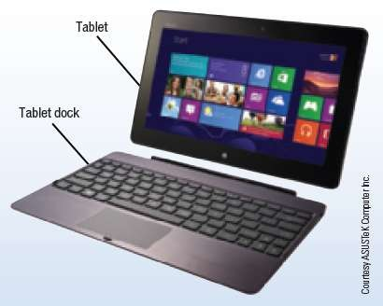
Trend Box
Tablet Docks
Used to help with tablet productivity
Some are just a stand
Many include a keyboard
Some include ports (USB, monitor, etc.) to connect peripherals
Some contain a battery

Slide 44
How the CPU Works
CPU (Central Processing Unit)
Consists of a variety of circuitry and components packaged together
Transistor: Key element of the microprocessor
Made of semi-conductor material that acts like a switch controlling the flow of electrons inside a chip
Today’s CPUs contain hundreds of millions of transistors;
the number doubles about every 18 months (Moore’s Law)

Slide 45
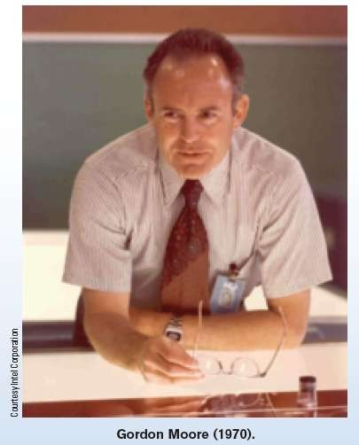
Inside the Industry Box
Moore’s Law
In 1965, Gordon Moore predicted that the number of transistors per square inch on chips had doubled every two years and that trend would continue
Moore’s Law is still relevant today for processors as well as other computer components

Slide 46
How the CPU Works
Typical CPU Components
Arithmetic/Logic Unit (ALU)
Performs arithmetic involving integers and logical
operations
Floating Point Unit (FPU)
Performs decimal arithmetic
Control Unit
Coordinates and controls activities within a CPU core
Prefetch Unit
Attempts to retrieve data and instructions before they are needed for processing in order to avoid delays

Slide 47
How the CPU Works
Decode Unit
Translates instructions from the prefetch unit so they are understood by the control unit, ALU, and FPU
Registers and Internal Cache Memory
Store data and instructions needed by the CPU
Bus Interface Unit
Allows the core to communicate with other CPU components

Slide 48
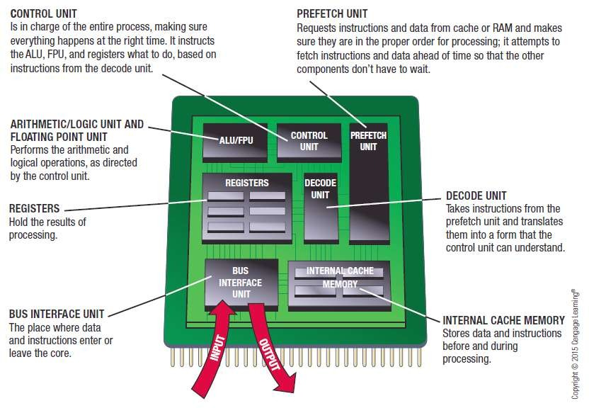

How the CPU Works

Slide 49
The System Clock and the Machine Cycle
System Clock
Small quartz crystal on the motherboard
Timing mechanism within the computer system that
synchronizes the computer’s operations
Sends out a signal on a regular basis to all computer components
Each signal is a cycle
Number of cycles per second is measured in hertz (Hz)
One megahertz = one million ticks of the system clock

Slide 50
The System Clock and the Machine Cycle
Many PC system clocks run at 200 MHz
Computers can run at a multiple or fraction of the system clock speed
A CPU clock speed of 2 GHz means the CPU clock “ticks” 10 times during each system clock tick
During each CPU clock tick, one or more pieces of
microcode are processed
A CPU with a higher clock speed processes more instructions per second than the same CPU with a lower CPU clock speed

Slide 51
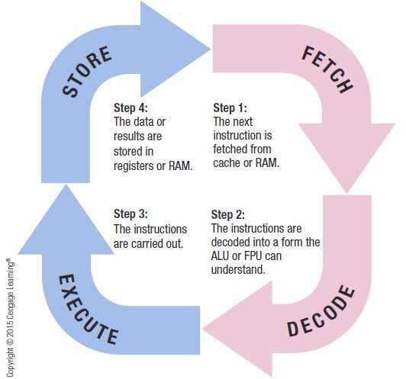
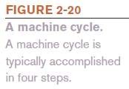

The System Clock and the Machine Cycle
Machine Cycle
– The series of operations involved in the execution of a single machine level instruction

Slide 52







Slide 53







Slide 54
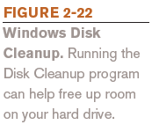
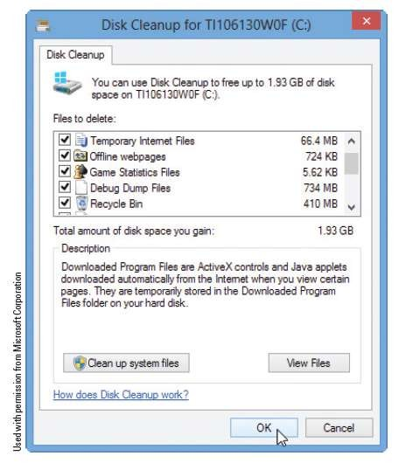
Making Computers Faster and Better Now and in the Future
Improving the Performance of Your System Today
Add more memory
Perform system maintenance
Uninstall programs properly
Remove unnecessary programs from the Startup list
Consider placing large files not needed on a regular basis on external storage
Delete temporary files

Slide 55
Making Computers Faster and Better Now and in the Future
Error check and defrag the hard drive periodically
Scan for viruses and spyware continually
Clean out dust once or twice a year
Buy a larger or second hard drive
Upgrade your Internet connection
Upgrade your video graphics card

Slide 56
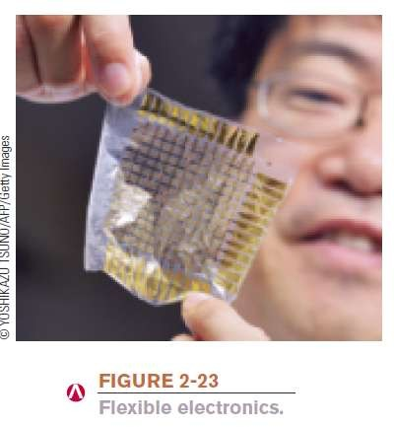
Making Computers Faster and Better Now and in the Future
Strategies for Making Faster and Better Computers
Improved Architecture
Smaller components, faster bus speeds, multiple CPU cores, support for virtualization
Improved Materials
Flexible electronic components
– Copper, high-k, graphene chip
Notes:
The term high-κ dielectric refers to a material with a high dielectric constant, as compared to silicon dioxide. High-κ dielectrics are used in semiconductor manufacturing processes where they are usually used to replace a silicon dioxide gate dielectric or another dielectric layer of a device.

Slide 57
Making Computers Faster and Better Now and in the Future
Pipelining
Allows multiple instructions to be processed at one time
Multiprocessing and Parallel Processing
Use multiple processors to speed up processing

Slide 58
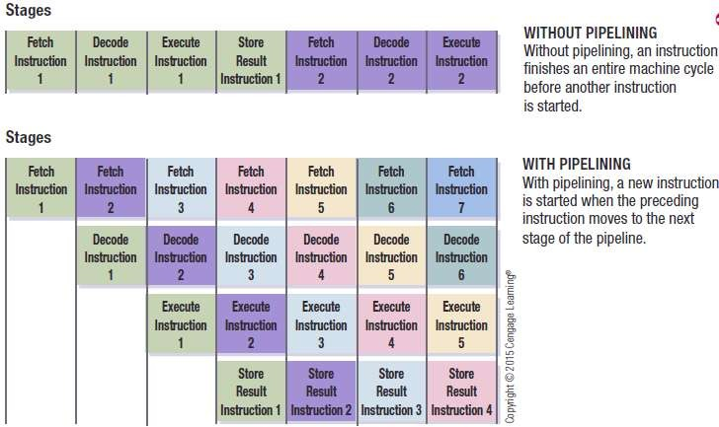
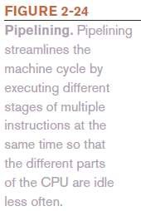

Making Computers Faster and Better Now and in the Future

Slide 59
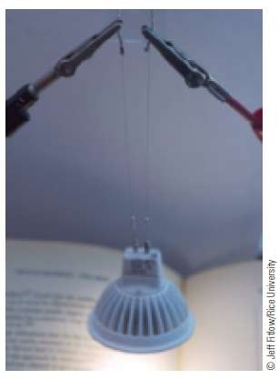
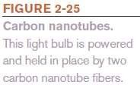
Future Trends
Nanotechnology
The science of creating tiny computers and components less than 100 nanometers in size
Carbon nanotubes (CNTs) used in many products today
Nanofilters and nanosensors
Future applications may be built by working at the individual atomic and molecular levels

Slide 60
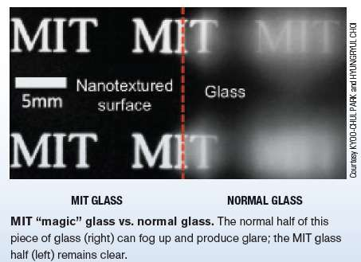
Technology and You Box
“Magic” Glass
MIT has developed nano-sized conical patterns on the surface of glass to eliminated its reflective properties
Glass resists fogging and is self-cleaning
Possible uses:
Smartphone screens
Eyeglasses
TVs
Car windshieds
Building windows

Slide 61
Future Trends
Quantum Computing
Applies the principles of quantum physics and quantum mechanics to computers
Utilizes atoms or nuclei working together as quantum bits (qubits)
Qubits function simultaneously as the computer’s processor and memory and can represent more than two states
Expected to be used for specialized applications, such as encryption and code breaking

Slide 62
Future Trends
Optical Computing
Uses light, from laser beams or infrared beams, to perform digital computations
Opto-electronic computers use both optical and electronic components
Silicon Photonics
The process of making optical devices using silicon manufacturing techniques
Possible low-cost solution to future data-intensive computing applications—telemedicine, cloud data centers

Slide 63
Future Trends
Tera-Scale Computing
The ability to process one trillion floating-point operations per second (teraflops)
Terascale research is focusing on creating multi-core processors with tens to hundreds of cores
Intel has created a Single-chip Cloud Computer which
contains 48 cores on one silicon chip
Expected to be needed for future applications

Slide 64
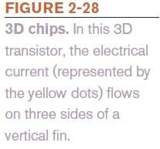
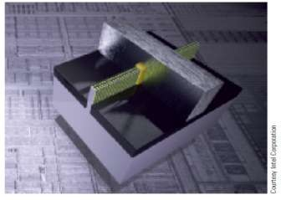
Future Trends
3D Chips
Contain transistors that are layered to cut down on the surface area required
Created by layering individual silicon wafers on top of one another
Being used with memory, flash memory, and CPUs

Slide 65
Summary
How Computer Process Data
Central Processing Unit
Control Unit
Arithmetic & Logic Unit
System Clock & Machine Cycle
Memory
Volatile & Non-Volatile, Flash Memory, Registers, Cache Memory
Bus & Types, and Ports

