Slide 1
CSC 101 – Introduction to Computing
Lecture 03 (Morley Ch-03)

Slide 2
Outline
Storage Devices:
Magnetic Storage Devices
Optical Storage Devices
Solid State Storage Devices
Data Read & Write Process.

Slide 3
Storage System Characteristics
Storage Media and Storage Devices
Medium
Hardware where data is stored
DVD disc, flash memory card, etc.
Device
DVD drive, flash memory card reader, etc.
Medium is inserted into device to be used
Can be internal, external, or remote
Storage devices are typically identified by letter

Slide 4
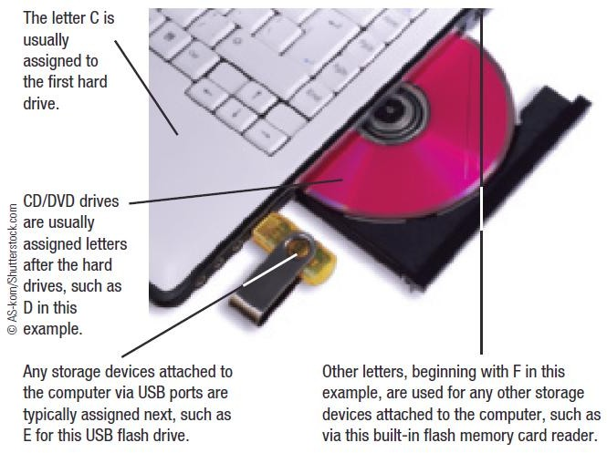
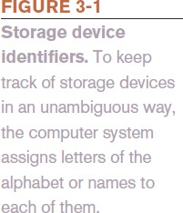
Storage System Characteristics

Slide 5
Storage System Characteristics
Volatility
Storage media are nonvolatile
Random vs. Sequential Access
Random access (direct access) allows data to be retrieved from any location on the storage medium
Virtually all storage devices use random access
Sequential access means retrieval of data can occur only in the order in which it was physically stored on the storage medium
Magnetic tape drive

Slide 6
Storage System Characteristics
Logical vs. Physical Representation
File
Anything stored on a storage medium, such as a
program, document, digital image, or song
Filename
Name given to a file by the user
Folder
Named place on a storage medium into which files can be stored

Slide 7
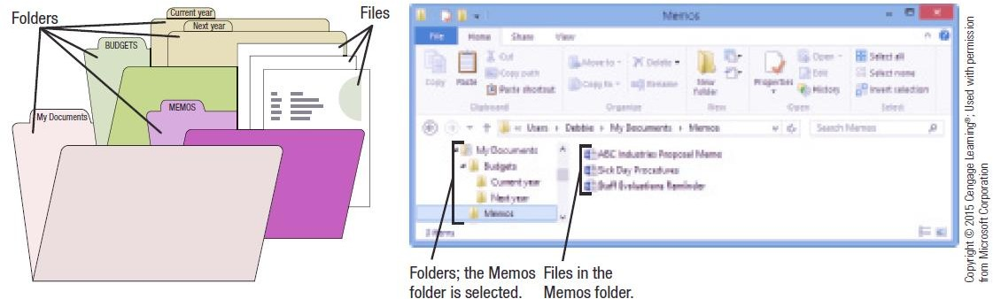
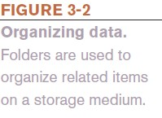
Storage System Characteristics

Slide 8
Storage System Characteristics
Logical file representation
Individuals view a document stored as one complete unit in a particular folder on a particular drive
Physical file representation
Computers access a particular document stored on a storage medium using its physical location or locations
Types of Storage Technology Used
Magnetic (conventional hard drives)
Optical (optical discs)
Electrons (flash memory media)

Slide 9
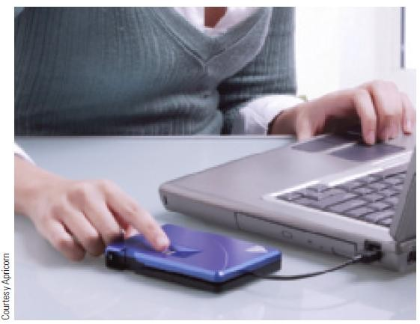
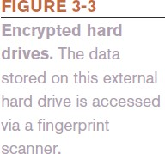
Hard Drives
Hard Drive
Used to store most programs and data
Can be internal or external
Can be encrypted
Magnetic Hard Drives
One or more permanently sealed metal magnetic disks with an access mechanism and read/write heads

Slide 10
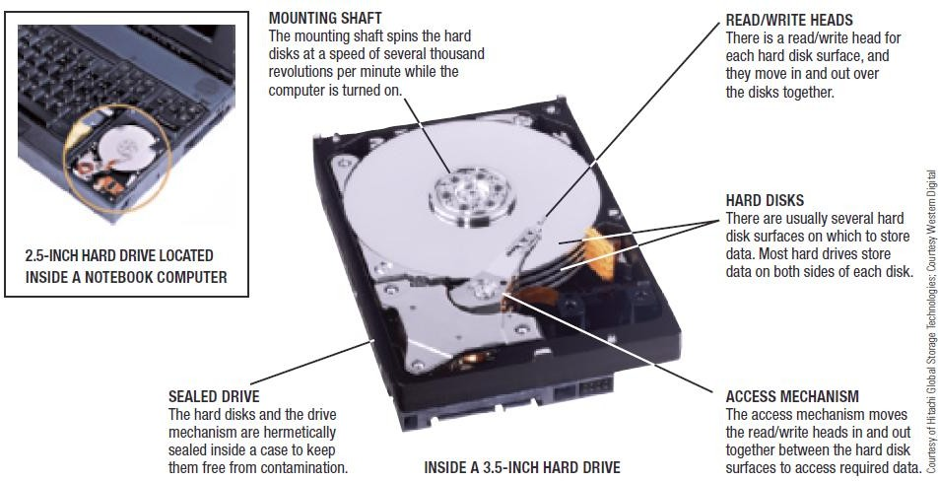

Hard Drives

Slide 11
Hard Drives
Hard disks are divided into:
Tracks
Concentric path on disk where data is recorded
Sectors
A small piece of the track
Clusters
One or more sectors; smallest addressable area of a disk
Cylinders
Collection of tracks located in the same location on a set of hard disk surfaces

Slide 12
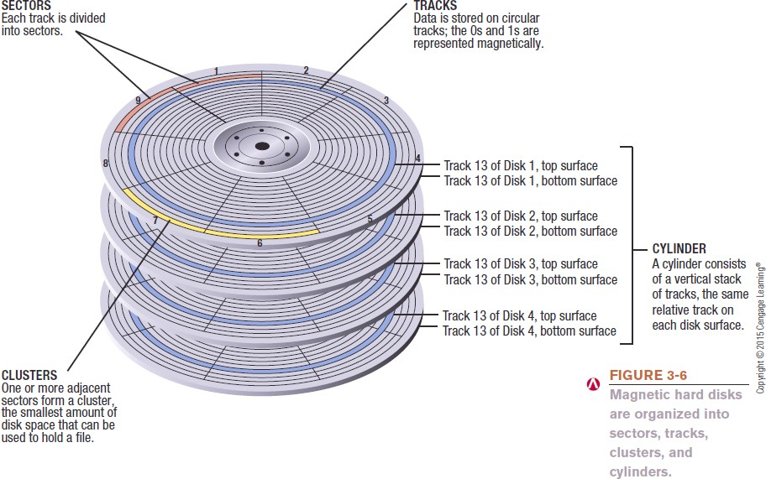
Hard Drives

Slide 13
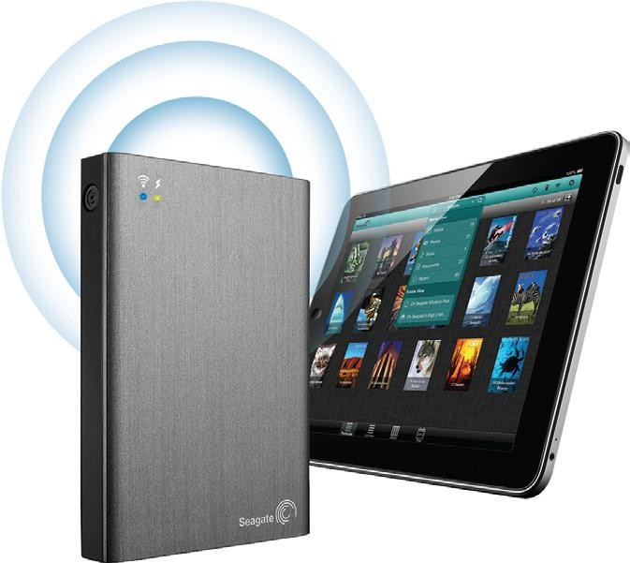
How It Works Box
More Storage for Your Tablet
Media tablets often have 64 GB of storage
To extend storage, can transfer content to and from PCs
Easier is to use a wireless hard drive
Need the appropriate app

Slide 14
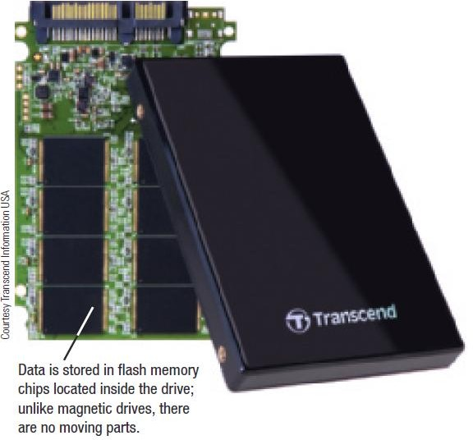

Hard Drives
Solid State Drives (SSDs)
Use flash memory technology
Use less power and have no moving parts
Particularly appropriate for portable computers and mobile devices

Slide 15
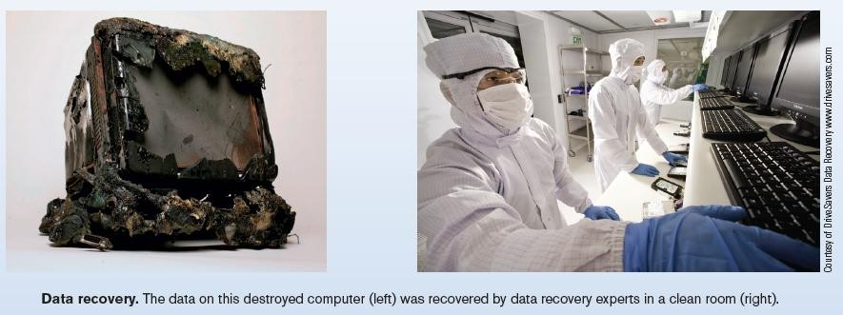
Inside the Industry Box
Data Recovery Experts
Can recover data from damaged storage devices
Can be used when devices are physically damaged or
just stop working
Back up to prevent data loss

Slide 16
Internal and External Hard Drives
Internal hard drives
Permanent storage devices located inside the system unit
Removed only if a problem develops
External hard drives
Commonly used to transport large amounts of data from one computer to another
Portable external hard drives are smaller and easier to transport
Most connect with a USB connection although some may
be wireless

Slide 17
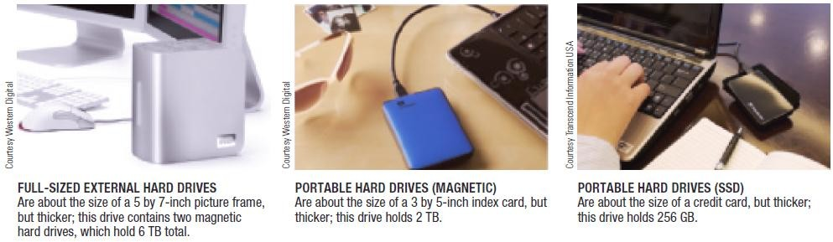

Internal and External Hard Drives

Slide 18
Hard Drive Speed, Disk Caching, and Hybrid Hard Drives
Disk access time
Total time that it takes for a hard drive to read or write data
Consists of seek time, rotational delay, and data movement time
SSDs don’t require seek time or rotational delays
Disk cache
Memory used in conjunction with a magnetic hard drive to improve system performance
Typically consist of memory chips on a circuit board inside the hard drive case

Slide 19
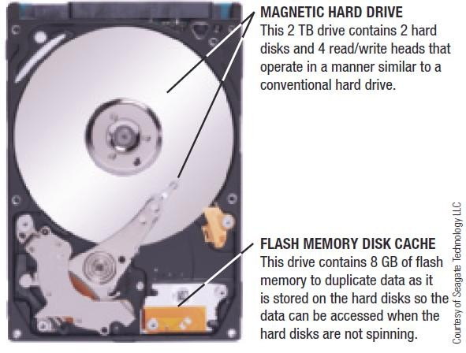
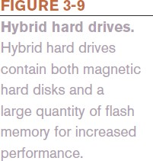
Hard Drive Speed, Disk Caching, and Hybrid Hard Drives
Hybrid Hard Drive
Combination of flash memory and magnetic hard drive
Uses flash memory for cache
Allows encryption to be built into the drive

Slide 20
Hard Drive Partitioning and File Systems
Partitioning
Divides the physical capacity of a single drive logically into separate areas, called partitions
Partitions function as independent hard drives
Referred to as logical drives
Increases efficiency (smaller drives use smaller clusters)
Partitions used to create:
A recovery partition
A new logical drive for data
A dual boot system

Slide 21
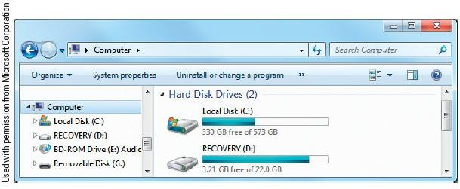
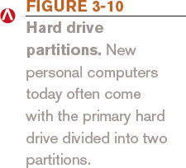
Hard Drive Partitioning and File Systems
File system
Determines the partition size, cluster size, maximum drive size, and maximum file size
FAT, FAT32, and NTFS

Slide 22
Hard Drive Interface Standards
Determine how a drive connects to the computer
Common standards
Parallel ATA (PATA) - older, slower standard
Serial ATA (SATA)
eSATA
SCSI and the newer serial attached SCSI (SAS)
Fibre Channel
Fibre Channel over Ethernet (FCoE)
Internet SCSI (iSCSI)

Slide 23
Optical Discs and Drives
Optical Disc Characteristics
A type of storage read from and written to using laser beams
Today’s standard for software delivery
Divided into sectors like magnetic discs but use a single spiral track (groove)
Have a relatively large capacity and are durable
Used for backup purposes and for storing and transporting music, photos, video, etc.

Slide 24
Optical Discs and Drives
Representing Data on an Optical Disc
Read-only optical disc
Surface of disc is molded or stamped
Recordable or rewritable disc
Optical drive is used and the reflectivity of the disc is changed using a laser to represent the data
Pits and lands are used to represent 1s and 0s
The transition between a pit and a land represents a 1; no transition represents a 0

Slide 25
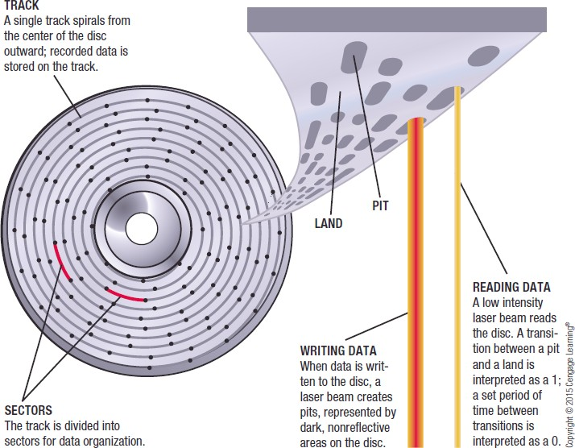

Optical Discs and Drives

Slide 26
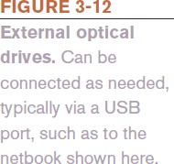
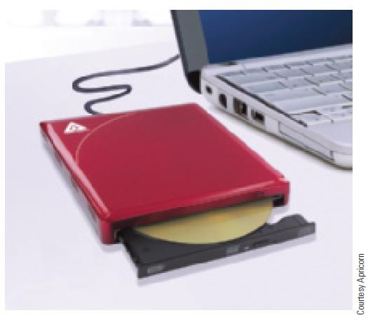
Optical Discs and Drives
Optical Drives
Three categories of discs: CD, DVD, or Blu-Ray Disc (BD)
Can be read-only, recordable, or rewritable
Almost always downward compatible
Can support single or dual layer discs
Recording data onto disc is called burning
Can be internal or external drives
External drives typically connect via USB port

Slide 27
Optical Discs and Drives
Optical Disc Shapes, Sizes, and Capacities
Standard size is 120-mm (about 4.7 inches)
Mini discs are smaller—80-mm
Theoretically can be made into various shapes—hearts, triangles, irregular shapes, or a hockey-rink shape
Patent battle exists about changing optical disc shapes
None of these different shapes are currently available

Slide 28

Optical Discs and Drives
Major advantage: large capacity
CD discs are normally single layer and hold 650 or 700 MB
DVD discs hold 4.7 GB (single-layer) or 8.5 GB (dual-layer
BD discs hold 25 GB (single-layer) or 50 GB (dual-layer
Discs can also be double-sided
Researchers continually work to
increase the capacity of optical discs
DL and XL discs
4K (Ultra HD) Blu-ray Discs

Slide 29
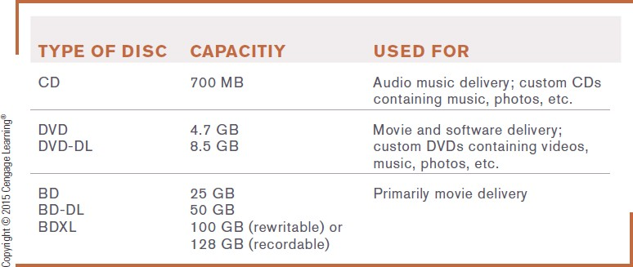

Optical Discs and Drives

Slide 30
Read-Only Optical Discs
CD ROM, DVD ROM, and BD-ROM
Can be read from, but not written to, by the user
CD-ROM (compact disc read-only memory)
DVD-ROM (digital versatile disc read-only memory)
BD-ROM (Blu-Ray Disc read-only memory)
Normally come pre-recorded
Software programs
Clip art and other graphics
Music
Movies
Games (PlayStation, Wii, Xbox, etc.)

Slide 31
Recordable Optical Discs
CD-R, DVD-R, DVD+R, BD-R Discs
Can be written to, but cannot be erased and reused
No physically molded pits
Most have a recording layer containing organic light- sensitive dye between disc’s plastic and reflective layers
Except the BD-R disc, which has inorganic material
Used for backing up files, sending large files to others, and creating custom music CDs

Slide 32
Rewritable Optical Discs
CD-RW, DVD-RW, DVD+RW, and BD-RE Discs
Can be written to, but cannot be erased and reused
Uses phase change technology
– Heating and cooling process is used to change the reflectivity of the disc
Capacities are identical to the read-only and recordable
discs, except BDXL
Appropriate for transferring large files from one computer to another or temporarily storing TV shows

Slide 33

Trend Box
DNA Data Storage
Possible data storage medium
Long-term, high-density encoding
Researchers have encoded data in DNA
Translated into binary 0s and 1s, then to a ternary code, and then as strings of DNA’s chemical bases and stored in DNA
Biggest obstacle is cost - $12,400/MB
Biggest possibility: archiving

Slide 34
Flash Memory Storage Systems
Flash Memory
Chip-based storage medium that represents data using electrons
Used in SSDs and hybrid hard drives
Embedded Flash Memory
Flash memory chips embedded into products, such as
Portable digital media players, digital cameras
Handheld gaming devices, GPS devices, mobile phones
Sunglasses and wristwatches

Slide 35
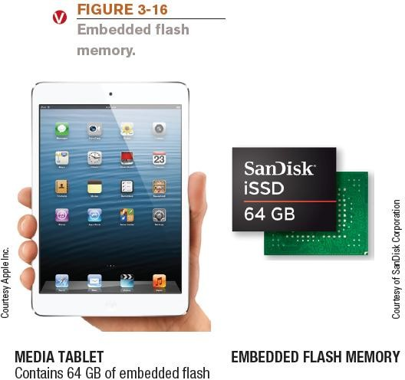
Flash Memory Storage Systems

Slide 36
Flash Memory Storage Systems
Flash Memory Cards and Readers
Flash memory card
Small card containing one or more flash memory chips, a controller chip, and metal contacts to connect the card to the device or reader with which it is being used
Available in various formats that are not
interchangeable:
CompactFlash | Secure Digital (SD) | xD Picture Card
Memory Stick | Secure Digital High Capacity (SDHC)
MultiMedia Card (MMC) | Secure Digital Extended Capacity (SDXC)

Slide 37
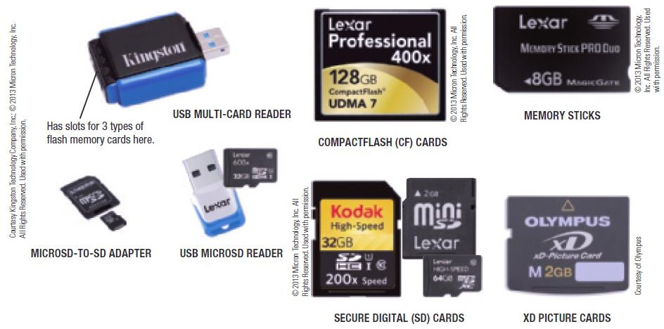
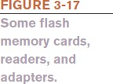
Flash Memory Storage Systems

Slide 38
Flash Memory Storage Systems
General-purpose flash memory card
Appropriate for most applications
Specialized flash memory cards
Professional flash memory cards
Designed for professional photographers
Gaming flash memory cards
Designed for gaming consoles
HD flash memory cards
Designed for capturing and transferring high-definition video

Slide 39
Flash Memory Storage Systems
USB Flash Drives
Sometimes called flash memory drives, jump drives, or thumb drives
Flash memory media integrated into a self-contained unit that plug into and is powered by a USB port
Designed to be very small and very portable
Available in a host of formats including custom shapes
Can be built into a consumer product
Can be used to lock a computer and to issue Web site passwords
Can include biometric features, such as a built-in fingerprint reader

Slide 40
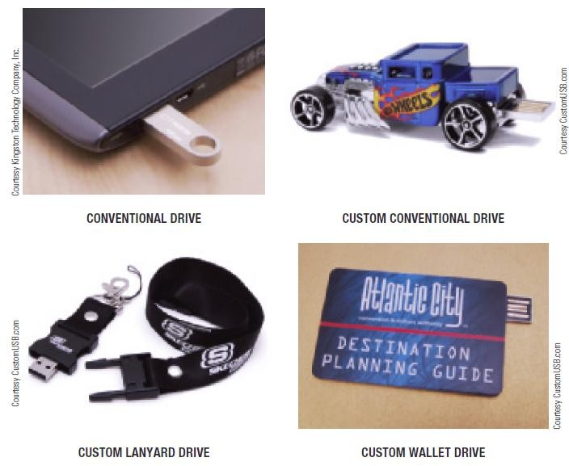

Flash Drive Storage Systems

Slide 41
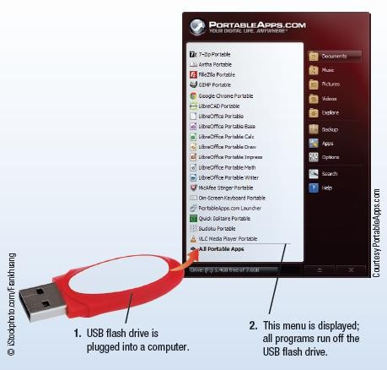
Technology and You Box
Thumb Drive PCs
Portable apps turn USB flash drives and other small devices into personal computers
Download app and desired software to the USB flash drive
To use, plug into a computer

Slide 42
Other Types of Storage Systems
Network Storage and Cloud Storage Systems
Remote storage
Using a storage device not directly connected to the
computer being used
Accessed through the Internet or through a network
Network storage
Remote storage via local network

Slide 43
Network and Cloud Storage Systems
Network attached storage (NAS)
High performance storage systems connected individually to a network
Designed for small business and home use
Storage area network (SAN)
Separate network of hard drives or other storage devices
which are attached to the main network

Slide 44
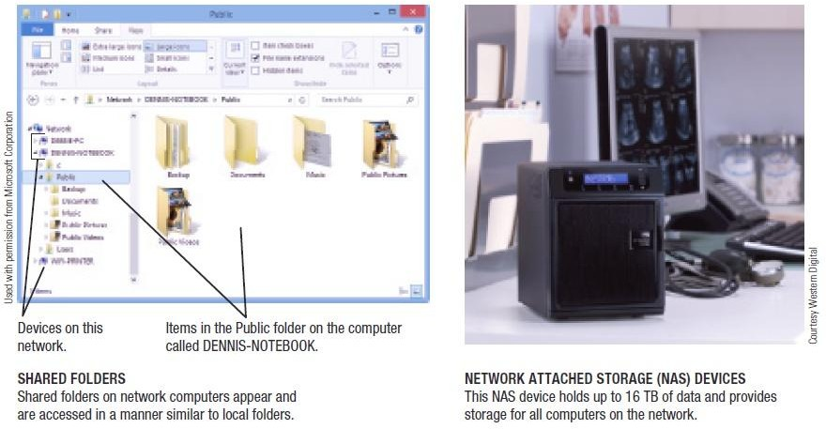

Network and Cloud Storage Systems

Slide 45
Network and Cloud Storage Systems
Cloud storage (online storage)
Accessed via the Internet
Via Web sites (Flickr, Facebook, Google Docs, etc.)
Via online storage sites (Box, Dropbox, etc.)
Growing in importance because more and more applications are Web based
Increasing being used for backup purposes
Files can be synched between PC and cloud storage
Many Web sites providing online storage offer it free
Business cloud storage is available

Slide 46
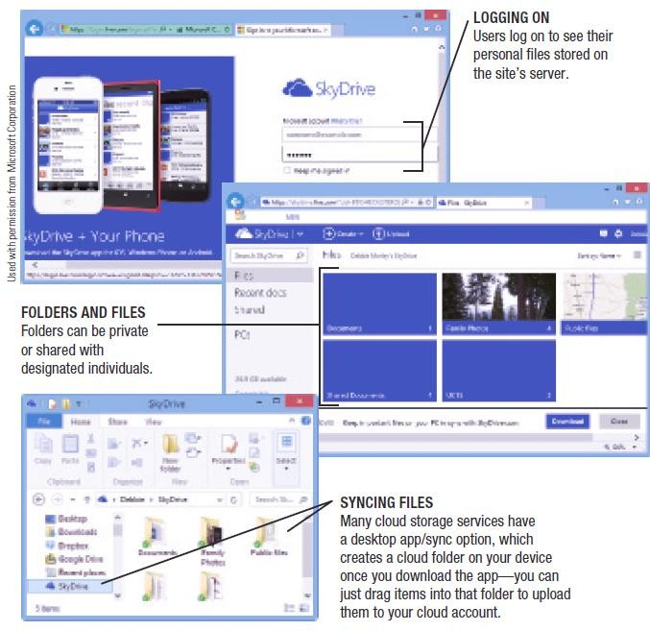

Network and Cloud Storage Systems

Slide 47
Smart Cards
Smart Card
Credit card-sized piece of plastic that contains some computer circuitry (processor, memory, and storage)
Stores small amount of data (about 64 KB or less)
Commonly used to store prepaid amounts of digital cash or personal information
Smart card readers are built into or attached to a computer, door lock, vending machine, or other device
Some smart cards store biometric data
Use of mobile smart cards is an emerging trend

Slide 48
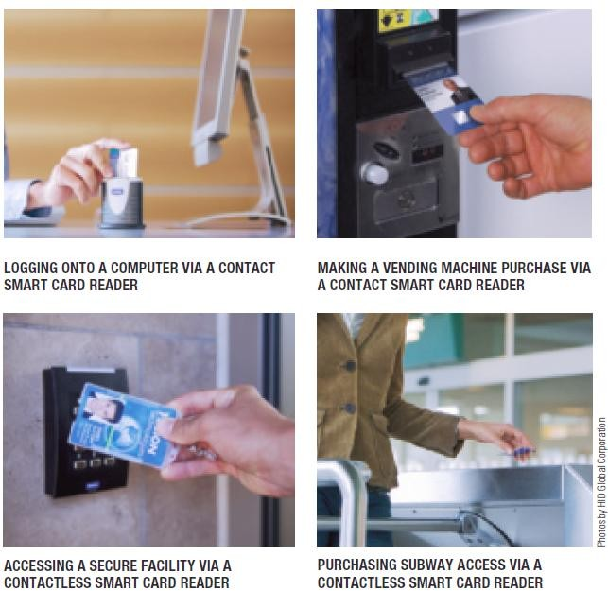

Smart Cards

Slide 49
Holographic Storage
Holographic storage
Holographic drives connect to a computer via a serial attached SCSI (SAS) or Fibre Channel interface
Uses multiple blue laser beams to store data in three dimensions
Reference beam and signal beam
Suited to applications in which large amounts of data need to be stored or retrieved quickly but rarely changed
Archiving business data, medical records, TV shows,
sensor data , etc.

Slide 50
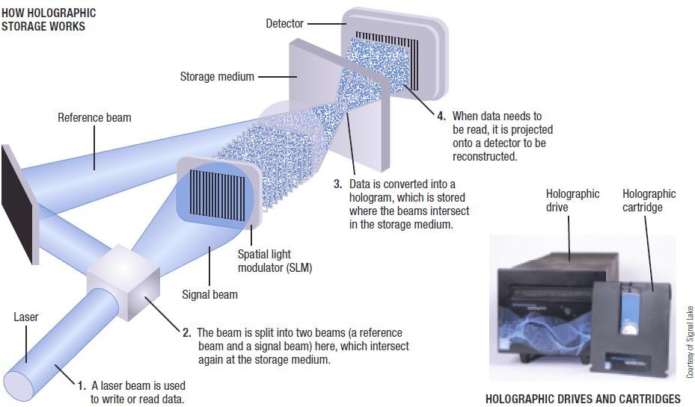
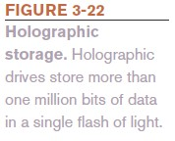
Holographic Storage

Slide 51
Storage Systems for Large Computer Systems
Business storage needs are growing exponentially
Digital data produced is expected to double every two years through 2020
Storage server
Hardware device containing multiple high-speed hard drives connected to the computer system or network
Most are based on magnetic hard discs

Slide 52
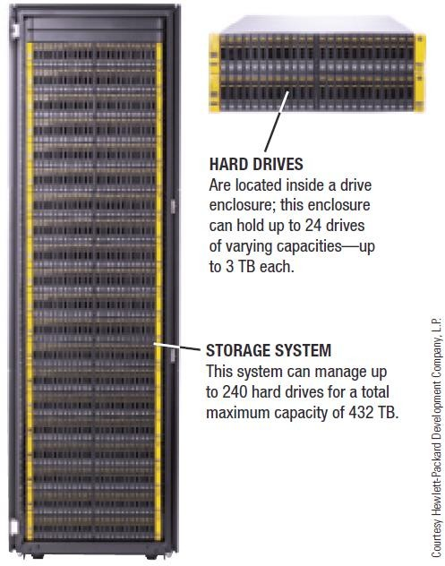
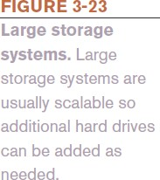
Storage Systems for Large Computer Systems

Slide 53
Storage Systems for Large Computer Systems
RAID (redundant arrays of independent discs)
Method of storing data on two or more hard drives that work together to do the job of a larger drive
Mostly used to protect critical data on large storage systems
Usually involves recording redundant copies of stored data
Helps to increase fault tolerance

Slide 54
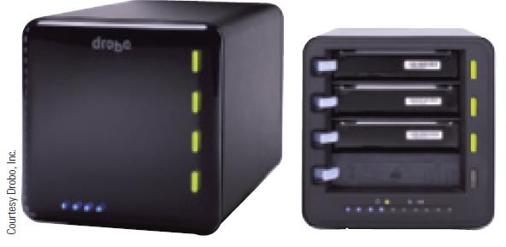

Storage Systems for Large Computer Systems
Different levels of RAID:
RAID 0 = disk striping (spread files over two or more hard drives)
RAID 1 = disk mirroring (duplicate copy)
Other level use a combination or striping and mirroring
Drobo system
New RAID storage system
Much easier to use than previous systems
Offers continuous data redundancy

Slide 55
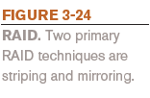
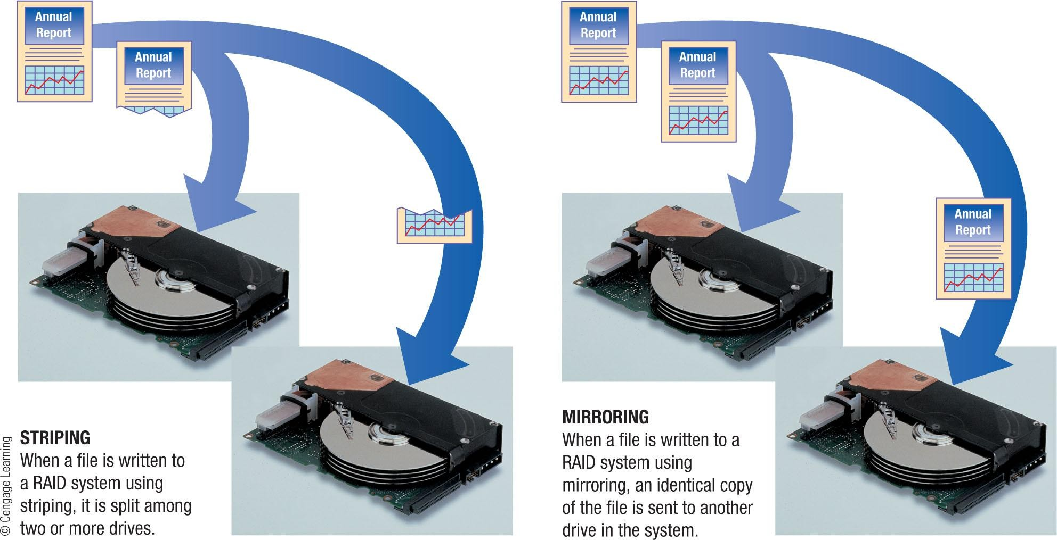
Storage Systems for Large Computer Systems

Slide 56
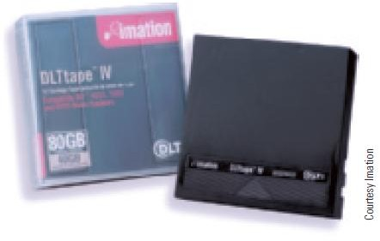
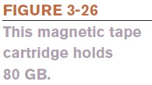
Magnetic Tape Systems
Magnetic Tape
Plastic tape coated with a magnetizable substance that represents the bits and bytes of digital data
Primarily used for backup and archival purposes
Sequential access only
Low cost per terabyte
Most tapes today are in the form of cartridge tapes

Slide 57
Evaluating Your Storage Alternatives
Product Characteristics to Consider:
Speed
Compatibility
Storage capacity
Convenience
Portability
Most Users Require:
Hard drive
Recordable or rewritable optical drive
Flash memory card reader
USB ports

Slide 58
Summary
Storage Devices:
Magnetic Storage Devices
Optical Storage Devices
Solid State Storage Devices
Data Read & Write Process.

