Slide 1
CSC 101 – Introduction to Computing
Lecture 04 (Ch 02)

Slide 2
Number Conversion
Decimal to Binary and Binary to Decimal
Decimal to Octal and Octal to Decimal
Decimal to Hexadecimal and Hexadecimal to Decimal
Binary to Hexadecimal
Octal to Hexadecimal
Hexadecimal to Binary and Octal

Slide 3
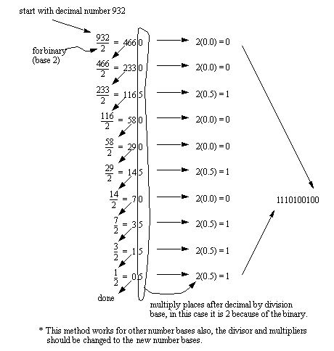
Decimal To Binary
1

Slide 4
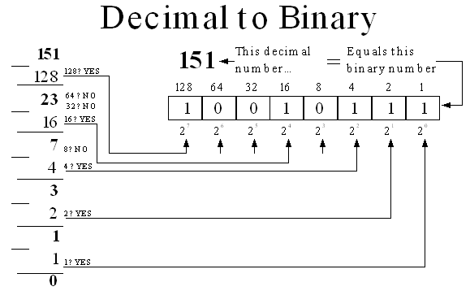
Decimal To Binary
(151)₁₀ = (10010111)₂

Slide 5
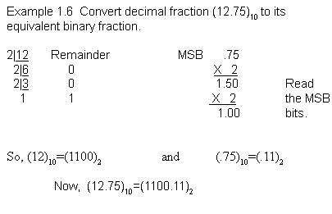
Decimal to Binary (with Fractions)
(12.75)₁₀ = (1100.11)₂

Slide 6
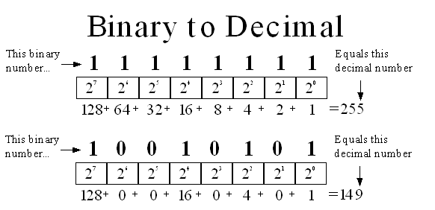
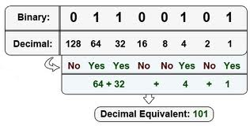
Binary to Decimal

Slide 7
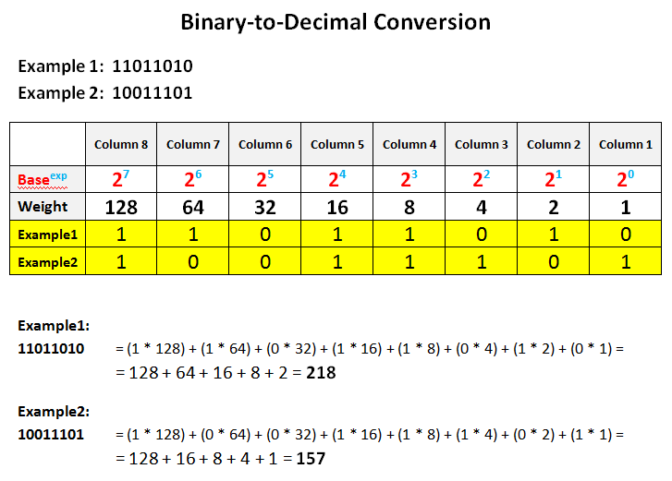
Binary to Decimal

Slide 8
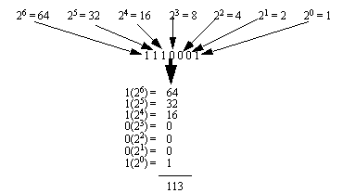
Binary to Decimal
1110001₂ = 113₁₀

Slide 9
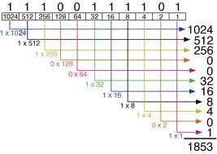
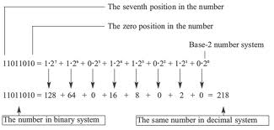
Binary to Decimal
11100111101₂ = 1853₁₀
11011010₂ = 218₁₀

Slide 10
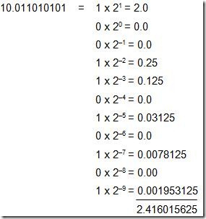
Binary to Decimal (with Fractions)
(10.011010101)₂ = (2.416015625)₁₀

Slide 11
Exercise Decimal to Binary

Slide 12
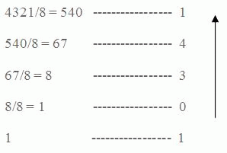
Decimal to Octal
4321₁₀ = 10341₈

Slide 13
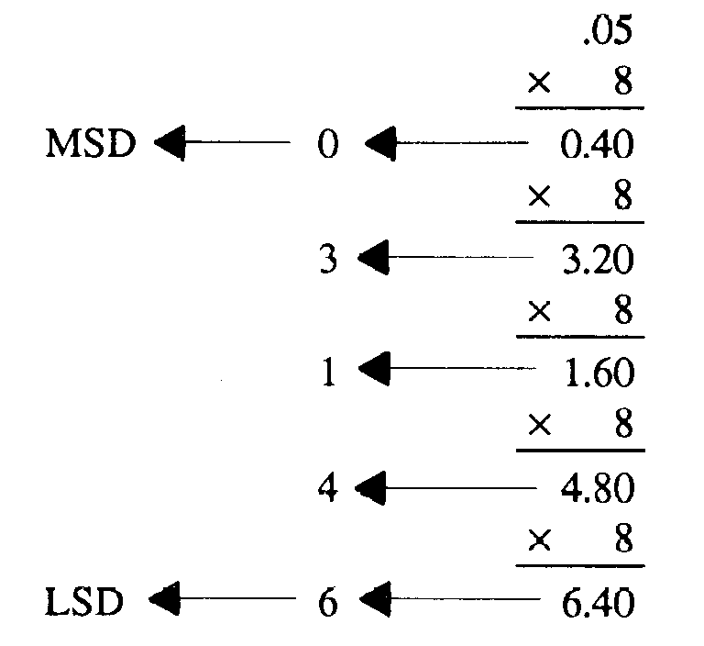
Decimal to Octal (Fractions)
0.05₁₀ = 0.03146₈

Slide 14
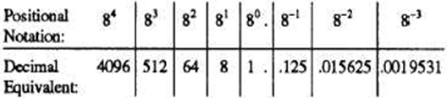
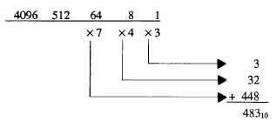
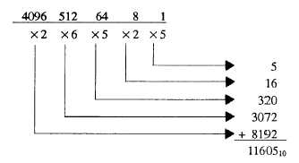
Octal to Decimal
743₈ = 483₁₀ 26525₈ = 11605₁₀

Slide 15
Exercise Decimal to Octal

Slide 16
Exercise Octal to Decimal
26601₈ =
1422₈ ₌

Slide 17
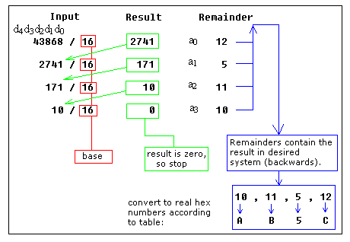
Decimal to Hexadecimal

Slide 18
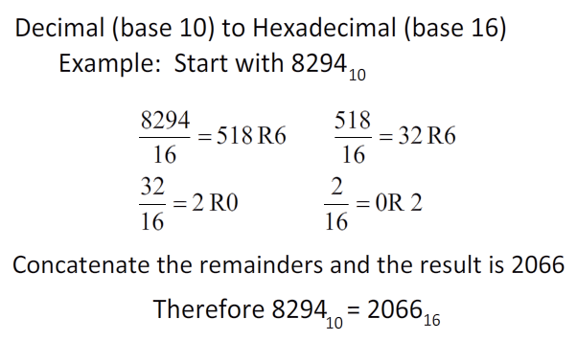
Decimal to Hexadecimal

Slide 19
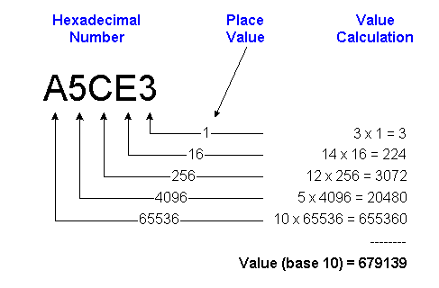
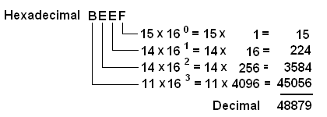
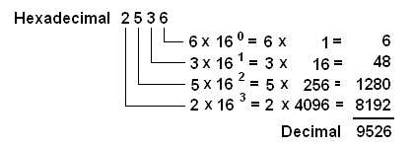
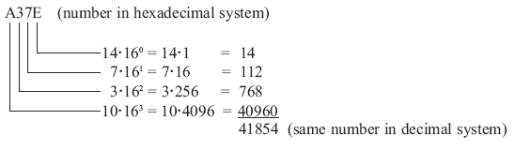
Hexadecimal to Decimal

Slide 20
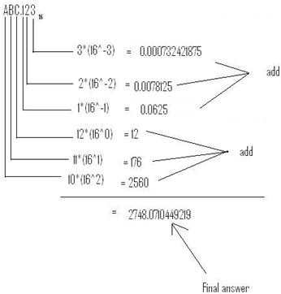
Hexadecimal to Decimal
(ABC.123)₁₆ = (2748.0710449219)₁₀

Slide 21
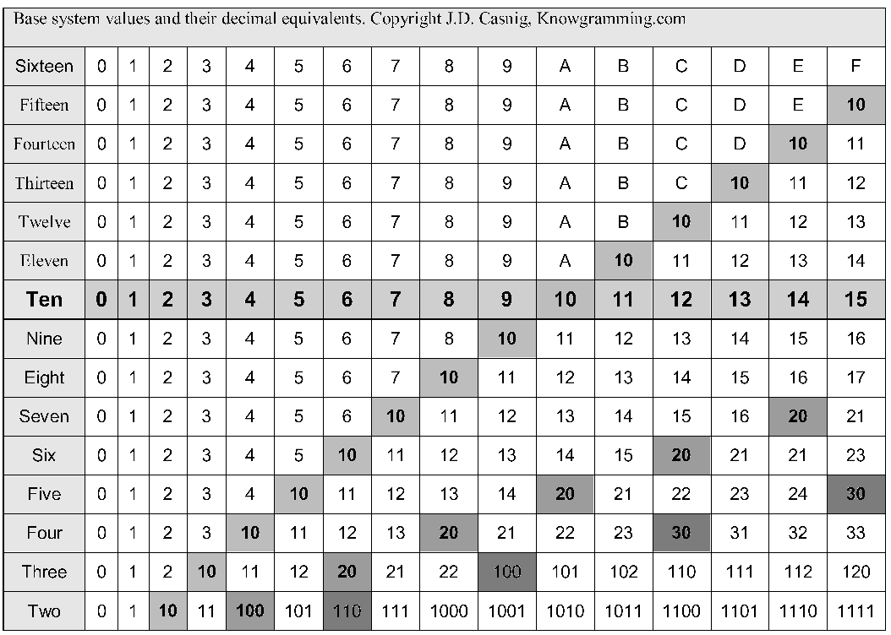
Comparison Base 2 to Base 16

Slide 22
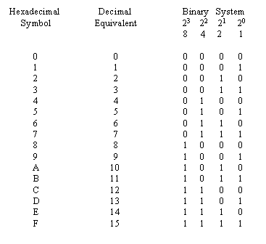
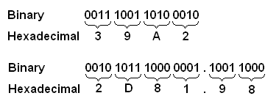
Binary to Hexadecimal

Slide 23
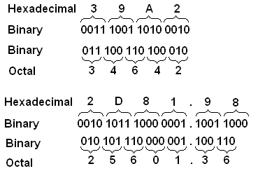
Hexadecimal to Binary and Octal

Slide 24
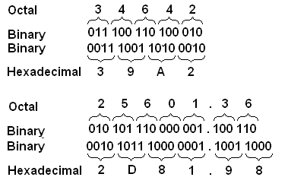
Octal to Hexadecimal

Slide 25
Exercise Binary to Hexadecimal
(10110101010101)₂
(1100010010)₂

Slide 26
Exercise Octal to Hexadecimal
(344)₈
(1422)₈

Slide 27
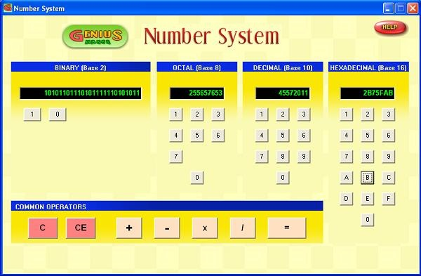
Number System Program
Genius Maker
Free software
Use the number system
http://www.goldenkstar.com/number-system-school-software-maths.htm

Slide 28
Summary
Number System
Decimal
Binary
Octal
Hexadecimal
Number conversion

Slide 29
Recommended Websites
http://www.cdrummond.qc.ca/cegep/informat/Professeurs/Alain/files/ascii.htm
http://www.lookuptables.com/ebcdic_scancodes.php
http://math.comsci.us/radix/hexadecimal.html

Slide 30
Number System - Exercise
Decimal | Binary | Octal | Hexadecimal
(786)₁₀ | (1100010010)₂ | (1422)₈ | (312)₁₆
(555)₁₀ | (1000101011)₂ | (1053)₈ | (22B)₁₆
(228)₁₀ | (11100100)₂ | (786)₈ | (786)₁₆
(179)₁₀ | (10110011)₂ | (786)₈ | (786)₁₆
(483)₁₀ | (111100011)₂ | (743)₈ | (1E3)₁₆
(4012)₁₀ | (111110101100)₂ | (7643)₈ | (FAC)₁₆
(4321)₁₀ | (1000011100001)₂ | (10341)₈ | (10E1)₁₆
(1853)₁₀ | (11100111101)₂ | (3475)₈ | (73D)₁₆
(9526)₁₀ | (1001010011011)₂ | (22466)₈ | (2536)₁₆
(11605)₁₀ | (10110101010101)₂ | (26525)₈ | (2D55)₁₆
(48879)₁₀ | (111111011101111)₂ | (137357)₈ | (BEEF)₁₆

