Slide 1
CSC 101 – Introduction to ICT
Lecture 06 (Morley Ch5,6)

Slide 2
Outline
Computer Software
System Software
Application Software
Operating System (OS)
Basic Purpose of OS
Types of OS
Operating System Functions
Providing User Interface
Running Programs
Managing Hardware
Utility Programs
PC Operating System
Network Operating System
Embedded Operating System

Slide 3
System Software vs. Application Software
System Software
The operating system and utility programs that control a computer system and allow you to use your computer
Enables the boot process, launches applications, transfers files, controls hardware configuration, manages files on the hard drive, and protects from unauthorized use
Application Software
Programs that allow a user to perform specific tasks on a computer
Word processing, playing games, browsing the Web, listening to music, etc.

Slide 4
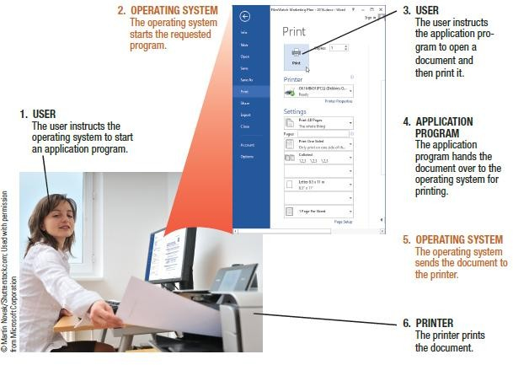

The Operating System
Operating System
A collection of programs that manage and coordinate the activities taking place within a computer
Acts as an intermediary between the user and the computer and between the
application programs and system hardware

Slide 5
Functions of an Operating System
Interfacing with Users (typically via a GUI)
Booting the Computer
Loads essential part of operating system (kernel) into
memory
Reads opening batch of instructions
Determines hardware connected to computer
Configuring Devices
Device drivers are often needed; can be reinstalled if needed
Plug and Play devices are recognized automatically

Slide 6
Functions of an Operating System
Managing Network Connections
Manages wired connections to home or office network
Manages wireless connections at home, school, work, or
on the go
Managing and Monitoring Resources and Jobs
Makes resources available to devices and programs
Monitors for problems and attempts to correct those that arise
Schedules jobs
Jobs to be printed
Files to be retrieved from hard drive

Slide 7
Functions of an Operating System
File Management
Keeps track of stored files on computer so they can be retrieved when needed
Files usually viewed in a hierarchical format
Security
Passwords
Biometric characteristics
Firewalls

Slide 8
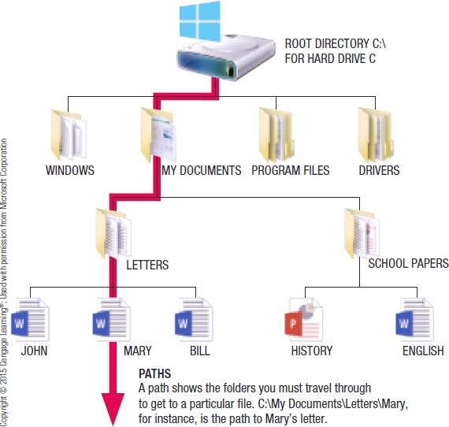

Functions of an Operating System

Slide 9
Processing Techniques for Increased Efficiency
Multitasking
The ability of an operating system to have more than one program (task) open at one time
CPU rotates between tasks
Switching is done quickly
Appears as though all programs executing at the same
time

Slide 10
Processing Techniques for Increased Efficiency
Multithreading
The ability to rotate between multiple threads so that processing is completed faster and more efficiently
Thread
Sequence of instructions within a program that is independent of other thread
Multiprocessing and Parallel Processing
Multiple processors (or multiple cores) are used in one computer system to perform work more efficiently
Tasks are performed sequentially

Slide 11
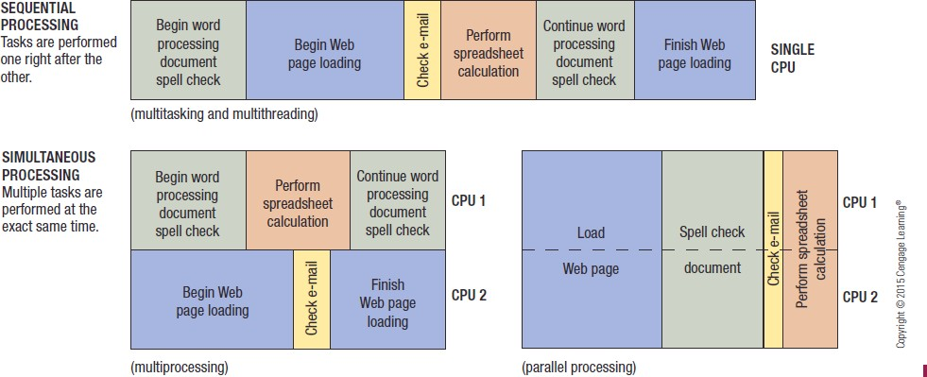

Processing Techniques for Increased Efficiency

Slide 12
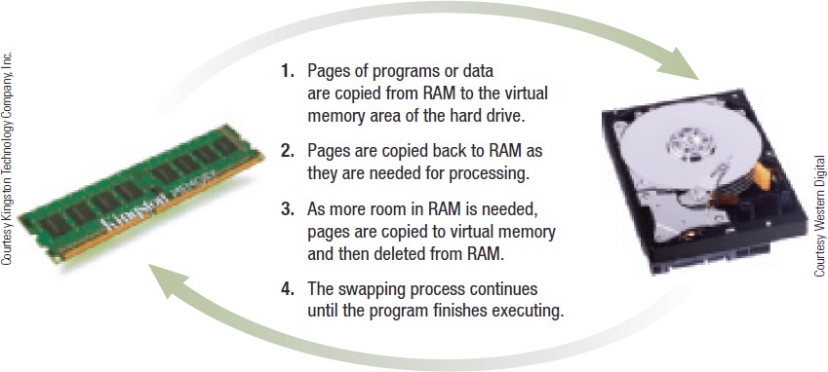

Processing Techniques for Increased Efficiency
Memory Management
Optimizing the use of main memory (RAM)
Virtual memory
Memory-management technique that uses hard drive space as additional RAM

Slide 13
Processing Techniques for Increased Efficiency
Buffering and Spooling
Buffer
Area in RAM or on the hard drive designated to hold data that is used by different hardware devices or programs
Buffering or Spooling
Placing items in a buffer so they can be retrieved by the appropriate device when needed

Slide 14
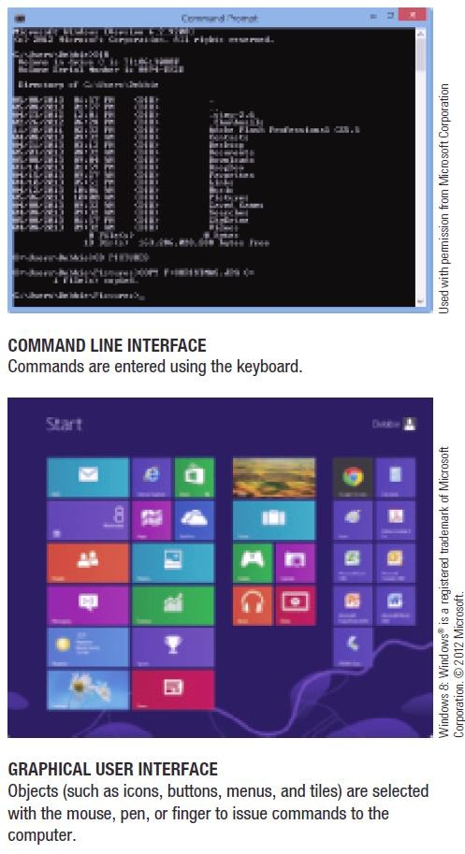

Differences Among Operating Systems
Command Line Interface
Require users to input commands using the keyboard
Graphical User Interface
Graphics based interface
Used by most operating systems

Slide 15
Differences Among Operating Systems
Categories of Operating Systems
Personal (Desktop) Operating Systems
Designed to be installed on a single computer
Server (Network) Operating Systems
Designed to be installed on a network server
Client computers still use a personal operating system
Server operating system controls access to network resources
Mobile and embedded operating systems are also
common

Slide 16
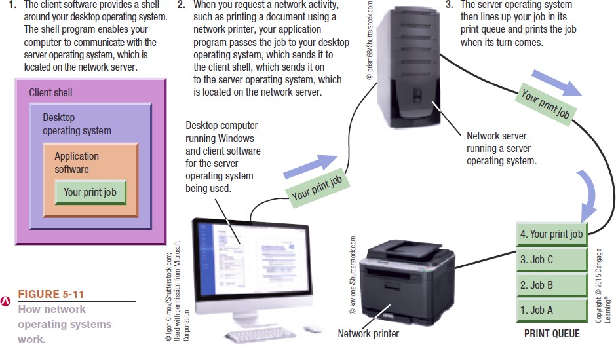
Differences Among Operating Systems

Slide 17
Operating Systems for Personal Computers and Servers
DOS (Disk Operating System)
DOS traditionally used a command-line interface
Dominant operating system in the 1980s and early 1990s
PC-DOS
Created originally for IBM microcomputers
MS-DOS
Created for use with IBM-compatible computers
Can enter DOS commands in Windows

Slide 18


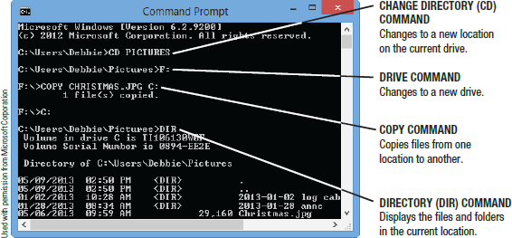
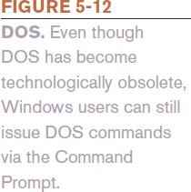
DOS

Slide 19
Windows
Windows
The predominant personal operating system developed by Microsoft Corporation
Windows 1.0 through Windows Vista
Windows 1.0 released in 1985
– Windows 1.0 through Windows 3.x were operating
environments for DOS
Windows 95, Windows 98, and Windows ME
Designed for personal computers

Slide 20
Windows
Windows NT (New Technology)
First 32-bit version of Windows designed for high- end workstations and servers
Replaced by Windows 2000
Windows XP
Replaced both Windows 2000 and Windows Me
Windows Vista
Replaced Windows XP
Introduced the Aero interface and Sidebar feature

Slide 21
Windows
Windows 7
Released in late 2009
Home Premium (primary version for home users)
Professional (primary version for businesses)
Libraries feature gives you virtual folders
Windows 8
Current version of Windows
Designed to be used with smartphones, desktop computers, with or without a keyboard or mouse
Supports multi-touch input
Includes Start screen, tiles, and charms bar

Slide 22
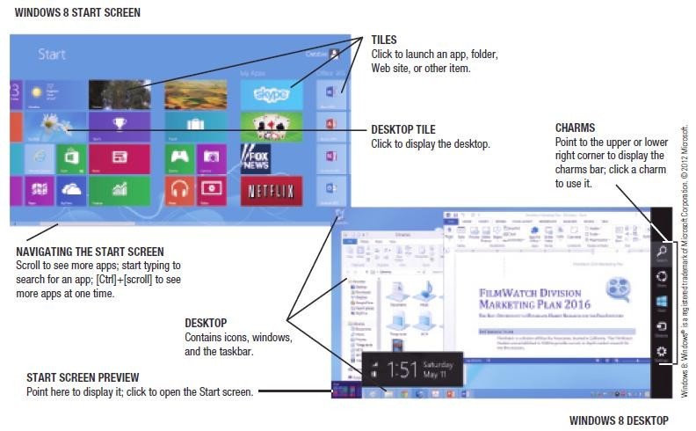

Windows

Slide 23
Windows
Windows Server
The version of Windows designed for server use
Windows Server 2012 is the latest version
Supports both virtualization and cloud computing
Windows Home Server
Preinstalled on home server devices
Designed to provide services for a home network
Can be set up to back up all devices in the home on a regular basis

Slide 24
Mac OS
Mac OS
Proprietary operating system for computers made by Apple Corporation
Based on the UNIX operating system
Originally set the standard for graphical user interfaces
Mac OS X Family
Mac OS X Mountain Lion and Mac OS X Mavericks
Mac OS X Server
Server version of Mac OS X

Slide 25
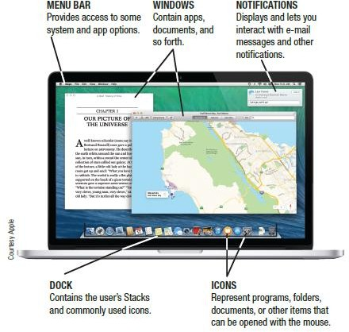

Mac OS

Slide 26
UNIX
UNIX
Operating system developed in the late 1960s for midrange servers
Multiuser, multitasking operating system
More expensive, requires high level of technical knowledge; harder to install, maintain, and upgrade
“UNIX” initially referred to the original UNIX operating system, now refers to a group of similar operating systems based on UNIX
Single UNIX Specification
A standardized UNIX environment

Slide 27
Linux
Linux
Developed by Linus Torvalds in 1991—resembles UNIX but was developed independently
Is open-source software; has been collaboratively modified by volunteer programmers all over the world
Originally used a command line interface, most recent
versions use a GUI
Strong support from mainstream companies, such as IBM, NVIDIA, HP, Dell, and Novell
Individuals and organizations are switching to Linux and other open source software because of cost

Slide 28
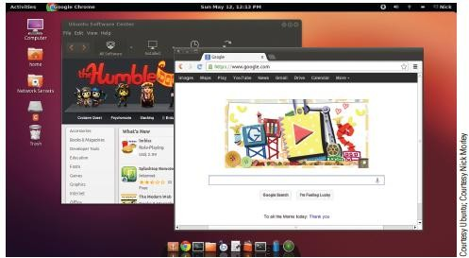
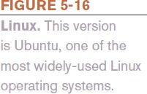
Linux

Slide 29
Chrome OS
Chrome OS
The first cloud operating system
Essentially is the Chrome Web browser redesigned to run a
computer, in addition to accessing Web resources
Replaces traditional desktop operating systems
Is currently only available preinstalled on Chrome devices

Slide 30
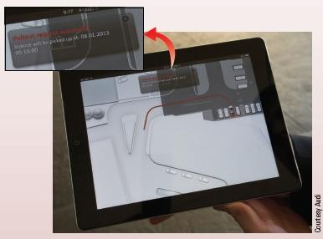
Technology and You Box
Smart Cars
Use of computers in cars has skyrocketed
Self-driving systems and self-parking systems
Lane departure and blind spot detection systems
Windshield displays
Collision warnings and auto
brake systems
Keyless entry and ignition systems
Distraction-prevention systems
Safety of gadgets is a concern

Slide 31
Operating Systems for Mobile Devices
Windows Phone 8, Windows RT, and Windows Embedded
Windows Phone
Latest version of Windows designed for smartphones
Windows Phone 8 is based on the Windows 8 operating system
Windows RT
Designed for tablet use
Windows Embedded
Designed primarily for consumer and industrial devices
that are not personal computers

Slide 32
Operating Systems for Mobile Phones and Other Devices
Android
Linux-based operating system created with current mobile device capabilities in mind
Can create applications that take full advantage of all the features a mobile device has to offer
Open platform
Current version is Android 4.3, also known as Jelly Bean
Devices support multitasking, multiple cores, NFC mobile payment transactions, Internet phone calls

Slide 33
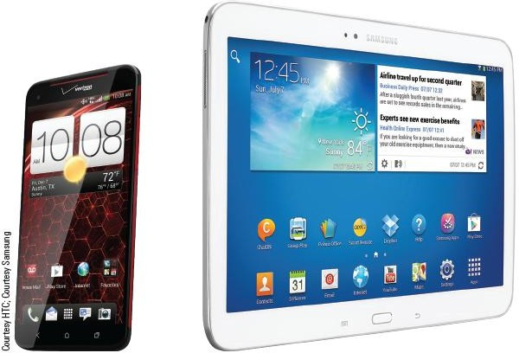

Operating Systems for Mobile Phones and Other Devices

Slide 34
Operating Systems for Mobile Phones and Other Devices
iOS
Designed for Apple Mobile phones and mobile devices
Current version is iOS 7
Supports multitasking
Includes Safari Web browser, the Siri intelligent assistant, Facetime video calling, AirDrop to send items to others, and apps for email, messaging, music, and search

Slide 35
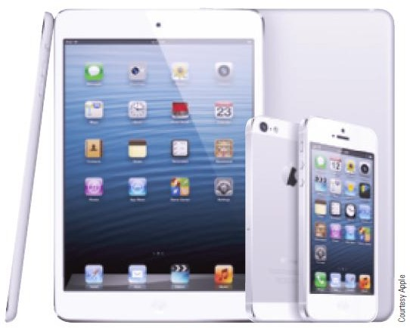

Operating Systems for Mobile Phones and Other Devices

Slide 36
Operating Systems for Mobile Phones and Other Devices
Blackberry OS and Blackberry PlayBook OS
Designed for Blackberry devices
Mobile Linux
Other mobile operating systems based on Linux besides Android and iOs
Ubuntu, webOS, Firefox OS, and Tizen

Slide 37
Operating Systems for Larger Computers
Larger computers sometimes use operating systems designed solely for that type of system
IBM’s z/OS is designed for IBM mainframes
Windows, UNIX, and Linux are also used with servers, mainframes, and supercomputers
Larger computers may also use a customized operating system
based on a conventional operating system

Slide 38
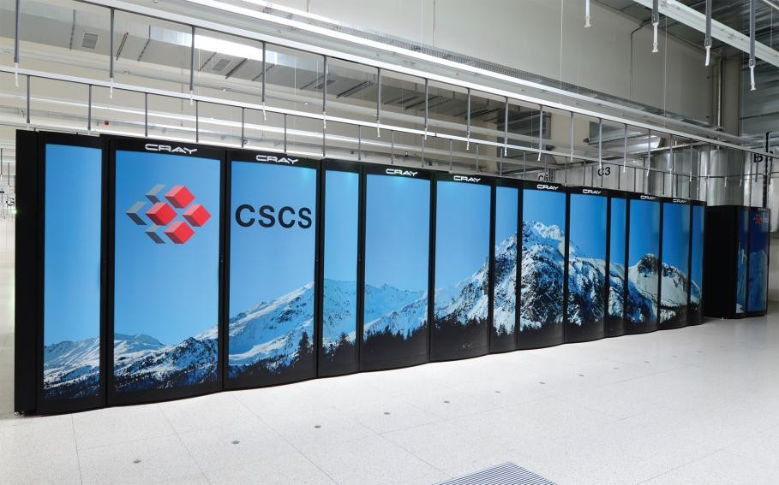
Inside the Industry Box
Weather Forecasting in the Alps
Weather forecasting is difficult in the Alps due to complex topography and intense precipitation
Supercomputer Piz Daint is Linux based, uses CPUs and GPUS, and runs at 750 teraflops
Can run 30 weather forecasting models simultaneously
Cooled with water from a nearby lake

Slide 39
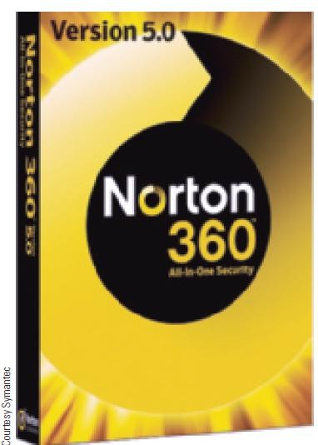
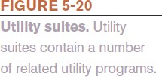
Utility Programs
Utility Program
Software that performs a specific task, usually related to managing or maintaining the computer system
Many utilities are built into operating systems (for finding files, viewing images, backing up files, etc.)
Utilities are also available as stand-alone products
and as suites

Slide 40
File Management Programs
Enable the user to perform file management tasks, such as:
Looking at the contents of a storage medium
Copying, moving, and renaming files and folders
Deleting files and folders
File management program in Windows 8 is File Explorer
To copy or move files, use the Home tab to copy (or cut)
and then paste
To delete files, use the Delete key on the keyboard or the Home tab

Slide 41
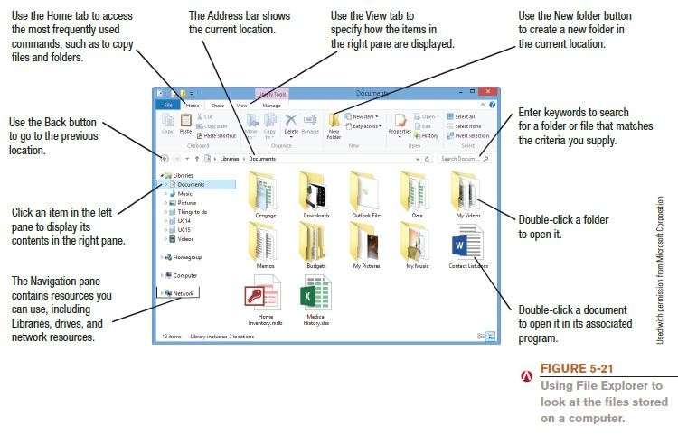
File Management Programs

Slide 42
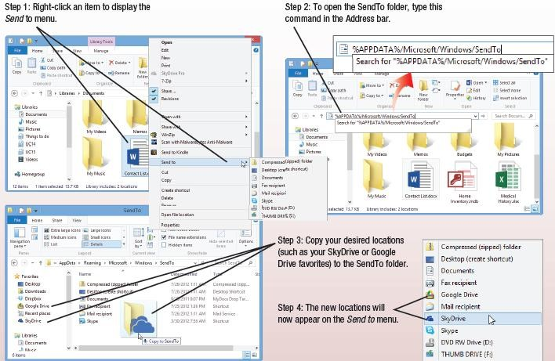
How It Works Box
Sending to the Cloud
Add cloud locations to the Send To menu
Google Drive, SkyDrive, etc.

Slide 43
Utility Programs
Search Tools
Designed to search for documents and other files on the user’s hard drive
Windows 8 has Search charm to search for files, apps, and Store items
Are often integrated into file management programs
Third-party search tools are also available
Diagnostic and Disk Management Programs
Diagnostic programs evaluate your system and make recommendations for fixing any errors found
Disk management programs diagnose and repair problems related to your hard drive

Slide 44
Utility Programs
Uninstall and Cleanup Utilities
Uninstall utilities remove programs from your hard drive without leaving bits and pieces behind
Important to properly uninstall programs, not just delete them
Cleanup utilities delete temporary files
Files still in Recycle Bin
Temporary Internet files
Temporary installation files

Slide 45
Utility Programs
File Compression Programs
Reduce the size of files to optimize storage space and transmission time
Both zip and unzip files
WinZip (Windows users) and Stuffit (Mac users)
Backup and Recovery Utilities
Make the backup and restoration process easier
Creating a backup means making a duplicate copy of important files
Can use a recordable or rewritable CD or DVD disc, a USB flash drive, or an external hard drive

Slide 46
Utility Programs
Good backup procedures are critical for everyone
Individuals should back up important documents, e-mail, photos, home video, etc.
Performing a backup can include backing up an entire computer (so it can be restored at a later date)
Can do the backup manually or use backup utility programs (stand alone or those built into operating systems)
Can also backup individual files are they are modified

Slide 47
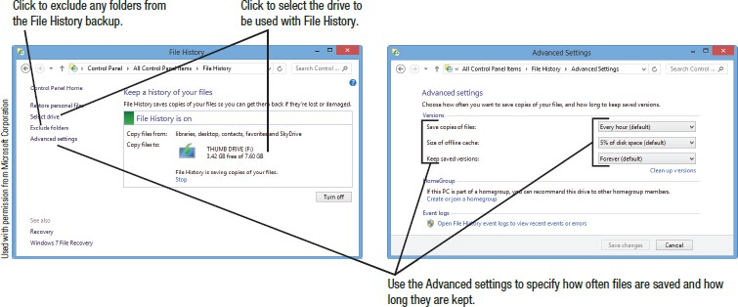

Utility Programs

Slide 48
Utility Programs
Antivirus, Antispyware, Firewalls, and Other Security Programs
Security Concerns
Viruses, spyware, identity theft, phishing schemes
Security programs protect computers and users and it is essential that all computer users protect themselves and their computers
Antivirus programs
Antispyware programs
Firewalls
Many are included in Windows and other operating systems

Slide 49
The Future of Operating Systems
Will continue to become more user-friendly
Will eventually be driven primarily by a voice interface, touch, and/or gesture interface
Likely to continue to become more stable and self-healing
Will likely continue to include security and other technological improvements as they become available
Will almost certainly include improvements in the areas of synchronizing and coordinating data and activities among a person’s various computing and communicating devices
May be used primarily to access software available through the Internet or other networks

Slide 50
The Basics of Application Software
Commercial Software
Copyrighted software developed and sold for profit
Typically comes with a single-user license
Shareware
Copyrighted software distributed on the honor system
Consumers should either pay for it or uninstall it after the trial
period
Freeware
Copyrighted software programs that are given away by the
author for others to use free of charge
Public Domain Software
Software that is not copyrighted and ownership rights have been donated to the public domain

Slide 51
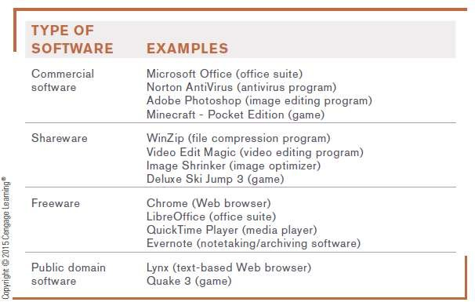

The Basics of Application Software

Slide 52
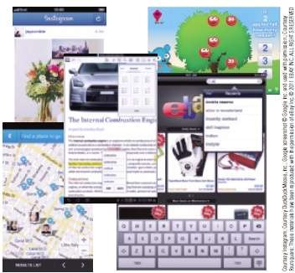

Desktop vs. Mobile Software
Personal computers use desktop software
Smartphones and other mobile devices typically require mobile software called apps
Specifically designed for a specific type of device
Wide range of software available via app stores (Google Play, Apple App Store, etc.)

Slide 53
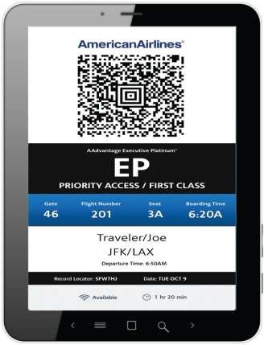
Technology and You Box
Mobile Ticketing
Download ticket to mobile device to use for admittance
Tickets for movies, sporting events, concerts, etc.
Boarding passes
Custom tickets

Slide 54
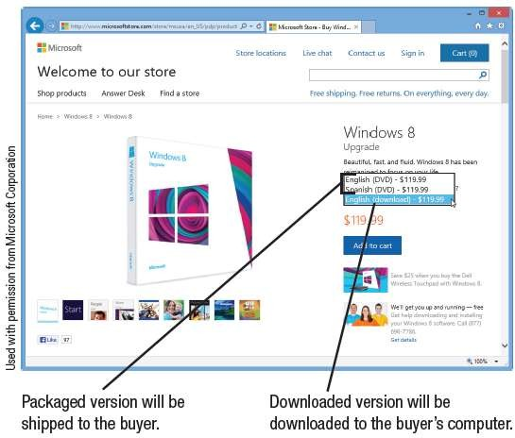

Installed vs. Cloud Software
Installed Software
Must be installed on the computer before it can be run
Can be purchased in physical form
Can be downloaded from the Internet

Slide 55
Installed vs. Cloud Software
Cloud Software
Is delivered on-demand via the Web
Also called Software as a Service (SaaS) and cloudware
Includes free software and fee-based software
Advantages of cloud software
Files can be accessed from any computer with an
Internet connection
Ease of implementation
Improved collaboration capabilities
Always working with the most current version of software

Slide 56
Installed vs. Cloud Software
Potential disadvantages of cloud software
Online applications tend to run more slowly
Have file size limits
Cost may eventually exceed the cost of purchasing a similar installed version of the software

Slide 57
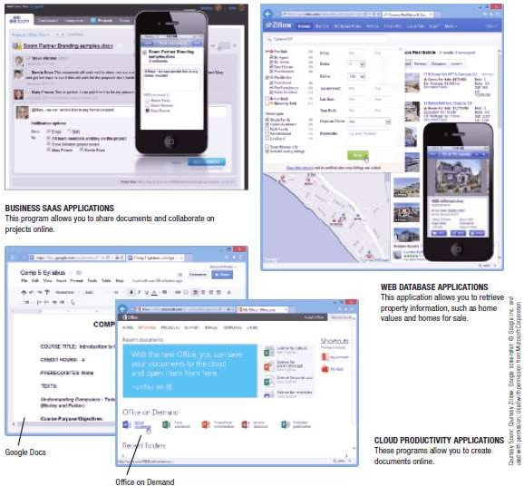

Installed vs. Cloud Software

Slide 58
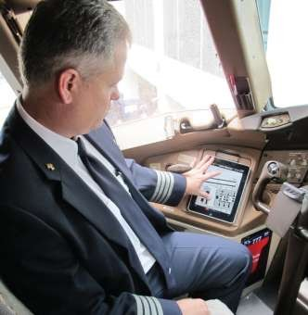
Trend Box
Airline Apps
American Airlines is issuing media tablets to all cabin personnel and iPads to all pilots
Replaces paper manuals and maps
Expected to be able to provide passengers with additional services such as connection and weather info and food purchases and other in-flight transactions

Slide 59
Outline
Computer Software
System Software
Application Software
Operating System (OS)
Basic Purpose of OS
Types of OS
Operating System Functions
Providing User Interface
Running Programs
Managing Hardware
Utility Programs
PC Operating System
Network Operating System
Embedded Operating System

