Slide 1
CSC 101 – Introduction to Computing
Lecture 07 (Morley Ch12)

Slide 2
What Is a Database?
Database
A collection of related data stored in a manner that enables information to be retrieved as needed
Database Management System (DBMS)
Used to create, maintain, and access databases
Database engine
The part of the program that actually stores and retrieves data
Microsoft Access, OpenOffice Base, Corel Paradox, Oracle
Database, etc.

Slide 3
Outline
Database
What is a Database
Advantages & Disadvantages of the DBMS Approach
Data Concepts & Characteristics
Data Definition
Data Hierarchy
Entities
Entity Relationships
Data Integrity, Security & Privacy
Centralized vs. Distributed Database Systems

Slide 4
What Is a Database?
A database typically consists of:
Tables
Collection of related records
Fields (columns)
Single category of data to be stored in a database (name, telephone number, etc.)
Records (rows)
Collection of related fields in a database (all the fields for one customer, for example)

Slide 5
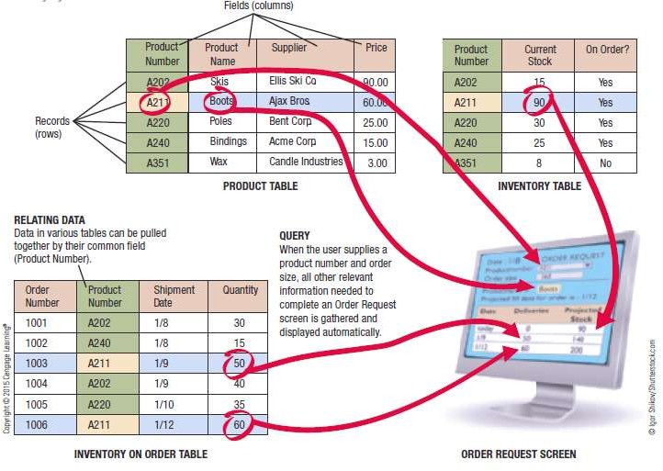

What Is a Database?
A Simple Relational Database Example

Slide 6
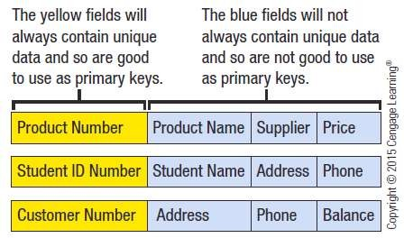
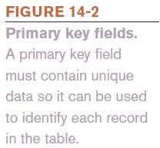
What is a Database?
Primary Key
Field that uniquely identifies the records in a table
Field in a table that is used to relate that table to other
tables

Slide 7
What Is a Database?
Individuals Involved with a Database Management System
Database Designers
Design the database
Database Developers
Create the database
Database Programmers
Write the programs needed to access the database or tie the database to other programs

Slide 8
What Is a Database?
Database Administrators
Responsible for managing the databases within an organization
Users
Individuals who enter data, update data, and retrieve information from the database

Slide 9
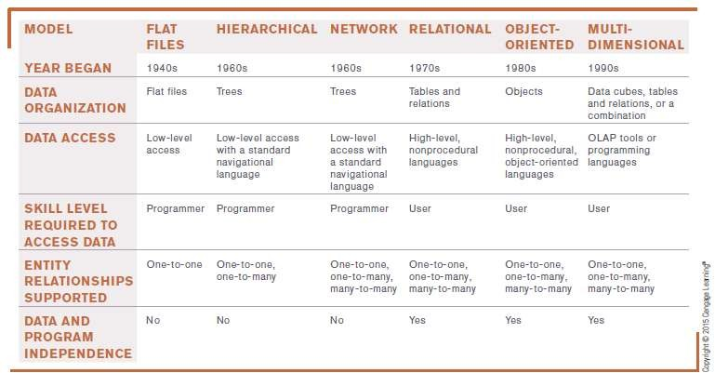
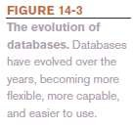
What Is a Database?
The Evolution of Databases

Slide 10
What Is a Database?
Advantages and Disadvantages of the DBMS Approach
Advantages
Low level of redundancy
Faster response time
Lower storage requirements
Easier to secure
Increased data accuracy
Disadvantages
Increased vulnerability (backup is essential)

Slide 11
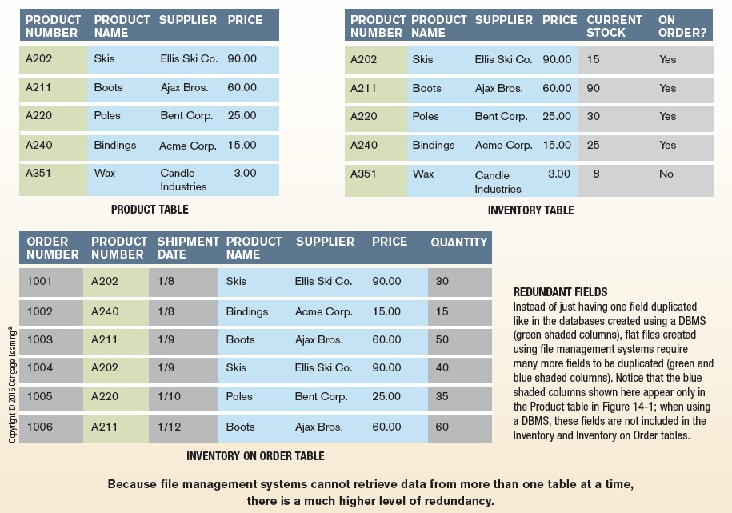
Inside the Industry Box
File Management Systems
– Tables are not related so more time- consuming and more redundancy

Slide 12
Data Concepts and Characteristics
Data Hierarchy
Fields/columns
Hold single pieces of data
Records/rows
Groups of related fields
Tables
Collection of related records
Database
Contains a group of related tables

Slide 13
Data Concepts and Characteristics
Entities and Entity Relationships
Entity
A person, object, or event of importance to the
organization
Entities that the organization wants to store data about typically becomes a database table
Attributes
Characteristics of an entity
Typically become fields in the entity’s database table
Relationship
An association between two or more entities

Slide 14
Data Concepts and Characteristics
One to One (1:1) Entity Relationships
One entity is related to only one other entity of a particular type
Not a common type of relationship
One to Many (O:M) Entity Relationship
Most common type of relationship
One entity can be related to more than one other entity
– A supplier can supply more than one product to a company
Many to Many (M:M) Entity Relationships
One entity can be related to more than one other entity, and those entities can be related to multiple entities of the same type as the original entity

Slide 15
Data Concepts and Characteristics
Data Definition
The process of describing the properties of data to be included in a database table
During data definition, each field is assigned:
Name (must be unique within the table)
Data type (such as Text, Number, Currency, Date/Time)
Description (optional description of the field)
Properties (field size, format of the field, allowable range, if field is required, etc.)
Finished specifications for a table become the table structure

Slide 16
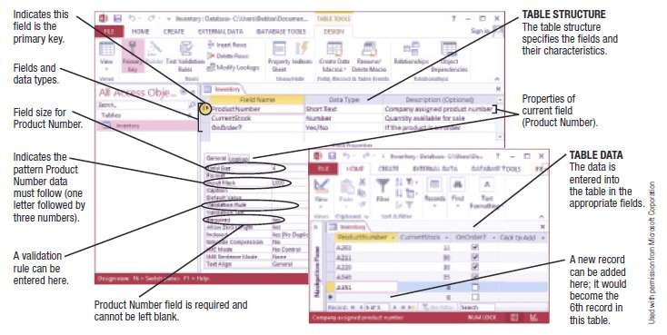
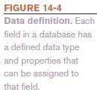
Data Concepts and Characteristics

Slide 17
Data Concepts and Characteristics
The Data Dictionary
Contains all data definitions in a database, including:
Table structures
Security information (passwords, etc.)
Relationships between the tables in the database
Basic information about each table, such as the current
number of records
Does not contain any of the data in the tables
Does contain metadata, which is information about the database tables
Ensures that data being entered into the database does not violate any specified criteria

Slide 18
Data Integrity, Security, and Privacy
Data Integrity
Accuracy of Data
Quality of data entered determines the quality of
generated information
Data Validation
Process of ensuring that data entered into the database is valid
Record validation rules
– Checks all fields before changes to a record are saved
Can be enforced on a per transaction basis so the entire transaction will fail if one part is invalid

Slide 19
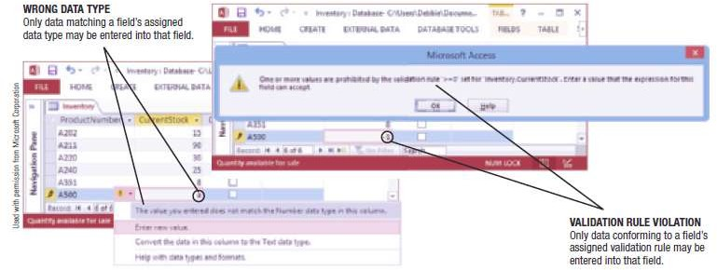
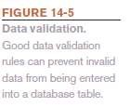
Data Integrity, Security, and Privacy
Database Locking
Prevents two individuals from changing the same data at the same time

Slide 20
Data Integrity, Security, and Privacy
Data Security
Protects data against destruction and misuse
Protects against unauthorized access to and unauthorized
use of a database
Database activity monitoring programs can be used to detect possible intrusions and risks
Prevents data loss
Should include strict backup and disaster-recovery procedures (disaster-recovery plan)
Should be used with both in-house and cloud databases

Slide 21
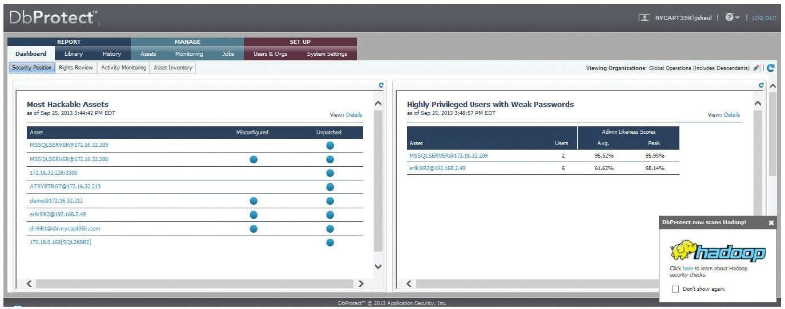
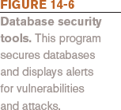
Data Integrity, Security, and Privacy

Slide 22
Data Integrity, Security, and Privacy
Data Privacy
Growing concern because of the vast amounts of personal data stored in databases today
Many states require businesses to notify customers when their personal data has been compromised
Data breaches can be costly
– One estimate is $200 per breached record

Slide 23
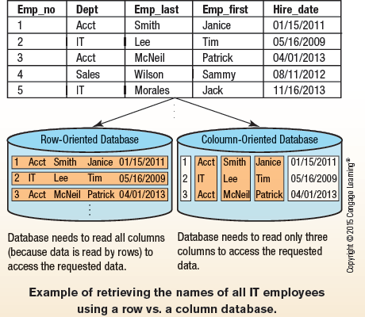
How It Works Box
Column Databases
Stores data by columns instead of rows
Improves performance by minimizing the time needed to read the disk
Used with data warehouses and other big data applications

Slide 24
Database Classifications
Single-User vs. Multiuser Database Systems
Single-User Database System
Located on a single computer
Designed to be accessed by one user
Widely used for personal applications and very small businesses
Multiuser Database System
Designed to be accessed by multiple users (most business databases today)

Slide 25
Database Classifications
Centralized vs. Distributed Database Systems
Centralized Database System
Database is located on a single computer, such as a
server or mainframe
Distributed Database System
Data is physically divided among several computers connected by a network, but the database logically looks like it is a single database

Slide 26
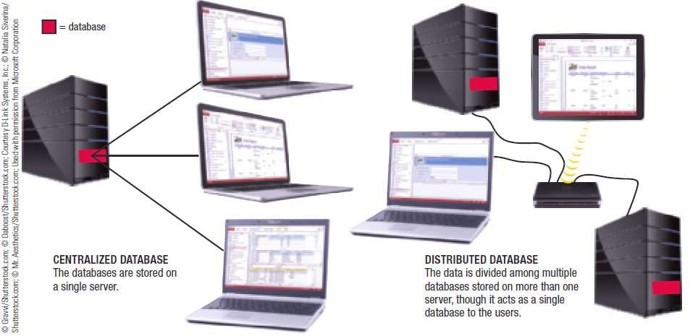

Database Classifications

Slide 27
Database Classifications
Disk-Based vs. In-Memory Database Systems
Disk-Based Systems
Data is stored on hard drives
In-Memory Databases (IMDBs)
Data is stored in main memory
Dramatically faster than disk-based databases
Good backup procedures are essential
Used both in high-end systems where performance is crucial and in small-footprint, embedded applications

Slide 28
Database Models
The Hierarchical and Network Database Models
Hierarchical Databases
Organizes data in a tree structure
Typically a one-to-many relationship between data entities
Network Databases
Allow both one-to-many and many-to-many relationships between data elements
Most databases today are neither hierarchical or network
models

Slide 29
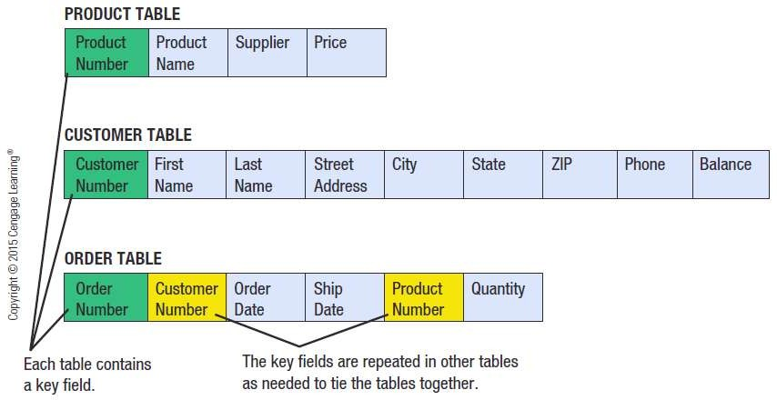
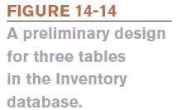
The Relational Database Model (RDBMS)

Slide 30
The Relational Database Model (RDBMS)
Creating a Relational Database
Creating the Tables
Each table is created using the table structure
developed during the database design process
In Access, can use Design view or Datasheet view
Entering and Editing Data
Existing data can be migrated to the new database
New data can be added via a form or Datasheet view
In either case, the same data is being manipulated

Slide 31
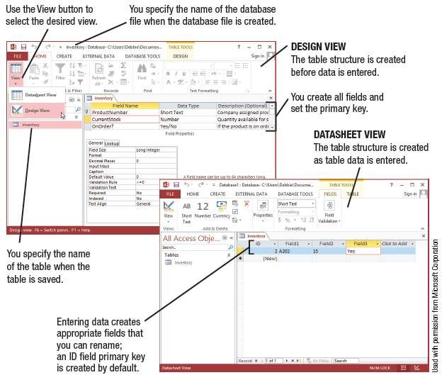

Database Models

Slide 32
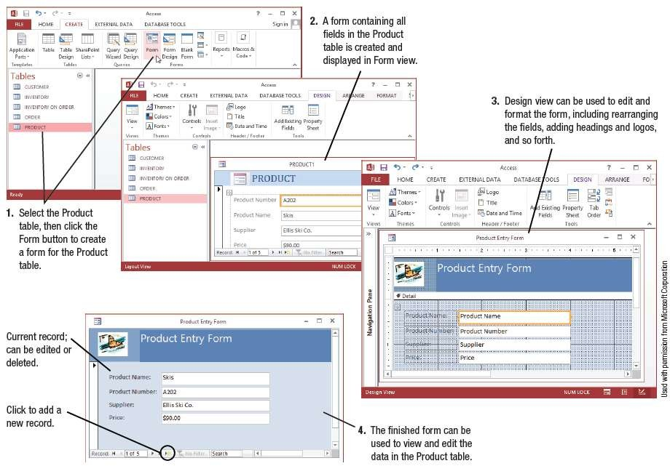

Database Models

Slide 33
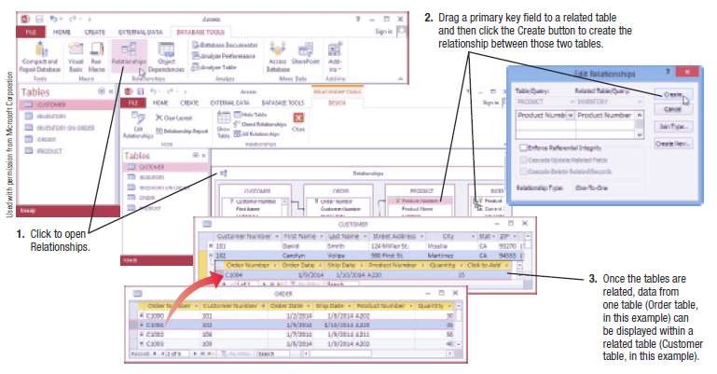

The Relational Database Model (RDBMS)
Relating Tables
Once all tables have been created, they can be related to one another using their primary keys

Slide 34
The Relational Database Model (RDBMS)
Retrieving Information from a Relational Database
Query
A request to see information from a database that
matches specific criteria
Every DBMS provides tools users can use to query the database for information
Can also write in structured query language (SQL)
Must be designed to extract information as efficiently as possible
Poorly written queries can impact the overall performance of the system

Slide 35
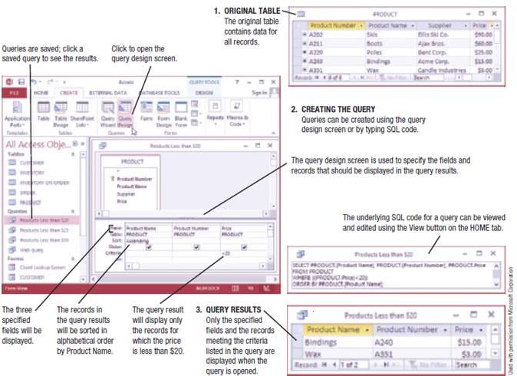
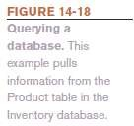
The Relational Database Model (RDBMS)

Slide 36
The Relational Database Model (RDBMS)
Reports
Formatted way of looking at a database table or the results of a query
Can pull data from more than one table
Many programs have wizards or other tools to make it easy to create a report
Can be modified and customized using the Design view
Reports in Microsoft Access are saved as objects in the database file

Slide 37
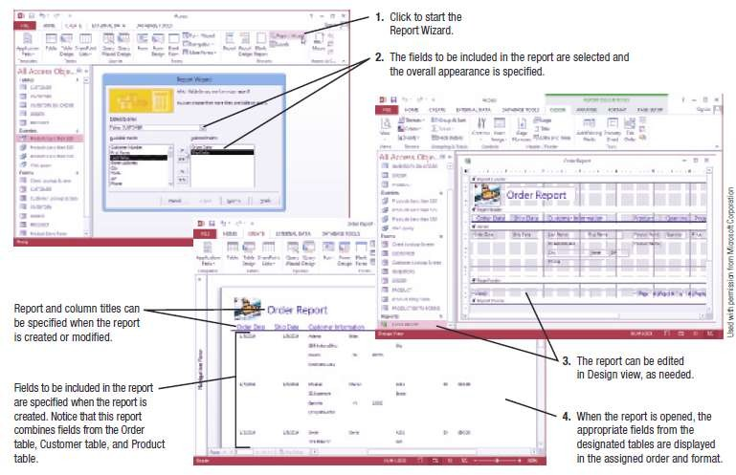

The Relational Database Model (RDBMS)

Slide 38
The Relational Database Model (RDBMS)
Maintaining a Relational Database
Table structures can be modified when needed
Other possible modifications:
Adding new indexes to speed up queries
Deleting obsolete data
Upgrading database software, installing patches
Repairing/restoring data that has become corrupt
Continuing to evaluate and improve security

Slide 39
The Object-Oriented Database Model
The Object-Oriented Database Model
Object-Oriented Database Management System (OODBMS)
Database system in which multiple types of data are stored as objects along with their related code
Can contain virtually any type of data (video clip, text with music, etc.) along with the methods to be used with that data
Objects can be retrieved using queries (object query language or OQL)
Objects can be reused in other applications to create new applications quickly

Slide 40

Trend Box
Law Enforcement Databases
Have been used for years but new database are now emerging that hold non-traditional data like photos and biometric data
Next Generation Identification (NGI)
Includes AFIT to store and
match fingerprints
Includes support for photos and face-matching
Future improvements include support for voice, iris, DNA, palm prints, etc.

Slide 41
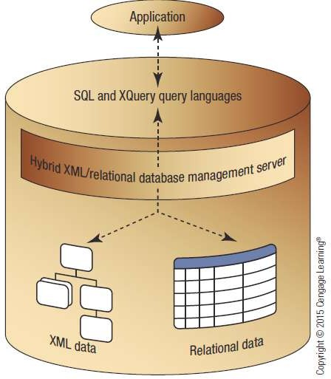

Hybrid Database Models
Hybrid Database Models
A combination of two or more database types or models
Hybrid XML/Relational
Database
– Can store and
retrieve both XML data
and relational data

Slide 42
Multidimensional Databases (MDDB)
Multidimensional Databases (MDDB)
Designed to be used with data warehousing
Often used in conjunction with Online Analytical
Processing (OLAP)
MOLAP (Multidimensional OLAP)
Data is stored in single structures called data cubes
ROLAP (Relational OLAP)
Data is stored in an existing relational database using tables to store the summary information
HOLAP (Hybrid OLAP)
Combination of MOLAP and ROLAP technologies

Slide 43
Cloud Databases
Typically hosted on a cloud database provider’s servers that is accessible to users via the Web
Examples of Cloud Databases in Use
Information retrieval
Data to be accessed and displayed on a Web page is often stored in a database, i.e, Search sites
Support and facilitate e-commerce
Display product information, pricing, customer information, shopping cart content, etc.
Cloud databases allow Web pages to be dynamic Web pages

Slide 44
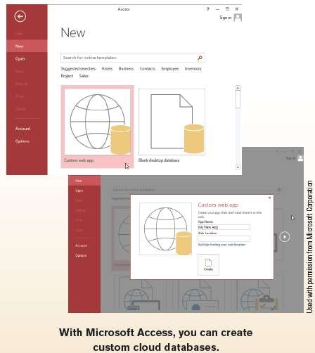
Technology and You Box
Cloud Databases
Use growing rapidly
Typically built using a cloud provider (Windows Azure, Amazon SimpleDB, or Google Cloud SQL)
Requires less in-house hardware and maintenance
Individuals can create via Microsoft Access web apps

Slide 45
Cloud Databases
How Cloud Databases Work
Visitor makes request by
Filling out a Web page form
Selecting an option from a menu displayed on a Web page form
Web server converts the request into a database query, passes it onto the database server, and then sends the results back to the visitor

Slide 46
Cloud Databases
Middleware
Software used to connect two otherwise separate applications, such as a Web server and a database management system
Commonly written as scripts
Common languages include
JavaScript
VBScript
CGI Scripts
Active Server Pages (ASPs)
PHP Scripts

Slide 47
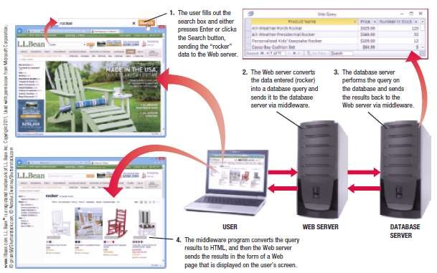

Cloud Databases

Slide 48
Summary
Database
What is a Database
Advantages & Disadvantages of the DBMS Approach
Data Concepts & Characteristics
Data Definition
Data Hierarchy
Entities
Entity Relationships
Data Integrity, Security & Privacy
Centralized vs. Distributed Database Systems

