Slide 1
CSC 101 – Introduction to Computing
Lecture 08 (Morley Ch 7)

Slide 2
What Is a Network?
Network
A connected system of objects or people
Computer network
A collection of computers and other hardware devices connected together so users can share hardware, software, and data, and electronically communicate
Networks range from small private networks to the Internet

Slide 3
Networking Applications
The Internet
Largest computer network in the world
Telephone Service
POTS (Plain Old Telephone Service) Network
One of the first networks
Still used today to provide telephone service to landline phones
Mobile Phones (wireless phones)
Use a wireless network for communications

Slide 4
Networking Applications
Cellular (cell) Phones
Must be within range of cell tower to function
Dual-mode Phones
Allow users to make telephone calls using more than one communications network
Cellular/Wi-Fi dual-mode phones can switch seamlessly between the Wi-Fi network and a cellular network
Satellite Phones
Communicate via satellite technology
Most often used by individuals such as soldiers, journalists, wilderness guides, and researchers

Slide 5
Networking Applications
Television and Radio Broadcasting
Still used to deliver TV and radio content to the public
Other networks involved with television content delivery are cable TV networks, satellite TV networks, and private closed-circuit television systems
Global Positioning System (GPS) Applications
Uses satellites and a receiver to determine the exact geographic location of the receiver
GPS receivers
Commonly used by individuals to determine their geographic location

Slide 6
Networking Applications
Videoconferencing, Collaborative Computing, and Telecommuting
Videoconferencing
Use of computers, video cameras, microphones, and networking technologies to conduct face-to-face meetings over a network
Telepresence Videoconferencing
A setup that more closely mimics a real-time meeting environment

Slide 7
Networking Applications
Collaborative Computing (workgroup computing)
Enables individuals to work together on documents and projects
Telecommuting
Individuals work from a remote location (usually home) and communicate with their places of business and clients using networking technologies
Allows for employee flexibility

Slide 8
Networking Applications
Telemedicine
Use of networking technology to provide medical information and services
Remote monitoring and consultations
Remote diagnosis
Telesurgery
Robot assisted surgery where doctor’s physical location is different from the patient’s and robot’s

Slide 9
Network Characteristics
Wired vs. Wireless Networks
Wired
A network in which computers and other devices are
physically connected to the network with cables
Found in schools, businesses, and government facilities
Wireless
A network in which computers and other devices are connected to the network without physical cables
Data is typically sent via radio waves
Found in homes, schools, and businesses

Slide 10
Network Characteristics
Network Topologies: Indicate how the devices in the network are arranged
Star Networks
All networked devices connect to a central device/server
If the central device fails, the network cannot work
Bus Network
Uses a central cable to which all network devices connect
Mesh network
Multiple connections among the devices on the network so that messages can take any of several possible paths

Slide 11
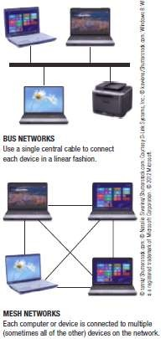
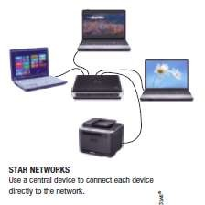
Network Characteristics

Slide 12
Network Characteristics
Network Architectures
Client-Server Networks
Client
Computer or other device on the network that requests and utilizes network resources
Server
Computer dedicated to processing client requests

Slide 13
Network Characteristics
Peer-to-Peer (P2P) Networks
Central server is not used
All computers on the network work at the same
functional level
Users have direct access to the computers and devices attached to the network
Less complicated and less expensive to implement than client-server networks

Slide 14
Network Characteristics
Network Size and Coverage Area
Personal Area Networks (PANs)
Connect an individual’s personal devices
– Devices must be physically located close together
Local Area Networks (LANs)
Connect devices located in a small geographic area
Metropolitan Area Networks (MANs)
Cover a metropolitan area such as a city or county
Wide Area Networks (WANs)
Cover a large geographic area
Two or more LANs connected together

Slide 15
Network Characteristics
Intranets and Extranets
Intranet
Private network designed to be used by an
organizations’ employees; set up like the Internet
Extranet
Company network accessible by authorized outsiders
Virtual Private Networks (VPNs)
Private, secure path over the Internet that provides authorized users a secure means of accessing a private network via the Internet

Slide 16
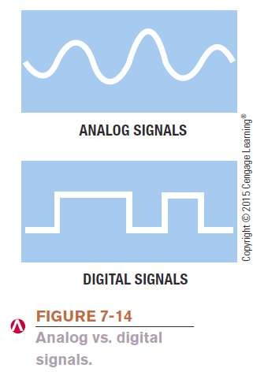
Data Transmission Characteristics
Bandwidth
The amount of data that can be transferred in a given period of time
Measured in bits per second (bps), Kbps (thousands), Mbps (millions ), or Gbps (billions)
Analog vs. Digital Signals
Data represented by two discrete states: 0s and 1s
Conventional telephone systems use
analog signals
Represent data with continuous waves

Slide 17
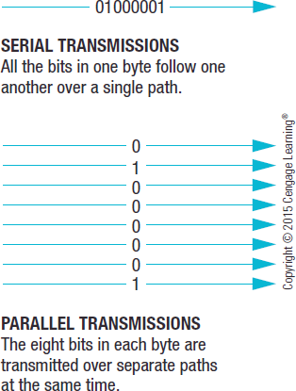

Data Transmission Characteristics
Transmission Type and Timing
Serial
Data sent one bit at a time, one after another, along a single path
Parallel
Data sent at least one byte at time with each bit in the byte taking a different path

Slide 18
Data Transmission Characteristics
Synchronous Transmission
Blocks of data are transferred at regular, specified intervals
Most data transmissions within a computer and over a
network are synchronous
Asynchronous Transmission
Data is sent when ready without being synchronized
Start bits and stop bits used to identify the bits that belong in each byte
Isochronous Transmission
Data sent at the same time as other, related, data

Slide 19
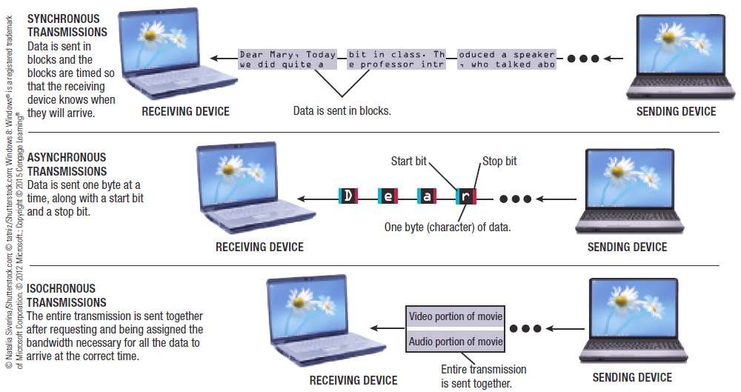

Data Transmission Characteristics

Slide 20
Data Transmission Characteristics
Simplex Transmission
Data travels in a single direction only
Half-Duplex Transmission
Data travels in either direction but only one way at a time
Full-Duplex Transmission
Data travels in both directions at the same time

Slide 21
Data Transmission Characteristics
Delivery Method
Circuit-Switching
Dedicated path over a network is established between
sender and receiver; all data follows that path
Packet-Switching
Messages are separated into small units called packets and travel along the network separately; packets are reassembled once destination is reached
Broadcasting
Data is sent out to all other nodes on the network and retrieved only by the intended recipient; primarily used with LANs

Slide 22
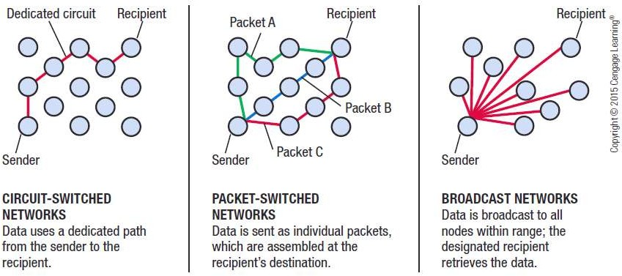
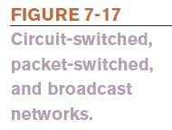
Data Transmission Characteristics

Slide 23
Networking Media
Wired Networking Media
Twisted-Pair Cable
Pairs of insulated wires twisted together
Used for telephone and network connections (LANs)
Coaxial Cable
Thick center wire surrounded by insulation
Used for cable television delivery
Fiber-Optic Cable
Utilizes hundreds of thin transparent clear glass or plastic fibers over which lasers transmit data as light
Used for high-speed communications

Slide 24
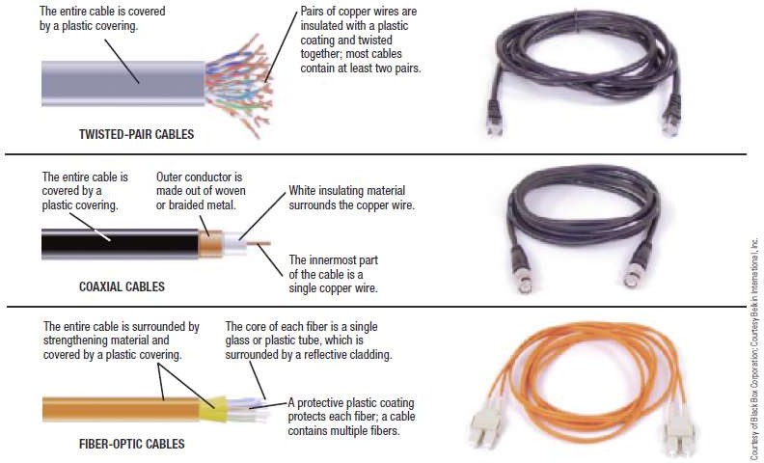

Networking Media

Slide 25
Networking Media
Wireless Networking Media
Data is sent through the airwaves using radio signals
The Electromagnetic and Wireless Spectrum
Radio frequencies are assigned by the FCC and are measured in hertz (Hz)
The electromagnetic spectrum is the range of common
electromagnetic radiation (energy)
Different parts of the spectrum have different properties, which make certain frequencies more appropriate for certain applications

Slide 26
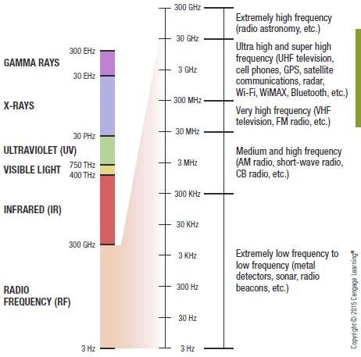
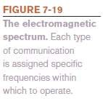
Networking Media

Slide 27
Networking Media
Frequencies assigned to an application usually consist of a range of frequencies to be used as needed
Most wireless networking applications use frequencies in the RF band at the low end of the spectrum—up to 300 GHz
Often called the wireless spectrum
The 900 MHz, 2.4GHz, 5 GHz, and 5.8 GHz frequencies are within an unlicensed part of the spectrum and can be used by any product or individual
Cordless landline phones, garage door openers, Wi-Fi, WiMAX, and Bluetooth

Slide 28
Networking Media
Cellular Radio Transmissions
Use cellular towers within honeycomb-shaped zones called cells
Calls are transferred from cell tower to cell tower as the individual moves
Cell tower forwards call to the MTSO
MTSO routes call to the recipient’s phone
Data sent via cell phones works in similar manner
The speed of cellular radio transmissions depends on the type of cellular standard being used

Slide 29
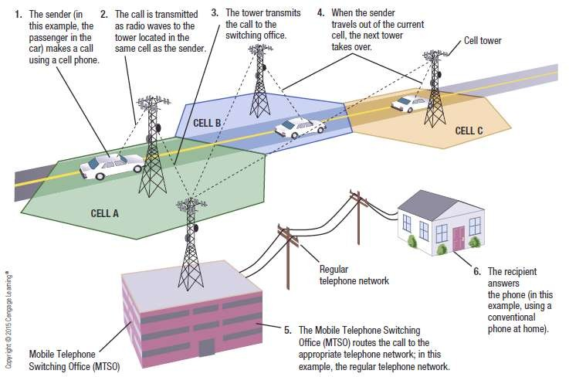

Networking Media

Slide 30
Networking Media
Microwave and Satellite Transmissions
Microwaves
High-frequency radio signals that are sent and received
using microwave stations or satellites
Signals are line of sight, so microwave stations are usually built on tall buildings, towers, mountaintops
Microwave stations
Earth-based stations that transmit signals directly to each other within a range of 30 miles
Stations designed to communicate with satellites (television and internet services) are called satellite dishes

