Slide 1
Computer Programming Languages
Lecture – 1

Slide 2
Computer Basics
Computer systems consist of hardware and software
A set of instructions for the computer to carry out is called a program
All the different kinds of programs used to give instructions to the computer are collectively referred to as software

Slide 3
Hardware and Memory
The CPU, or central processing unit, or processor, performs the instructions in a program
Computer’s memory holds data for the computer to process
It holds the result of the computer’s intermediate calculations
A byte is the quantity of memory
1 gigabyte of RAM is approximately 1 billion bytes of memory

Slide 4
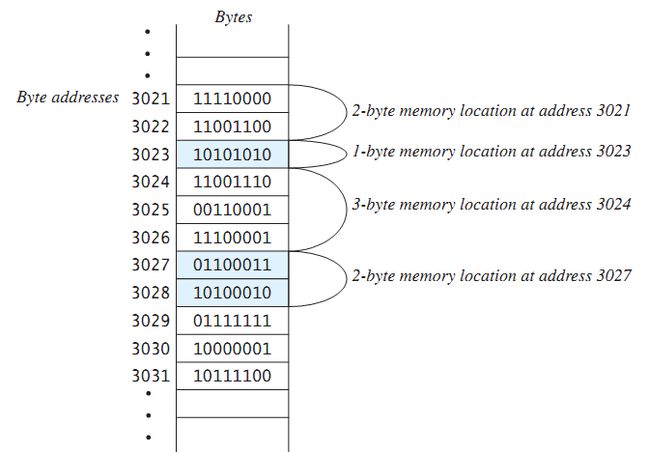
Hardware and Memory
Main memory consists of a long list of numbered bytes
The number of a byte is called its address
A byte is the smallest addressable
unit of memory
Data (numbers, letters and string of characters) is encoded as a series of 0s and 1s and placed in the computer’s memory

Slide 5
Programming Languages
Computer programs(software) are instructions that tell a computer what to do
Many programming languages
All programs are converted into instructions that computer can execute
Types of Languages
Machine Language
Assembly Language
High-Level Language
Example
To add Two Numbers:
1101101010011010
add 2, 3, result
result = 2 + 3

Slide 6
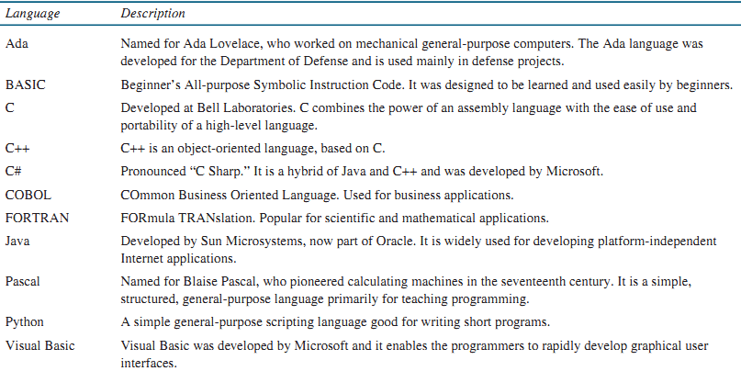

Slide 7
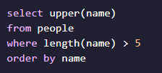
Programming Paradigm
A programming paradigm is a fundamental style of computer programming
Imperative in which the programmer instructs the machine how to change its state.
Examples: C, C++, Java, PHP, Python, Ruby etc.
Declarative the programmer states only what the result should look like, not how to obtain it. Example SQL, HTML , CSS
Notes:
HOW means describing the Inputs and describing how the Outputs are produced.

Slide 8
Programming Paradigm
Structured Programming
Kind of imperative programming
Control flow is defined by nested loops, conditionals, and subroutines
Sequence, Selection and Repetition
x= 5; y = 11; z = x + y; System.out.println(z);
if (x % 2 == 0) { System.out.println("The number is even."); }
while(x < 100) { System.out.println(x); x = x * x }

Slide 9
Programming Paradigm
Object Oriented Programming (OOP)
Object-oriented programming is about creating objects that contain both data and methods
Classes and objects are the two main aspects of object-oriented programming
Examples: C++, C#, Java, Python.
Class | Object
Fruit | Apple, Banana, Mango
Car | Volvo, Audi, Toyota
Student | Ali, Hamza, Ahmad

Slide 10
Programming Paradigm
Example
public class Car {
String carReg;
int carModel;
String carClass;
public Car(String num) {
carReg = num;
}
public String getReg(){
return carReg;
}
public static void main(String[] args) {
Car Audi = new Car("AX-7865");
System.out.println(Audi.getReg());
}
}

Slide 11
Programming Paradigm
Functional Programming
Basic method of computation is the application of functions to arguments
Supports and encourages the functional style
Examples of FP languages
Lisp, Haskell, Python

Slide 12
Program Development

Slide 13
Outline
Program Development Cycle
Algorithm
The First Four Steps

Slide 14
Programming: Plan First, Then Code
A good programmer will plan first and write second
Breaking down a large programming task into several smaller tasks

Slide 15
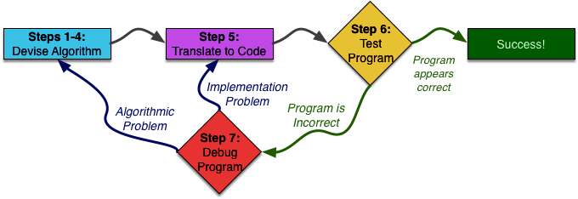
An Overview of Seven Steps

Slide 16
Algorithm
Set of well-defined logical steps that must be taken to perform a task
For example, suppose you have been asked to write a program to calculate and display the gross pay for an hourly paid employee.
Here are the steps that you would take:
1. Get the number of hours worked.
2. Get the hourly pay rate.
3. Multiply the number of hours worked by the hourly pay rate.
4. Display the result of the calculation that was performed in Step 3.

Slide 17
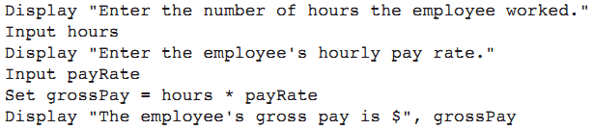
Pseudocode
Pseudocode: fake code
Informal language that has no syntax rule
Not meant to be compiled or executed
Used to create model program
No need to worry about syntax errors, can focus on program’s design
Can be translated directly into actual code in any programming language

Slide 18
Flowcharts
Flowchart: diagram that graphically depicts the steps in a program
Ovals are terminal symbols
Parallelograms are input and output symbols
Rectangles are processing symbols
Symbols are connected by arrows that represent the flow of the program

Slide 19
Flow Chart – Raptor Example

Slide 20
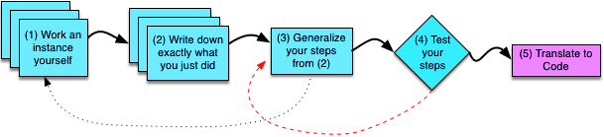
First Four Steps
Step 1: Work an Example Yourself
Step 2: Write Down What You Just Did
Step 3: Generalize Your Steps
Step 4: Test Your Algorithm

Slide 21
Example-1
Write a program to compute x raised to the y power (x ^{y})
Step 1: Work an Example Yourself
x = 3 and y = 4, getting an answer of 3^4 = 81.

Slide 22
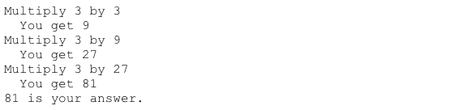
Example-1
Step 2: Write Down What You Just Did

Slide 23
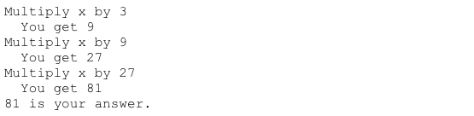
Example-1
Step 3: Generalize Your Steps
1-Replacing this occurrence of 3 with x

Slide 24
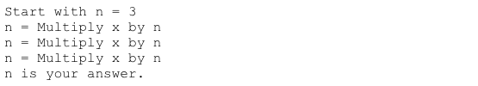

Example-1
Step 3: Generalize Your Steps
2-Find repetition

Slide 25

Example-1
Step 3: Generalize Your Steps

Slide 26
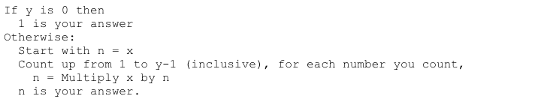
Example-1
Step 4: Test Your Algorithm

Slide 27

Example-1
Step 4: Test Your Algorithm

