Slide 1
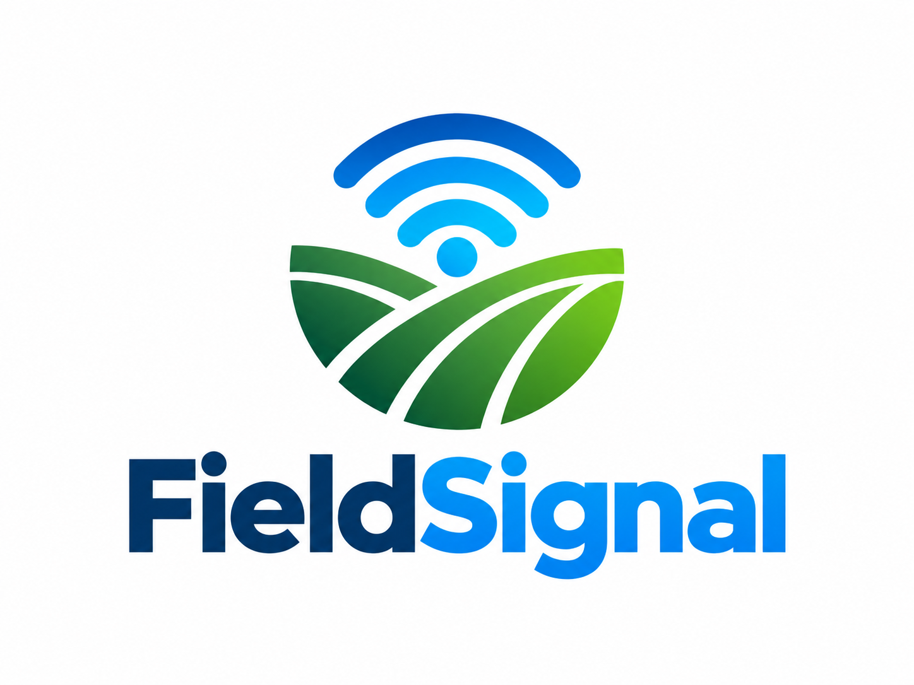
FieldSignal
Morning Briefing
Which research plots
need a closer look today?
Cornstellation
Notes:
Timing: 0:00–0:20 (20 seconds)
A scouting crew starts the morning with more research plots than it can visit. Which ones deserve a closer look? We built FieldSignal Morning Briefing to combine agronomic records and satellite observations into a suggested inspection list, with the evidence behind each choice.
Sources (not spoken): Presentation (1).pptx, slides 2–3. Original FieldSignal logo from the supplied deck.

Slide 2
Too many plots, limited scouting hours
Crews need to choose where to go
before harvest reveals the outcome.
2,131
5
2022
labeled research plots
trial locations
season in this prototype
Research trials in Nebraska and Iowa
Notes:
Timing: 0:20–0:45 (25 seconds)
Our prototype covers 2,131 labeled research plots across five locations in Nebraska and Iowa. Visiting every plot is difficult when scouting time is limited. Crews need a way to focus attention before harvest. We frame this as a prioritization problem: where to inspect first, then what to check when they arrive.
Sources (not spoken): Presentation (1).pptx, slide 2; README.md; deliverables/IoT4Ag/tables/model_comparison.csv, Overall cohort.

Slide 3
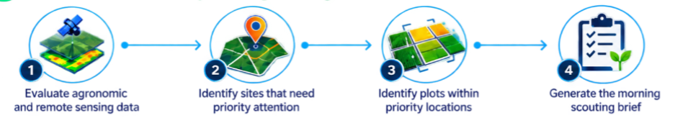
The morning briefing
A suggested site order and a plot list sized to the crew’s capacity
Each plot includes a forecast, recent imagery context
and a reason to inspect.
Notes:
Timing: 0:45–1:10 (25 seconds)
FieldSignal organizes the decision into a morning briefing. It combines the available data, suggests a site order, and identifies plots within each site. The crew sets how many plots it can visit. The output includes the forecast, recent satellite context and a reason to inspect, plus a downloadable list for use in the field.
Sources (not spoken): Presentation (1).pptx, slides 3, 5–6; README.md, Scouting plan description. Original workflow artwork from the supplied deck.

Slide 4
How FieldSignal builds the list
Forecast inputs
Scouting logic
Planting date, hybrid,
nitrogen and irrigation
Satellite bands and vegetation
indices available by the cutoff
Compare forecasts within each site
Flag low forecasts that fall below
the agronomy-only ranking
Order sites by their flagged share
Prototype screening rule. A flag calls for field inspection; it does not diagnose crop stress.
Notes:
Timing: 1:10–1:40 (30 seconds)
The model uses planting date, hybrid and management records, together with satellite observations available by the selected cutoff. In the scouting-plan view, a candidate flag combines a bottom-twenty-percent yield forecast with a drop of at least twenty within-site percentile points compared with the agronomy-only model. Sites rank by the share flagged. This rule is a prototype, and scouts still need to confirm what is happening.
For questions: CatBoost predicts yield. Agronomy inputs are planting day-of-year, nitrogen, irrigation and genotype. Satellite inputs include spectral summaries, NDVI/NDRE, recent changes and observation age. The site-priority and anomaly ordering has not been evaluated.
Sources (not spoken): README.md, Scouting plan and Scientific interpretation; scouting_plan.py.

Slide 5
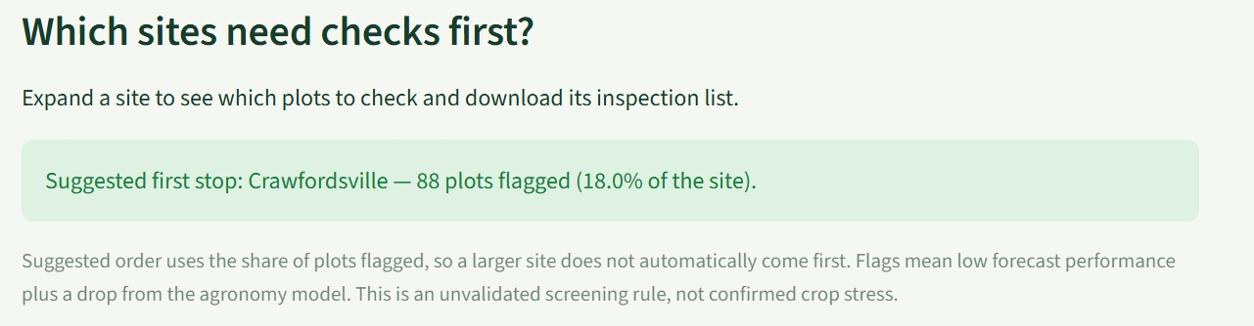
Demo: the suggested first stop
Crawfordsville
88 plots flagged
Historical replay. The suggested order uses the flagged share, not the total number of plots.
Notes:
Timing: 1:40–2:10 (30 seconds)
Here is the briefing in action. In this historical replay, Crawfordsville is the suggested first stop, with 88 plots flagged, or eighteen percent of that site. Using a share prevents a large site from automatically taking first place. The crew can open the site to see the first three plot summaries and download an inspection list that fits its capacity.
This screenshot is an illustrative historical replay, not a live alert. Its site-ordering rule has not been validated.
Sources (not spoken): Presentation (1).pptx, slide 6, original embedded dashboard screenshot image5.jpeg.

Slide 6
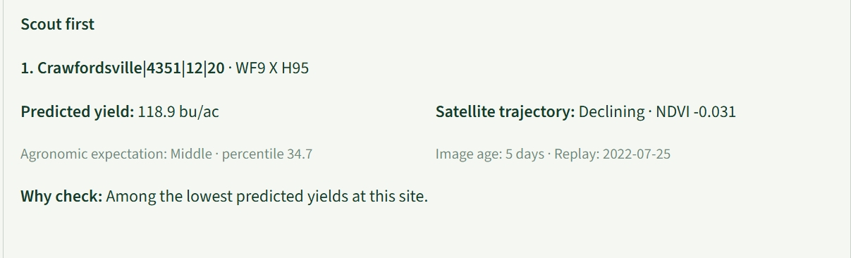
Demo: a plot and a reason to inspect
Crew action: inspect crop condition and record the findings
Forecasts guide inspection. The prototype does not identify a cause or prescribe a treatment.
Notes:
Timing: 2:10–2:45 (35 seconds)
The first summary identifies the exact plot: experiment 4351, range twelve, row twenty, with hybrid WF9 by H95. Its predicted yield is 118.9 bushels per acre, and the recent vegetation index has declined. Those signals tell the crew why this plot deserves attention. The image is five days old, so timing is visible too. A scout can now inspect crop condition and record findings. The forecast alone cannot tell us the cause or the right treatment.
Shown replay date: July 25, 2022. NDVI change is −0.031. The dashboard identifies this as one of the lowest predicted yields at the site.
Sources (not spoken): Presentation (1).pptx, slide 6, original embedded dashboard screenshot image4.jpeg.

Slide 7
Imagery found 6 more low-yield plots
Retrospective test at day 75: 10 visits per site, 50 visits total
30 / 50
visits found a plot in
the actual bottom 20%
7% of all low-yield plots
Low-yield plots found in the inspection list
Five held-out sites in 2022. This test uses lowest forecast first, a different ordering from the demo.
Notes:
Timing: 2:45–3:30 (45 seconds)
We also tested a simpler inspection rule: visit the ten lowest yield forecasts at each site. Each test location was excluded from model training. At day seventy-five, agronomic records alone found 24 plots that later finished in their site’s bottom twenty percent. Adding satellite observations found thirty, using the same fifty visits. That is six additional low-yield plots and sixty percent precision. It still finds only seven percent of all low-yield plots. This result supports prioritization in these trials. It does not validate the demo’s newer anomaly ordering, prove a stress diagnosis, or establish performance in another season.
Low yield is the actual within-site bottom 20% at harvest. Five leave-one-location-out folds use the same cohort. Combined precision is 30/50 = 60%; recall is 30/428 = 7.0%. Harvest labels enter evaluation only.
Sources (not spoken): deliverables/IoT4Ag/tables/model_comparison.csv, cutoff=75, location=Overall, agronomy and combined. Hits 24 and 30, k=50, target_n=428, n=2131. README.md distinguishes the unvalidated Scouting plan ordering from the evaluated lowest-yield-first list.

Slide 8
A focused start to the scouting day
A site to visit.
A plot list.
Evidence to guide the inspection.
Next: test the briefing with a scouting crew
and validate forecasts on another season.
FieldSignal Morning Briefing
Notes:
Timing: 3:30–4:00 (30 seconds)
FieldSignal gives the crew a focused starting point: a site to visit, a plot list and evidence to guide inspection. The prototype also keeps hybrid performance available for longer-term trial decisions. Our next step is to test the briefing with a scouting crew, record what they find, and validate the forecasts on another season. The goal is to make limited scouting time more useful, while keeping field judgment central.
Sources (not spoken): Presentation (1).pptx, slides 7–8; README.md; deliverables/IoT4Ag/FieldSignal_scope_and_demo.md.

