Slide 1

CRYPTO TRANSACTION ANALYSIS FOR DIGITAL FORENSICS
CIAP
Rishi Kadam BTech 09 - 21
Manas More BTech 09 - 29

Slide 2
WHY CRYPTO FORENSICS ?
01
Blockchain Transparency
02
Pseudonymity
03
Complex Transaction Networks
04
Forensic Challenge
Cryptocurrency transactions are recorded on a public, verifiable ledger.
Blockchain addresses are visible, but they do not directly reveal the real-world identity of their controller
Funds can move through multiple addresses and transactions, making manual tracing difficult
Investigators must analyze transaction relationships, trace fund flows, identify suspicious activity, and correlate blockchain evidence with external evidence.

Slide 3
CRYPTOCURRENCY FORENSIC INVESTIGATION
Collect
Trace
Correlate
Transactions
Addresses
Timestamps
Graphs
Wallets
Fund flows
External Evidence
Attribution
Analyze
Detect
Inputs
Outputs
Relationships
Anomalies
Fraud
Obfuscations

Slide 4
EXISTING APPROACHES
Visualization
Graph Analysis
ML Anomaly Detection
Obfuscation Analysis
Forensic Evidence
Human-centered investigation explores complex wallet relationships and transaction activity
Relationship modelling
represents connections between addresses, wallets and transactions.
Automated detection identifies suspicious or unusual transaction patterns.
Tracing under adversarial conditions addresses mixing and other techniques that complicate fund tracing.
Evidence correlation
combines blockchain observations with relevant external evidence.
Existing approaches address different parts of cryptocurrency investigation, but their capabilities remain fragmented rather than forming a complete forensic workflow.

Slide 5
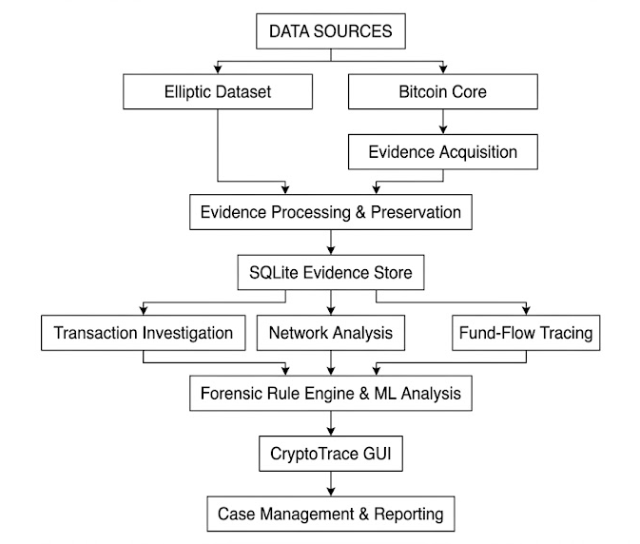
CryptoTrace Architecture

Slide 6
FINAL FEATURES & PROBLEMS ADDRESSED
IMPLEMENTED FEATURE | LIMITATION OVERCOME
Bitcoin Core Integration | Provides direct access to locally available Bitcoin blockchain evidence
Network Analysis | Makes complex transaction relationships easier to explore than manual inspection
Suspicious Activity Detection | Helps prioritize unusual transaction patterns for further investigation
Backward Fund-Flow Tracing | Allows investigators to follow transaction relationships and identify preceding transactions

Slide 7
KEY FINDINGS AND LIMITATIONS
KEY FINDINGS | LIMITATIONS
Transaction graphs provide a useful representation of relationships and fund movement. | Scalability - Large transaction networks are difficult to explore manually.
Visual analytics can help investigators understand complex transaction networks. | Pseudonymity - An address does not directly reveal the identity of its controller.
ML and anomaly-detection techniques can assist in identifying suspicious activity. | Obfuscation - Mixing can break or weaken straightforward transaction trails.
On-chain analysis can provide investigative leads, but real-world attribution may require external evidence. | Blockchain data alone may not establish sufficient context or identity for a forensic conclusion.

Slide 8
FUTURE SCOPE
AI & Graph Neural Networks
Real-Time Analysis
Cross-Chain Forensics
Integrated Forensic Analysis
Use advanced graph-based learning to improve detection of suspicious transaction and wallet relationships.
Develop systems capable of monitoring transactions and identifying suspicious activity as it emerges
Investigate relationships and fund movement across multiple blockchain networks.
Combine blockchain transaction analysis with external digital-forensic evidence

Slide 9
CONCLUSION
Combining blockchain analysis with external forensic evidence can strengthen investigative conclusions.
The key direction for cryptocurrency digital forensics is the integration of multiple analytical techniques with conventional forensic evidence to produce reliable investigative conclusions.

