Slide 1

Aidan Litt
Ben Soderberg
Chase Sonnemaker
Joe Tortorello
Notes:
Ben

Slide 2
What is Kickstarter?
Notes:
Ben

Slide 3
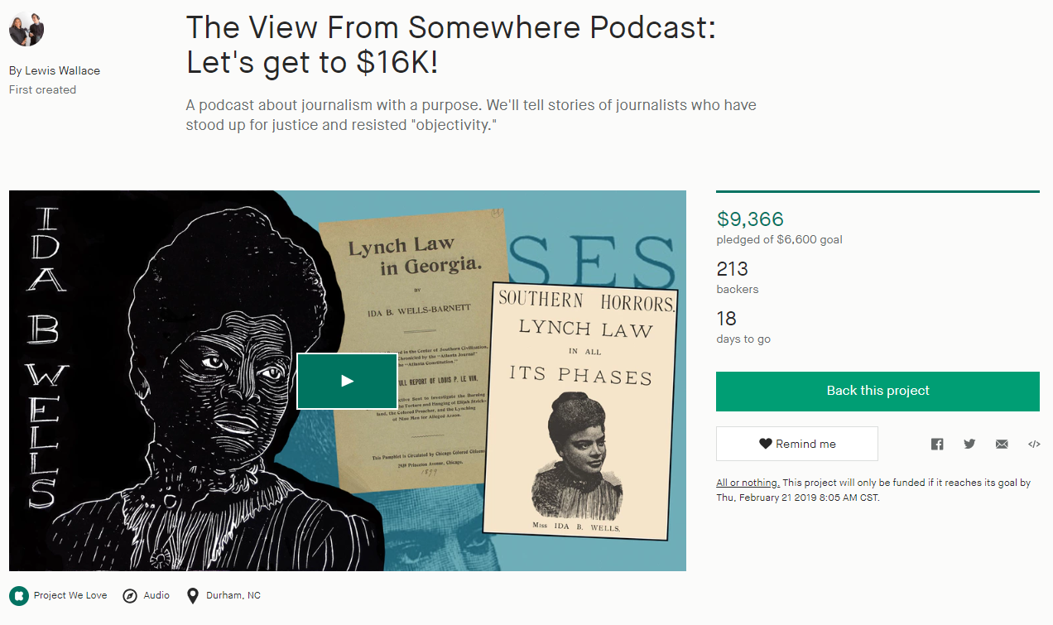
Title
Creator
Blurb
Pledged Amount/ Goal
Number of Backers
Time Remaining
Category
Staff Pick
Location
The Anatomy of a Kickstarter Project
Notes:
Ben

Slide 4
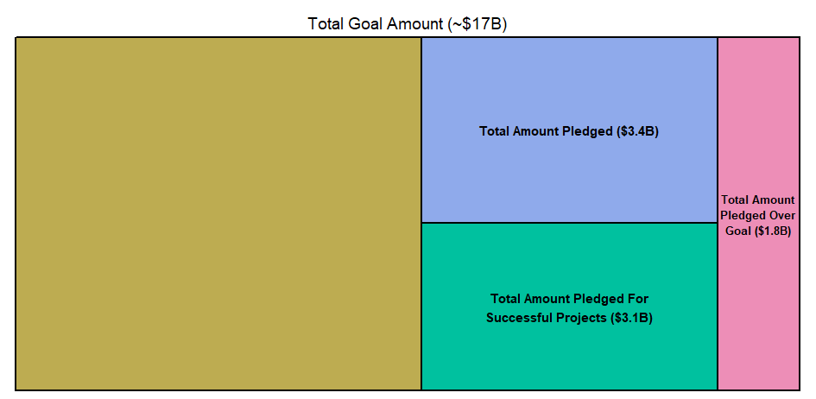
With billions of dollars invested, Kickstarter is a big deal!
Notes:
Ben

Slide 5
How’d we get this data?
Notes:
Ben

Slide 6
Cleaning
Process…
Kaggle: Data Sharing Website
Creation of Variables
Year
Percent Goal
Indicator
Removal of Variables
Issues…
Launch Years
Suspended Projects
Outliers
Notes:
Ben

Slide 7
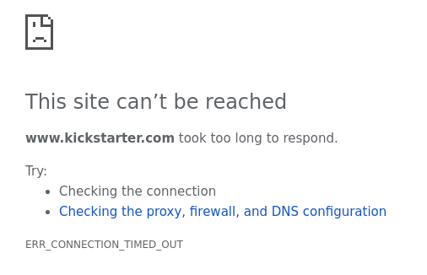
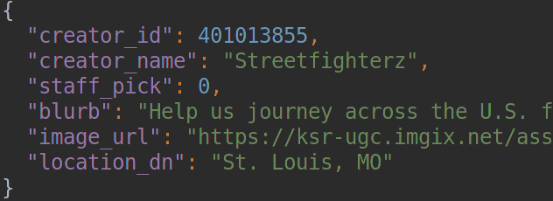
We got additional pieces of data for 172,941, about 45% of the projects in our original data set
Notes:
We used a Python program and the rPython package to scrape several additional data fields from Kickstarter’s advanced search form
After many hours, Kickstarter temporarily banned us
Some of the projects we searched for were not found, likely because the creators had changed the project names
Because of these two things, we ended up with the additional data for 172,941 projects our of our original 378,661

Slide 8
Demographics of
the Data

Slide 9
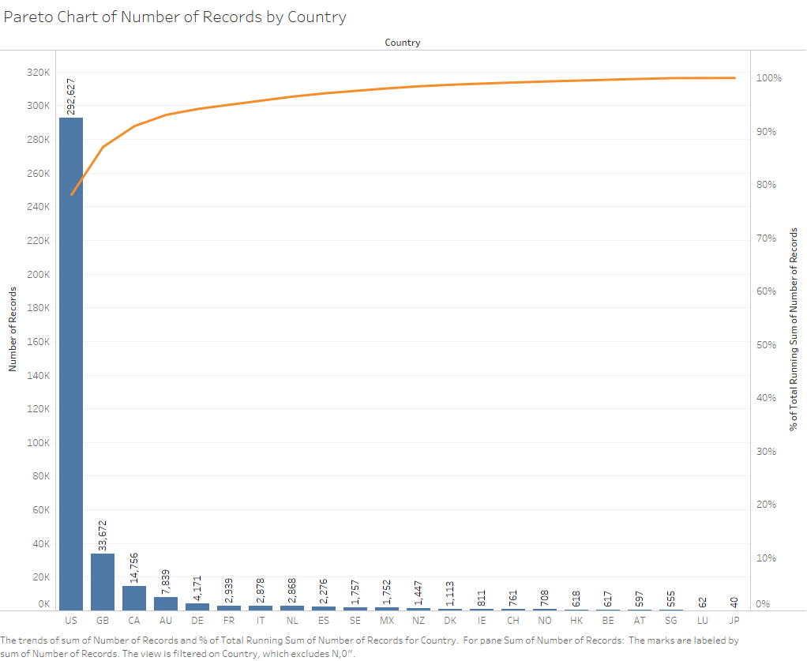
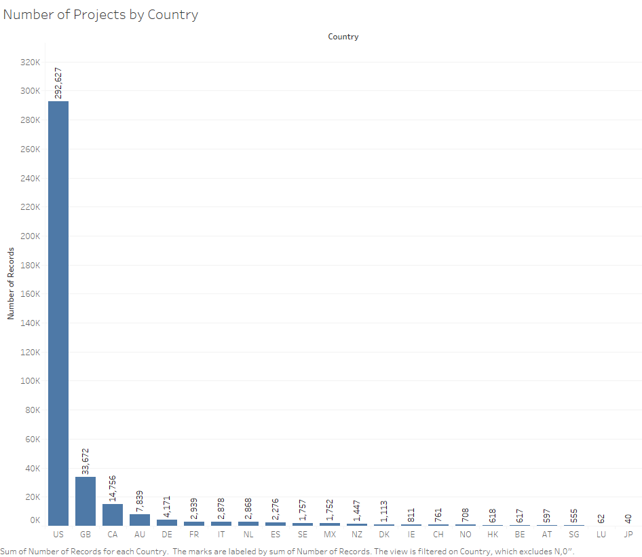
English-speaking, western countries have the largest number of projects.

Slide 10
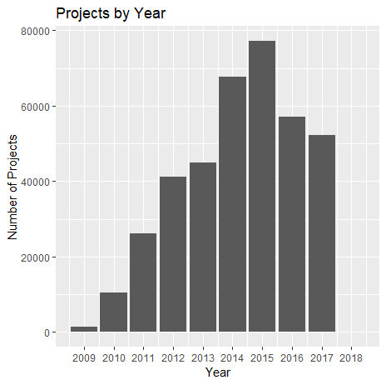
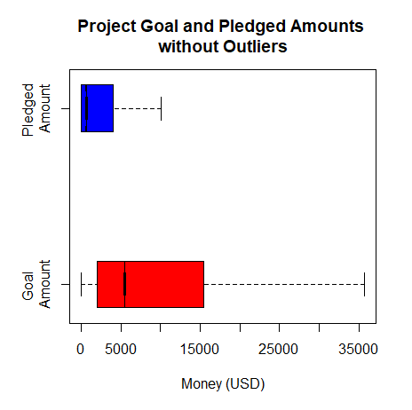
Number of projects rises until 2015, then falls
Most projects ask for $15,000 but get less than $5,500

Slide 11
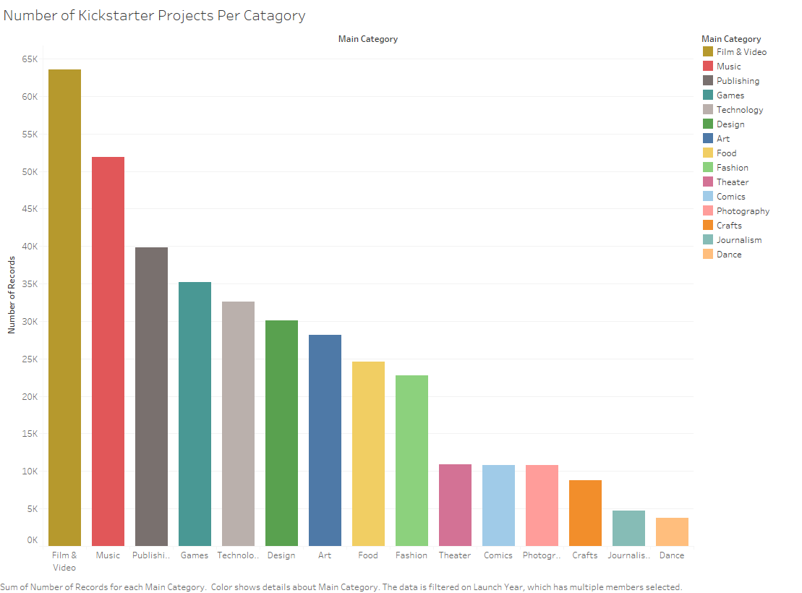
Most popular categories: Film/Video, Music, and Publishing

Slide 12
Alright, Chief. I want to make the best Kickstarter ever. What should I make?

Slide 13
When should I
create my project?

Slide 14
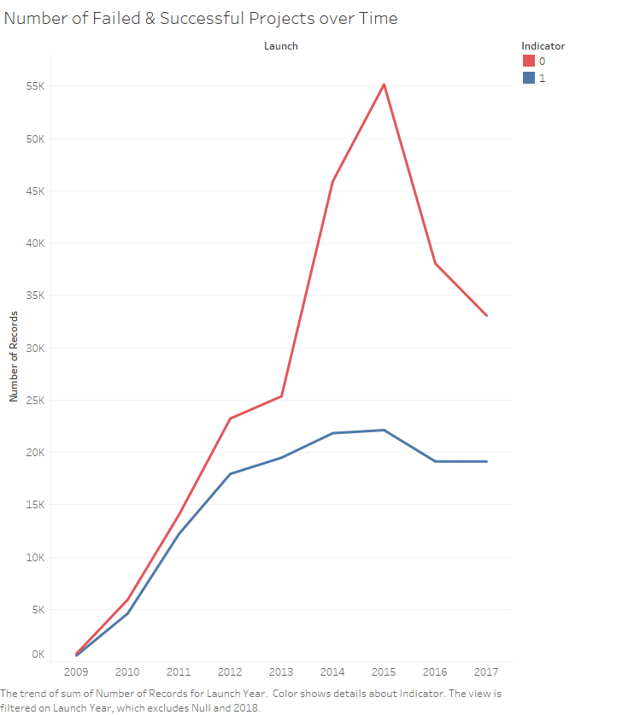
Failed
Succeeded
You should have made your project in 2011. Oops!

Slide 15
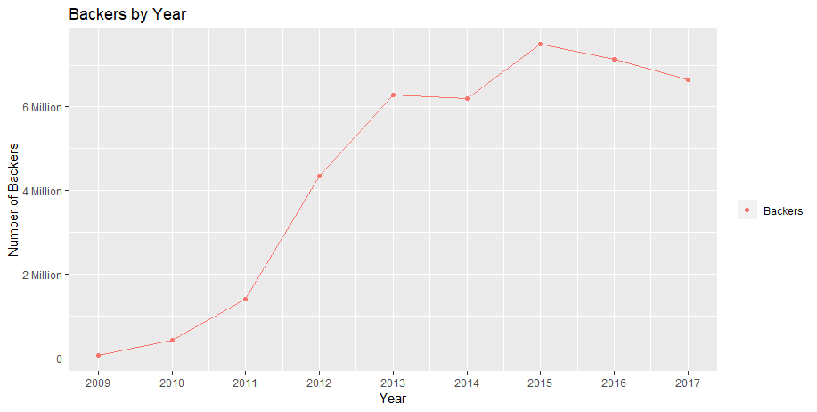
2013: Growth of Backers Levels Out

Slide 16
What Country
should it be based in?

Slide 17
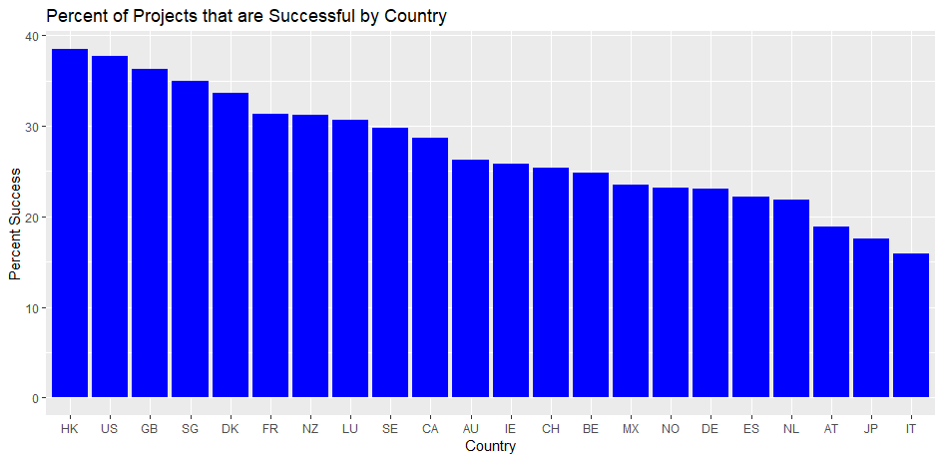
Hong Kong has the highest success rate.

Slide 18
What Category
should it be?

Slide 19
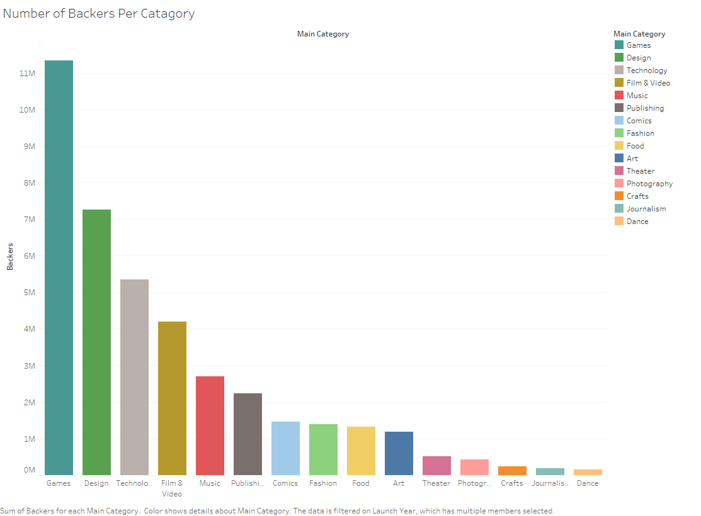
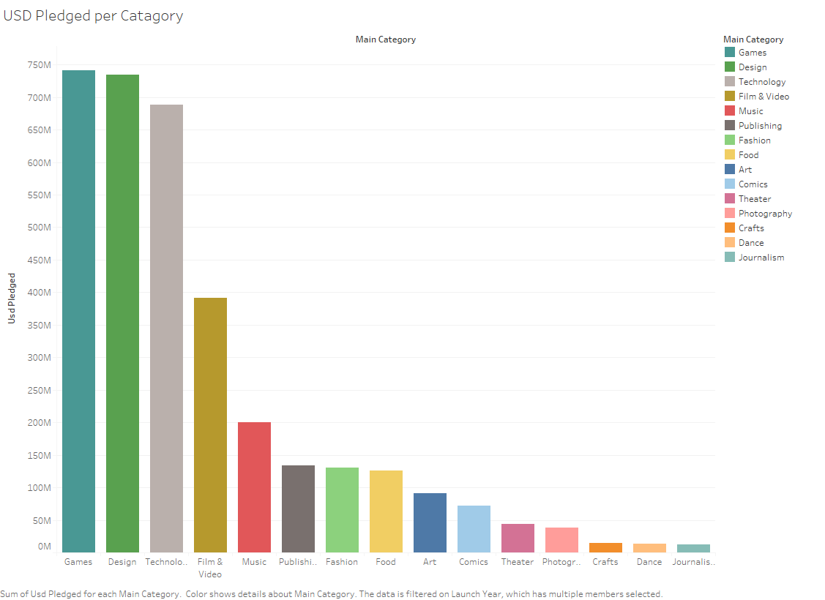
Graphs for Backers and USD Pledged per Category

Slide 20
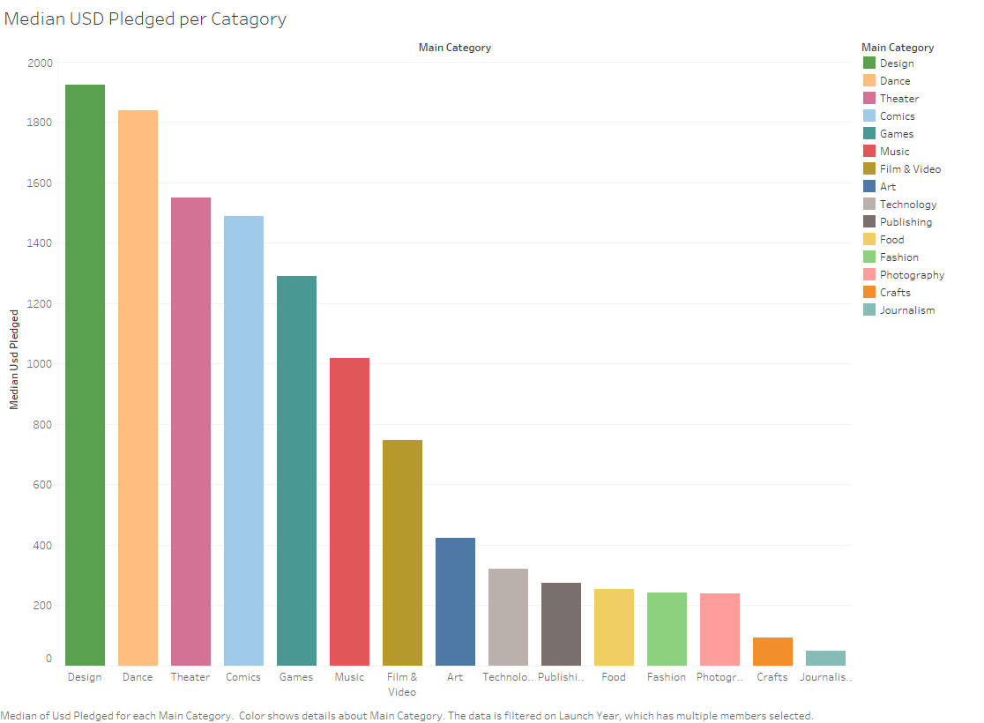
Median USD Pledged per Category

Slide 21
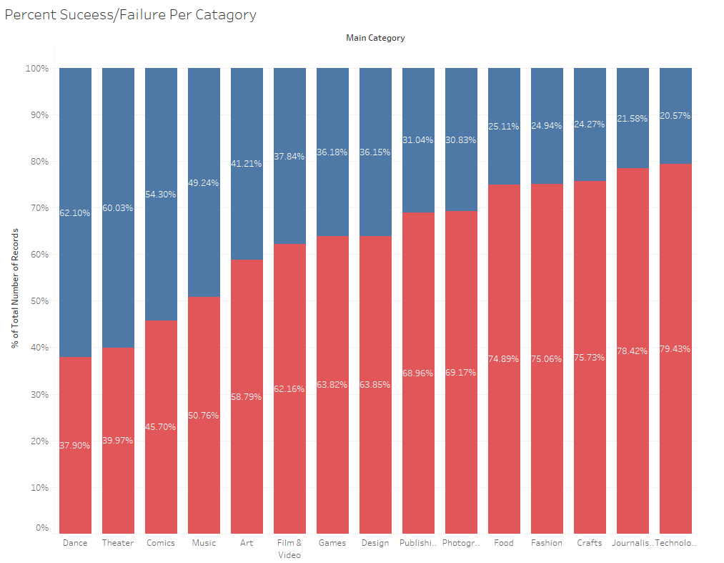

Slide 22
What words should be used in the blurb?

Slide 23
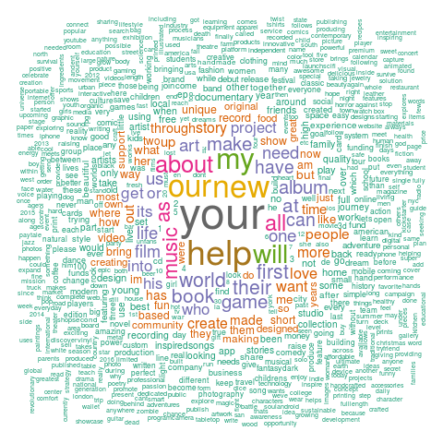
Our blurbs contain 124,108 unique words, after normalizing case and removing punctuation.
We removed these common words:
And
The
To
Are
You
For
In
I
An
A
With
On
We
It
This
From
Of
By
That
Be
Is

Slide 24
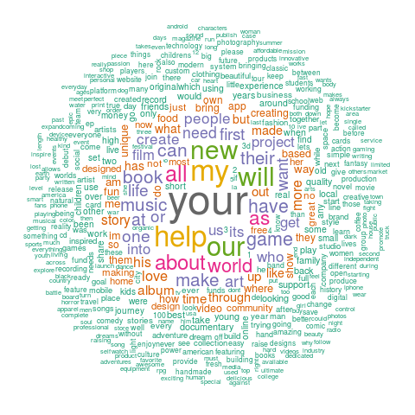
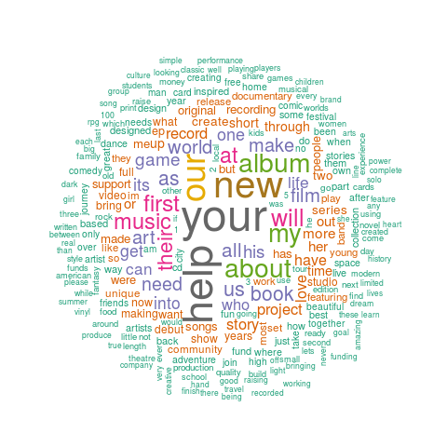

Which words are better?
Failed Projects
Successful Projects
Notes:
Minimum frequency for these graphs was 500, so even though a lot of the words appear in both, fewer made the cut for successful, and the big ones are generally bigger. Also note that “my” is bigger than “our” in the failed projects, but this is reversed in the successful ones.

Slide 25
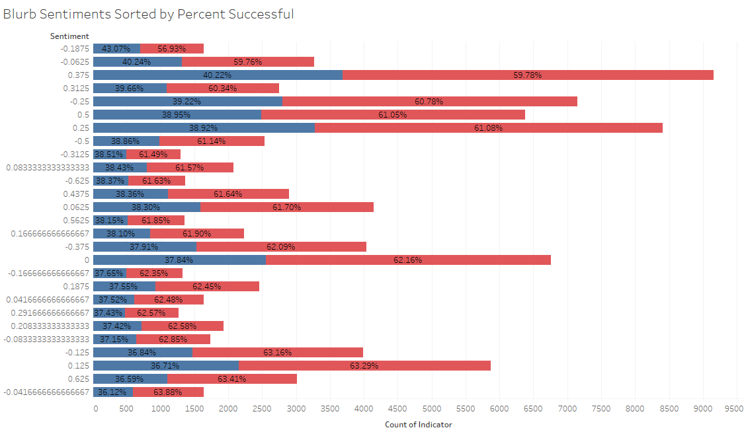
Failed
Succeeded
A sentiment score of -0.1875 has the highest success rate!

Slide 26
Create multiple Projects!

Slide 27
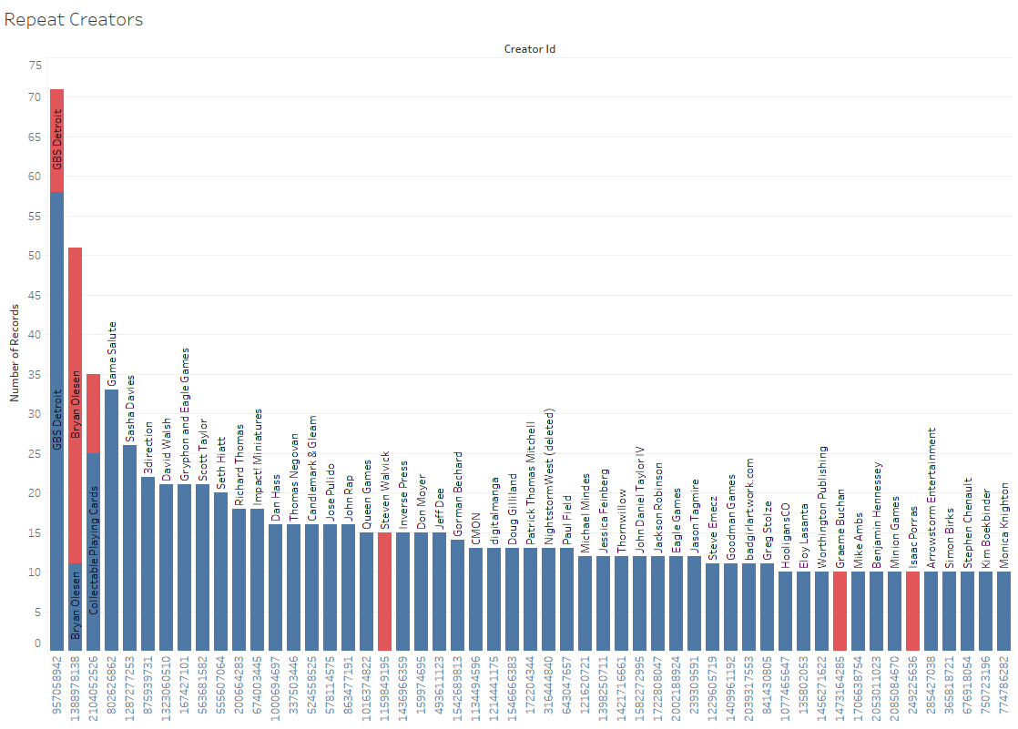
Failed
Succeeded
Most creators who make multiple projects have high success rates among their projects (besides Steven Walvick).
Notes:
Ben

Slide 28
Is it a Staff Pick?

Slide 29
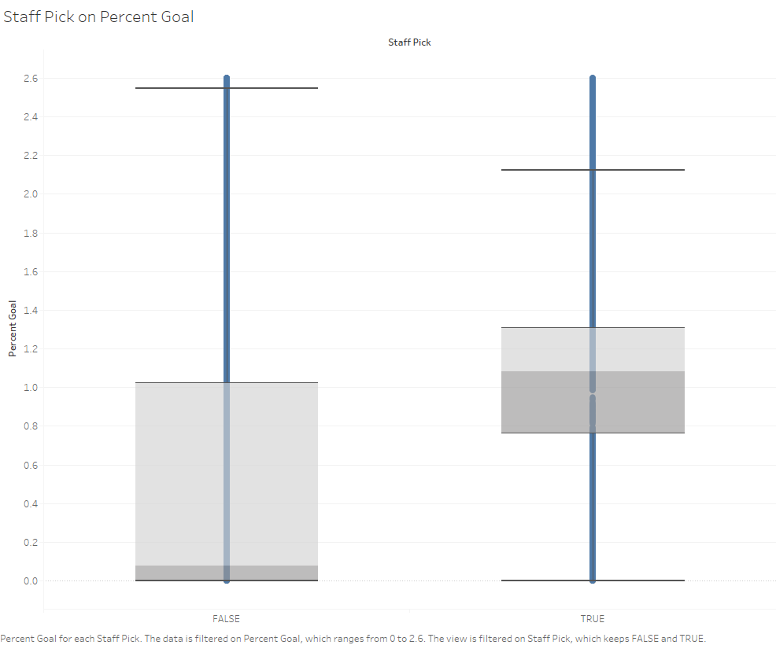
Chicken or the Egg? Do staff picks make success or do the staff chose projects more likely to succeed?

Slide 30
So, what’s the Conclusion?

Slide 31
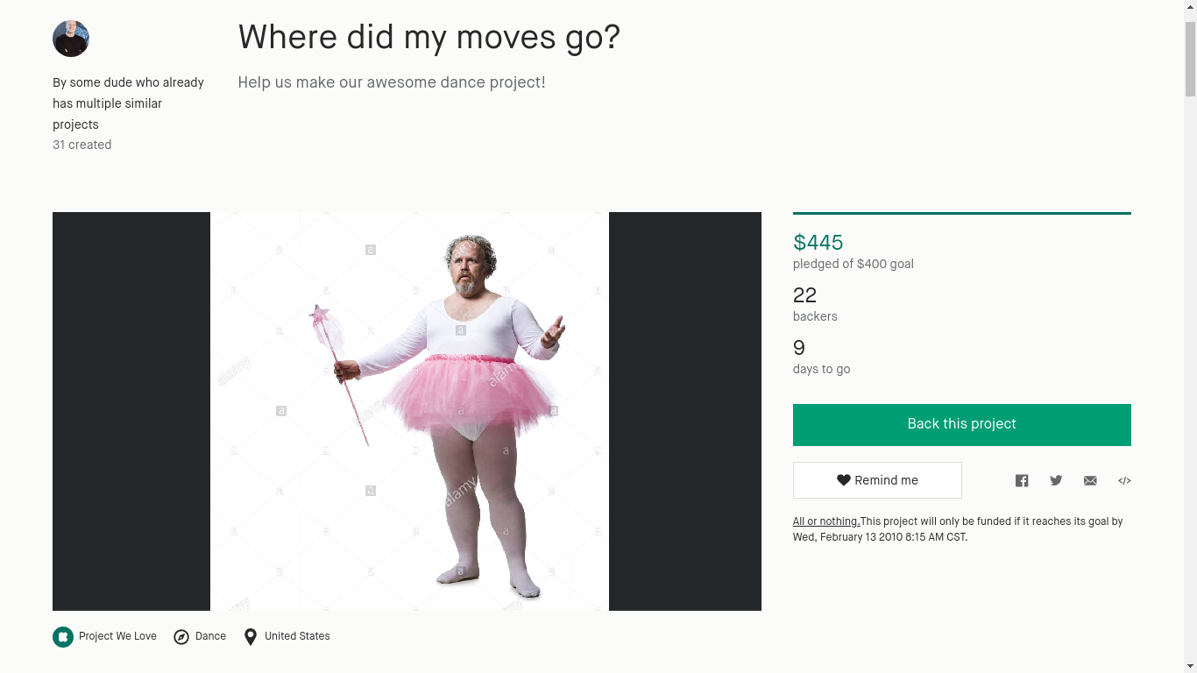
What kind of project should you make?
Year?
2009 - 2011
Country of Origin?
Countries advancing in technology
Ex. US, Hong Kong, Singapore, UK
Category?
Dance, Theater, Comics
Words?
Sentiment Score of -0.1875
Cooperative words like “our” and “help”
Multiple Projects?
Yes! Make multiple, similar projects.
Staff Pick?
Yes!

Slide 32
What would we do if we had more time?

Slide 33
We got most of what we wanted to do done. Just a few more small things to add:
Scrape data for remaining records
Investigate backer statistics
Gather all of the data for 2018
Investigate the Hong Kong Phenomenon (HKP) further
Create a better model
Test our model by creating a Kickstarter project of our own.

Slide 34
Have an Idea?

Slide 35
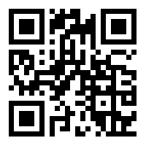
Try your project idea on your laptop or mobile device
Scan
Questions?
}
aidan
ben
chase
joe
or type
@kickstats.org
www.kickstats.org/try
Try it out for yourselves!

