Slide 1

FIRST REVIEW · PHASE I
Adaptive Study Planning for
Self-Directed Learners
A verified, closed-loop adaptive study planner
Rohit Saji · PES2PGE24DS201
M.Tech in Data Science and Artificial Intelligence · PES University
Guide: Prof. Ramesh Prakash Guledgudd 7 June 2026
Notes:
Good morning, Professor — and welcome to any additional panel members. I am Rohit Saji, PES2PGE24DS201. This is my Phase I First Review for Adaptive Study Planning for Self-Directed Learners.
→ Walk the slide, then move quickly — this is a title slide.

Slide 2
SLIDE 2
The Vision
What we are building, and the problem it kills
THE PROBLEM
THE VISION
Self-directed learners build fixed study plans that diverge from reality within days — they fall behind or surge ahead, and the plan never adapts.
Worse, self-reported study time has no ground truth: logged hours may produce no real learning.
A verified closed-loop planner that learns each learner's true pace from assessment-verified sessions, detects behavioural shifts, projects completion with calibrated uncertainty, and regenerates the schedule — beating a static planner on adherence and genuine learning gains.
learn pace → detect shift → project completion → regenerate schedule ↺ verified by assessment
Adaptive Study Planning · Rohit Saji · First Review (Phase I)
2 / 12
Notes:
Hook: Self-directed learners build plans that break within days, and self-reported time has no ground truth.
→ Key point: 'verified closed-loop' means the system checks whether learning happened, then adapts the schedule.

Slide 3
SLIDE 3
Since the Guidance Call
From one adaptive engine to two interlocking pillars
Your directive — “how do you stop users passing false session data?” — reshaped the project into two co-equal research pillars.
PILLAR A — Adaptation
PILLAR B — Verification
Phase I · research resolved
Phase II · researching now
Pace calibration — hierarchical Bayesian
Shift detection — CUSUM change-point
Projection — Gaussian process (uncertainty)
Scheduling — constraint-based generation
Item generation — LLM, material-grounded
Grading — code test-cases + theory rubric
Knowledge tracing — cold-start mastery
Placement — spaced-practice cadence
Evaluation (3 legs): synthetic ground truth + public KT benchmark + closed-loop vs open-loop. Pillar B supplies the measured learning-gain leg.
Adaptive Study Planning · Rohit Saji · First Review (Phase I)
3 / 12
Notes:
CRITICAL SLIDE. Open with: 'Professor, your question — how do you stop users passing false session data — reshaped this entire project.'
→ Pillar A = adaptation engine. Pillar B = verification signal. Neither works without the other.

Slide 4
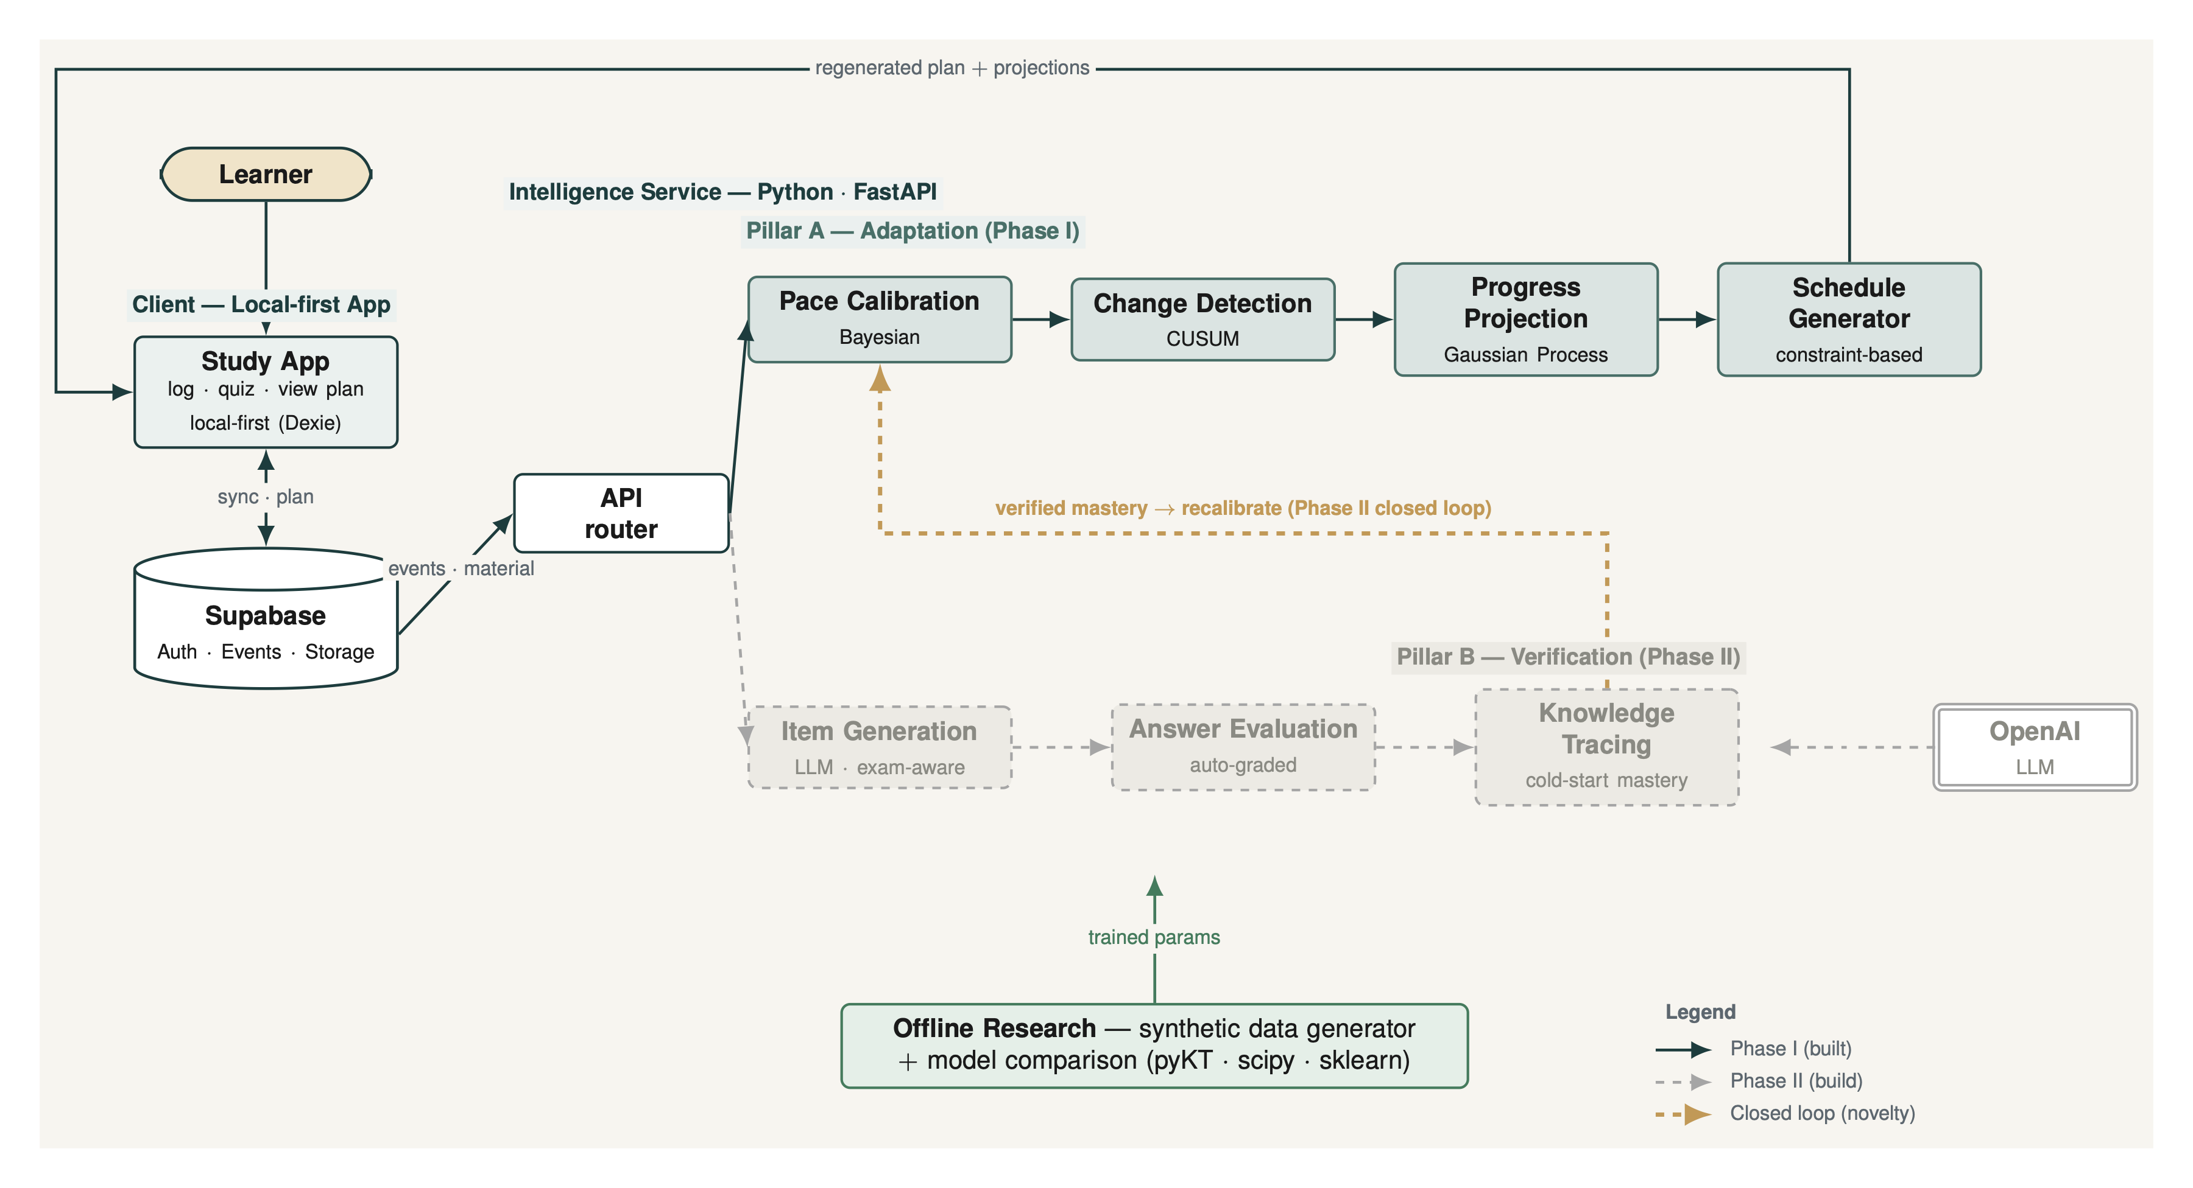
SLIDE 4
Two-Pillar System Architecture
Phase I builds the open-loop platform; Phase II adds the verified closed loop
solid = Phase I (built) dashed = Phase II (build) gold = closed loop (the novelty)
Adaptive Study Planning · Rohit Saji · First Review (Phase I)
4 / 12
Notes:
Describe the diagram verbally: solid = Phase I (built/researching), dashed = Phase II (novelty), gold arrows = the closed feedback loop.
→ Three tiers: client app (bottom) → Python intelligence service (middle) → offline research (top). Supabase is the data hub.

Slide 5
SLIDE 5
Pillar A — Algorithms
Predict-then-optimize, made adaptive · base paper: Islam (2024)
1
›
2
›
3
›
4
Pace Calibration
Change Detection
Progress Projection
Schedule Generator
Hierarchical Bayesian
CUSUM / control charts
Gaussian Process
Constraint-based + role-phasing
Learn the learner's true pace from sparse sessions
Catch behavioural shifts as they happen
Completion date with a calibrated uncertainty band
Regenerate a concrete, feasible plan
Phase I computes calibration open-loop (computed, not yet fed back). Phase II closes the loop.
Adaptive Study Planning · Rohit Saji · First Review (Phase I)
5 / 12
Notes:
Walk the pipeline left to right: (1) Bayesian calibration learns true pace, (2) CUSUM catches habit shifts, (3) GP gives a completion band not just a date, (4) constraint-based scheduler regenerates the plan.
→ Phase I computes calibration open-loop; Phase II closes it.

Slide 6
SLIDE 6
Pillar B — Algorithms
Exam-realistic, material-grounded verification · base paper: CLST (2024)
ingest material → LLM item generation (concept-tagged) → auto-grading → cold-start knowledge tracing
DESIGN — decided
PARAMETERS — under user research
User-selected style: Tier 1 presets (Generic / Exam-realistic) + Tier 2 build-your-own pattern
One pattern schema: sections · item types · marks · timing · negative marking
Two modalities: auto-graded coding (POJ) + theory MCQ / short-answer (Eedi)
Concept-level cold-start KT; LLM cost controls (cache · batch)
Exam-pattern template library — which target exams (GATE, GRE, course papers, certs)
Timing & item counts per section
Difficulty mix
Pass / mastery thresholds
Assessment specifics are finalized through primary user research — a Phase-I requirements activity. A timed, exam-patterned test is harder to game = a more valid learning signal. Build is Phase II.
Adaptive Study Planning · Rohit Saji · First Review (Phase I)
6 / 12
Notes:
Design is decided; build is Phase II. Flow: ingest material → LLM generates questions → auto-grade → knowledge tracing → mastery estimate.
→ Key point: a timed, material-grounded test is hard to game — that is the valid verification signal.

Slide 7
SLIDE 7
Literature Survey
48 papers surveyed (2024–2026) · 12 anchors across both pillars · ★ = base paper
Pillar A — Adaptation
Pillar B — Verification
Pace / Bayesian | Chen 2024 | Hierarchical Bayesian (N=312)
Shift detection | Saqr 2026 | CSD; 88% warn early
Projection | Pérez-Suay 2024 | GP-ARD, R=0.89
Scheduling ★ | Islam 2024 | Predict-then-optimize
Adaptive vs static | Pagano 2026 | 2,064 students; adaptive wins
SRL analytics | Alhazbi 2024 | Time-management indicators
KT / cold-start ★ | CLST 2024 | LLM-as-tracer
Item generation | Lecture→Quiz 2026 | Local-LLM material→MCQ
Concept tagging | KC-Tag 2024 | GPT-4 KC, expert-checked
Auto-grading | Jukiewicz 2026 | 6,000 code submissions
Integrity | Integrity 2024 | Misconduct detection
Retention timing | Spaced 2025 | Spaced repetition
THE GAP Each technique exists in isolation. None combines calibration + shift-detection + uncertainty-aware projection + adaptive scheduling into a closed loop — and none verifies the learning signal that drives planning.
Adaptive Study Planning · Rohit Saji · First Review (Phase I)
7 / 12
Notes:
48 papers, 12 anchors, 2 base papers (Islam 2024 for Pillar A; CLST 2024 for Pillar B).
→ THE GAP: nobody combines calibration + shift detection + uncertainty projection + adaptive scheduling into a verified closed loop. Each piece exists; the combination does not.

Slide 8
SLIDE 8
Datasets & Evaluation
Controlled ground truth + public benchmark + head-to-head
Synthetic generator
Public KT (pyKT)
Literature-grounded learner archetypes with known nonlinear ground truth — the generator is itself a contribution
Eedi (MCQ) + POJ (coding) — benchmark vs DKT / BKT baselines
Honest-vs-faker overlay
N = 1 real
Synthetic gaming data to test the verification signal
Own logged sessions — validation (not proof); logging starts now
Evaluation — three legs: (1) synthetic ground truth (2) public KT benchmark (KT-AUC ≈ 0.70–0.82) (3) closed-loop + verified vs open-loop + unverified
Adaptive Study Planning · Rohit Saji · First Review (Phase I)
8 / 12
Notes:
Four data sources: synthetic generator (known ground truth), pyKT public benchmarks (Eedi + POJ), honest-vs-faker overlay, N=1 real sessions.
→ Three-leg evaluation: synthetic ground truth + public benchmarks + closed-loop vs open-loop.

Slide 9
SLIDE 9
Expected Outcomes
Per-component metric · baseline it is compared against · expected result (only KT-AUC commits to a number)
Component | Metric | Compared against | Expected result
Pace calibration | MAE / RMSE of pace | Bayesian vs moving average | Lower error, esp. with sparse data
Change detection | Latency, false-alarm rate | CUSUM vs EWMA vs CSD | Clear winner per profile
Progress projection | 95% CI coverage, point error | GP vs linear extrapolation | Calibrated intervals; linear not
Schedule generation | Deadline drift, adherence | Constraint vs rule vs DP | Competitive, prerequisite-aware
Mastery (KT) | AUC on public KT | vs DKT, BKT | ≈ 0.70 – 0.82 (literature range)
Cold-start mastery | AUC at few interactions | cold-start vs standard KT | Higher AUC in low-data regime
Verification | Precision / recall of fake flags | honest-vs-faker synthetic | High precision; no over-flagging
Item generation | Validity / answerability | human-checked sample | Majority valid; failures characterised
Learning signal | Pre / post mastery delta | — | Detectable gain after genuine study
Adaptive Study Planning · Rohit Saji · First Review (Phase I)
9 / 12
Notes:
Directional hypotheses only — the only committed number is KT-AUC 0.70–0.82 (published benchmark range).
→ Walk key rows: Bayesian < SMA error (sparse data); GP calibrated band vs overconfident linear; KT-AUC in benchmark range; high precision on fake-session detection.

Slide 10
SLIDE 10
Phase I Roadmap
Three reviews — Review 1 is today
May 31
Jun 7
Jun 14
Jun 21
Jun 28
Jul 5
Guidance 1
REVIEW 1
Guidance 2
REVIEW 2
Guidance 3
REVIEW 3
TODAY
REVIEW 1 · 30%
REVIEW 2 · 80%
REVIEW 3 · 100%
Abstract + two-pillar architecture
Algorithms — both pillars
Expected outcomes (per-component)
48 references (12 anchors)
Data-capture foundation built
Synthetic data generator built
Algorithm comparison — 4 components
Static scheduler + dashboards
Intermediate comparison results
Full model comparison vs baselines
Performance evaluation (synthetic + KT)
Working demo — open-loop planner
Draft journal paper
Phase I also delivers the offline research: synthetic data generator + algorithm comparison for Pillar A (next slide: what is already built).
Adaptive Study Planning · Rohit Saji · First Review (Phase I)
10 / 12
Notes:
Today = R1 (30%). June 21 = R2 (80%): generator built + comparison running + scheduler live. July 5 = R3 (100%): full results + demo + journal draft.
→ Phase II begins after July — that is where the loop closes.

Slide 11
SLIDE 11
Review 1 — The 30%
Measured against the full two-pillar + research scope: the 30% is the data-capture foundation, with the research designed
BUILT — Data-capture foundation
DESIGNED — Offline research
the Review-1 code
also Phase-I scope · build in R2
Session logging + lifecycle (timer · pause / resume)
Per-user event store (Dexie, isolated) + event data model
Auth (Supabase) + cloud sync (queue · snapshots · restore)
4-stage algorithm-comparison methodology defined
Synthetic-data generator designed — 6 archetypes, known ground truth
Pillar B assessment approach surveyed + designed
Remaining on the Phase-I rubric → R2 · 80%: static scheduler · progress dashboards · data generator built + algorithm comparison + intermediate results. R3 · 100%: full model comparison + demo. (Tagged r1/30pct.)
Adaptive Study Planning · Rohit Saji · First Review (Phase I)
11 / 12
Notes:
The 30% = data-capture foundation: session logging, per-user event store, auth + cloud sync.
→ BUILT = the code. DESIGNED = 4-stage methodology + synthetic generator design + Pillar B architecture. The remaining 70% is Reviews 2 and 3.

Slide 12
SLIDE 12
Phase II Plan — What We Will Deliver
Three reviews that close the loop and build the verification pillar (the novelty)
R1 · 40%
R2 · 80%
R3 · 100%
foundations + first loop
full loop + verification build
evaluation + publication
Python Intelligence Service (FastAPI); migrate Pillar-A engines TS → Python
Close loop v1: calibration → reschedule
Pillar B: lock assessment design from user research; item-generation prototype
Novelty proposal + Phase-II expected outcomes
Full loop: CUSUM → replan triggers; GP uses calibrated pace
Pillar B: auto-grading (code + theory) + cold-start KT → mastery
Assessment styles: Tier-1 presets + Tier-2 pattern builder
Intermediate results: closed-vs-open; KT-AUC on Eedi / POJ
End-to-end verified closed loop (real + synthetic data)
Full eval: closed + verified vs open + unverified — adherence + learning gain
Model comparison vs base papers (Islam, CLST) + baselines
Working demo + journal paper (publication proof)
Phase-II thesis: turn the open-loop platform into a verified closed loop — Pillar B verifies the learning signal that drives Pillar A's replanning.
Adaptive Study Planning · Rohit Saji · First Review (Phase I)
12 / 12
Notes:
Phase II closes the loop and builds Pillar B — the real novelty.
→ End with: 'Phase I gives us the validated open-loop baseline. Phase II is where we answer the thesis question: does verified, closed-loop adaptation beat open-loop self-reporting?'

