Slide 1

RESEARCH TIER · STATUS UPDATE
Where the Offline /research
Tier Stands Today
Pillar A done & genuine · Pillar B data now secured · two parts remain
7 / 8
2 / 2
2
phases complete
datasets secured
parts remain
Rohit Saji · M.Tech DS & AI · PES University Guide: Prof. Ramesh Prakash Guledgudd

Slide 2
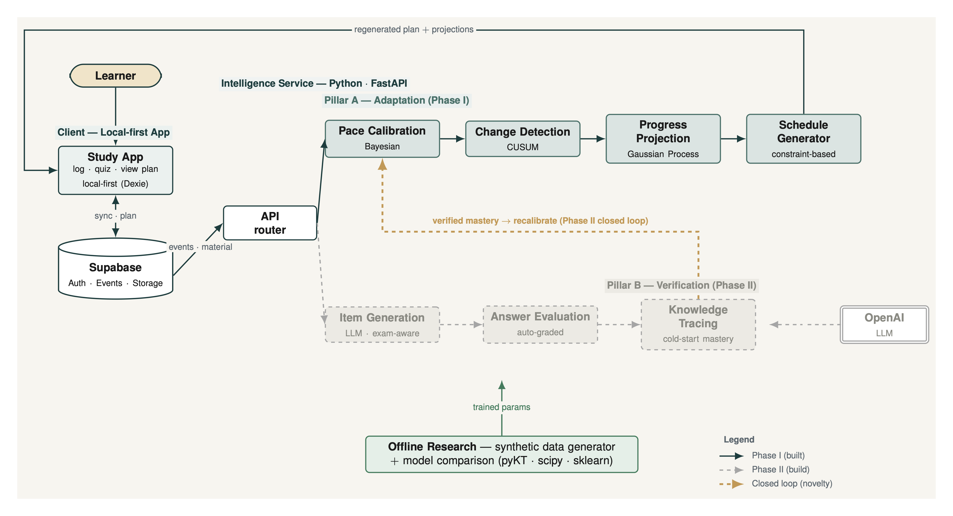
SLIDE 2
The System We Are Building
Two horizontal pillars behind one Intelligence Service; the gold loop is the Phase-II novelty
solid = Pillar A, built dashed = Pillar B, Phase II gold = closed loop (held for Phase II) green = offline research tier (this status)
Adaptive Study Planning · Rohit Saji · Research-tier status — 2nd Guidance Call (14 Jun 2026)
2 / 6

Slide 3
SLIDE 3
Built vs Pending — Mapped to the Architecture
Every block on the diagram, with its current research-tier status
BUILT
PLACEHOLDER
PENDING
PHASE II
re-run pending
Architecture block | Status | Where it stands
Pillar A — calibration · detection · projection · scheduling | BUILT | Genuine 720-learner Monte-Carlo comparison; figures + tables auto-generated
Offline research — synthetic generator + comparison | BUILT | 6 archetypes × 3 bands, frozen pre-registered params, seed-deterministic
Pillar B — knowledge-tracing bench (pipeline) | PLACEHOLDER | Real Eedi + ACcoding data now in hand — re-run swaps smoke fixtures for real numbers
Pillar B — item generation · answer evaluation | PHASE II | Designed; build deferred to Phase II (LLM, exam-aware)
Closed loop — verified mastery → recalibrate | PHASE II | Built & archived; deliberately held as the Phase-II headline novelty
N=1 validation · report/journal wiring | PENDING | Not started — Phase 5 (own sessions) + Phase 6 (\input figures)
Adaptive Study Planning · Rohit Saji · Research-tier status — 2nd Guidance Call (14 Jun 2026)
3 / 6

Slide 4
SLIDE 4
Pillar A — Results
Synthetic learners with known ground truth → a genuine, paired multi-candidate comparison
DATASET synthetic generator, known ground truth — 6 archetypes × 3 length-bands × 40 seeds = 720 learners · pre-registered frozen params (hash e716cd12dddc) · seed-deterministic · oracle upper-bounds confirm each task is solvable.
Track | Candidates (★ shipped) | Test / metric | Result → conclusion
Pace calibration | Bayesian ★ vs SMA · EWMA · pooled | recovery error vs truth · paired t (Δ, p, effect) | Bayesian wins — err 0.033 vs EWMA 0.109, p<1e-16, d=2.2
Change detection | CUSUM ★ vs EWMA-chart · CSD | latency ↔ false-alarm, split step/drift · ROC | Trade-off — CSD fastest (lat ≈4–5); CUSUM fewest false alarms (≈0.016)
Progress projection | GP ★ vs linear · Kalman | finish-date error · 95% CI coverage | GP lowest error (16.6 vs 29 d) — but all CIs under-cover (≈0.2–0.68)
Schedule generation | greedy ★ vs DP · rule-based | deadline drift · capacity · prereq order | DP scales best — greedy drifts ≈30 d on complex mixes; capacity ok
TEST FURTHER → real data (N=1 own sessions + public KT benchmark) · widen the sweep + more seeds (243-cell grid, ranking stable ~96%) · fix projection interval calibration (coverage well below 0.95) · blind held-out + more archetypes.
Adaptive Study Planning · Rohit Saji · Research-tier status — 2nd Guidance Call (14 Jun 2026)
4 / 6

Slide 5
SLIDE 5
Pillar B — Data Secured, Numbers Next
The bench pipeline was already done — only its public data was missing. Both datasets are now in hand.
EEDI / NeurIPS-2020 · MCQ
ACcoding · coding (POJ substitute)
Real train_task_3_4.csv — 1.38M MCQ rows
Exact pyKT NIPS34 format (user · question · correct)
Subject tags → concept-level cold-start KT
4.05M submissions · 27,444 students · 4,559 tasks
100 knowledge-point tags (richer than POJ)
Maps to poj_log.csv: creator→User · problem→Problem · AC→correct
One caveat: ACcoding has no submit-time column → use the auto-increment id as chronological order (provenance-noted). Drop WT/JG (non-terminal); AC = correct, every other verdict = incorrect.
ASK → confirm Eedi (MCQ) + ACcoding (coding, replacing the dead POJ). Next: wire both in and re-run make kt → real cold-start AUC + ECE replace today's placeholders.
Adaptive Study Planning · Rohit Saji · Research-tier status — 2nd Guidance Call (14 Jun 2026)
5 / 6

Slide 6
SLIDE 6
What's Pending — Path to R3
Data's now in hand: one immediate re-run, then two parts remain
PHASE 5
PHASE 6
N = 1 real-data validation
Report & journal wiring
Export your own logged study sessions
Overlay real-vs-synthetic for generator face-validity
Run sessions through the harness as a feasibility case — no performance claims
\input the generated figures/tables into main.tex
Add provenance footnotes + IMRAD journal skeleton
Reproducibility gate: clean clone → make all → 0 undefined refs
Action: start logging now — want ~15–25 sessions by R3
Artifacts already exist in report/generated/
Now unblocked → wire in Eedi (MCQ) + ACcoding (coding) and re-run make kt: today's placeholder KT numbers become real cold-start AUC + ECE before R3.
Adaptive Study Planning · Rohit Saji · Research-tier status — 2nd Guidance Call (14 Jun 2026)
6 / 6

