Slide 1
PES UNIVERSITY, BENGALURU
Adaptive Study Planning
for Self-Directed Learners
Context-aware pace calibration, change detection, and a local-first adaptive planner
PRESENTED BY
Rohit Saji
PES2PGE24DS201 · M.Tech, Data Science & AI
UNDER THE GUIDANCE OF
Prof. Ramesh Prakash Guledgudd
Project Phase-1 · 3rd Review · 04 July 2026

Slide 2
OVERVIEW
What this review covers
01
The problem & Phase-1 objectives
Why static study plans fail self-directed learners
02
System architecture
Local-first client + Python intelligence service
03
The Phase-1 application
Onboarding, roadmap, sessions, progress & replan — walked through live
04
Evaluation results
Honest offline comparison on synthetic ground truth
05
Phase-2 future work
Closing the loop with verified learning
Adaptive Study Planning for Self-Directed Learners · Phase-1 · 3rd Review
2

Slide 3
PROBLEM STATEMENT
A one-time plan stops matching reality
A self-directed learner starts with a fixed plan — “two hours a day, finish by this date.”
Within days the plan no longer holds: pace varies, material takes longer than guessed, and the fixed schedule never adjusts. The finish date silently becomes wrong while still being displayed as valid.
Existing tools cover only one side.
Time-trackers record effort but never plan; static generators schedule once and never revise against realised pace.
Two constraints shape every method choice:
sparse per-learner data and non-stationary behaviour.
THE GAP
No planner treats a learner's own logged behaviour as evidence, updates its pace estimate, and regenerates the plan.
SPARSE DATA
A learner logs only a handful of sessions before the plan first needs to adapt.
NON-STATIONARY
Pace shifts with circumstances — a real change must be told apart from daily noise.
Adaptive Study Planning for Self-Directed Learners · Phase-1 · 3rd Review
3

Slide 4
PHASE-1 OBJECTIVES
Build & evaluate the open-loop adaptive planner
1
2
3
Calibrate pace
Hierarchical Bayesian + context-aware shrinkage — usable from few sessions.
Detect shifts
Statistical change-point detection so the plan reacts to real change, not noise.
Project completion
Gaussian-process regression giving a calibrated band, not a single date.
4
5
6
Regenerate schedule
Re-plan from realised capacity when the projected finish drifts from the deadline.
Evaluate honestly
Compare each component vs. baselines on synthetic ground truth, with CIs & correction.
Ship a real app
Realise the selected models in a working, local-first web application.
Adaptive Study Planning for Self-Directed Learners · Phase-1 · 3rd Review
4

Slide 5
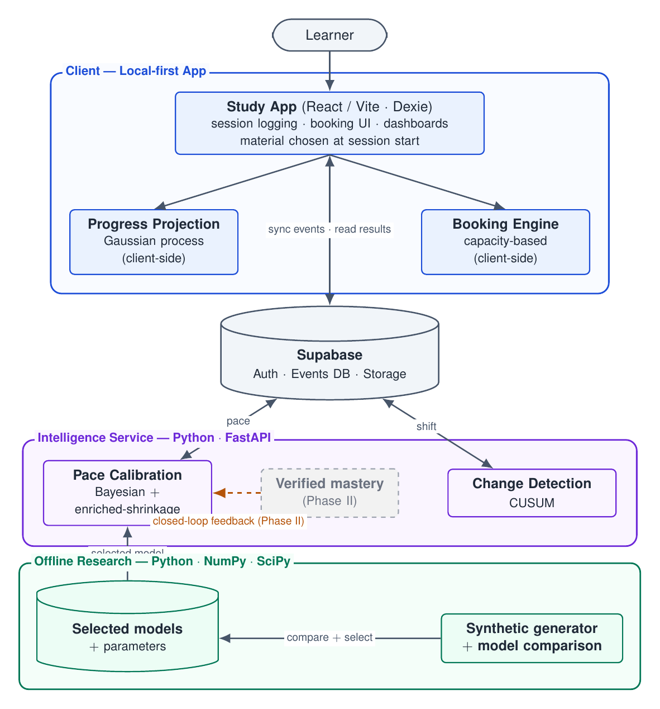
SYSTEM ARCHITECTURE
One behaviour, split across client & service
Client — local-first app
React / Vite over Dexie (IndexedDB). Session logging, booking UI and dashboards. Progress projection and the capacity-based booking engine run in the browser.
Intelligence Service — Python / FastAPI
Model-fitting over accumulated history: Bayesian + enriched-shrinkage pace calibration and CUSUM change detection, reached over a token-verified HTTP endpoint.
Offline Research — Python / NumPy / SciPy
The research harness imports the production engines as candidates, so a measured result is a result about the shipped code.
Dashed feedback = Phase-2 closed loop.
Adaptive Study Planning for Self-Directed Learners · Phase-1 · 3rd Review
5

Slide 6
THE PHASE-1 APPLICATION
A working planner built around four capabilities
Plan creation
Study execution
4-step onboarding turns a deadline, weekly capacity and materials into a booked schedule.
A session runtime with Pomodoro, YouTube tracking and a stale-session recovery state machine.
Progress & adaptation
Plan lifecycle
Home, Week and Replan report calibrated pace, a projected finish and levers to adjust the plan.
A month-grid roadmap calendar and a dashboard tracking plans from draft to completion.
All four rest on a local-first, event-sourced data layer — every view is derived by replaying an immutable event log.

Slide 7
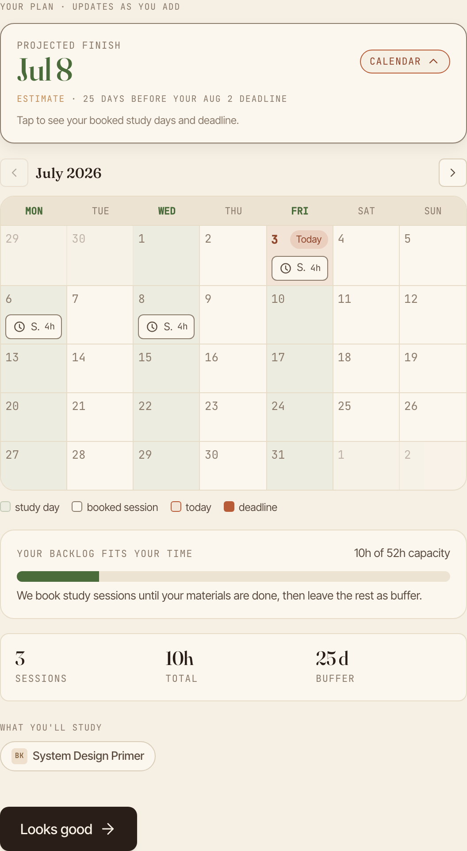
WALKTHROUGH · PLAN CREATION
Onboarding & roadmap generation
A 4-step wizard collects the planner's inputs:
deadline & purpose · weekly capacity (weekday / weekend split) · materials (link → auto-classified, role-tagged) · a read-only summary.
The client-side engine lays capacity-sized bookings across study days between start and deadline — the specific material is chosen at session start, not pre-packed.
Draft state is written to the local log on every step, so a closed tab resumes where it stopped.
Commits emit MaterialAdded · RoadmapCreated · SessionBooked · OnboardingCompleted
Adaptive Study Planning for Self-Directed Learners · Phase-1 · 3rd Review
7

Slide 8
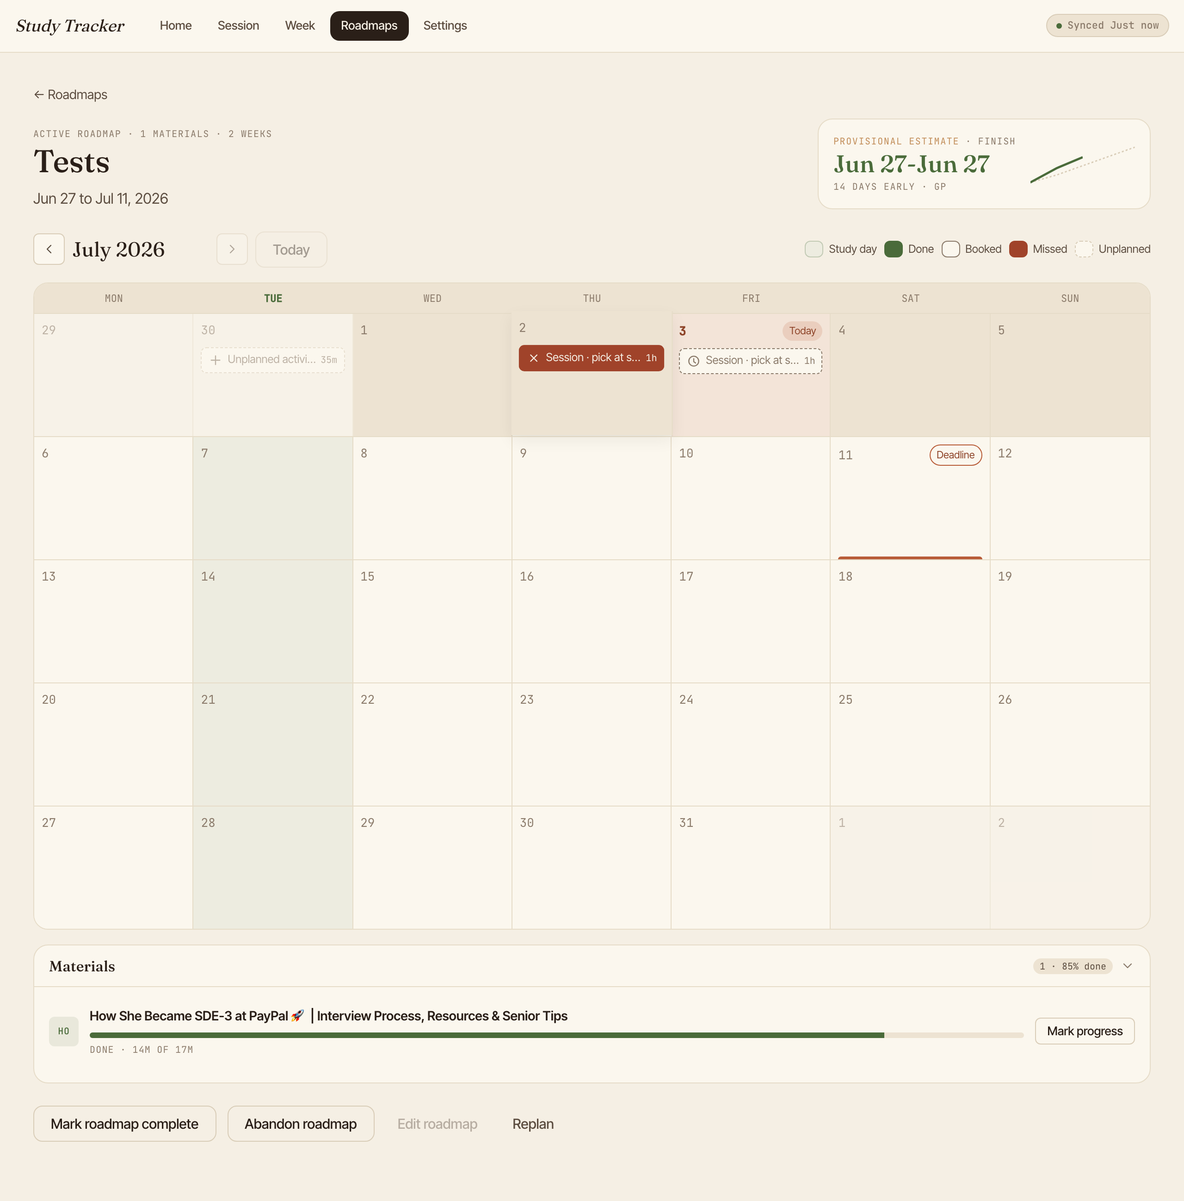
WALKTHROUGH · PLAN LIFECYCLE
The roadmap calendar — newly built this phase
The whole plan as a month grid.
Study days are tinted; each booking sits on its day, coloured by material role.
A booking's status — unstarted, in-progress, done, trimmed or interrupted — is derived from logged sessions, never stored, so it always matches what happened.
Selecting a day opens a sheet to add, edit or clear a booking and mark progress.
A provisional finish estimate and a burn-up line sit alongside the grid.
Adaptive Study Planning for Self-Directed Learners · Phase-1 · 3rd Review
8

Slide 9
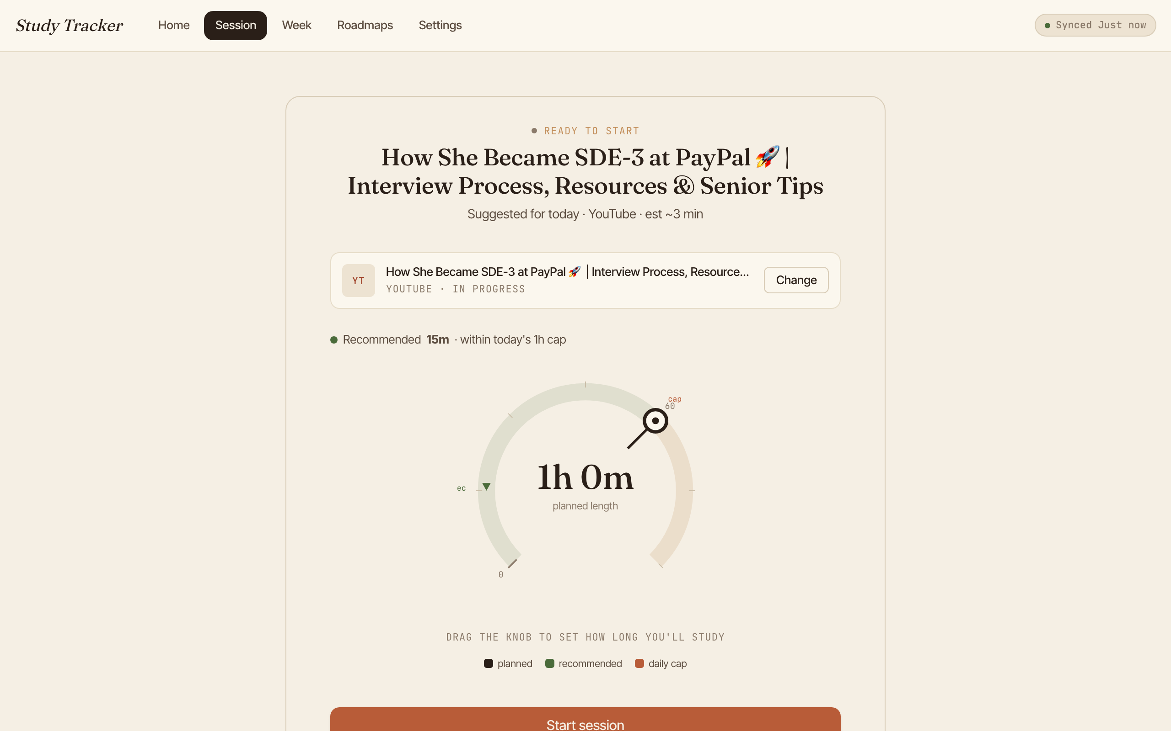
WALKTHROUGH · STUDY EXECUTION
The study session runtime
Study is started from the plan; the material is chosen at that moment.
A timer with optional Pomodoro (50 / 10) runs on wall-clock time, so a due break still arrives after a pause. YouTube plays in a tracked embedded player that resumes a playlist where it left off.
A small state machine over idle / active / paused recognises a stale session (timer left overnight) and offers recovery instead of logging a spurious multi-hour session.
On end it records minutes worked, pauses, Pomodoro blocks and position reached.
Adaptive Study Planning for Self-Directed Learners · Phase-1 · 3rd Review
9

Slide 10
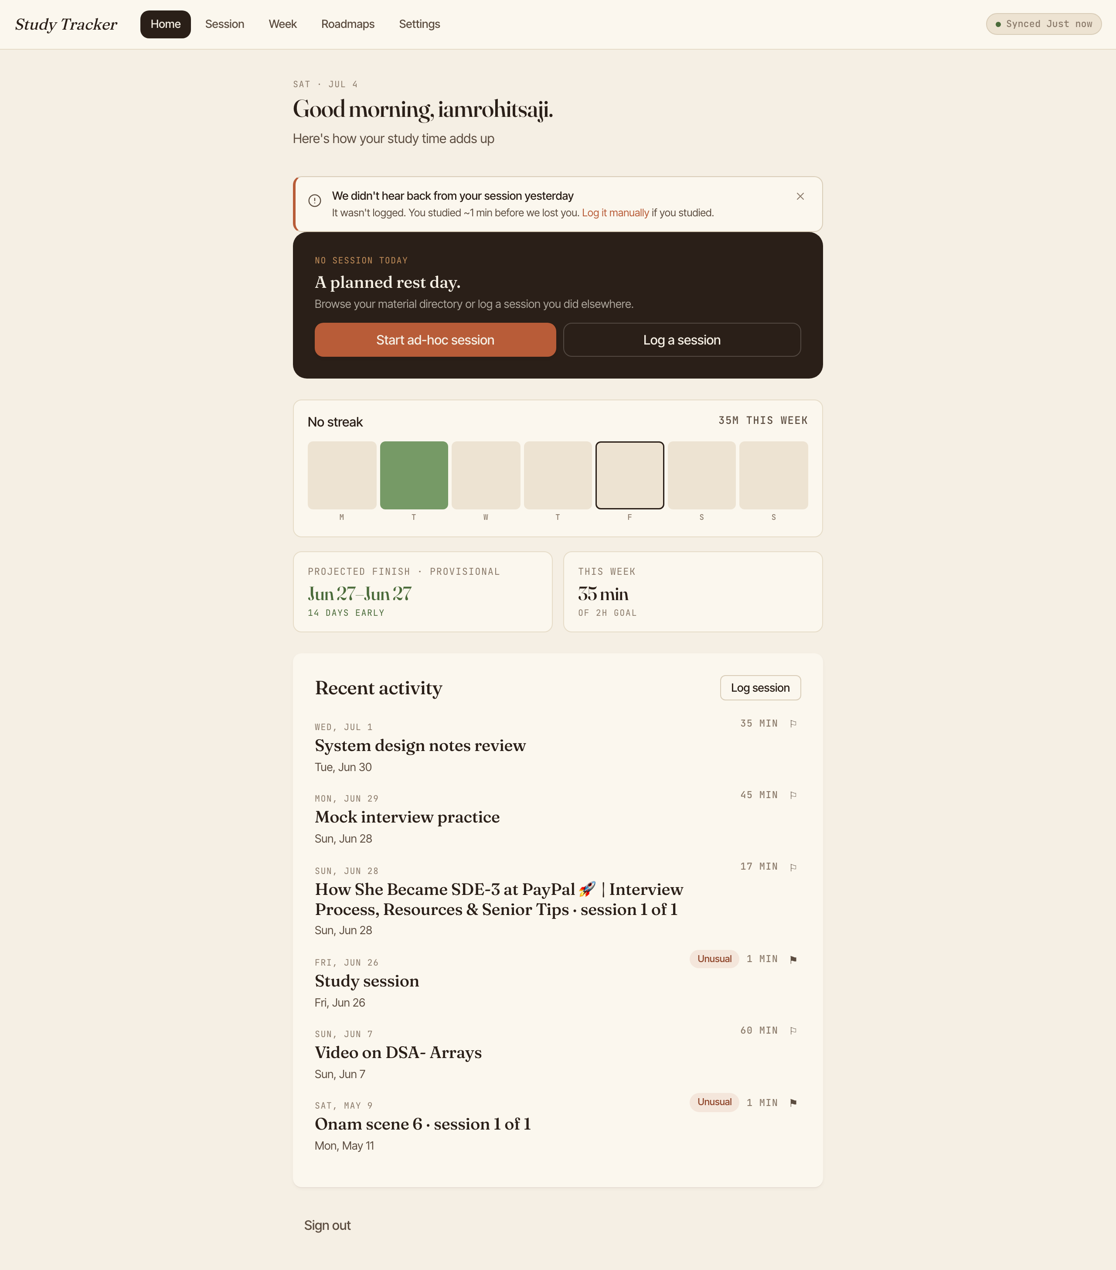
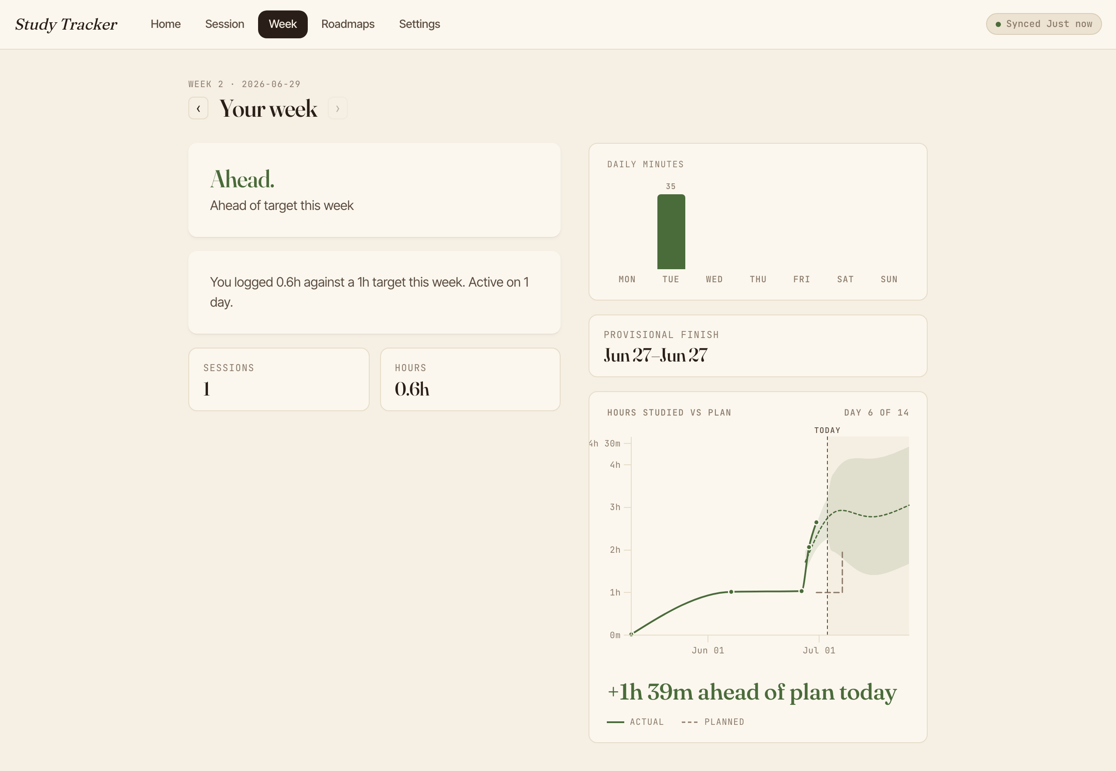
WALKTHROUGH · PROGRESS & ADAPTATION
Home & Week: how the plan is tracking
Home summarises the state in one view: next booking, current & best streak, calibrated pace (from the service) and the projected finish date. Week gives a single verdict — ahead / on-track / behind — over a daily-minutes chart and a burn-up projection with a 95% band.
HOME DASHBOARD
WEEK VIEW
Adaptive Study Planning for Self-Directed Learners · Phase-1 · 3rd Review
10

Slide 11
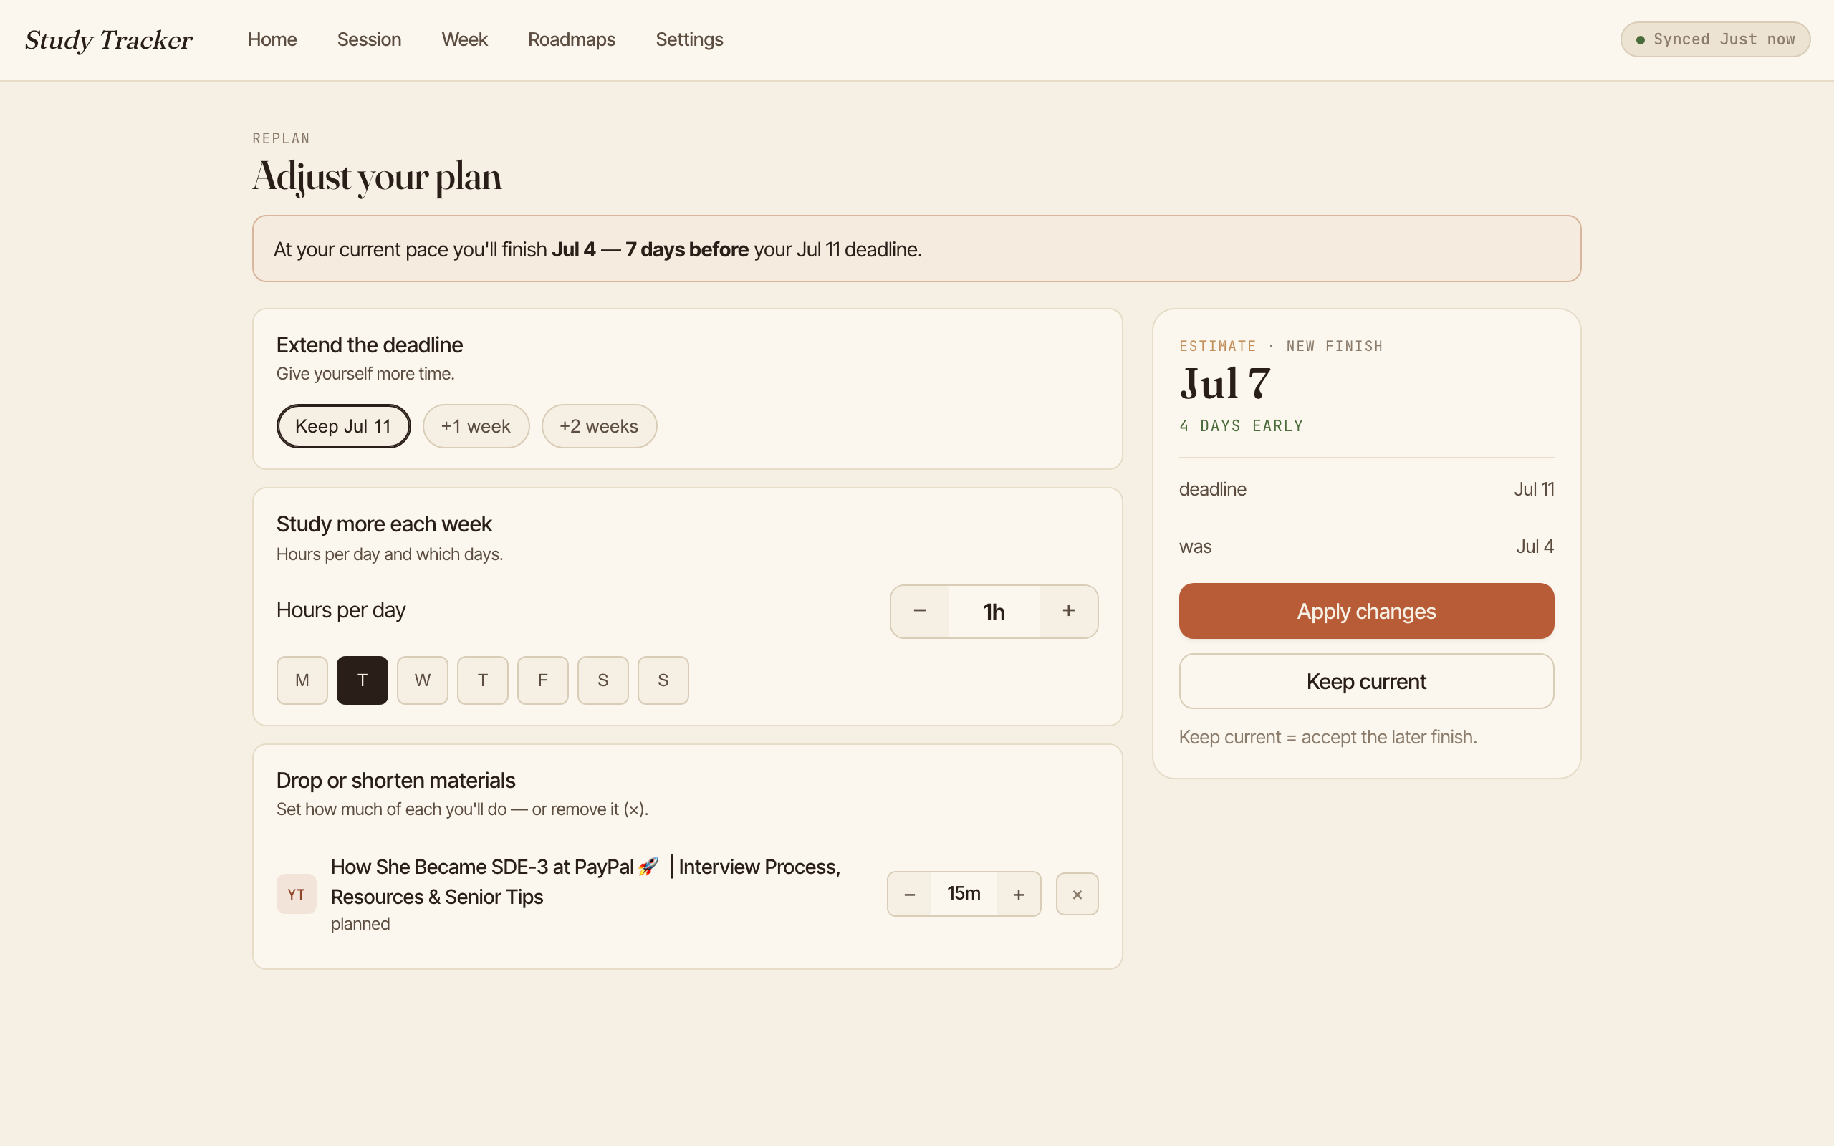
WALKTHROUGH · PROGRESS & ADAPTATION
Replan: adjust without silent rewrites
Divergence never rewrites the plan on its own.
Change detection runs server-side on the same calibration call and surfaces a recalibration prompt the learner can accept, acknowledge or defer.
Replan offers three independent levers:
extend / shorten the deadline · raise / lower weekly hours · drop or trim materials.
Each lever shows its effect on the projected finish before it is committed. Confirming re-lays bookings and records a RoadmapReplanned event that preserves the plan's identity.
Adaptive Study Planning for Self-Directed Learners · Phase-1 · 3rd Review
11

Slide 12
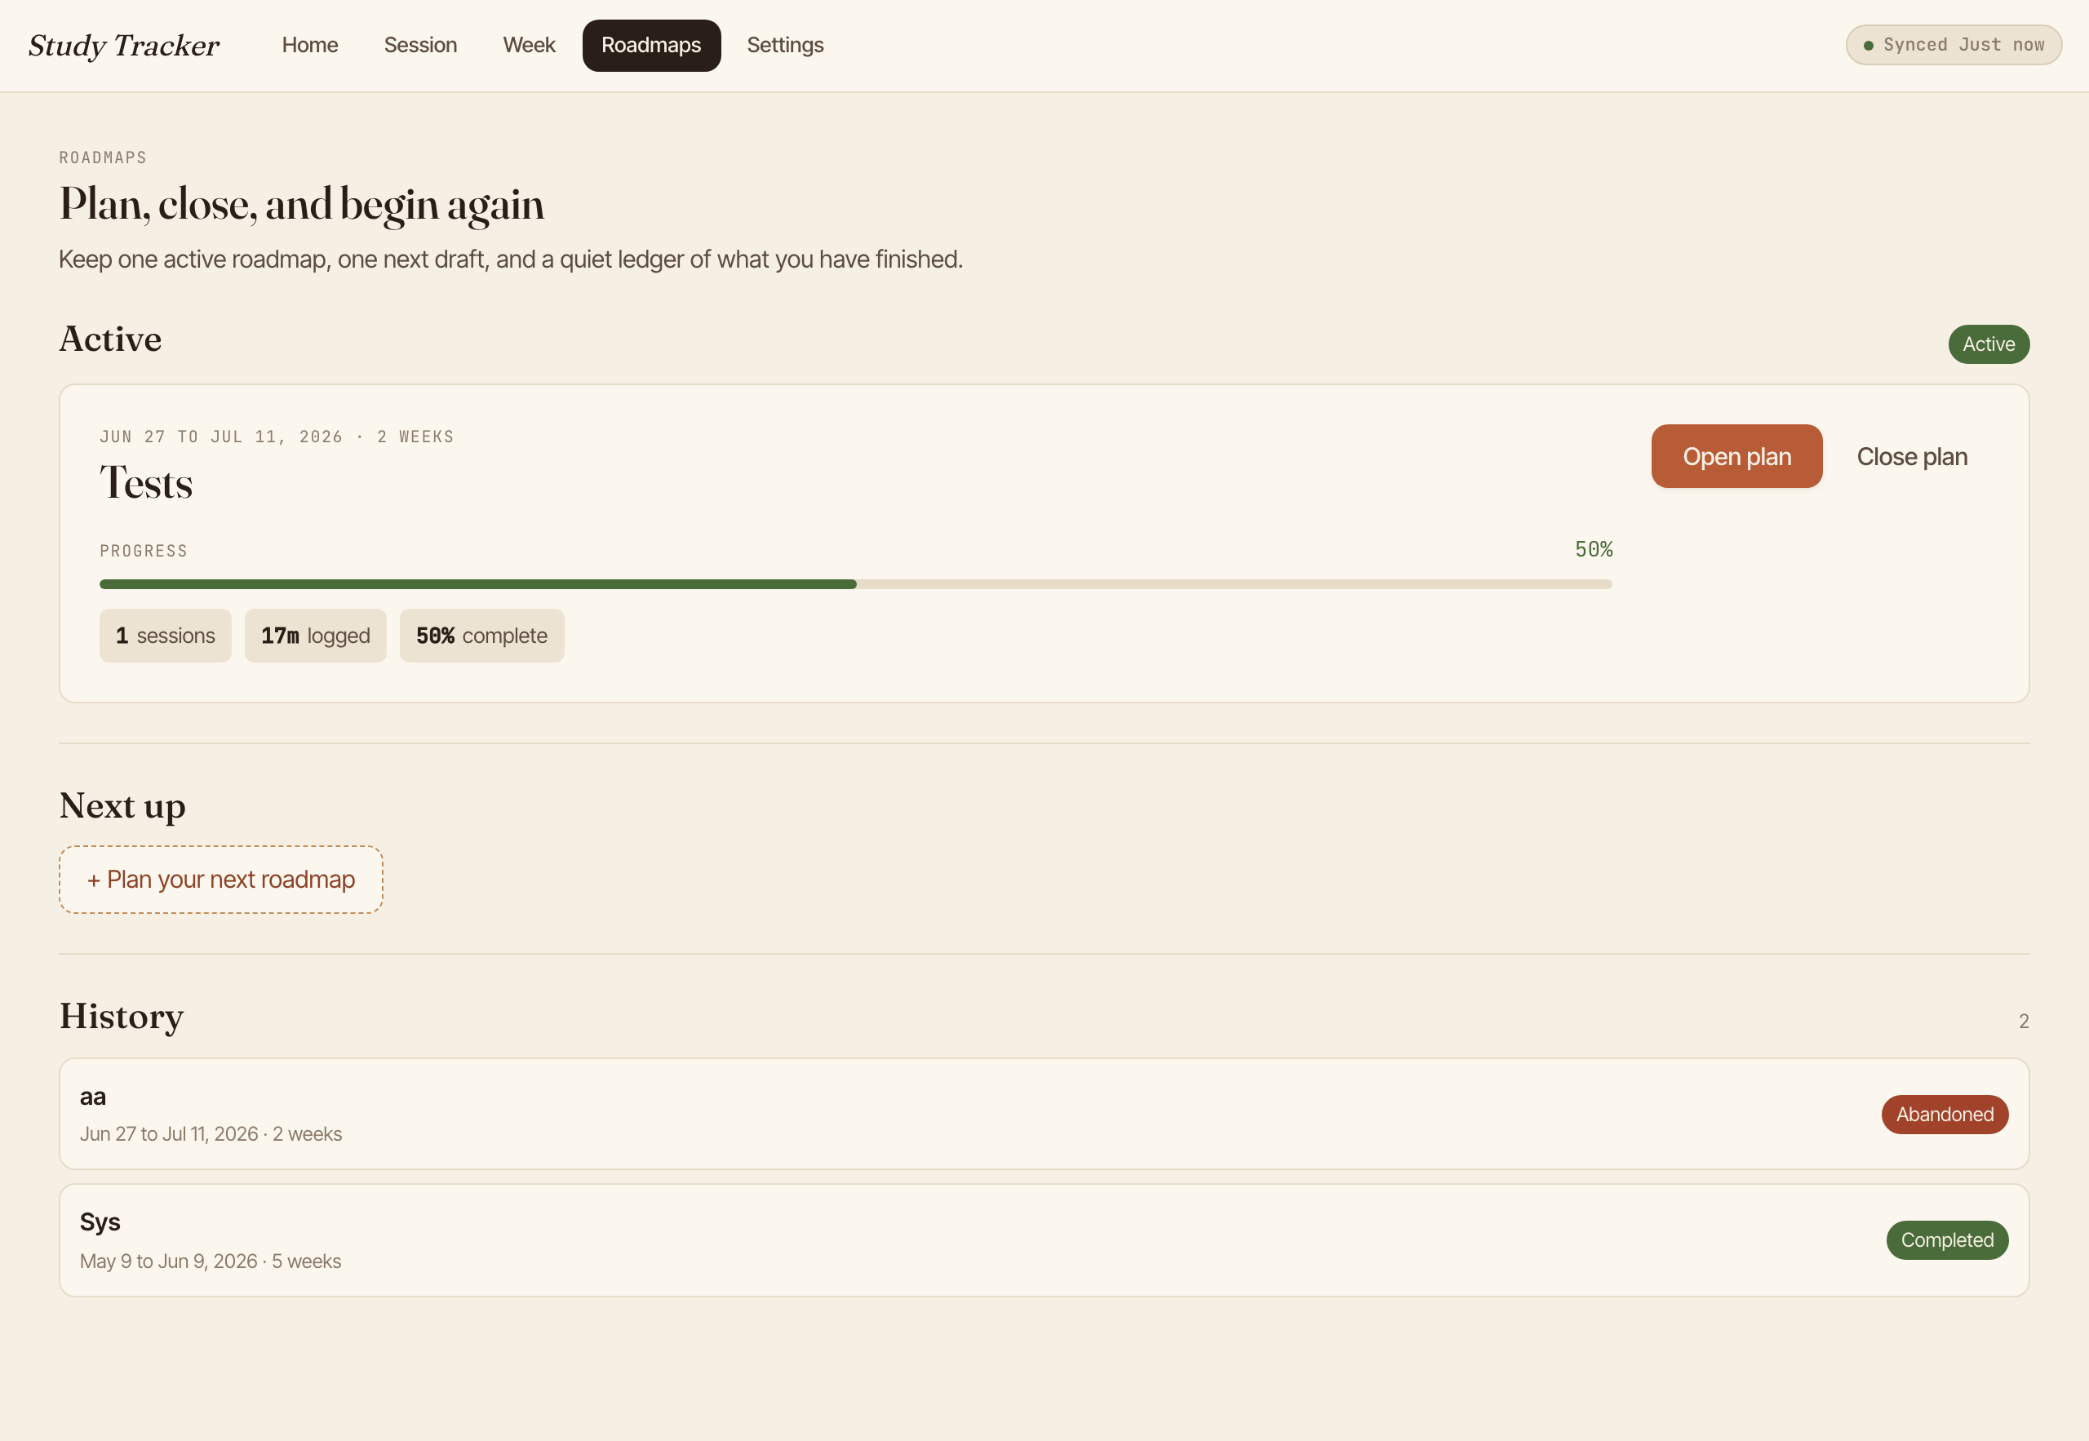
WALKTHROUGH · PLAN LIFECYCLE & DATA
Roadmaps dashboard + a local-first core
Plans across their lifecycle.
Active plan with progress, a resumable onboarding draft, and completed / abandoned plans kept as reopenable history. Replans collapse into one entry.
Local-first, event-sourced.
Every action is an immutable event in the browser's IndexedDB; every view is a replay. The loop works offline and reconciles when a connection returns.
Per-user local DB (no cross-account bleed) + a write-ahead queue and periodic snapshots to Supabase for cloud durability.
Adaptive Study Planning for Self-Directed Learners · Phase-1 · 3rd Review
12

Slide 13
EVALUATION
How each component was judged
Synthetic ground truth.
A generator plants each learner's true pace, the timing/size of any shift, and completion behaviour — so latency, coverage and recovery error are all measurable. Its realism regime is calibrated against OULAD (not used as a benchmark).
Held-out & corrected.
200 seeds and held-out learner archetypes; every comparison carries a bootstrap confidence interval on the candidate–incumbent difference, with Holm / Benjamini–Hochberg correction across the family.
Reproducible.
Fixed seeds and make targets regenerate the dataset, comparisons and figures deterministically; each figure carries a provenance stamp.
METRICS PER COMPONENT
Pace calibration
recovery error · prospective error
Change detection
detection latency · false-alarm rate
Progress projection
interval coverage · point error
Schedule generation
deadline drift · capacity violations
Adaptive Study Planning for Self-Directed Learners · Phase-1 · 3rd Review
13

Slide 14
RESULTS
Honest nulls, real wins, one deferred fix
Pace calibration
WIN (prospective)
Honest null on recovery error — but a Holm-surviving WIN on the short-history prospective estimate the planner acts on.
Change detection
NULL — ship CUSUM
Robust null: nothing beats the CUSUM frontier. Ship the fastest (≈1.4 sessions) — it feeds a human-confirmed prompt.
Progress projection
FIX DEFERRED
Clearest finding: raw GP interval under-covers; split-conformal fixes it. Validated but DEFERRED to Phase-2.
Schedule generation
WIN — not shipped
DP allocator cuts deadline drift (39→8 days on the full mix) — a real win the system deliberately does NOT ship (redesign removed the packing problem).
Raw GP under-covers badly (0.19–0.49); a split-conformal correction restores 0.94–0.99 at the same point error.
Adaptive Study Planning for Self-Directed Learners · Phase-1 · 3rd Review
14

Slide 15
FUTURE WORK
Phase-2: close the loop with verified learning
The pace signal today is self-reported time — which is gameable. Phase-2 checks that studying produced learning.
Verified learning — the principal novelty
1
Generate concept-tagged assessments from the learner's own material with LLMs, tag items to knowledge components, auto-grade, and estimate genuine mastery with cold-start knowledge tracing. Feed verified mastery back into pace calibration — closing the dashed loop — with spaced-repetition review timing.
Ship the deferred fix — validated in Phase-1
2
Deliver the split-conformal correction that restores projection-interval coverage past the cold-start threshold.
Longitudinal validation — beyond synthetic data
3
Validate on one learner's own logged sessions over time — closed-loop adaptive vs. static open-loop — on schedule adherence and measured learning gain.
Phase-1 contribution: an integrated, open-loop adaptive planner over a single learner's own behaviour, with an honest account of what improves, what doesn't, and what is validated but not yet shipped.

Slide 16
Phase-1 delivered a working,
honestly-evaluated adaptive planner.
Calibration · change detection · projection · booking — realised in a local-first app, with Phase-2 set to close the loop through verified learning.
Thank you — questions welcome
Rohit Saji (PES2PGE24DS201) · Guide: Prof. Ramesh Prakash Guledgudd · PES University

