Slide 1

Mobile AR Viewer for Dynamic 3D Model Iterations
A mobile augmented reality application that brings evolving 3D engineering models into the real world — built from scratch by a team of AR engineers and app developers.
FINAL PROJECT EVALUATION
UNITY 6 · AR FOUNDATION · ANDROID

Slide 2
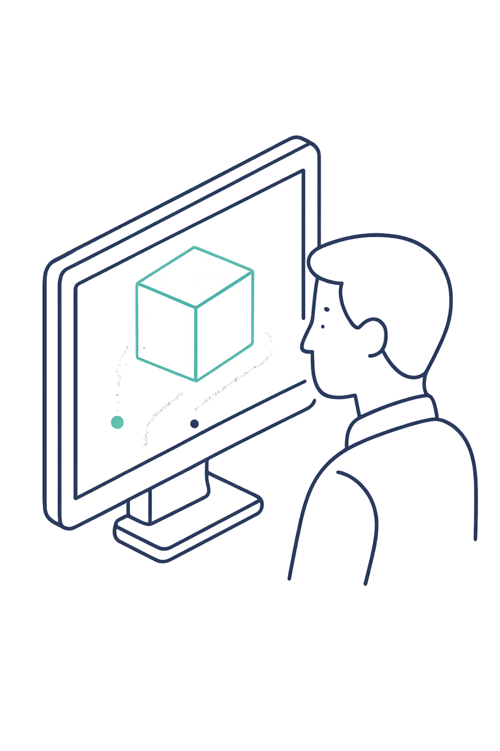

The Problem with Flat Screens
Complex, iterative 3D models — topology optimizations, structural meshes, evolving geometries — are routinely reviewed on standard 2D monitors. This flattens spatial relationships, hides geometric nuance, and makes it difficult to perceive how a model changes across iterations.
No Spatial Context
2D projections strip real-world scale and depth from 3D geometry.
Static Comparison
Viewing a sequence of 20+ STL iterations on a 2D screen forces engineers to mentally reconstruct depth and change — a high-cognitive-load task prone to misinterpretation.
Side-by-side screenshots cannot convey dynamic iteration sequences.
No Interactivity
Passive viewing prevents hands-on inspection of geometry at any angle.

Slide 3
Project Objective
Place. Inspect. Iterate.
Build a fully functional mobile AR application — from zero — capable of anchoring real STL model sequences into physical space and replaying their evolution interactively.
Surface Detection
STL Loading
Dynamic Playback
Detect real-world planes and anchor 3D models precisely using AR raycasting.
Read and parse multiple STL file iterations directly from Android local storage at runtime.
Simulate the evolution of model iterations with controllable speed and interactive touch input.

Slide 4

The Engine: Unity 6 & AR Foundation
The AR runtime is built on Unity 6 with AR Foundation — providing a cross-platform abstraction layer over ARCore on Android. Two core AR systems power the experience:
1
Plane Detection
2
Raycasting
Continuously tracks horizontal and vertical surfaces in the environment, identifying valid anchor candidates in real time.
On tap, a ray is cast from screen-space into AR world-space. The first hit point on a detected plane becomes the model's anchor origin.

Slide 5


The Logic: Parsing & Playback
C# STL PARSER
UIMANAGER STATE MACHINE
Custom Mesh Pipeline
Interactive Playback Controller
A bespoke C# parser reads binary and ASCII STL files directly from Android's local storage — no Unity Editor dependency. Each file is decoded into vertex and triangle arrays and dynamically assembled into Unity Mesh objects at runtime, supporting high-poly geometry without pre-baking.
A UIManager state machine governs all playback logic: play, pause, step-forward, step-back, and speed adjustment. States are driven by user touch events, keeping the AR scene and UI overlay in strict sync across all iteration transitions.
Parse Geometry
Build Mesh
Read STL
Render AR

Slide 6
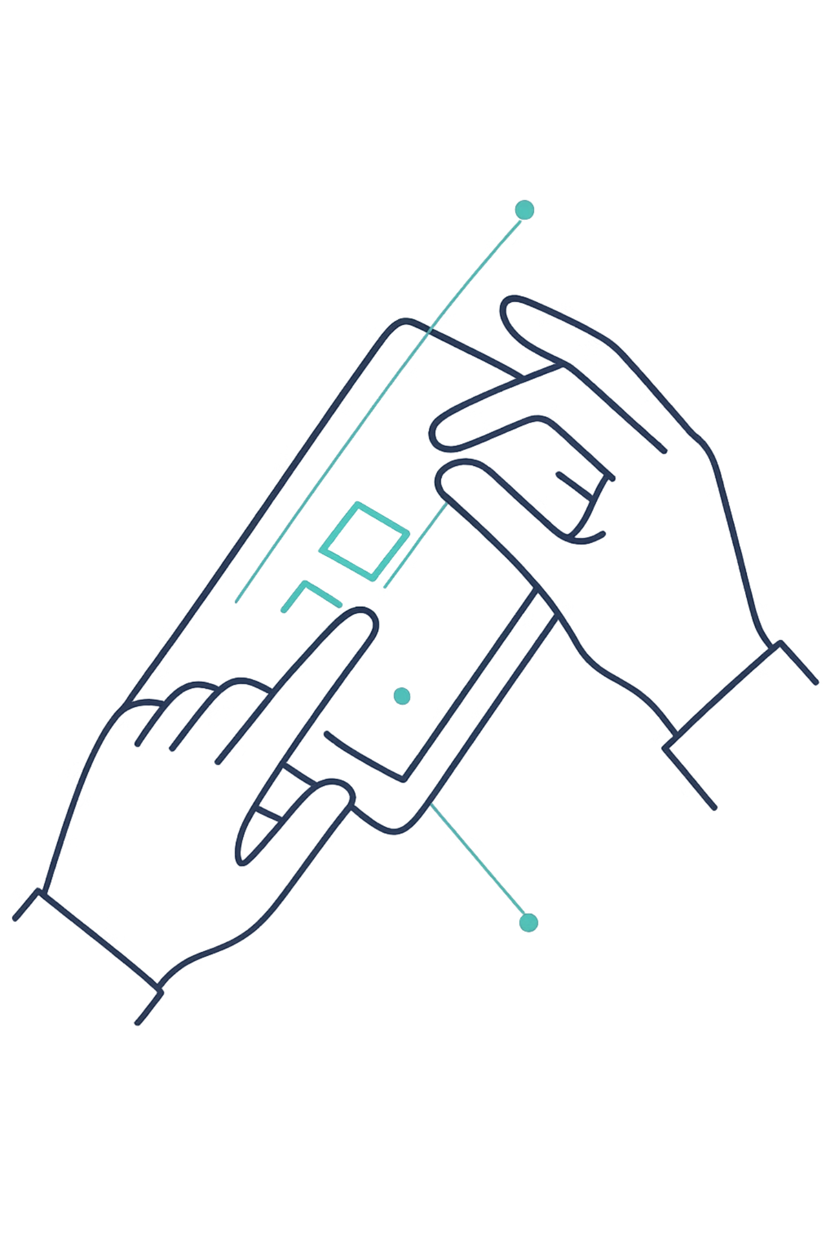
App Capabilities
Tap-to-Place
One tap anchors the model to any detected real-world surface at the exact raycast hit point.
Touch Controls
Pinch-to-zoom and swipe-to-rotate provide fluid, intuitive model inspection from any angle.
Dynamic Playback
Sequences of 20+ STL iterations play back smoothly with adjustable transition speed.
Instant Reset
A single action clears the scene and restores the app to its initial detection state.

Slide 7
Results & Future Work
RESULTS
FUTURE WORK
Stable, Responsive, Production-Ready
Next Milestones
Real-Time File Upload
The application successfully renders high-poly STL sequences across 20+ iterations with no frame drops. The AR anchoring is stable, the touch controls are responsive, and the UI overlay remains in sync throughout all playback states.
Enable users to import STL files directly within the app, removing the local-storage dependency.
Grouped Iteration Comparison
Zero frame drops on high-poly geometry
Reliable plane detection and model anchoring
Smooth iteration transitions at variable speed
Render multiple selected iterations simultaneously in AR to support direct spatial comparison.

