Slide 1

Introduction to Keras for Neural Networks
Stuart Whipp
Ben Whalley

Slide 2



Agenda
What is a neuron?
What can it do?
How is it trained?
Practical: Train a model on the NASA Engine dataset
Summary: Where next?

Slide 3
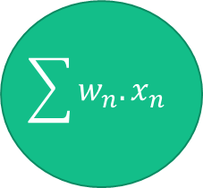
Perceptron
Imagine a ‘node’ or ‘neuron’ where we calculate a weighted sum of just 2 inputs.
By applying a ‘gate’ or threshold, we can decide what information passes for downstream processing, and which doesn’t
this is termed ‘activation function’ or transfer function
$$\sum{w_{n}.x_{n}}$$

Slide 4
‘Training’
We may utilise ‘steepest descent’ whilst monitoring the rate of change of error in our models
The objective is to minimise this error. If the ‘error landscape’ is complex, we may end up in a local minimum
Borrowing from physics, the rate of ‘momentum’ can be controlled such that we can seek the global minimum
momentum

Slide 5
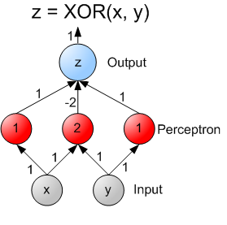
OR, AND & Exclusive Or.. XOR
Neural Representation of AND, OR, NOT, XOR and XNOR Logic Gates (Perceptron Algorithm) | by Stanley Dukor | Medium
https://www.sciencealert.com/a-never-before-seen-type-of-signal-has-been-detected-in-the-human-brain
Other news…
https://www.independent.co.uk/life-style/gadgets-and-tech/ai-artificial-intelligence-maths-deepmind-b1967817.html
https://www.nature.com/articles/d41586-021-03593-1
After the session, we will send code to show this may be solved with 1 neuron only

Slide 6
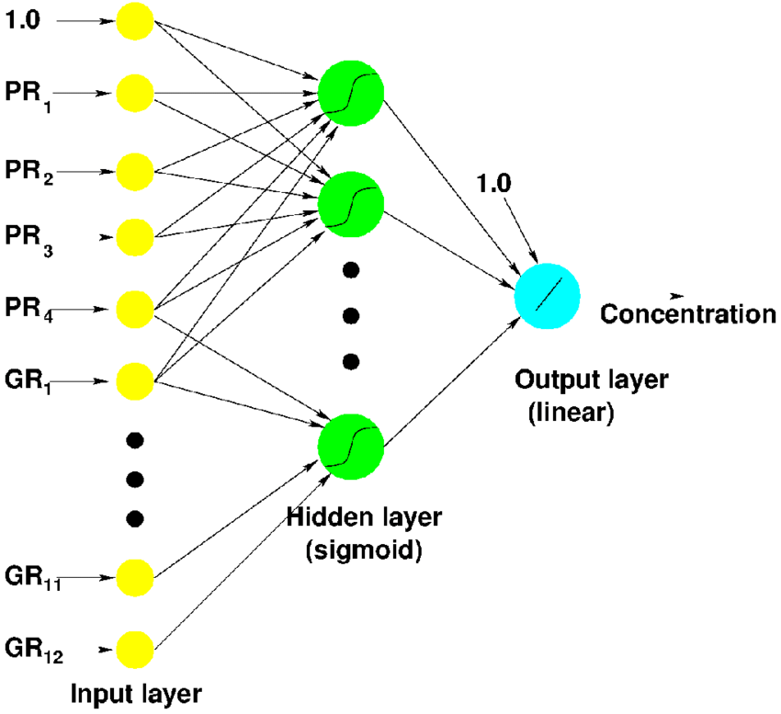
Multi-Layered Perceptron
We may apply these in many layers.
Non-linear activations allow single layers to achieve what would otherwise require many layers to achieve

Slide 7
How many neurons? Weights?
If we have 10 inputs and 10 neurons which each are ‘fully connected’ to the inputs, how many connections is this?
If we have an image of size 100x100 where every pixel is an input, followed by a layer of 100 neurons, how many weights?

Slide 8
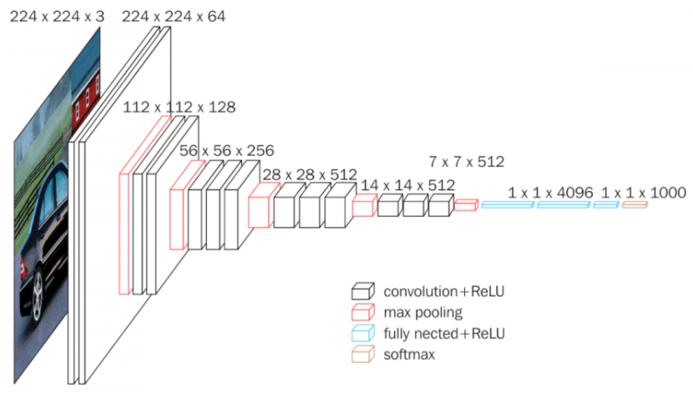
Convolutions
If we look at MS Excel example now.. We see the effect of ‘striding’ before a weighted sum operation
Padding can help control output sizes
What is spatial invariance?

Slide 9
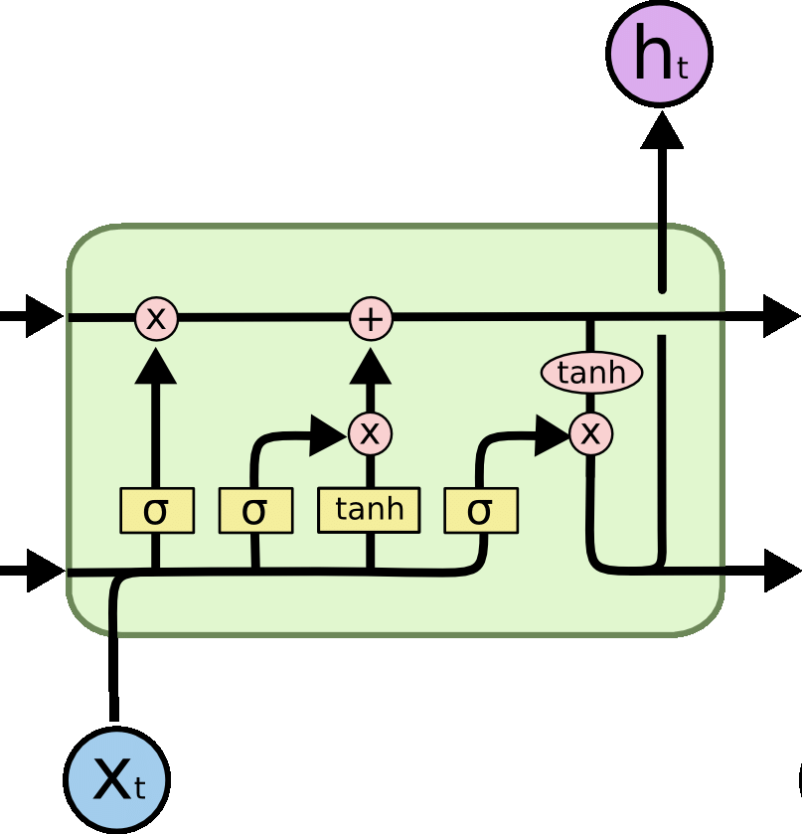
Recurrent models
For timeseries models, it can be useful to feedback prior time steps into neurons
In practice, these models suffer from vanishing gradient without clever gating arrangements
Please see LSTM as further research

Slide 10
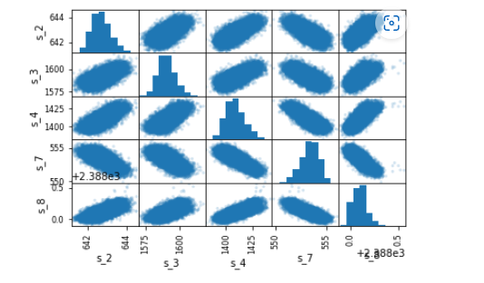
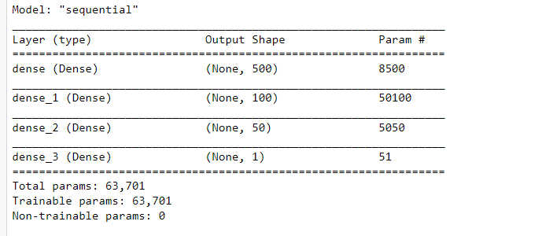
Practical
Lets now look again at NASA engine dataset
conda create --name python310 python=3.10
conda activate python310
conda install -c anaconda tensorflow-gpu
pip install jupyterlab

Slide 11

Summary
With neural networks, you can approach almost any problem.
Dense layers give us flexibility but lots of parameters
Convolutions can handle much larger inputs provided ‘spatial invariance’ becomes useful (features occur across images or feature maps)
Recurrrent models can be especially useful with time series or sequences such as natural language models

Slide 12


Thank You
Stuart Whipp
stuart.whipp@baesystems.com

Slide 13
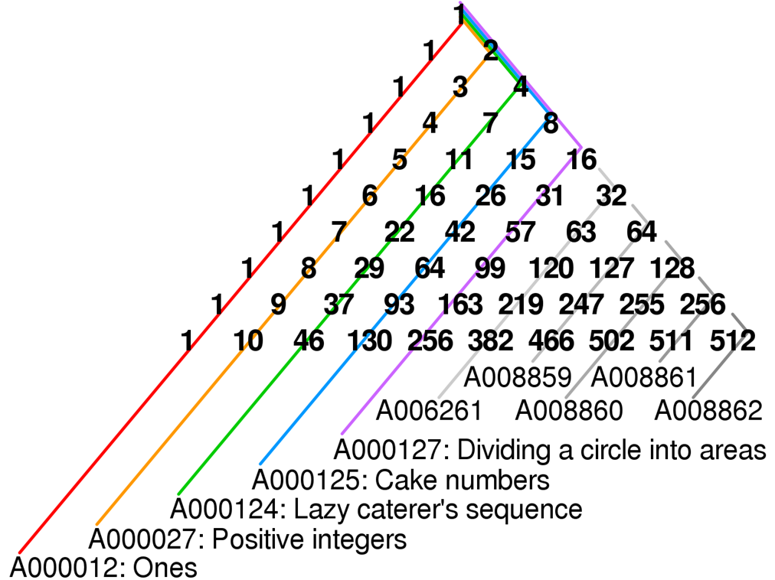
Bonus slide
See spreadsheet on how this can be achieved with neurons of weights 1,1 and bias 0

Slide 14
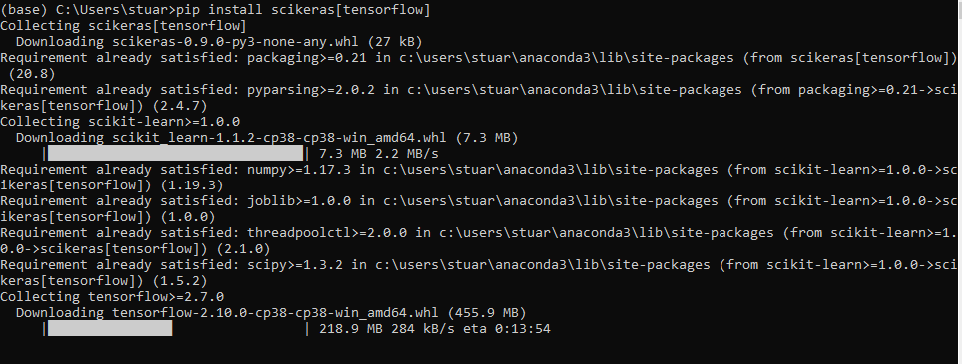
Week 4- outer loop optimisation
Required: scikeras package
scikeras · PyPI
pip install –user scikeras[tensorflow]

Slide 15
What do we mean by train, validation and test?
We should consider how we know our model has overfit, or underfit.
What represents a fair test?
Consider mock and final exams – what if the final is easier or harder than the mock?

Slide 16
What is regularising?
-validation set. Here we make changes to the model to see whether changes help improve against a dataset that isn’t trained upon
-test. No adjustments are made here against model tuning wise
- regularise: consider dropout, or L2. Ensuring weights are ‘small’

Slide 17
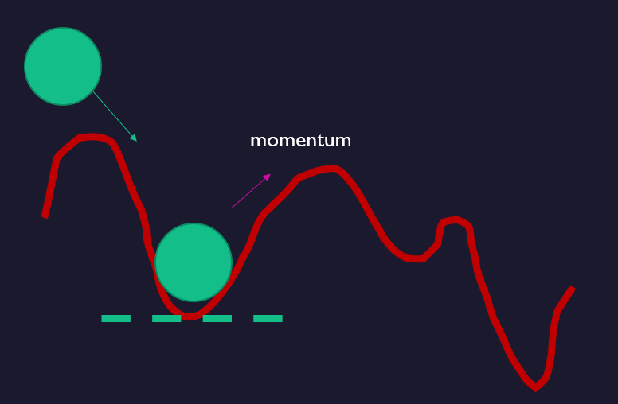
What is Outer loop optimising?
Outer loop
Inner loop
-AutoML is sometimes termed as the automatic selection of ‘hyper-parameters’ and typically runs a model repeatedly
Consider: curse of dimensionality

Slide 18
Week 5- BatchNorm, LSTM
Required: scikeras package
scikeras · PyPI
pip install –user scikeras[tensorflow]

Slide 19
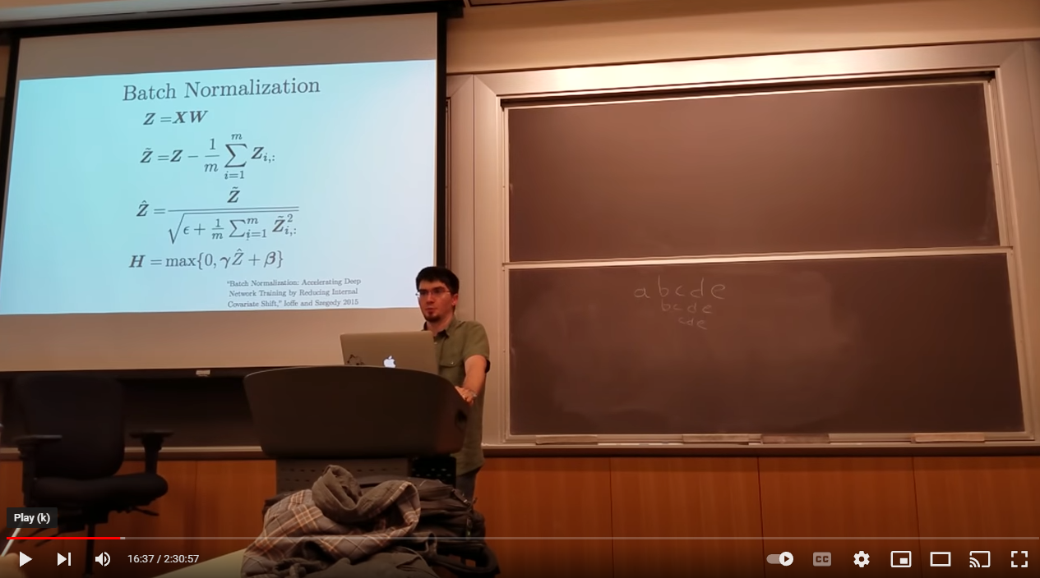
Batch norm
Ian Goodfellow discusses the use of batch norm ad describes a multi-layer network with 1 neuron in each week as we discussed last week
Ch 9: Convolutional Networks - YouTube
Recall – the use of normalisation and bias to effect relu threshold points.
If we normalise after each non-linear function and allow a centre and scale parameter to be learned – we have efficient learning allowing higher learning rates
In practice – it helps to Regularise the model and reduce overfitting

Slide 20
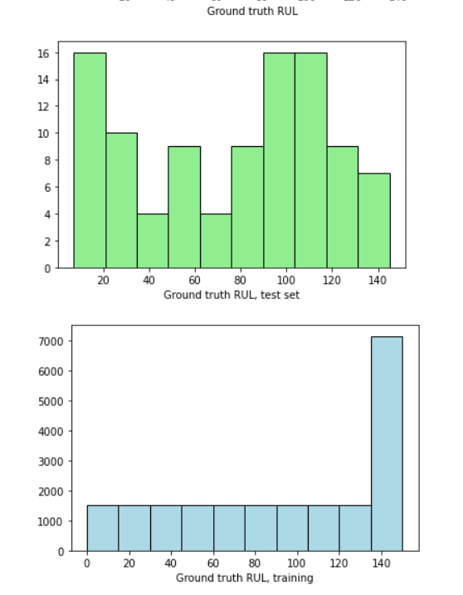
Data treatments
How representative are the training and test sets? Can we exploit this realisation?
How about smoothing the training data..? Or calculating new features (future week)

Slide 21
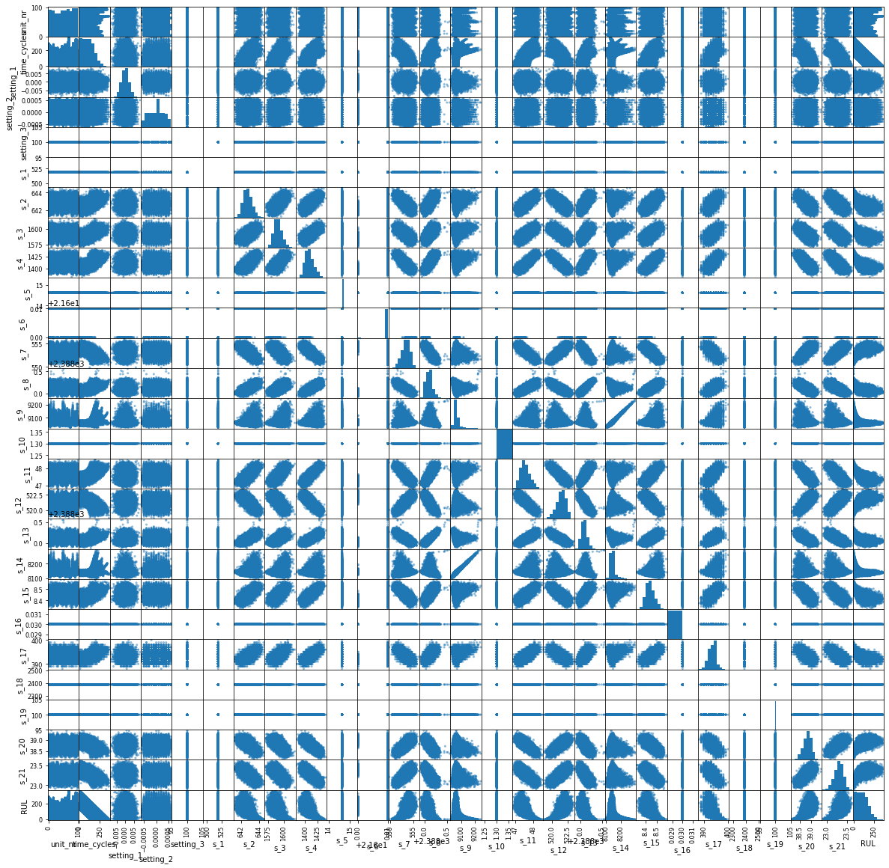
Column selection
How can we use visual representation to highlight data characteristics?
Which columns have no variance – how can changes in outputs be explained by inputs which don’t change?
How do differing signals vary with one another?

Slide 22
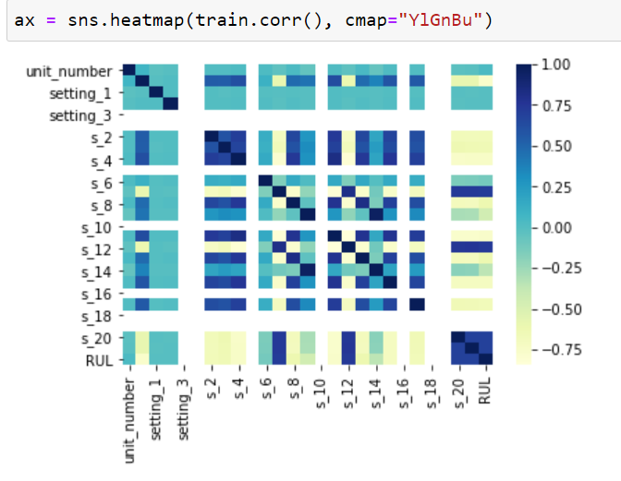
CNN on NASA dataset
With and without PCA
Use of rolling mean for ‘smooth’
Use of grid-search
New visual: correlation matrix

Slide 23
Links..
tf.keras.layers.Conv2D | TensorFlow v2.10.0
sklearn.decomposition.PCA — scikit-learn 1.1.2 documentation
https://pandas.pydata.org/pandas-docs/stable/reference/api/pandas.DataFrame.rolling.html
RUL prediction | Kaggle
https://mlfromscratch.com/gridsearch-keras-sklearn/#/
https://scikit-learn.org/stable/modules/model_evaluation.html#common-cases-predefined-values
https://github.com/Vardoom/PredictiveMaintenanceNASA/blob/master/trainNN.ipynb

Slide 24
Can we rephrase as classification? Why?
How do our customers’ interpret RMSE, MAE and other regression metrics?
model.compile(optimizer=tf.keras.optimizers.Adam(learning_rate=1e-3),
loss=tf.keras.losses.BinaryCrossentropy(),
metrics=[tf.keras.metrics.BinaryAccuracy(),
tf.keras.metrics.FalseNegatives()])
Before next week: Stu to send xls on softmax

