Slide 1

Introduction to Decision Tree Ensembles
Stuart Whipp
Ben Whalley

Slide 2
Agenda
What is a decision tree?
What can it do? Regression or classification
How does it work? (Gini index, splitting criteria)
Practical: Train a model on the NASA Engine dataset
Summary: Word report? Literature review?
Plot a decision tree
sklearn.ensemble.RandomForestRegressor — scikit-learn 1.1.3 documentation

Slide 3
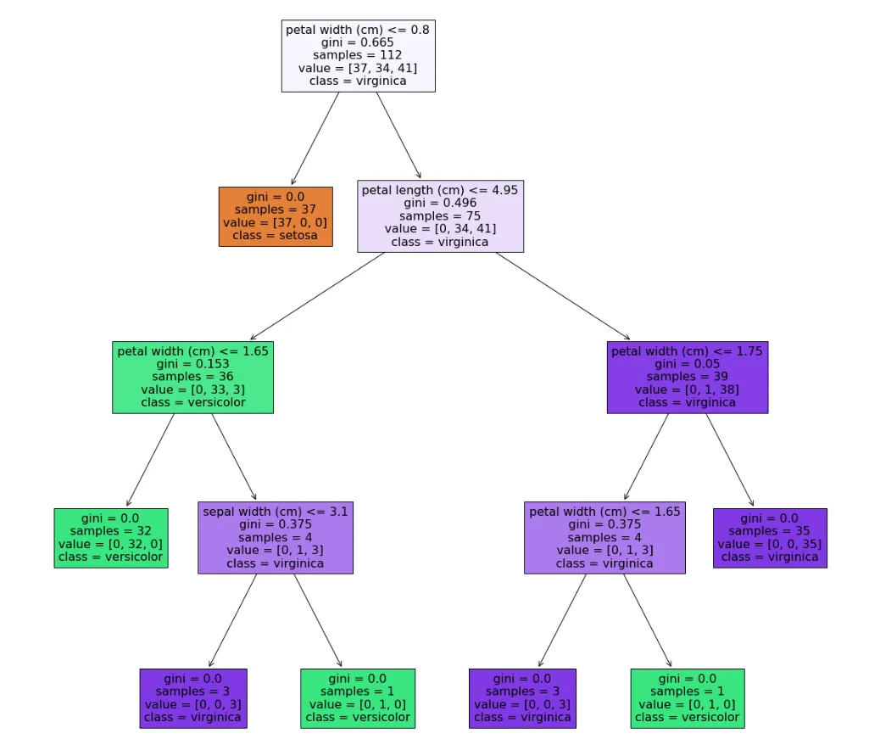
Explainability
Decision tree may be easily interpreted
Hey are sometimes referred to as weak learners
Heir internal mechanisms allow lots of variability – lots of ways to achieve similar outcomes with different branching split criterion
His allows us to make lots of them and combine their collective output
Random Forest is an ensemble of models.
Bagging and Boosting. XGBoost is another example.
Decision Trees are sometimes called White-Box. Ensembles are sometimes called Grey Box. Traceability Tractability

