Slide 1
BIACC Data Science TFX ‘On The Job’ (OTJ) ML Training Monday 28/11/2022

Slide 2
Progress So Far
Our initial brief was to take a look at the NASA Engine Degradation dataset, making use of Keras library
We covered the concept of neural networks (NN), as a collation of neurons or ‘perceptrons’. This name gives rise to terminology such as ‘Multi-Layer-Perceptron’ (MLP)
We discussed that whilst a MLP is a neural network with dense connectivity, modern NN tend to be designed at the abstraction of ‘layers’ and may have hundreds
We discussed the use of Convolutions and how a small grid can be thought of as sliding across an input in width and height terms, applying the same weighted-sum operation. This is more locally-connected for each output value, and if we treat each as a ‘neuron’ this means they have ‘shared weights’

Slide 3
Progress So Far (Neural Networks)
We discussed ways to ‘reduce overfitting’ i.e. Regularising. In particular, we looked at dropout layers and batch-normalising layers as commonplace techniques in Deep Learning
We hadn’t discussed L2 regularisation, common in NN, nor L1 common elsewhere
In general, fewer parameters underlying our model will reduce risk of overfitting
In general, ‘smaller magnitude’ weights will reduce overfitting
We discussed ReLU as an activation function 𝑦=max⁡(0,𝑥). As a neuron’s weighted sum has a ‘bias’ added – this controls the actual threshold point rather than 0.
In general, ensuring data at each transformation is close to zero-centred which reduces requirement for large bias values.
We discussed complex non-sequential NN architectures requiring functionalAPI

Slide 4
Progress So Far (Neural Networks)
We discussed how NN were ‘trained’ in an effort to optimise their weight and bias values. We illustrated gradient descent and taking steps (according to a ‘learning rate’) in a direction such that ‘the rate of change of error’ appears to represent an improvement.
We noted a common pitfall – local minima where gradient may be 0. We discussed how this may be overcome with ‘momentum’ such as a ball rolling under gravity with a physical mass.

Slide 5
Progress So Far (autoML)
We noted that there were still many settings to consider for our models; how many neurons, epochs for instance or what the learning rate and momentum should be. These can be selected by the AI designer, or else incorporated into an AutoML pipeline.
We looked at GridSearch and Bayesian Optimisation with GridSearch imported from sklearn and ‘KerasRegressor’ wrapper utilised. BayesOpt was native to Keras optimisers.
We discussed some other decision tree based algorithms for context of NN performances against competitor algorithms

Slide 6
Agenda Monday
Understand how a problem may be phrased as a Classification problem
Look at another code example: RandomForestClassifier
Look at another Auto-ML technique: Feature Selection using Genetic Algorithms
Discuss briefly Ensembling methods: Bagging and Boosting
Discuss Softmax Layer and number of output neurons
Return to Neural Networks with Keras, Classification Example
Discuss refactoring code, for use with Tpot tomorrow

Slide 7
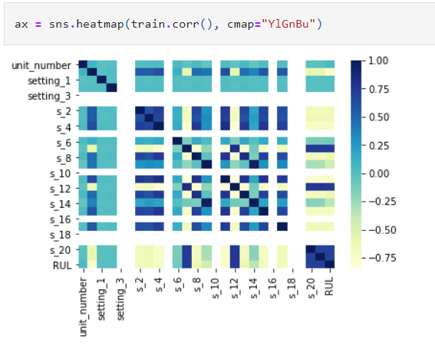
Review the Dataset
What do we know about the training and test dataset for NASA?
We used visual inspection to identify columns with no variation. We discussed how no variation in an input, cannot possibly explain variations in an output we aim to predict
We utilised Principal Components to reduce the number of salient inputs to our model whilst hopefully retaining the majority of information
We viewed histograms of Remaining Useful Life (RUL) and found the range was much smaller in the test data
We noted that the training data was a sequence in time for each engine but not so with test data

Slide 8
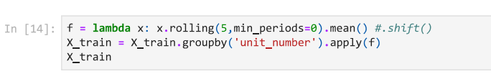
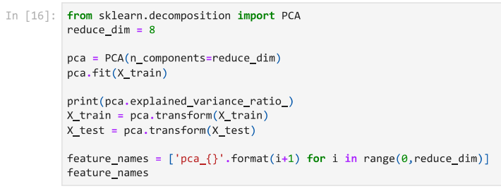
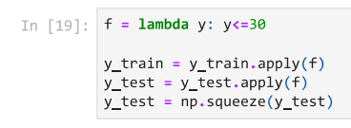
Code Example
Please review code item 001: Random Forest with PCA, GridSearch Auto-ML and Genetic Selection
How is the problem rephrased as Classification?
Accuracy is one of the simplest measures to interpret. Overall, for every category (2 if binary problem) how often does our model prediction match the ground-truth variable:,y_Test?
What is the accuracy for our first-pass Random Forest classifier?
What is the accuracy score of our model after GridSearch?
What is the purpose of genetic selection auto-ML?

Slide 9
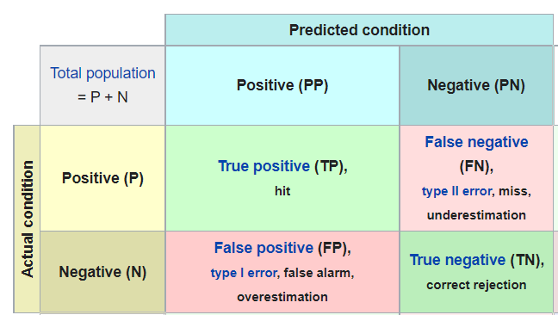
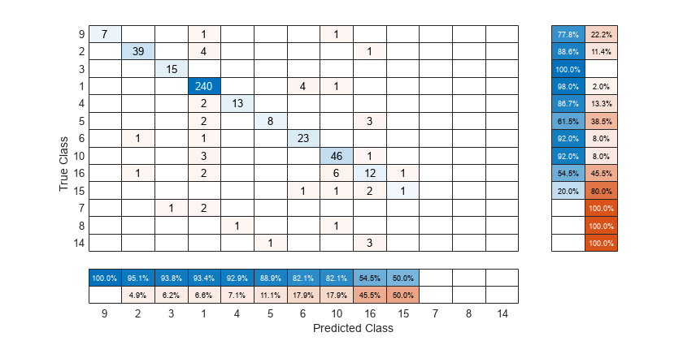
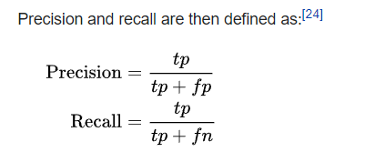


Confusion Matrices – How to Interpret
We can say when the ‘truth’ was actually a given class A, how many times was this correctly identified? This is the recall rate
We can say when we predicted the class was a certain value such as ‘A’, how many times was that right..? This is known as the precision
Sometimes these metrics are displayed on the ‘margins’ of a confusion matrix as per the image on the right
Precision
Recall

Slide 10
Random Forest Classifier Results
Random Forest Classifier | Accuracy | Precision (or PPV) | Recall (sensitivity or TPR) | f1 score | AUC_ROC | Specificty (or TNR) | NPV | True Positive | True Negative | False Positive | False Negative
First-attempt Model | 0.9 | 1 | 0.6 | 0.75 | 0.8 | 1 | 0.6 | 75 | 15 | 0 | 10
GridSearch | 0.93 | 1 | 0.72 | 0.84 | 0.86 | 1 | 0.72 | 75 | 18 | 0 | 7
Genetic Selection | 0.92 | 0.9 | 0.76 | 0.82 | 0.87 | 0.9 | 0.76 | 73 | 19 | 2 | 6
Here are the results from our Random Forest Classifier. The best in each is highlighted bold

Slide 11
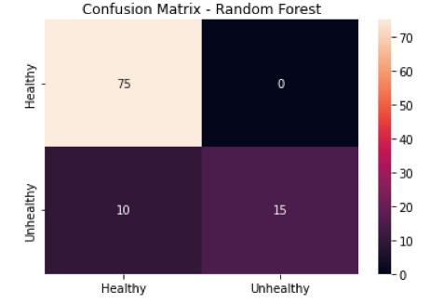
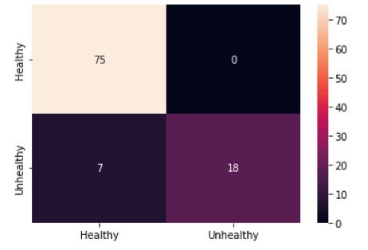
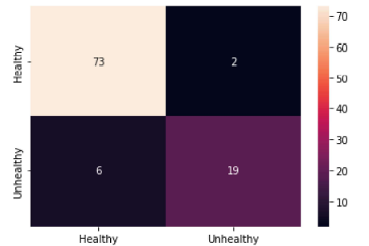
Random Forest Classifier Results
GridSearch
Genetic Selection
There is another chart in the script called ROC ‘Receiver Operator Characteristic’. What does this show?
What did our genetics experiment say about the importance of the 8 principal components?

Slide 12
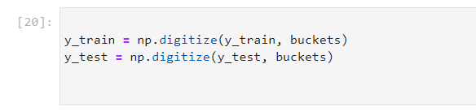
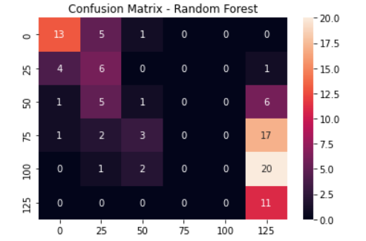
Random Forest Multi-Class Results
Note that, by capping our RUL at a certain point, our dataset has a heavy bias towards these larger values (more frequently occur)
We may wish to increase model capacity for multi-class problem vs binary

Slide 13
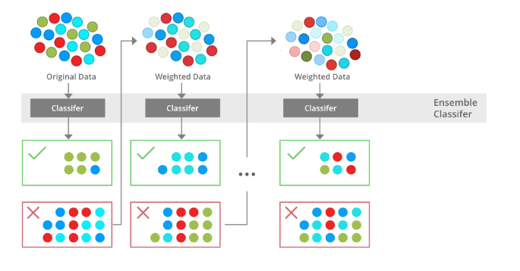
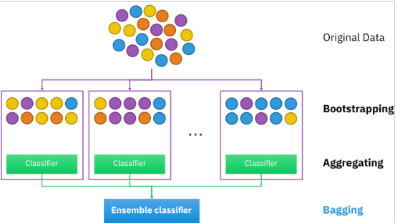
Theory – what is a Random Forest anyway?
A Random Forest is an ensemble of weak learners known as decision-trees. These are readily explainable white-box algorithms and their branches are formed using the Gini Index during ‘training’ (model.fit)
The trees are sensitive to the data they receive as well as initial random conditions. By taking differing sampling subsets of the dataset to train each tree, we encourage diversity amongst them.
Random Forest is a form of Bagging (Bootstrap Aggregation). By contrast, another ensemble mechanism is Boosting, such as XGBoost. In this case, further models are trained on the error of prior models with added weight to mis-classifications
Source: Bagging vs Boosting in Machine Learning - GeeksforGeeks

Slide 14
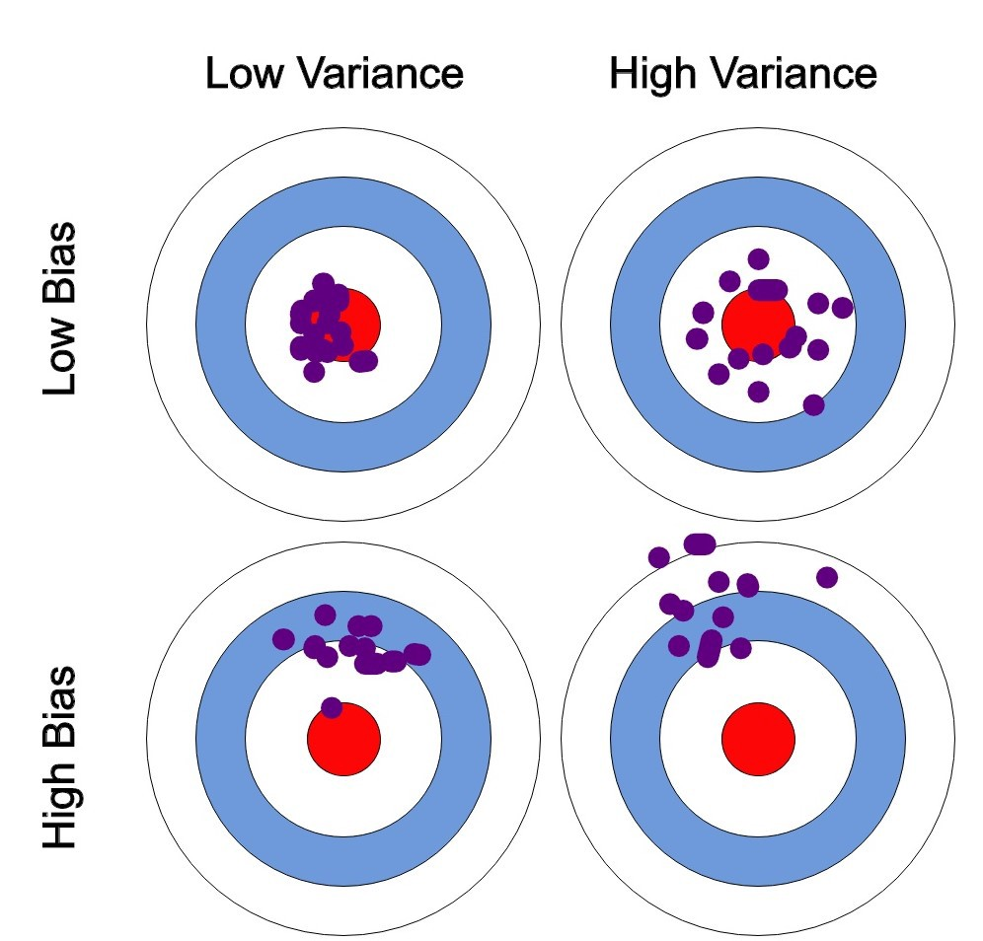
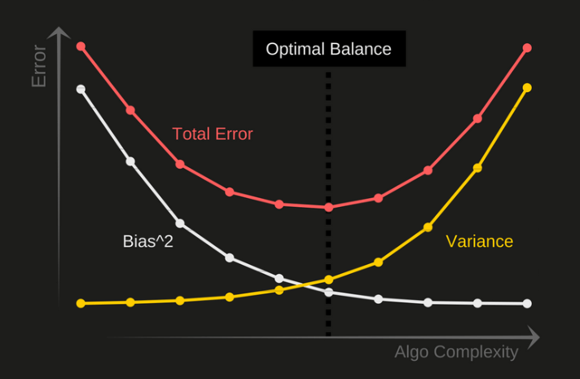
Theory – what is bias and variance?
Simpler algorithms, tend to have high bias, but low variance.
As we increase model complexity, we often end up with low bias but high variance. This is typical of non-linear models (NN), and decision trees also which is why we prune trees or apply L2 regularisation and avoid over-parameterising (making models too complex)
Random Forest and Bagging Ensembles are said to be good at reducing variance and bias respectively and may perform comparatively better in different situations
What is Bias-Variance Tradeoff?. Avoid the mistake of overfitting and… | by NVS Yashwanth | Towards Data Science
WTF is the Bias-Variance Tradeoff? (Infographic) (elitedatascience.com)

Slide 15
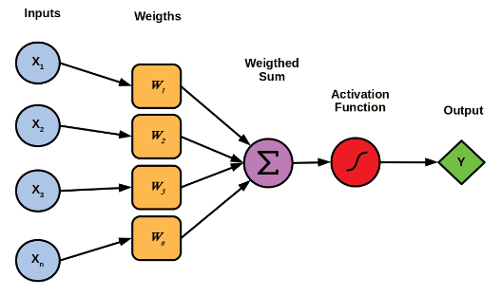
Neural Networks Recap
Take a look at our print-outs for MS Excel implementations of Dense neuron (perceptron), Convolution Layer (1 kernel filter), Batch-Normalisation and Pooling
Notice the similarity in ‘average’ pooling layers to convolutions but note no learning occurs
Notice that batch-normalisation does not change the shape. It performs Zscore (standard scaler) but then has learnable parameters to add and multiply should zero centre and unit mean not be ideal.
Notice the use of same-padding to control the output sizes
What about number of neurons in output layers, for regression?
What about, number needed in classification problems?

Slide 16
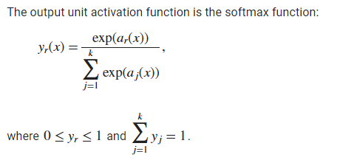
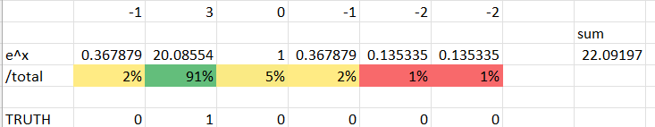
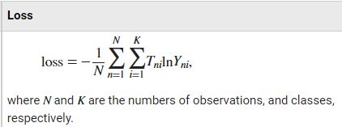
Softmax Layer and Cross-Entropy
A softmax layer, performs the function of taking a selection of inputs and representing them as percentages, totallying 100%
It is expected that just one class, will be the answer and so we can say e^x and fraction of the sum of e^x across all classes
This is sometimes known as as the normalized exponential and can be considered the multi-class generalization of the logistic sigmoid function
Softmax layer - MATLAB - MathWorks United Kingdom
[1] Bishop, C. M. Pattern Recognition and Machine Learning. Springer, New York, NY, 2006.
Softmax layer (keras.io)

Slide 17
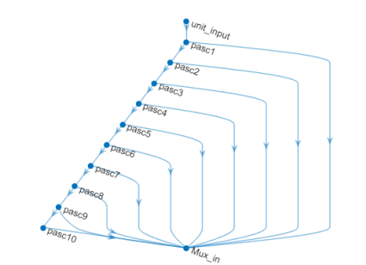
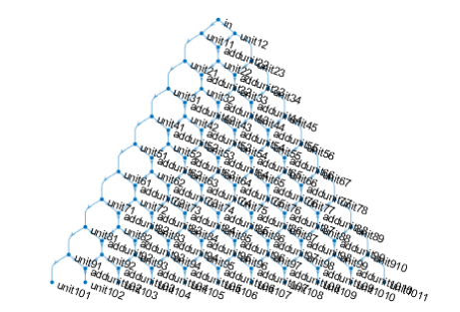
Pascal Triangle Exercise
Consider the importance of DAGs
Earlier in our OTJ learning, we showed how Python’s Functional API could be used to make NN with parallel pathways (as opposed to the sequential models)
Here, we see examples in MATLAB and python which show how MLP can generate a given row of Pascal.
How a sequential model with CNN can also generate Pascal or cumulative sum operation (Bernoulli).
Note that for a model to display all of Pascal at once, we need to use skip connections to combine the outputs of prior layers

Slide 18
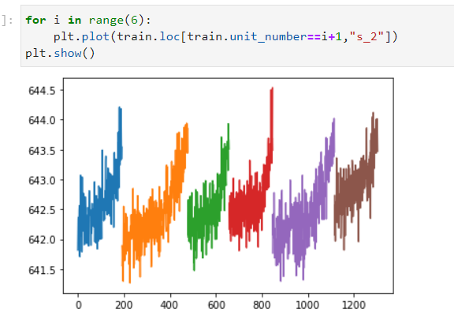
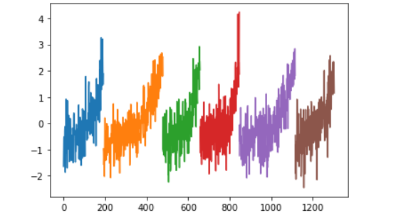
Final Thoughts for the Day and work so far..
AutoML is a tool, but doesn’t always guarantee best model. On our ResNet1d regression model, patience was used to limit the number of epochs
This was not considered in the BayesOpt which did not return a superior result. (fixed epoch may have led to overfitting)
In our method section we can discuss normalising by standard scaler (pipeline), the manual calculation of this and consider other methods (minMax rescaling?) Tpot will help us select model and pipeline tomorrow
What if we’d considered engine-wise normalising?

