Slide 1
BIACC Data Science TFX ‘On The Job’ (OTJ) ML Training Tuesday 29/11/2022

Slide 2
Progress So Far
We now have a table of classifier results. We fought hard for these with lots of code and hard theory!
Having trained Random Forest, CNN, Dense models and realised a lot of our data preparation is repeating code – we need to think more DRY!
We have written a short data handling class to refactor more pragmatically.
We can now begin training our models in fewer lines of code, more repeatably.
I noticed last night – a mistake in the CNN script normalisation code! On correction, the model now has 94% versus Random Forest’s 93%
Today’s script is much shorter but potentially powerful using tpot to automatically select models and pipelines (data processing approaches)

Slide 3
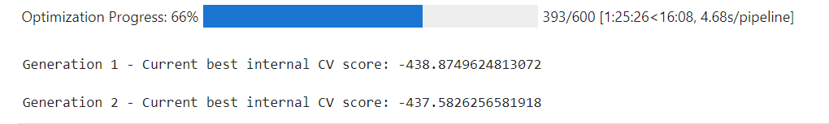
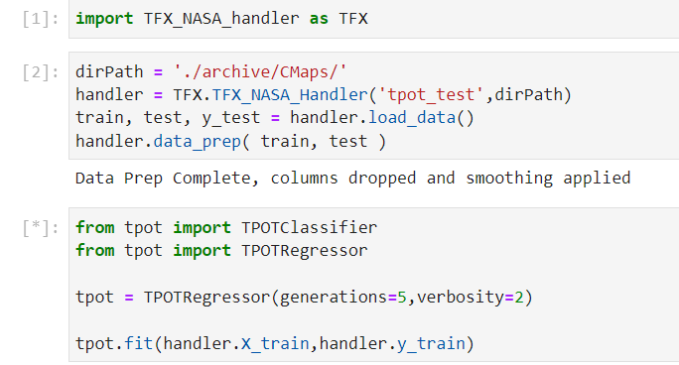
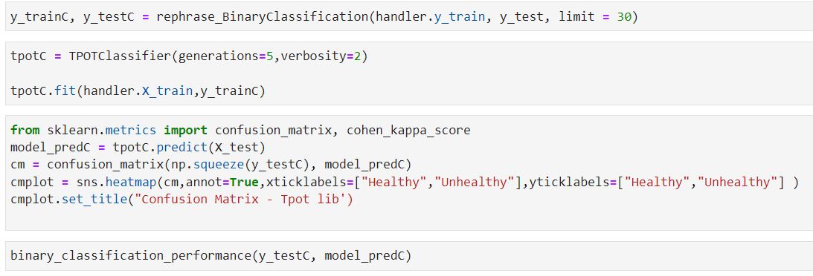
Code Approach
All our data process steps live inside a .py file
We import and use it as follows:

Slide 4
Code Approach - Classification
Within the same script we then try to optimise the best classifier. Much more elegant than our prior model.

