Slide 1
Containerisation Workshop
DevOps workshop #1
af Daniel Freiling

Slide 2
KB’s strategi
Leverandør af viden og kulturarv
Med Kubernetes og containerization first kan vi levere hurtigere og mere driftsstabil adgang til vores digitale materialer og tjenester.
En digital og datadrevet organisation
Kubernetes er et af vores værktøjer til at skabe en robust og sikker infrastruktur
Ensartet monitorering og ensartet log-opsamling = mere datadrevet drift
En attraktiv og inspirerende arbejdsplads
Muligheden for at udvikle sine kompetencer og for at arbejde med moderne standarder for it-drift og udvikling

Slide 3
Agile teams: Autonome og mynddiggjorte
Vi vil gerne gøre vores agile teams så selvkørende og selvbestemmende som muligt
Selvfølgelig i tæt samarbejde med PO'er og ejerkredse
Arbejdet med DevOps skal løfte applikationsdrift ud på alle teams således at de både udvikler og drifter applikationer
You build it → you run it → you kill it
Det kommer til at tage tid
Der skal afklares nye snitflader mellem agile teams, TEK og Team Platform
DevOps-afklaringerne starter i efteråret så vi kan nå at have aftalt snitflader for de første container-applikationer, når produktionsplatformen er klar ultimo 2026

Slide 4
Vi ved at det tager tid
Det er en opgave vi prioriterer i DT, og vil sikre at også forretningen prioriterer
Vi ved at det er en stor forandring og noget der tager tid
projektet har i første omgang sat en 3 årig periode af til processen med at implementere Kubernetes
Vi er stolte over at vi selv kan køre kurser
Vi vil sikre at der er den rette tid og mulighed for hjælp og sparring

Slide 5
Containerisation
Build your app once, run it consistently anywhere!

Slide 6
Workshop indhold
Containerisation basics
Dockerfile
Exercises: Basics
Layers & Base-images
Container Runtime
Exercises: Advanced
Docker Compose
Exercises: Compose
Notes:
Containerisation basics
Dockerfile
Exercises: Basics (1/2 time)
Layers & Base-images
Container Runtime
Exercises: Advanced (1 time)
Docker Compose
Exercises: Compose (rest. tid)

Slide 7
1.
Containerisation Basics

Slide 8
Hvorfor containerisation?
Fixer “Works on my machine” problemet.
Containers er (stort set) deterministiske.
Et bygget container image, fungerer ens uanset hvor det køres.
Fixer “Dependency hell”
🛑 “Hvilken version af java, tomcat og JDBC var det nu vi skulle have på serveren?”
🛑 “Har du installeret libpq og lagt ffmpeg i den rigtige mappe?”
Containerised apps er pakket med alle nødvendige runtime dependencies.
Dynamisk deling af ressourcer
Containere deler tilgængelige ressourcer uden unødig reservation ift. peak.
Containerised apps kan hurtigt startes op og lukkes ned → Responsiv skalering.

Slide 9
Hvorfor containerisation?
Automatisering: Hurtigere fra kode til idriftsættelse (time-to-market).
Applikationers afhængigheder og bygge-konventioner nedfældes i maskinlæsbar kode.
Maskinlæsbar → Automatiserbar.
Extensibility & Composability: Alt kan bygges videre på, stables oven på hinanden og sættes sammen til komplekse systemer.
Toolchain simplicity: “All you need is Docker”
Din container runtime kan hente alle andre nødvendige værktøjer (som en slags app-store).
Docker var første container runtime på markedet. Nu har vi en standard kaldet Open Container Initiative (OCI) og derfor mange alternativer.

Slide 10
Demo – Smagsprøve på gevinsterne
Hent og start self-contained produkter på sekunder
Fx. Postgres, ElasticSearch, Redis, RabbitMQ
Opsæt komplekse systemer af flere containers
Udvikler onboarding
Forudsigelig & automatiseret udrulning (i flere platforme og miljøer)
Notes:
docker run -d -p 8080:80 --name web nginx -> Browser at http://localhost:5000
What other images could we try? Let’s check https://hub.docker.com/
Tools running in seconds:
docker run --rm python:3.8 python --version docker run --rm python:3.12 python –version
docker run --rm -it openjdk:21 java –version
docker run -p 8080:8080 springio/gs-spring-boot-docker
docker run -d -e POSTGRES_PASSWORD=secret -p 5432:5432 postgres
Fully featured applications in seconds:
GITEA docker run -d -p 3000:3000 --name git gitea/gitea
RABBITMQ (OPT)
docker run -d --publish 8082:15672 --name rabbit rabbitmq:management
WORDPRESS + DB
docker run -d --name wp -p 8081:80 wordpress
docker network create wp-net
docker run -d \ --name wp-db \ --network wp-net \ -e MYSQL_ROOT_PASSWORD=secret \ -e MYSQL_DATABASE=wordpress \ -e MYSQL_USER=wp \ -e MYSQL_PASSWORD=wp \ mysql:8 docker run -d \ --name wp \ --network wp-net \ -p 8081:80 \ -e WORDPRESS_DB_HOST=wp-db:3306 \ -e WORDPRESS_DB_USER=wp \ -e WORDPRESS_DB_PASSWORD=wp \ -e WORDPRESS_DB_NAME=wordpress \ wordpress
docker rm -f wp wp-db docker network rm wp-net

Slide 11
What is a container anyway?
A container image is a packaged filesystem containing an application, its runtime, libraries, dependencies, and configuration.
The same image runs consistently on your laptop, your coworker’s machine, and in the cloud.
A container is not a VM! It’s just a sandboxed Linux process - isolated using modern kernel features.
Much lighter and faster to start than virtual machines.
Containers share the Host OS kernel.
But have their own network & users.
A container has its own isolated filesystem, which is all it sees when running.
A container can be seen as a sort of “parasite” on its host. Allowed to use some of its resources, but being completely isolated in its own little world.

Slide 12
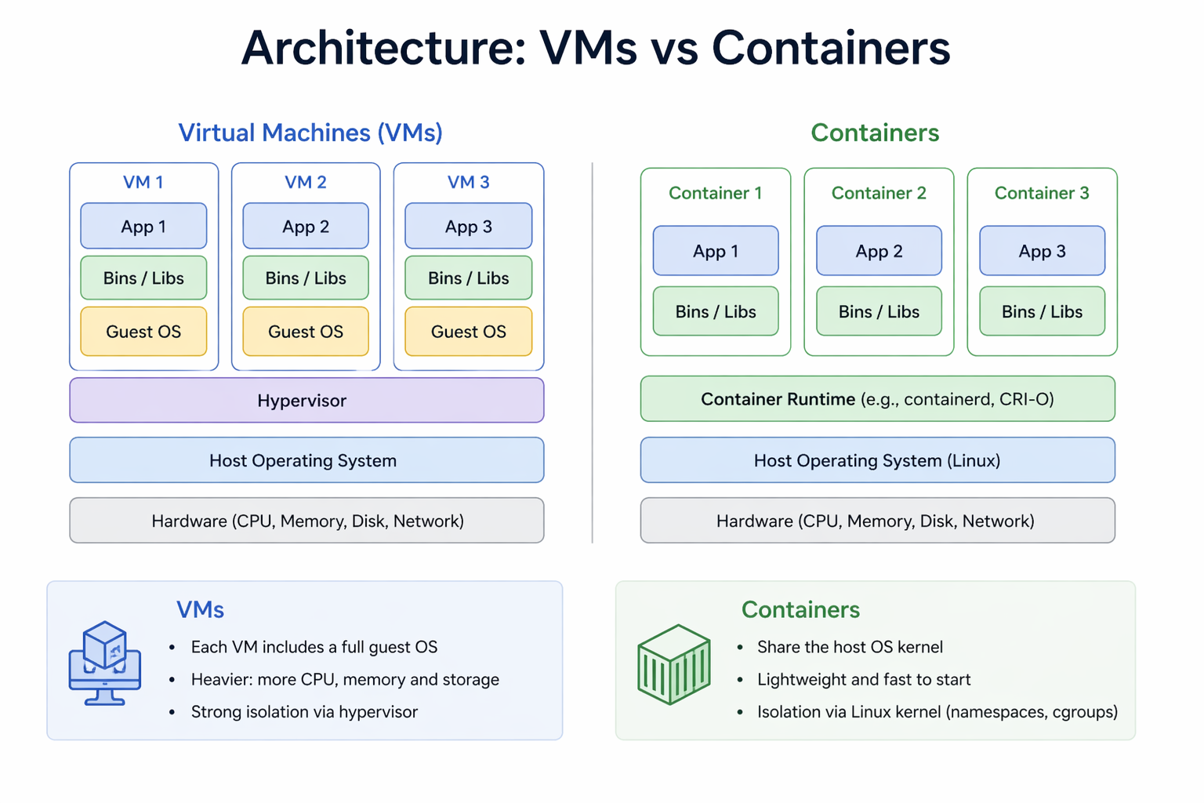
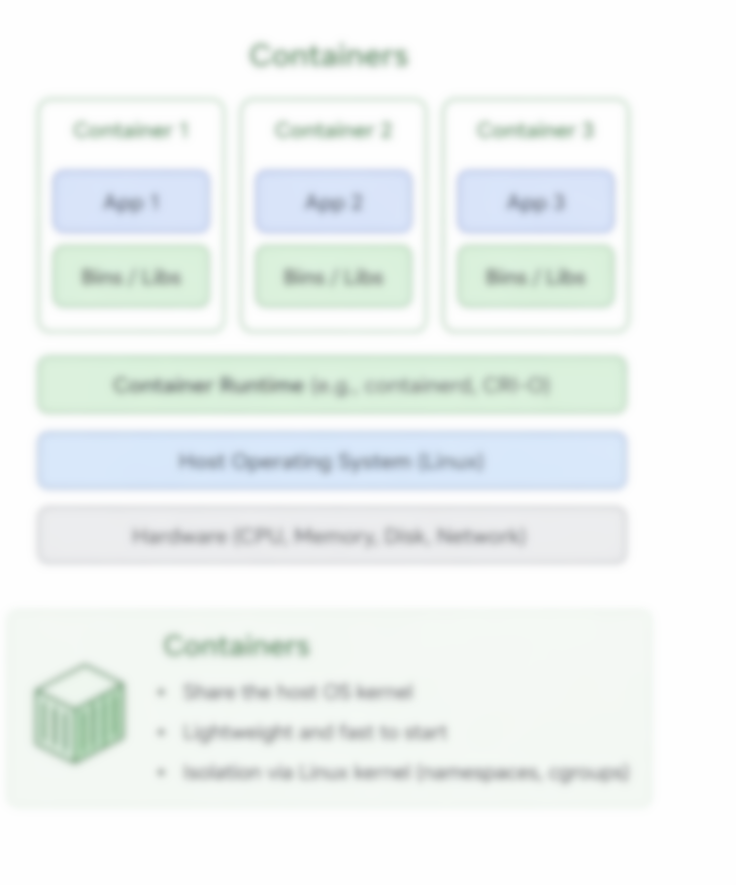

Slide 13
Docker vs Kubernetes (k8s)
Docker is a container runtime used to build, package, and run containers on a single machine.
Docker makes applications portable by packaging code, dependencies, libraries, and configuration into a consistent container image.
Kubernetes is a platform for deploying, managing, and scaling containers across multiple machines (aka. a cluster).
Kubernetes also handles orchestration tasks such as scheduling, self-healing, service discovery, rolling updates, and load balancing.
Docker creates and runs containers, while Kubernetes also ensures those containers stay available, scalable, and reliable in production

Slide 14
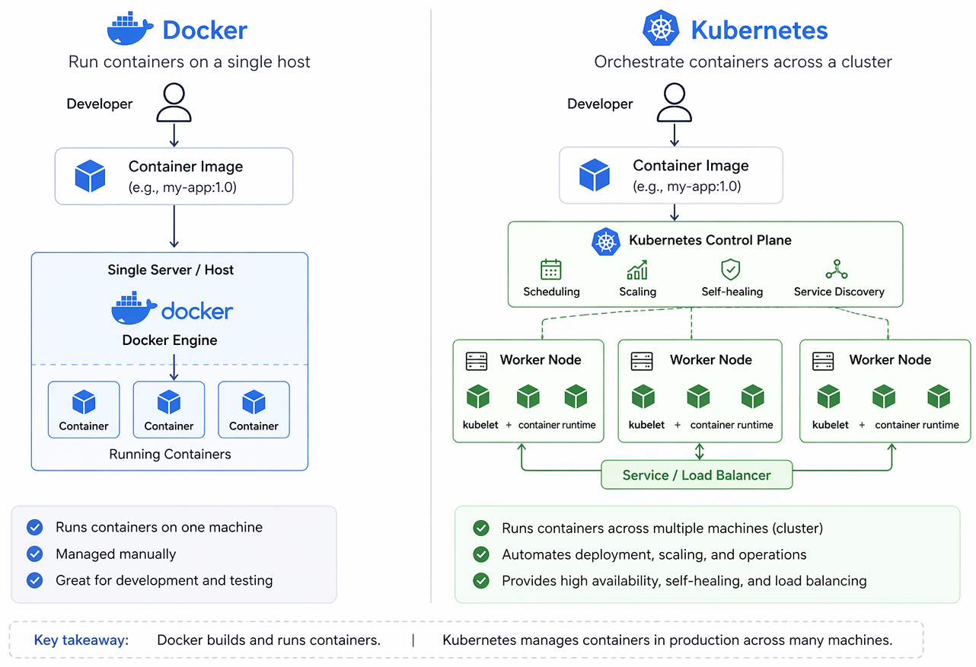
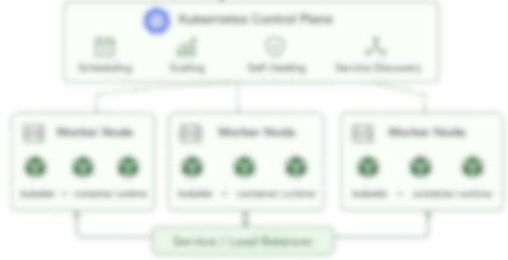

Slide 15
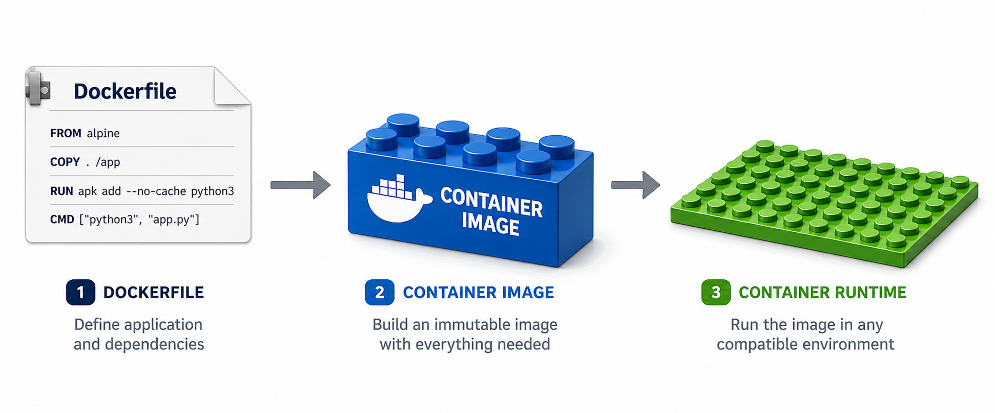
Container = Legoklods
Hvis vi kan bygge hvert komponent i vores system som selvstændige isolerede komponenter…
Kan vi køre systemet hvor som helst.
Kan vi hurtigt skalere efter behov, ved at sætte flere af de samme legoklodser på pladen.
Kan vi opbygge komplekse systemer ud af flere lego-klodser, ved at sætte dem sammen.
Også legoklodser vi ikke selv kender opskriften på eller har bygget.
Legoklodser kan hentes fra forskellige forretninger (repositories).
Vi kan bygge vores egen legoklodser ovenpå andres.

Slide 16
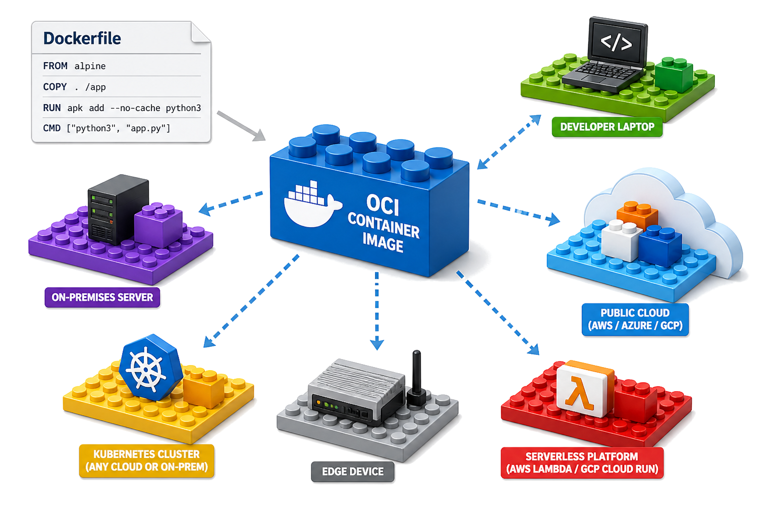

Slide 17
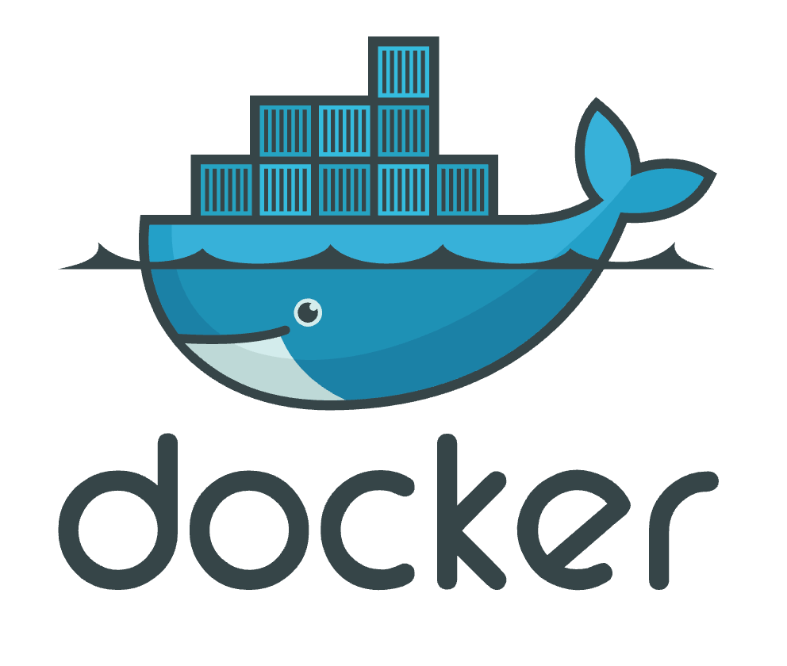
Dockerfile, Images og Containers
Dockerfile → Opskrift på et container image.
Udviklernes ansvar – Dependencies håndteret, konfigurerbar opsætning.
Container image → Den færdigbyggede containerized app, klar til at køre hvor som helst!
Er artefakt der kan afvikle en app uafhængigt af host maskinen.
Container runtime = Der hvor container images/apps afvikles.
Docker
Kubernetes

Slide 18
Docker CLI
Dockerfile
docker build . --tag <image-name>
Container image
Container runtime
docker exec
docker run
docker push <image-name>
docker pull <image-name>
docker logs

Slide 19
2.
Dockerfile Container opskriften

Slide 20
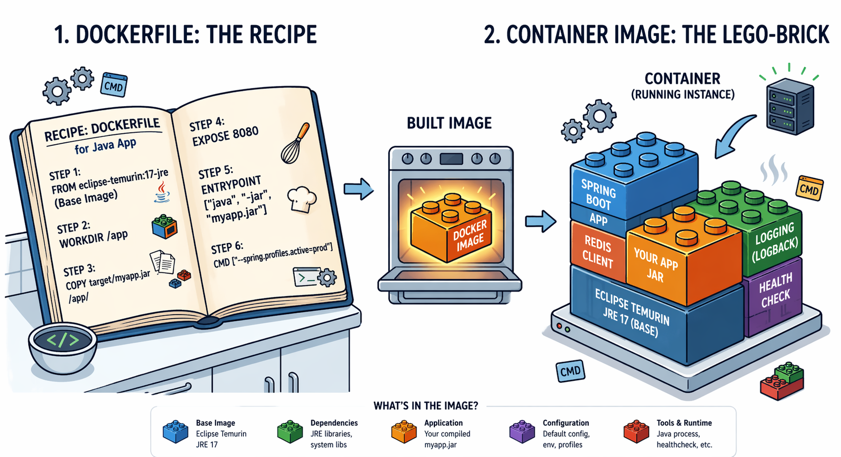
Notes:
Forklar udfra udvikler synspunkt. Ny app version -> Ny “bagning” ud fra opskriften.
Færdigbagt image = Genbrugeligt artefakt (oftest versioneret via tag).

Slide 21
Basic Dockerfile
En Dockerfile er vores opskrift på at bygge et genbrugeligt container image.
En Dockerfile består af linjer med instruktioner “VERB params”
Filename: Dockerfile
FROM docker.io/ubuntu:24.04 USER root (implicit)
RUN apt update && apt install -y openjdk-21-jdk
WORKDIR /app
COPY Hello.java .
RUN javac Hello.java
ENTRYPOINT ["java", "Hello"]
1. Setup base environment and tools
2. Copy in your source
3. Build your app
4. Define startup
Virker en Dockerfile så kun med Docker CLI’en? Nej - navnet har bare hængt fast
Notes:
Narrate each VERB
Narrate the Dockerfile as:
1. Start from a base environment
2. Copy in application code
3. Build the app
4. Define startup command

Slide 22
Dockerfile – Instructions
Setup
FROM repo/image-name:version (default repo: docker.io)
WORKDIR /src
USER not-root
Modification (image build)
ADD/COPY ./src1 ./src2 ./srcN /dest
RUN apt install -y curl && apt clean
Injection
ENV FOO=bar (runtime)
ARG BUILD_SECRET=abc (build-time)
Execution (container runtime)
ENTRYPOINT [“java”]
CMD [“-jar”, “my-app.jar”, “--arg”, “foo”]
Documentation
EXPOSE 80/tcp
LABEL description=“My app”
Reference:
https://docs.docker.com/reference/dockerfile/
Notes:
Følg link til docker.io og vis tilgængelige images og søgning efter et.
ENTRYPOINT defines the main executable of the container
CMD defines the default arguments to that executable. It’s easier to override: docker run myapp -version
EXPOSE is purely metadata/documentation!

Slide 23
3.
Exercise: Basics Let’s build a basic container image

Slide 24
Let’s build a container image!
Fetch workshop repo https://github.com/Notalib/workshop-containerisation
Read the top part of README.md
Suggest starting with 1-ubuntu-debugger
Then pick app using your preferred language
Complete the Dockerfile for that language (see TODOs)
Make sure it builds docker build . --tag app
Make sure it runs (correctly) docker run app

Slide 25
Exercise: Basics - Retrospective
Learnings
Issues
Let’s look at a solution together
Can you debug a Dockerfile?
Notes:
Very likely issues that should be covered:
Build Context (which folder does paths to COPY start in?)
Steps that need user interaction (e.g. missing -y flag in apt cmds)
Folders not existing where you think
Debug Dockerfile
VSCode extension /w debugger and breakpoints
docker inspect
docker exec -it <layer-sha> /bin/bash

Slide 26
4.
Layers & Base-images

Slide 27
Dockerfile – Stages & Layers
Layer: Each INSTRUCTION creates a new layer in the image.
Layers are “overlayed/stacked” on-top of eachother to create a filesystem.
Pull image → Fetch all layers individually.
Push image → Upload all layers individually.
Number of instructions and their order = Very important for speed and size of image.
Stage: FROM image AS stage-name
Allows for splitting the container build process into discrete stages.
Change images in the middle of a Dockerfile. E.g. use smaller image for runtime than build.
Allows to build many images from single Dockerfile. E.g. small variations with extra tools.

Slide 28
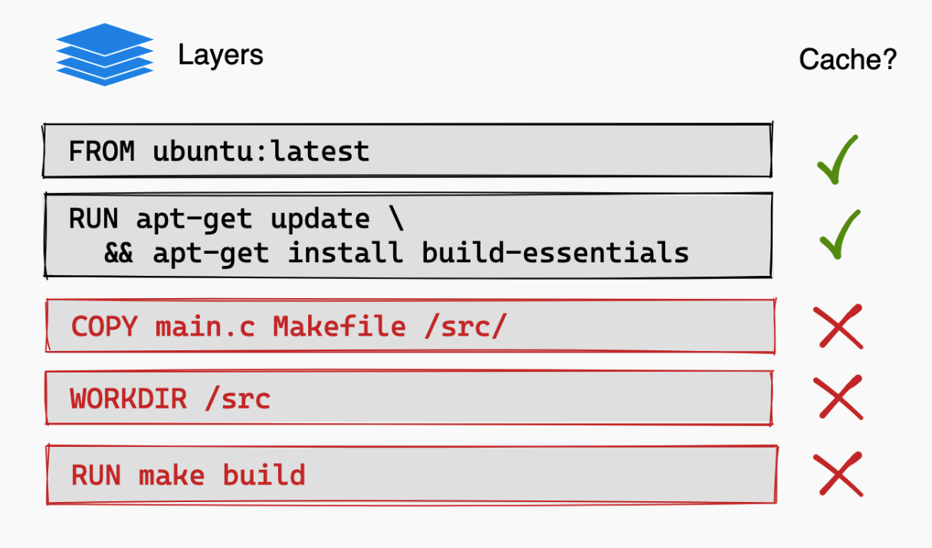
Dockerfile – Layers
“Each instruction in a Dockerfile translates to a layer in your final image … Once a layer changes, then all downstream layers need to be rebuilt as well”
If Makefile was modified,
docker (re-)builds from here

Slide 29
Dockerfile – Layers are cached
Build context/input changes → layer cache is invalidated!
Dockerfile instruction order matters!
This is where we can optimize image size and build-times.
Se https://docs.docker.com/build/cache/
What happens here when you change your Java src and rebuild?
FROM fat-JDK-image
COPY ./java-project /src
COPY ./large-ext-deps /src/deps
RUN apt upgrade && apt install curl jq

Slide 30
Dockerfile – Multi-stage
Ved at dele en Dockerfile op i flere stages, opnår vi:
Langt mindre runtime images – Ikke behov for SDK tools og store distros for at køre app’en.
Mindre angrebsflade → Forbedret sikkerhed.
Færre bevægelige dele → Nemmere maintenance.
Bedre build caching → Hurtigere CI pipelines.
FROM alpine/java:21-jdk AS build-stage
WORKDIR /out
... [Build the app artifact]
FROM alpine/java:21-jre AS runtime-stage
COPY --from=build-stage /out /app
ENTRYPOINT /app/my-app.jar
Stage 1
Stage 2
Notes:
TODO: Mere realistiske image referencer og Entrypoint

Slide 31
Dockerfile – Base images
Size matters! 😳
Base-image types:
Scratch → Literally nothing
Distro → Full filesystem of a Linux distro ( Ubuntu / RHEL / Alpine )
Distro-less → Runtime of a Linux distro, but no package manager, shell, etc.
Smaller base-image
✔ Faster image pull
✔ Smaller attack surface
🐞 Slightly more difficult to debug
Notes:
scratch → minimal native binaries
distro images → development/debugging flexibility
https://github.com/googlecontainertools/distroless
gcr.io/distroless/static-debian12
distroless → secure production runtime
Distroless images
Only runtime dependencies included
No shell or package manager
Smaller and more secure than full distros
Common for production Java/Node apps

Slide 32
5.
Container runtime

Slide 33
Container runtimes
Single node (Udvikler):
Docker
Podman
Rancher Desktop
Multi node (Serverdrift):
Kubernetes
Implements the Docker CLI

Slide 34
Runtime – Execution & logs
Run (new container)
docker run --detach <image:tag> cmd
docker run --rm --entrypoint /bin/do-stuff <image:tag>
docker run --publish 8080:80 nginx:latest
Execute (existing container)
docker exec --interactive --tty <container-name> /bin/bash
docker exec --user root <container-name> whoami
docker exec --detach <container-name> /app/cleanup.sh
Logs
docker logs --follow <container-name>
docker logs --tail 200 <container-name>
docker logs --since=2026-01-01 --until=1h <container-name>
Notes:
Debugging distro-less image: docker debug my-app:latest (Docker Desktop)
This launches a temporary sidecar/debug container with shell tools attached to the distroless container.
Open-source alternative:
brew install cdebug
cdebug exec -it mycontainer
Requires “Sudo access” in Rancher Desktop
https://docs.rancherdesktop.io/ui/preferences/application/general/#administrative-access

Slide 35
Runtime – Volume mapping
Map host folders into a running container
Example: Let’s mount a local folder into an nginx container docker run --volume ./web:/usr/share/nginx/html \ --publish 8080:80 \ nginx:latest
Useful for:
Overriding config files
Injecting secrets
Persist changes!

Slide 36
6.
Exercise: Advanced Let’s build more optimized container images & see how they work in practice!

Slide 37
Exercise: Advanced
Continue from where you left off in https://github.com/Notalib/workshop-containerisation
Finish containerising the applications.
Optimize Dockerfiles for faster (re-)build and slimmer images.
See README.md in each app folder for more instructions
See root README.md for bonus tasks & best-practices. Recap kl. 13:00

Slide 38
Exercise: Advanced - Retrospective
Learnings & issues
Look at solutions together
Best practices?

Slide 39
7.
Docker Compose Multi-component systems

Slide 40
Docker Compose
Tool for defining a multi-container application, where we compose several containers to work together as a single multi-container system.
Manage services, networks, and volumes in a single YAML configuration file
Declarative infrastructure (document) instead of imperative (commands)
Includes commands for managing the whole lifecycle of your application:
Start, stop, and build services (container images)
View the status of running services
Stream the logs of running services
Run one-off commands on a service

Slide 41
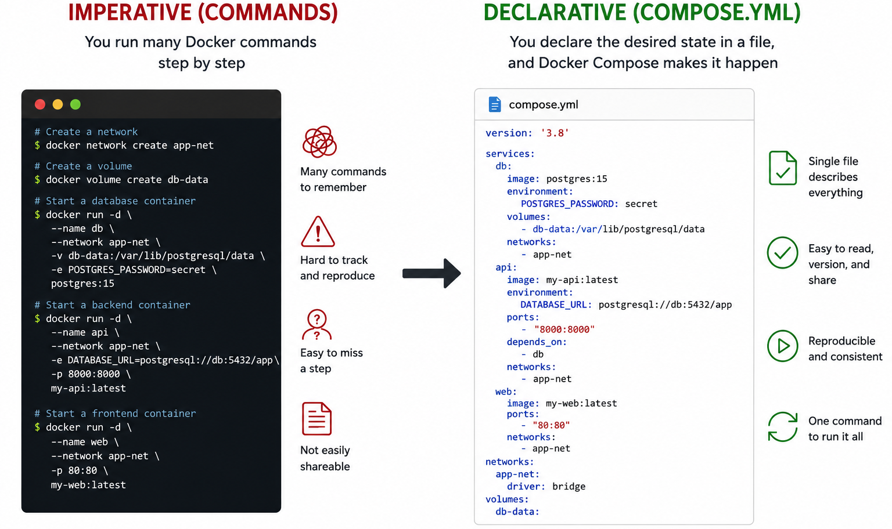

Slide 42
Docker Compose – Monorepo example
Each component is a service
File: docker-compose.yml or just compose.yml
services:
frontend:
build: ./frontend
backend:
build: ./backend
database:
image: postgres:17
Pull, build & bring up all services with a single command:
docker compose up –-detach

Slide 43
Docker Compose – Basic Commands
docker compose up
Start all services (builds if needed)
--detach = Start in background (detached)
docker compose down
Stop and remove containers + network
docker compose ps
List running services
docker compose logs <service-name> -f
Follow logs from all services
--tail n = Give me n latest lines
--since “1h” = Give me logs from past hour
Notes:
Relate this to the CLI-demo spring+db app

Slide 44
Docker Compose – Useful daily cmds
docker compose build
Build/rebuild images
docker compose restart
Restart all services
docker compose exec <service> sh
Open shell inside a container
docker compose run <service> <cmd>
Run one-off command (fx. migrations or jobs)
docker compose pull
Fetch latest images
Notes:
Relate this to the CLI-demo spring+db app

Slide 45
Docker Compose – Ports
Internal networking
Docker Compose creates a default network for every compose file.
Every service from the same compose file joins it automatically.
All services can reach each other via: <service-name>:<container-port>
Host networking
ports: - "HOST_PORT:CONTAINER_PORT”
Example: ”8080:80” would expose host port 8080 to container port 80
⚠️ By default, services are exposed on ALL network interfaces ⚠️
Limit to loopback-only with ”127.0.0.1:8080:80”
Notes:
Add more compose examples, so audience remembers frontend/backend definition.
In our example frontend can reach backend via http://backend:5000

Slide 46
Compose example /w ports
Compose example with ports
services:
frontend:
build: ./frontend
ports:
- “8080:80”
backend:
build: ./backend
redis:
image: redis:alpine

Slide 47
Docker Compose – Environment Vars
We can modify environment variables inside the containers
Most common way to re-configure apps across environments
services:
frontend:
build: ./frontend
env:
- BACKEND_URL: ”backend:5000”
- FOO: bar
backend:
build: ./backend
Notes:
Relation: 12-factor app, app’s should be configurable and able to change “backing service”.

Slide 48
Docker Compose – Practical Example
Example: edu-spring-postgres/compose.yml
Follow the steps in README.md
Example: DIT ExamSystem
Using compose for development & CI/CD
Notes:
See:
https://github.com/Notalib/BookCoverService/blob/master/compose.yml
https://github.com/Notalib/BookCoverService/blob/master/.github/workflows/docker-publish.yml
https://github.com/Notalib/ExamSystem/blob/main/ci/docker-compose.yml

Slide 49
Docker Compose – Volumes
Host files and folders can be mounted into services. services: backend: volumes: - "HOST_PATH:CONTAINER_PATH"
Named volumes can persist data from services services: database: volumes: - "db-data:/var/lib/data" volumes: db-data
Notes:
Show example in edu-spring-postgres

Slide 50
Docker Compose – Exercises
Try docker compose in edu-spring-postgres folder
Try some awesome-compose examples
https://github.com/docker/awesome-compose
Run the ./get-awesome.sh script
Inspect the demos cd awesome-compose; ls –al
Pick one and docker compose up -d inside its folder

Slide 51
Opt.
Extras & Container Technicals

Slide 52
Containerisation – The 12 factor app
Guidelines for hvordan en applikation bør tilpasse sig til en containerised verden.
Aka. ”Cloud-native apps”
Goal: Be portable and scalable!
Principper applikationer bør følge:
Baked-in dependencies
Explicitly declared and baked into image.
Disposable
Stateless processes
Fast startup, graceful shutdown
Configurable
Config via ENV variables, with sane defaults.
Able to change “backing services”.
Standardised Logging
Write to stdout/stderr → container platform aggregates
Configurable levels
Concurrently scalable
Multiple instances must co-exist.
etc…
Required reading: https://12factor.net/ or https://w.wiki/MHUu

Slide 53
Docker Debug
How to get a shell in a scratch or distro-less container?
You debug the container!
docker debug <container-name>
Docker Desktop feature 😭
Open-source alternative
brew install cdebug
cdebug exec -it <container-name> sh
Manually run in same isolation
docker run --pid container:<name> \ --network container:<name> \ --rm –it busybox sh
Notes:
docker run -d --name distroless gcr.io/distroless/base-debian13:debug "-c" "sleep 666"
docker run --rm -it --pid container:distroless --network container:distroless alpine sh
github.com/iximiuz/cdebug

Slide 54
OCI – Standardisering af Containers
The Open Container Initiative (OCI) created specs for:
Image format → OCI Image Format
Runtime interface → OCI Runtime Specification
Distribution protocol → OCI Distribution Specification
These ensure that:
An image built by one tool can run anywhere.
Runtimes like containerd, CRI-O, or Docker can execute the same image.
Registries can distribute the same artifacts.

Slide 55
Container isolation - Technicals
Linux kernel features used by container runtimes:
Namespaces → Process isolation
Cgroups → Resource allocation
OverlayFS → Layered filesystem
Virtual Machines (VMs) are parasites on their host machine
Complete VMs exists as full machines inside their hosts
Slim VMs use the capabilities of their hosts; they cannot exist independently
More fundamental than “userspace” VMs such as JVM.
More userspacey than Libvirt or VirtualBox VMs

Slide 56
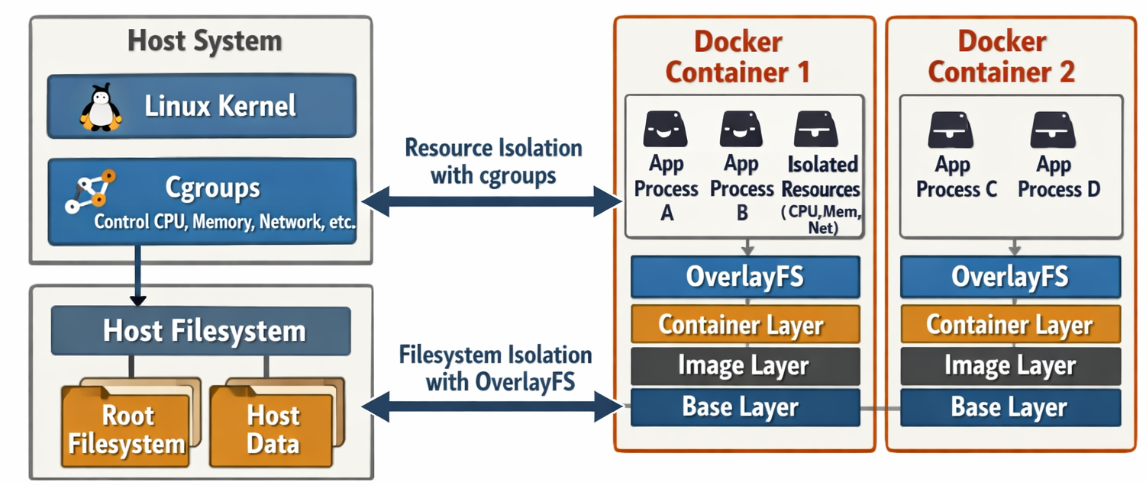
Container isolation

Slide 57
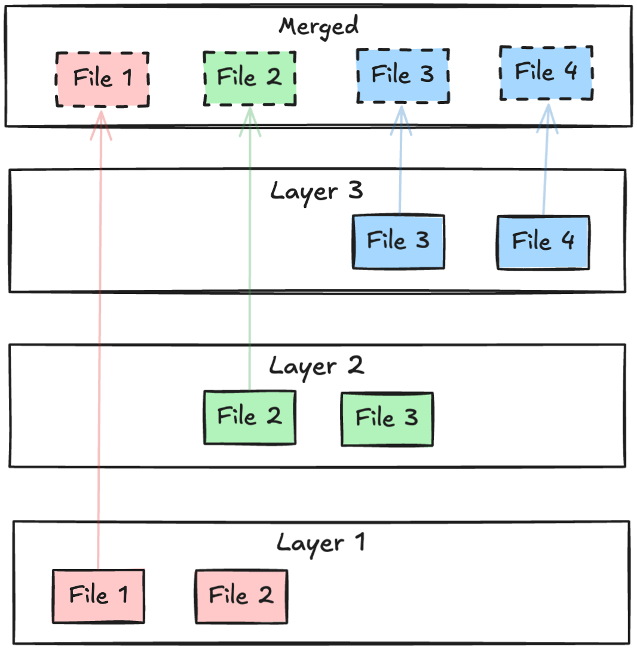
OverlayFS
Sequentially layered filesystem for unix.
Run container → Create filesystem using OverlayFS.
All individual layers are overlayed into one unified (merged) view of the complete filesystem.
All files in your container image comes from a layer.
An image contains a manifest with references to each layer.
Bottom-most layer is called the base image.
Usually a Linux distribution
Where the root filesystem comes from, like /bin /etc
But – You can also start from scratch!
Notes:
Visualisering: Navngiv lag – OS, App, Metadata (eg. EXPOSE), Config,

Slide 58
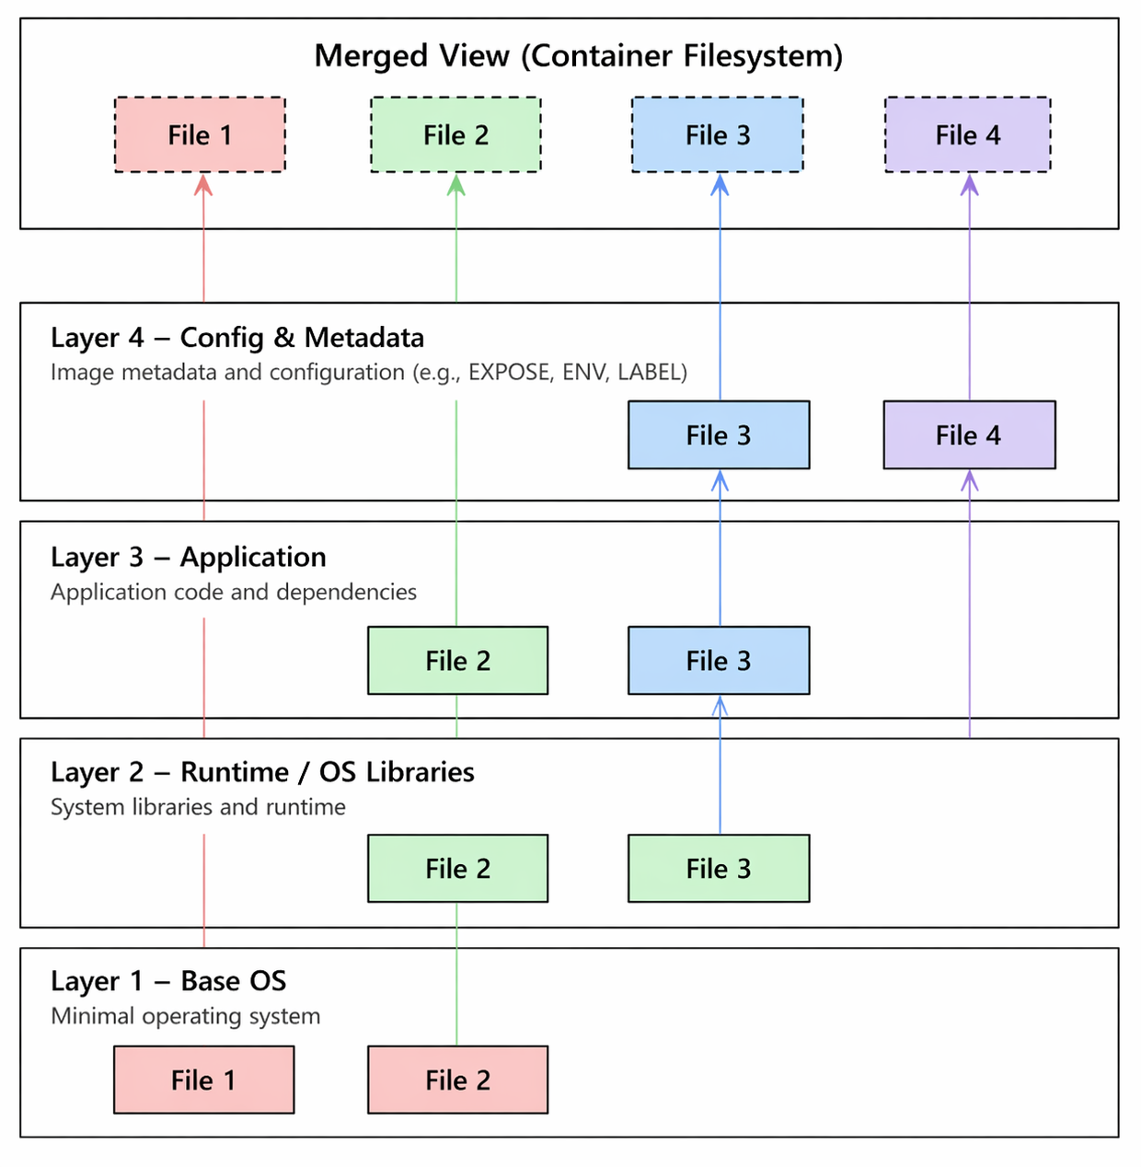
OverlayFS
Image layers example:
Base OS
Runtime & Libraries
Your app
Config & Metadata

