Slide 1
Kubernetes Workshop
DevOps workshop #2
af Daniel Freiling

Slide 2
Kubernetes Workshop
Part #2

Slide 3
Workshop indhold
Kubernetes Basics
CLI Demo
Deployments & Pods [+Exercise]
Exposing containers [+Exercise]
Manifests & Reconciliation
Kubectl, k9s og Rancher UI
Environment & Volume Mounts [+Show & Copy]
Orchestration
Complex systems [+Show & Copy]

Slide 4
1.
Kubernetes Basics

Slide 5
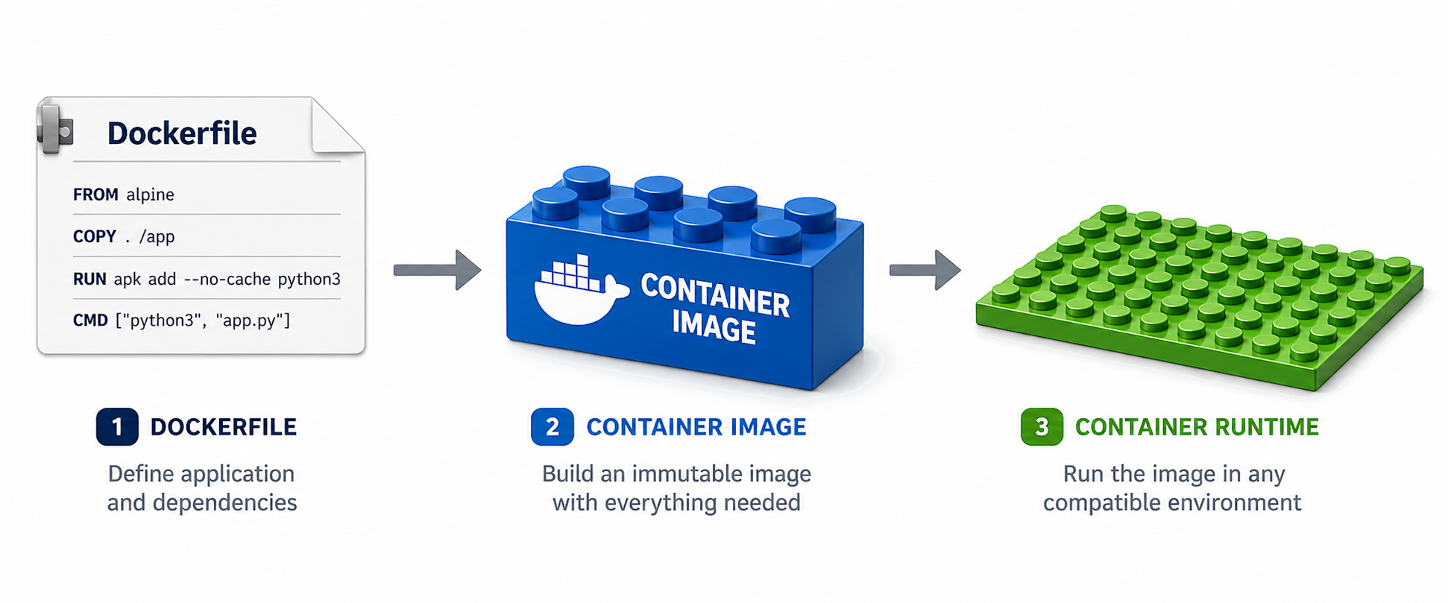
Container = Legoklods
Hvis vi kan bygge hvert komponent i vores system som selvstændige isolerede komponenter…
Kan vi køre systemet hvor som helst.
Kan vi hurtigt skalere efter behov, ved at sætte flere af de samme legoklodser på pladen.
Kan vi opbygge komplekse systemer ud af flere lego-klodser, ved at sætte dem sammen.
Notes:
Resumé

Slide 6
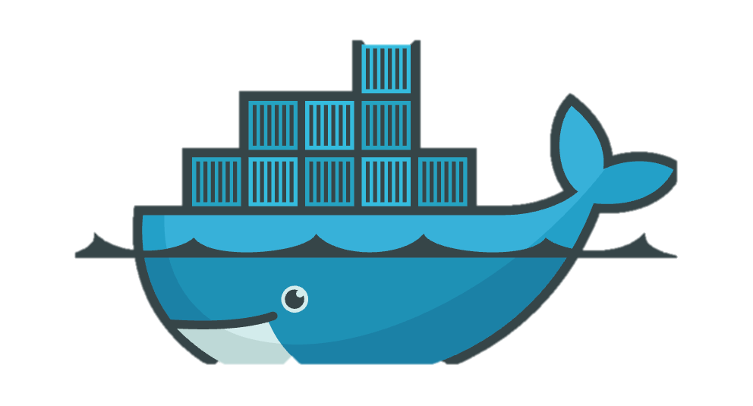
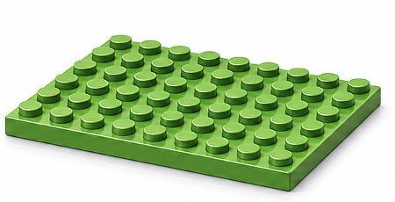
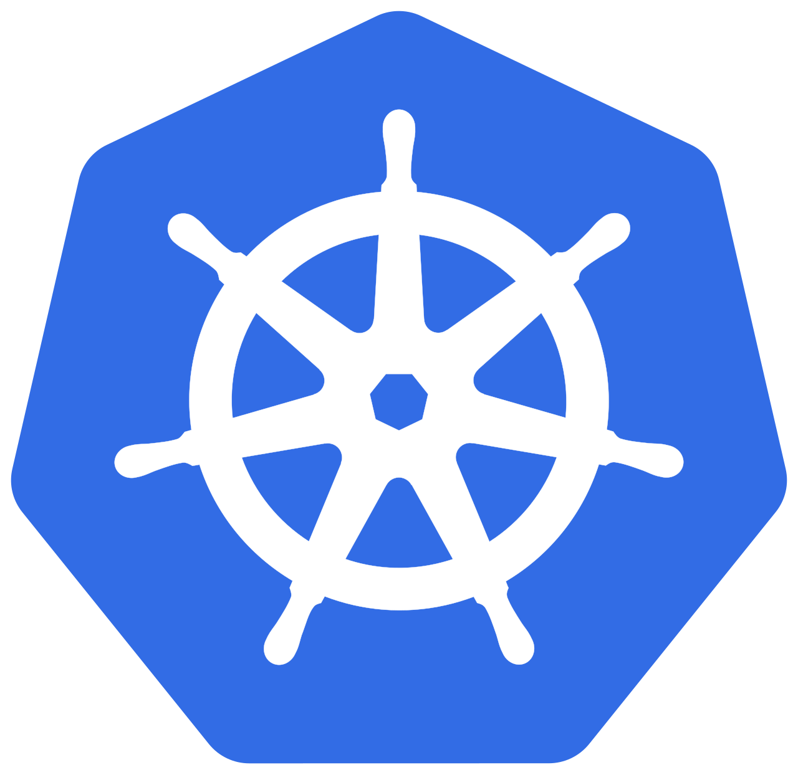
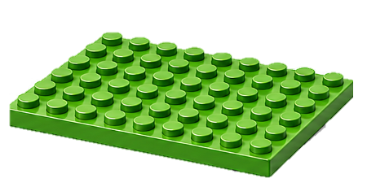
Containerization
Dockerfile = Opskrift på en containerized applikation.
Udviklernes ansvar – Dependencies håndteret, konfigurerbar opsætning.
Container image = Den byggede containerized app, klar til at køre hvor som helst!
Er artefakt der kan afvikle en app uafhængigt af host maskinen.
Container runtime = Der hvor container images/apps afvikles.
Docker
Kubernetes
Fokus for workshop

Slide 7
Docker vs Kubernetes (k8s)
Docker is a container runtime used to build, package, and run containers on a single machine.
Docker makes applications portable by packaging code, dependencies, libraries, and configuration into a consistent container image.
Kubernetes is a platform for deploying, managing, and scaling containers across multiple machines (aka. a cluster).
Kubernetes also handles orchestration tasks such as scheduling, self-healing, service discovery, rolling updates, and load balancing.
Docker creates and runs containers, while Kubernetes also ensures those containers stay: available, scalable, and reliable in production

Slide 8
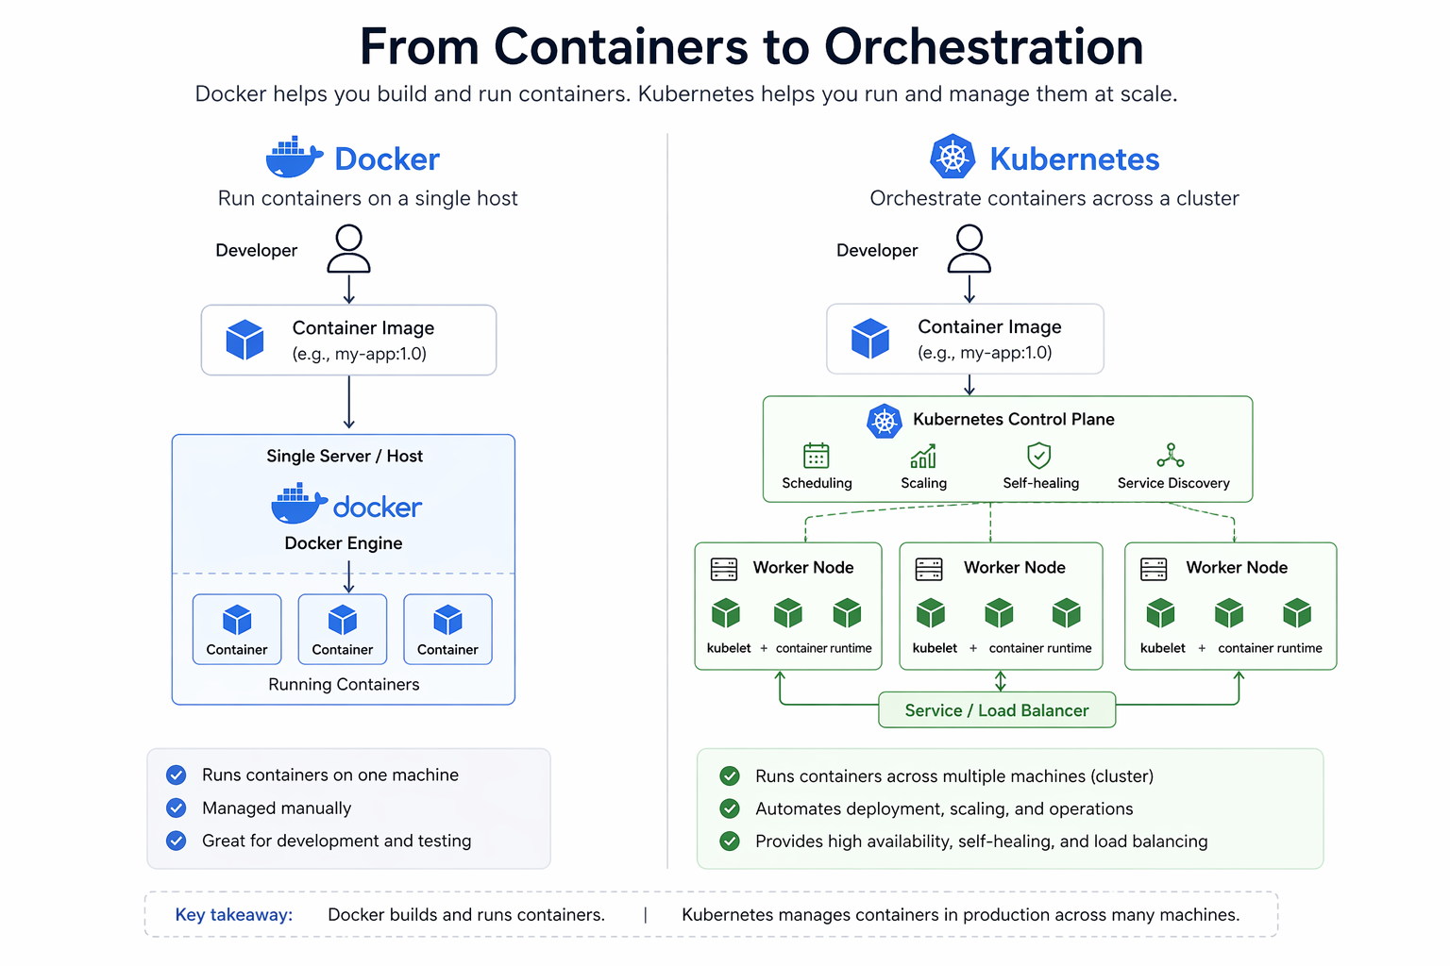
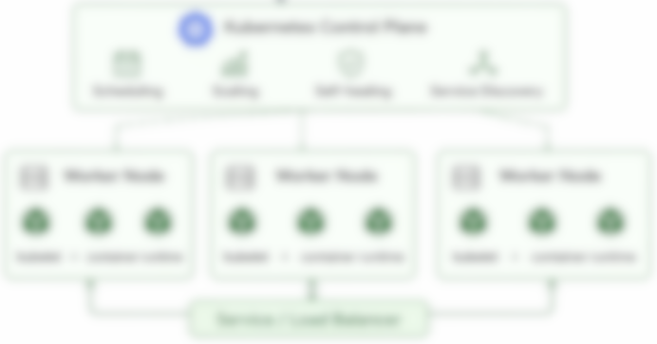
Notes:
Kubernetes as: “The Great Conductor”

Slide 9
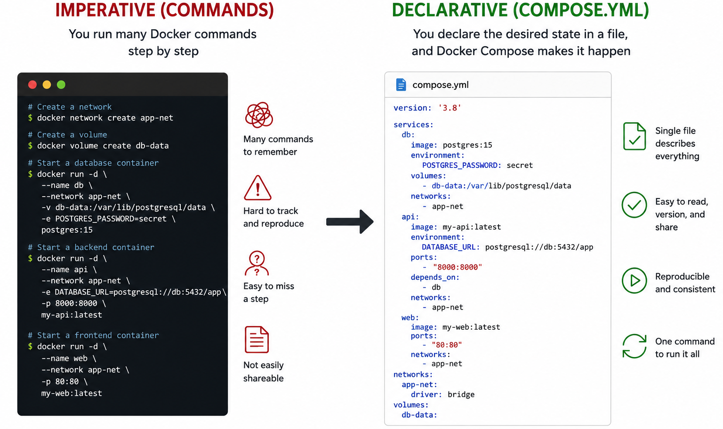
Aka. Infrastructure as Code (IaC)
Notes:
Reminder fra sidste workshop. Imperative vs. Declarative.
Både Docker Compose og Kubernetes har declarative som fokus.

Slide 10
Docker Compose vs. Kubernetes
Både Docker Compose og Kubernetes er deklarative
Du beskriver en ønsket tilstand for din IT arkitektur.
Platformen forsøger at gøre den til virkelighed.
Docker Compose er:
Single-host orkestrering
Udvikler-fokuseret
Men… Begrænset scaling, load-balancing og self-healing.
Men… Hvis Docker hosten dør, er dine systemer bare nede.
Compose = Deklarativ opstart af infrastruktur
Kubernetes = Deklarativ kontinuerlig drift af infrastruktur
Commands:
docker network create my-network
docker volume create my-data
docker run -d --network=mynet my-app
...
VERSUS
My desired state
My desired state
My desired state

Slide 11
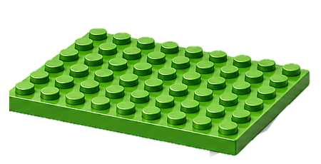
Hvad er Kubernetes?
Et multi-node high-availability container runtime.
I forhold til Docker Compose får vi også:
Orkestrering: Automatic management of containerized applications across multiple servers
Service & Load Balancing: Automatic service detection and internal traffic distribution
Automatiseret udrulning: Streamlined application rollouts, updates, and rollbacks
Self-healing features: Continuously monitors health to automatically restart, replace, or reschedule failed containers, maintaining service uptime.
Ressource styring: Optimization of CPU, memory, and storage usage through precise configuration and dynamic allocation, maximizing hardware utilization.
Kubernetes is a declarative control plane that continuously reconciles desired cluster state against actual runtime state.

Slide 12
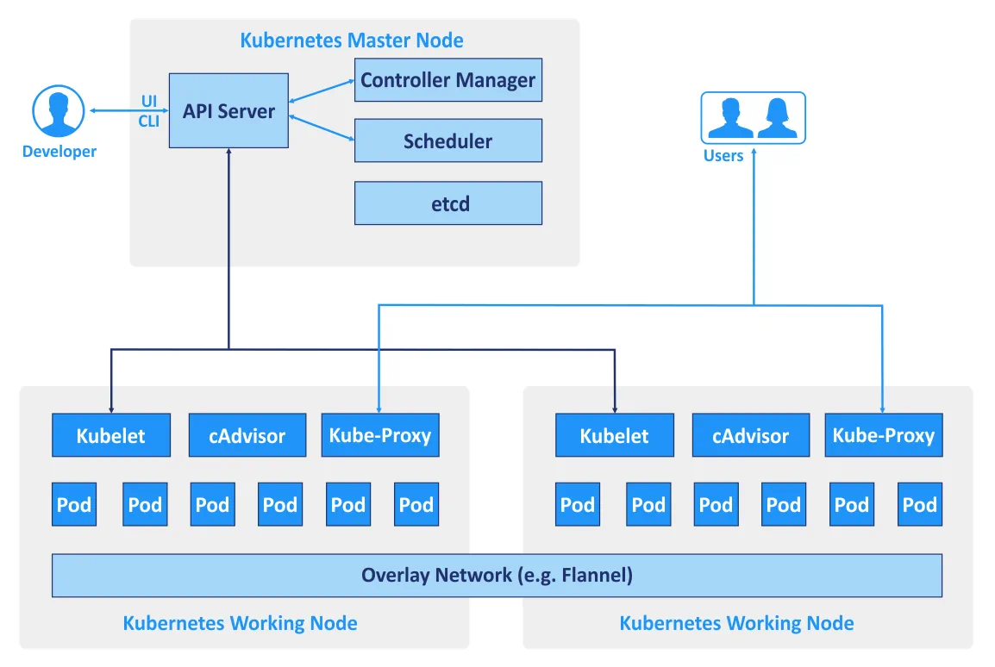
Kubernetes Cluster
🧠
💪
💪
Notes:
Lige nu kører alt dette på jeres lokale maskine → agerer hjerne og muskel på én gang

Slide 13
Control Plane (“The Brain”)
🧠
kube-apiserver
Central API entrypoint
Stores & validates desired state
All components communicate through it
etcd
Distributed cluster database
Stores all cluster state/configuration
kube-controller-manager
Ensures actual state matches desired state via “reconciliation loops
Examples:
Deployment controller
Node controller
ReplicaSet controller
kube-scheduler
Decides where Pods should run
Considers: resources, affinity, taints/tolerations and more.

Slide 14
Worker Nodes (“The Muscle”)
💪
kubelet
Node agent
Ensures Pods are running correctly
Talks to API server – “What’s our state? What should I run?”
Container Runtime
Examples:
containerd
CRI-O
Responsible for:
pulling images
starting/stopping containers
kube-proxy
Cluster networking/load balancing
Service routing rules

Slide 15
Kubernetes API
The core of Kubernetes control plane is the API server.
API server exposes an HTTP API that lets end-users, parts of your cluster, and external components communicate with one another.
Query and manipulate the state of API objects in Kubernetes
Fx. Namespaces, Deployments, Pods, ConfigMaps.
These objects (or manifests) simply describes the desired state of the cluster.
kubectl → is just an easy way to interact with API

Slide 16
Hvordan bruger man så Kubernetes?
CLI værktøjet kubectl
Meget ens med docker og docker compose (cmds og flag)
Faktisk laver kubectl bare API kald der opretter og redigerer dokumenter.
Lad os prøve at oprette en Deployment! kubectl create deployment web --image=nginx kubectl get all -o wide
Notes:
See API calls with -v=8
kubectl get pods -v=8
kubectl create namespace test --dry-run=server -v=8

Slide 17
2.
Kubernetes CLI Demo
Appetitvækker

Slide 18
2. Demo – Smagsprøve på k8s
Let’s create a Deployment and mess with it!
Deployment → ReplicaSet → Pod
Destroy stuff and watch Kubernetes reconcile 😈
Let’s horizontally scale our Deployment
Zero-downtime changes
Reach a container from our browser
Notes:
kubernetes-workshop/kubectl-demo/README.md

Slide 19
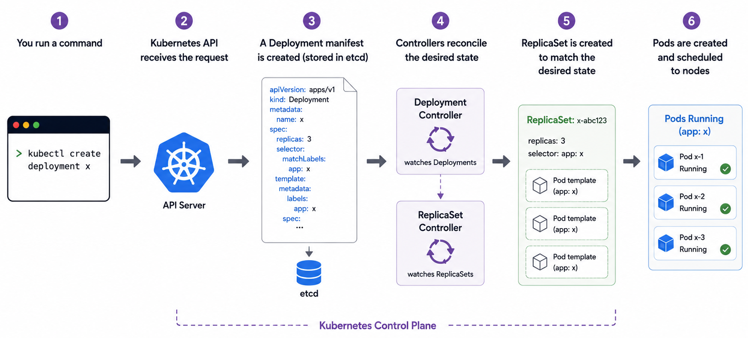
Fra kubectl til kørende Pod

Slide 20
Kubernetes Manifests (YAML)
YAML manifests are the documents describing our desired state.
Let’s look at a Manifest (YAML) for one of our objects.
# From imperative to declarative
kubectl create deployment … → kubectl get deploy –o yaml > deploy.yml
# From gone to re-applied kubectl delete deployment … → kubectl apply -f deploy.yml
Notes:
kubectl create deployment nginx --image=nginx:latest
kubectl get deploy/nginx -o yaml my-deployment.yml
kubectl delete nginx
kubectl apply my-deployment.yml

Slide 21
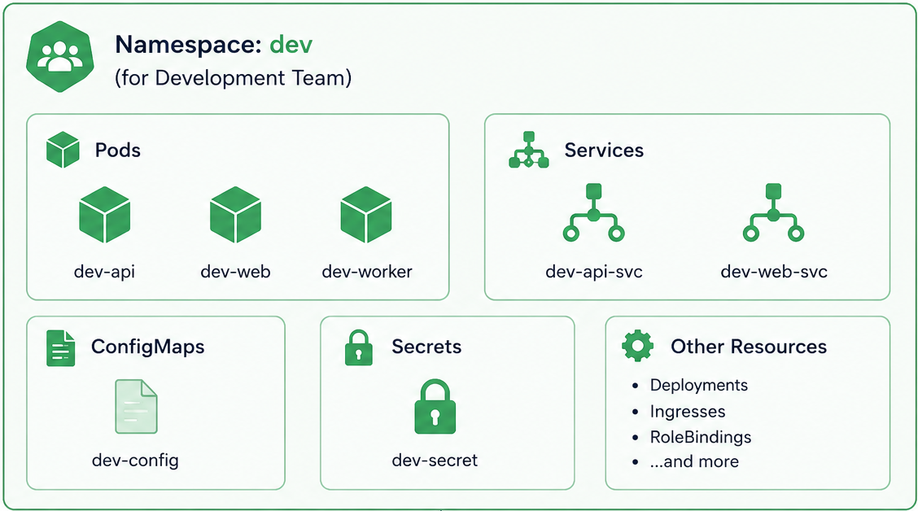
Namespaces
Logisk opdeling af ressourcer (aka. Labeled fence).
Optionally:
Group-wide resource limits.
Role-based access policy.
Network separation.

Slide 22
What is a Pod?
“Pods are the smallest deployable unit you can create and manage in Kubernetes.”
En Pod er en eller flere containere der kører som én enhed. De kører i samme “kravlegård” ift. ressourcer og deler én intern IP adresse.
Hver container i en Pod har hvert deres filsystem, men kan dele enkelte mounts.
En Pod har altid én eller flere normale containere – Oftest bare 1.
Kan også have en eller flere init containers, en container der skal køre og exit uden fejl før de normale starter.

Slide 23
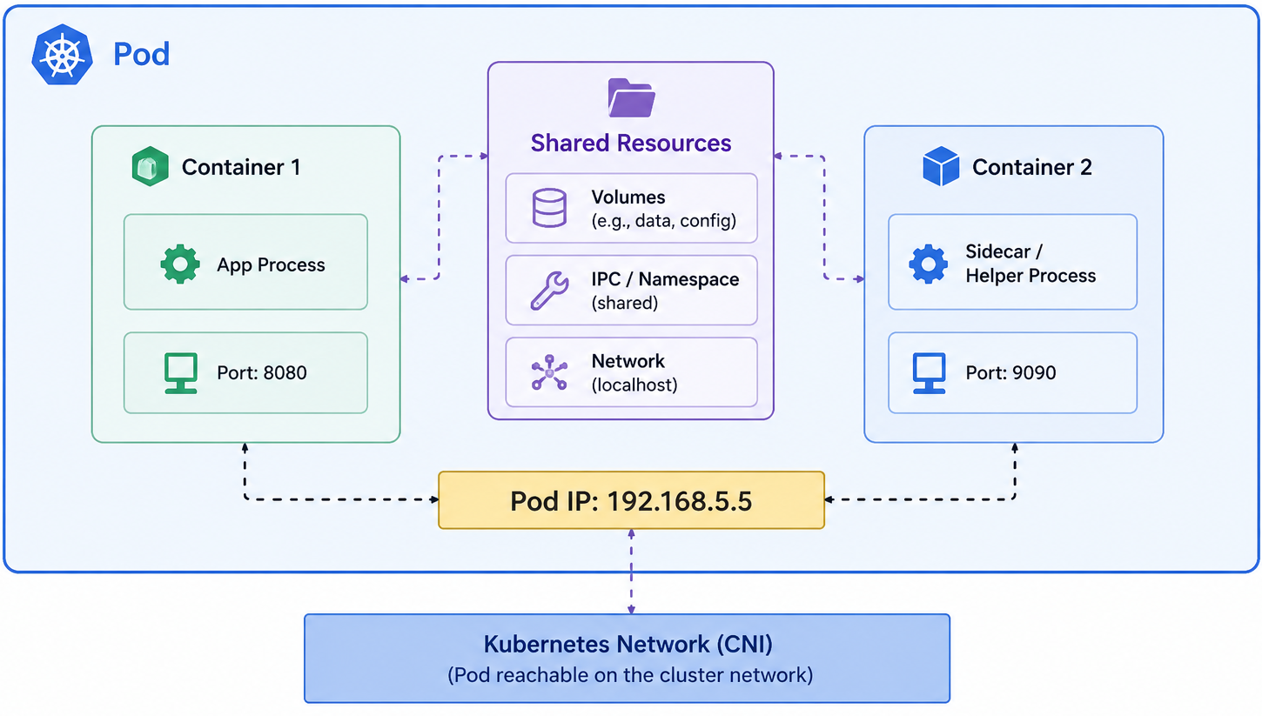
Notes:
En Pod der indeholder en App container, samt en Sidecar container.
De har samme interne IP - deler porte & ressourcer, men som udgangspunkt ikke filsystem.

Slide 24
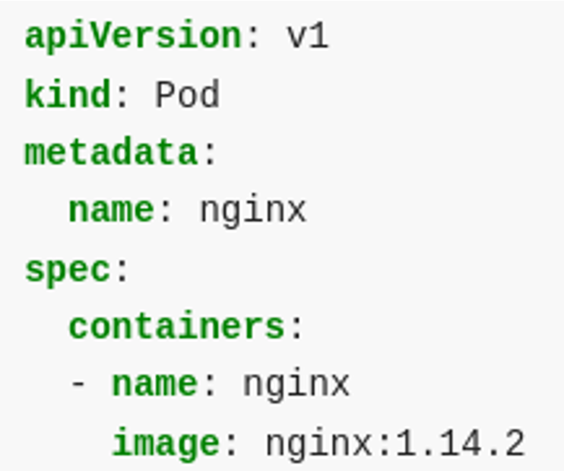
Pod manifest
Manifests describe a desired “state” of the cluster.
This manifest says:
A Pod should exist
It should be named nginx
It should have a container also named nginx
This container should use the Container image nginx tag “1.14.2”
Like Docker, default repository is hub.docker.com

Slide 25
What is a Deployment?
A Deployment provides declarative updates for Pods and ReplicaSets.
A ReplicaSet must maintain a stable set of replicas of the same Pod.
Replicas must be running at any given time (self-correcting).
Used to guarantee availability of a specified number of identical Pods.

Slide 26
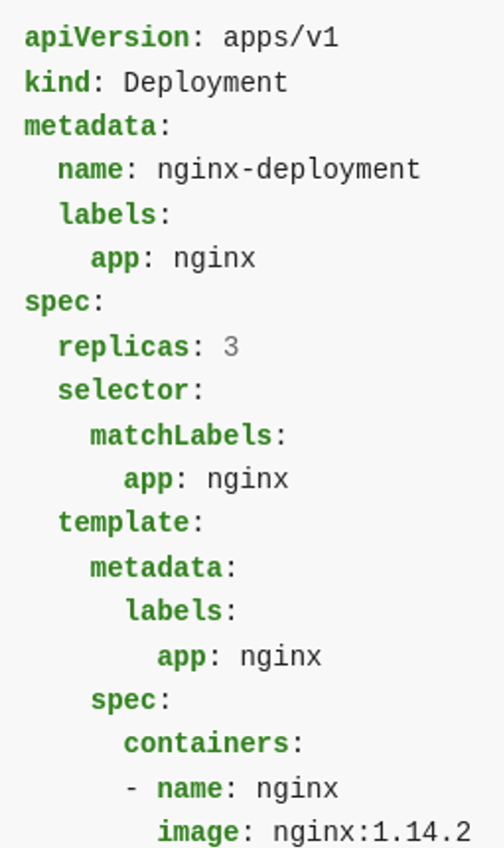
Deployment manifest
This manifest says:
The Deployment is called "nginx-deployment"
It should contain 3 identical Pods
It identifies its “owned” Pods by matching the label app = nginx
All 3 Pods should be created from the same template
Each Pod has the label app = nginx
Template says each Pod has 1 container using nginx:1.14.2 image
Notes:
TODO: Undlad app labels

Slide 27
3.
Exercise: Deployments & Pods

Slide 28
Setup a local Kubernetes cluster
Windows:
Rancher Desktop
kind (choco install)
Linux / Mac
Rancher Desktop
kind
k3d
Have the docs at hand!
https://kubernetes.io/docs
ChatGPT or similar LLM knows lots about Kubernetes!

Slide 29
Workshop Repo
Sørg for at Kubernetes kører lokalt
Tjek at kubectl get nodes virker og viser din egen maskine som node.
Hent repo: git clone https://github.com/notalib/workshop-kubernetes
Følg instruktioner i setup/README.md for at få lokalt cluster op at køre.
Følg instruktioner i 1-deployments-pods/README.md
Først kører vi tingene via kommandoer (imperative)
Så skriver vi det samme som manifester (declarative).

Slide 30
Exercise recap
Hvad lærte vi?
Hvad var svært?
Se på løsning

Slide 31
4.
Exposing containers

Slide 32
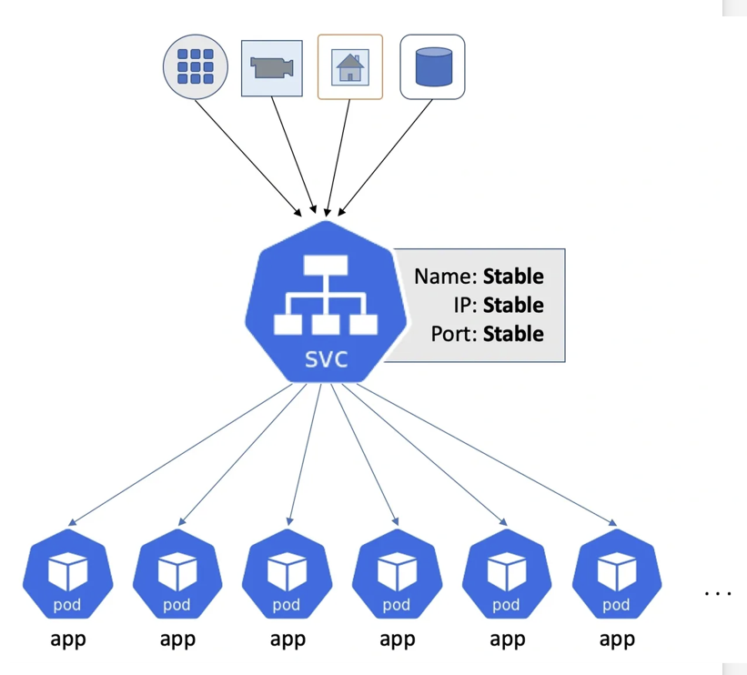
Services
One stable DNS name & IP for one type of Pod(s)
Query-based binding between a service-name and Pod workloads
Service (long-lived) → Pod (short-lived)
Abstracts away the need to know Pod IP addresses.
A cluster’s “Internal DNS”

Slide 33
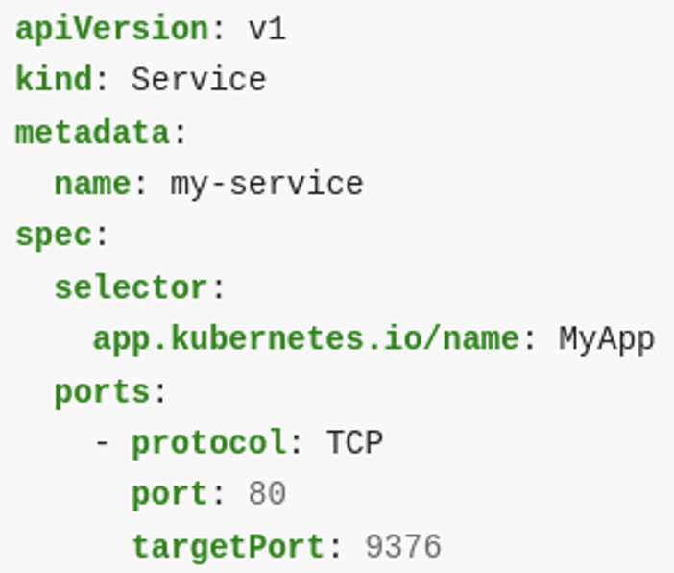
Service - Manifest
Name = Navn som andre Pods i Kubernetes kan bruge i stedet for IP til at finde specifikke Pods
Servicens navn er: my-service
Selector = Labels der matcher med Pods, som den sender trafik til
Send trafik til Pods med name=MyApp
Ports = How ports map from Service to Pods
Send trafik som skal til my-service:80 videre til matchende Pod’s port 9376

Slide 34
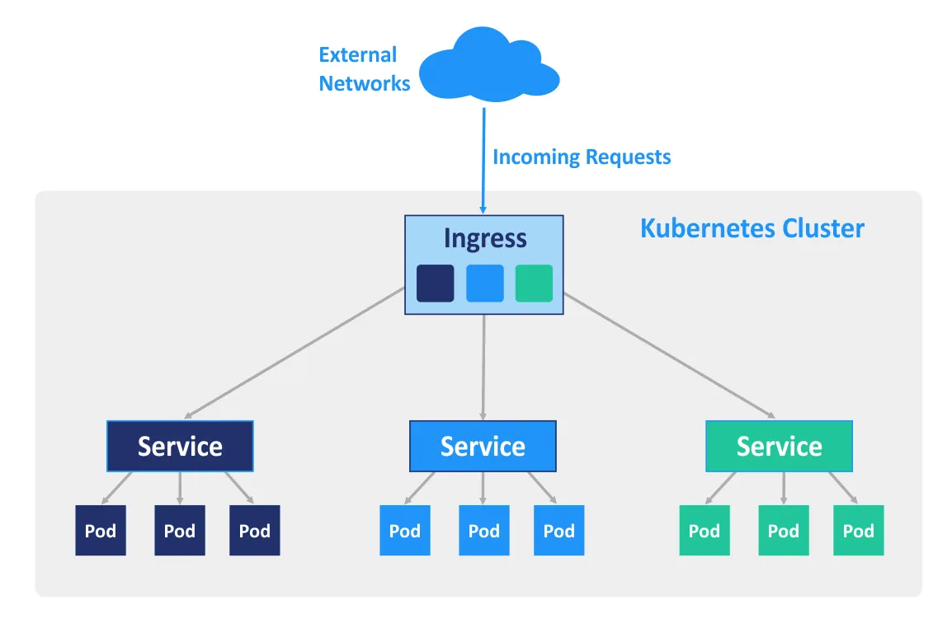
Services & Ingress
Service:
Intern DNS
Fx. my-service.<namespace>.svc
Ingress:
External DNS
SSL termination
Connects to services
Fx. my-app-devel.kb.dk
Request → Ingress → Service → Pod
Real-life eksempel fra DIT
Notes:
Se på eksempel i Rancher
https://kubernetes.io/docs/concepts/services-networking/dns-pod-service/#namespaces-of-services

Slide 35
Expose a service
kubernetes.io/docs/tutorials/services/connect-applications-service
kubectl expose deployment/test --port 80
Creates a Service manifest with name test
kubectl create ingress test --rule=host/path=service:port [--class=traefik]
kubectl create ingress test --rule=demo.localhost/=test:80
kubectl edit ingress/test
kubectl describe ingress test

Slide 36
4.
Exercises for Exposing containers
Følg instrukser i 2-exposing-workloads

Slide 37
Exercise recap
Hvad lærte vi?
Hvad var svært?
Se på løsning

Slide 38
5.
Manifests & Reconciliation

Slide 39
Manifest vs. Controller
Manifest
Definition of desired state in YAML for a resource type.
Fx. MyDeployment.yaml, MyIngress.yaml
Multiple manifests per file possible → Split with a --- line
Controller
Code responsible for reaching desired state as defined by manifests.
Usually responsible for 1 type of Manifest each.
Fx. Pod Controller -> Make sure Pods are running as described by Pod manifests.
Ingress Controller -> Make sure traffic reaches the desired Service as described by Ingress manifests.

Slide 40
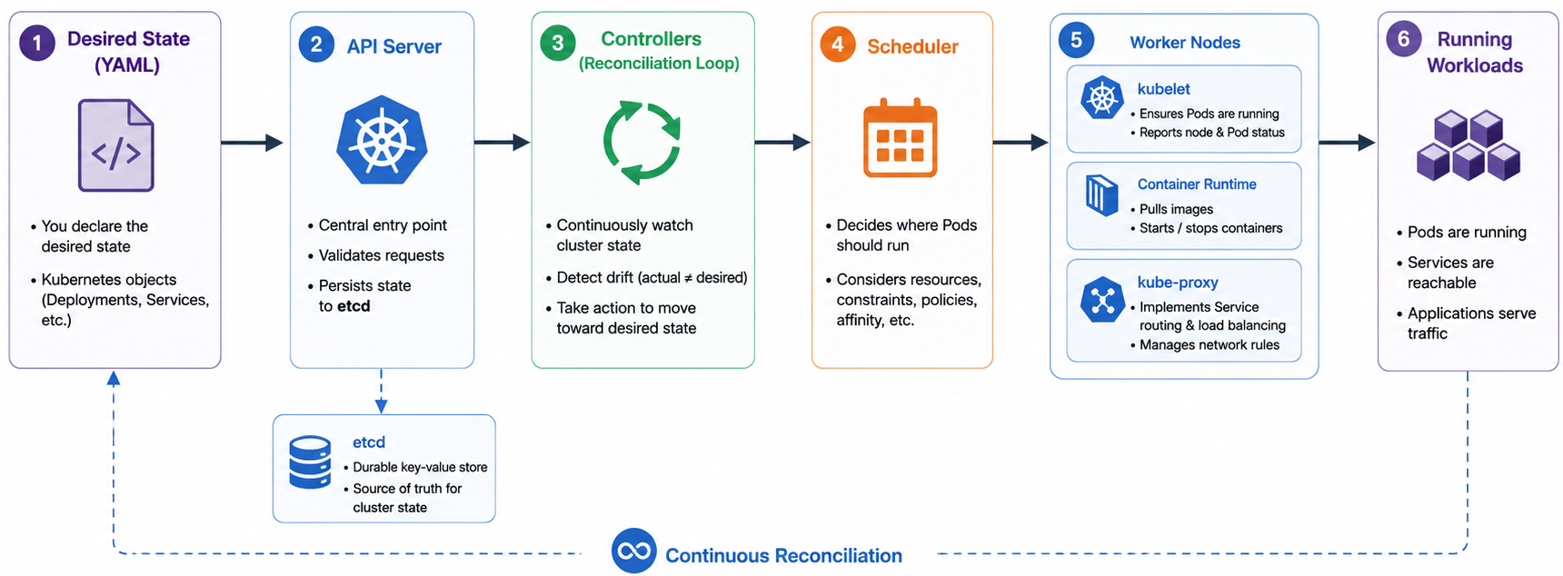
Core Kubernetes loop

Slide 41
6.
kubectl, k9s
og Rancher UI

Slide 42
Kubernetes Tools
Terminal CLI
kubectl
Has its own plugin eco-system via kubectl krew
Recommendations: ctx, ns, neat, radar, resource-capacity
k9s
Terminal UI, keyboard-styret interaktion med Kubernetes
brew install derailed/k9s/k9s
Quick demo
GUI
Rancher (Web UI + RBAC) 🤠
Headlamp (Desktop)
Kubernetes Dashboard (Web UI)
Notes:
kubectl krew install ctx / ns → Now you have kubectl ctx

Slide 43
Kubectl commands
Most Docker commands have an analogous kubectl command
kubectl run|exec|cp|logs etc.
TIP: source <(kubectl completion bash)
Basic CRUD operations kubectl create/get/edit/delete <resource-type>/<name>
What manifests are in my cluster? kubectl get all/deployment(s)/configmap
Run a Pod: (ephemeral) kubectl run test -it --image busybox

Slide 44
Kubectl commands
Get help & examples for any commands: kubectl exec --help
Have kubectl explain any yaml property: kubectl explain Deployment.spec
Get resource: kubectl get <type>/<name> [-n <namespace> or -A]
Output format: –o wide|json|yaml
Some examples: kubectl get deployment/my-app –o json kubectl get configmap/my-config –o yaml > my-config.yaml kubectl get pod –A

Slide 45
Kubectl commands
Edit any resource: kubectl edit deployment/test
Use KUBE_EDITOR, or EDITOR to specify editor app
Use -o json to edit in JSON instead of YAML
Scale a deployment kubectl scale --replicas=3 deployment/test
Interact with your deployment! kubectl port-forward deployment/test 8888:80 (local:pod)
Target can also be pod/my-pod or service/my-service

Slide 46
Exec & Logs
Get logs for a Pod or Deployment
Contents of stdout and stderr
kubectl logs <pod-name> [-c <container-name>]
Monitor: --follow / -f
Before crash: --previous / -p
Execute into running container
kubectl exec <pod-name> -- date (one-off command)
kubectl exec -it deployment/demo -- /bin/sh (interactive shell)

Slide 47
Kubectl apply
Create k8s resources from yaml files (local or remote): kubectl apply -f ./my-deployment.yaml kubectl apply -f https://k8s.io/examples/application/nginx-with-request.yaml
Notes:
https://k8s.io/examples/application/nginx-with-request.yaml

Slide 48
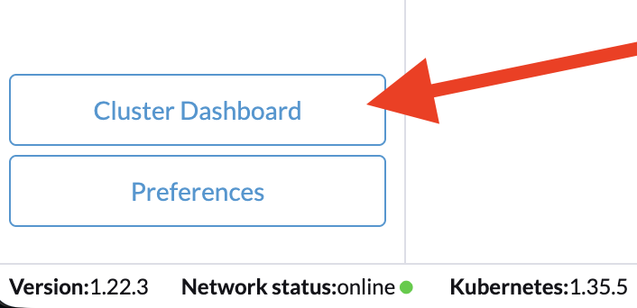
6.
Demo Rancher UI
If you installed Rancher Desktop, you already have Rancher UI installed!

Slide 49
7.
Environment &
Volume mounts

Slide 50
Containerisation – The 12 factor app
Guidelines for hvordan en applikation bør tilpasse sig til en containerised verden.
Goal: Be portable and scalable! → Be a ”Cloud-native” app.
Principper applikationen bør følge (udsnit):
Configurable
Config via ENV variables, with sane defaults.
Able to change “backing services”.
Standardised Logging
Write to stdout/stderr → container platform aggregates
Configurable levels
Disposable
Stateless processes
Fast startup, graceful shutdown
Concurrently scalable
Multiple instances must co-exist.
Og flere…
Scan QR or open: 12factor.net

Slide 51
Volume Mounts
Volume mount = directory or file injected into a container’s filesystem.
Data coming from outside the container, to share or externalize data.
E.g. configuration files, credentials, shared files between containers in a Pod, or data that must survive container restarts (persistence).
Can be: ConfigMap, Secret, PVC, emptyDir
apiVersion: v1
kind: ConfigMap
metadata:
name: my-configmap
data:
foo: bar
DB_HOSTNAME: my-db.kb.dk
apiVersion: v1
kind: Secret
metadata:
name: secret
data:
foo: dmFsdWUxCg==
DB_PASSWORD: YWJjCg==
Secrets are only secured by access controls
Value is base64 encoded, not encrypted!

Slide 52
Volume Mount – Example
ConfigMap:
Use in Deployment:
apiVersion: v1
kind: ConfigMap
metadata:
name: my-nginx-configmap
data:
default.conf: |-
server {
listen 80;
server_name _;
error_page 404 @sorry;
location @sorry {
return 404 ”Sorry";
}
}
spec:
...
containers:
my-app: volumeMounts:
- name: nginx-config
mountPath: /etc/nginx/conf.d/default.conf
readOnly: true
subPath: default.conf
volumes:
- name: nginx-config
configMap:
name: my-nginx-configmap
defaultMode: 420
optional: false

Slide 53
Environment variables
spec:
...
containers:
my-app:
# Manual key/values env:
- name: NAME
value: "Workshop”
- name: DB_HOSTNAME
value: "postgres.kb.dk”
# From ConfigMap or Secrets
envFrom:
- configMapRef:
name: my-app-env-configmap
- secretRef:
name: my-app-env-secrets
key: DB_PASSWORD
Standard way to configure a cloud-ready app.
Many options:
Define directly on Deployment with env:
Import from volume with envFrom:
ConfigMap
Secret

Slide 54
7.
Exercises for Config & Environment
Følg instrukser i 3-config-and-env

Slide 55
Volume Mounts - Persistence
Storage Class
En type af storage
Fx. Local-path, NFS, SMB, Longhorn, S3.
Each class has a storage-controller that handles PVC -> PV binding (bestykning).
Persistent Volume Claim
Et ønske om en mængde storage
A request for storage of a specified class, size and access-mode.
storageClass = Which type of storage do you need.
accessModes = Read-only or Write, Single-node or Multi-node.
E.g. giv mig 10 GB storage af NFS (distributed) klassen, i RWX mode (multi-node writable).
Persistent Volumes
Et konkret stykke dedikeret storage på clusteren.
May be bound by a PVC or released if no longer used.
⚠️ ReclaimPolicy: Retain vs. Delete ⚠️

Slide 56
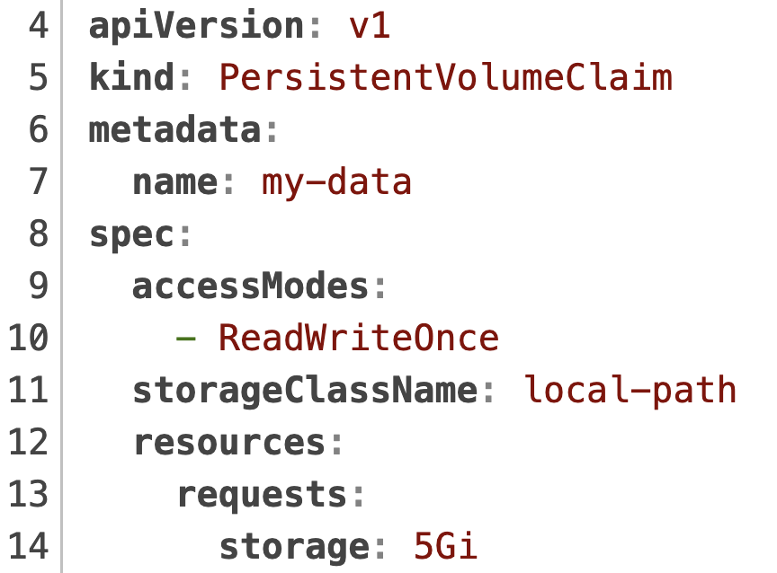
Volume Mounts – PVC eksempel
An app has requested this storage:
Name: my-data
Mode: read+write on 1 node
Once = One simultanous node
Many = Many nodes
Class: local-path
Size: 5 Gigabytes

Slide 57
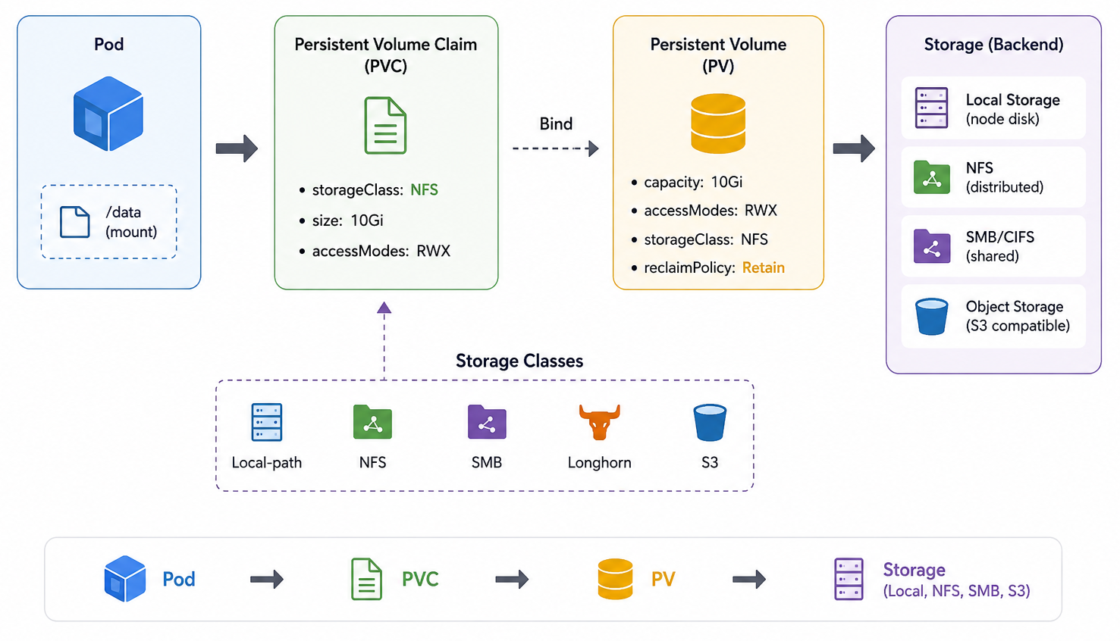

Slide 58
7.
Exercises for Volume Mounts
Show & Copy af 4-volumes-and-persistence

Slide 59
8.
Orchestration Health & Resources

Slide 60
Orchestration – Health Probes
Kubernetes’ health probes kan svare på følgende spørgsmål om en container:
Probe mechanisms (same for all three):
httpGet (most common),
exec (run a command, exit 0 = healthy)
tcpSocket
Probe | Question | On failure
livenessProbe | Is the process alive? | Restart the container
readinessProbe | Can it serve traffic right now? | Remove Pod from the Service's endpoints (no restart)
startupProbe | Has the app finished booting? | Hold off other probes until OK
"Running" is not the same as "ready” A container can be up while the app inside is still booting, deadlocked, or cut off from its database. Probes let Kubernetes tell the difference

Slide 61
Orchestration – Health Probes for API
It’s best-practice for API-based containers to have health-probe endpoints:
Endpoint | Probe | Should check
/healthz | liveness | Process is alive and API service is running.
/readyz | readiness | Operational dependencies are up & we’re ready for traffic. e.g. DB connection is up and migrations applied.
Deployment.yaml
…
readinessProbe:
httpGet:
path: /readyz
port: 8080
initialDelaySeconds: 5
periodSeconds: 5

Slide 62
Orchestration – Resource limits
Kubernetes distributes and monitors Pods based on resource requests & limits.
Request: Minimum ressourcer Kubernetes lover din Pod
Garanterede ressourcer en Pod har til rådighed.
Afgør hvilken “node” din Pod startes på.
Hvis ingen node har nødvendige ressource → Ingen Pod
Limits: Regulering af din Pods ressourcer
Loft for ressourcer din Container ikke må eller kan overskride.
Beskyttelse imod “noisy neighbor” problemer.
Consequence:
Reach CPU limit → Throttled execution.
Reach RAM limit → OOM killed if exceed.

Slide 63
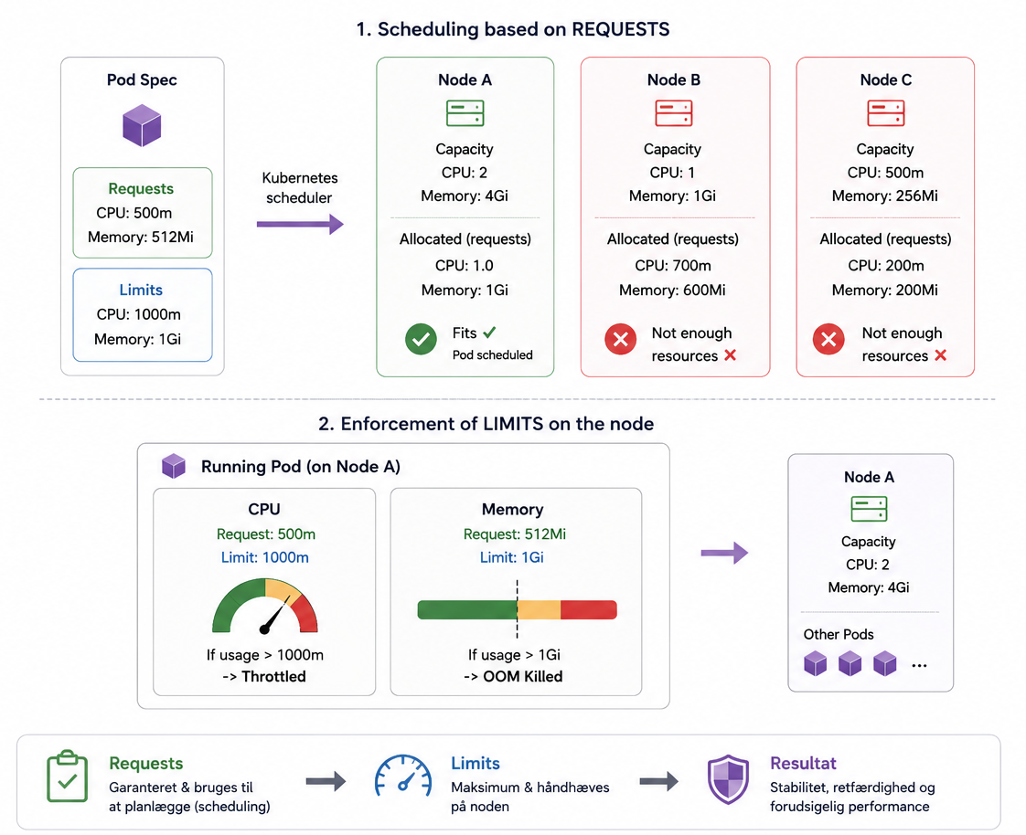

Slide 64
9.
Complex systems Systemer bestående af flere Deployments, som skal kunne snakke sammen

Slide 65
Komplekse systemer
Et system består som regel af flere separate komponenter
Backend og Database skal kunne skalere forskelligt → Derfor hver sin Deployment
Hvordan får man flere Pods/komponenter til at snakke sammen?
Services (intern DNS)
Konfiguration af apps (backing services)
DB_HOSTNAME=database.demo.svc.cluster.local
Systemarkitektur - Hvorfor micro-services fungerer godt i Kubernetes
Notes:
Eksempel:
https://kubernetes.io/docs/tutorials/stateless-application/guestbook/

Slide 66
Show & Copy: Composite Systems
Følg med og kopier, når jeg løser øvelse 5-composite-system
En Spring Boot + Postgres app, vi kender fra Workshop #1
Pushed til GitHub Container registry (ghcr.io): ghcr.io/notalib/workshop-containerisation/edu-spring-boot
Opgave: Få vores Spring Boot backend til at snakke med en Postgres database i kubernetes

Slide 67
Komplekse systemer – Helm
Hvad hvis vi kunne pakke vores store fagsystemer til ét samlet versioneret release der kan køre i Kubernetes?
Og samtidig kunne ændre på konfigurationen når vi installerer det.
Det er her Helm Charts kommer ind, fokus for workshop #3.
Packages all manifests for a complex system into a .zip file
Exposes configuration knobs instead of forcing you to edit raw YAML
Teaser til næste workshop: Demo af DT-DIT helm charts
Notes:
workshop-kubernetes/helm-teaser/README.md

Slide 68
X
Extras

Slide 69
Debugging Pods
https://kubernetes.io/docs/tasks/debug/debug-application/debug-running-pod/
Debug a running Pod
kubectl run pause --image=registry.k8s.io/pause:3.1 --restart=Never kubectl debug -it pause --image=busybox:1.28 --target=pause
Debug a crashing Pod
kubectl run --image=busybox:1.28 myapp – false kubectl debug myapp -it --copy-to=myapp-debug --container=myapp -- sh

Slide 70
StatefulSet & DaemonSet
DaemonSet
Deployment med garanti for at 1 Pod kører på hver node/maskine.
Kan bruges til cluster-wide værktøjer der bør køre på alle noder i clusteren.
StatefulSet
Et specifikt antal Pods, som hver får et unikt og persistent ID (såkaldt sticky Pod ID).
Kan f.eks bruges til at et cluster af ens Pods, hvor de kan kende forskel på hinanden og få den samme storage mounted hver gang.

Slide 71
Test images
For debugging and playing around
HTTP debugging
nginx (port 80)
traefik/whoami (port 80)
mendhak/http-https-echo (ports 8080 & 8443)
General tools
busybox (very slim!)
wbitt/network-multitool (:extra tag for additional tools)
nicolaka/netshoot (swiss-army knife)
Notes:
https://hub.docker.com/r/wbitt/network-multitool
https://hub.docker.com/r/nicolaka/netshoot

