Slide 1
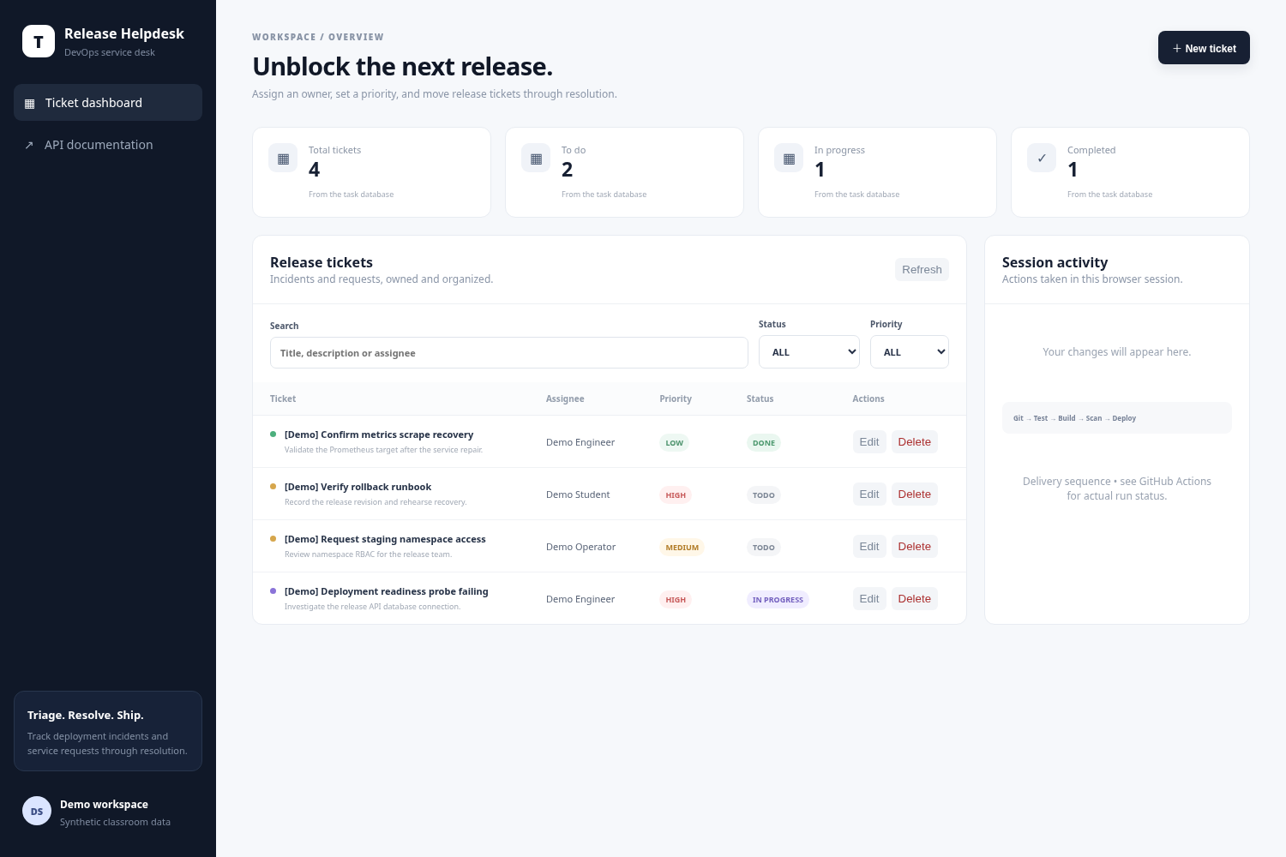
RH / RELEASE HELPDESK
PLATFORM WALKTHROUGH
BUILT · DEPLOYED · VERIFIED
Release
Helpdesk
From Git commit to
monitored Kubernetes.
End-to-end release engineering
React · FastAPI · PostgreSQL · October 2026
ACTUAL AWS APPLICATION · CAPTURED 16 OCT 2026
19
2 → 4 → 2
66
WATCH THE RECORDED DEMO
API test cases
Ready replicas
IaC resources
RELEASE ENGINEERING / PLATFORM WALKTHROUGH
01 / 16
Notes:
This project is Release Helpdesk, a service desk for deployment incidents, access requests and release follow-ups. I will show how a change moves from Git through tested and scanned container images into a monitored AWS EKS deployment. The AWS screenshots and measurements were captured on 16 October 2026. The cloud environment was then deliberately torn down after its evidence was preserved; the local stack remains reproducible.
Evidence / source links:
https://github.com/NoteLegend/devOps-TaskBoard/blob/main/images/aws-application-desktop.png
https://github.com/NoteLegend/devOps-TaskBoard/blob/main/README.md
https://github.com/NoteLegend/devOps-TaskBoard/blob/main/docs/VERIFICATION.md
https://drive.google.com/file/d/1ZSxd5RlMJAqJkvLA3E_098BrKF4OgJLT/view?usp=sharing

Slide 2
RH / RELEASE HELPDESK
01 / APPLICATION
A focused desk for release operations.
Capture the incident, assign an owner, and move the next release forward.
01
Capture
Create a release ticket with context,
priority and an assignee.
02
Triage
Search and filter the queue; edit
ownership and status.
03
Resolve
Complete or delete tickets; see
database-backed counts update.
Actual application through AWS ALB · full original screenshot
Evidence · Real AWS browser walkthrough and responsive UI
RELEASE ENGINEERING / PLATFORM WALKTHROUGH
02 / 16
Notes:
The original application domain is a release helpdesk. Tickets represent deployment incidents and operational requests. In the demo I create a ticket called Release rollback approval, assign Demo Student, select HIGH priority, and move it from TODO to IN_PROGRESS. I then filter the queue, show updated counts, edit and delete the ticket. The frontend has mobile, loading, empty and error states. Its activity feed is explicitly limited to the current browser session. The original TaskBoard API and field names are retained for compatibility. This is a classroom application using synthetic data, without end-user authentication. Show the supplied browser walkthrough or demonstrate the same flow locally.
Evidence / source links:
https://github.com/NoteLegend/devOps-TaskBoard/blob/main/images/README.md
https://github.com/NoteLegend/devOps-TaskBoard/blob/main/images/aws-application-desktop.png
https://github.com/NoteLegend/devOps-TaskBoard/blob/main/images/aws-application-mobile.png
https://github.com/NoteLegend/devOps-TaskBoard/blob/main/images/aws-browser-walkthrough.webm
https://github.com/NoteLegend/devOps-TaskBoard/blob/main/application/frontend/src/main.jsx
https://github.com/NoteLegend/devOps-TaskBoard/blob/main/docs/ATTRIBUTION.md

Slide 3
RH / RELEASE HELPDESK
02 / ARCHITECTURE
One system. Three connected paths.
Request serving, release delivery and observability share the same deployed application.
SERVE
/
React / Nginx
Browser
AWS ALB
2 frontend replicas
Same origin
Ingress controller
/api
FastAPI
SQLAlchemy
PostgreSQL 16
2–4 backend replicas
5 GiB gp3 PVC
/metrics
DELIVER
GitHub
Actions
GHCR
Helm + Flux
OBSERVE
Prometheus
→ Grafana
Commit SHA
Test + build + scan
SHA-tagged images
Reconciled release
Source · Implemented architecture and routing
RELEASE ENGINEERING / PLATFORM WALKTHROUGH
03 / 16
Notes:
Read the architecture as three paths. For requests, the AWS Load Balancer Controller implements the ALB Ingress: slash goes to React served by Nginx, and slash api goes to the FastAPI ClusterIP Service. Nginx also proxies API documentation to the backend. The API stores tickets in PostgreSQL on a persistent EBS volume. For delivery, GitHub Actions tests and scans source/dependencies/secrets, then builds and scans both images before publishing their full-SHA tags. Current GitOps promotion pins that verified SHA in Git and Flux reconciles the Helm release locally. The earlier cloud delivery used a short-lived AWS OIDC role and Helm. Terraform creates the VPC, EKS and IAM infrastructure before this application delivery flow. For observability, Prometheus scrapes the FastAPI metrics endpoint through a ServiceMonitor and Grafana visualizes those measurements. Arrows indicate logical flows; Terraform bootstrap and Alembic migration are explained on later slides.
Evidence / source links:
https://github.com/NoteLegend/devOps-TaskBoard/blob/main/README.md
https://github.com/NoteLegend/devOps-TaskBoard/blob/main/helm/taskboard/templates/ingress.yaml
https://github.com/NoteLegend/devOps-TaskBoard/blob/main/application/frontend/nginx.conf
https://github.com/NoteLegend/devOps-TaskBoard/blob/main/.github/workflows/ci-cd.yml
https://github.com/NoteLegend/devOps-TaskBoard/blob/main/monitoring/prometheus-values.yaml

Slide 4
RH / RELEASE HELPDESK
03 / API, TESTS & DATA
Correctness starts before deployment.
A tested API contract and one migration authority protect the data layer.
SIX REST OPERATIONS
DB
Alembic only
19
GET /api/tasks
Schema revision
0001_create_tasks;
migrations run before traffic
is ready.
GET /api/tasks/{id}
passing API test cases
GET /api/tasks/stats
Isolated test database
POST /api/tasks
IO
Data survives
PUT /api/tasks/{id}
4 records survived a
PostgreSQL Pod restart.
DELETE /api/tasks/{id}
/health
/ready
DB outage: 200 → 503 → 200
Process is alive
Database + tasks table are usable
Evidence · PostgreSQL tests, migration and restart persistence
RELEASE ENGINEERING / PLATFORM WALKTHROUGH
04 / 16
Notes:
The backend implements six business REST operations, including list, detail, statistics and full create, update, delete behavior. Nineteen parametrized API cases cover CRUD, statistics, validation, missing records, documentation, metrics and database failure recovery. Unit tests default to isolated in-memory SQLite. CI and the integration runner use a separate PostgreSQL database that is migrated before tests run. The test suite does not silently create a PostgreSQL schema. Alembic is the deployment schema authority. Readiness checks the database and tasks table, while liveness checks the process. In an isolated real outage, ready changed from 200 to 503 and back to 200 while health stayed 200. Separately, the AWS PostgreSQL Pod restart changed the Pod UID while all four synthetic records remained on its PVC. Show Swagger CRUD and the saved PostgreSQL table screenshot while explaining this slide.
Evidence / source links:
https://github.com/NoteLegend/devOps-TaskBoard/blob/main/docs/VERIFICATION.md
https://github.com/NoteLegend/devOps-TaskBoard/blob/main/application/backend/tests/test_api.py
https://github.com/NoteLegend/devOps-TaskBoard/blob/main/application/backend/tests/conftest.py
https://github.com/NoteLegend/devOps-TaskBoard/blob/main/images/aws-postgresql-pytest-passed.png
https://github.com/NoteLegend/devOps-TaskBoard/blob/main/images/aws-postgresql-table-and-persistence.png
https://github.com/NoteLegend/devOps-TaskBoard/blob/main/evidence/logs/readiness-outage.txt
https://github.com/NoteLegend/devOps-TaskBoard/blob/main/evidence/logs/aws-database-persistence.json

Slide 5
RH / RELEASE HELPDESK
04 / CONTAINERS
The complete stack starts with one command.
Compose encodes dependencies; runtime containers execute as non-root users.
docker compose up --build -d --wait
PostgreSQL
Alembic
FastAPI
React / Nginx
Healthy
Completed
Ready
Serving
Backend runtime
Frontend multi-stage build
Python 3.13 → Uvicorn
Node 24 build → unprivileged Nginx
USER 10001
USER 101
Only compiled assets enter the frontend runtime.
Evidence · Real Compose stack, images and runtime users
RELEASE ENGINEERING / PLATFORM WALKTHROUGH
05 / 16
Notes:
The full local stack runs using docker compose up with build and wait. Dependencies are explicit: PostgreSQL must be healthy, the migration must complete, the API must be ready, and then the frontend starts. The backend runs as UID 10001. The frontend uses a Node build stage and copies only static output into unprivileged Nginx running as UID 101 on port 8080. Local host ports are loopback-bound: the UI is on localhost 3000 and the API documentation is on localhost 8000 slash docs. PostgreSQL is not published to a host port. A named database volume keeps data across normal restarts. Show the saved real Compose image and user screenshot, then open the local application if demonstrating live.
Evidence / source links:
https://github.com/NoteLegend/devOps-TaskBoard/blob/main/images/local-compose-images-and-users.png
https://github.com/NoteLegend/devOps-TaskBoard/blob/main/docker-compose.yml
https://github.com/NoteLegend/devOps-TaskBoard/blob/main/docker/backend.Dockerfile
https://github.com/NoteLegend/devOps-TaskBoard/blob/main/docker/frontend.Dockerfile
https://github.com/NoteLegend/devOps-TaskBoard/blob/main/evidence/logs/compose-persistence.txt

Slide 6
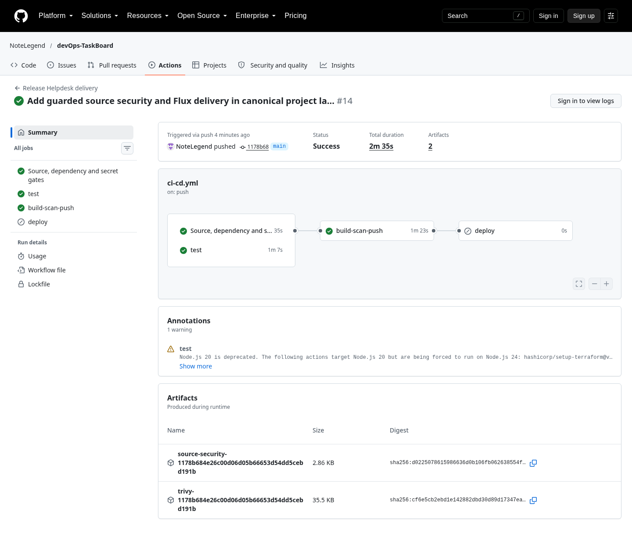
RH / RELEASE HELPDESK
05 / CONTINUOUS DELIVERY
A guarded path from commit to cluster.
Tests and source-security gates must succeed before either image is published.
01
Validate
PostgreSQL tests, frontend build and
source/dependency/secret gates
02
Build, scan & publish
Both images → Trivy → GHCR with immutable
full-SHA tags
03
Promote through Git
Pin the verified SHA → Flux → Helm → drift
correction
Actual hosted run · test, source security and publication passed
Meaningful, traceable Git history
PRs validate without publishing; AWS deploy remains disabled after teardown.
Evidence · Actual integrated source-security and image publication run
RELEASE ENGINEERING / PLATFORM WALKTHROUGH
06 / 16
Notes:
The current GitHub Actions workflow validates tests and security independently, then requires both jobs before building and publishing images. The security job runs Bandit, Semgrep, pip-audit, npm audit and Gitleaks over full history plus working text. It writes fresh report artifacts for that execution. Tests use a clean migrated PostgreSQL service and also check the frontend, Compose, Helm, GitOps manifests, Terraform and the account guard. Both final images pass the Trivy HIGH/CRITICAL gate before the exact scanned images are pushed with the full source SHA. Pull requests cannot log in to the registry, publish or obtain AWS deployment credentials. The historical OIDC cloud release was verified separately. Current promotion changes the Git-owned HelmRelease to a tested image SHA, and Flux performs the rollout. The screenshot is run 39583131700 for image-source commit 1178b68; later evidence/documentation commits do not change the deployed image source.
Evidence / source links:
https://github.com/NoteLegend/devOps-TaskBoard/actions/runs/39583131700
https://github.com/NoteLegend/devOps-TaskBoard/blob/main/images/final/ci-security-release.png
https://github.com/NoteLegend/devOps-TaskBoard/blob/main/.github/workflows/ci-cd.yml
https://github.com/NoteLegend/devOps-TaskBoard/blob/main/evidence/logs/ci-security-release.json
https://github.com/NoteLegend/devOps-TaskBoard/blob/main/evidence/logs/ci-final-source
https://github.com/NoteLegend/devOps-TaskBoard/blob/main/evidence/logs/ci-final-images
https://github.com/NoteLegend/devOps-TaskBoard/blob/main/gitops/releases/release.yaml

Slide 7
RH / RELEASE HELPDESK
06 / SECURITY
Security findings lead to repairs, then a release.
Source analysis, dependency audits and secret checks run before image publication.
BACKEND IMAGE
FRONTEND IMAGE
0
0
HIGH / CRITICAL
findings reported
HIGH / CRITICAL
findings reported
Certifi trust-store advisory → upgrade to 2026.10.19 → rebuild and rescan
01
Source + dependencies
02
Secrets + final images
Bandit / Semgrep; pip-audit / npm audit.
Full-history Gitleaks; both Trivy severity gates.
Evidence · Fresh source and image reports for release 1178b68
RELEASE ENGINEERING / PLATFORM WALKTHROUGH
07 / 16
Notes:
The refreshed scans cover four layers. Bandit checks Python source and migrations; checked-in Semgrep rules check selected dangerous frontend patterns. pip-audit checks the complete pinned Python dependency set, while npm audit includes the frontend build/development graph. Gitleaks scans full reachable Git history and working text with redacted reports. Trivy checks OS and language packages in both final images and fails all HIGH/CRITICAL findings, including unfixed findings. The new dependency audit found the certifi trust-store advisory published after the earlier cloud run. The dependency was upgraded to 2026.10.19 and the images rebuilt. Both new images reported zero HIGH/CRITICAL findings at the recorded scan. Exact public CPython signing fingerprints in archived Trivy metadata have a narrow path/value exception; application secrets are not excluded. Synthetic unsafe Python, unsafe JavaScript and a fake secret each triggered a failed gate. These are dated results and do not claim immunity to future advisories or all application weaknesses.
Evidence / source links:
https://github.com/NoteLegend/devOps-TaskBoard/actions/runs/39583131700
https://github.com/NoteLegend/devOps-TaskBoard/blob/main/security/README.md
https://github.com/NoteLegend/devOps-TaskBoard/blob/main/security/gitleaks.toml
https://github.com/NoteLegend/devOps-TaskBoard/blob/main/evidence/logs/security-final/summary.json
https://github.com/NoteLegend/devOps-TaskBoard/blob/main/evidence/logs/security-final/negative-controls.json
https://github.com/NoteLegend/devOps-TaskBoard/blob/main/evidence/logs/security-initial/pip-audit.json
https://github.com/NoteLegend/devOps-TaskBoard/blob/main/evidence/logs/ci-final-images

Slide 8
RH / RELEASE HELPDESK
07 / INFRASTRUCTURE AS CODE
AWS infrastructure is declared in Terraform.
Mumbai / ap-south-1 · EKS 1.35 · two managed m7i-flex.large workers
66
VPC 10.20.0.0/16 · TWO AVAILABILITY ZONES
ZONE A
ZONE B
Public subnet
Public subnet
Terraform resources created
10.20.101.0/24
10.20.102.0/24
01
Pinned configuration
Modules, providers, add-ons and
node AMI are versioned.
Private subnet
Private subnet
10.20.1.0/24
10.20.2.0/24
02
Explicit account guard
Managed worker
Managed worker
Approved Free-plan credit use; no
Paid-plan upgrade.
ALB across public subnets · single NAT for egress
Evidence · Actual approved plan, apply and AWS Console captures
RELEASE ENGINEERING / PLATFORM WALKTHROUGH
08 / 16
Notes:
Terraform provisioned the real AWS environment in ap-south-1. The network spans two availability zones with two public and two private subnets. The ALB uses the public subnets; managed workers use the private subnets. A single NAT gateway supports private egress as a classroom cost tradeoff, rather than claiming full zonal resilience. The EKS cluster used Kubernetes 1.35 and two eligible m7i-flex.large AL2023 workers. Terraform also configures IAM roles, OIDC, EBS CSI and cluster add-ons. The recorded apply created sixty-six Terraform resources. Versions and provider locks are retained. The approved run used account credits under the active Free plan; it did not upgrade the account. Show the saved actual Terraform plan and AWS VPC/EKS Console screenshots. Infrastructure is now removed, and recreation needs a newly approved plan and budget.
Evidence / source links:
https://github.com/NoteLegend/devOps-TaskBoard/blob/main/docs/VERIFICATION.md
https://github.com/NoteLegend/devOps-TaskBoard/blob/main/terraform/main.tf
https://github.com/NoteLegend/devOps-TaskBoard/blob/main/terraform/variables.tf
https://github.com/NoteLegend/devOps-TaskBoard/blob/main/terraform/.terraform.lock.hcl
https://github.com/NoteLegend/devOps-TaskBoard/blob/main/terraform/terraform.tfvars.example
https://github.com/NoteLegend/devOps-TaskBoard/blob/main/images/aws-terraform-plan.png
https://github.com/NoteLegend/devOps-TaskBoard/blob/main/images/aws-vpc-console.png
https://github.com/NoteLegend/devOps-TaskBoard/blob/main/images/aws-eks-active-console.png
https://github.com/NoteLegend/devOps-TaskBoard/blob/main/images/aws-terraform-apply-and-ready-nodes.png

Slide 9
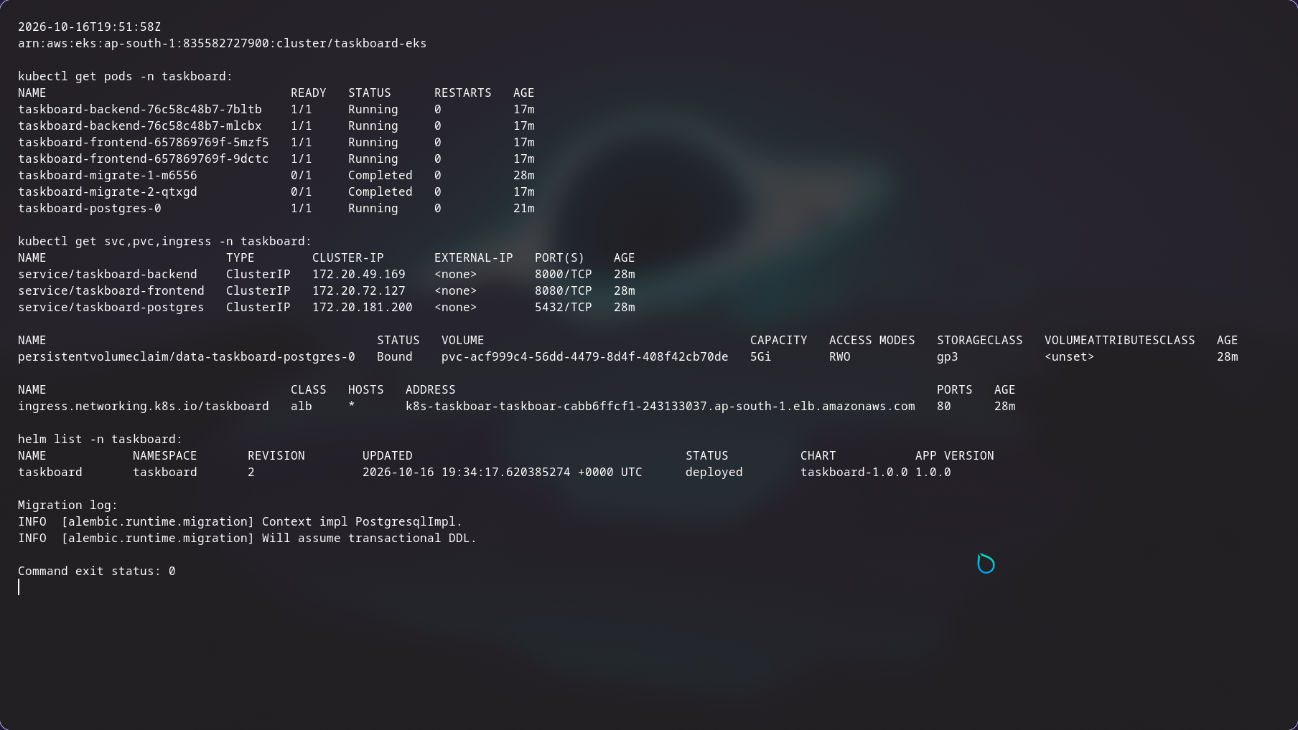
RH / RELEASE HELPDESK
08 / KUBERNETES & HELM
Helm turns the stack into a repeatable release.
One versioned chart connects workloads, storage, probes, Services and Ingress.
01
Replicated workloads
2 frontend Pods; backend HPA starts at 2
and can reach 4.
02
Persistent database
PostgreSQL StatefulSet + encrypted 5 GiB
gp3 volume.
03
Controlled release
One migration Job with advisory lock;
readiness gates traffic.
Real AWS resource listing · taskboard namespace
Ingress: / → frontend:8080 /api → backend:8000
Evidence · Actual AWS Pods, Services, PVC, Helm release and Ingress
RELEASE ENGINEERING / PLATFORM WALKTHROUGH
09 / 16
Notes:
The Helm chart deploys into the taskboard namespace. The frontend has two replicas, and the backend HPA maintains at least two replicas. Both Services use ClusterIP networking. The Ingress routes slash to frontend port 8080 and slash api to backend port 8000 through the actual ALB controller. PostgreSQL runs as a StatefulSet with a bound five-GiB encrypted gp3 volume provisioned through EBS CSI. A single migration hook Job runs the Alembic upgrade under a PostgreSQL advisory lock; it is not run concurrently in every API replica. On first install the hook runs after the database resources exist, and on upgrades it runs before the update. The deployment script explicitly checks StatefulSet and Deployment rollouts, then performs external readiness and CRUD checks. Explain Helm values, release history and rollback, noting that destructive database changes would require a compatible migration strategy.
Evidence / source links:
https://github.com/NoteLegend/devOps-TaskBoard/blob/main/images/aws-kubernetes-helm-ingress.png
https://github.com/NoteLegend/devOps-TaskBoard/blob/main/helm/taskboard/Chart.yaml
https://github.com/NoteLegend/devOps-TaskBoard/blob/main/helm/taskboard/values.yaml
https://github.com/NoteLegend/devOps-TaskBoard/blob/main/helm/taskboard/values-prod.yaml
https://github.com/NoteLegend/devOps-TaskBoard/blob/main/helm/taskboard/templates/migrate.yaml
https://github.com/NoteLegend/devOps-TaskBoard/blob/main/application/backend/app/migrate.py
https://github.com/NoteLegend/devOps-TaskBoard/blob/main/scripts/deploy.sh
https://github.com/NoteLegend/devOps-TaskBoard/blob/main/evidence/logs/aws-persistent-storage.json

Slide 10
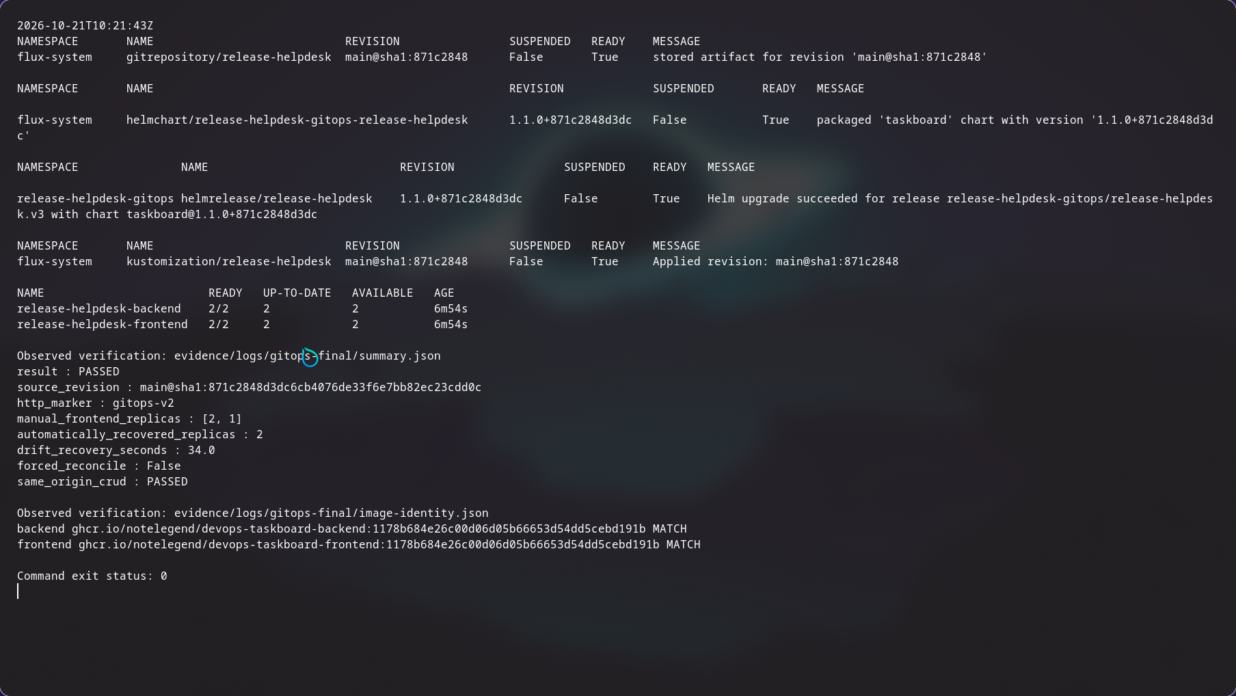
RH / RELEASE HELPDESK
09 / GITOPS
Committed intent keeps the running service honest.
Flux reconciles this application and Helm chart from the public repository on local Kubernetes.
2 → 1 → 2
Manual frontend drift → automatic repair
01
Promote from Git
Scanned image SHA + gitops-v2 header
arrived through Flux.
02
Automatic recovery
2 frontend replicas restored in 34 seconds.
Actual controller state and recorded verification · local kind
Registry digests match both running application images.
Evidence · Actual Flux promotion, drift recovery and digest checks
RELEASE ENGINEERING / PLATFORM WALKTHROUGH
10 / 16
Notes:
Flux source-controller fetches this public repository. A Kustomization applies the Git-owned HelmRelease, and helm-controller installs or upgrades the same application chart. The baseline served gitops-v1. Commit 871c284 pinned both newly scanned 1178b68 image tags and changed the release marker to gitops-v2. The Nginx configuration checksum triggered a real frontend rollout, and HTTP exposed the new header. The verification then changed frontend replicas from two to one and observed Flux restore two in 34 seconds, without a forced reconcile, manual Helm upgrade or apply as the repair. The baseline exercise had independently recovered in 37 seconds. Backend replicas remain HPA-owned. The running image IDs were checked against public GHCR manifest digests and matched for both components. This GitOps verification is local kind; the earlier AWS environment remains deliberately removed.
Evidence / source links:
https://github.com/NoteLegend/devOps-TaskBoard/blob/main/evidence/logs/gitops-final/summary.json
https://github.com/NoteLegend/devOps-TaskBoard/blob/main/images/final/gitops-verification.png
https://github.com/NoteLegend/devOps-TaskBoard/blob/main/gitops/README.md
https://github.com/NoteLegend/devOps-TaskBoard/blob/main/gitops/releases/release.yaml
https://github.com/NoteLegend/devOps-TaskBoard/blob/main/evidence/logs/gitops-baseline/summary.json
https://github.com/NoteLegend/devOps-TaskBoard/blob/main/evidence/logs/gitops-final/image-identity.json

Slide 11
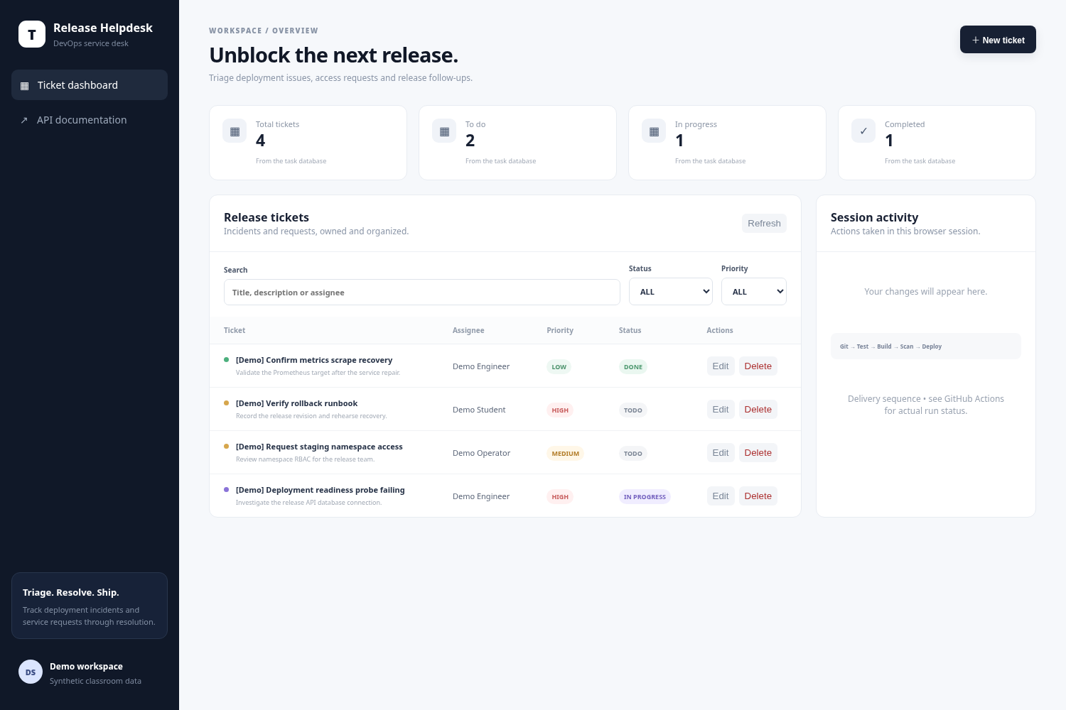
RH / RELEASE HELPDESK
10 / END-TO-END RELEASE
One small change proves the delivery chain.
A visible triage-help change reached the real AWS application through CI.
BEFORE · 3ffe809
AFTER · 179ad20
Commit → tests → build → scan → SHA-tagged GHCR images → OIDC / Helm → visible update
Evidence · Successful AWS update for commit 179ad20 · click to open
RELEASE ENGINEERING / PLATFORM WALKTHROUGH
11 / 16
Notes:
This is the end-to-end release proof required by the presentation rubric. The before screenshot comes from the previous deployed application commit 3ffe809. Commit 179ad20 clarified the visible help text to: Assign an owner, set a priority, and move release tickets through resolution. The linked real GitHub Actions run passed all three jobs and deployed that full SHA. Registry and Kubernetes inspection verified the deployed tags and digests. The after screenshot shows the new text through the AWS ALB. During the recording, open the commit, the successful run and these two original images at readable zoom. These are preserved screens from the actual release; the AWS endpoint has since been torn down. A current push still runs CI, but deployment is intentionally disabled after cleanup.
Evidence / source links:
https://github.com/NoteLegend/devOps-TaskBoard/actions/runs/38955563228
https://github.com/NoteLegend/devOps-TaskBoard/blob/main/images/aws-live-update-before.png
https://github.com/NoteLegend/devOps-TaskBoard/blob/main/images/aws-live-update-after.png
https://github.com/NoteLegend/devOps-TaskBoard/blob/main/evidence/logs/aws-registry-image-verification.json
https://github.com/NoteLegend/devOps-TaskBoard/commit/179ad20c5e4995bf458a33531905d6f0e694b580

Slide 12
RH / RELEASE HELPDESK
11 / AUTOSCALING
CPU demand produced real scaling and recovery.
Observed on AWS: ready backend replicas increased under load, then recovered automatically.
2 → 4 → 2
READY BACKEND REPLICAS
4
Ready replicas, measured
68,466
3
successful requests
0
2
failed load requests
180.1 s
0
60
120
180
240
300
360
Elapsed seconds · sampled observations
24-worker in-cluster load
HPA: 60% CPU target · 100m request / Pod · min 2, max 4 · peak 442% of requested CPU
Evidence · Chart drawn from actual timestamped HPA observations
RELEASE ENGINEERING / PLATFORM WALKTHROUGH
12 / 16
Notes:
This chart is derived from the actual saved AWS HPA observations. It plots ready backend replicas rather than merely desired replicas, so it proves usable capacity increased. A bounded in-cluster load ran twenty-four workers for 180.1 seconds, completing 68,466 requests with zero load-client failures. Ready replicas moved from two to four and later recovered automatically to two. The HPA target stayed at sixty percent of the existing 100-millicore CPU request, and observed CPU peaked at 442 percent of that request. That percentage is relative to the resource request, not percent of an entire worker node. An earlier external load completed without errors but did not generate enough backend CPU to scale; that honest non-scaling result is retained. The follow-up client ran in an isolated namespace, and its CPU was excluded from the backend HPA. These are observations of this specific test, not a general throughput or production-capacity guarantee.
Evidence / source links:
https://github.com/NoteLegend/devOps-TaskBoard/blob/main/evidence/logs/aws-hpa-internal/frames.json
https://github.com/NoteLegend/devOps-TaskBoard/blob/main/evidence/logs/aws-hpa-internal/summary.json
https://github.com/NoteLegend/devOps-TaskBoard/blob/main/evidence/logs/aws-hpa/summary.json
https://github.com/NoteLegend/devOps-TaskBoard/blob/main/images/aws-hpa-before-load.png
https://github.com/NoteLegend/devOps-TaskBoard/blob/main/images/aws-hpa-scaled-under-load.png
https://github.com/NoteLegend/devOps-TaskBoard/blob/main/images/aws-hpa-recovered.png
https://github.com/NoteLegend/devOps-TaskBoard/blob/main/helm/taskboard/templates/hpa.yaml

Slide 13
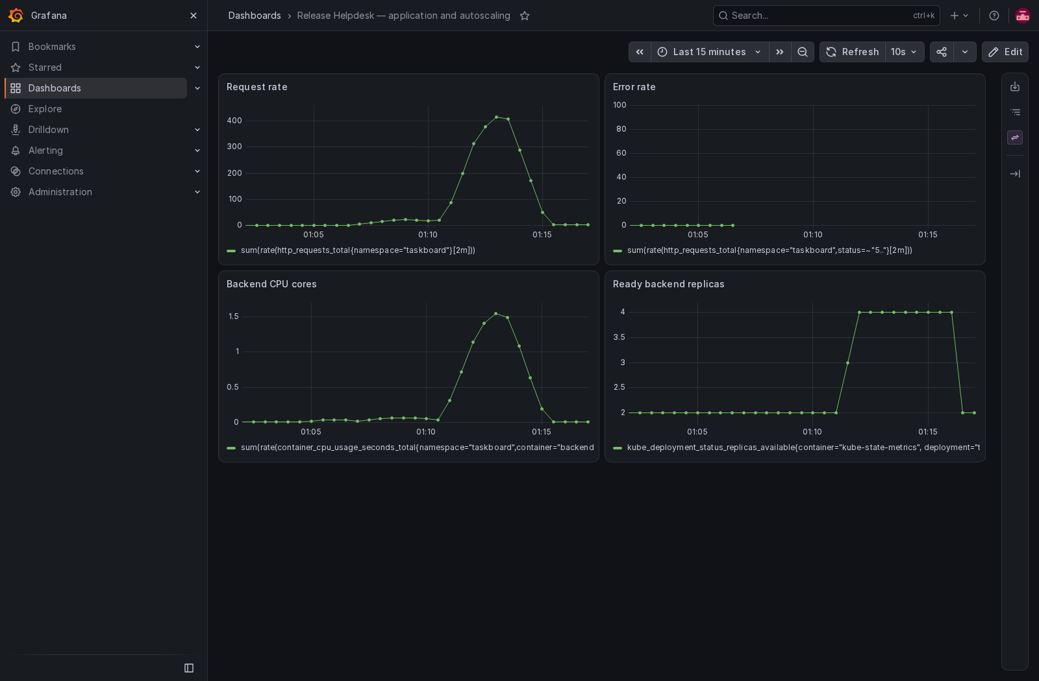
RH / RELEASE HELPDESK
12 / OBSERVABILITY
See traffic, latency and errors in one place.
Application instrumentation → ServiceMonitor → Prometheus → authenticated Grafana.
01
Instrument
Request counter + latency
histogram; route-template labels.
02
Scrape
Backend /metrics; real Prometheus
application targets UP.
03
Inspect privately
Grafana via private port-forward
with generated credentials.
Actual recorded AWS dashboard · HTTP traffic, errors, latency and replicas
Evidence · Authenticated AWS Grafana dashboard with populated panels
RELEASE ENGINEERING / PLATFORM WALKTHROUGH
13 / 16
Notes:
The API exposes an actual HTTP request counter and a response-latency histogram at slash metrics. Handler labels use route templates, which avoids unbounded labels for every ticket ID. A ServiceMonitor selects the backend Service and named HTTP port, and Prometheus was verified scraping the application targets as UP. The screenshot is the real authenticated Grafana dashboard from the AWS run, with populated request rate, error rate, p95 latency and ready replica panels. Grafana stays a private ClusterIP Service and is accessed by authenticated port-forward. The small real error-rate sample includes the controlled PostgreSQL readiness interruption. Show the original metrics endpoint screenshot and Prometheus targets before opening this dashboard at full size.
Evidence / source links:
https://github.com/NoteLegend/devOps-TaskBoard/blob/main/images/aws-grafana-live-dashboard.png
https://github.com/NoteLegend/devOps-TaskBoard/blob/main/application/backend/app/main.py
https://github.com/NoteLegend/devOps-TaskBoard/blob/main/helm/taskboard/templates/servicemonitor.yaml
https://github.com/NoteLegend/devOps-TaskBoard/blob/main/monitoring/dashboard.json
https://github.com/NoteLegend/devOps-TaskBoard/blob/main/images/aws-metrics-endpoint.png
https://github.com/NoteLegend/devOps-TaskBoard/blob/main/images/aws-prometheus-targets-up.png
https://github.com/NoteLegend/devOps-TaskBoard/blob/main/evidence/logs/aws-prometheus-queries.json

Slide 14
RH / RELEASE HELPDESK
13 / TROUBLESHOOTING
Two failures. Two traceable recoveries.
Controlled exercises ran in an isolated namespace; diagnosis followed observable evidence.
IMAGE FAILURE
SERVICE FAILURE
ImagePullBackOff
No reachable backend
01
Pod not Ready
01
Service has no endpoints
02
Describe Pod + events
02
Compare selector + Pod labels
03
Nonexistent image tag
03
Selector does not match
Correct tag → rollout → Ready
Correct selector → HTTP success
Evidence · Actual AWS failure symptoms, diagnosis and recovered HTTP responses
RELEASE ENGINEERING / PLATFORM WALKTHROUGH
14 / 16
Notes:
In the first isolated exercise, the Pod was not Ready because its image tag did not exist. Pod description and events exposed the registry pull failure. After correcting the tag, the rollout reached Ready. In the second, the Service selector did not match the Pod labels, so EndpointSlices contained no usable endpoints. Comparing the selector against labels identified the cause. Correcting the selector restored endpoints and a successful HTTP response. Both exercises ran in taskboard-troubleshooting and the recorded recovery is saved. In the video, open the original image and Service diagnosis screenshots and the final recovery screenshot, or show the saved terminal logs. Keep the explanation in the order symptom, evidence, cause, correction, verification.
Evidence / source links:
https://github.com/NoteLegend/devOps-TaskBoard/blob/main/evidence/logs/aws-troubleshooting
https://github.com/NoteLegend/devOps-TaskBoard/blob/main/troubleshooting/broken-image.yaml
https://github.com/NoteLegend/devOps-TaskBoard/blob/main/troubleshooting/broken-service.yaml
https://github.com/NoteLegend/devOps-TaskBoard/blob/main/scripts/troubleshooting.sh
https://github.com/NoteLegend/devOps-TaskBoard/blob/main/images/aws-broken-image-diagnosis.png
https://github.com/NoteLegend/devOps-TaskBoard/blob/main/images/aws-broken-service-diagnosis.png
https://github.com/NoteLegend/devOps-TaskBoard/blob/main/images/aws-troubleshooting-recovered.png

Slide 15
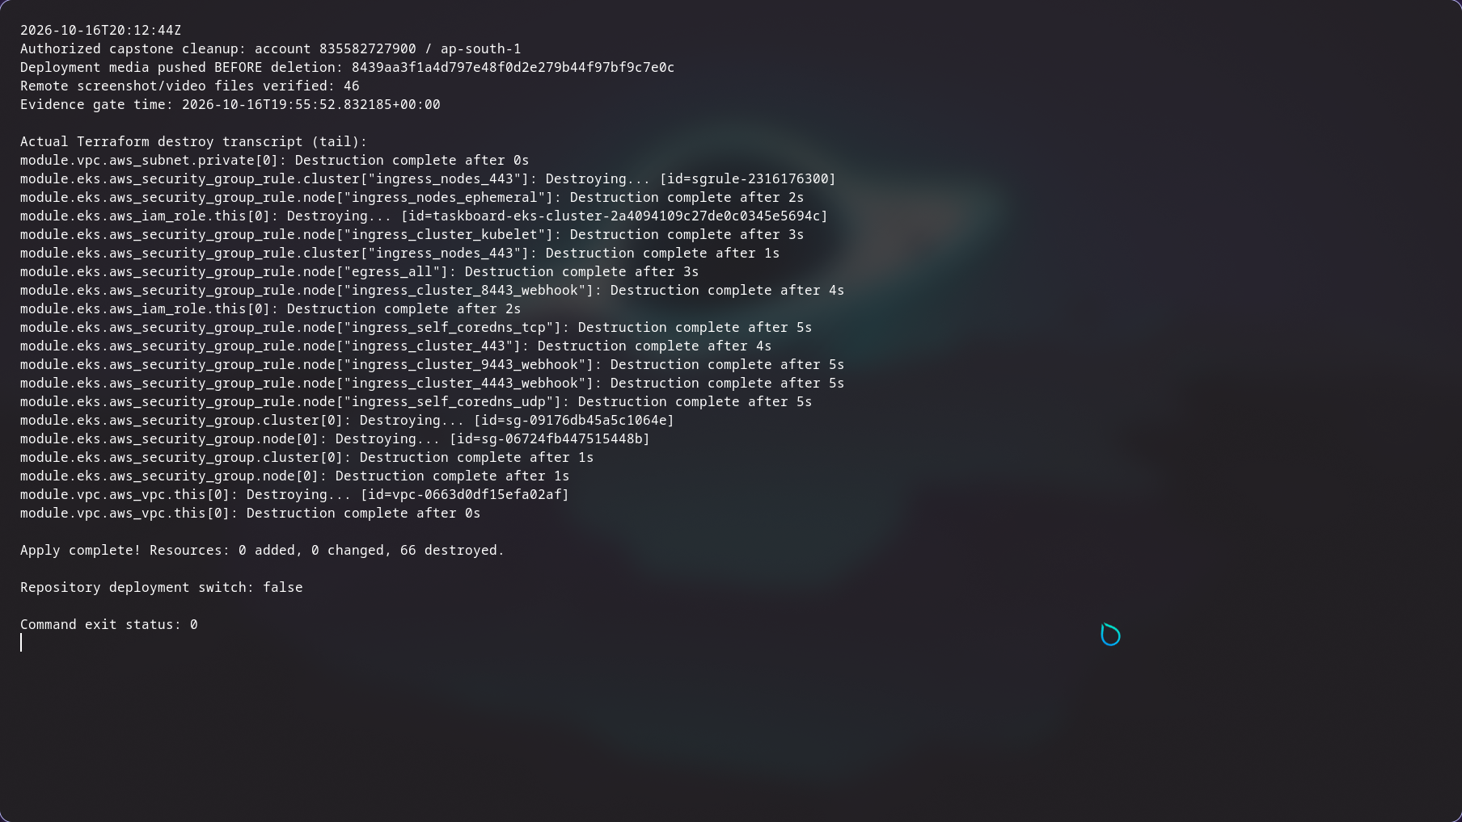
RH / RELEASE HELPDESK
14 / TEARDOWN & COST DISCIPLINE
The deployment was verified, then removed.
Cloud evidence was pushed and checked before the authorized teardown.
66
Terraform resources destroyed
01
Residual checks passed
Project EKS, VPC, ALB, workers, NAT and
retained disks absent.
02
Deployment disabled
DEPLOY_ENABLED=false; AWS application
URL is historical.
Actual Terraform destroy completion · 66 resources destroyed
Recorded cleanup: 16 Oct 2026 · KMS key disabled / pending deletion · billing settlement may lag
Evidence · Destroy completion and recorded residual-resource checks
RELEASE ENGINEERING / PLATFORM WALKTHROUGH
15 / 16
Notes:
The lifecycle ends with cleanup. All deployment screenshots and the walkthrough were pushed and verified remotely before deletion. The application and ALB were removed while the controller was still available; retained project storage was handled deliberately. Terraform then reported sixty-six resources destroyed. Read-only residual checks recorded the project EKS cluster, VPC, workers, ALB, target groups, NAT, EIP, network interfaces, retained disks and related roles as absent. The project KMS key is disabled and PendingDeletion for the required AWS waiting period, rather than already physically erased. Billing and credit reporting can lag, so the presentation does not claim zero usage or a settled cost total. DEPLOY_ENABLED is false and the old ALB URL is offline. The local stack remains available for review. No cloud resources need to be recreated to explain the preserved deployment evidence.
Evidence / source links:
https://github.com/NoteLegend/devOps-TaskBoard/blob/main/evidence/logs/aws-cleanup-verification.json
https://github.com/NoteLegend/devOps-TaskBoard/blob/main/images/aws-terraform-destroy-complete.png
https://github.com/NoteLegend/devOps-TaskBoard/blob/main/images/aws-cleanup-residual-checks.png
https://github.com/NoteLegend/devOps-TaskBoard/blob/main/evidence/logs/aws-terraform-destroy.txt
https://github.com/NoteLegend/devOps-TaskBoard/blob/main/evidence/logs/aws-evidence-before-teardown.json
https://github.com/NoteLegend/devOps-TaskBoard/blob/main/docs/CLEANUP.md

Slide 16
RH / RELEASE HELPDESK
15 / OUTCOMES
Tested. Reconciled. Observable.
01
02
03
Reproducible
Guarded
Self-correcting
Compose locally. Terraform for
AWS. One chart for the
application.
Source and dependency checks,
secret scans and immutable
image gates.
GitOps restores intent. HPA
reacts to CPU. Metrics explain
behavior.
Next production steps
End-user identity · HTTPS + DNS · managed database backups · service alerts
github.com/NoteLegend/devOps-TaskBoard
Review · Executed results and reproducible project source
RELEASE ENGINEERING / PLATFORM WALKTHROUGH
16 / 16
Notes:
The system connects product behavior to engineering evidence. The application is reproducible, data survives normal restarts, source and image gates stop unsafe changes, image SHAs connect source to registry artifacts, and Flux continuously reconciles the chosen release. The AWS lifecycle demonstrated real provisioning, ingress, persistent storage, monitoring, scaling and teardown. The later local GitOps verification adds real promotion and drift correction for the same application. Lessons are to verify application behavior after rollout, separate process liveness from database readiness, measure ready replicas for scaling, and tie every result to its revision and environment. Production improvements would add end-user authentication, HTTPS and DNS, managed database backups and service-level alerting. The repository includes original evidence, instructions and attribution; the recorded narration explains those results.
Evidence / source links:
https://github.com/NoteLegend/devOps-TaskBoard/blob/main/docs/VERIFICATION.md
https://github.com/NoteLegend/devOps-TaskBoard/blob/main/README.md
https://github.com/NoteLegend/devOps-TaskBoard/blob/main/docs/ATTRIBUTION.md

