Slide 1


NoteSpace
Multi-platform Web Application for Real-Time Document
Collaboration & Sharing
Guilherme Ferreira 49472 | Ricardo Costa 49511
Supervisors: Paulo Pereira
March 2024

Slide 2
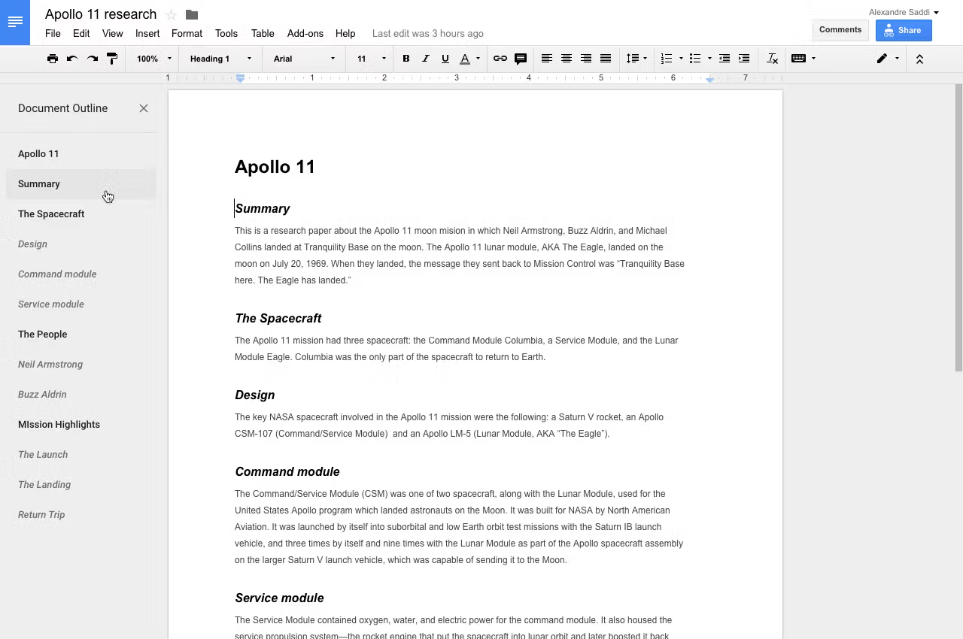
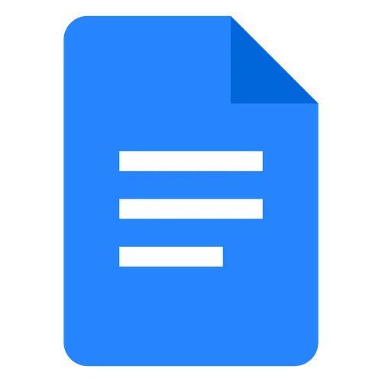
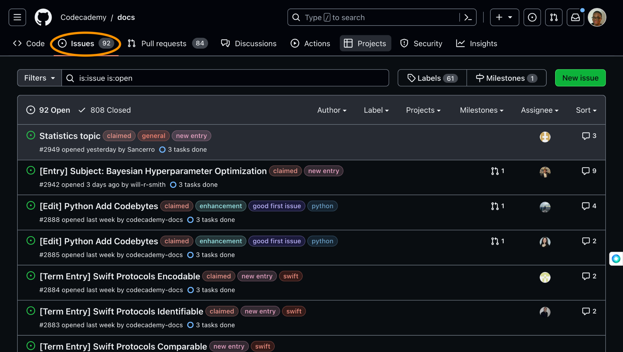

Introduction
Google Docs
✅Real-time Document Editing
✅Rich Text Editor
✅Collaborative Features
❌Explicit Version Control
❌Offline Support
❌Platform for Sharing Documents
❌Project Management
GitHub
✅Version Control
✅Project Management
✅Repositories for Code Sharing
✅Markdown Support
❌Synchronous Editing
❌Live Collaboration Features

Slide 3
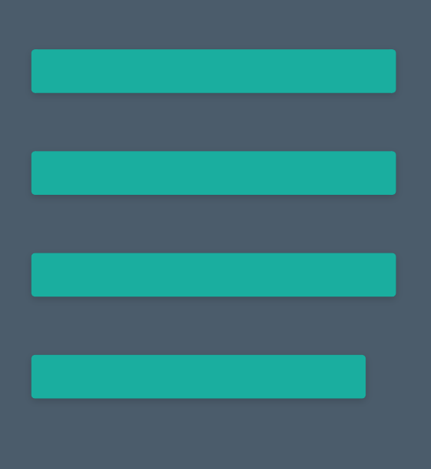



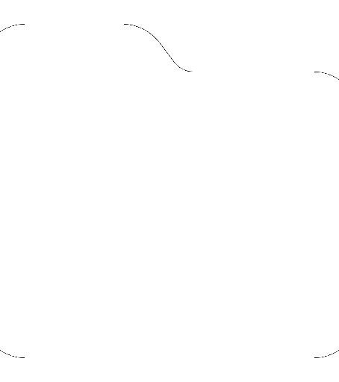

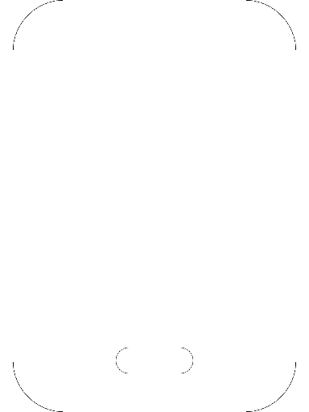
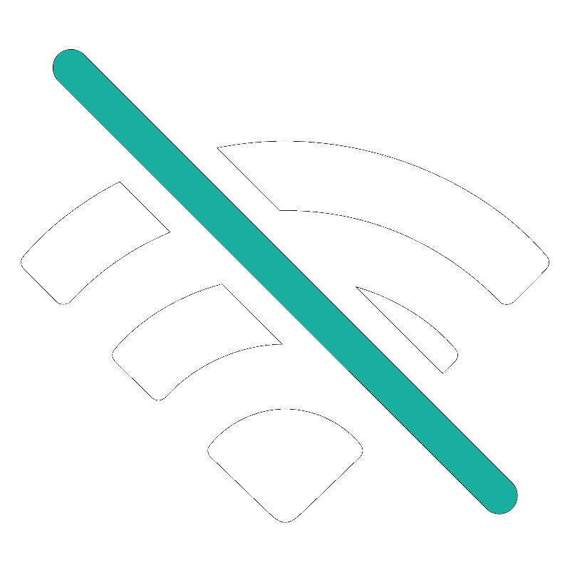
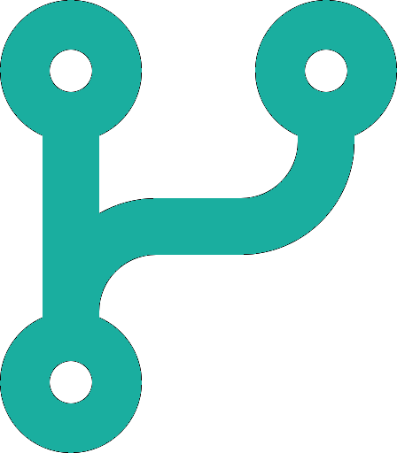
Goals
Markdown-Supported Editor
Live Collaboration Features
Workspace Management
Sharing Platform
Multi-platform (PWA)
Offline Support
Version Control

Slide 4


Research - Conflict Resolution Algorithm
• Operational Transformation (OT):
Operations are transformed when a conflict is detected.
• Conflict-Free Replicated Data Type (CRDT):
Operations must be commutative and idempotent, so that the same state is always reached for all clients.

Slide 5
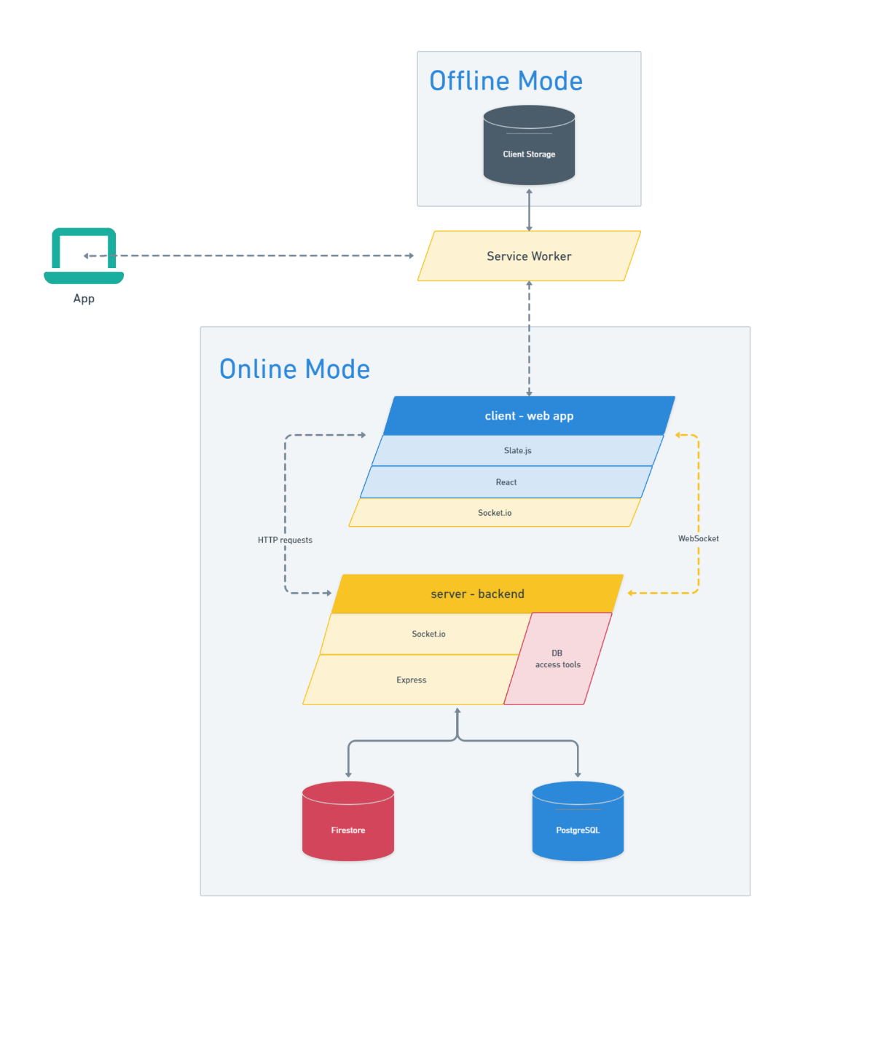

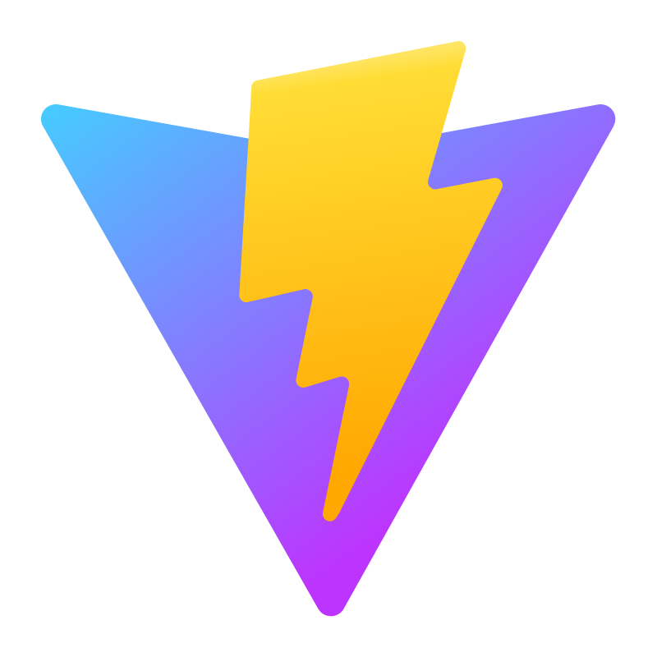

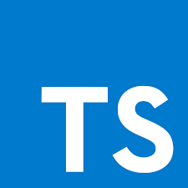
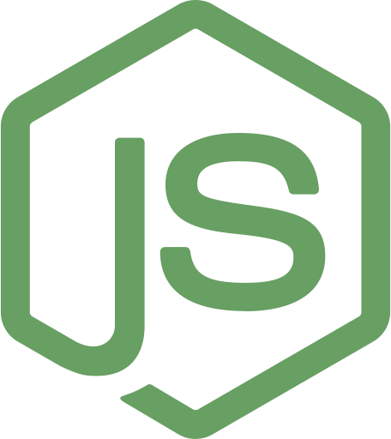
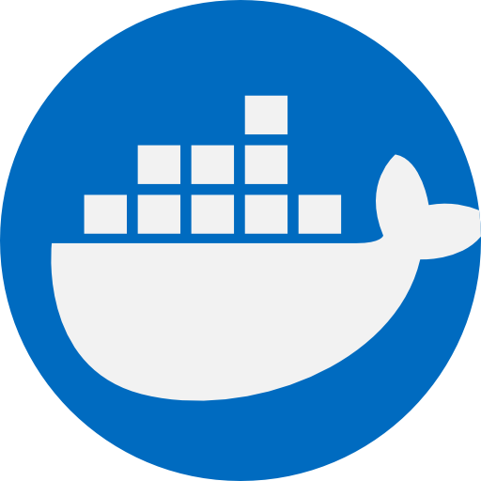




Architecture
Frontend
Backend
Optionals
Load Balancing
Content Caching
Redis Adapter

Slide 6
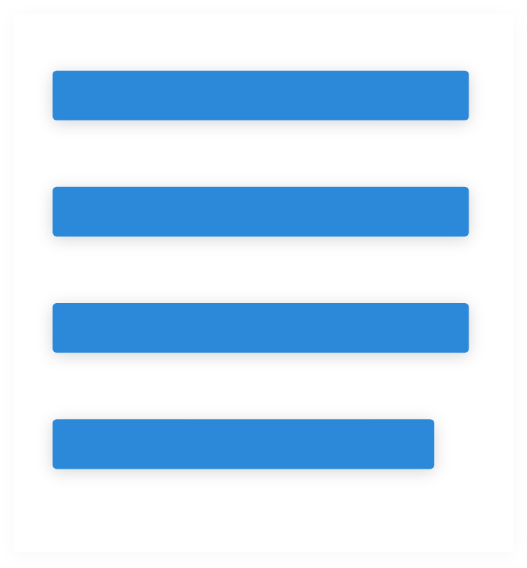
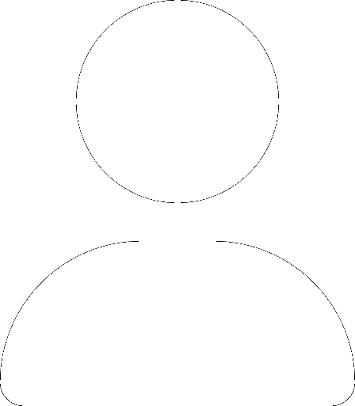

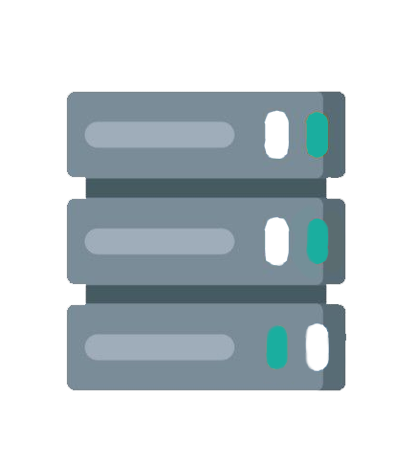
Challenges
Concurrent Editing
Conflict Resolution
State Consistency
No Data Loss
Offline Support
Read and Write Documents Offline
Version Control
Revision
Rollback
Fork & Merge
Scalable Architecture
Fast Content Access
Elastic Scaling

Slide 7
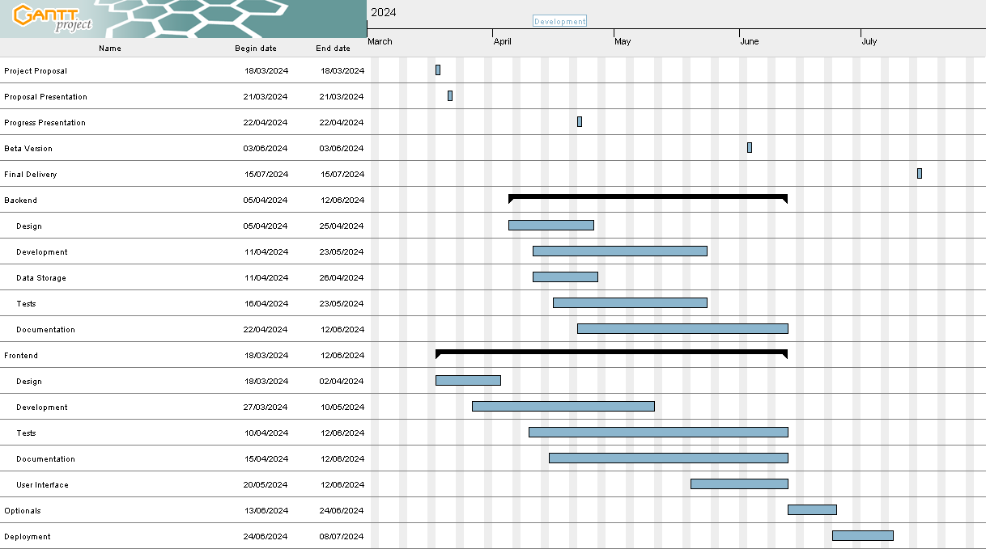
Project Plan

Slide 8
Questions?
“We are trying to prove ourselves wrong as quickly as possible, because only in that way can we find progress.”
Richard P. Feynman

