Slide 1
Radiofrequency Pulses in MRI
Lab Demo
Mahesh Keerthivasan
BME 639
University of Arizona

Slide 2
RF Excitation
Main
Field
Bo
z
North
z
B1(t)
B1
M₀
y
y
Applied B1 RF Field
x
M₀
x
The RF pulse rotates Mo the about applied field
Adapted from Larry Wald’s slides, fMRI MR Physics

Slide 3
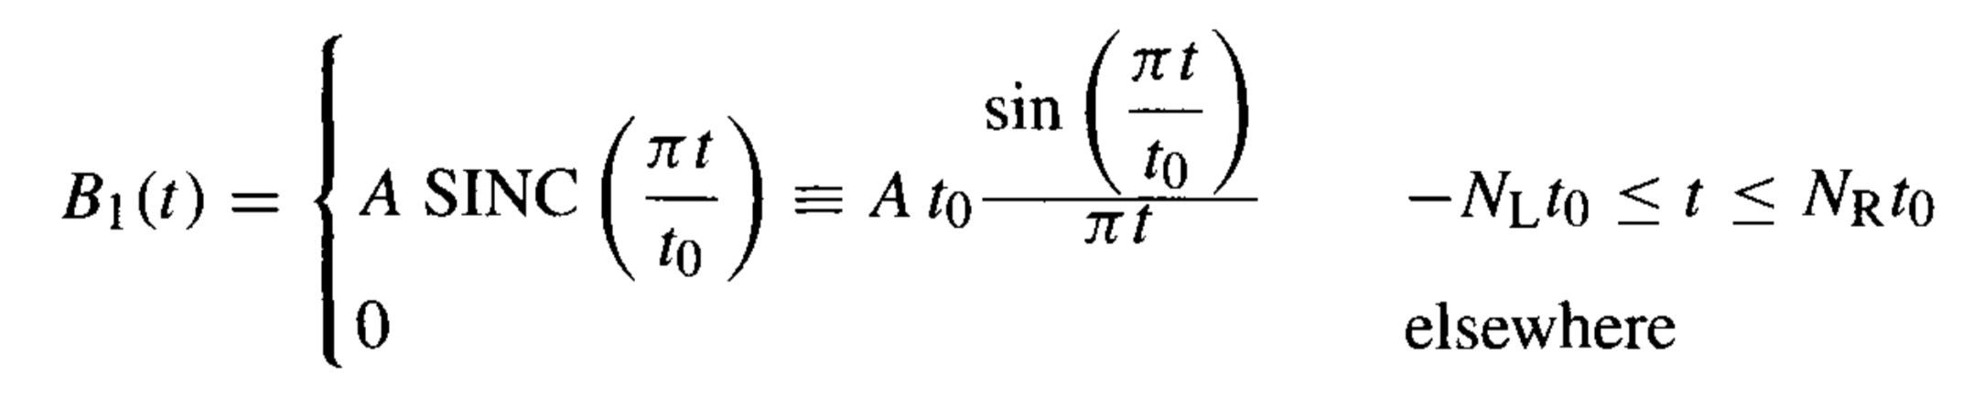



RF Pulse Design: Sinc
Sinc function:
$N_{L}, N_{R}$: Number of zeros crossing of the sinc
$t_{0}$: first zero crossing
$$Δf≈1/t_{0}$$
Time-Bandwidth product:
$$T Δf=N_{L}+N_{R}$$
Use the SLR Transform to generate slice profile
Handbook of MRI Pulse Sequences, Bernstein

Slide 4
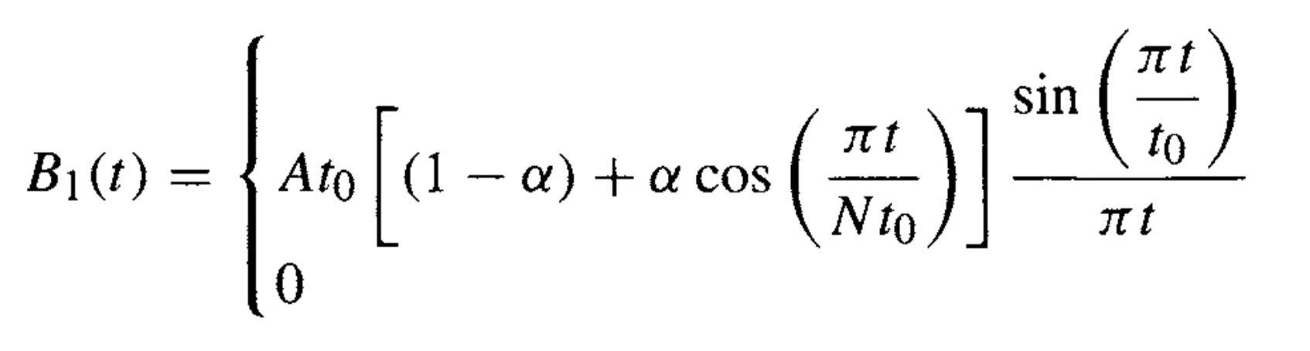
RF Pulse Design: Sinc
Windowed RF Pulse:
Multiple the RF pulse function by an appropriate window function to taper the RF amplitude at the beginning and end
Enable smooth roll off in slice profile
Sinc RF
window function w(t)
sinc(t)
Windowed Sinc RF

Slide 5
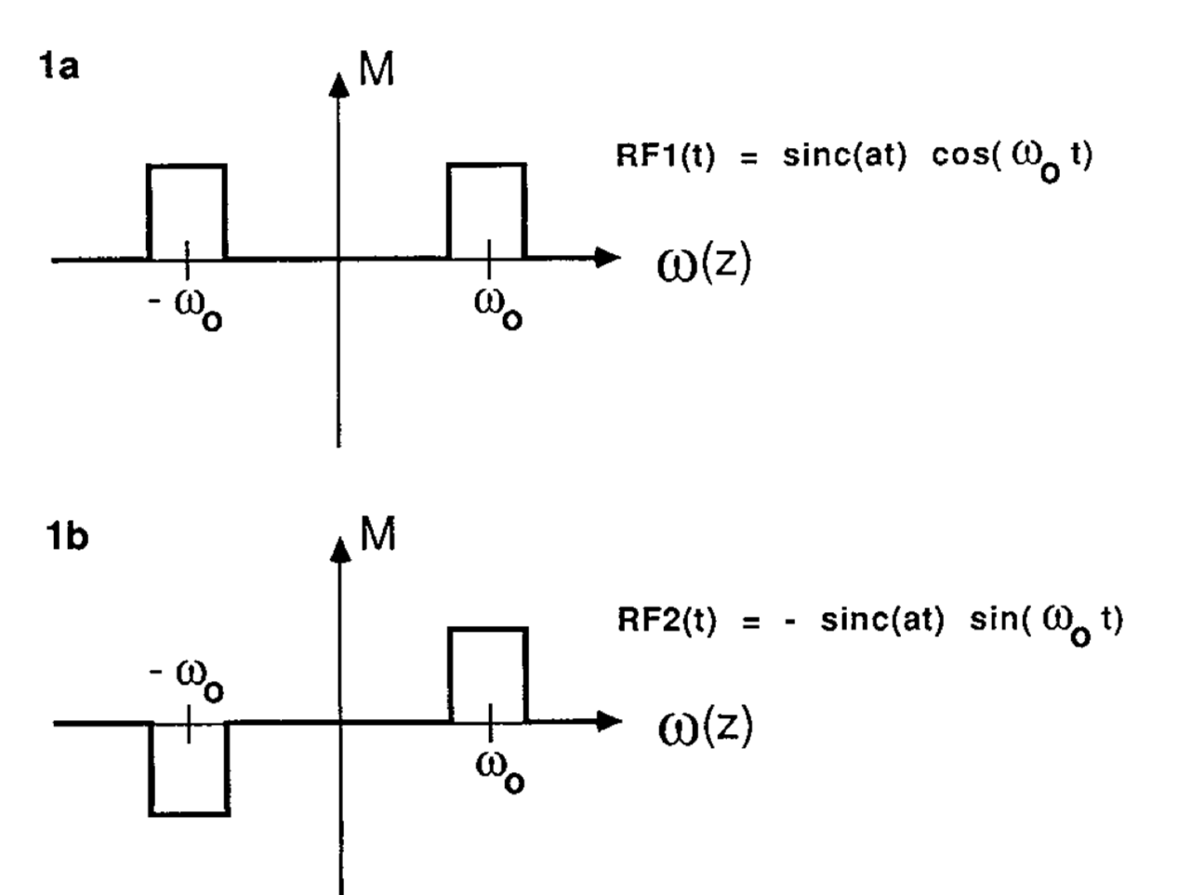
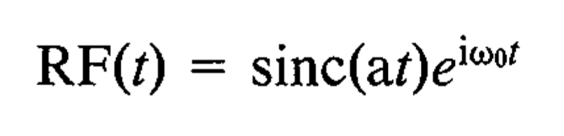
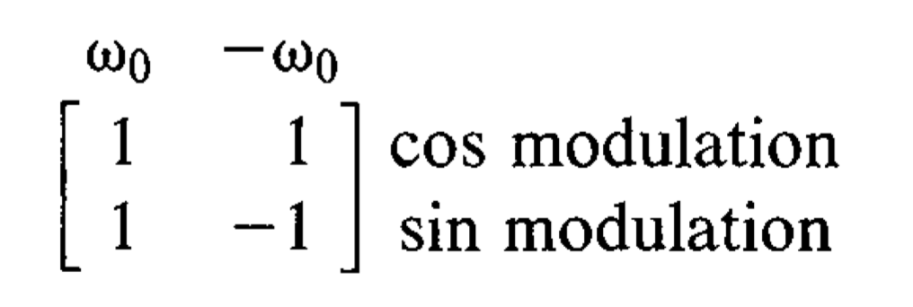
Simultaneous Multi-slice Excitation
Hadamard Encoding
S. P. Souza, J. Szumowski, C. L. Dumoulin, D. P. Plewes, G. Glover, SIMA: simultaneous multislice acquisition of MR images by Hadamard-encoded excitation. J Comput Assist Tomogr. 1988 Nov-Dec; 12(6): 1026–1030

Slide 6
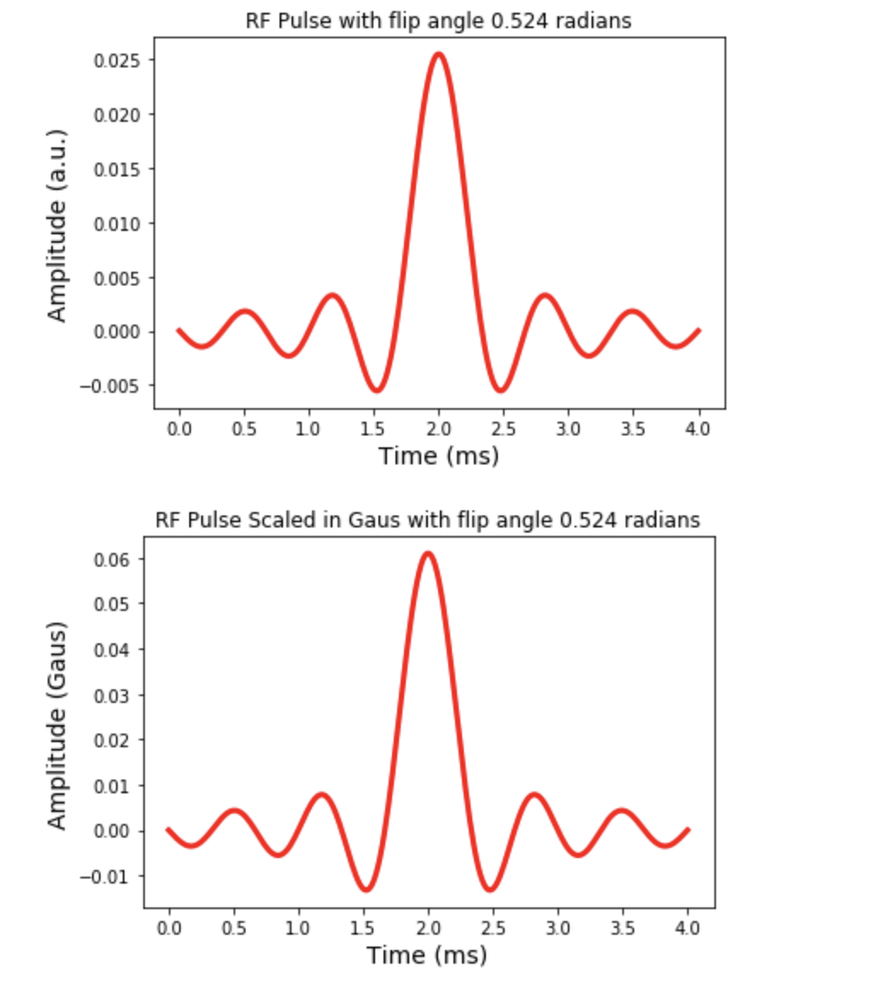
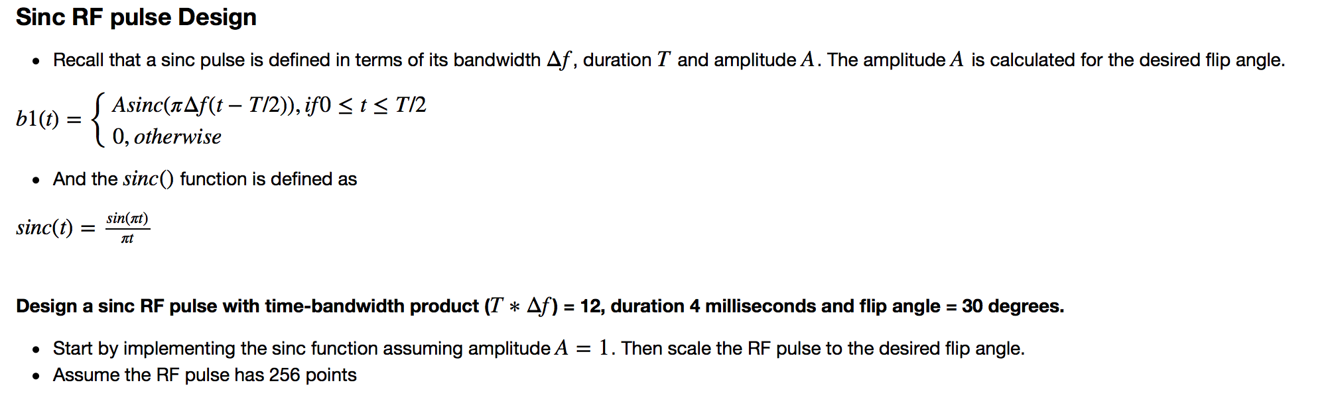
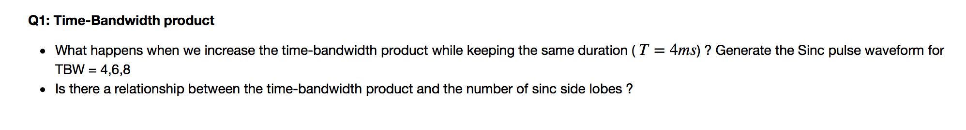

Slide 7
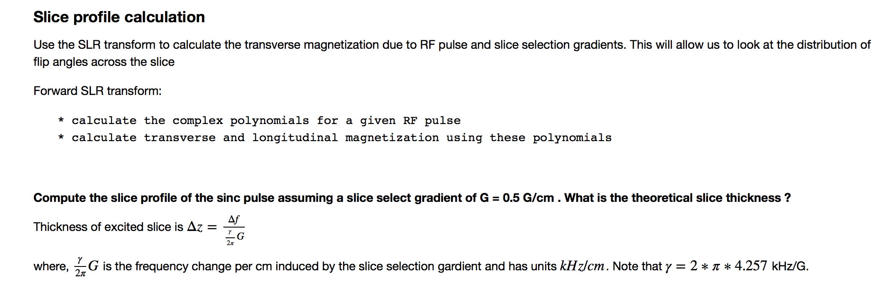
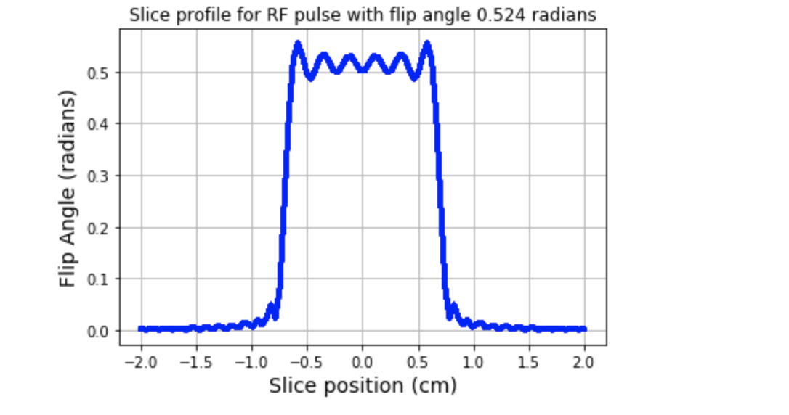

Slide 8
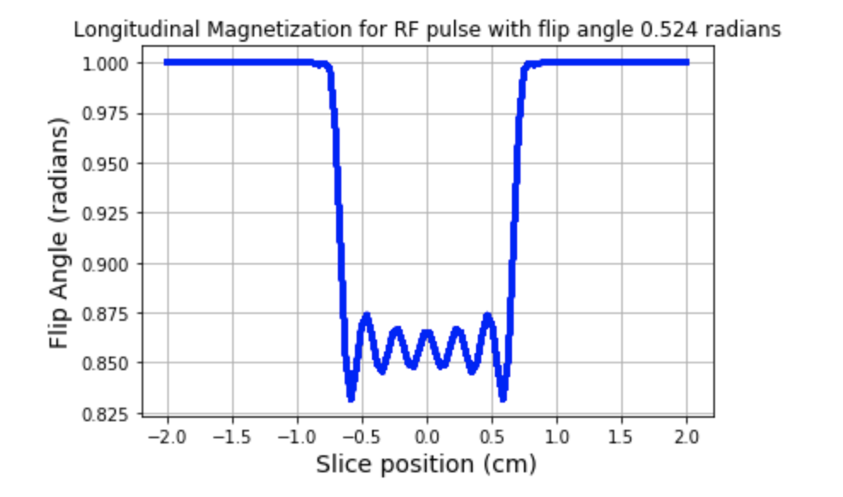
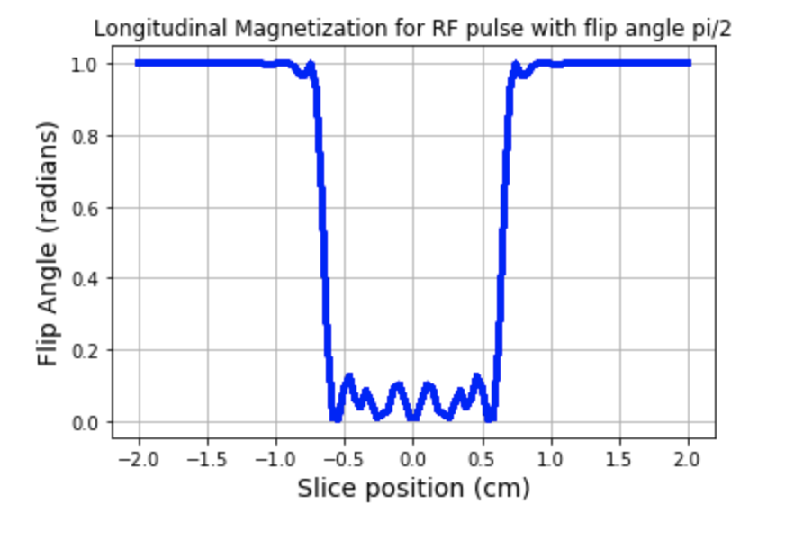
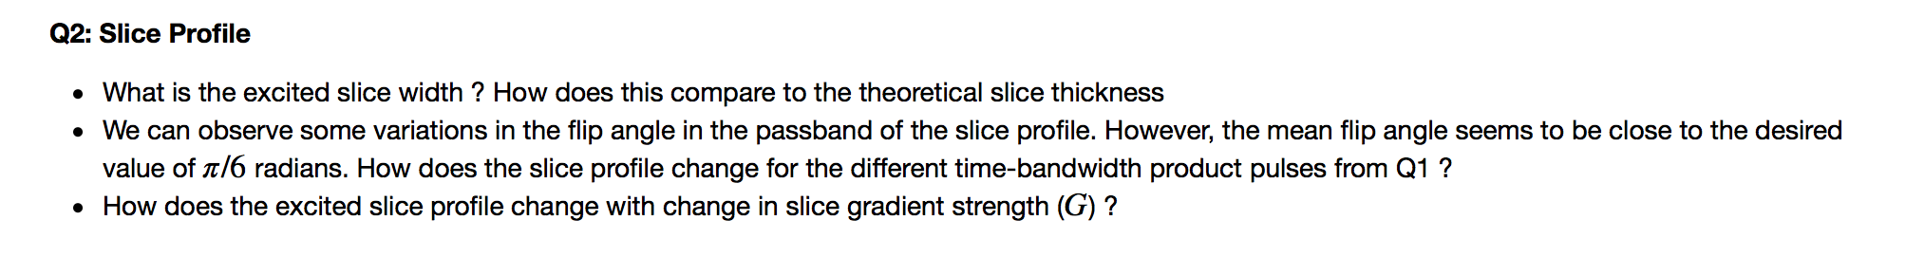

Slide 9
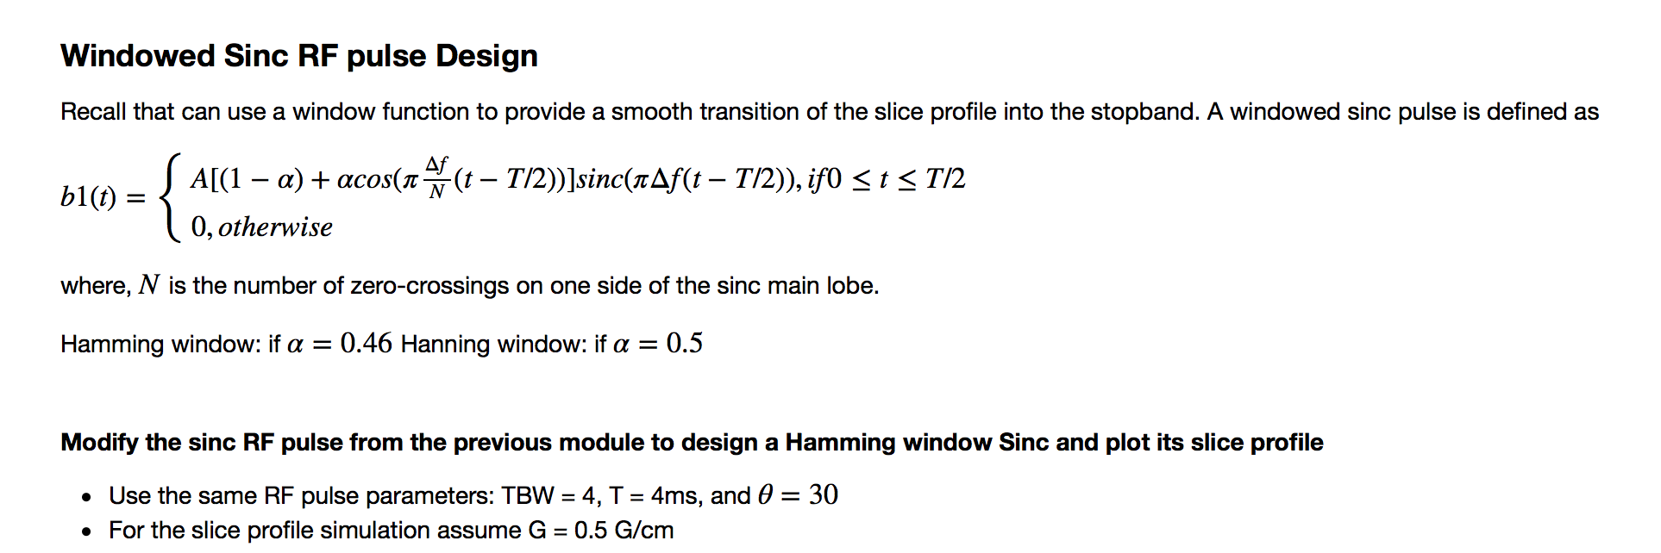
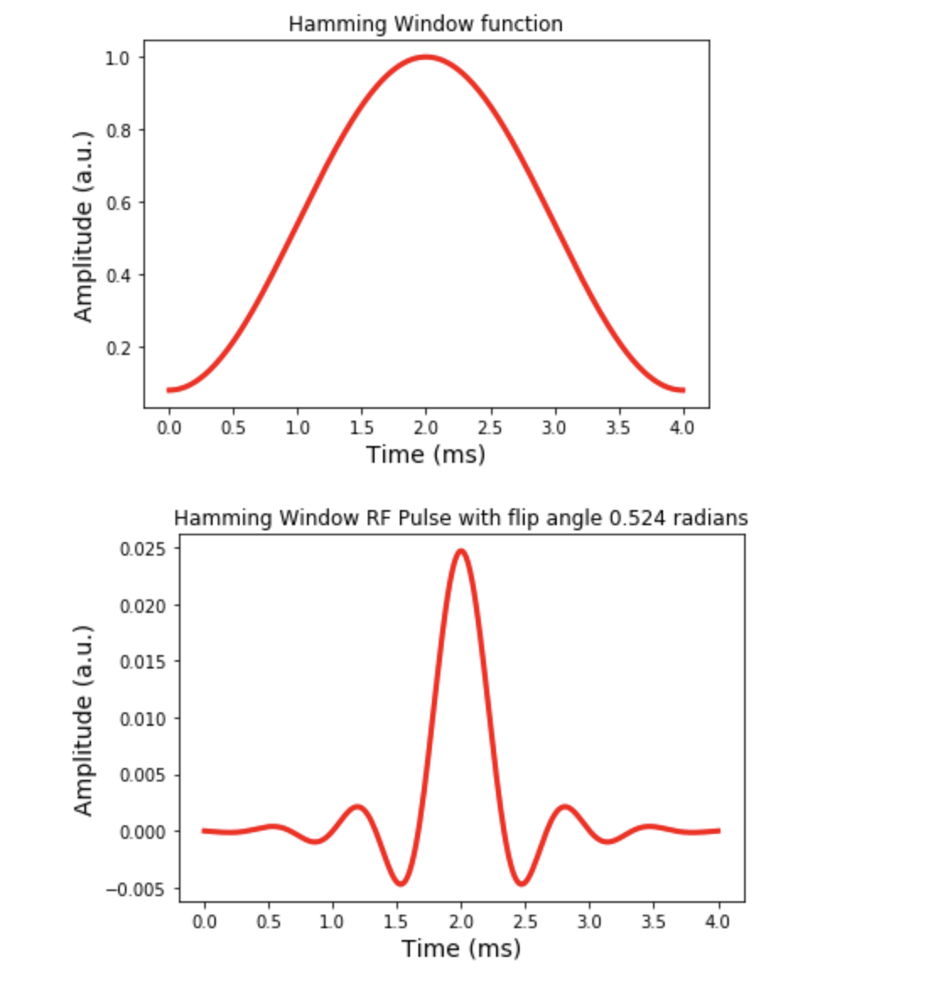
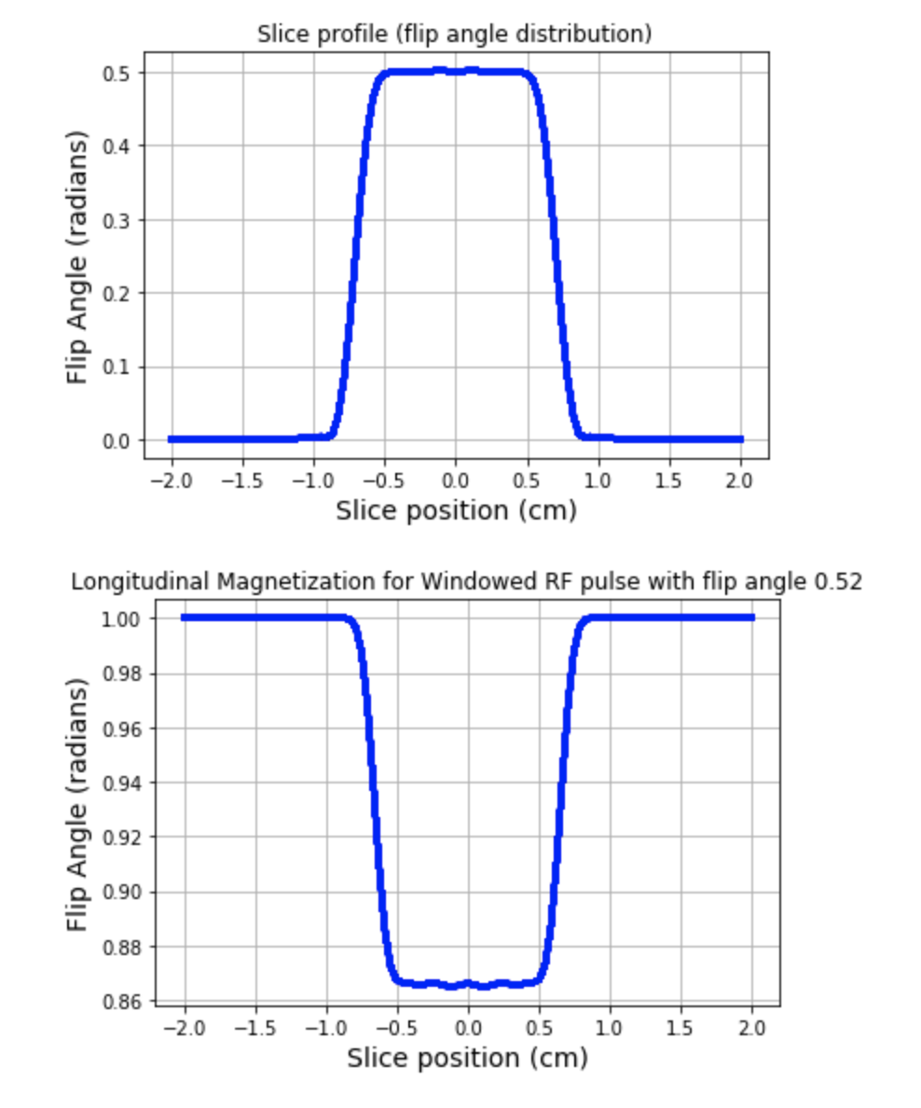
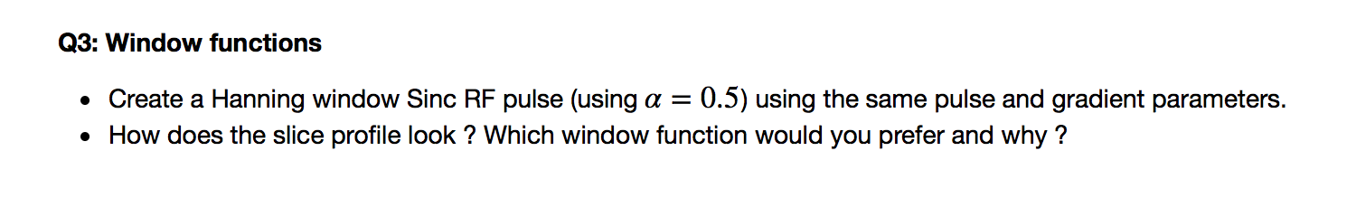

Slide 10
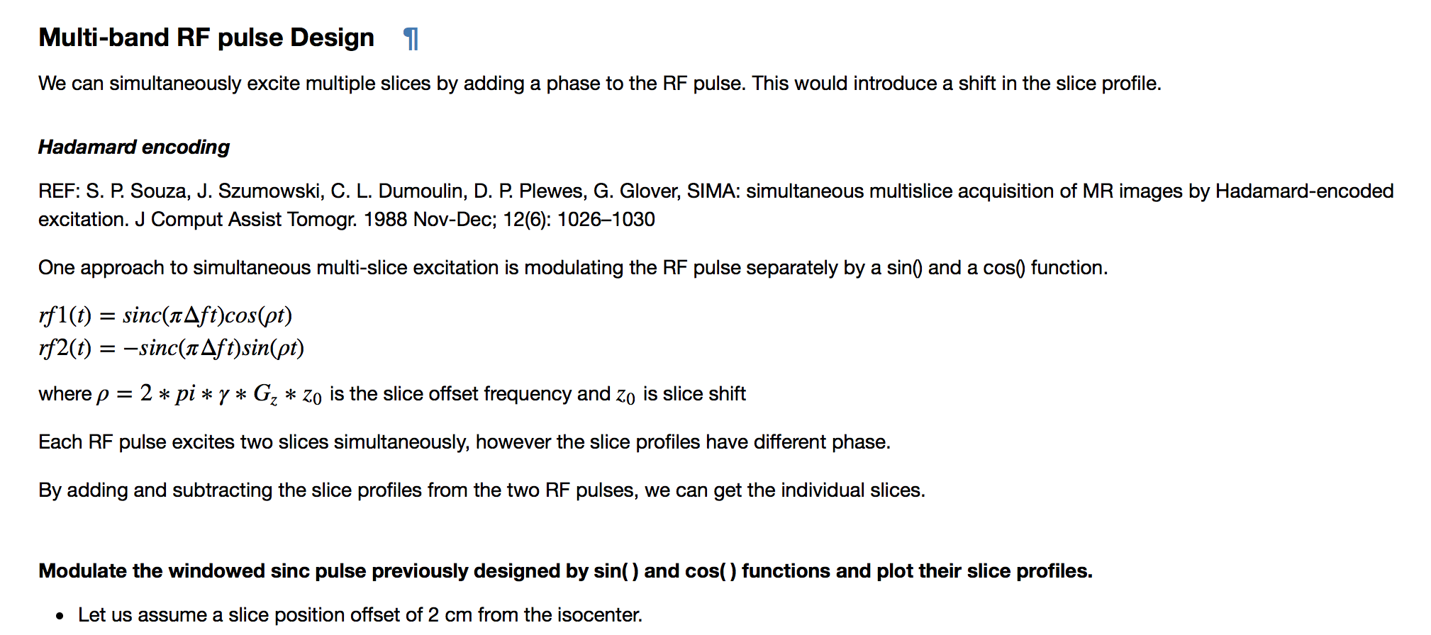
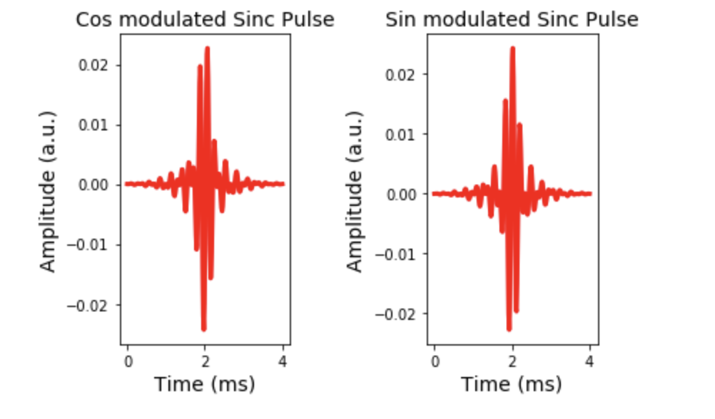
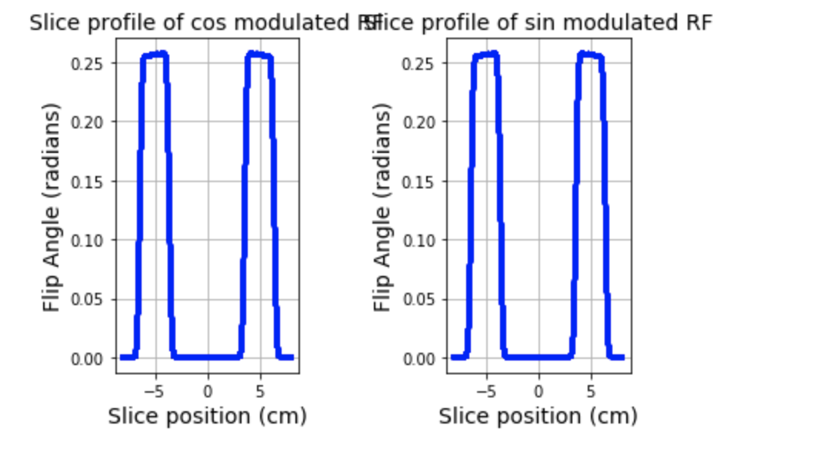

Slide 11
