Slide 1
DATA STRUCTURES AND ITS APPLICATIONS (UE22CS252A)
Mini Project

Slide 2
Project Title & Team Members
Title : Enhancement of an ecommerce website
Team Members : 1)Narayan S PES2UG22CS339
2)Nikhil Srivatsa PES2UG22CS357
3)Nitheesh Pugazhanthi PES2UG22CS371

Slide 3
SYNOPSIS
We each designed 3 Features for our ecommerce website:
Json parser : Parses the JSON database file and provides endpoints for the other components.
Product Search using Prefix Trees.
Recommendation system using graphs. The system suggests related product to the product of interest based on a given parameter.

Slide 4
ADT USED
Autocomplete System: Implemented Trie to match closest search based on Prefix matching . ADTs used: insert, display, display_prefix.
The insert function helps initializes the word inside the trie.
Display , traverses the parent trie and its children then prints out the particular searched word
Display_prefix , takes in a particular prefix , and prints out all the words with that prefix .

Slide 5
ADT USED
Recommendation System : The database is read using the json parser and made into a linked list for easy traversal, we use create node to make new nodes and update node function to update to linked list.
We use array of pointers to represent the graph . According to cost of the interested node, the weight of the others are decided, and the closest ones are updated in the array.
We then use the outdegree count to display related items to the interested one. Json Parser : It uses 2 stacks .It uses the pop and push ADT of stack .

Slide 6
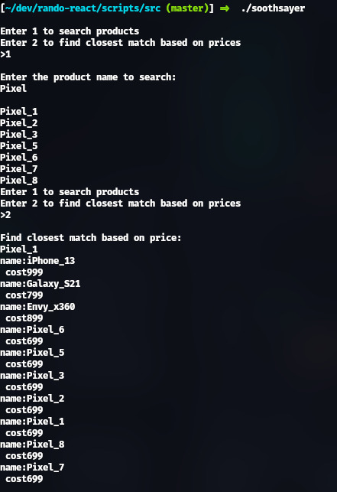
ADT USED
Output image:

Slide 7
Contribution of each Team Member
Narayan S: Json parser
Nikhil : Auto complete system
Nitheesh :recommendation system

Slide 8
Thank You

