Slide 1

PROGRAMMING 2B POE PART 3 ST10440515 NOTHANDO MPOFU

Slide 2
Problem Statement & Motivation
In many educational institutions, managing lecturer claims for hours worked is often a manual, paper-based process. This leads to delays, lost documents, and lack of transparency. Coordinators and managers spend significant time tracking approvals, and lecturers have limited visibility of their claim statuses. The Contract Monthly Claim System (CMCS) was developed to solve these issues. It automates the submission, review, and approval of lecturer claims, reduces manual errors, ensures accountability, and allows real-time tracking for all users.

Slide 3
Features Overview

Slide 4
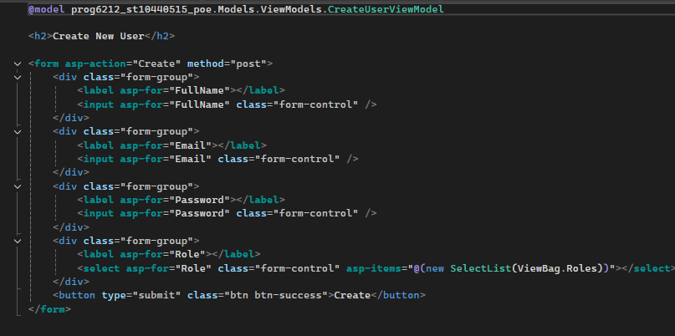
HR VIEW
4
This Razor View (Create.cshtml) provides the interface that allows an HR user to create new accounts within the system. It uses the CreateUserViewModel to bind form fields such as Full Name, Email, Password, and Role directly to the model, ensuring that any data entered by the user is automatically mapped when the form is submitted. The form posts its data to the Create action in the HRController using an HTTP POST request, where the input is validated and then saved to the database. The dropdown list for the user’s role is dynamically populated using values passed from the controller via ViewBag.Roles, allowing HR to select whether they are creating a Lecturer, Coordinator, Manager, or another HR user. When the form is submitted, the system creates the user account and, if the selected role is “Lecturer,” it automatically generates a corresponding Lecturer profile. Overall, this view acts as the front-end entry point for managing system users and ensures that new accounts are created in a structured and validated way.

Slide 5
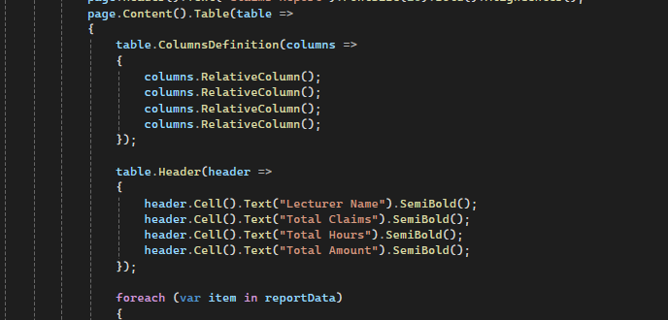
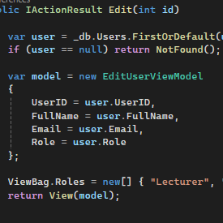
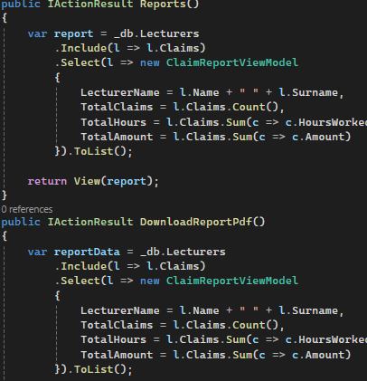
HR CONTROLLER

Slide 6

The HRController is the restricted administrative controller (annotated [Authorize(Roles = "HR")]) that centralises HR responsibilities: listing users (Index), creating new users (Create GET/POST), editing existing users (Edit GET/POST) and producing summary reports (Reports — and the downloadable PDF action). In practice the Create POST validates the incoming CreateUserViewModel, prevents duplicate emails, constructs a User entity (in your current code storing the password in plain text) and saves it; if the new user is a Lecturer the controller also auto-creates a corresponding Lecturer row (splitting the full name into first/last) so the lecturer/claim relationship is established. The reporting functionality uses EF Core/LINQ to compose aggregates: the Reports action loads Lecturers with their Claims (Include(l => l.Claims)), then projects each lecturer into a ClaimReportViewModel that contains LecturerName, TotalClaims, TotalHours and TotalAmount (computed with Count() and Sum()), which is returned to a view for on-screen inspection. For PDF output the controller follows the same pattern but then maps the aggregated list into an in-memory PDF document: it builds a tabular layout (column definitions, header row, then one data row per lecturer), renders the document to a byte array using a PDF library (e.g. QuestPDF), and returns File(pdfBytes, "application/pdf",
"ClaimsReport.pdf") so the browser downloads the file. Important implementation details to call out: (1) use of Include ensures related claims are loaded for correct aggregations; (2) the LINQ projection is executed server-side and efficient when written as a single query (avoid pulling all rows into memory before aggregation); (3) when generating PDFs you must set the library license (QuestPDF requires QuestPDF.Settings.License = LicenseType.Community at startup) and catch/handle generation exceptions; (4) format totals (currency, decimal places) and consider culture/localisation; (5) secure the endpoints with role checks and anti-forgery on state-changing actions; and (6) for robustness consider adding filtering parameters (date range, only approved claims), paging for very large data sets, transactional safety for multi-step user creation, validation error feedback, logging of generated reports and optionally persisting the generated PDF to a storage location for auditing. These practices make the HR reporting pipeline accurate, performant and auditable while keeping the controller code straightforward and testable.

Slide 7
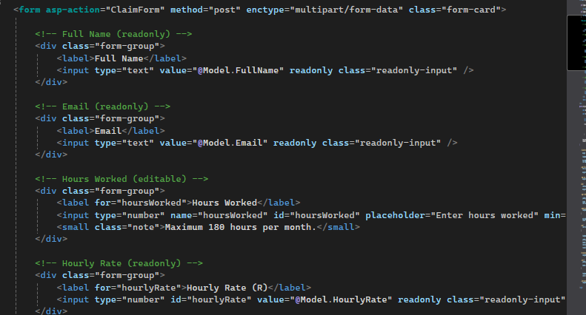
LECTURER VIEW-CLAIM FORM
7

Slide 8
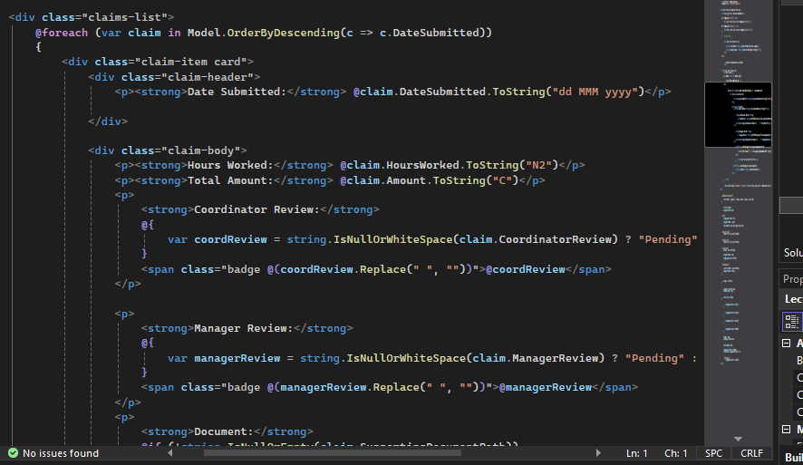
The ClaimForm functionality manages the entire process of submitting a work-hour claim for a lecturer. When the form is opened (GET request), the controller checks whether the lecturer is properly logged in, retrieves their profile from the database, and sends that information to the view so the form can be filled out correctly. When the lecturer submits the form (POST request), the controller again verifies the logged-in lecturer and prepares to save the claim. If a supporting document is uploaded, the system validates that the file type is allowed (PDF, DOCX, or XLSX) and that the file size is under 5 MB. The file is then saved securely into the wwwroot/uploads directory with a unique filename. After handling the file, the system creates a new Claim object containing the hours worked, notes, calculated amount (based on the lecturer’s hourly rate), and the uploaded document path. It automatically sets all review fields, CoordinatorReview, ManagerReview, and overall Status, to Pending, starting the approval workflow. The claim is then stored in the database using EF Core, and the lecturer is redirected back to the dashboard with a success message. This ensures a smooth, safe, and fully logged claim submission process.

Slide 9
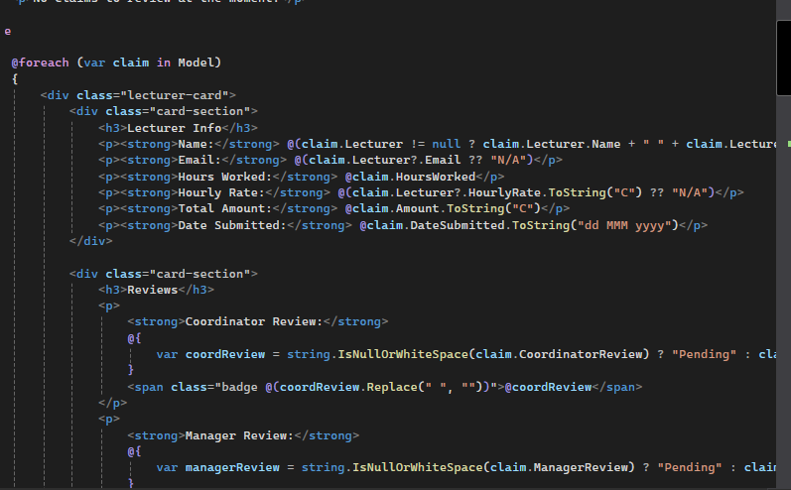
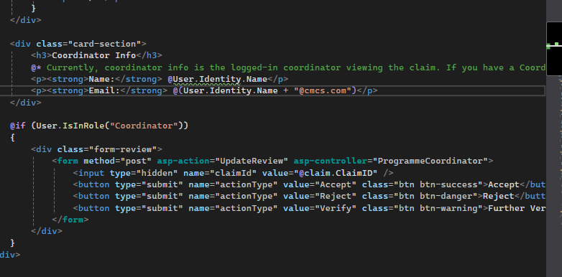
PROGRAMME COORDINATOR AND ACADEMIC MANAGER

Slide 10
The Coordinator and Manager CSHTML pages provide the review interfaces for handling lecturer claims, each tailored to that role’s responsibilities. Both pages display a styled dashboard built with Razor syntax, HTML, and server-side data passed through ViewBag and model lists. Each claim is shown inside a card layout that includes key details such as hours worked, amount calculated, submission date, attached documents, and the lecturer’s information. Using conditional Razor statements, the views render dynamic status badges, such as Pending, Accepted, Rejected, or Further Verification, with color-coded UI styling for clarity.
Each claim also includes action buttons that trigger POST requests back to the controller (e.g., Accept, Reject, Send for Verification), allowing coordinators and managers to update claim status directly from the interface. Behind the scenes, the UI uses forms, hidden inputs, route values, and MVC tag helpers (asp-action, asp-route-id) to connect the view to its corresponding controller logic. The Coordinator page shows both the lecturer’s details and the claim information and updates the CoordinatorReview field, while the Manager CSHTML does the same but updates the ManagerReview field and finalizes the claim’s overall status. As a result, both pages function as interactive approval dashboards that combine Razor rendering, MVC routing, and database-driven data to manage the workflow efficiently.

Slide 11
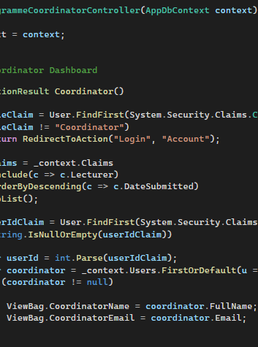
CONTROLLER
The Coordinator and Manager controllers handle the multi-level approval workflow for lecturer claims, using sessions and role-based authentication to ensure secure access. When a user logs in, ASP.NET stores their UserID and Role in session cookies, and each controller checks these values to ensure that only a Coordinator can access the Coordinator actions and only a Manager can access Manager actions. Both controllers retrieve claims from the database using Entity Framework and display them on their dashboard views, where the user can review hours worked, documents submitted, and previous decisions. When a Coordinator updates a claim, accepting it, rejecting it, or sending it for further verification, the controller saves the decision into the CoordinatorReview field and updates the claim status accordingly. The Manager controller performs the final review, modifying the ManagerReview field and setting the overall Status of the claim (Accepted, Rejected, or Pending). These controllers therefore enforce workflow control, protect restricted pages using session-based identity checks, and update claims through EF Core to move them through the approval stages.

Slide 12
Backend Overview

Slide 13
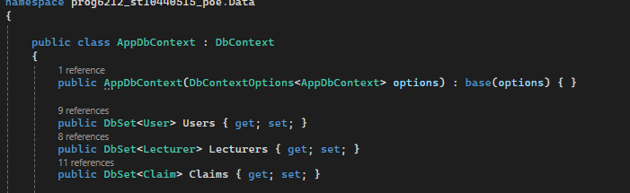
SSMS INTERGRATION
The AppDbContext class is the core of the application's data layer, acting as the bridge between the C# models and the SQL Server database using Entity Framework Core. It defines the database tables through DbSet properties such as Users, Lecturers, and Claims, allowing the application to query and update data using LINQ instead of manual SQL. When the program runs, EF Core uses this context to track changes, load related data with .Include(), and save updates using .SaveChanges(). The AppDbContext is registered in Program.cs with dependency injection, meaning every controller that requires database access automatically receives a configured instance of the context. This ensures consistent, secure, and efficient communication with the database. Relationships are handled through navigation properties, for example, a Lecturer has many Claims, allowing EF Core to automatically link foreign keys. Overall, the AppDbContext manages all persistence in the application, ensuring that authentication data, lecturer details, uploaded claims, coordinator reviews, manager reviews, and HR records are stored and retrieved accurately throughout the entire system.

Slide 14
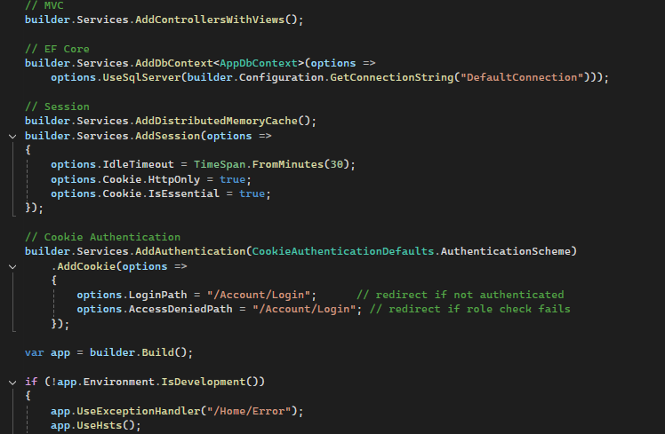
PROGRAM
The Program.cs file is the entry point of the ASP.NET Core application and is responsible for configuring the services and middleware needed for the system to run. It sets up MVC with AddControllersWithViews() to enable the application to handle requests and render views, and configures Entity Framework Core with AddDbContext<AppDbContext> to connect to the SQL Server database, allowing access to users, lecturers, coordinators, managers, and claims. It also enables session management using AddDistributedMemoryCache() and AddSession(), which stores temporary user data such as roles and messages during a session, ensuring personalized dashboards and role-based access. Cookie-based authentication is configured to secure the application, redirecting unauthenticated users to the login page. The middleware pipeline, including UseHttpsRedirection(), UseStaticFiles(), UseRouting(), UseSession(), UseAuthentication(), and UseAuthorization(), defines the order in which requests are processed, ensuring security, session tracking, and proper routing. Finally, MapControllerRoute() sets the default routing pattern so the application can correctly direct user requests to the appropriate controllers and actions. Overall, Program.cs establishes the foundational setup that enables the application to function securely and efficiently.

Slide 15
Thank You
ST10440515
NOTHANDO MPOFU

