Slide 1
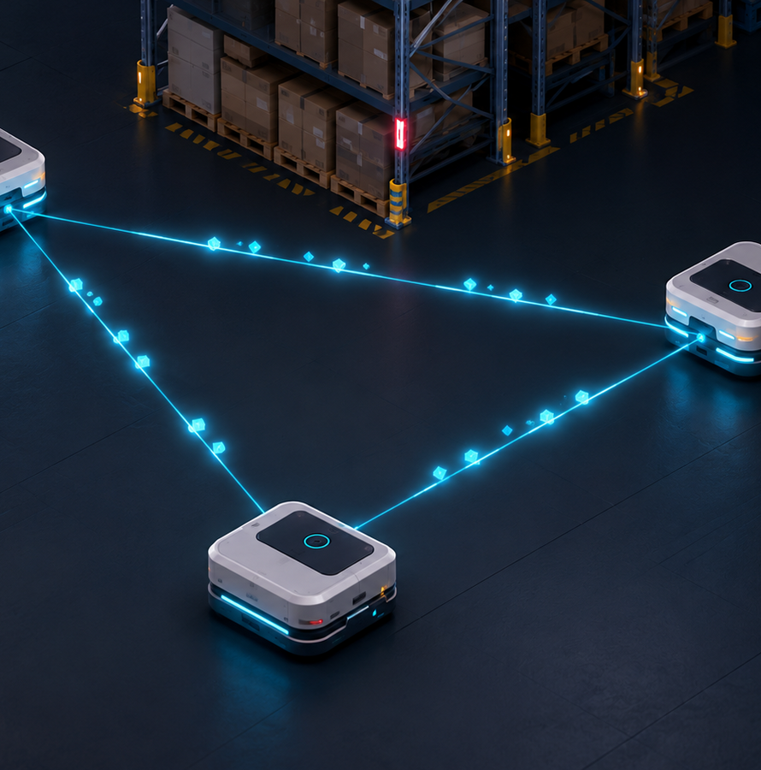
SIH26123
Distributed edge coordination
for warehouse AMRs
Independent robot processes, authenticated peer traffic, local safety, and reproducible failure evidence.
Implementation review · August 2026
Notes:
[Sources]
- README.md
- frontend/assets/heroes/hero_peer_mesh.png

Slide 2
The requirement is three systems, not one algorithm
01
02
03
Coordinate
Stay safe
Recover
Resolve task ownership and path conflicts without a central movement decision.
Protective stopping must remain onboard and independent of peer packets.
Packet loss, partitions, blocked aisles and crashed winners must converge safely.
02
Notes:
[Sources]
- reference/problem_statements.md
- src/amr.py
- src/scenarios.py

Slide 3
Every AMR owns its control loop and its decisions
AMR01 process
AMR02 process
AMR03 process
50 Hz safety
10 Hz traffic
local route + task state
50 Hz safety
10 Hz traffic
local route + task state
50 Hz safety
10 Hz traffic
local route + task state
HMAC UDP multicast · relative TTLs · replay window
The dashboard listens. The WMS announces work. Neither sends a motor command.
03
Notes:
[Sources]
- src/distributed_demo.py
- src/edge_runtime.py
- docs/WIRE_PROTOCOL.md

Slide 4
The wire protocol assumes loss, reordering and unrelated clocks
Validate
Authenticate
Expire
Bounded schemas reject malformed, oversized and non-finite datagrams before brain ingestion.
HMAC-SHA256 protects priority, intent and award integrity; session replay windows reject duplicates.
Intent windows and leases are relative durations converted to each receiver's monotonic clock.
04
Notes:
[Sources]
- src/messages.py
- src/transport.py
- tests/test_core.py

Slide 5
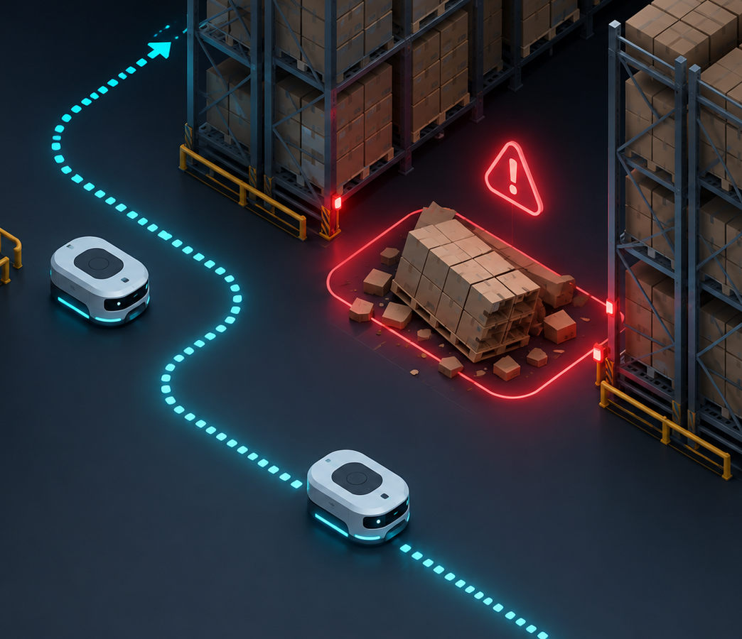
Anonymous obstacles and silent robots trigger bounded recovery
Blocked aisle
Persistent local detections become expiring blocked cells; A* replans around them.
Crashed auction winner
Its lease expires, peers raise the epoch, and a survivor completes the task. The chassis remains a sensed obstacle.
Human worker
No message dependency: local braking and off-aisle parking keep the worker path clear.
05
Notes:
[Sources]
- src/world.py
- src/amr.py
- src/scenarios.py
- tests/test_resilience.py
- frontend/assets/heroes/hero_blocked_reroute.png

Slide 6
The full fault campaign passes after catalog convergence
180 runs
loss + partition + crash matrix
30/30
partition-heal completion
0 contacts
robot · human · rack
06
Notes:
[Sources]
- artifacts/benchmarks/fault-campaign.json
- src/fault_campaign.py

Slide 7
Every fleet clears the 20% requirement conservatively
Minimum per-seed reduction lower bounds
66.06%
4 AMRs
51.03%
6 AMRs
32.66%
8 AMRs
Right-censored lower bounds—not exact speedups. Stop-and-wait did not finish before 1200 s.
07
Notes:
[Sources]
- artifacts/benchmarks/sih-acceptance.json
- docs/SIH_ACCEPTANCE_BENCHMARK.md

Slide 8
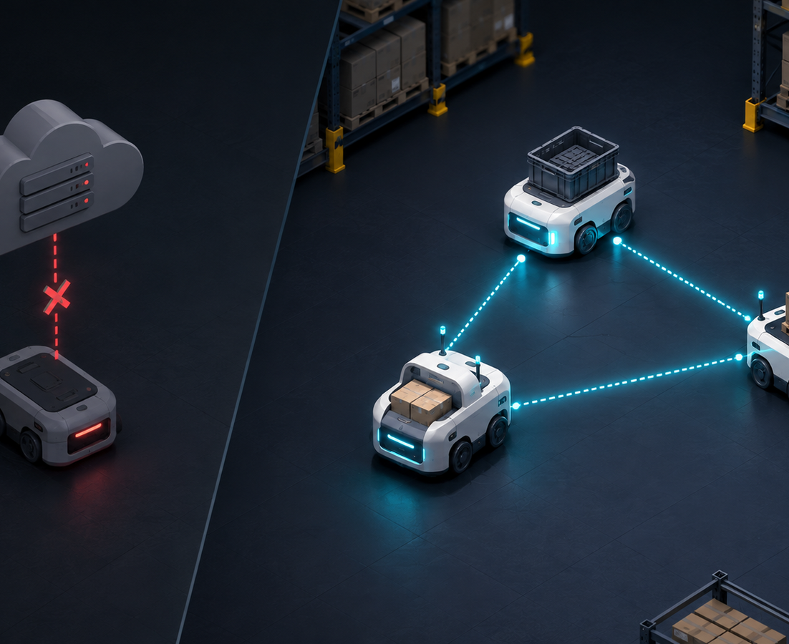
The deployment boundary is executable today
3 distinct PIDs
Each owns a brain, clock, replay window and authenticated socket.
~0.68 ms loop p95
Measured on the development Mac against a 20 ms control period.
0 deadline misses
Not a Raspberry Pi claim; the same JSON harness is ready for device evidence.
08
Notes:
[Sources]
- src/distributed_demo.py
- src/edge_runtime.py
- docs/EDGE_DEPLOYMENT.md
- frontend/assets/heroes/hero_edge_vs_cloud.png

Slide 9
The prototype is now reproducible, testable and deployable
93 tests
CI gate
Team runbook
Pi service
Protocol, safety, dashboard, failure and real-socket regressions.
Ruff, pytest, bytecode, JavaScript and process smoke test.
Clone, venv, exact commands, packet schema and troubleshooting.
Restricted systemd unit, non-secret config and JSON timing report.
09
Notes:
[Sources]
- tests/
- .github/workflows/ci.yml
- docs/EDGE_DEPLOYMENT.md
- deploy/systemd/sih-edge-node@.service

Slide 10
Ready for hardware integration—with one honest boundary
Implemented
External validation
• Independent edge processes
• Authenticated, replay-safe wire
• Loss and partition convergence
• Crash reassignment and rerouting
• Hardened dashboard and CI
Run the supplied harness on the named Pi/Jetson, connect the real sensor and motor bridge, and retain the unedited CPU/RSS/deadline report.
Decision: proceed to device integration and controlled warehouse trials.
10
Notes:
[Sources]
- docs/EDGE_DEPLOYMENT.md
- docs/DEMO_AND_JUDGING.md
- README.md

