Slide 1
DIRECTED RESEARCH (498R)
Project Title: A Systematic Review of Scrum in Software development
Submitted to: Dr. Dihan Md. Nuruddin Hasan
Name: MD. Mehedi Hasan Bhuiyan Nipu [CSE]
ID: 1911870642
Section-24
Email: mehedi.nipu@northsouth.edu
Name: Md Ibrahim Khalil Ullah [CSE]
ID: 1812015042
Section-15
Email: ibrahim.ullah@northsouth.edu
Name: Jahid Akand Nahid [CSE]
ID: 1813142642
Section-15
Email: jahid.nahid@northsouth.edu
Date of Submission: 20-6-2023

Slide 2
Introduction
Scrum is a framework for organizing and managing work.
The Scrum framework is based on a set of values ,principle and practices that provide the foundation to which the organization will add its unique implementation of relevant engineering practices and in software development system.

Slide 3
Background
The iterative, incremental Scrum project management methodology offers an easy "inspect and adapt" framework. Software is provided using the Scrum methodology in increments termed "Sprints" (often 2–4-week iterations). Planning and review are the two main components of each Sprint. A Scrum team's sprint planning is a time-boxed meeting that can take up to 4 hours. It is committed to growing. They were planned in detail for the Sprint. In sprint review meetings, project participants discuss the company's state, the market, and technology. These sessions may go on for up to four hours. A retrospective meeting may be held to evaluate the finished sprints' teamwork effectiveness. Each team member answers three questions during a 15-minute daily Scrum meeting: what did I do yesterday? What will I accomplish today, and what obstacles are in my path? Burndown charts, sprint backlogs, and product backlogs are the three artifacts produced by Scrum. Customer needs are listed in backlogs, and daily burndown charts display the work to be done.

Slide 4
Problem Statement
Software industries are demanded to provide a high quality software in such turbulence and uncertain environment. One of the solution to overcome those problems is Scrum methodology that had been widely used in the software development process. It is very important to pay attention on several challenges which may occur during the implementation of Scrum in desired environment. The Scrum framework facilitates Agile software development, encouraging adaptability, teamwork, and incremental development. Bangladesh may have many software firms, but Scrum is only sometimes used as a development process. This talk will examine why Scrum is essential and how implementing it may completely transform Bangladesh's software sector.

Slide 5
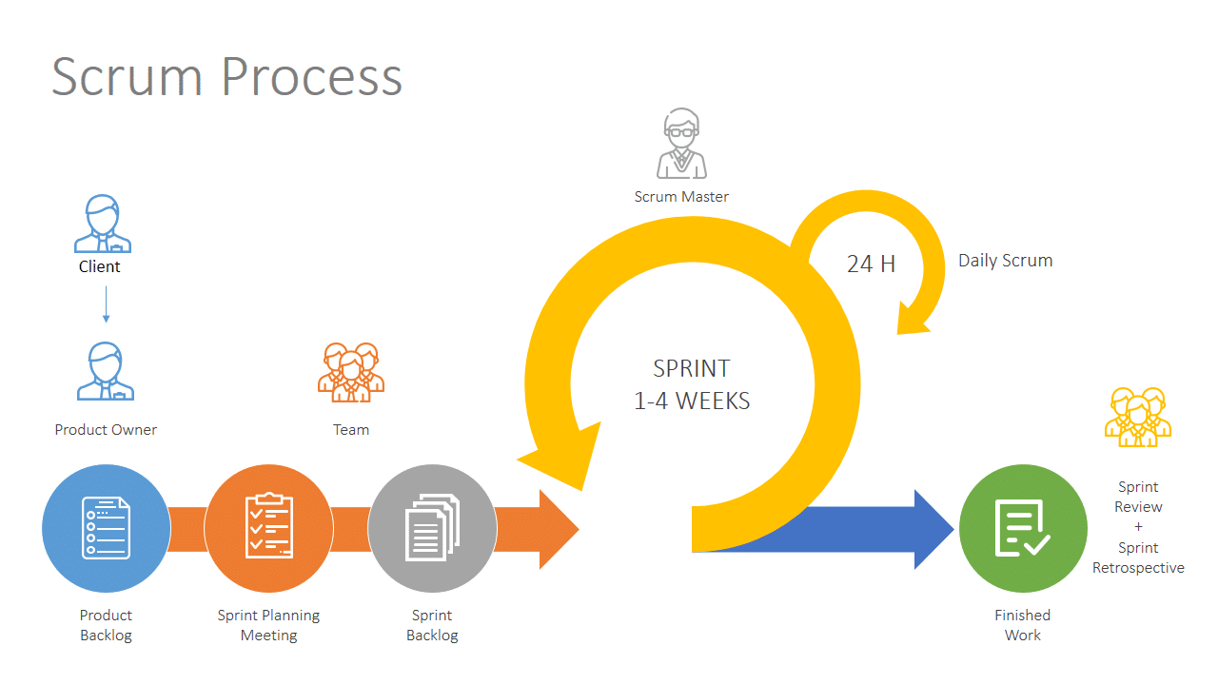
System diagram representation

Slide 6
Scrum Roles
In contrast to classical project management methods, Scrum doesn’t have and doesn’t need a product manager, a task manager or a team leader. A scrum team has a slightly different composition than a traditional waterfall project, with three specific roles: 1) Product Owner, 2) Scrum Master, and
3) Development Team.

Slide 7
Product Backlog- Here, the Product owner meets the client and takes down all the requirements. A document referred to as Product Backlog captures these requirements.
Sprint Backlog– Now, the Product Owner shares this Product Backlog with the Sprint team (consists of Scrum Master, Developers, and testers) in a meeting referred to as the “Sprint Planning” meeting. In sprint planning, the entire team agrees to complete a sub-set of product backlog items. This agreement is called the Sprint Backlog & its basis the team’s velocity/ capacity & the length of the sprint.
First Iteration– Story 1 and 3 will be released (Sprint 1)
Second Iteration- Release of Story 2, 4 and 6 will happen(Sprint 2)
Third Iteration– Story 5 will be released (Sprint 3)
Daily Scrum- The Scrum Master conducts a daily meeting of the duration of 15 minutes with the Sprint team to ensure progress is on track.

Slide 8
Sprint Review- At the end of each phase or “Sprint” – Scrum Master organizes a meeting referred to as the “Sprint Review” meeting. In this meeting, the Product owner reviews the product and assess whether the product is as per client expectations or not. It is an informal meeting & is kept to less than 4 hours a week for a 4-week sprint.
Sprint Retrospective meeting: is conducted to discuss “What went well during the Sprint” and “What needs improvement”. This meeting takes place after the sprint review but before the next Sprint Planning Meeting. Its duration can be of a maximum of 3 hours for a 4-week sprint.

Slide 9
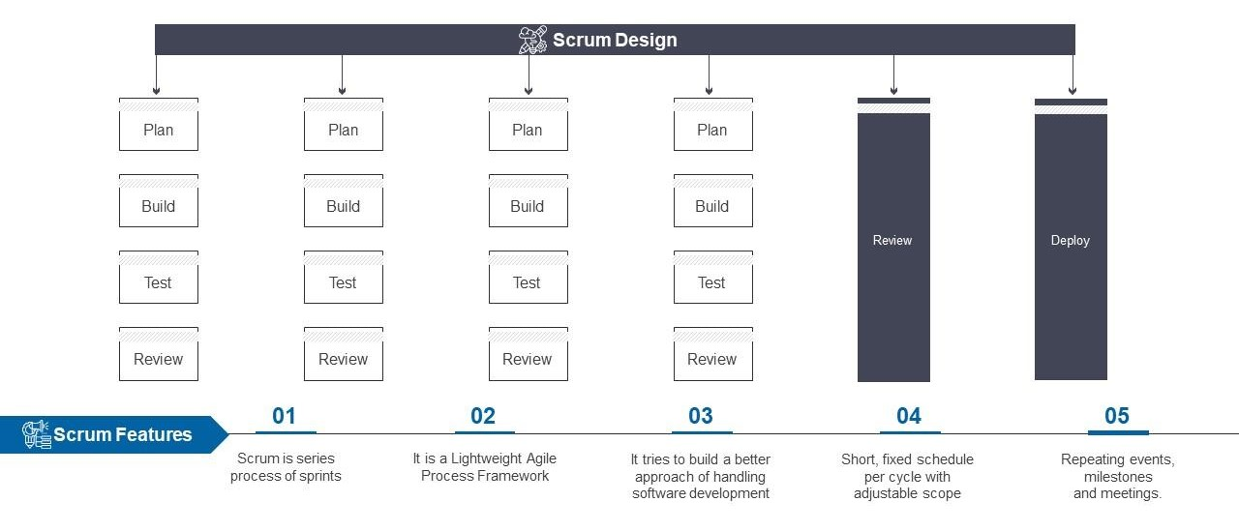

Slide 10
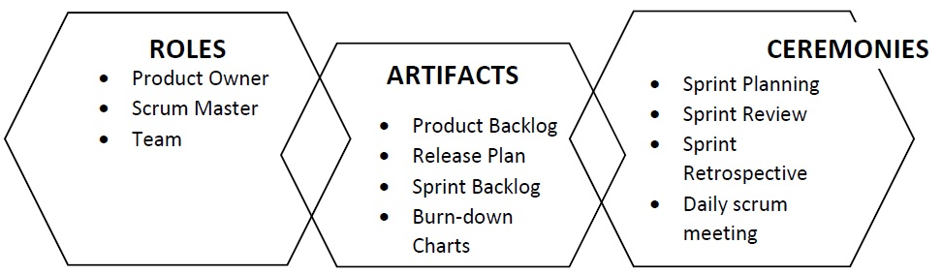
Features

Slide 11
Technology to be used:
Project management tools (e.g., Jira, Trello)
Communication and collaboration tools (e.g., Slack, Microsoft Teams)
Data analysis software (e.g., Excel, SPSS)

Slide 12
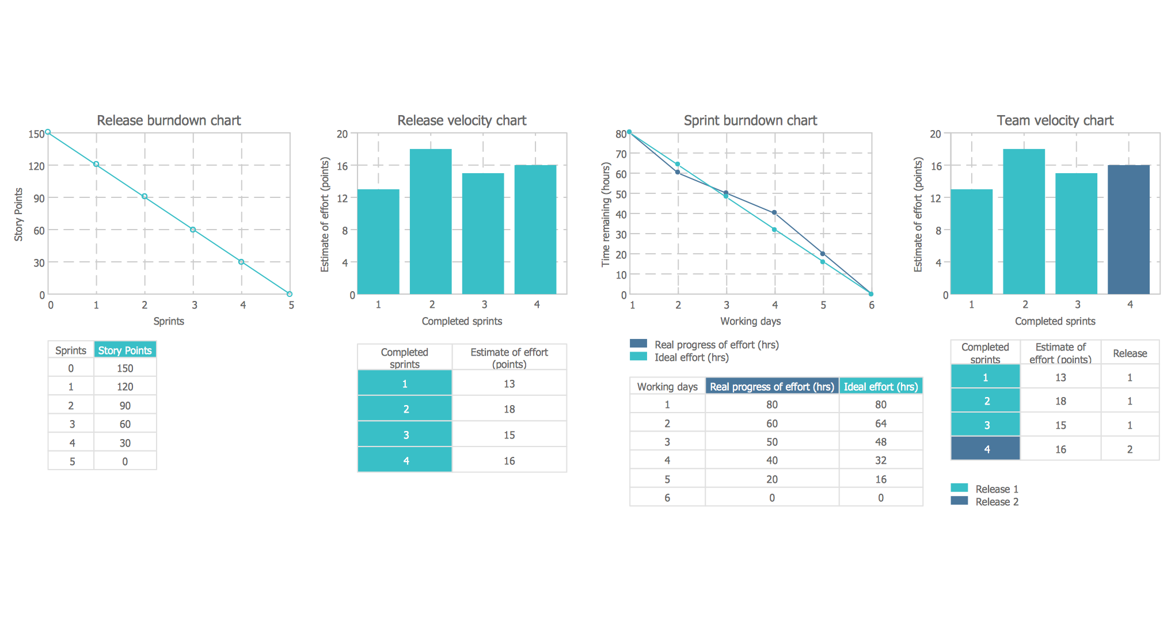
Results

Slide 13
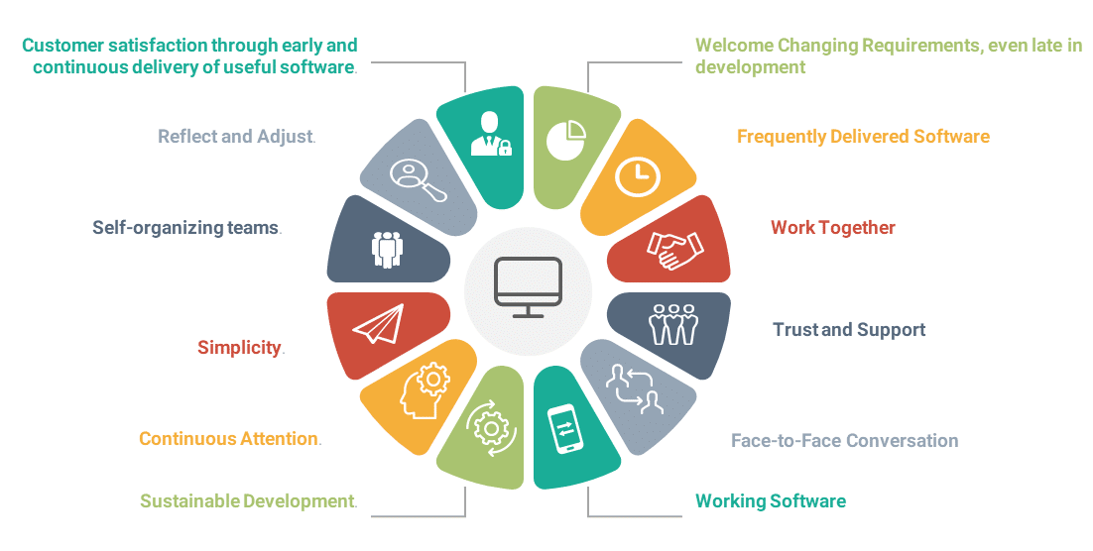
Scrum Principle

Slide 14
Difference between existing method vs Our Scrum methodology
Traditional Method | Scrum
It consists of five phases: Requirements analysis Design Implementation Coding and Testing Maintenance | It consists of three phases: Project initiation Sprint planning Demos
Work is divided into phases. The team works closely. | Work is divided into teams as an individual responsibility
Phases and processes are completed one at a time. | The development process is divided among the team as an individual, it does not wait for the previous stage to get completed.

Slide 15
Limitation
Like every research project, this study has some restrictions. There may have been some publications that didn't make it into this review, which examines the usage of Scrum methods in software development. Indeed, it would be a limited oversight. It was discovered that several articles needed more information during the data extraction procedure; however, identifying and classifying the themes from the publications synthesized the data used in the study. The extraction method may have led to mistakes because some of the chosen research did not offer thorough information. Despite the benefits of applying Scrum methods described in this analysis, some software development contexts have limitations on these approaches. Despite the benefits of applying Scrum methods highlighted in this study, these approaches are also constrained by contextual elements of some software development projects, which may be resolved by employing other methodologies.

Slide 16
Improvement
The following researchers are encouraged to conduct further study in this field since this analysis of previous work is being made. This essay addresses various solutions to the problems of applying Scrum to software development. More methods can be covered in more in-depth research to help Scrum. Therefore, this study's results opened the door for anyone who wishes to employ Scrum in software development for various reasons. Therefore, it is advised that more work be put into adequately mitigating Scrum's problems before deploying into a software development project because it represents a significant hurdle for such projects.

Slide 17
Publication
Plan for publishing the research findings in relevant journals or presenting them at conferences
Conclusion
Demonstrated the effectiveness of Scrum methodology in improving project management efficiency
Identified common challenges and proposed solutions for successful Scrum implementation
Highlighted the significance of continuous communication and collaboration within cross-functional teams
Suggested areas for future research and improvements in Scrum methodology

