Slide 1
Chapter_4 Lexical and Syntax Analysis
CS 4308 - Concepts of Programming Languages
Notes:
1

Slide 2
Objectives
4.1 Introduction
4.2 Lexical Analysis
4.3 The Parsing Problem
4.4 Recursive-Descent Parsing
4.5 Bottom-Up Parsing

Slide 3
Introduction
Language implementation systems must analyze source code, regardless of the specific implementation approach
Nearly all syntax analysis is based on a formal description of the syntax of the source language (BNF)
Copyright © 2009 Addison-Wesley. All rights reserved.
1-3
Notes:
3

Slide 4
Lexical Analysis
A lexical analyzer is a pattern matcher for character strings
A lexical analyzer is a “front-end” for the parser
Identifies substrings of the source program that belong together - lexemes
Lexemes match a character pattern, which is associated with a lexical category called a token
Copyright © 2009 Addison-Wesley. All rights reserved.
Notes:
4

Slide 5
Lexical Analysis (continued)
The lexical analyzer is usually a function that is called by the parser when it needs the next token
Three approaches to building a lexical analyzer:
Write a formal description of the tokens and use a software tool that constructs table-driven lexical analyzers given such a description
Design a state diagram that describes the tokens and write a program that implements the state diagram
Design a state diagram that describes the tokens and hand-construct a table-driven implementation of the state diagram
Copyright © 2009 Addison-Wesley. All rights reserved.
1-5
Notes:
5

Slide 6
Lexical Analysis (cont.)
In many cases, transitions can be combined to simplify the state diagram
When recognizing an identifier, all uppercase and lowercase letters are equivalent
Use a character class that includes all letters
When recognizing an integer literal, all digits are equivalent - use a digit class
Copyright © 2009 Addison-Wesley. All rights reserved.
Notes:
6

Slide 7
Lexical Analysis (cont.)
Reserved words and identifiers can be recognized together (rather than having a part of the diagram for each reserved word)
Use a table lookup to determine whether a possible identifier is in fact a reserved word
Copyright © 2009 Addison-Wesley. All rights reserved.
Notes:
7

Slide 8
Lexical Analysis (cont.)
Convenient utility subprograms:
getChar - gets the next character of input, puts it in nextChar, determines its class and puts the class in charClass
addChar - puts the character from nextChar into the place the lexeme is being accumulated, lexeme
lookup - determines whether the string in lexeme is a reserved word (returns a code)
Copyright © 2009 Addison-Wesley. All rights reserved.
Notes:
8

Slide 9
Syntax Analysis
The syntax analysis portion of a language processor nearly always consists of two parts:
A low-level part called a lexical analyzer (mathematically, a finite automaton based on a regular grammar)
A high-level part called a syntax analyzer, or parser (mathematically, a push-down automaton based on a context-free grammar, or BNF)
Copyright © 2009 Addison-Wesley. All rights reserved.
1-9
Notes:
9

Slide 10
Advantages of Using BNF to Describe Syntax
Provides a clear and concise syntax description
The parser can be based directly on the BNF
Parsers based on BNF are easy to maintain
Copyright © 2009 Addison-Wesley. All rights reserved.
1-10
Notes:
10

Slide 11
Reasons to Separate Lexical and Syntax Analysis
Simplicity - less complex approaches can be used for lexical analysis; separating them simplifies the parser
Efficiency - separation allows optimization of the lexical analyzer
Portability - parts of the lexical analyzer may not be portable, but the parser always is portable
Copyright © 2009 Addison-Wesley. All rights reserved.
1-11
Notes:
11

Slide 12
State Diagram Design
A naïve state diagram would have a transition from every state on every character in the source language - such a diagram would be very large!
State diagram – directed graph (digraph)
Nodes – states
Edges – characters causing transitions
Representation of finite automata
Used to recognize regular languages – generated by regular grammar
Copyright © 2009 Addison-Wesley. All rights reserved.
1-12
Notes:
12

Slide 13
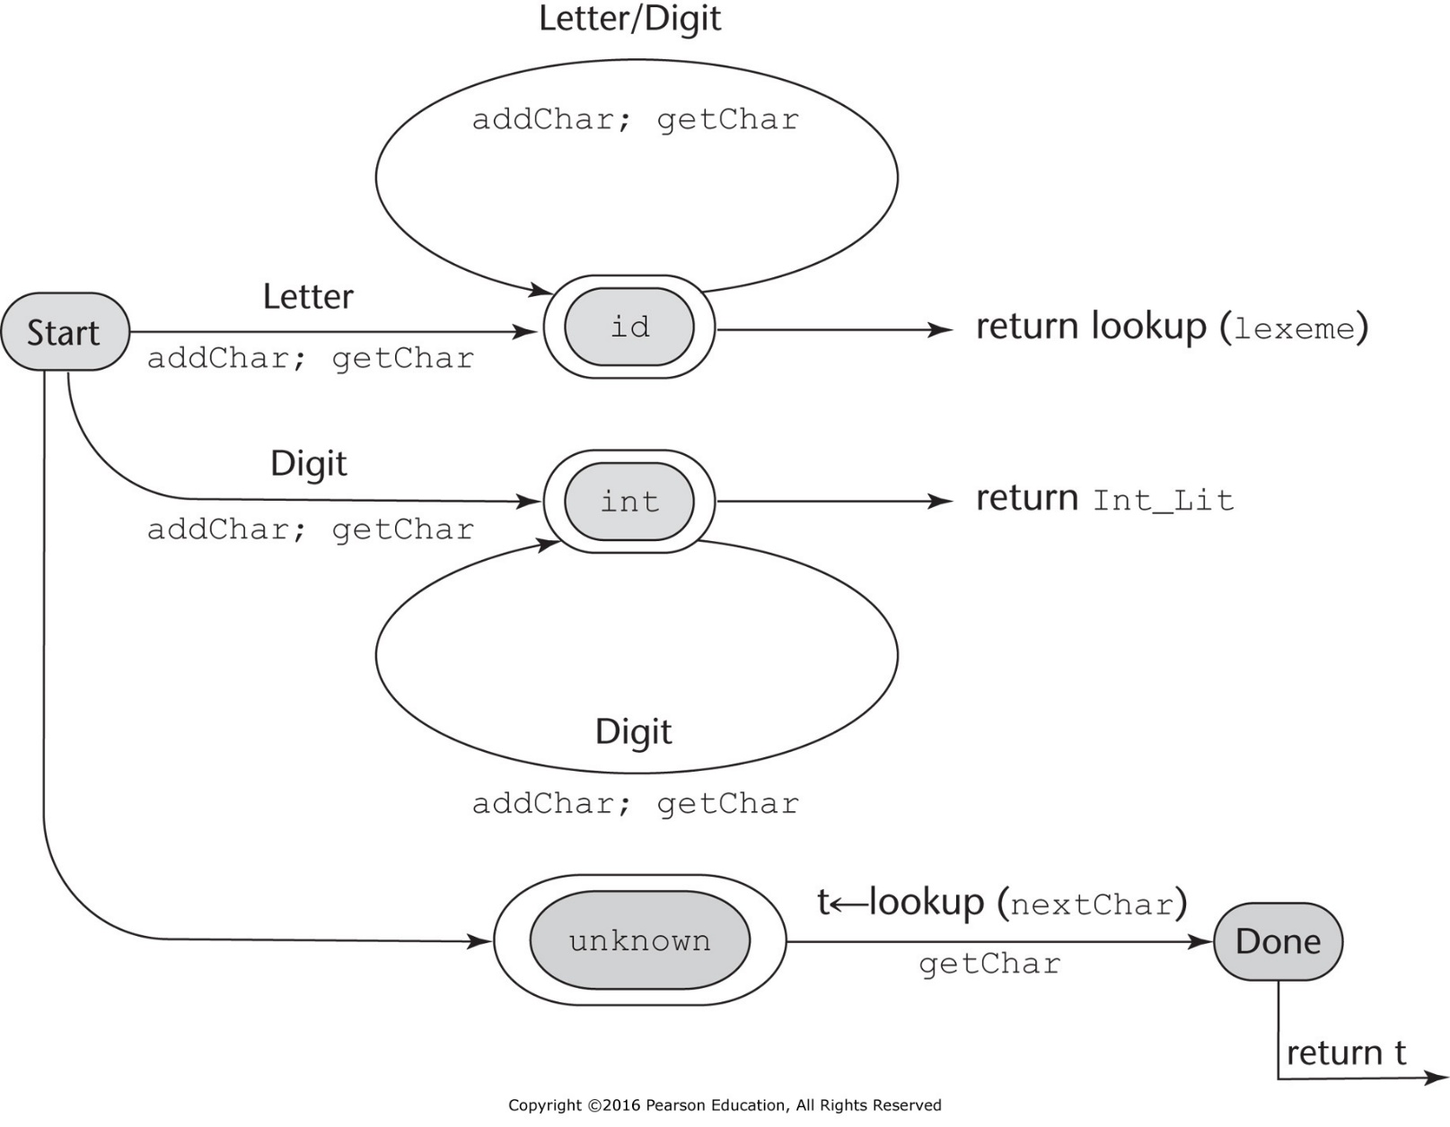
State Diagram
Figure 4.1 A state diagram to recognize names, parentheses, and arithmetic operators. The state diagram describes the patterns for our tokens. It includes the actions required on each transition of the state diagram.
Copyright © 2009 Addison-Wesley. All rights reserved.
Notes:
13

Slide 14
Lexical Analyzer
Implementation:
front.c
- Following is the output of the lexical analyzer of
front.c when used on (sum + 47) / total
Next token is: 25 Next lexeme is (
Next token is: 11 Next lexeme is sum
Next token is: 21 Next lexeme is +
Next token is: 10 Next lexeme is 47
Next token is: 26 Next lexeme is )
Next token is: 24 Next lexeme is /
Next token is: 11 Next lexeme is total
Next token is: -1 Next lexeme is EOF
Copyright © 2009 Addison-Wesley. All rights reserved.
Notes:
14

Slide 15
The Parsing Problem
The part of the process of analyzing syntax that is referred to as syntax analysis is often called parsing.
Goals of the parser, given an input program:
Find all syntax errors; for each, produce an appropriate diagnostic message and recover quickly
Produce the parse tree, or at least a trace of the parse tree, for the program
Copyright © 2009 Addison-Wesley. All rights reserved.
Notes:
15

Slide 16
The Parsing Problem (cont.)
Two categories of parsers
Top down - produce the parse tree, beginning at the root Order is that of a leftmost derivation
Traces or builds the parse tree in preorder
Bottom up - produce the parse tree, beginning at the leaves
Order is that of the reverse of a rightmost derivation
Useful parsers look only one token ahead in the input
Copyright © 2009 Addison-Wesley. All rights reserved.
Notes:
16

Slide 17
The Parsing Problem (cont.)
Top-down Parsers
Given a sentential form, xAα, the parser must choose the correct A-rule to get the next sentential form in the leftmost derivation, using only the first token produced by A
The most common top-down parsing algorithms:
Recursive descent - a coded implementation
LL parsers - table driven implementation
Copyright © 2009 Addison-Wesley. All rights reserved.
Notes:
17

Slide 18
The Parsing Problem (cont.)
Bottom-up parsers
Given a right sentential form, α, determine what substring of α is the right-hand side of the rule in the grammar that must be reduced to produce the previous sentential form in the right derivation
The most common bottom-up parsing algorithms are in the LR family
Copyright © 2009 Addison-Wesley. All rights reserved.
Notes:
18

Slide 19
The Parsing Problem (cont.)
The Complexity of Parsing
Parsers that work for any unambiguous grammar are complex and inefficient ( O(n³), where n is the length of the input )
Compilers use parsers that only work for a subset of all unambiguous grammars, but do it in linear time ( O(n), where n is the length of the input )
Copyright © 2009 Addison-Wesley. All rights reserved.
Notes:
19

Slide 20
Recursive-Descent Parsing
A recursive-descent parser is so named because it consists of a collection of subprograms, many of which are recursive, and it produces a parse tree in top-down order.
This recursion is a reflection of the nature of programming languages, which include several different kinds of nested structures

Slide 21
Recursive-Descent Parsing
There is a subprogram for each nonterminal in the grammar, which can parse sentences that can be generated by that nonterminal
EBNF is ideally suited for being the basis for a recursive-descent parser, because EBNF minimizes the number of nonterminals
Copyright © 2009 Addison-Wesley. All rights reserved.
Notes:
21

Slide 22
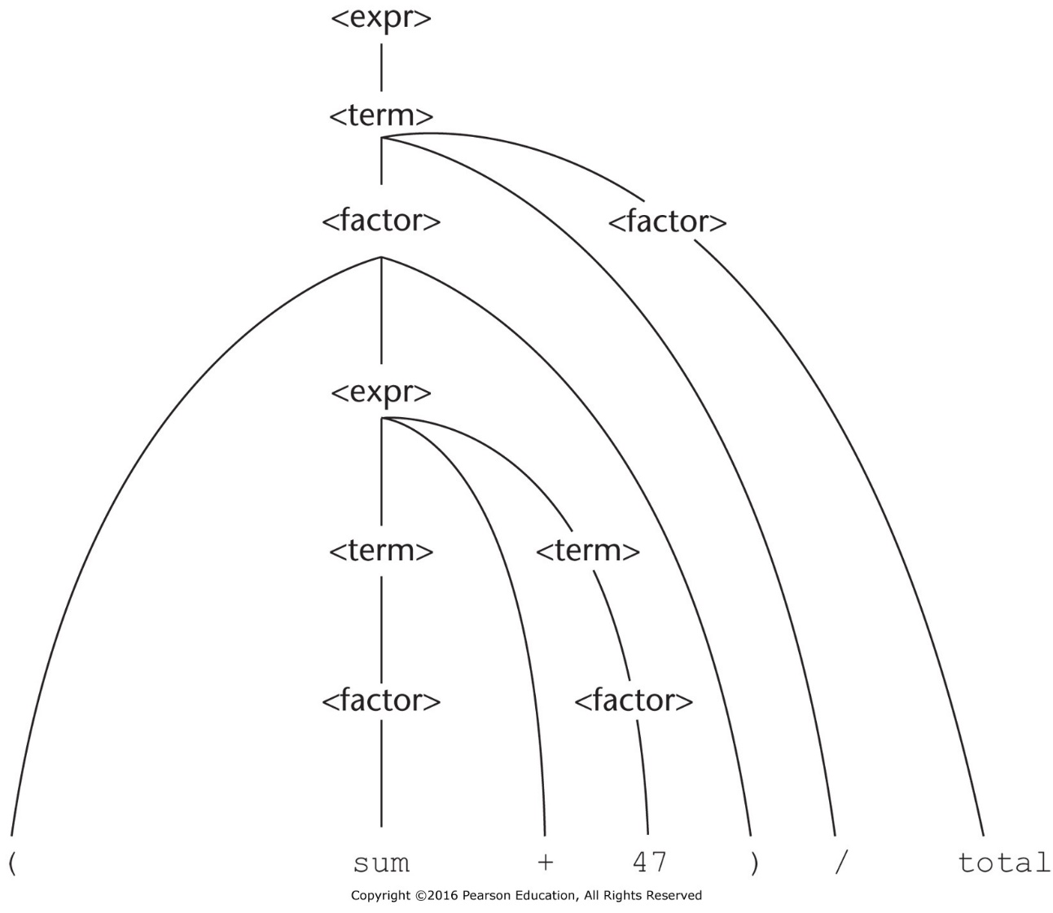
Recursive-Descent Parsing (cont.)
Figure 4.2 Parse tree for (sum + 47) / total
A grammar for simple expressions:
<expr> -> <term> {(+ | -) <term>}
<term> -> <factor> {(* | /) <factor>}
<factor> -> id | int_constant | ( <expr> )
Copyright © 2009 Addison-Wesley. All rights reserved.
Notes:
22

Slide 23
Recursive-Descent Parsing (cont.)
Assume we have a lexical analyzer named lex, which puts the next token code in nextToken
The coding process when there is only one RHS:
For each terminal symbol in the RHS, compare it with the next input token; if they match, continue, else there is an error
For each nonterminal symbol in the RHS, call its associated parsing subprogram
Copyright © 2009 Addison-Wesley. All rights reserved.
Notes:
23

Slide 24
Recursive-Descent Parsing (cont.)
/* Function expr
Parses strings in the language
generated by the rule:
<expr> → <term> {(+ | -) <term>}
*/
void expr() {
/* Parse the first term */
term();
/* As long as the next token is + or -, call
lex to get the next token and parse the
next term */
while (nextToken == ADD_OP ||
nextToken == SUB_OP){
lex();
term();
}
}
Copyright © 2009 Addison-Wesley. All rights reserved.
Notes:
24

Slide 25
Recursive-Descent Parsing (cont.)
A nonterminal that has more than one RHS requires an initial process to determine which RHS it is to parse
The correct RHS is chosen on the basis of the next token of input (the lookahead)
The next token is compared with the first token that can be generated by each RHS until a match is found
If no match is found, it is a syntax error
Copyright © 2009 Addison-Wesley. All rights reserved.
Notes:
25

Slide 26
Recursive-Descent Parsing (cont.)
/* term
Parses strings in the language generated by the rule:
<term> -> <factor> {(* | /) <factor>)
*/
void term() {
printf("Enter <term>\n");
/* Parse the first factor */
factor();
/* As long as the next token is * or /,
next token and parse the next factor */
while (nextToken == MULT_OP || nextToken == DIV_OP) {
lex();
factor();
}
printf("Exit <term>\n");
} /* End of function term */
Copyright © 2009 Addison-Wesley. All rights reserved.

Slide 27
Recursive-Descent Parsing (cont.)
/* Function factor
Parses strings in the language
generated by the rule:
<factor> -> id | (<expr>) */
void factor() {
/* Determine which RHS */
if (nextToken) == ID_CODE || nextToken == INT_CODE)
/* For the RHS id, just call lex */
lex();
/* If the RHS is (<expr>) – call lex to pass over the left parenthesis,
call expr, and check for the right parenthesis */
else if (nextToken == LP_CODE) {
lex();
expr();
if (nextToken == RP_CODE)
lex();
else
error();
} /* End of else if (nextToken == ... */
else error(); /* Neither RHS matches */
}
Copyright © 2009 Addison-Wesley. All rights reserved.
Notes:
27

Slide 28
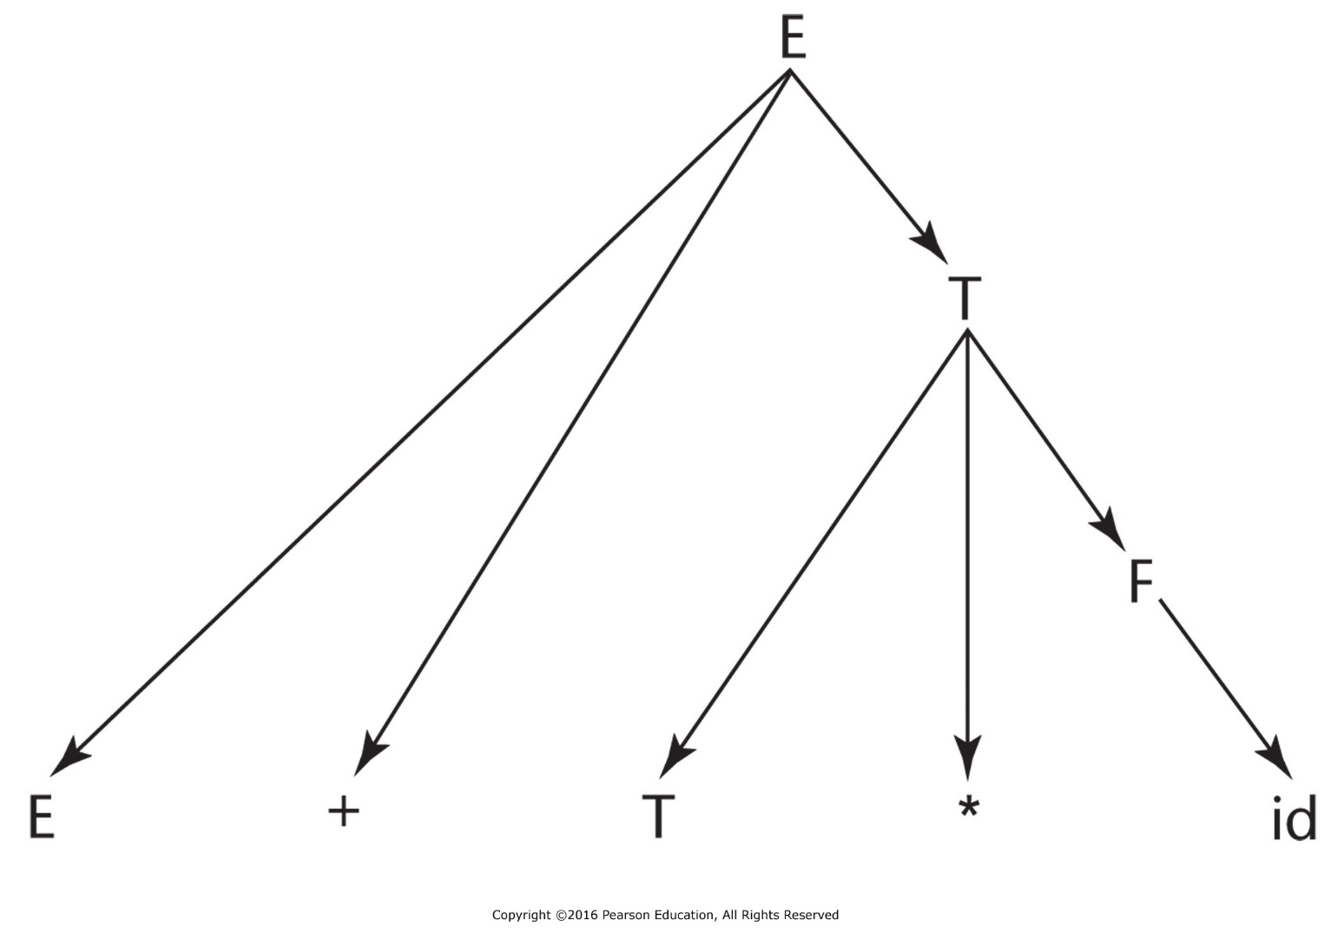
Bottom-up Parsing
Figure 4.3 A parse tree for E + T * id
The parsing problem is finding the correct RHS in a right-sentential form to reduce to get the previous right-sentential form in the derivation
Copyright © 2009 Addison-Wesley. All rights reserved.
Notes:
28

