Slide 1
Overview of Linux
CS3530
Fall 2018
Dr. José M. Garrido
Department of Computer Science
College of Computing and Software Engineering

Slide 2
Introducing Linux (and Unix)
See Appendix A, of textbook
A multi-user OS
  Users log on by typing their user names and their passwords
A Multitasking OS
  Users can have more than one program executing
A portable OS
  Unix runs on a wider variety of different systems than any other OS

Slide 3
Brief History of Unix
In the 1960s, a joint venture with GE, MIT, AT&T Bell Labs, and other entities were engaged in a project to develop Multics.
Multics was to be an advanced, multiuser, interactive, very large operating system.
Ken Thompson and Dennis Ritchie (of Bell Labs) wrote Unix in the early 70s with ideas from Multics. The machine used was a PDP-8 then a PDP-11 built by DEC.

Slide 4
Linux History
In 1991, Linus Torvalds of Finland, developed a kernel for a Unix-like operating system.
From that time on, hundreds of volunteer programmers worldwide maintain and enhance the system, called Linux.
The Free Software Foundation provides Linux free of charge.
There are many distributions (packaging) of Linux

Slide 5
Unix Standards
The Portable Operating System Interface (POSIX) standards
Most Unix systems are POSIX compliant
The Open Group also promotes Unix standards and currently owns the Unix trademark

Slide 6
User Interfaces
Most users and developers use the text-oriented command mode from a terminal emulator.
More recent Unix systems provide some type of Graphical User Interface (GUI) with several windows on the screen.
The most important user interface is based on the X Window System, developed at MIT.

Slide 7
Window Manager on Linux
A window manager is a program that determines the “look and feel” of the GUI
The desktop environments are based on a window manager
  GNOME
  CDE
  KDE
  Others

Slide 8
Terminal Emulator Programs
Simple terminal emulator programs are character oriented (text-based)
More recent terminal emulator programs emulate an X terminal
X terminals are graphical and are intended to access a Unix server via a GUI using a desktop environment like KDE.

Slide 9
Download and Install SSH
Search the university Web page: www.kennesaw.edu
Select/click “Computing Resources”
Select “Student Technology Services”
Click on “Software Downloads”
Login
Click on: “Secure shell File Transfer”
to download
After downloading, execute the install program on your PC

Slide 10
Using SSH
Two modes of operation are provided by this utility:
Secure File Transfer Client
Secure Shell Client

Slide 11
The CS3 Server
A Computer Science Department server
All assignments are to be developed on the CS3 server
Access to CS3 is via a command-level interface using a ‘terminal’ utility, such as SSH on Windows

Slide 12
Connecting to CS3 Server
Make sure you are connected to Internet
Start SSH (Secure Shell Client) to connect to a remote Unix server
Type cs3.kennesaw.edu
Logon to Linux on the CS3 server
Start using the appropriate Linux shell

Slide 13
Logon to Linux
Type your NETID account info
  user name
  your password

Slide 14
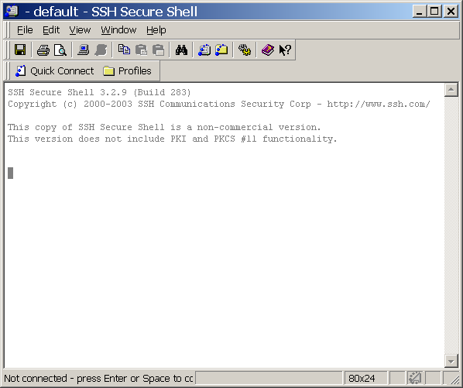
Window for SSH Shell Client

Slide 15
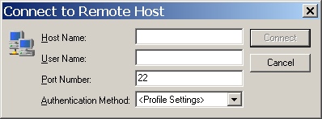
Dialog Box Logon

Slide 16
Unix Shells
A shell is a Unix program that interprets the commands that users type on their terminal keyboards
Different Unix shells:
  Bourne
  Korn
  C shell
  Bash (default on Linux)
  Tcsh
Similar to command window on Windows

Slide 17
Basic Unix Commands
In addition to Appendix A, for a more complete set of Unix commands visit:
http://www/unixguide.net/linux
Important commands:
  ls, mkdir, cd, cp, more, rm, pwd, exit, man, chmod
Change password: passwd
Text editor: nano
Start nano and read the help screens

Slide 18
Printing
Normally, every printer connected to a network has a symbolic name
In this course, you will carry out file tranfer to copy the file you want to print, from CS3 to your local computer (PC)
Print the file from your computer.

Slide 19
Linux Graphical Interface
Most popular on Linux
  GNOME (GNU Network Object Model Environment)
  KDE (K Desktop Environment)
Based on the X Window system developed by MIT for Unix

Slide 20
Running Simulation Models on CS3
Create a working directory for running simulations with the OS models
$ mkdir myos
Copy two files from the /home/jgarrido/psim3 directory to your working directory:
  the corresponding simulation model (batch.cpp)
  the psim3c script file
$ cp /home/jgarrido/psim3/batch.cpp myos
$ cp /home/jgarrido/psim3/psim3c myos

Slide 21
Steps to Run a Simulation Model on cs3 (Cont.)
Change to the new directory: $ cd myos
Compile and link the simulation model:
$ ./psim3c batch.cpp
Run the model (output on the screen):
$ ./a.out
Run the model, redirect the output to a file
$ ./a.out |tee res1.txt
View the output file
$ more res1.txt

Slide 22
Steps to Run a Simulation Model on cs3 (Cont.)
Run the program again to change one or more parameters in the model
Compile and link again (if necessary)
Run the program again
Get the results in another file
After the third simulation run, exit Unix.
Use SSH File Transfer from your PC to get the output files

Slide 23
‘ls’ Command
List files and subdirectories in current directory or specified directory
$ ls
The long listing is produced with the -l option:
$ ls -l
$ ls -lt | more

Slide 24
‘man’ Command
To get a short online manual or documentation on the specified command
$ man ls (help with ‘ls’)
$ man cd (help with ‘cd’)
The space key shows the next page

Slide 25
Make and Change Directory
To make a new directory under your current directory:
$ mkdir mydir
To change to a directory:
$ cd mydir (change to mydir)
$ cd myos (change to myos)

Slide 26
Directories
The system root directory is denoted as a slash (/)
An absolute path denotes the position of a file in the file structure
/home/jgarrido/psim3/batch.cpp
The current working directory is denoted as dot (.), The parent of the current directory as dotdot (..)

Slide 27
Show Current Working
To display the current working directory:
$ pwd
To return to your home directory:
$ cd

Slide 28
The ‘script’ Command
Open a new record session (log session) to a text file:
$ script mysession.txt
To terminate the session, type the ‘exit’ command

Slide 29
Copying Files
The copy (cp) command copies one or more files from a source directory to a destination directory.
$ cp /home/jgarrido/psim3/batch.cpp .
The previous command copied file ‘batch.cpp’ located in /home/jgarrido/psim3 to your current directory (dot)

Slide 30
Moving Files
The move (mv) command is used to move files from a source directory to a destination directory.
The command is also used to change the name of a file, in the same directory:
$ mv lll batch.txt

Slide 31
File Protection -- Access Permissions
Types of users for file access:
  Owner of the file or directory (user)
  Group, users in the same group as the owner
  Others, all other users
  Types of access permissions
    Read (r)
    Write (w)
    Execute (x)

Slide 32
Change File Access Mode
To change the read access permission to all users for batch.cpp
$ chmod a+r batch.cpp
$ chmod o-w batch.cpp
(this removes write permission to others)
When writing a shell script, it is necessary the change to execute permission
$ chmod u+x psim3c

Slide 33
Unix File Concept
A file is a sequence of bytes
All input/output devices are treated as files
Types of files
  simple/ordinary
  directory
  symbolic link
  special (device)
  named pipe

Slide 34
CS3 Accounts
Username: NETID
Password: new123
Change the password using the ‘passwd’ command

