Slide 1
Operating Systems
CS3502
Fall 2018
Notes 01
Dr. Jose M. Garrido
Department of Computer Science
College of Computing and Software Engineering
Kennesaw State University

Slide 2
Computer Systems
See Appendix G in textbook
A computer system consists of two basic types of components:
Hardware components, which are the electronic devices and electromechanical devices, such as the processors, memory modules, disk units, keyboard, screen, and other devices.
Software components, such as the application programs, operating system, utilities, and other programs.

Slide 3
Computer Architecture
The architecture of a computer system is the relationship among the various components.
Computer systems have the following three fundamental functions: processing, input, and output.

Slide 4
Structure of a Computer System
The basic structure of a computer normally consists of one or more of the following hardware components:
One or more processors
RAM or random access memory, also known as main memory
The massive storage devices, which store large amounts of data and programs in permanent form
The I/O devices or input/output units
The system bus, which provides interconnections for all components of the system

Slide 5
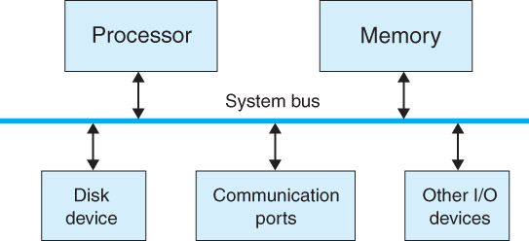
Hardware Structure of a Computer

Slide 6
Computer Networks
On a local area network (LAN), several small computers are connected to a larger computer called a server, and depending on the network topology, the smaller computers may also be connected to each other.
The server stores the global files or databases and may include one or more shared printers.
A much larger type of network is known as a wide area network (WAN) and covers a large geographical region and connects local area networks located in various remote places.

Slide 7
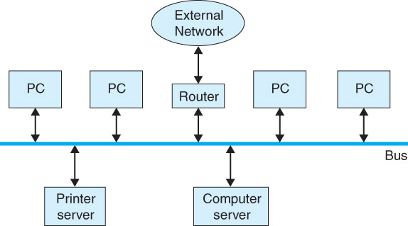
Computer Network

Slide 8
Hardware Interrupts
An interrupt mechanism in which a hardware component (i.e., an I/O device) sends an interrupt request signal to the CPU.
This interrupt signal causes a temporary stop of the normal execution of a program, and the CPU then starts to execute a special function called an interrupt service routine (ISR) that handles the interrupt.
When the execution of this routine is complete, the CPU can resume the execution of the program that was interrupted.

Slide 9
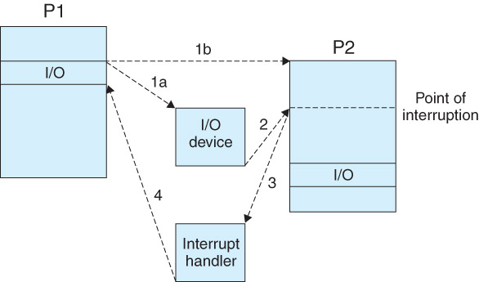
Interrupt Processing

Slide 10
Interrupts
An application requests an operating system to perform an operation by using a Software Interrupt.
Interrupts are requests to the operating system to perform some actions
An operating system is interrupt driven

Slide 11
Software
A program is a set of data definitions and one or more sequence of instructions to be executed in the computer for the purpose of carrying out some specific task.
Before a program executes, it has to be translated from its original text form (source program) into a machine language program. Then, the program needs to be linked and loaded into memory.

Slide 12
Software Components
See Chapter 1 of textbook
The software components are the collection of programs that execute in the computer.
These programs perform computations, control, manage, and carry out other important tasks.
Two general types of software components are:
  System software
  Application software

Slide 13
System Software
The system software is the set of programs that control the activities and functions of the various hardware components, programming tools and abstractions, and other utilities to monitor the state of the computer system.
The system software forms an environment for the programmers to develop and execute their application programs.
Various types of users can be identified, such as: system programmers, application programmers and end-users.

Slide 14
Application Software
Application software consists of those programs that solve specific problems for the users and execute under control of the operating system.
Application programs are developed by individuals and organizations for solving specific problems.

Slide 15
Types of Software Systems
System software - Operating System, Assemblers, Loaders, Linkers, Compilers, Editors, …
Application software - All User-Oriented Programs.
APPLICATION PROGRAMS
Users
SYSTEM PROGRAMS
HARDWARE

Slide 16
What is an Operating System?
A large and complex software component for the operation and control of the computer system.
It acts as an intermediary between a user and the computer system.
Examples: Linux, Unix, MS Windows, MacOS X, Sun Solaris, DEC VMS, and others.

Slide 17
The Operating System
A provider of services to user programs
A huge resource manager

Slide 18
Design Goals
User goals – operating system should be convenient to use, easy to learn, reliable, safe, and fast.
System goals – operating system should be easy to design, implement, and maintain, as well as flexible, reliable, error-free, and efficient.

Slide 19
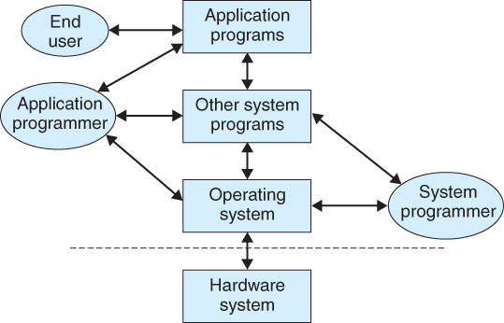
External View of a Computer

Slide 20
Operating Systems Interfaces
Three levels of interface:
Graphics GUI (windows oriented)
Command level (shell). At login time,
the shell starts computing
System calls Invoked from user programs

Slide 21
The Shell
A text-oriented program that handles user interaction with the system:
Command-line interpreter
The most common shell on Linux is ‘bash’
On Windows, the command window

Slide 22
System Call Interface
This is also known as the Programming Interface
Programs use the PI to request the OS to perform some operation

Slide 23
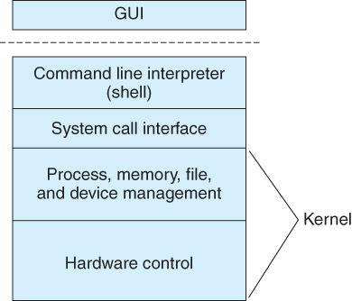
Basic Structure of an OS

Slide 24
Abstract Views
The overall structure of an operating system is divided into the various software components using a top-down (layered) approach.
The top layer provides the easiest interface to the human operators and users interacting with the system.
Any layer uses the services or functions provided by the next lower layer.

Slide 25
Operating Systems Abstract Views
External views
  As an user interface of the computer system
  As a layer of software on top of the hardware
Internal view
  Resource manager - It controls and manages CPU, memory, I/O devices, etc.

Slide 26
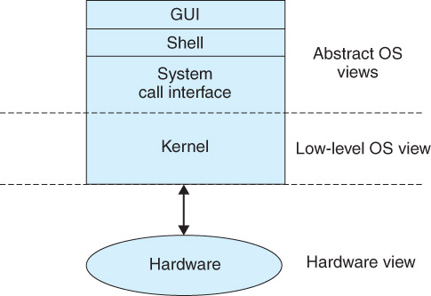
Abstract Views of an OS

Slide 27
Layered Structure of an OS
Users (top layer)
Application User Interface (AUI): shell, commands, application programs
Application program Interface (API): libraries, system calls
OS kernel

Slide 28
System Programs
The Operating System
Programs that are not part of the operating system kernel.
Examples
  Web Browser
  Email program
  Other utilities

Slide 29
Internal View of an Operating System
The system the system call interface separates the kernel from the application layer and the kernel is located above the hardware
The kernel is the core, and most critical part, of the operating system and needs to be always resident in memory.
A detailed knowledge about the different components including these lower-level components of the operating system, corresponds to an internal view of the system.

Slide 30
Functional Components of an OS
The most important components of an operating system are:
Process manager
Memory manager
Resource manager
File manager
Device manager

Slide 31
Services Provided by the OS
Process Control, execution, scheduling, etc.
Communication between processes
File Manipulation
Device Manipulation
Information Maintenance
Memory Management

Slide 32
Categories of Operating Systems
Batch systems, in which a set of jobs are submitted in sequence for processing.
Interactive systems, which support computing for on-line users. The most common type of operating systems that support interactive computing is time-sharing, which are multi-user systems.
Real-time systems, which support application programs with very tight timing constraints.
Hybrid systems, which support batch and interactive computing.

Slide 33
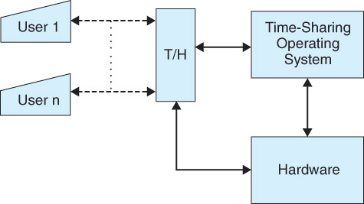
A Time-Sharing System

Slide 34
Modern Operating Systems
General Purpose
Linux (Linus Torvalds)
Windows (Microsoft Corporation)
Unix (AT&T)
Solaris (Oracle/Sun Microsystems)
IRIX (Silicon Graphics)
OS2 (IBM)
OS/390 (IBM)
VMS (Dec/Compaq/HP)
MacOS (Apple)

Slide 35
Specialized OS
Real-time OS for control
  Large systems
  Embedded
OS for portable devices
  Linux
  Windows
  iMacOS
  Android

Slide 36
History of Operating Systems
First generation - No operating system, bare hardware, machine language.
Second generation
  Batch systems, assemblers, linkers, loaders, compilers
  Batch systems with Automatic Job Sequencing

Slide 37
History of Operating Systems(2)
Third generation -- O.S. for complete families of computers (OS/360)
  Batch with Multiprogramming
  Spooling
  Timesharing (MULTICS, UNIX, …)
Fourth generation
  Network and distributed operating systems

Slide 38
Jobs and Processes
A job is a unit of work submitted by a user to the operating system. A typical job consists of the parts listed below:
A sequence of commands to the operating system
A program either in a source language or in binary form
A set of input data used by the program when it executes
A process is an execution instance of a program.

