Slide 1
OPERATING SYSTEMS
CS3502
Fall 2018
Processes and Threads
(Chapter 2)

Slide 2
Processes
Two important types of dynamic entities in a computer system are processes and threads.
Dynamic entities only exist at execution time, and their behavior exhibits state changes.
A process is basically a program in memory either in execution or waiting to execute, I/O, or other service.
A process is the fundamental computational unit that requests various types of services in the computer system.
Processes and threads are handled by the process manager module of the operating system.

Slide 3
Processes and Threads
Several processes can be active at a time (O.S with multiprogramming)
Only one process is actually running at any instant of time (in a single-processor system)
The OS switches the processor from one process to another
Each process can have several threads running within it

Slide 4
Process Creation
On a typical operating system, a process is created
  In response to a new job arriving
  A new user who carries out a login
  A currently executing process that creates a new process.
A process is created if there is sufficient memory available; creating the process waits if other resources it needs are not available.

Slide 5
Process Behavior
A process requests processor and I/O servicing at various times and usually will have to wait for these services.
The OS maintains a waiting line or queue of processes for every one of these services.
At some point in time, a process will be in a queue waiting for processor service. At some other point in time, the process will be in a different queue waiting for I/O service.
When a process completes all service requests, it terminates and exits the system.

Slide 6
System Resources
Active resources: CPU, I/O devices
Passive resources: memory

Slide 7
Process States
Created
Ready (waiting in the ready queue a processor)
Running (executing)
Blocked (suspended and waiting for I/O or other event)
I/O processing
Waiting for passive resources
Interrupted by the OS
Terminated

Slide 8
Process State Diagram
Represents the various states of a process and the possible transitions in the behavior of a process.
Each state is indicated by a rounded oval and the arrows connecting the states are the transitions from one state to the next.
The small black circle denotes that the state it points to is the initial state.
In a similar manner, the state before the hollow small circle indicates that it is the last state in the behavior of a process.
Normally a process spends a short finite time in every state.

Slide 9
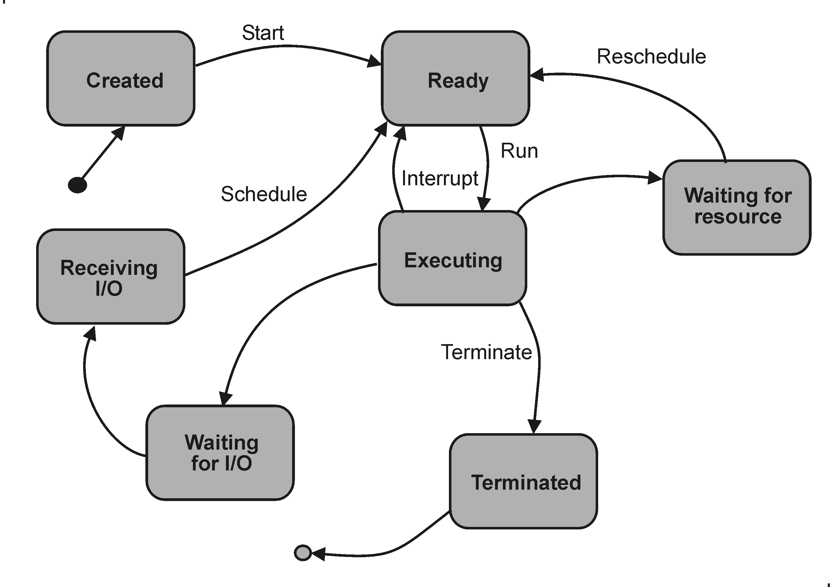
Process State-Transition Diagram

Slide 10
Process Descriptor
Also called process control block (PCB)
A data structure in which the OS maintains data about a process.

Slide 11
Data in a Process Descriptor
Each process is represented by its own PCB
  Process name
  Process state
  Program counter
  CPU registers
  I/O status
  Memory information
  Accounting information
  Scheduler information (priority, queues, …)
  List of resources

Slide 12
Threads
A Thread is:
A light-weight process
A single execution sequence of a process
A component of a process
Shares with other threads code and resources allocated to the process
Most OSs support multi-threading: several threads in a process

Slide 13
Multiple Threads
In addition to multiple processes, modern operating systems support other computational units known as threads, a lightweight process.
A thread is a dynamic component of a process.
Several threads are usually created within a single process. These threads share part of the program code and the resources of the process.
Most modern operating systems support multiple processes and multiple threads of execution within a single process, this feature is called multi-threading.

Slide 14
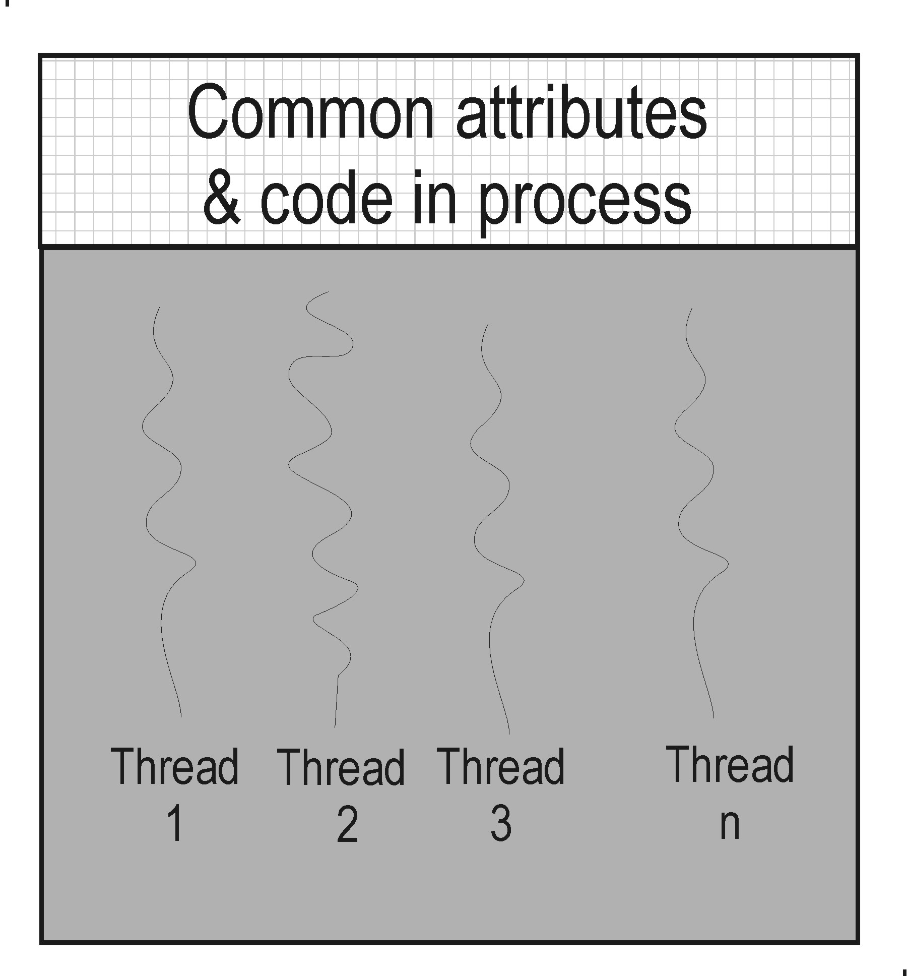
Threads Executing in a Process

Slide 15
Threads in a Process
The operating system manages processes and threads in a multiprogramming environment
The execution of threads are handled much more efficiently than the execution of processes.
The modern view of threads represents them as the active elements of computation within a process.
All threads that belong to a process share the state and resources of the process.

Slide 16
Thread Attributes
Execution state
Context, its own program counter within the process
Execution stack
Local memory block (for local variables)
Reference to parent process to access the shared resources allocated to the process

Slide 17
Thread Descriptor
A thread descriptor is a data structure used by the OS to store all the relevant data of a thread.
  It contains the following fields:
  thread identifier
  execution state of the thread
  the process owner of the thread
  list of related threads
  execution stack
  thread priority
  thread-specific resources
Some of the fields of a thread descriptor also appear as part of the corresponding process descriptor.

Slide 18
Thread States
Threads have their own execution state, context, execution stack, local memory (for local variables), in addition to the resources allocated to the process.
When a process is created, only one thread is created called the base thread of the process; then other threads of the process may be created by the process or by the base thread.
A process can have a single thread; in this case it is considered a simple process because it has only one thread of execution.

Slide 19
Types of Threads
There are two general types of threads:
User-level threads (ULT)
Kernel-level threads (KLT).

Slide 20
User-level Threads
With the user-level threads, the thread management is carried out at the level of the application without kernel intervention.
The application carries out threads management using a thread library, such as the POSIX Pthreads Library.
Using this library, the application invokes the appropriate functions for the various thread management tasks such as: creating, suspending, and terminating threads.

Slide 21
Kernel-Level Threads
The thread management tasks are carried out by the kernel.
A process that needs these thread handling services has to use the API to the kernel thread facility.
One of the advantages of kernel-level threads is that the process will not be blocked if one of its threads becomes blocked. Another advantage is that the possibility of scheduling multiple threads on multiple processors.

Slide 22
Multiprogramming
Process management is one of the major functions of the operating system; it involves creating processes and controlling their execution.
In most operating systems, several processes are stored in memory at the same time and the operating system (OS) manages the sharing of the CPU and other resources among the various processes.
This facility of the operating system is called multiprogramming.

Slide 23
Multiprogramming (2)
One of the requirements of multiprogramming is that the OS must allocate the processor(s) and other resources to the various processes in such a way that these active resources are maintained busy the longest period possible.
If there is only one processor, then only one process can be in execution at any given time.
The other processes are ready, waiting for processor service. Processes also request access to passive resources, such as memory.

Slide 24
Context Switch
When the OS switches the processor to another process, the OS must save the context of the current process and load the (saved) context of the new process
Context switch time is short and is overhead time
Context switch time is dependent on hardware support

Slide 25
Degree of Multiprogramming
The number of processes that the system supports in memory is known as the degree of multiprogramming.

Slide 26
Multi-Programming (2)
In most computer systems, the I/O controllers enable a system to overlap device I/O operation with processor (CPU) operation.
This results in a higher utilization of the system facilities
Several processes can be in memory at a time; one receiving CPU service and another receiving I/O service, the others are waiting.

Slide 27
Processes and Multiprogramming
With multiprogramming, several processes can be active at a time
Only one process is actually running at any instant of time (if there is only a single CPU)
The OS switches rapidly the CPU from one process to another (context switching)
The selection of which process to run next is made by the scheduler

Slide 28
Features Needed for Multiprogramming
I/O routines supplied by the system
Memory management
Processor scheduling
Allocation of devices

Slide 29
Service Requests
A process will require (demand) several processor and I/O requests
The total processor request of a process is divided into shorter service periods: each one is known as a CPU burst
The total I/O request is divided into shorter service periods called I/O bursts
In normal behavior of a process, it alternates between a CPU and I/O burst

Slide 30
Total Processor Demand
The total processor service demand for a process is the sum of all its CPU bursts
Each CPU burst has a different duration τ
The total CPU service time requested by process P_{i} is:
τ_{i} = τ₁ + τ₂ + ... τ_{m}

Slide 31
Total I/O Service Demand
The total I/O service demand for a process is the sum of all its I/O bursts
Each I/O burst has a different duration, δ
The total I/O service time requested by process P_{i} is:
δ_{i} = δ₁ + δ₂ + ... δ_{n}

Slide 32
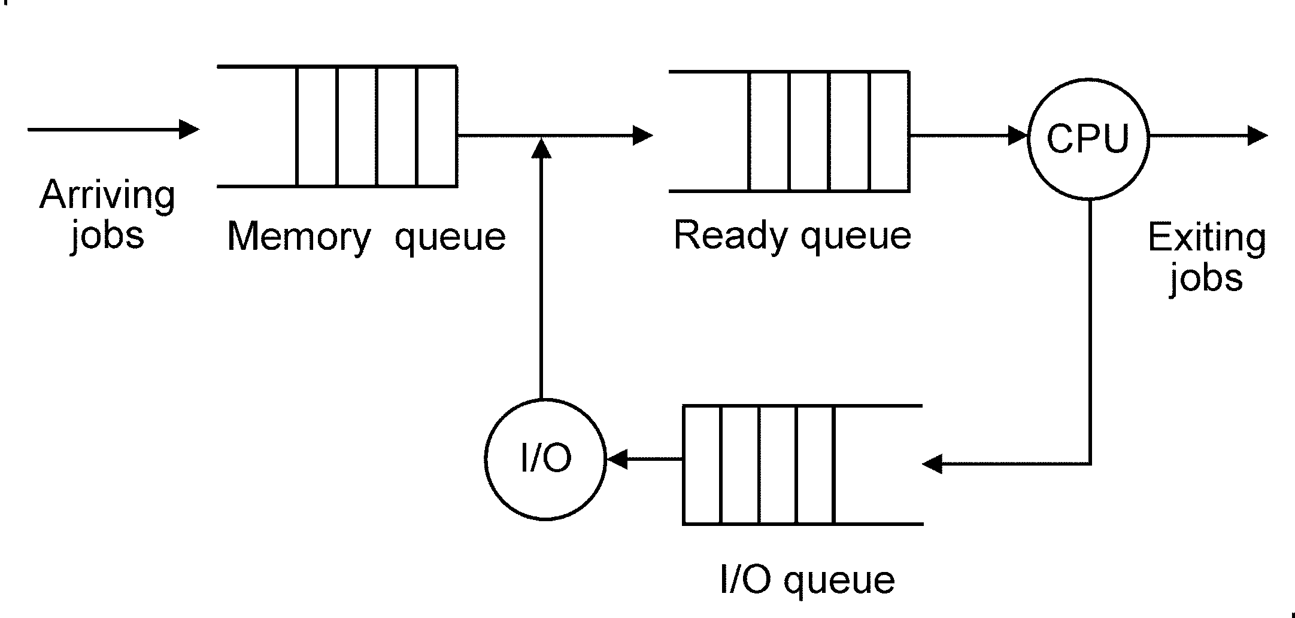
Batch OS with I/O

Slide 33
Interrupts and Context Switches
A context switch occurs when:
The executing process completes its current CPU burst and needs an I/O operation, such as reading data from a file.
The executing process is interrupted by a timer under OS control. The process is returned to its ready state in the wait line for CPU service, the ready queue.
A high priority process arrives into the ready queue, the OS interrupts the running process if it has a lower priority.

Slide 34
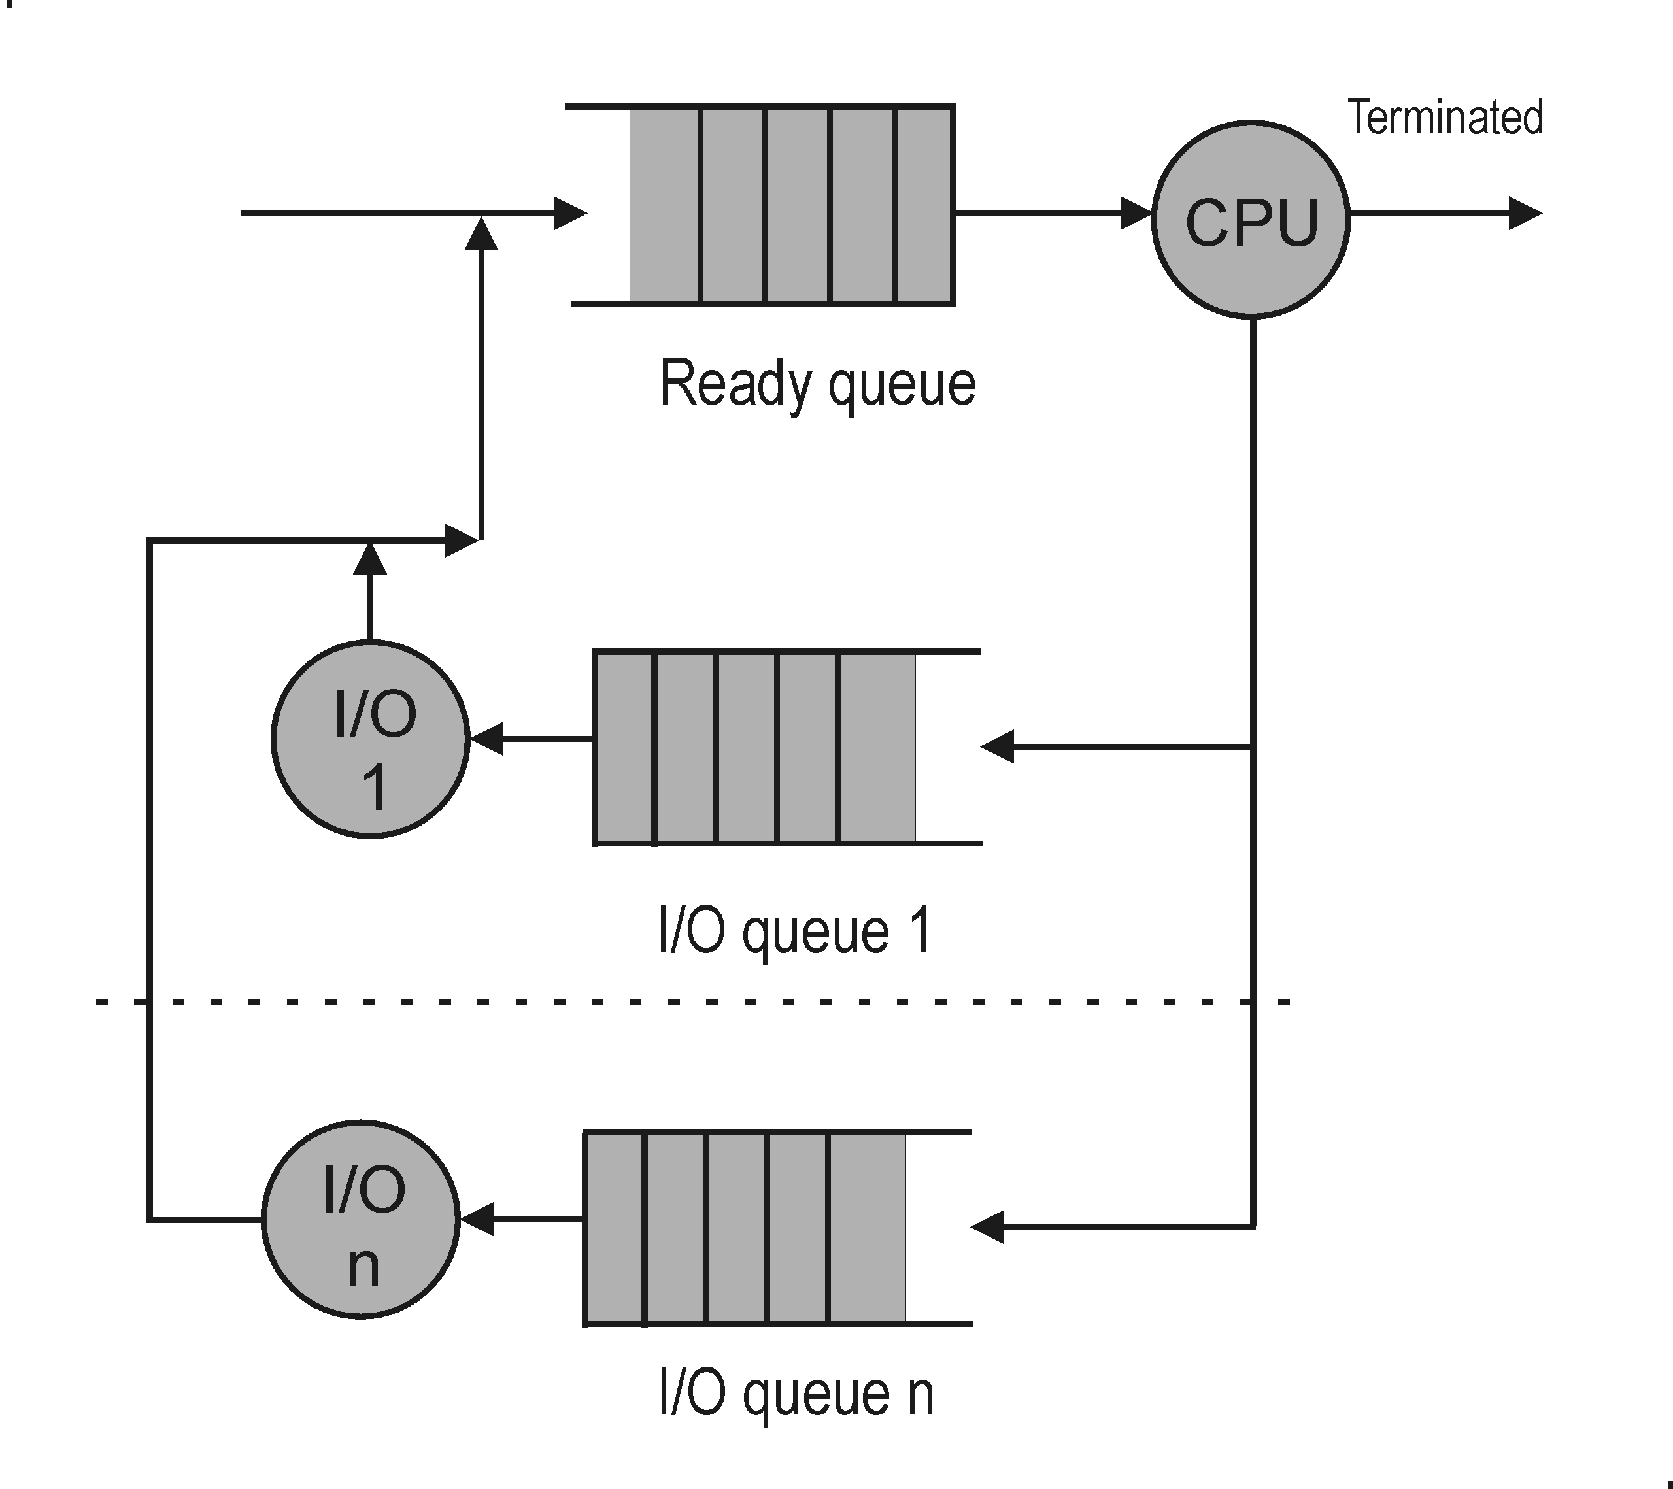
CPU and I/O Queues

Slide 35
A Model with I/O Processing – Assignment No. 2
The C++ simulation model for the batch operating system with I/O is implemented in file batchmio.cpp
Only one process is allowed to be stored in memory at a time. The degree of multiprogramming is set to 1 (no multi-programming)
When the degree of multi-programming is greater than 1, then several processes are allowed in memory

