Slide 1
OPERATING SYSTEMS
CS 3502
Fall 2018
Systems and Models
Chapter 03

Slide 2
Systems and Models
A system is the part of the real world under study. It is composed of a set of entities interacting among themselves and with the environment.
A model is an abstract representation of a system.
The system behavior is dependent on the input data and actions from the environment.

Slide 3
Abstraction
The most important concept in analysis and design
A high-level description of a collection of objects
Only the relevant properties and features of the objects are included.

Slide 4
System
A system has:
Structure
Behavior
The model of a system is simpler than the real system in its structure and behavior. But it should be equivalent to the system.

Slide 5
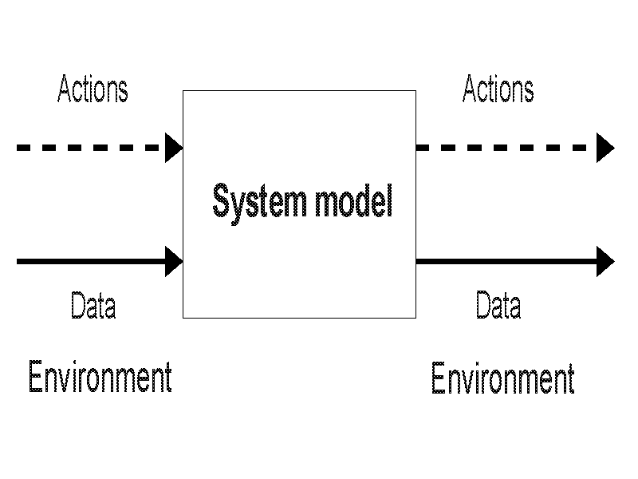
A High-Level Model

Slide 6
Using Models
A user can:
Manipulate the model by supplying it with a set of inputs
Observe its behavior or output
Predict the behavior of the real system by analyzing the behavior of the model.

Slide 7
Behavior of a Model
Depends on:
The passage of time
Input data
Events generated by the environment

Slide 8
Types of Model
The most general categories of models are:
Physical models (scale models)
Graphical models
Mathematical models. These are the most flexible ones and are the ones studied here.

Slide 9
Solutions to Mathematical Models
Analytic, the solution is a set of expressions that define the behavior of the model.
Numeric, mathematical techniques are used to derive values for the model behavior within given intervals.
Deterministic and stochastic models are solved with numerical techniques.

Slide 10
Models with Uncertain Behavior
Models are further categorized as:
Deterministic - models that display a completely predictable behavior (with 100% certainty)
Stochastic - models that display some level of uncertainty in their behavior. This random behavior is implemented with random variables.

Slide 11
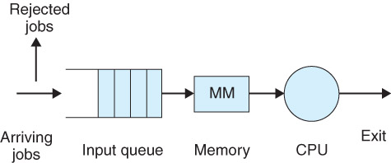
Model of a Simple Batch System

Slide 12
Stochastic Models
One or more attributes (implemented as random variables) change value according to some probability distribution.
Example of random variables in the simple batch OS model:
  Inter-arrival time of jobs
  CPU service time of jobs

Slide 13
Random Variables
The values of most workload parameters change randomly, and are represented by a probability distribution.
For example, in a model of a computer system, the inter-arrival intervals of jobs usually follow an exponential distribution. Other probability distributions that are used in the models discussed in this book are: normal, uniform, and Poisson.
In the simulation models considered, most workload parameters are implemented as random variables.

Slide 14
Simulation Models
A simulation model is a mathematical model implemented with a general-purpose programming language, or a simulation language.
A simulation run is an experiment carried out for some observation period and with the simulation model to study the behavior of the model.

Slide 15
Continuous and Discrete Models
Continuous models change their state continuously with time. Mathematical notation is used to completely define the behavior. For example, the free-falling object.
Discrete models only change their state at discrete instants. For example, arrival of a job in the Simple batch OS model.

Slide 16
Simulation Results
For every simulation run there are two types of output:
Trace - sequence of events that occur during the simulation period
Performance measures - summary statistics about the simulation.

Slide 17
Studying Operating Systems
To study the structure and behavior of an OS is a very complicated task
Modeling and simulation are used to study the different components and various aspects of an operating system.

Slide 18
Performance Measures
Measures that indicate how well (or bad) is the system being studied carrying out its functions, with respect to some aspect
In studying a system, usually several performance measures are necessary.

Slide 19
Approaches for Studying Performance
Measurements on the real system
Simulation models
Analytical models

Slide 20
Performance: External Goals
Goals that can be measured without looking at the internals of a system
Examples
  Maximize Work Performed (Throughput)
  Minimize Response Time
  Fairness
  Scheduling processes
Goals often conflict

Slide 21
Performance: Internal Goals
Performance Goals for sub-systems that are internal to the computer(s)
Examples
  Maximize CPU Utilization
    % time CPU is busy
  Maximize Disk Utilization
    % time Disk is busy
  Minimize Disk Access Time
    Time it takes to perform a disk request

Slide 22
Performance Study
Define a set of relevant objectives and goals
Decide on the following:
  The performance metrics
  The system parameters
  The system factors
  The system workloads

Slide 23
Workload on a System
The performance measures depend on the current workload of the system
The workload for a system can be characterized by another series of measures, which are made on the input to the system
Errors in characterizing the workload may have serious consequences.

Slide 24
Workload Parameters
Inter-arrival time
Task size
I/O request rate
I/O service rate
Memory request

Slide 25
System Parameters
System memory
Processor speed
Number and type of processors
Degree of multi-programming
Length of time slice
Number and type of I/O ports

Slide 26
Arrival Interval & Rate
Arrival Interval is the time between 2 resource requests arriving
Arrival Rate = 1 / Arrival Interval
  How often requests for a resource arrive
  Denoted by λ

Slide 27
Service Time & Rate
Service Time is the time to actually perform a request
  e.g. 500 Msec / request
Service Rate = 1 / Service Time
  Denoted by μ
  e.g. 2 requests / second

Slide 28
Arrival Rate vs Service Rate
Arrival Rate < Service Rate
  Resource can handle requests
  Queuing Time will be small
  If Arrival Rate significantly less
    Resource may be under-utilized

Slide 29
Arrival Rate vs Service Rate
Arrival Rate = Service Rate
  Resource fully utilized
  Resource can generally handle requests
  But…Requests will often be queued

Slide 30
Arrival Rate vs Service Rate
Arrival Rate > Service Rate
  Resource unable to handle all requests
  Queuing Time may be large
  If difference is large
    Resource will be over-utilized

Slide 31
Arrival Rate vs Service Rate
Both rates will change from one instant to another
Queuing system & resource scheduling handle momentary imbalances
Long-term imbalances indicate a system with a major resource utilization problem

Slide 32
Service Time
Is the Service Time for a given request always the same?

Slide 33
Service Time
Service Time for a given request can vary
  A request to read data from a certain part of a disk will not always take the same amount of time.
For some resources, a request’s Service Time may be affected by the previous requests that have been executed

Slide 34
Relevant Performance Measures
Throughput
Capacity
Response time
Utilization
Reliability
Speedup
Backlog

Slide 35
Meaning of Performance Measures
The average number of jobs in the system
The average number of jobs in the queue(s) (i.e., that are waiting)
The average time that a job spends in the system
The average time that a job spends in the queue(s)
The CPU utilization
Throughput - the total number of jobs serviced.

Slide 36
System Capacity
The capacity of a system is determined by its maximum performance
The nominal capacity of a system is given by the maximum achievable throughput under ideal conditions
The usable capacity is the maximum throughput achievable under specified constraints.

Slide 37
Bottleneck
The computer system reaches capacity when one or more of its servers or resources reach a utilization close to 100%.
The bottleneck of the system will be localized in the server or resource with a utilization close to 100%, while the other servers and resources each have utilization significantly below 100%.

Slide 38
Modeling Bottleneck
The bottleneck of the computer system described here can be localized at the processor, the queue, or the memory.
  The queue may become full (reaches capacity) very often as the processor utilization increases.
  The memory capacity may also be used at capacity (100%).
  Thus, in any of the three cases, the processor, the queue, or the memory will need to be replaced or increased in capacity.

Slide 39
Efficiency and Reliability
The efficiency of a system is the ratio usable capacity to nominal capacity
The reliability of a system is measured by the probability of errors. Also defined as the mean time between errors.
Availability is the fraction of time that the system is available for user requests, also called the system uptime.

Slide 40
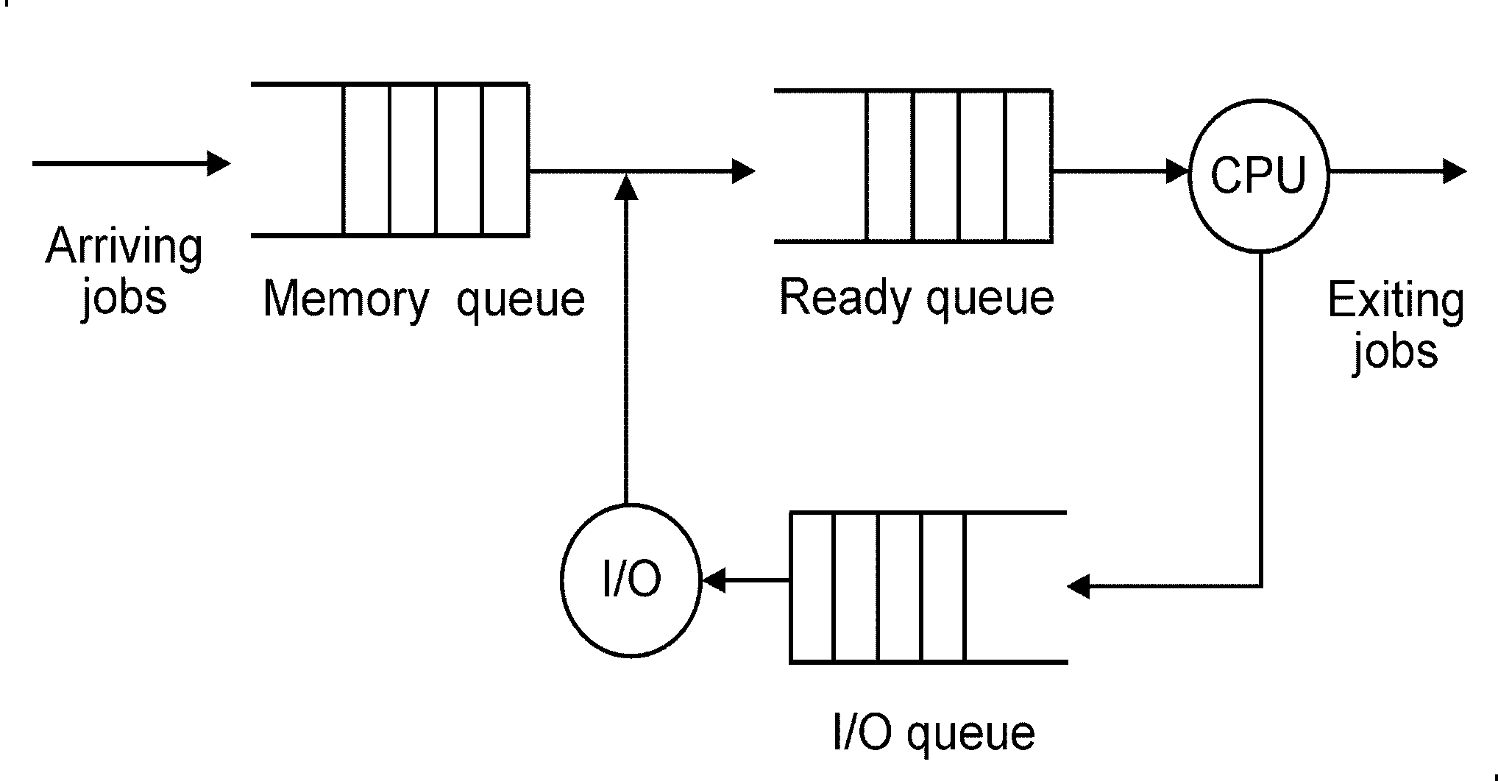
A More Complete Model of a Computer System

Slide 41
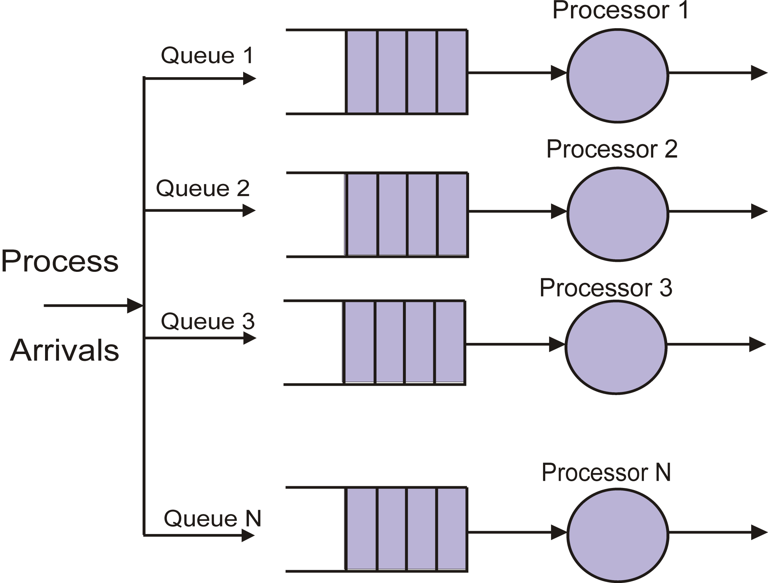

Slide 42
