Slide 1
Segmentation
Memory-management scheme that supports user view of memory.
A program is a collection of segments. A segment is a logical unit such as:
  main program,
  Procedure,
  function,
  local variables, global variables,
  common block,
  stack,
  symbol table, arrays

Slide 2
Segmentation
Segments are variable-length modules of a program that correspond to logical units of the program, that is, segments represent the modular structure of how a program is organized.
Each segment is actually a different logical address space of the program. Examples of segments are the program's main function, additional functions, data structures.

Slide 3
Segmentation and Memory Allocation
Before a program can execute, all its segments need to be loaded into memory.
For every segment, the operating system needs to find a contiguous block of available memory to allocate to the segment.

Slide 4
Virtual Memory
The memory space of a process is normally divided into blocks that are either pages or segments.
Virtual memory management takes advantage of the typical behavior of a process: not all blocks of the process are needed during the execution of a process.
Therefore, the physical address space of a process is smaller than its logical address space.

Slide 5
Virtual Memory (2)
Therefore, not all block of a process need main memory allocation,
The physical address space of a process is smaller than its logical address space.
For example, a process has 15 pages and only 7 frames allocated.

Slide 6
Virtual Memory Principles
A process can execute without having all its pages in physical memory. Some advantages are:
A user process can be larger than physical memory
Higher degree of multiprogramming
Less I/O for loading and unloading for individual user processes
Higher CPU utilization and throughput.

Slide 7
Address Space
The virtual address space of a process is the entire set of all its addresses in the absolute program.
After linkage, the absolute version of the program is stored on disk. The disk area that stores all the processes in absolute form is called the virtual memory
The physical address space of a process is much smaller than its virtual address because only a portion of the process will ever be loaded into main memory.

Slide 8
Referencing A Page
A page reference is the page that has the address being referenced.
The virtual memory manager swaps in a page of an executing process whenever the execution of a process references a page that is not in physical memory.
Any unused page in physical memory will normally be swapped out to disk.

Slide 9
Virtual Memory Techniques
Overlays (old technique)
Paged virtual memory
Segmented virtual memory

Slide 10
Paged Virtual Memory
When to swap pages into memory:
Demand paging- a page is not swapped in until it is referenced
Prepaging - a page is swapped in before it is referenced

Slide 11
Demand Paging
Load a page into memory only when it is needed (when it is referenced):
  Less I/O needed
  Less memory needed
  Faster response
  More users

Slide 12
Valid/Invalid Bit in Demand Paging
For every page referenced, a check of the resident bit is carried out
  invalid reference ⇒ abort
  not-in-memory ⇒ load page into physical memory

Slide 13
Valid-Invalid Bit
With each page table entry a valid–invalid bit is associated:
  1 (in-memory)
  0 (not-in-memory)
Initially valid–invalid but is set to 0 on all entries.
Example of a page table snapshot.
Frame #
valid-invalid bit
1
1
1
1
0

0
0
page table

Slide 14
Page Fault
Each page table entry has a resident bit, it indicates whether the corresponding page is currently in memory.
If the page is not in memory, a page fault has occurred and the control is trapped to the OS.
During address translation, if valid–invalid bit in page table entry is 0, a page fault has occurred.

Slide 15
Demand Paging
In demand paging, a page fault occurs when a reference is made to a page not in memory. The page fault may occur while:
fetching an instruction, or
fetching an operand of an instruction.

Slide 16
Performance in Virtual Memory
The performance of a virtual memory management system depends on the total number of page faults, which depend on:
The paging policies
The frame allocation

Slide 17
Types of Page Allocation
Static allocation - the number of frames allocated to a process is fixed
Dynamic allocation - the number of frames allocated to a process changes

Slide 18
Paging Policies
Fetch policy -- decides when a page should be loaded into memory
Replacement policy -- decides which page in memory should be replaced
Placement policy -- decides where in memory should a page be loaded

Slide 19
Page Faults and Performance Issues
A page fault requires the operating system to carry out the page fault service. The total time it takes to service a page fault includes several time components:
The time interval to service the page fault interrupt.
The time interval to store back (swap out) the replaced page to the secondary storage device.
The time interval to load (swap in) the referenced page from the secondary storage device (disk unit).
Delay in queuing for the secondary storage device.
Delay in scheduling the process with the referenced page.

Slide 20
Page Replacement
When there is a page fault, the referenced page must be loaded
If there is no available frame in memory one page is selected for replacement.
If the selected page has been modified, it must be copied back to disk (swapped out)

Slide 21
Performance and Page Replacement
Page replacement – there are several algorithms
  For improved performance – select a replacement algorithm that will result in minimum number of page faults.
Same pages may be referenced several times.

Slide 22
Handling Of A Page Fault
For every page reference, the page table entry for the page referenced is examined. If the access is invalid, the process is terminated.
If the referenced page is not in memory, a page fault occurs and the OS interrupts the process
The OS handles the page fault
  carries out the page replacement.
  Swaps out the replaced page
  Swaps in the referenced page
  Reschedules the process that caused the page fault
The instruction which caused the page fault is restarted when the process resumes execution.

Slide 23
Performance Goal in VM
Directly dependent on the number of page faults
It is very important to keep the page fault rate low.
How can this be accomplished?

Slide 24
Priority Allocation
Use a proportional allocation scheme using priorities rather than size
If process Pi generates a page fault,
  select for replacement one of its frames
  select for replacement a frame from a process with lower priority

Slide 25
FRAME ALLOCATION
Allocation schemes:
Equal allocation
Proportional allocation (based on size, priority, )
Global vs. local replacement
Global: a replacement frame can be selected from the set of all frames
Local: a replacement frame for a process can be selected only from its own set of allocated frames.

Slide 26
PROBLEMS TO BE SOLVED IN DEMAND PAGING
Two major problems must be solved to implement demand paging:
Each process needs a minimum number of frames. This minimum number is based on the machine architecture.
Frame allocation. decide how many frames to allocate to each process.
Select which frames are to be replaced when a page fault occurs.

Slide 27
Types of Paging Algorithms
Static allocation - the number of frames allocated to a process is fixed
Dynamic allocation - the number of frames allocated to a process changes

Slide 28
Paging Policies
Fetch policy -- decides when a page should be loaded into memory
Replacement policy -- decides which page in memory should be replaced
Placement policy -- decides where in memory should a page be loaded

Slide 29
Selection of a Replacement Algorithm
How is a particular page replacement algorithm selected?
In general, select the one with the lowest page fault rate,
An algorithm is evaluated by running it on a particular string of memory references, and computing the number of page faults.

Slide 30
PAGE REPLACEMEMT ALGORITHMS
Goal: to minimize the page fault rate.
Input:
  size of the process in pages
  number of page frames allocated
  a set of page reference strings
Output: number of page faults

Slide 31
PAGE REPLACEMENT ALGORITHMS
A page reference string is a sequence of page numbers in order of reference. A subsequence of the same page number can be reduced to a single occurrence.
A page replacement algorithm is said to satisfy the inclusion property or is called a stack algorithm if the set of pages in a k-frame memory is always a subset of the pages in a (k + 1)-frame memory.

Slide 32
Stack Algorithms
Every Process generates a sequence of memory references as it runs.
Each memory reference corresponds to a specific virtual page.
A process’ memory access may be characterized by an ordered list of page numbers.
  Ordered list referred to as the Reference String.
To simplify: remainder of discussion centers around a machine w/1 process.
Paging System may be characterized by 3 items:
  The Reference String.
  The Page Replacement Algorithm.
  The number of page frames available in memory, m.

Slide 33
PAGE AND FRAME TABLES
Contents of each entry in a page table:
valid/invalid bit
resident (or presence) bit
frame number
disk address
Contents of each entry in a frame table:
mode: free, used, in transition, or locked in
page-description address
dirty bit: whether the page has been modified
reference bit.

Slide 34
Page Reference
A page reference string is a sequence of page numbers in order of reference. A subsequence of the same page number can be reduced to a single occurrence.
An example of a sequence of page references is:
< 3,6,2,1,4,7,3,5,8,9,2,8,10,7 >
The sequence of page references represents the behavior of a process during execution.

Slide 35
Static Replacement Algorithms
The static paging algorithms implement the replacement policy when the frame allocation to a process is fixed.
The three most common static paging algorithms:
  First-in-first-out (FIFO) replacement
  Optimal replacement
  Least recently used (LRU) replacement

Slide 36
FIFO Algorithm
When a page fault occurs and there are no empty frames for the process, the page selected to be replaced is the one that has been in memory the longest time, the oldest page.
This selection of the page to replace is completely independent of the locality of the process.
Thus, it does not follow very well the general behavior of processes.

Slide 37
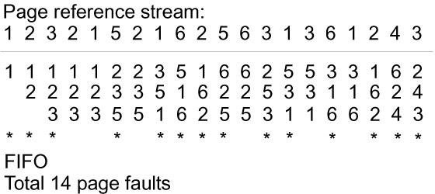
FIFO Example

Slide 38
Optimal Algorithm
The optimal algorithm for page replacement requires knowledge of the entire page reference stream in advance.
When a page fault occurs and there are no empty frames for the process, the algorithm looks ahead in the page reference stream to find out about future references to the pages currently in physical memory.
The approach used is to replace the page in memory that will not be used for the longest period.

Slide 39
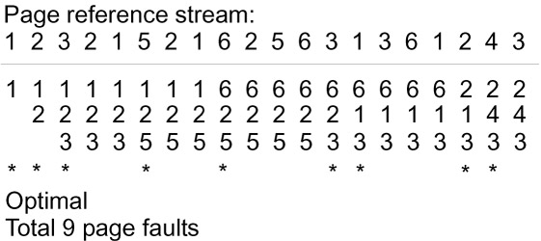
Optimal Example

Slide 40
LRU Algorithm
The least recently used (LRU) replacement algorithm replaces the page that has not been used for the longest period.
The assumption is that recent page references give a good estimation of page references in the near future.
When a page fault occurs and there are no empty frames the algorithm selects the least recently referenced page for replacement.

Slide 41
APPROXIMATION TO LRU
Most methods employ reference (or used) bits, one for each frame. when a page is brought into memory, its reference bit is set to 0. whenever a page is referenced, its reference bit is set to 1 (by hardware) . The reference bit may be reset to 1 periodically.
Method 1. recording value of reference bits.
Keep a byte counter for each frame
At regular intervals (say 100 msec), a timer interrupt occurs . The o.s. shifts the reference bit for each frame into the highest order (leftmost) bit of the corresponding counter. also, the o.s. resets all reference bits.
A higher value of the counter indicates a more recently used page.

Slide 42
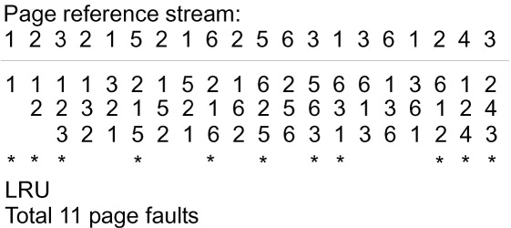
LRU Example

Slide 43
APPROXIMATION TO LRU (CONT.)
METHOD 2: SECOND CHANCE METHOD
THE FRAME TABLE IS VIEWED AS A CIRCULAR QUEUE WITH A POINTER.
WHEN A PAGE FAULTS OCCUR, THE POINTER ADVANCES UNTIL IT FINDS A FRAME WHOSE REFERENCE BIT IS 0.
AS IT ADVANCES, IT RESETS EACH REFERENCE BIT TO 0. NOTE THAT A FRAME WITH REFERENCE BIT 1 IS GIVEN A SECOND CHANCE.
OTHER METHODS:
CLOCK ALGORITHM. SIMILAR TO SECOND CHANCE, BUT INCLUDES ALSO THE DIRTY BIT.
POOL OF FREE FRAMES. USED IN VAX/VMS WITH FIFO.
LEAST/MOST FREQUENTLY USED.

Slide 44
Frames Needed by a Process
A process should be allocated enough frames for its current locality
If more frames are allocated, there is little improvement
If less frames are allocated, there is very high page fault rate

Slide 45
Frame Allocation Problem
If a process does not have “enough” frames allocated, the page-fault rate would be very high. This leads to:
Low CPU utilization
The OS attempts to increase the degree of multiprogramming
Thrashing -- a process spends most or all of its time swapping pages.

Slide 46
Thrashing
A process is thrashing if is spending more time paging than executing
A thrashing process can cause other processes to thrash if a global page replacement strategy is used
When CPU utilization is low, the OS may increase the degree of multiprogramming and cause other processes to thrash

Slide 47
Locality
Why does paging work?
  The locality model is used -- the set of pages used for that particular phase of computation
  A process migrates from one locality to the next, as the process moves to a different phase of computation
  Localities may overlap

Slide 48
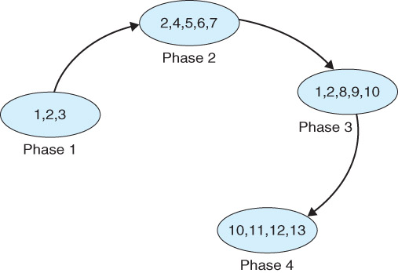
Example of Locality

Slide 49
Locality of Program Execution
A set of pages that are actively used together
Temporal locality - one a location is referenced, it is often referenced again soon
Spatial locality - once a location is referenced, a nearby location is often referenced soon

Slide 50
Locality and Thrashing
Why does thrashing occur?
The size of a locality is greater than the allocated memory (in frames)

Slide 51
Solve Thrashing
To stop thrashing, each active process should be allocated enough frames for its current locality

Slide 52
Dynamic Paging Algorithms
The previous algorithms assume that a process is allocated a fixed amount of frames from the start of execution.
Dynamic paging algorithms attempt to adjust the memory allocation to match the process’ needs as it executes
The Working Set algorithm is the best known algorithm for dynamic paging.

Slide 53
The Working Set Model
The working set for each model is the set of pages referenced by the process during the most recent w page references
The working set window is w, which is difficult to determine.
Ideally, w is chosen so that at any time, the working set for a process is exactly the process’ current locality

Slide 54
Total Demand of Frames
Let d be the sum of the sizes of the working sets of all active processes.
Let FA be the total number of frames
If d < FA then the OS can allow more active processes
If d > FA then the OS must suspend some active processes, otherwise thrashing occurs.

Slide 55
Page Fault Frequency Scheme
A strategy to control thrashing
Set the lower and upper bounds of page fault rate for each process
Establish “acceptable” page fault rate
  If actual rate is lower than lower bound, decrease the number of frames
  If actual rate is larger than the upper bound, increase the number of frames

