Slide 1

Coding with p5.js
By Chen Wen Kang

Slide 2
First of all….

Slide 3
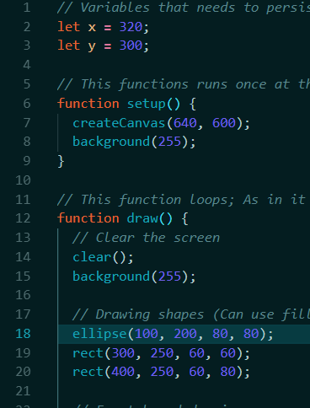
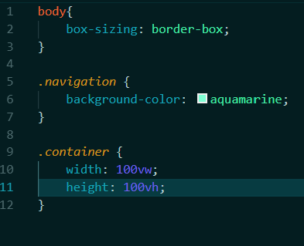
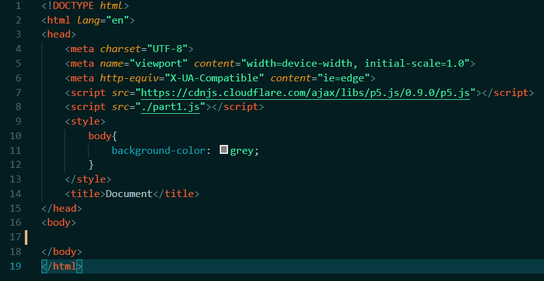
An introduction to the Web
Consists of 3 main web technologies: HTML, CSS, Javascript
HTML houses the content of the page.
CSS describe how pages are displayed.
Javascript powers the page, allowing responsiveness and interactiveness

Slide 4
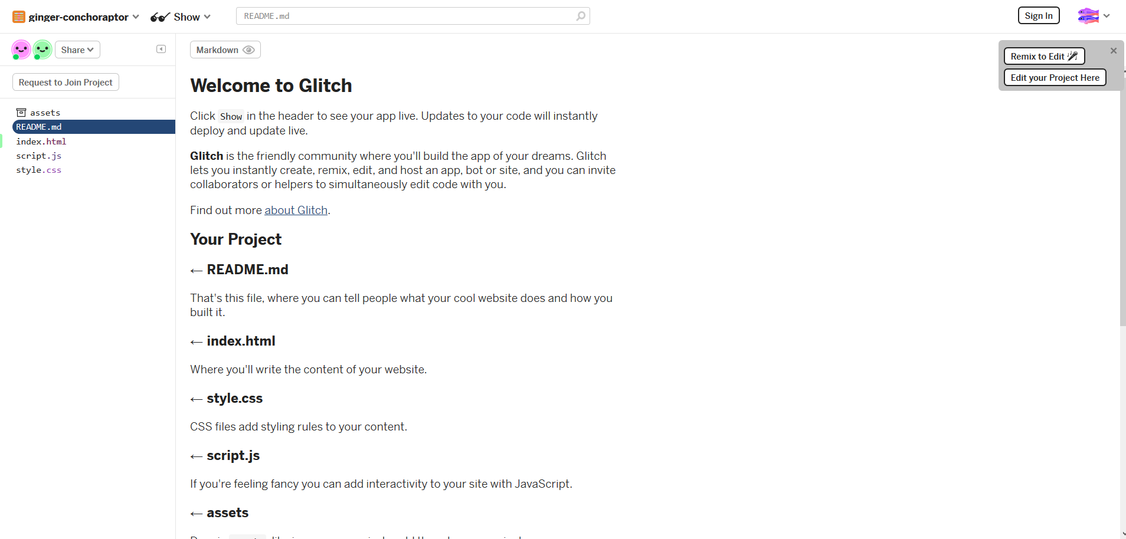
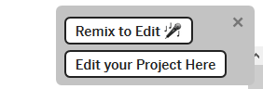
Preparing our tool: Glitch
Go to this URL:

Slide 5
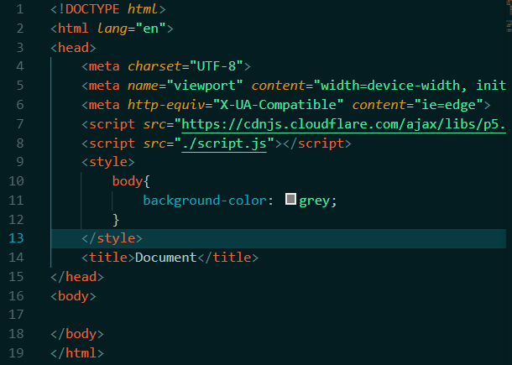
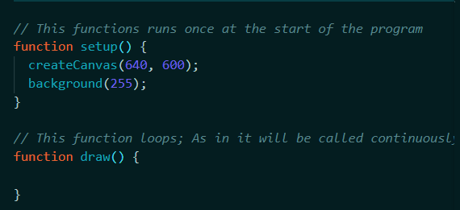
Short explanation on existing code

Slide 6
p5.js
Javascript library used for creative coding
Good starting point for learning coding graphically.
Code runs in 2 main function, setup() and draw().

Slide 7
Structure of p5.js

Slide 8

Let’s get drawing

Slide 9
Making it reactive

Slide 10
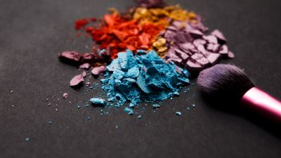
Let’s make a Paint App!

Slide 11
Other Projects?

Slide 12
Thank you!

