Slide 1
Antoine de Saint-Exupery
Help me

Slide 2
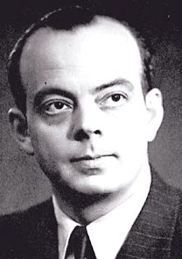
Antoine de Saint-Exupery
Full name Antoine Marie Jean-Batiste Roge de Saint-Exupérye. He born 29th June, 1900 and he died 31st July, 1944.

Slide 3

Childhood
Antoine de Saint-Exupery was born in the French city of Lyon on Peira Street. Exupery began attending the St. Bartholomew Christian Brothers School in Lyon in 1908, and after moving his family to Le Mans, he and his brother Francois studied at the Jesuit College of St. Croix until 1914.

Slide 4
Works
He most popular work is childish and philosophies story little Prince. He wrote him in 1943, but published in 1958. It includes in Land of men.
Also he has written feature article about war (He has been a pilot and participated in The Second World war), for example war pilot or Letter to a hostage.

Slide 5
Thanks for attention.

