Slide 1
OPENING
FINAL YEAR PROJECT DEFENSE
AI-Assisted Research Paper Submission and Review Platform
AI-Assisted Research Paper Submission and Review Platform
Value Delivered
Final year engineering project
Traceable paper lifecycle
Web platform for submission, assignment, and review
Local AI for confidentiality
Angular, Spring Boot, FastAPI, PostgreSQL, local AI
A secure web platform that structures submission, reviewer assignment, AI-assisted evaluation, and final decision.
Reviewer support before evaluation
Human control with AI assistance
Admin-controlled assignment
01
02
03
04
05
06
PDF upload
GROBID
Human correction
Embedding
Review tools
Decision
Angular + Spring Boot + FastAPI + PostgreSQL/pgvector + Ollama
1/13
1/13
Notes:
Exact speech:
Good morning members of the jury. Today I am presenting my final year project: an AI-assisted web platform for managing scientific paper submission and review. The idea is to move from a manual email-based process to a structured workflow where researchers submit papers, administrators assign reviewers, and reviewers receive local AI support before giving their evaluation. The important point is that AI does not replace the human decision. It supports extraction, matching, summarization, similarity checking, and review preparation while the final validation remains human.
Slide goal: AI-Assisted Research Paper Submission and Review Platform
Visual suggestion: Cover layout with a left thesis block and a right end-to-end workflow ribbon.
Transition: I will now give the structure of the presentation so the jury can follow the progression.
Estimated duration: 35 seconds

Slide 2
OPENING
Presentation Roadmap
Context and problem
Objectives and requirements
01
02
03
04
05
06
Architecture and data flow
Context
Problem
Solution
Architecture
Sprints
Demo & Closing
Three Scrum sprints
Demo, perspectives, conclusion
The plan moves from the business need to the technical choices, then to the implemented increments.
2/13
Notes:
Exact speech:
The presentation is organized in six parts. First, I will explain the context and the problem. Then I will present the objectives and the main requirements. After that, I will describe the technical architecture and the data flow. The implementation will be explained through exactly three Scrum sprints. Finally, I will present the demonstration scenario, the perspectives, and the conclusion.
Slide goal: Presentation Roadmap
Visual suggestion: Six-step horizontal roadmap with the current section highlighted.
Transition: I will start with the context that motivated this project.
Estimated duration: 30 seconds

Slide 3
CONTEXT
Scientific Review Still Depends on Fragmented Manual Work
Papers are exchanged by email
Email
Manual tracking creates delay and weak traceability.
Metadata is copied manually
Reviewer choice is informal
Spreadsheet
Manual tracking creates delay and weak traceability.
Status tracking lacks traceability
Informal choice
Manual tracking creates delay and weak traceability.
Unclear audit
Manual tracking creates delay and weak traceability.
3/13
Notes:
Exact speech:
In many academic environments, the review process is still managed through email exchanges and informal tracking. A researcher sends a PDF, an administrator extracts or copies metadata, reviewers are selected manually, and the status of each paper may be followed in a spreadsheet or in separate messages. This works for a small number of papers, but it becomes slow, difficult to audit, and error-prone when the volume increases. The project therefore starts from a business need: make the review workflow structured and traceable.
Slide goal: Scientific Review Still Depends on Fragmented Manual Work
Visual suggestion: Before-state flow: email inbox, spreadsheet, manual reviewer choice, unclear status.
Transition: From this context, the project problem becomes clear.
Estimated duration: 45 seconds

Slide 4
CONTEXT
The Core Problem Is Not Only Uploading a PDF
Manual metadata entry wastes time
Metadata quality
This bottleneck must be supported in the platform.
Reviewer assignment lacks objective support
Similarity checks are not integrated
Reviewer relevance
This bottleneck must be supported in the platform.
Reviewers lack preparation tools
Originality signal
This bottleneck must be supported in the platform.
Review preparation
This bottleneck must be supported in the platform.
4/13
Notes:
Exact speech:
The problem is larger than simply uploading a PDF. The workflow must handle metadata quality, reviewer selection, originality checking, reviewer assistance, and final decision tracking. If these steps remain disconnected, the platform would only replace email with another file repository. The challenge is to connect the full lifecycle while keeping the process understandable and controllable by the administrator and the reviewers.
Slide goal: The Core Problem Is Not Only Uploading a PDF
Visual suggestion: Problem stack with four linked bottlenecks from submission to final decision.
Transition: To answer this problem, I defined a solution centered on automation with human validation.
Estimated duration: 45 seconds

Slide 5
SOLUTION
The Proposed Solution Automates the Workflow, Not the Judgment
Upload PDF and extract metadata with GROBID
01
02
03
04
05
06
07
08
Upload PDF
GROBID
Correction
Submit
Embedding
Assignment
Review tools
Decision
Researcher corrects metadata before submission
Local embeddings support search and matching
Reviewer receives summary, similarity report, chatbot
Admin validates assignment and final decision
Core principle
AI supports evidence and preparation; it does not replace the final human decision.
5/13
Notes:
Exact speech:
The solution is a web platform that automates repetitive operations but keeps human validation at the important points. The researcher uploads a PDF. GROBID extracts the title, authors, abstract, and keywords. The researcher can correct these fields before submitting. After submission, the paper is indexed with local embeddings generated through Ollama. The administrator receives reviewer suggestions and confirms the assignment. The reviewer then has access to an AI summary, a similarity report, and a paper-grounded chatbot before submitting an evaluation. The administrator can then issue the final decision after the completed reviews.
Slide goal: The Proposed Solution Automates the Workflow, Not the Judgment
Visual suggestion: Main chain: upload -> GROBID -> correction -> submission -> embedding -> assignment -> review tools -> decision.
Transition: Before discussing the implementation, I will summarize the expected requirements.
Estimated duration: 60 seconds

Slide 6
SOLUTION
Requirements Balance Usability, Security, and Maintainability
Researcher: upload, correct, submit, track
Researcher
Upload, correct, submit, track
CHECKER: expertise, assigned papers, review tools
Admin: users, assignments, statistics, final decision
CHECKER
Expertise, assigned papers, evaluation
JWT, BCrypt, role-based authorization
Layered backend for maintainability
Admin
Users, assignment, statistics, decision
Non-functional baseline: JWT, BCrypt, RBAC, clear errors, layered backend.
6/13
Notes:
Exact speech:
The platform has three business roles. The researcher manages the submission lifecycle. The reviewer role is called CHECKER in the backend, and it covers expertise management, assigned papers, AI support tools, and review submission. The administrator manages users, validates reviewer assignment, monitors reviews and statistics, and issues the final decision. On the non-functional side, the system uses JWT authentication, BCrypt password hashing, role-based authorization, local storage for PDFs, and a layered backend structure to keep the code maintainable.
Slide goal: Requirements Balance Usability, Security, and Maintainability
Visual suggestion: Three actor lanes plus a thin non-functional requirement rail.
Transition: These requirements are supported by the technical architecture.
Estimated duration: 55 seconds

Slide 7
ARCHITECTURE
The Architecture Separates UI, Core Workflow, and Local AI
Angular frontend for role-specific interfaces
Angular
Role-specific UI
Spring Boot secures APIs and paper lifecycle
FastAPI isolates AI inference tasks
Spring Boot
Security, lifecycle, authorizations
PostgreSQL stores relational data and vectors
Local PDF
storage
Ollama keeps paper content local
FastAPI + Ollama
Embeddings, summary, keywords, chatbot
PostgreSQL + pgvector
Relational data and vectors
7/13
Notes:
Exact speech:
Technically, the platform separates responsibilities. Angular provides the user interface. Spring Boot is the core backend: it manages authentication, authorization, users, papers, assignments, reviews, notifications, and file access. The AI capabilities are isolated in a FastAPI service that calls Ollama locally. PostgreSQL stores the business data, and pgvector is used for embedding storage through the vector extension. PDF files are stored locally on the server file system. This separation is important because the AI layer can evolve without rewriting the core business workflow.
Slide goal: The Architecture Separates UI, Core Workflow, and Local AI
Visual suggestion: Four-layer architecture: Angular, Spring Boot, FastAPI/Ollama, PostgreSQL + local PDF storage.
Transition: I will now show how this architecture was implemented progressively through Scrum.
Estimated duration: 70 seconds

Slide 8
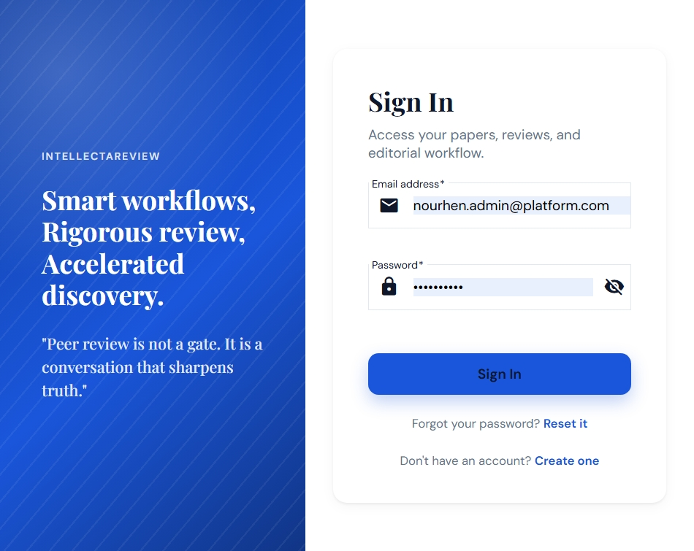
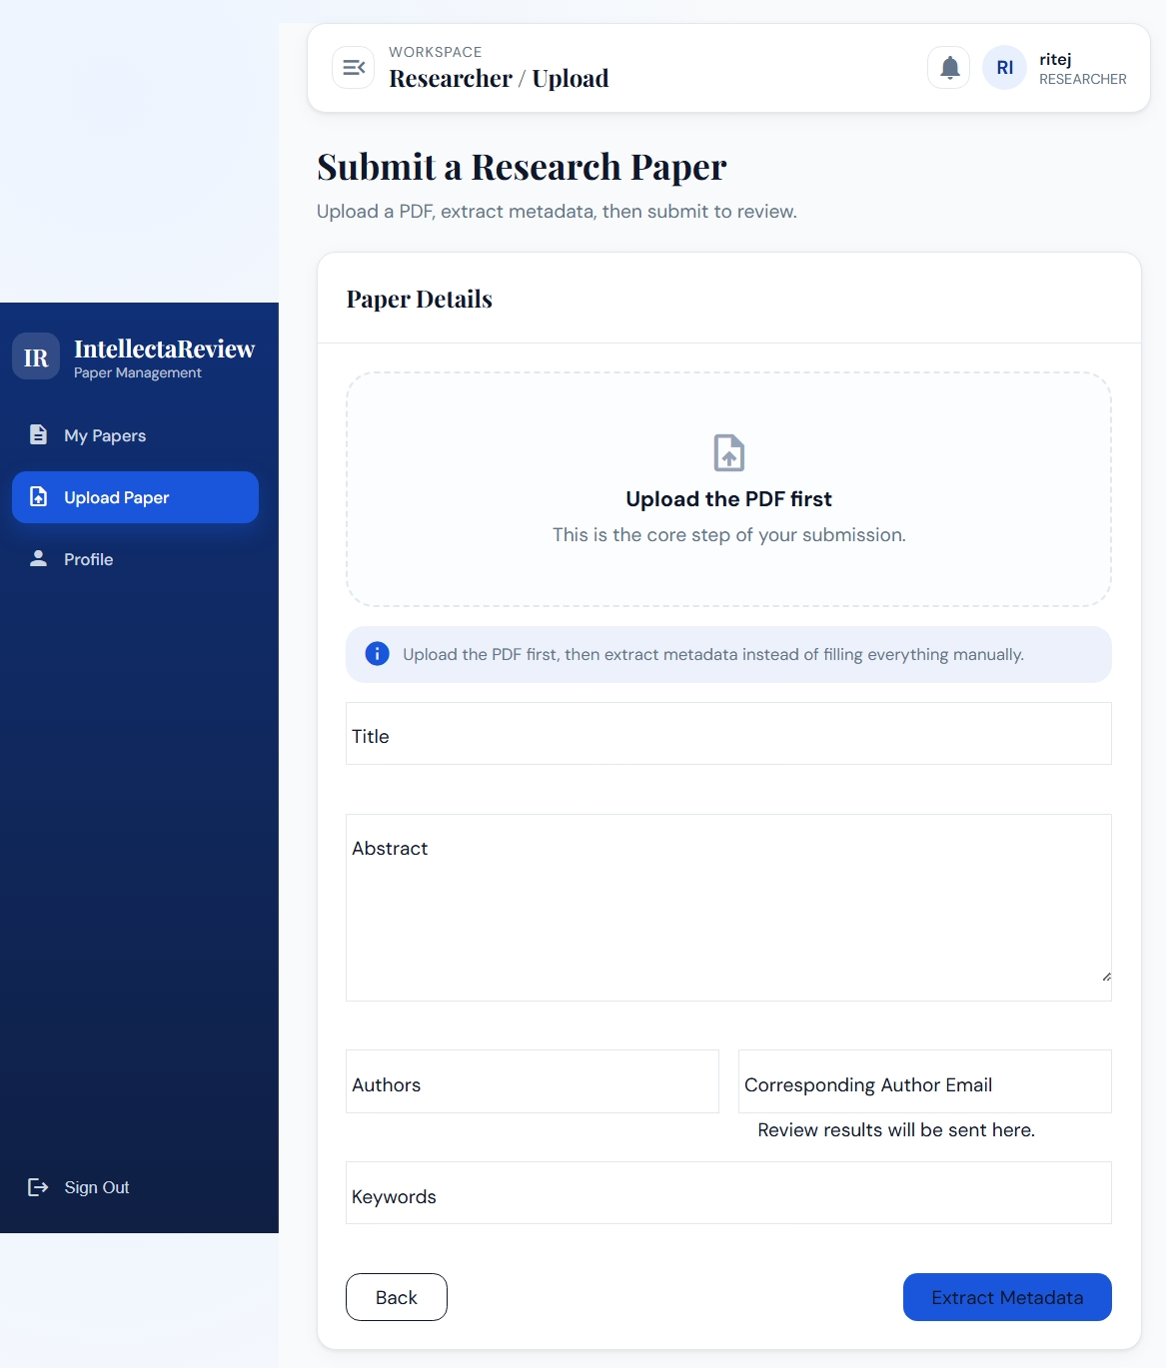
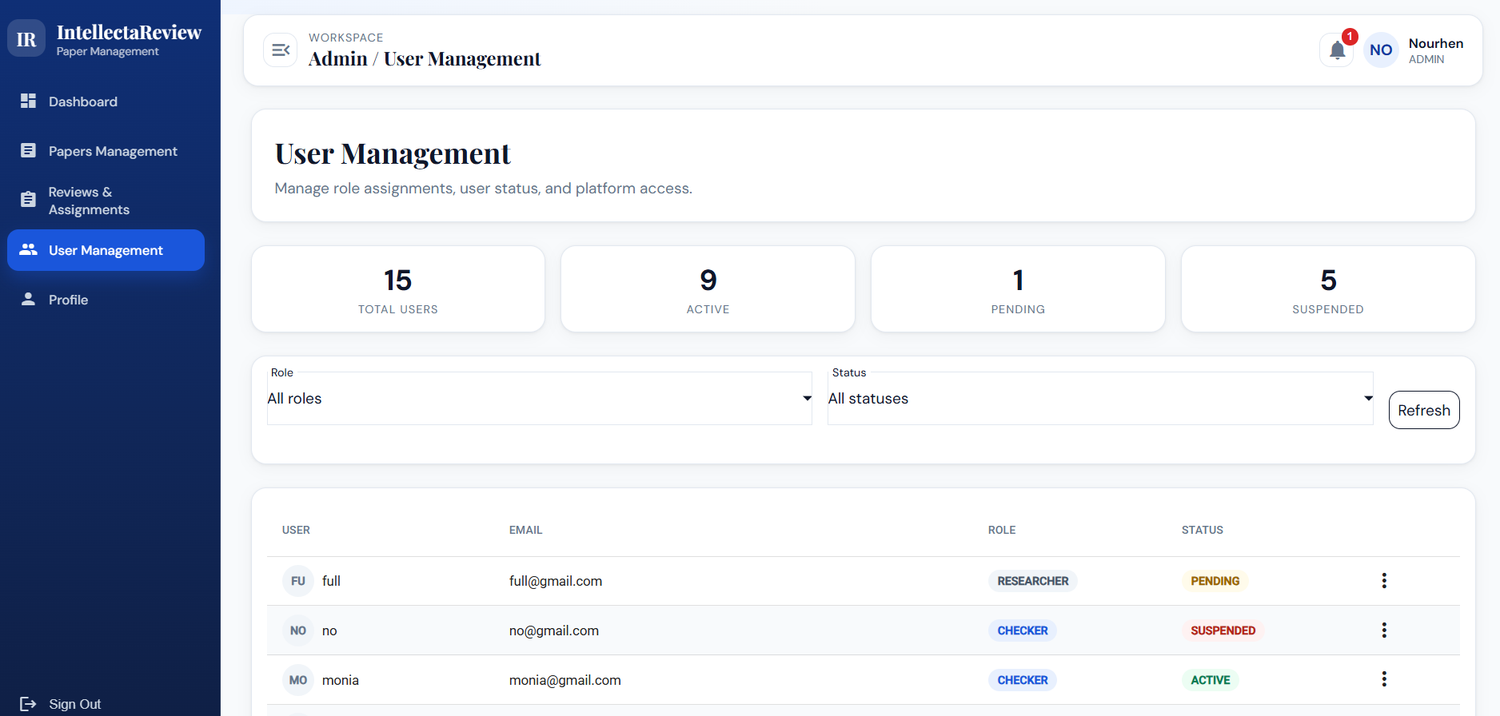
IMPLEMENTATION
Sprint 1 Built the Secure Foundation
JWT authentication and protected routes
Roles: RESEARCHER, CHECKER, ADMIN
Profile management and expertise fields
PDF upload to local storage
Admin user activation and role management
8/13
Notes:
Exact speech:
Sprint 1 focused on the secure base of the platform. It delivered account registration, login, JWT-based authentication, and role-based access control for the three roles. It also added profile management, including reviewer expertise fields, and the first PDF upload workflow. On the administrator side, the platform supports user activation, suspension, and role changes. At the end of this sprint, users could access the system securely and researchers could create draft paper records with files stored locally.
Slide goal: Sprint 1 Built the Secure Foundation
Visual suggestion: Sprint 1 timeline with proof screenshots: login, upload, user management.
Transition: With this foundation ready, Sprint 2 introduced the AI-assisted submission pipeline.
Estimated duration: 55 seconds

Slide 9
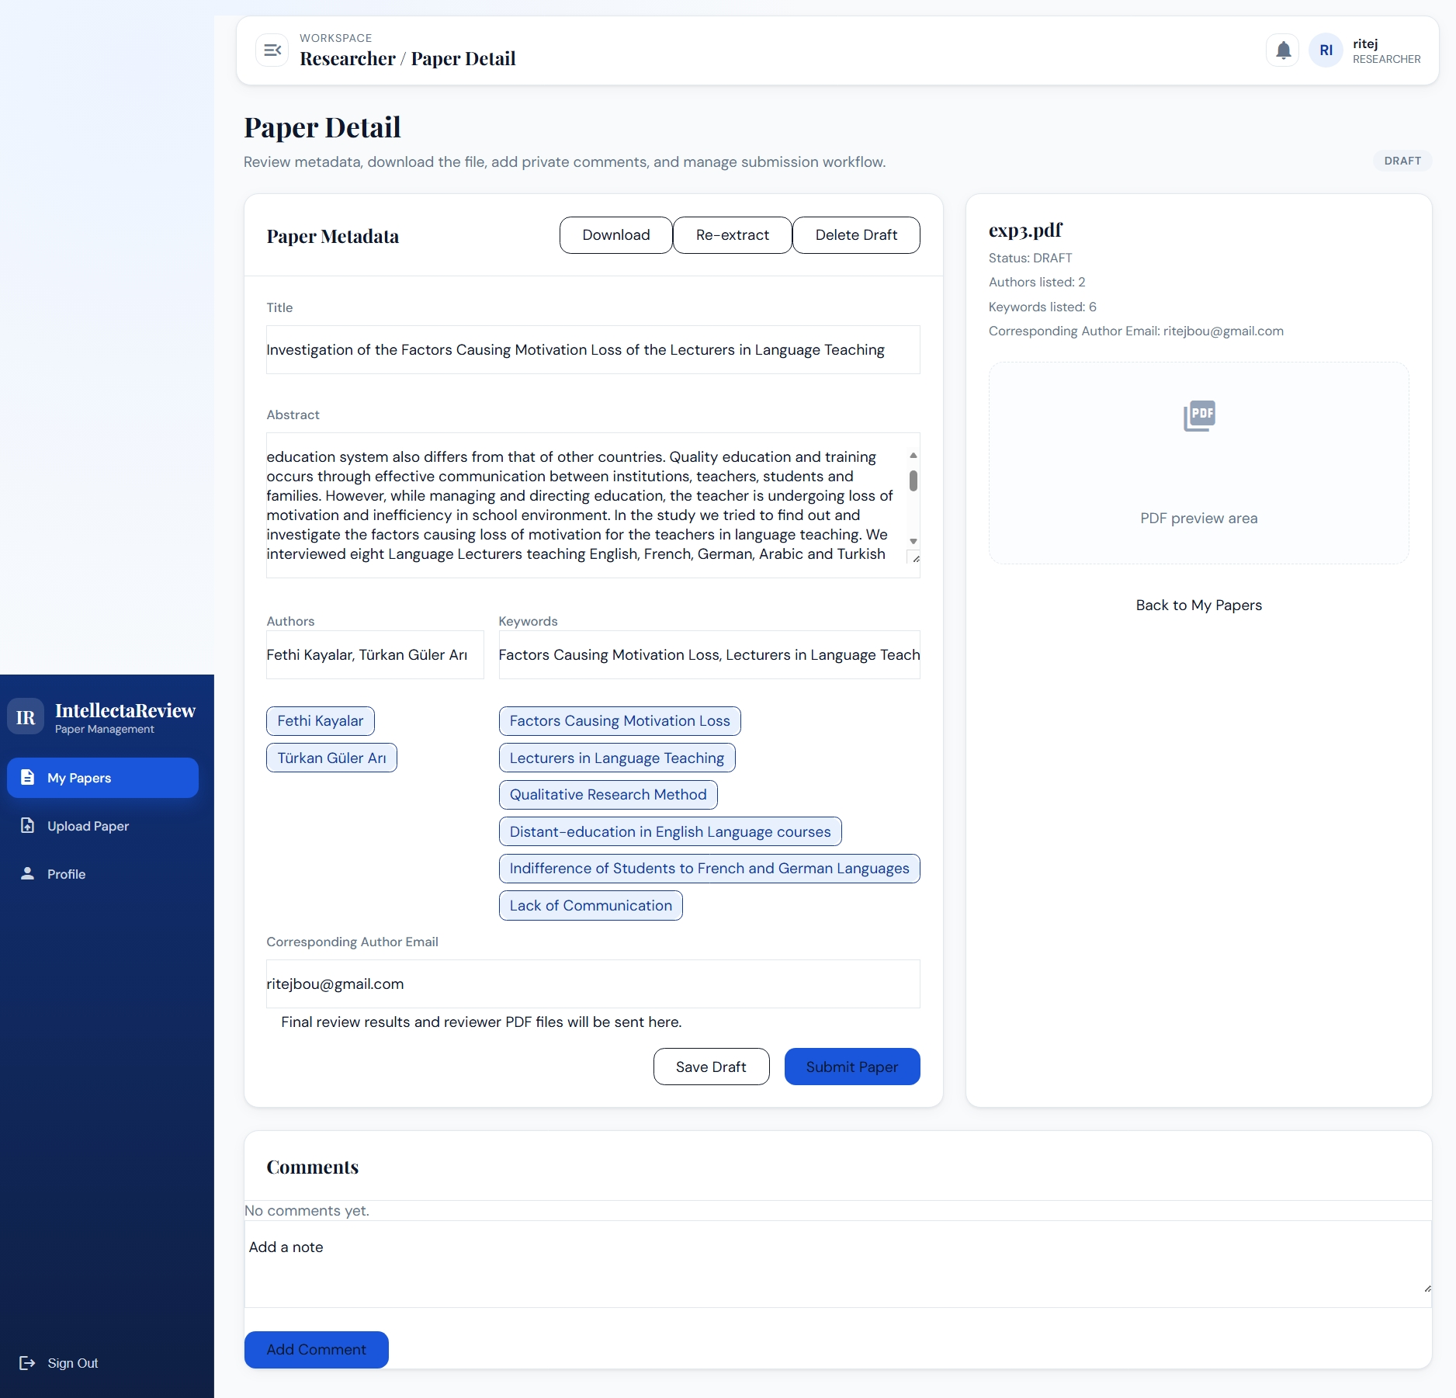
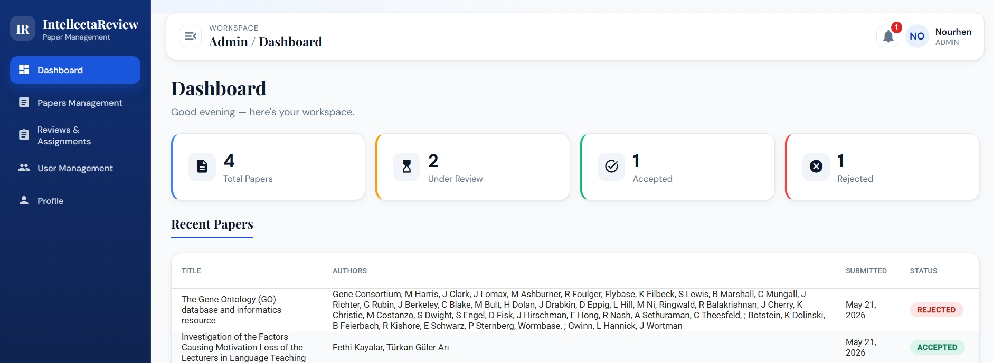
IMPLEMENTATION
Sprint 2 Turned a Draft PDF into Structured, Indexed Data
GROBID extracts title, authors, abstract, keywords
Researcher edits metadata before submission
AI keyword extraction improves metadata
Submission triggers asynchronous embedding
pgvector stores embeddings for later retrieval
01
02
03
04
PDF
Metadata
Submit
Vector
9/13
Notes:
Exact speech:
Sprint 2 transformed the uploaded PDF into structured data. The backend sends the stored PDF to GROBID, receives TEI XML, and parses it into fields such as title, abstract, authors, and keywords. These fields are not blindly accepted: the researcher reviews and corrects them in an Angular form. The AI service can also extract technical keywords using Mistral through Ollama. When the researcher submits the paper, Spring Boot changes the status to submitted and triggers asynchronous embedding through the FastAPI service. The resulting vector is stored in PostgreSQL using pgvector.
Slide goal: Sprint 2 Turned a Draft PDF into Structured, Indexed Data
Visual suggestion: Data pipeline from PDF to editable metadata to vector storage, with metadata form screenshot.
Transition: Once papers are indexed, Sprint 3 can support assignment and review assistance.
Estimated duration: 65 seconds

Slide 10
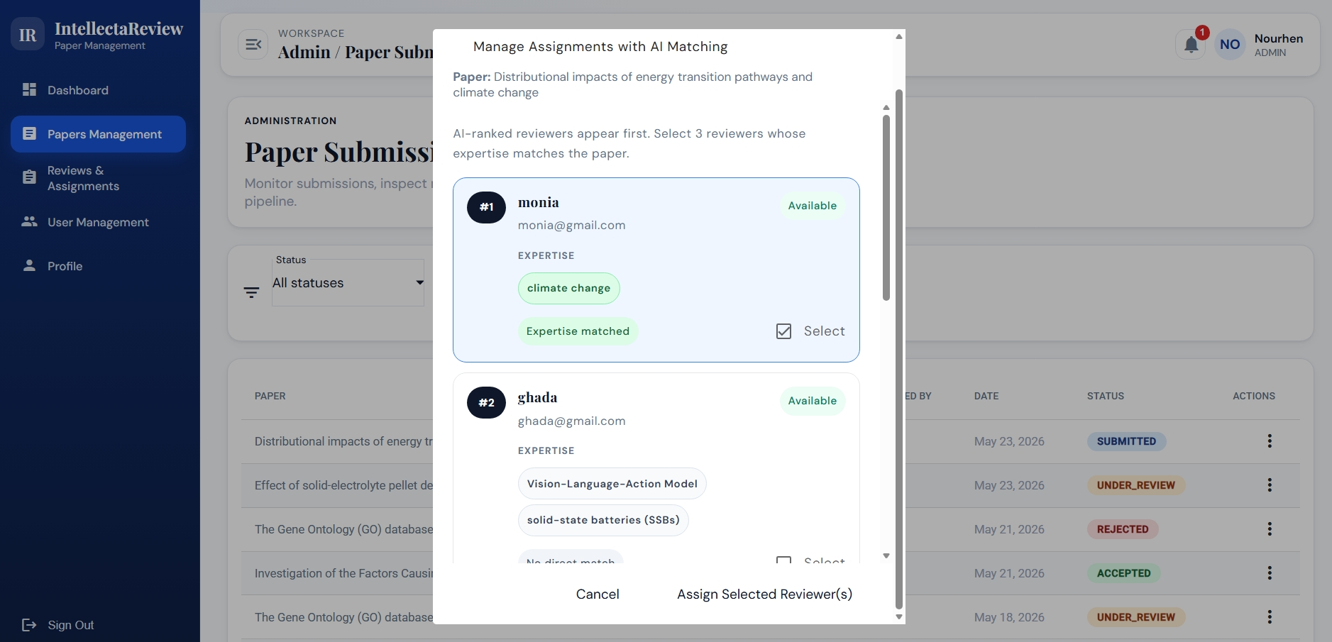
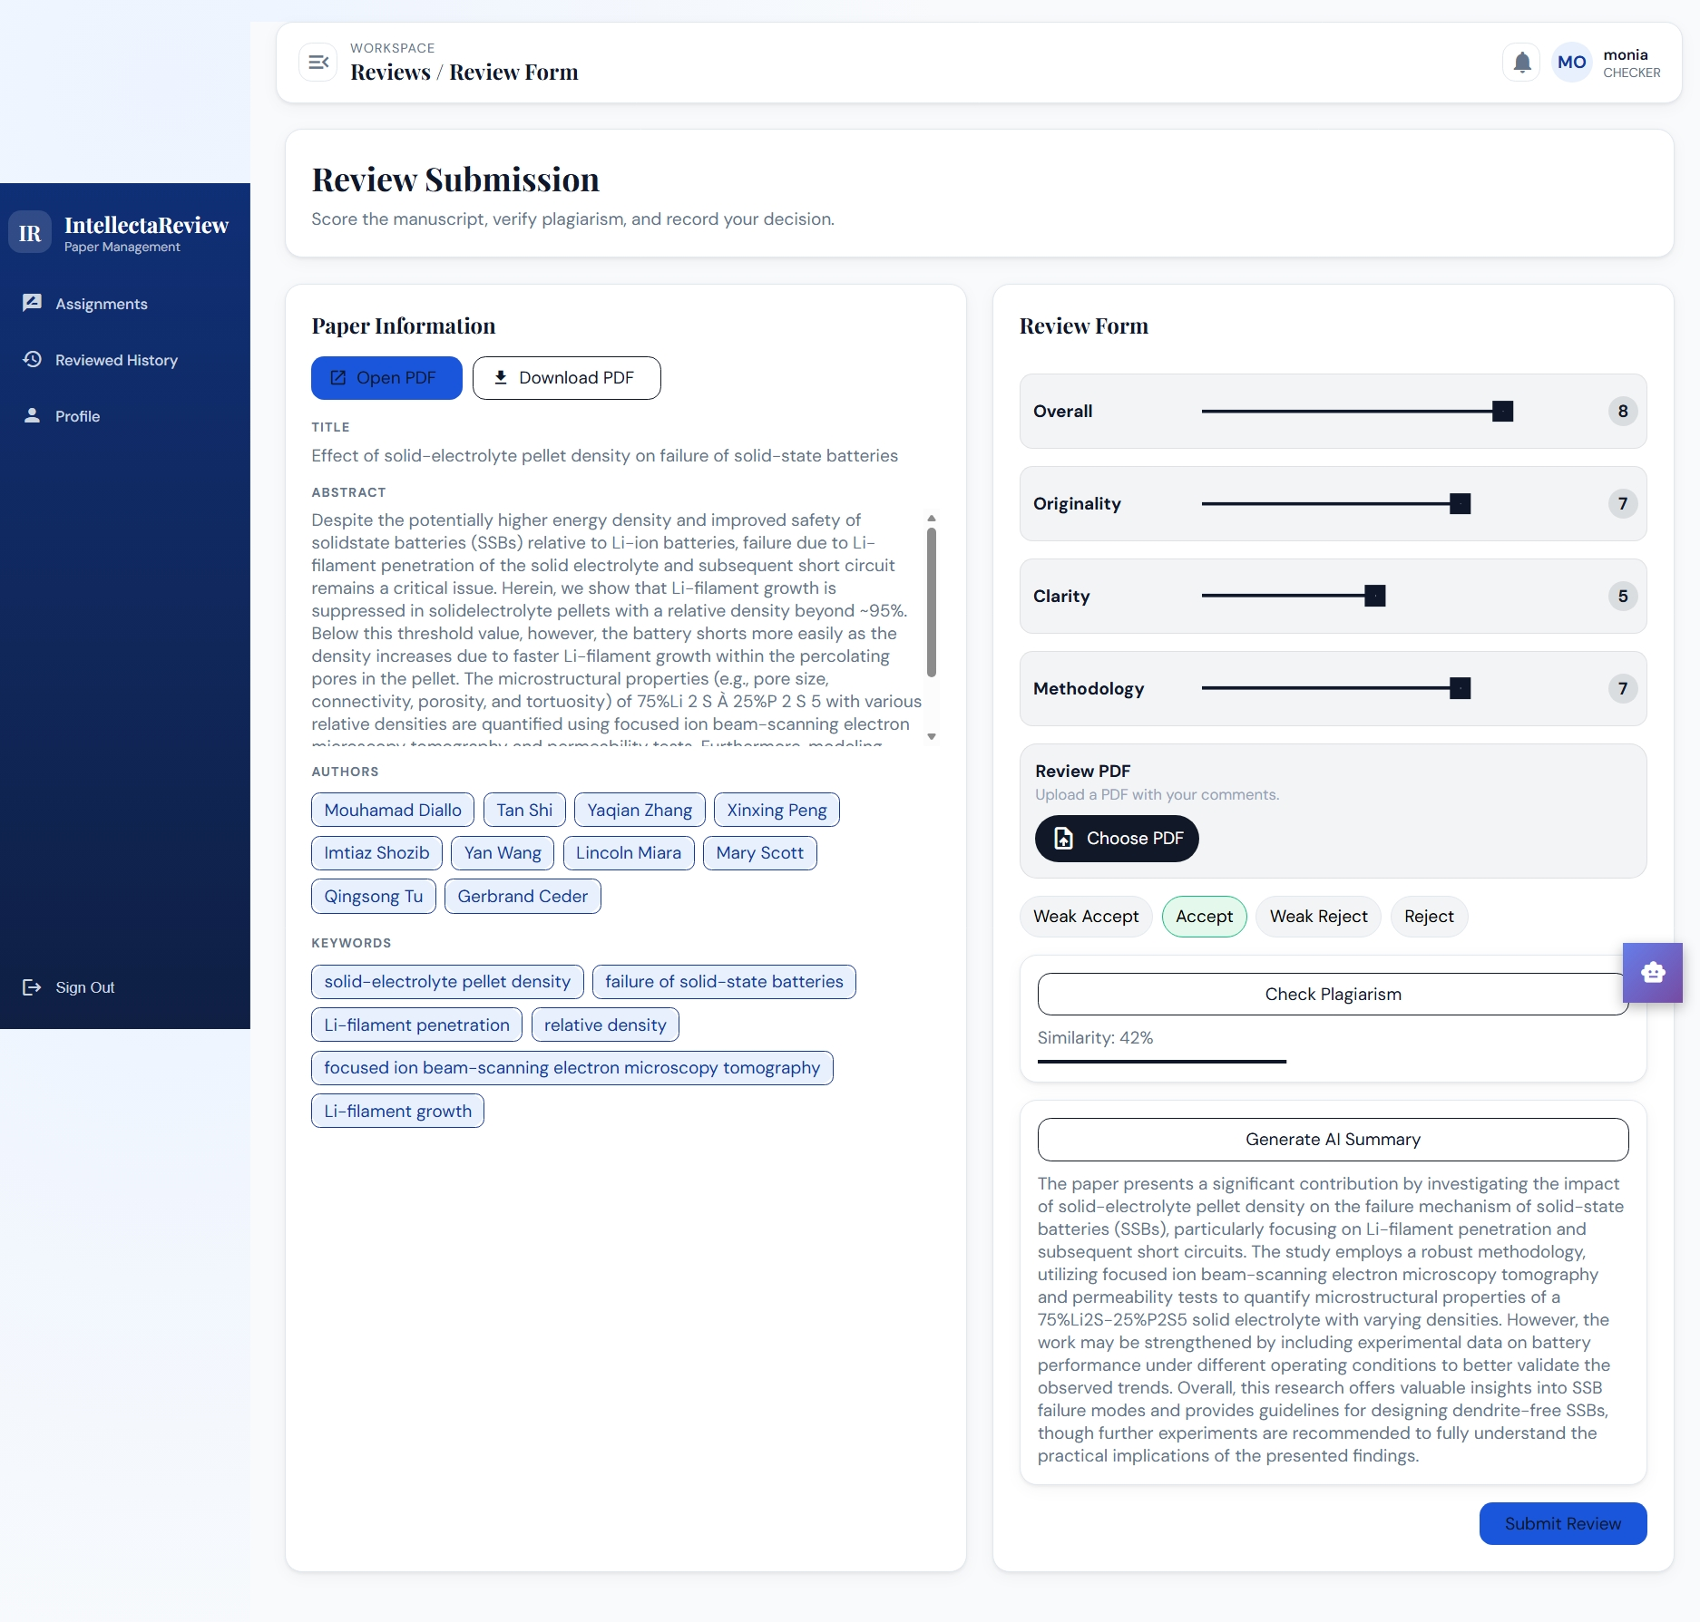
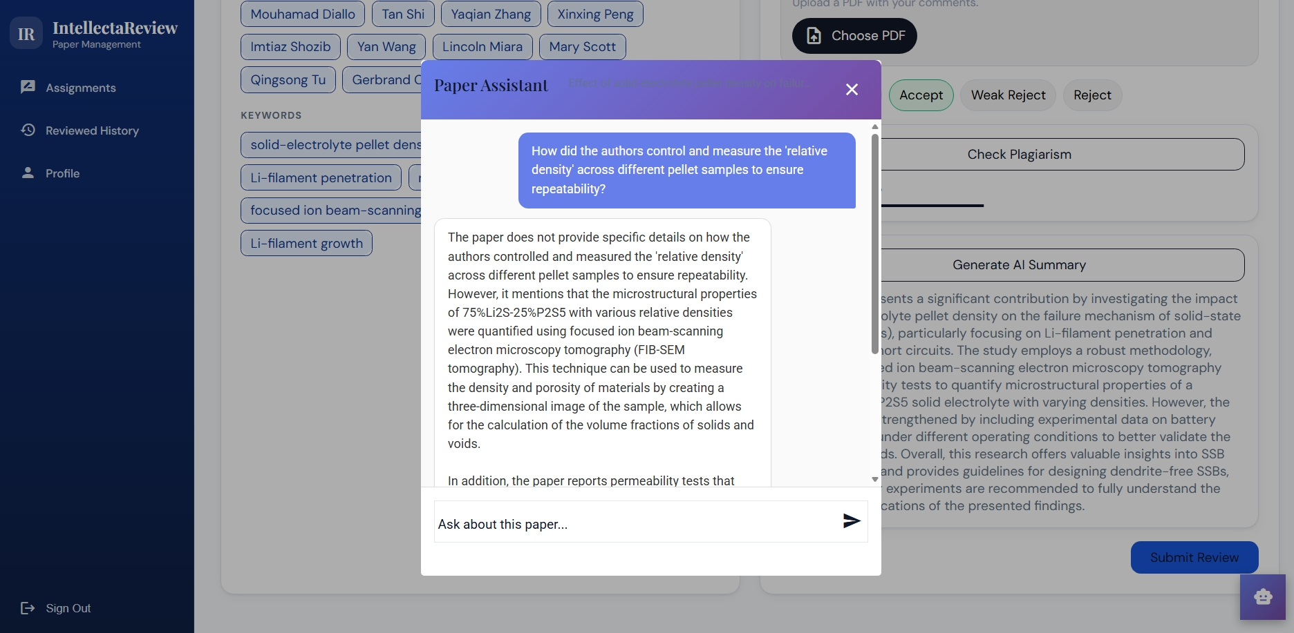
IMPLEMENTATION
Sprint 3 Completed Assignment, Review, and Decision Support
Admin receives ranked reviewer suggestions
Assignments are validated by the admin
CHECKER accepts, reviews, scores, and comments
Summary, similarity report, and chatbot assist review
Admin issues the final decision after reviews
01
02
03
04
05
Suggest
Assign
Assist
Review
Decide
10/13
Notes:
Exact speech:
Sprint 3 completed the core review lifecycle. The administrator can request reviewer suggestions and then validate the assignment manually. In the implemented workflow, reviewer suggestions combine AI search with a fallback based on keyword and expertise matching plus reviewer workload. The assigned CHECKER receives an invitation, accepts it, and then accesses the review workspace. The reviewer can generate an AI summary, run a similarity or plagiarism check, ask questions through the chatbot, and submit scores, comments, and a decision. After exactly three completed reviews, the administrator can issue the final decision.
Slide goal: Sprint 3 Completed Assignment, Review, and Decision Support
Visual suggestion: Review loop: suggestions -> assignment -> reviewer toolkit -> review submission -> final decision.
Transition: These three sprints produce a coherent scenario that I will use for the demonstration.
Estimated duration: 70 seconds

Slide 11
DEMONSTRATION
The Demonstration Follows One Complete Paper Lifecycle
Researcher uploads and corrects metadata
1
Researcher
Upload + correction
Paper is submitted and indexed locally
2
System
Index locally
Admin reviews suggestions and assigns CHECKERs
Reviewer uses summary, similarity, chatbot
3
Admin
Assign reviewers
Review and final decision close the loop
4
CHECKER
Use review toolkit
5
Admin
Final decision
11/13
Notes:
Exact speech:
For the demonstration, I will follow a single paper from upload to decision. I will start as a researcher, upload a PDF, extract and correct metadata, then submit it. Next, I will switch to the administrator view to show reviewer suggestions and assignment. Then I will use the reviewer workspace to accept the invitation, generate the AI summary, check similarity, ask the chatbot a question, and submit the review. Finally, I will return to the administrator view to show how the review results support the final decision.
Slide goal: The Demonstration Follows One Complete Paper Lifecycle
Visual suggestion: Numbered demo storyboard with five screens and expected role changes.
Transition: After the demo scenario, I will present realistic future improvements.
Estimated duration: 45 seconds

Slide 12
CLOSING
Perspectives Focus on Production-Grade Review Quality
Improve reviewer matching with direct vector comparison
Index full paper chunks for stronger RAG answers
AI quality
Governance
Full vector matching and chunked RAG
Conflict-of-interest controls
Add reviewer conflict-of-interest checks
Dockerize deployment and monitoring
Deployment
Analytics
Extend analytics for admin decision support
Containerization and monitoring
Decision-support dashboards
12/13
Notes:
Exact speech:
The current platform is functional, but several improvements can make it more production-ready. First, reviewer matching can be strengthened by comparing reviewer expertise embeddings and paper embeddings directly with pgvector. Second, the chatbot can be improved by indexing full paper chunks instead of relying mainly on metadata context. Third, the assignment process can include conflict-of-interest checks, for example affiliation or author-reviewer relations. Finally, deployment can be improved with full containerization, monitoring, and richer analytics for administrators.
Slide goal: Perspectives Focus on Production-Grade Review Quality
Visual suggestion: Future roadmap split into AI quality, governance, deployment, analytics.
Transition: I will now conclude by summarizing the value delivered by the project.
Estimated duration: 50 seconds

Slide 13
CLOSING
CONCLUSION
Thank You. I Am Ready for Your Questions.
Thank You. I Am Ready for Your Questions.
Structured lifecycle from upload to final decision
Thank you for your attention.
Local AI preserves confidentiality
Scrum increments align with architecture
Structured lifecycle from upload to final decision
Questions and discussion
Human validation remains central
Local AI preserves confidentiality
Scrum increments align with architecture
Human validation remains central
01
02
03
04
05
06
07
Upload
Extract
Correct
Index
Assign
Review
Decide
13/13
13/13
Notes:
Exact speech:
To conclude, this project delivers a structured platform for scientific paper submission and review. It replaces fragmented email-based management with a traceable workflow from PDF upload to final decision. The architecture combines Angular, Spring Boot, FastAPI, PostgreSQL with pgvector, local PDF storage, GROBID, and Ollama-based local AI. The three sprints are coherent: first the secure foundation, then the AI-assisted submission pipeline, and finally the review workflow. Thank you for your attention. I am ready to answer your questions.
Slide goal: Thank You. I Am Ready for Your Questions.
Visual suggestion: Clean closing slide with the full workflow reduced to one thin line and a Q&A marker.
Transition: I now welcome your questions and comments.
Estimated duration: 35 seconds
Likely jury questions:
Q: Why did you use local AI instead of cloud APIs?
A: Because submitted papers may contain confidential research. Ollama allows embeddings and text generation to run locally, reducing external data exposure and keeping the review workflow under institutional control.
Q: What is the role of Spring Boot in the architecture?
A: Spring Boot is the core workflow service. It handles authentication, authorization, users, paper lifecycle, file storage access, assignments, reviews, notifications, and calls to GROBID and the FastAPI AI service.
Q: Why use FastAPI as a separate AI service?
A: The AI tasks are Python-oriented and may evolve independently. Separating them keeps the Java backend focused on business rules and lets the AI layer change models or prompts without changing the core application.
Q: What does pgvector bring to PostgreSQL?
A: pgvector adds a vector column type and similarity-search capability to PostgreSQL, so semantic embeddings can be stored near relational data without adding a separate vector database.
Q: How are reviewers suggested?
A: The target design uses semantic similarity between paper content and reviewer expertise. In the implemented backend, the service first tries AI search and falls back to keyword-expertise matching and workload ordering, then the admin validates the final assignment.
Q: Does AI make the final decision?
A: No. AI helps with extraction, indexing, summary, similarity checking, and review preparation. Reviewer evaluations and the administrator's final decision remain human-controlled.
Q: How do you secure the application?
A: The backend uses Spring Security, JWT tokens, BCrypt password hashing, account status control, and role-based endpoint authorization for RESEARCHER, CHECKER, and ADMIN.
Q: What happens if GROBID or Ollama is unavailable?
A: The backend returns clear errors for extraction or AI tasks and keeps the business workflow protected. For indexing, submission can remain recorded while embedding can be retried or regenerated later.
Q: Why is metadata editable after GROBID extraction?
A: GROBID can make mistakes depending on PDF quality. Human correction ensures that downstream search, categorization, and matching use better-quality metadata.
Q: What are the main limitations?
A: The main limitations are that full paper chunk indexing should be strengthened for RAG, reviewer matching should move fully to vector comparison, and production deployment needs stronger monitoring and conflict-of-interest rules.

