Slide 1
💪
BeFit AI
Smart Fitness Platform
Team Members:
Jimmy Maroun Zouein
Yorgo Bekaii
François Moarbes
Anthony Imad

Slide 2
Project Overview
AI-Powered Fitness E-Commerce Platform
🎯 Primary Objectives
• Provide personalized AI-generated workout plans
• Offer premium fitness equipment/supplements
• Track user progress with analytics
• Deliver 15% member discounts on products
🔑 Key Features
• Gemini AI integration for workout generation
• Secure authentication (2FA via email)
• Cart/order management system
• User profile with medical condition tracking

Slide 3
User Roles & Responsibilities
System Access & Management
User Type | Role | Responsibilities
👥 Members | Fitness enthusiasts | • Complete fitness profile • Purchase products with discount • Generate personalized workouts • Track progress and history
🔍 Guests | Browsers | • View product catalog • Browse fitness content • Register for new accounts • Access basic information
⚙️ Database Admin | Technical maintainer | • Manage MariaDB tables • Optimize database queries • Maintain data integrity • Handle system backups

Slide 4
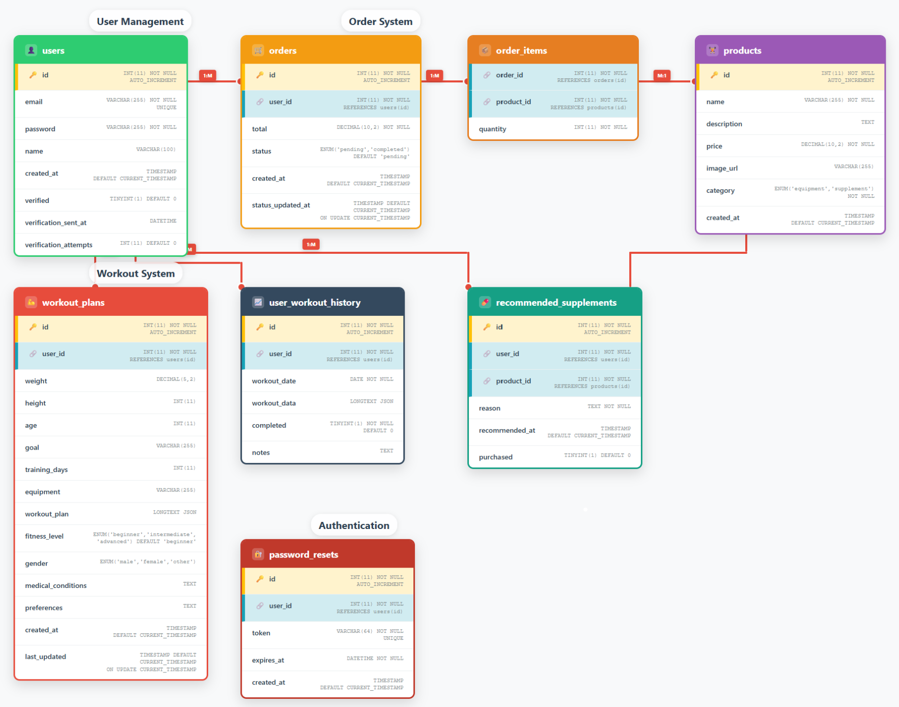
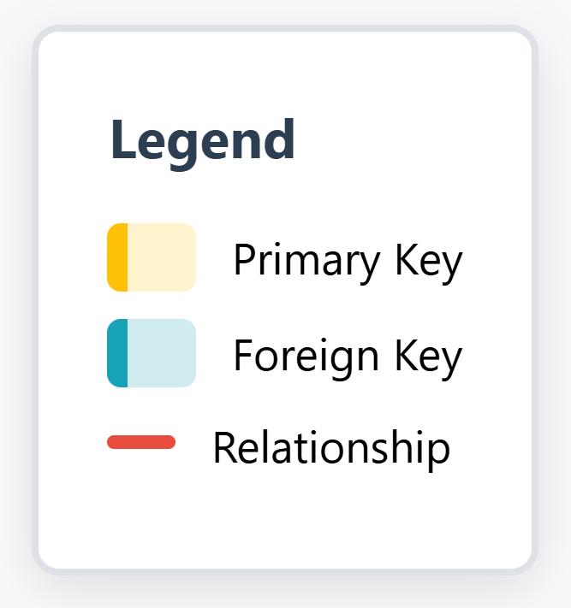
Database Structure
MariaDB Schema Architecture

Slide 5
Technology Stack
Modern Development Technologies
🌐 Frontend
HTML5, CSS3, JavaScript Responsive Design
⚙️ Backend
PHP
🗄️ Database
MariaDB Relational Structure
🤖 AI Integration
Google Gemini API Workout Generation
🔒 Security
Email 2FA Password Hashing
☁️ Deployment
Web Hosting Cloud Services

