Slide 1

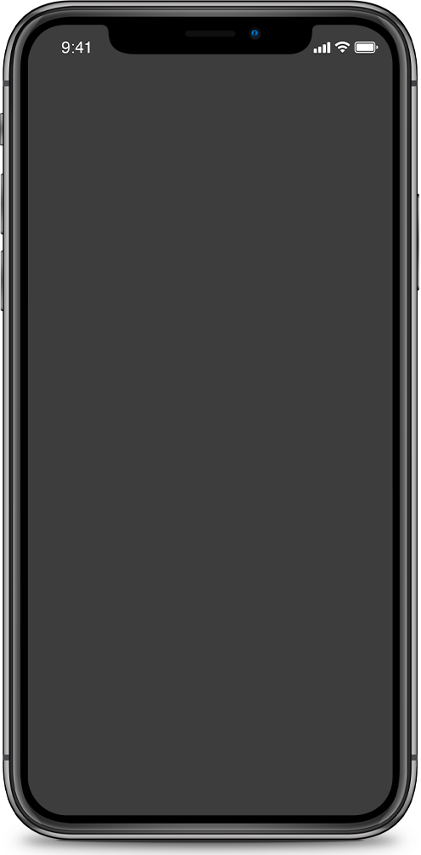

Google Play Store Apps
NOUF ALKHALDI

Slide 2
Introduction
01
Design
02
Data
03
Results
04
Conclusion
05
Tools
05

Slide 3
App analytics are a common concept in the mobile app world in which app marketers collect valuable data, that represent user behavior and app performance and the goal is to transform data into valuable information that provides insight into App and the user behavior and customer satisfaction are critical to any business because the planning and executing advertising campaigns depending on this data
Introduction

Slide 4
the most categories of applications that people are interested in.
Does the high rating of the application effect on the number of times it is installed
What are the categories that contain the most non-free applications
did the paid apps effect on the total number of installing it
Design
The project aims to
find out

Slide 5
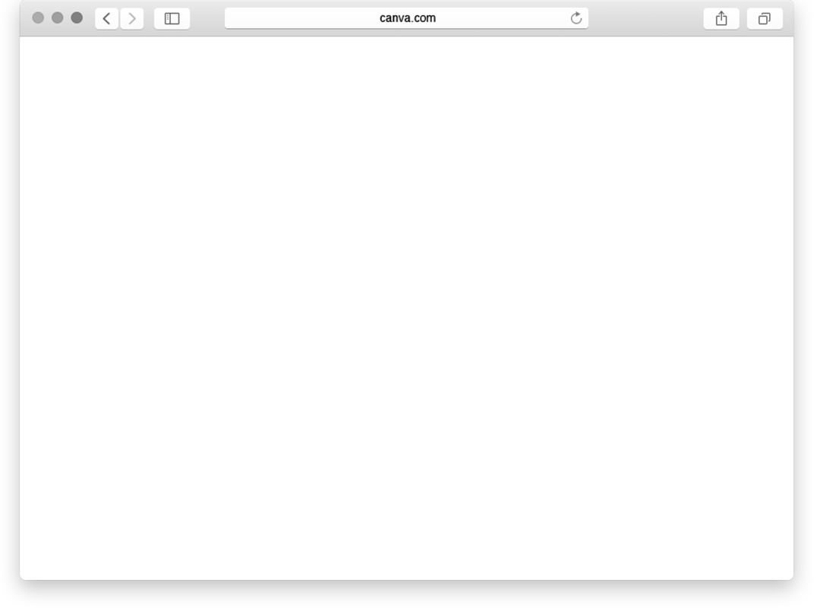
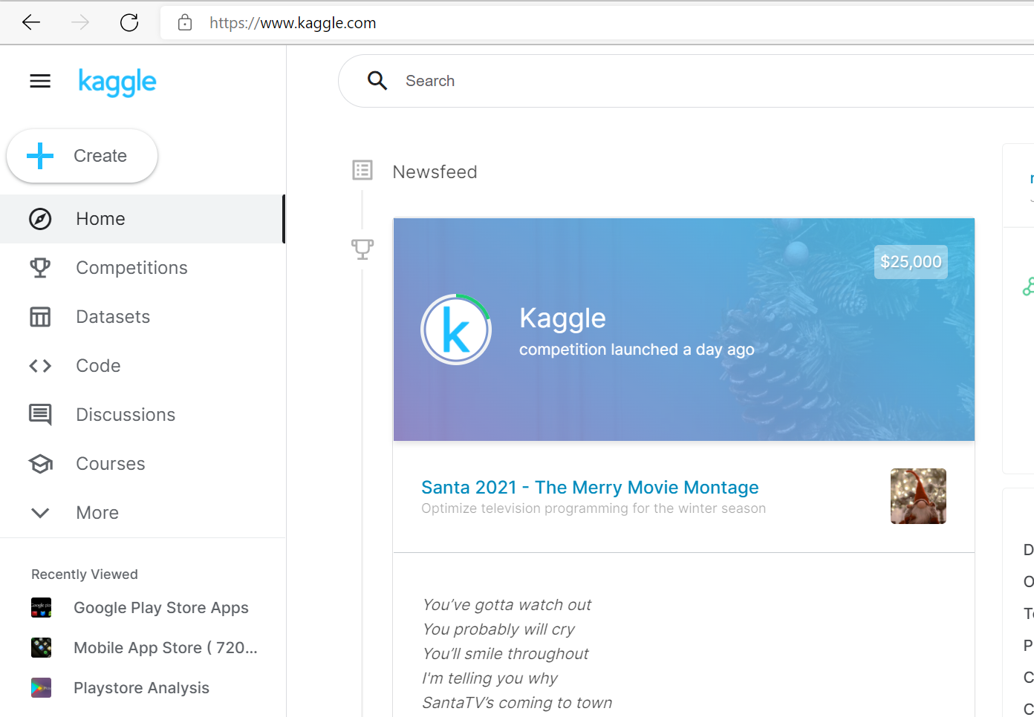
Data
It can be found at Kaggle.
contains 10842k rows and 13 columns.

Slide 6
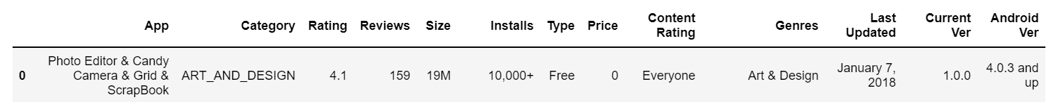
Age group the app is targeted at - Children / Mature 21+ / Adult
Overall user rating of the app
Application name
Size of the app
Paid or Free
Category the app belongs to (ART, GAME, Other)
Number of user reviews for the app
Number of user downloads for the app
Price of the app
An app can belong to multiple genres.

Slide 7
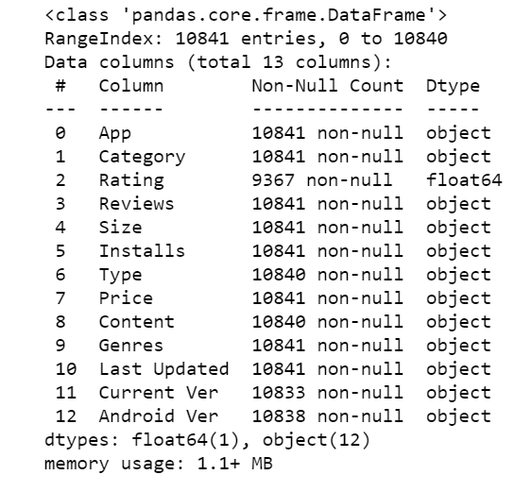
challenges
there is 4 object features need to convert into integer or float(Reviews, Size, Installs, Price)
remove the letters from values (Size, Installs, Price)
out layer value (Rating, , Installs)
null values (Rating, , Size, Installs)

Slide 8
Results

Slide 9
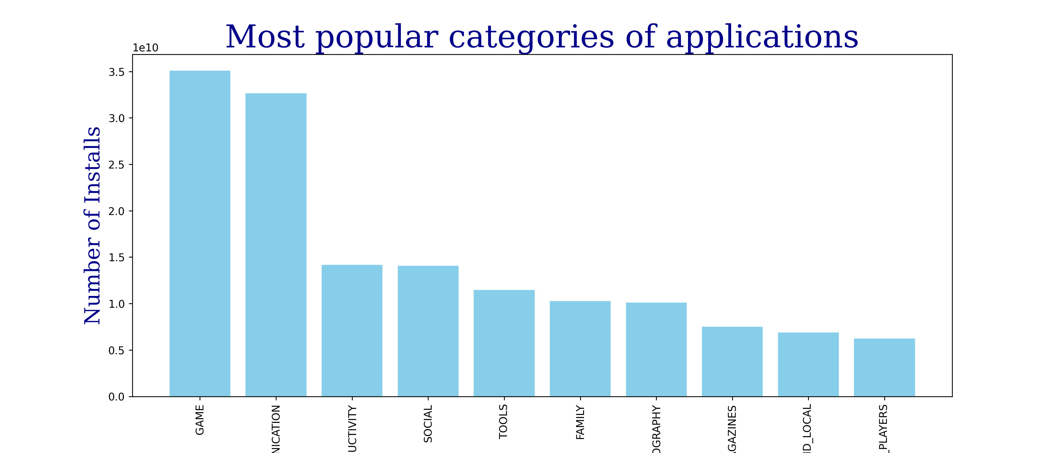
the most categories of applications that people are interested in.

Slide 10
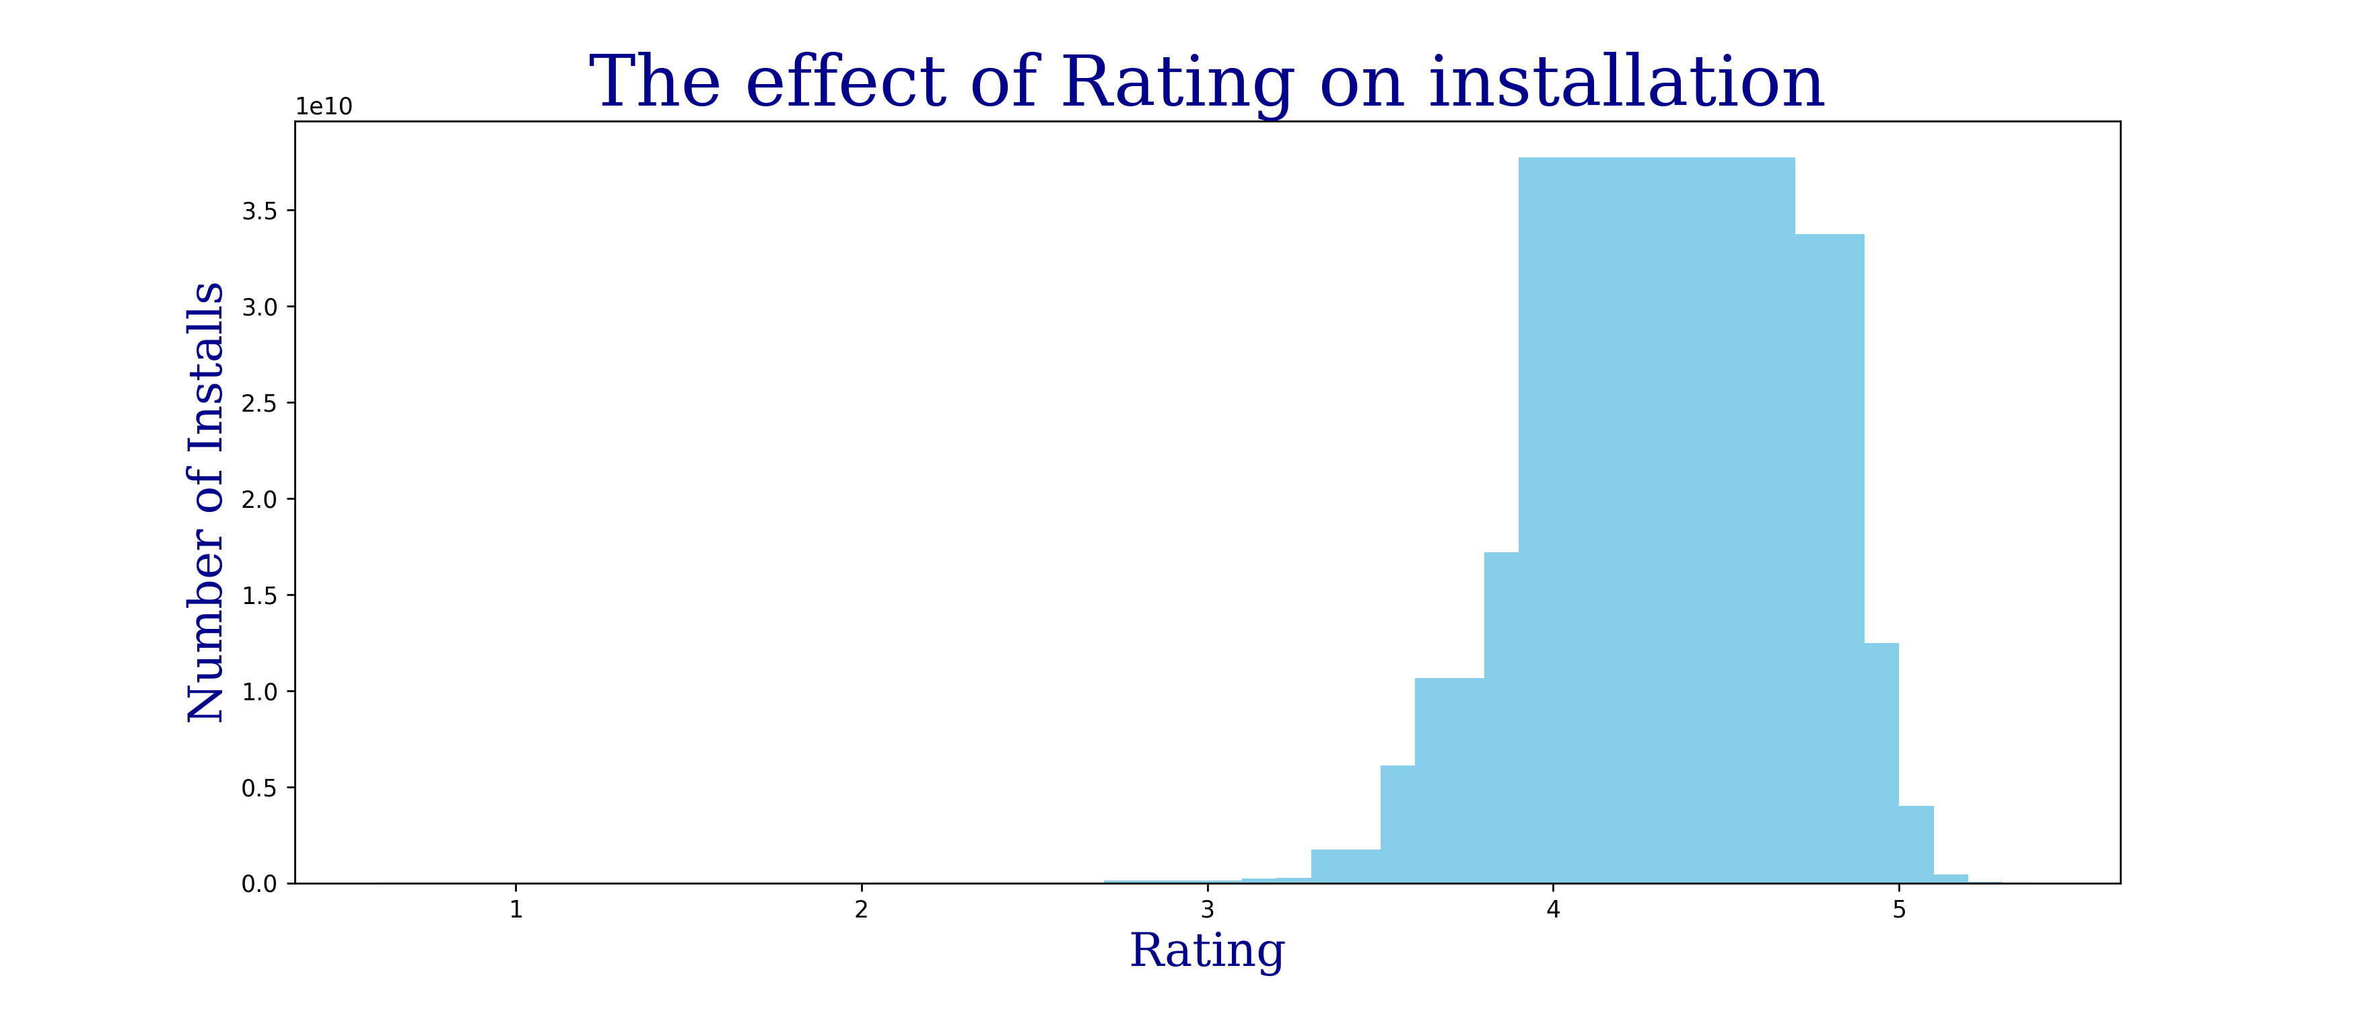
Does the high rating of the application effect on the number of times it is installed

Slide 11
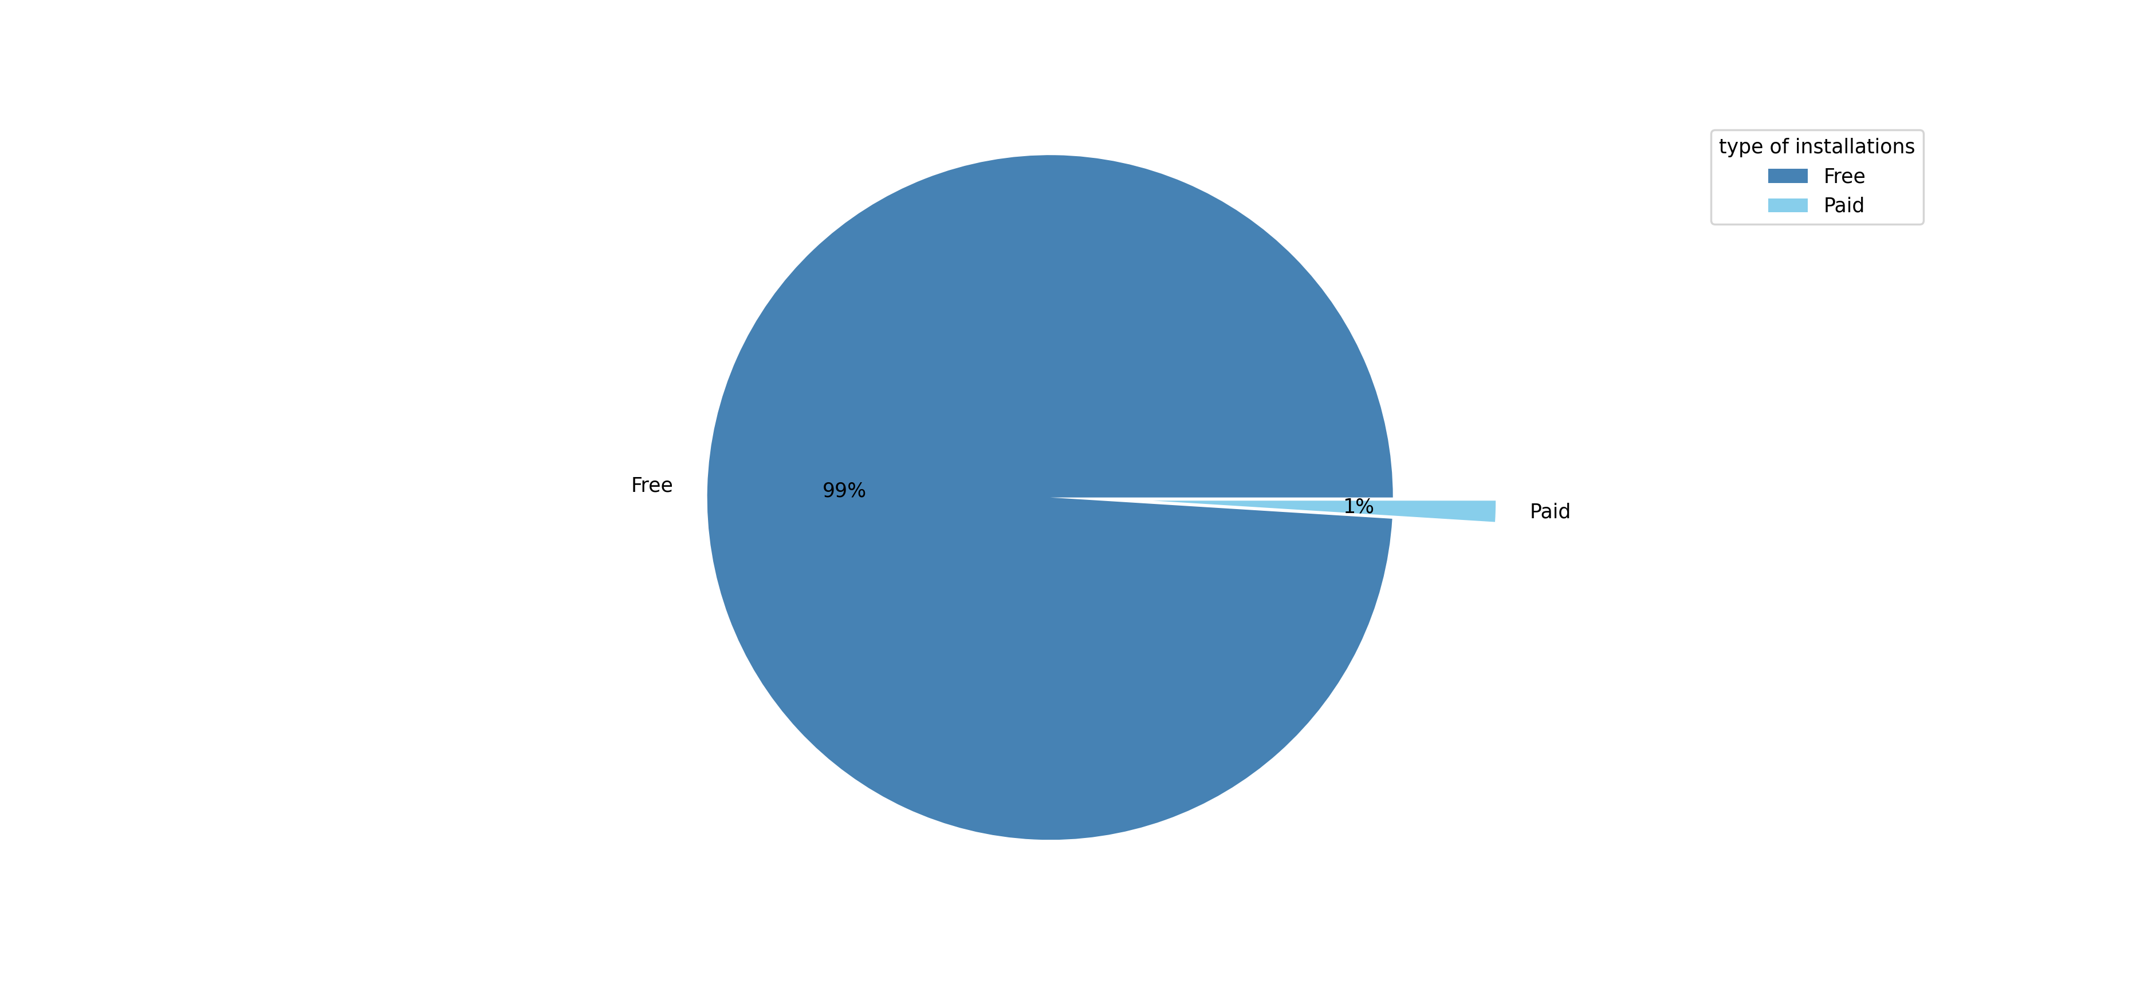
Does the type of the app effect on the total number of installing it

Slide 12
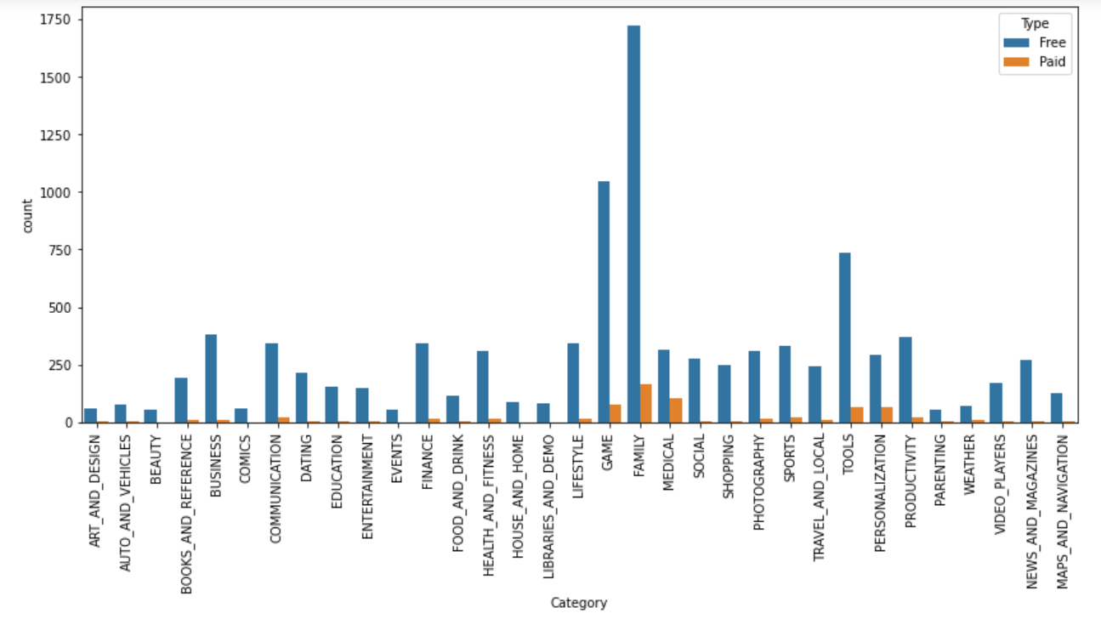
What are the categories that contain the most non-free applications

Slide 13
From the graph we found that Game is the most categories of applications that people are interested in.
There is Positive relationship between rating and number of installed.
Most people prefer free apps.
the Family category contain the most non-free applications
I suggest to company an advertising campaign
in the categories of free games with the
highest rating.
Conclusion

Slide 14





Tools

Slide 15
Thank
you

