Slide 1



L.G.Balakrishnan & Bros
Octomber 2026
6 AXIS INDUSTRIAL ROBOT
“Engineering Our First Robot”
PRESENTED BY:
OT - RnD TEAM

Slide 2


03 | Objectives
04 | Robot at a glance
05 | In-house vs Outsourced Activities
06 | Approach for in-house activities
07 | Timeline
08 | Message from project founder
09 | Team
10 | Contacts
Agenda

Slide 3

Objectives
04/10
We are developing a 6-axis pick-and-place robot as our first in-house robotics platform. The robot is designed for automated material handling and pick-and-place applications, with an approximate payload capacity of 10 kg and reach of 1400 mm.
This project involves,
1. Mechanical Design - Robot arm, joints, gearbox, CAD
2. Electrical & Firmware Design - Servo drives, PCBs, EthernetCAT, embedded control
3. Robotics Software - ROS2, kinematics, motion planning, teach pendant
4. Assembly & Testing - Robot assembly, calibaration, validation

Slide 4
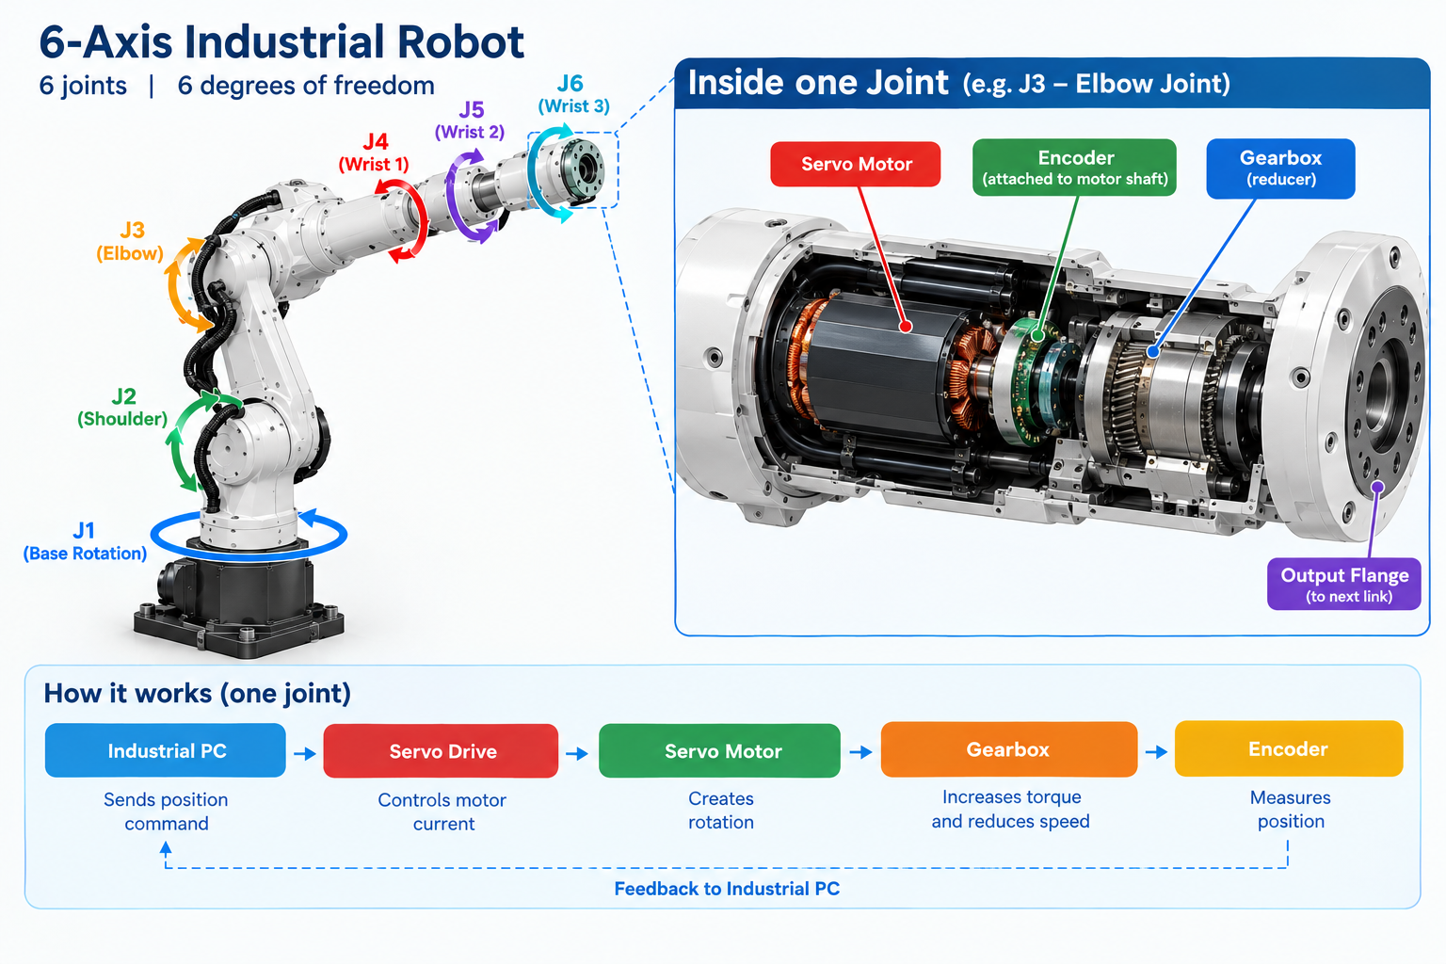
03/10
Robot at a Glance
To Manufacture Our First Industrial Robot, We Need to Make 3 Things
1.Robotic Arm:
Proper mechanical design with appropriate servo motors, encoders, and gearboxes for smooth movement without distortion.

Slide 5
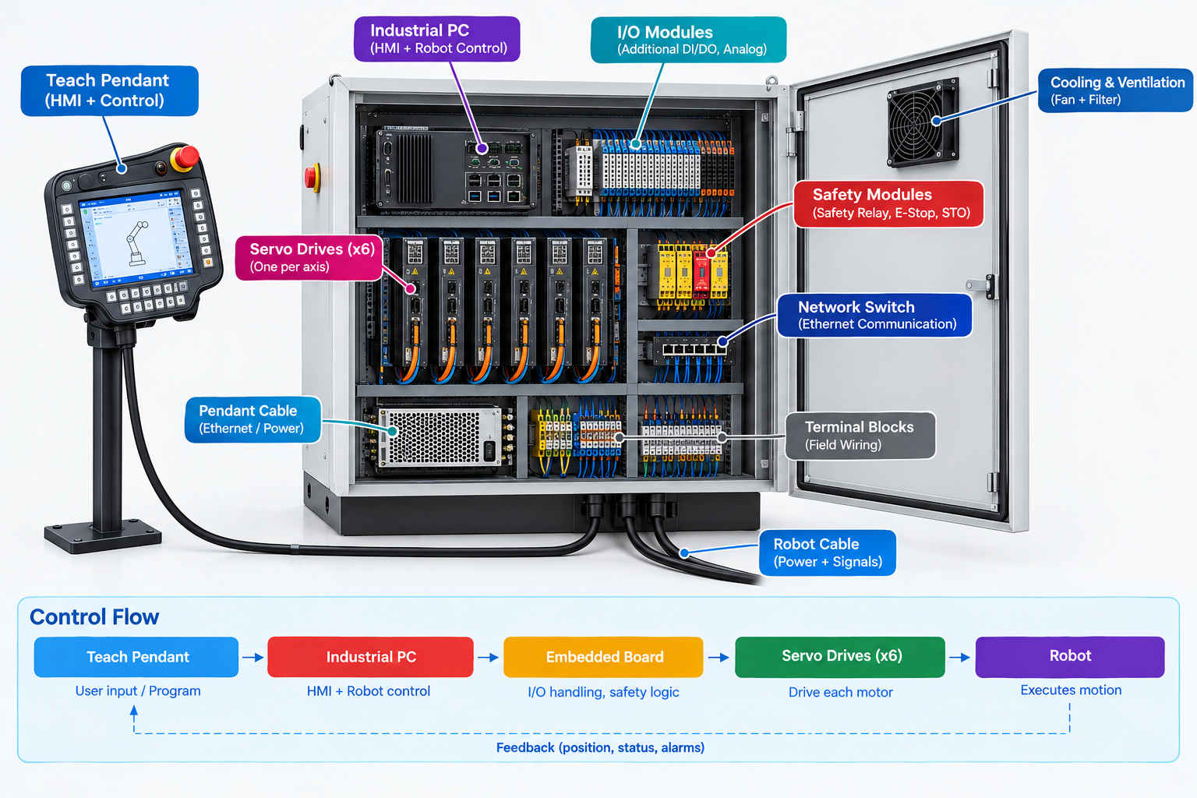
03/10
Robot at a Glance
2. Teach Pendant:
To control the robot, teach positions, and program movements.
3. Control Panel:
To house the robot controller, servo drives, and required electrical components.

Slide 6

In-House vs Outsource Activities
04/10
Activity | Approach | Reason
Mechanical design and Robot CAD | In-house | Core product knowledge
Torque and gearbox calculation | In-house | Avoid undersized jonts
Custom part fabrication | Outsource | Avoid design issues
Gearbox and bearing procurement | Outsource | Use established products
Control cabinet fabrication | Outsource | Reduce setup costs
EtherCAT and servo integration | In-house | Core control capability
ROS2 integration and kinematics | In-house | Retain software ownership
Safety assessment | In-house | Reduce machine and integration issues
Calibaration and validation | In-house | Build repeatable testing procedures

Slide 7
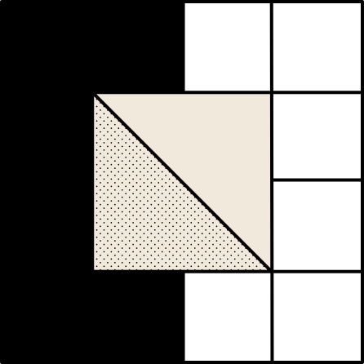
Approach for in-house activities
04/10
1. Mechanical design and Robot CAD
Requirements: Define payload, reach, mounting position, speed and application
Component selection: Verify motor dimensions, gearbox ratio, torque, bearings and brakes
Robot layout: Define 6 joint axes, link lengths, base and wrist arrangements
Part modelling: Create 3D models of links, housings, shafts, flanges and adapters
Assembly: Assemble all six joints with motors, gearboxes and bearings

Slide 8


05/10
Target Audience
Identify the key audiences for which
the project is intended.

Slide 9
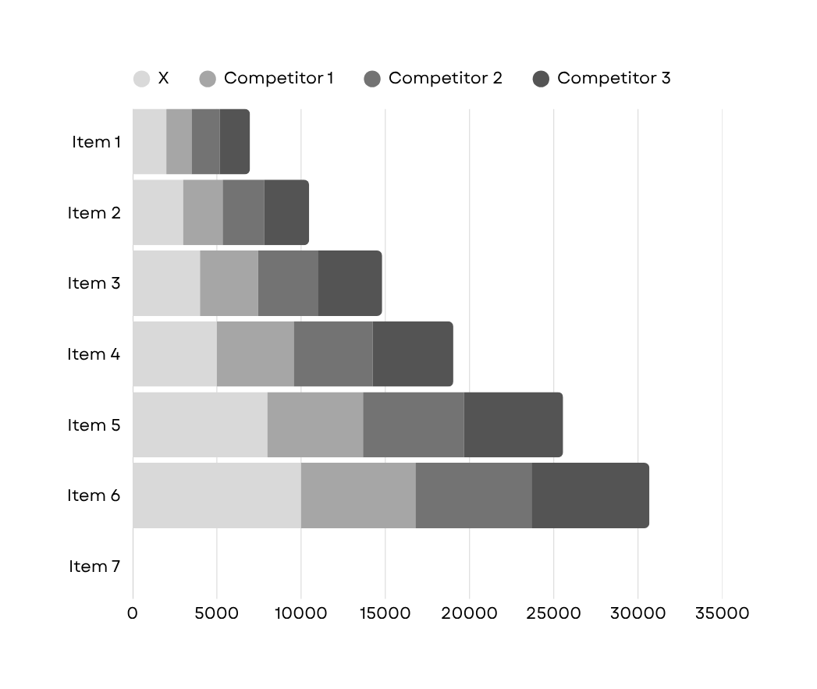
Competition
06/10
Introduce the company's main competitors.
Competitor #1
Write an observation about the competitor.
Competitor #2
Write an observation about the competitor.
Competitor #3
Write an observation about the competitor.

Slide 10
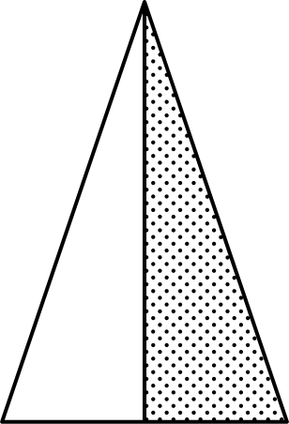
Timeline
07/10
Briefly discuss the key dates for the project.
1st Quarter
2nd Quarter
3rd Quarter
4th Quarter
List a milestone or deadline.
List a milestone or deadline.
List a milestone or deadline.
List the expected wrap-up date for the project.

Slide 11

08/10
Message from project founder
Presentations are communication tools that can be used as demonstrations, lectures, speeches, reports, and more. It is mostly presented before an audience. It serves a variety of purposes, making presentations powerful tools for convincing and teaching.

Slide 12




Our team
09/10
Project Manager's Name
Project Manager's Name
Project Manager's Name
Project Manager's Name
Add role
Add role
Add role
Add role

Slide 13
10/10
Thank you
CONTACT US
E-mail
hello@reallygreatsite.com
Social Media
@reallygreatsite
Phone
+123-456-7890
Address
123 Anywhere St., Any City, ST 12345
www.reallygreatsite.com

Slide 14



Resource
Page
USE THESE DESIGN RESOURCES IN YOUR CANVA PRESENTATION. HAPPY DESIGNING!
DELETE OR HIDE THIS PAGE BEFORE PRESENTING.

Slide 15

Resource
Page
B for blur | C for confetti
D for a drumroll | M for mic drop
O for bubbles | Q for quiet
U for unveil | Any number from 0-9 for a timer
FIND THE MAGIC AND FUN IN PRESENTING WITH CANVA PRESENTATIONS. PRESS THE FOLLOWING KEYS WHILE ON PRESENT MODE!
DELETE OR HIDE THIS PAGE BEFORE PRESENTING.

Slide 16
Resource
Page
Click the Share button on the top right corner of your screen and select 'Present and Record.'
Click ‘Go to recording studio,’ where you can choose the video and audio source for your video presentation.
Feel free to choose the ‘No camera’ option and record your voice only.
Start recording, and press pause in between takes if you have to.
Once you're done, download your Canva Presentation in MP4 file format or get a link to your Talking Presentation and share it with others.
You can also record a video inside the editor! Go to 'Uploads' and click on 'Record yourself'.
PRESENTING LIVE NOT YOUR THING? NO WORRIES! RECORD YOUR CANVA PRESENTATION YOUR AUDIENCE CAN WATCH AT THEIR OWN PACE.
DON'T FORGET TO DELETE OR HIDE THIS PAGE BEFORE PRESENTING.

