Slide 1

LGB
LGB
OPERATIONS TECHNOLOGY
OPERATIONS TECHNOLOGY
October 2026
October 2026
Weekly Project Progress
Weekly Project Progress
Robotic Automation Projects
Robotic Automation Projects
Stellantis • Daimler • Helical • Ather • BMW RAD
Stellantis • Daimler • Helical • Ather • BMW RAD
LGB | Operations Technology
LGB | Operations Technology

Slide 2
PROJECT OVERVIEW
S.No | Project | Process Scope | Robots / Cobots | Start Date | End Date | Current Status
1 | Stellantis line 1-Phase | OP10 , Ultrasonic washing , Vision , OilWashing | 2 × UR12e Cobots | 07-07-2025 | 20-07-2026 | Installation & inprogress
2 | Helical Line | OP10 → OP20 | 2 UR12e Cobot + 1 yaskawa 20kg robot | 31-03-2026 | 20-10-2026 | 2 Cobot cell installation & commissioning inprogress
3 | Daimler Line | OP10 → OP20 | 4 × UR12e Cobots | 24-04-2026 | 15-10-2026 | One cell production trail done, To start program for next cell
4 | Ather Line | OP10 → OP20 | 5 × ABB 12kg Cobots | 15-02-2026 | 24-10-2026 | Waiting for FAT
5 | BMW RAD Line | OP10 → OP20→OP30→OP40 | 4 Cobots + 1 AMR | 02-02-2026 | 28-10-2026 | DAP Review Completed, 24.10.2026 Materail Inward
LGB | Operations Technology
WEEKLY REPORT

Slide 3
STELLANTIS LINE - PHASE 1
WEEK 02 (PLAN vs ACTUAL)
S.No | Task | Responsibility | Planned |  | Actual |  | Status | Remarks
 |  |  | Start | End | Start | End
1 | OP10 Plunger mechanism Implementation | Robonetics | 01.10.2026 | 03.10.2026 | 01.10.2026 |  | OPEN | Robonetics working on Plunger
2 | UW - Complete Cobot Programming | Robonetics | 05.10.2026 | 08.10.2026 | 08.10.2026 | 15.10.2026 | CLOSE | Complete program completed
3 | UW - Oil dipping station grouting | LGB/Robenetics | 07.10.2026 | 07.10.2026 | 14.10.2026 |  | OPEN | Station position done and grouting pending for robonetics team input
4 | UW - Metal bin modification for programming | LGB | 07.10.2026 | 07.10.2026 | 13.10.2026 | 13.10.2026 | CLOSE | Completed
5 | UW - Complete Trail without pusher setup | Robonetics | 13.10.2026 | 16.10.2026 | 15.10.2026 |  | OPEN | Bin in lifter not aligned in same position on continous process
WEEK 03 (PLANNED ACTIVITY)
S.No | Task | Responsibility | Planned |  | Actual |  | Status | Remarks
 |  |  | Start | End | Start | End
1 | Alignment correction for bin in lifter | Robonetics | 20.10.2026 | 22.10.2026 |  |  |  | Design Team work
2 | Continous running of UW station | Robonetics | 22.10.2026 | 24.10.2026
LGB | Operations Technology
WEEKLY REPORT

Slide 4
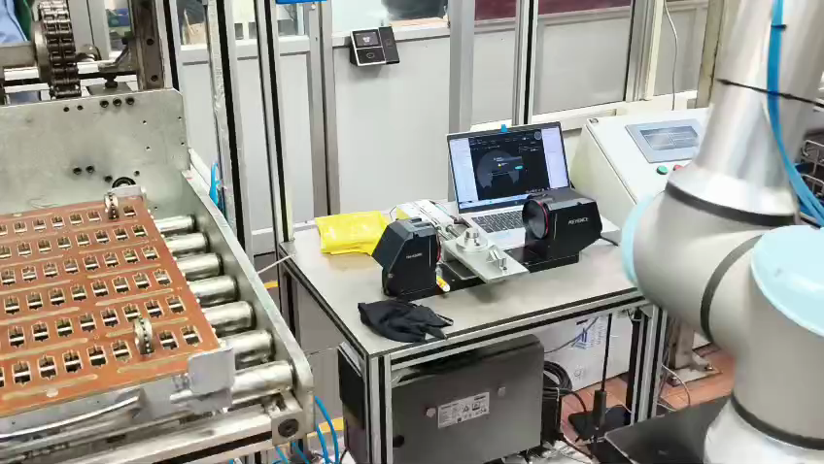
STELLANTIS LINE - PHASE 1
Stellantis line UW cobot program completion
LGB | Operations Technology
WEEKLY REPORT

Slide 5
HELICAL LINE
WEEK 02 (PLAN vs ACTUAL)
S.No | Task | Responsibility | Planned |  | Actual |  | Status | Remarks
 |  |  | Start | End | Start | End
1 | Cobot cells Mechanical setup assembly and grouting | Robonetics | 07.10.2026 | 08.10.2026 | 09.10.2026 |  | OPEN | Waiting for part confirmation and trail taken for 1790 OP10 machined part with exixting setup and shared for quality check. Confirmed line operator for scratch issue and observed parallelism around 100-200 micron
2 | Cobot programming for 1 cell | Robonetics | 08.10.2026 | 10.10.2026 | 15.10.2026 |  | OPEN
3 | Completion of PLC logic for 1 cell | Robonetics | 12.10.2026 | 13.10.2026 | 15.10.2026 |  | OPEN
4 | Complete trail in 1 cell | Robonetics | 12.10.2026 | 14.10.2026 |  |  | OPEN
5 | Machine Movement for robot cells | LGB | 08.10.2026 | 08.10.2026 |  |  | OPEN | Pending with plant team
6 | Robot reach check confirmation | LGB | 16.10.2026 | 17.10.2026 |  |  | OPEN
WEEK 03 (PLANNED ACTIVITY)
S.No | Task | Responsibility | Planned |  | Actual |  | Status | Remarks
 |  |  | Start | End | Start | End
1 | Confirmation on 1790 part to proceed | LGB | 17.10.2026 | 17.10.2026
2 | Cobot programming for 1 cell | Robonetics | 20.10.2026 | 21.10.2026
3 | Complete trail in 1 cell for 1790 | Robonetics | 22.10.2026 | 23.10.2026 |  |  |  | Flipping station pending
4 | Confirmation on parts for commissioning | LGB | 20.10.2026 | 20.10.2026
LGB | Operations Technology
LGB l Operations Technology
WEEKLY REPORT

Slide 6
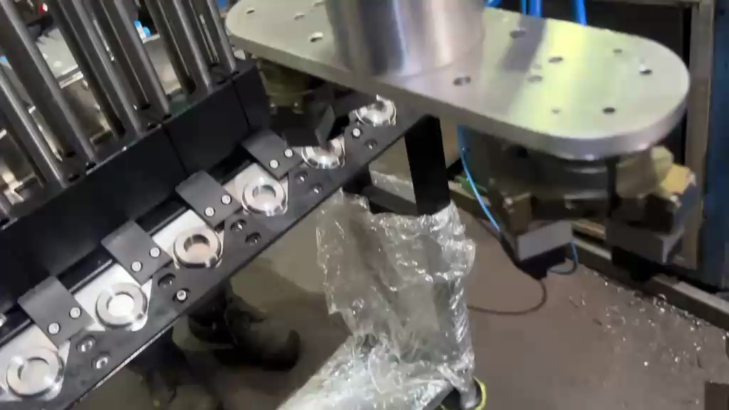
HELICAL LINE
HELICAL LINE 1790 CELL TRAIL ON SCRATCH WITH OP10 MACHINED PARTS
LGB | Operations Technology
LGB l Operations Technology
WEEKLY REPORT

Slide 7
DAIMLER LINE
WEEK 02 (PLAN vs ACTUAL)
S.No | Task | Responsibility | Planned |  | Actual |  | Status | Remarks
 |  |  | Start | End | Start | End
1 | 1361 - Production trail | Multivista | 05.10.2026 | 09.10.2026 | 05.10.2026 | 10.10.2026 | CLOSE
2 | 1361 - HMI stand mounting | Multivista | 09.10.2026 | 09.10.2026 | 09.10.2026 | 09.10.2026 | CLOSE
3 | LMW team support I/O configuration | Multivista | 09.10.2026 | 13.10.2026 | 09.10.2026 |  | OPEN | 2 machines completed, 2 machines planned on 17.10.2026
4 | Remaining cell cobot installation | Multivista | 12.10.2026 | 13.10.2026 | 14.10.2026 | 14.10.2026 | CLOSE
5 | Remaining cell mechanical assembly | Multivista | 12.10.2026 | 14.10.2026 | 16.10.2026 |  | OPEN | Delayed in confirmation of part and machine handover from plant team
6 | Cobot programming for 1 cell - 1217 | Multivista | 14.10.2026 | 15.10.2026 |  |  | OPEN
7 | Completion of PLC logic for 1 cell - 1217 | Multivista | 14.10.2026 | 16.10.2026 |  |  | OPEN
8 | Complete trail in 1 cell - 1217 | Multivista | 16.10.2026 | 17.10.2026 |  |  | OPEN
WEEK 03 (PLANNED ACTIVITY)
S.No | Task | Responsibility | Planned |  | Actual |  | Status | Remarks
 |  |  | Start | End | Start | End
1 | 1361 - Handover to production | Multivista/LGB | 22.10.2026 | 22.10.2026
2 | Dry run and Cycle time optimization - 1217 | Multivista | 23.10.2026 | 23.10.2026
3 | Electrical wiring and cable connections for all cells | Multivista | 16.10.2026 | 19.10.1026
LGB | Operations Technology
LGB l Operations Technology
WEEKLY REPORT

Slide 8
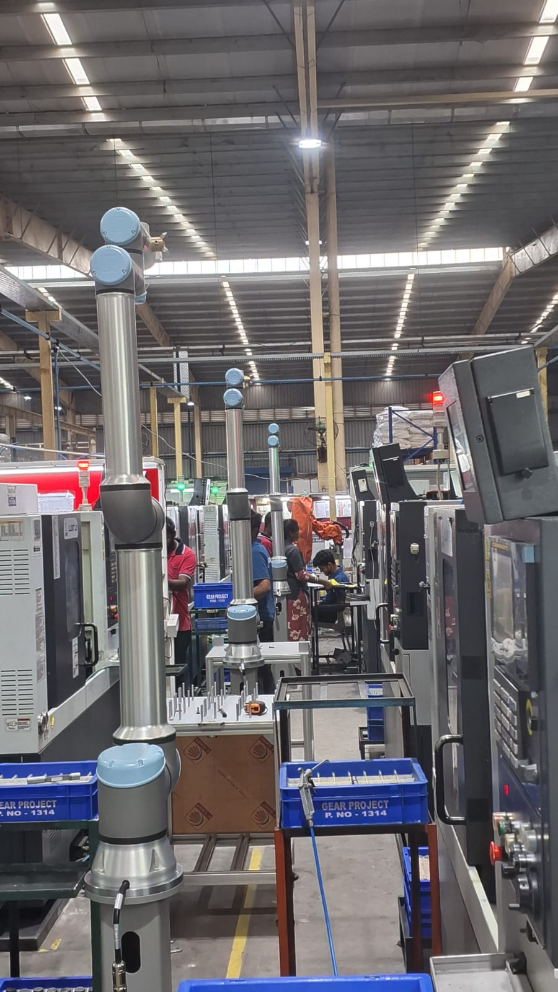
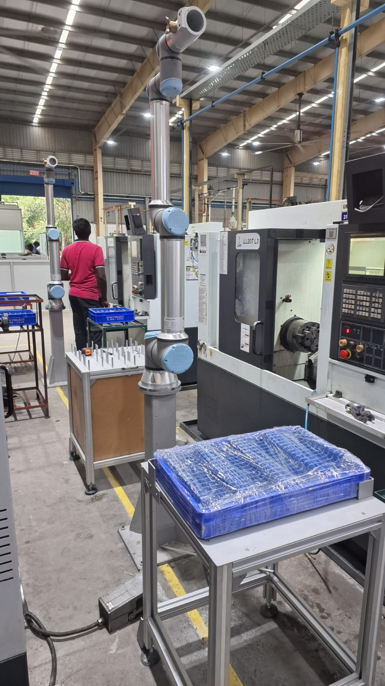
DAIMLER LINE
DAIMLER LINE 4 CELL COBOT GROUTING
DAIMLER LINE 1217 PART INPUT TABLE & OUTPUT TABLE IS GROUTED
LGB | Operations Technology
WEEKLY REPORT

Slide 9
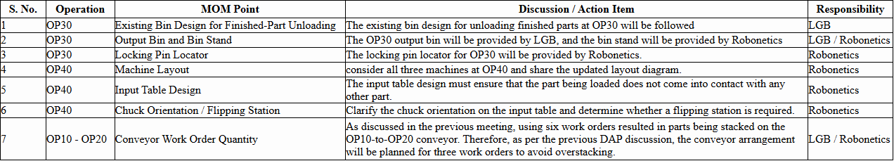
BMW - RAD LINE
WEEK 03 (PLANNED ACTIVITY)
S.No | Task | Responsibility | Planned |  | Actual |  | Status | Remarks
 |  |  | Start | End | Start | End
1 | OP40 Three cell layout redesign in DAP | Robonetics | 15.10.2026 | 21.10.2026
2 | Inward of materails commited | Robonetics | 15.10.2026 | 24.10.2026
DAP Discussion MOM Points
LGB | Operations Technology
LGB l Operations Technology
WEEKLY REPORT

Slide 10
OTHER PROJECT DETAILS
S.No | Task | Responsibility | Planned | Status | Remarks
1 | Ather Material Readiness | Melss | 21.10.2026 | In-Progress | FAT planned on 26.10.2026 - Commited by Melss
2 | Camera Installation in Diamler line | OT Team | 17.10.2026 | In-Progress | Temporary camera view changed with existing, New camera in Capex budget
3 | Texsonics robot trail | OT Team/Texsonics | 28.10.2026 | In-Progress | Tenative on trail date. Quotation to be shared on 22.10.2026
LGB | Operations Technology
WEEKLY REPORT

Slide 11
October 2026
Weekly Project progress review
LGB | Operations Technology
Thank You

