Slide 1

Analysis of the National Rural Employment Guarantee Act (NREGA)
Presented by Nouhaila TYOUBI

Slide 2
Project Overview
Brief Introduction to NREGA
A social security policy known as the National Rural Employment Guarantee Act (NREGA) was passed in 2005 with the intention of improving the livelihood security of rural households in India. Every rural household whose adult members agree to perform unskilled manual labor is guaranteed 100 days of paid employment under NREGA within a fiscal year.
Importance of the Scheme for Rural Employment:
Alleviation of Rural Poverty and Unemployment: NREGA is essential in lowering unemployment and poverty in rural regions by creating job possibilities.
Economic Empowerment: NREGA gives rural households the financial means to meet their basic necessities and raise their level of living by guaranteeing a minimum income.
Infrastructure Development: The NREGA work contributes to the development of rural infrastructure through the use of water conservation, drought resistance, land development, and rural connectivity.
Social Inclusion: By giving women and members of underprivileged populations like Scheduled Castes (SCs) and Scheduled Tribes (STs) jobs, the program fosters social inclusion.
Sustainable Development: By emphasizing ecological conservation and natural resource management, NREGA promotes sustainable development methods.

Slide 3
Problem Statement
Key questions and challenges:
Effectiveness of NREGA in providing employment
Regional disparities
Budget utilization and employment generation
Factors contributing to work completion
Role of data-driven insights for policy optimization

Slide 4
Dataset Information
Content: 28 columns covering various aspects of NREGA implementation
Key Variables:
State and district names
Number of job cards and workers (total and active)
Details on SC/ST workers
Budget and expenditure details
Work completion and ongoing works
Employment metrics (persondays, wage rate, household participation)
Expenditure breakdowns (NRM, agriculture, administrative costs)

Slide 5
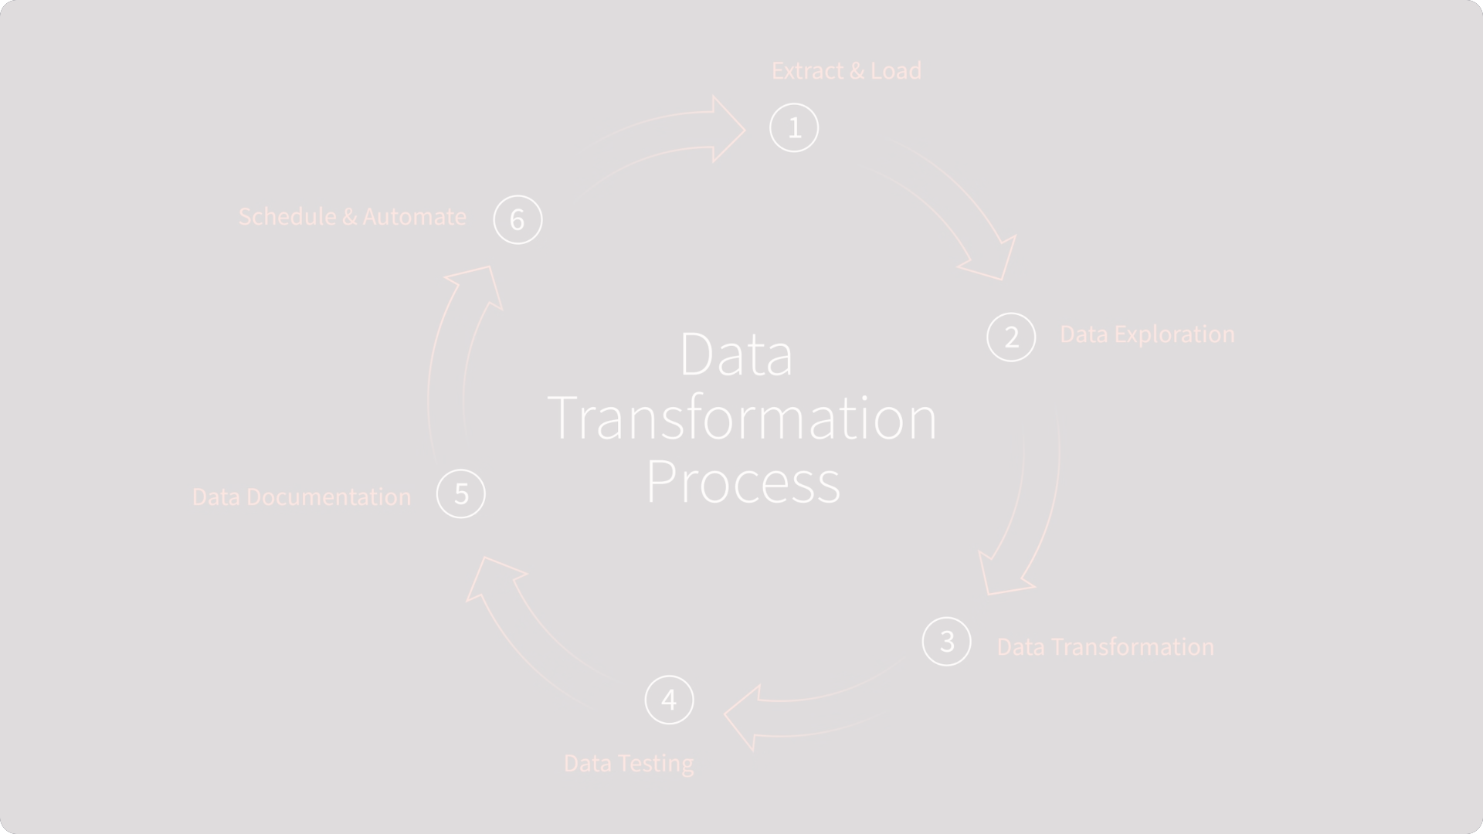
Scope of the Project
Objectives:
Data preprocessing and cleaning
Exploratory Data Analysis (EDA)
Data visualization
Insights for policymakers
Recommendations for optimization

Slide 6
Steps Taken
Handling missing values :
Verification: Carefully examined each column for any missing values. It was discovered that the dataset was full and that no missing values needed to be removed or imputationed.
Exploratory Data Analysis (EDA):
Descriptive statistics (mean, median, mode, and standard deviation) were computed for important variables such the total number of job cards issued, the total number of workers, the budget allocation, and the spending.
Correlation Analysis: Examined the connections between various variables to find noteworthy correlations, like those between employment creation and budget allocation.

Slide 7
Key Findings from EDA
High Correlation Among Financial Metrics: There is a strong correlation between Total Exp (in rupees), Wages (in rupees), and Material and Skilled Wages (in rupees). There is a direct correlation between rising labor and material expenses and higher overall spending.
Workers and Job Cards:Total Number of Active Workers and Total Number of Active Job Cards have a strong correlation with total spending, suggesting that greater levels of active engagement translate into higher total spending.
Approved Labour Budget: has a strong association with wages and overall spending, suggesting that budget allocation is a major factor influencing these costs.
Persondays Metrics: The significant contribution of Central Liability Persondays and their subcategories, such as SC Persondays and Women Persondays, to overall expenditures is demonstrated by their strong correlation with total expenditures.

Slide 8
Key Findings from EDA
Performance Metrics: The number of households that have completed 100 days of wage employment and the average number of days of employment per household have moderately favorable associations with total expenditure.
Works in Category B and NRM Expenditure: Positive association with the number of works undertaken and completed. NRM Expenditure and Agriculture & Allied Works have an inverse relationship.
Administrative Expenditure:Strong relationship with wages, material expenses, and overall spending, indicating a large portion of administrative costs in total expenditure.
Contrary Correlations: The average daily pay per person demonstrates somewhat negative associations with multiple indicators, suggesting that greater wage rates may not always translate into higher overall expenditures.

Slide 9
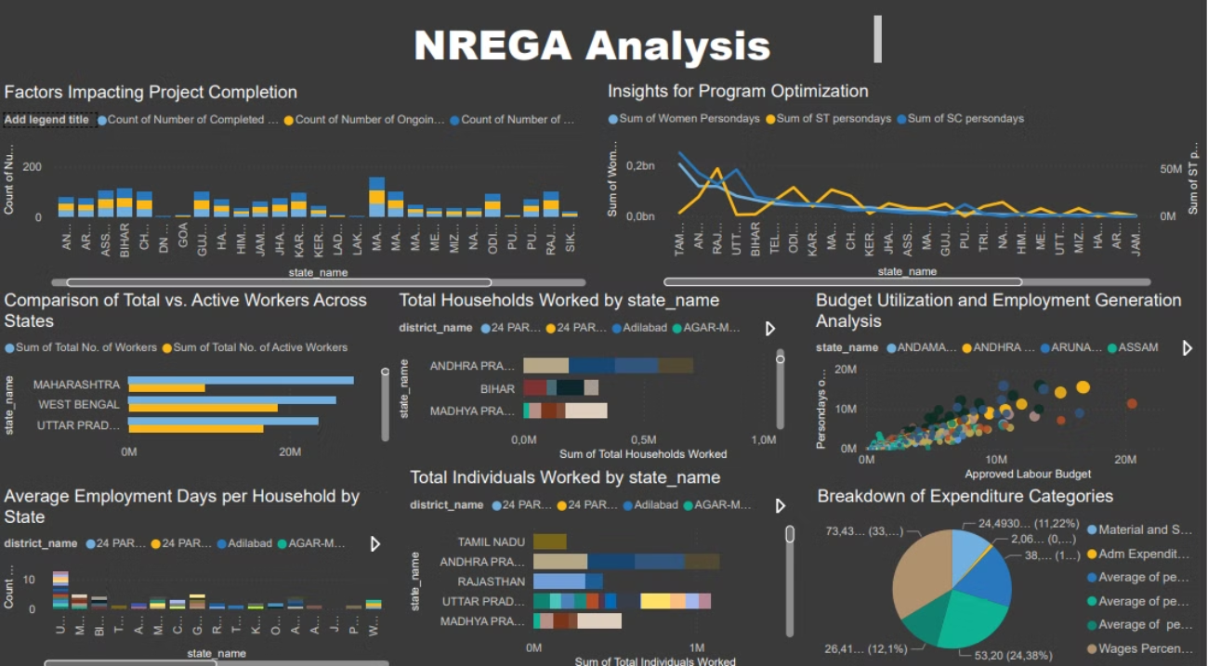
Data Visualization

Slide 10
Insights and recommendations from Data Analysis
Budget Allocation Impact:
Insight: There is a strong correlation between approved budgets and actual expenditures, indicating that meticulous budget planning is crucial for managing overall costs.
Recommendation: Optimize budget allocation based on historical expenditure patterns to ensure funds are used effectively and overall costs are controlled.
Focus on Inclusivity:
Insight: High correlations of SC (Scheduled Castes) and women person-days with total expenditure highlight the significant impact of inclusive employment policies on financial metrics and overall program success.
Recommendation: Strengthen programs targeting SC and women workers to leverage their substantial impact on expenditure and program effectiveness.
Administrative Efficiency:
Insight: A significant correlation exists between administrative expenditure and total costs, suggesting that improving administrative efficiency can potentially reduce overall expenditures.
Recommendation: Streamline administrative processes by reducing redundancies and investing in technology to lower administrative costs.

Slide 11
Work Completion Rates:
Insight: A positive correlation between Category B works and the number of works completed suggests that focusing on these types of works may improve project completion rates.
Recommendation: Prioritize Category B works to increase the number of projects undertaken and completed, thereby enhancing overall project completion rates.
Investment in NRM (Natural Resource Management):
Insight: An inverse relationship between NRM and agricultural expenditure implies a need for balanced investment strategies to ensure sustainable development without compromising agricultural projects.
Recommendation: Develop balanced investment strategies to ensure both NRM and agricultural projects receive adequate funding, promoting sustainable development without compromising either area.

Slide 12
Insights and Recommendations for NREGA Dashboard Analysis
Factors Impacting Project Completion:
Insight: States with a higher number of completed projects have a balanced distribution of ongoing and new projects. States like Maharashtra and Uttar Pradesh show more ongoing and new projects compared to completed ones, indicating potential bottlenecks or delays.
Recommendation: Conduct root cause analysis in states with high ongoing and new projects but low completions to identify and mitigate delays. Implement stricter project timelines and regular monitoring to ensure timely completion.
Program Optimization and Inclusivity:
Insight: States like Tamil Nadu, Rajasthan, and Bihar exhibit high person-days for women, ST, and SC, indicating better inclusion. States like Karnataka and Madhya Pradesh show lower person-days for these groups, suggesting a need for targeted interventions.
Recommendation: Enhance outreach and support mechanisms for marginalized communities in states with low person-days for women, ST, and SC to ensure equitable participation. Implement community-specific interventions.
Worker Engagement:
Insight: States with the highest total number of workers (Maharashtra, West Bengal, and Uttar Pradesh) see a significant drop in active workers, indicating issues in worker engagement or retention.
Recommendation: Increase worker participation by offering incentives for active participation and regular attendance. Provide skill development programs to make work more attractive and beneficial for workers.

Slide 13
Household Engagement:
Insight: States like Andhra Pradesh and Bihar have high household engagement, showing effective program reach. States with lower engagement may need improved awareness campaigns and streamlined processes.
Recommendation: Strengthen awareness campaigns in states with low household and individual engagement to boost participation. Simplify registration and work allocation processes to make it easier for workers to join and stay engaged.
Budget Utilization and Employment Generation:
Insight: There is a positive correlation between approved labor budgets and person-days generated, with states like Andhra Pradesh, Maharashtra, and Uttar Pradesh leading. States with lower person-days despite high budgets may need to audit fund utilization.
Recommendation: Regularly audit fund usage in states with low person-days despite high budgets to identify and eliminate inefficiencies. Reallocate unutilized funds to states or districts demonstrating effective utilization.
Average Employment Days per Household:
Insight: Districts in Andhra Pradesh and Tamil Nadu show higher average employment days per household, indicating better employment distribution. Districts with lower average employment days might need policy adjustments.
Recommendation: Implement policies to ensure more consistent and longer-term employment opportunities in districts with lower average employment days. Provide flexible work options and ensure timely payments to retain workers.

Slide 14
Individual Engagement:
Insight: States like Tamil Nadu, Andhra Pradesh, and Rajasthan have a high number of individuals engaged, reflecting strong program implementation. States with fewer individuals engaged may need improved outreach strategies.
Recommendation: Improve outreach and registration processes in states with fewer individuals engaged to increase participation. Implement strategies to ensure more individuals are aware of and can easily join the program.
Expenditure Categories:
Insight: A significant portion of expenditure is directed towards material and skilled wages, which is essential for infrastructure but must be balanced with wages for unskilled workers.
Recommendation: Ensure a balanced allocation of funds between material/skilled wages and unskilled wages to maintain a fair distribution of resources and support for all worker categories

Slide 15
Thank you

