Slide 1
Using Convolutional Neural Network (CNN) to Classify Text
Presented by:
Abdoul-Nourou Yigo

Slide 2
Project Outline
Motivation
Implementation
Demonstration
Evaluation
Conclusion

Slide 3
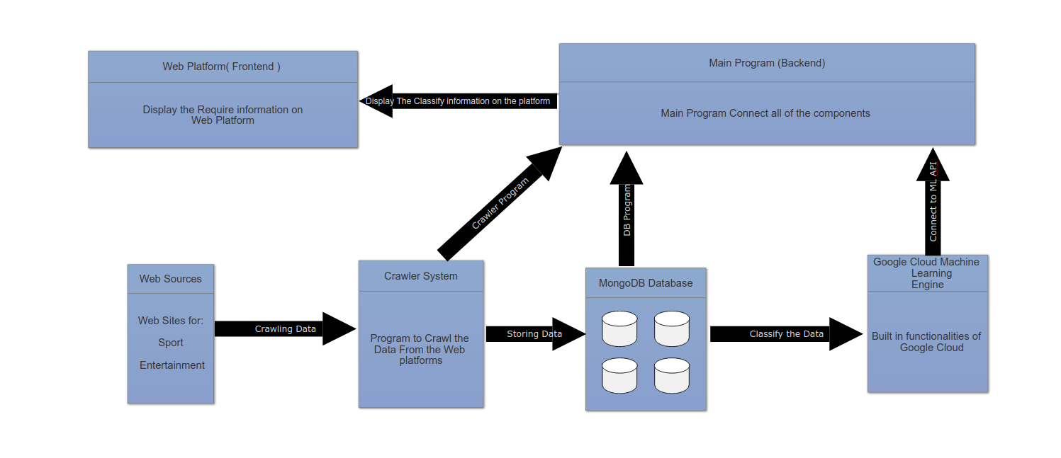
Motivation

Slide 4
Neural Network for Natural Language Processing ( NLP )
The Obejctive of this project was to learn the concept of Neural Network for Natural Language Processing ( NLP )
Doing some research we found that the best ressource to use for NLP is
Convultional Neural Network ( CNN )
In “Convolutional Neural Networks for Sentence Classification” , they state that
CNN could be the better approach for text classification
What is Neural Network
It is machine learning technique that allows the processing and validation of data
It has different layers
Starting from the input where the data is passed
For instance “text”
The Ouputs
That’s the outcome of the processing traversing the layers
In our case we tested the performance of the netowork
Improvement of the accuracy by checking the loss

Slide 5
CNN Architecture
CNN is one of the variety of neural network with different layers that requires some special modeling
In (Zhang et al,. 2016) have found a modeling that could be well-suited to the implementation
Input word vector representation from an unsupervised neural language model ( Glove )
GloVe: Global Vectors for Word Representation
Glove represents each word with a real-valued vector.
Filter region size( s )
Use the filters with widths equal to the dimensionality of the word vectors
The most popular filter used for CNN is ( 3, 4, 5 )
The pooling strategy
A function that applied to each feature map to induce a fixed length vector
The number of features maps
1-max pooling
Extracts the scalar from each feature map
Concatenated into a fixed-length
Which is fed to the softmax function
Regulation terms ( dropout / l2 )
Softmax layer is the probalitity distribution over labels

Slide 6
CNN Structural Approaches
For the implementation we have used different CNN structural approaches to test the performance of each structure with various dataset.
In (Zhang et al,. 2016) they found CNN could be implemented in different ways
CNN-static:
Model with pre-trained vector from Glove
All word including the unknown are randomly initialized
Kept static and only the parameter of the model are learned
CNN-non-static
The pretrained vectors are fine-tuned for each task
Region size ( 3, 4, 5 )

Slide 7
Implementation
I have used three different datasets with different categories
The list of dataset are:
20newsgroups
With 20 categories
Sports
technology
relegion
Politics
sales, etc.
bbc News dataset
With 5 categories
business
Entertainment
politics
sport
tech

Slide 8
Implementation Cont...
bbcsport:
Category
Sports
subCategories
Athletics
Cricket
football
rugby
tennis
We have done 6 different tests with this set of data
Three tests using a static CNN implementation
Three tests using non static CNN implementation with filter size ( 3, 4, 5 )
For a more complex CNN structure

Slide 9
Major features Use for The implementation
For the implementation we have used valuable ressources that have made this implementation possible
Keras Library to build the CNN model
Layers Use:
Concatenate: Layers that concatenates a list of inputs
Conv1D: a tensor, result of 1D convultion
MaxPooling1D: Max pooling for temporal data
Dense : In a dense, all nodes in the previous layer connect to the nodes in the current layer
TensorFlow
For high numerical computation
Numpy
It is used to structure the data
Matplotlib
For Plotting
Sklearn
To download the data

Slide 10
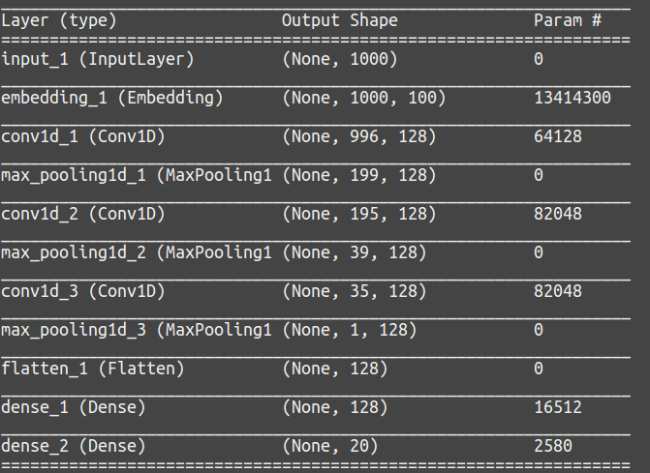
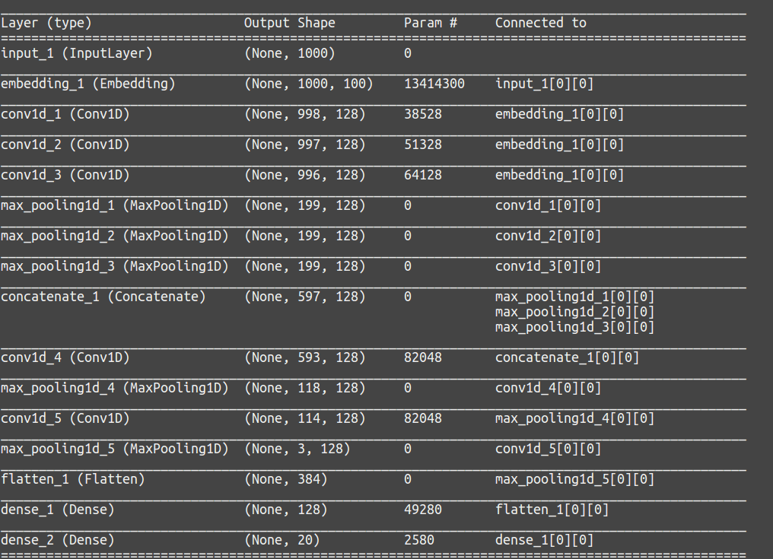
Model Structures Using Keras
CNN-static CNN-non-static

Slide 11
Demonstration of the Application with bbcsport dataset
I am going to do a demonstration using the bbcsport dataset

Slide 12
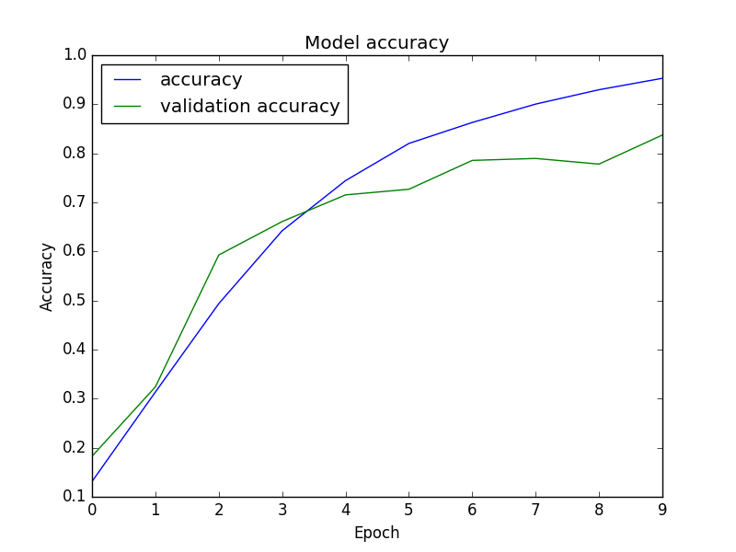
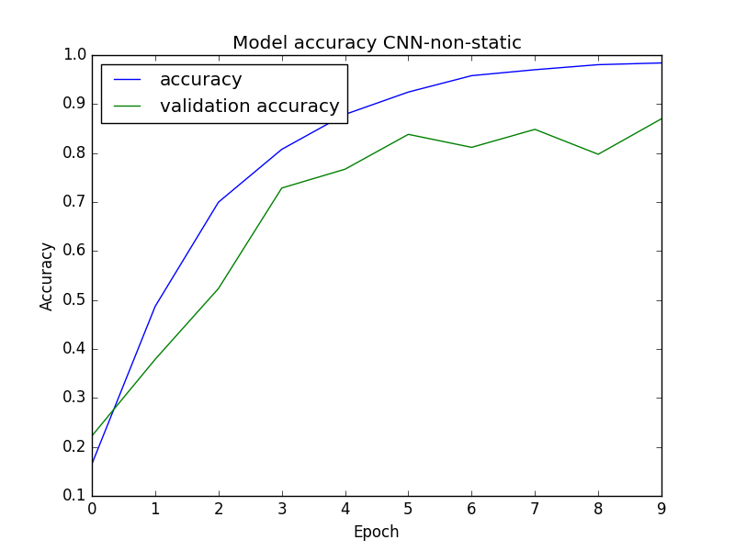
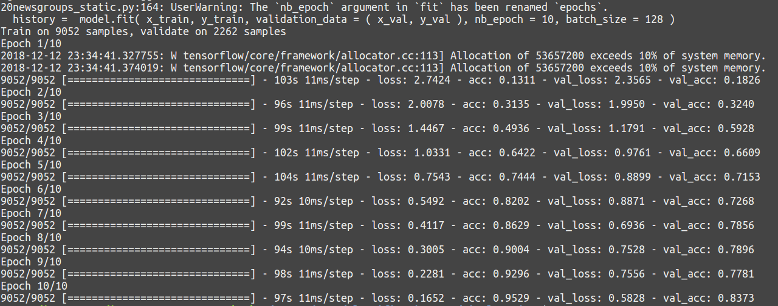
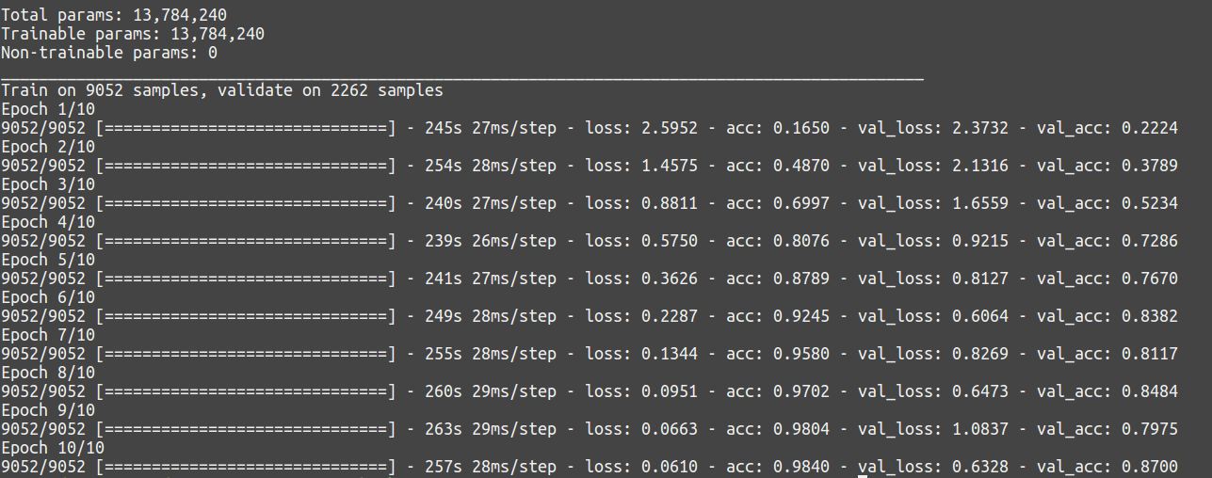
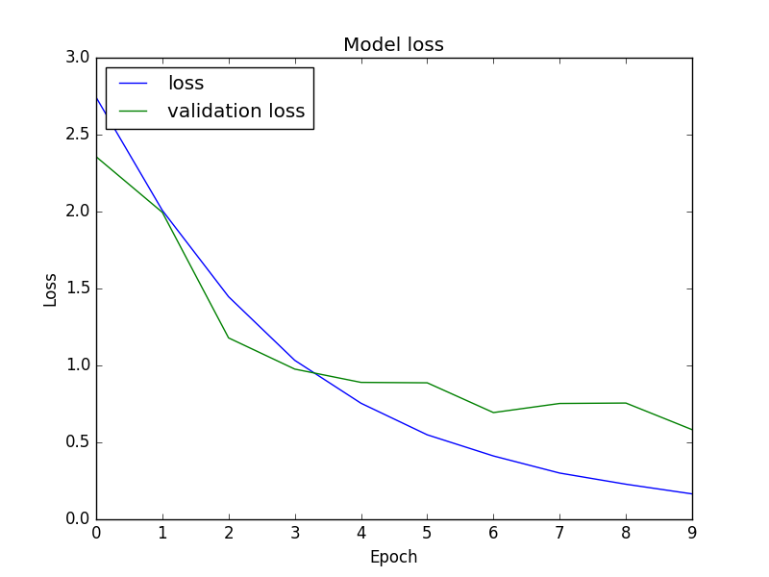
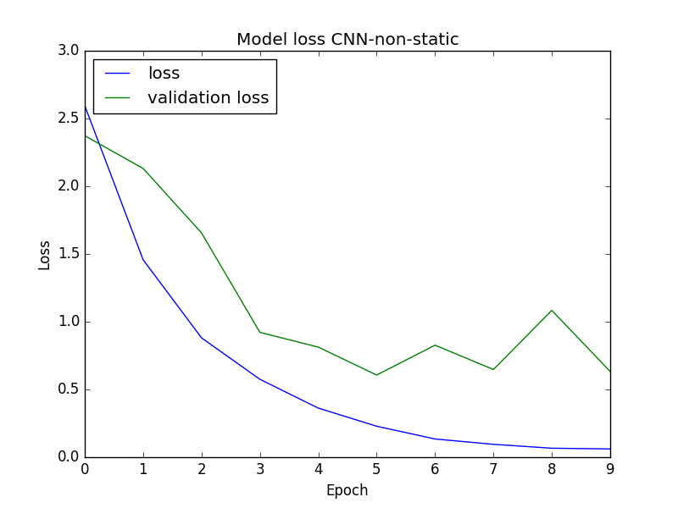
Evaluation for 20newsgroups dataset
We did 2 tests for each dataset, one CNN-Static and another CNN-non-static

Slide 13
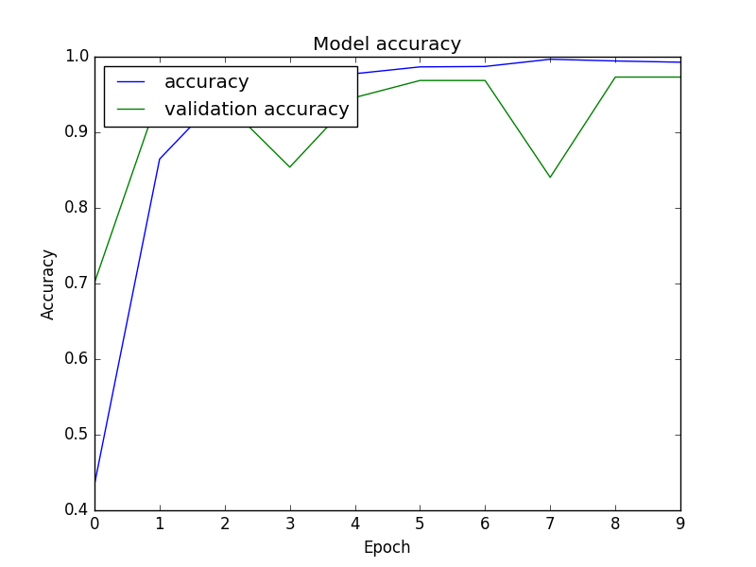
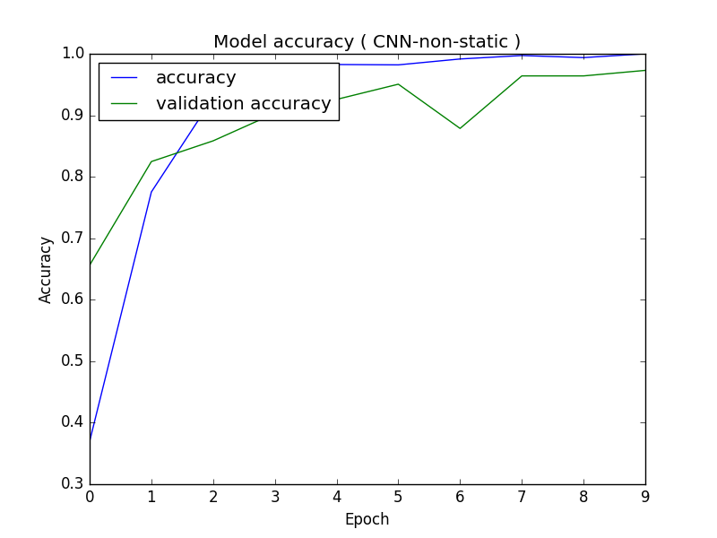
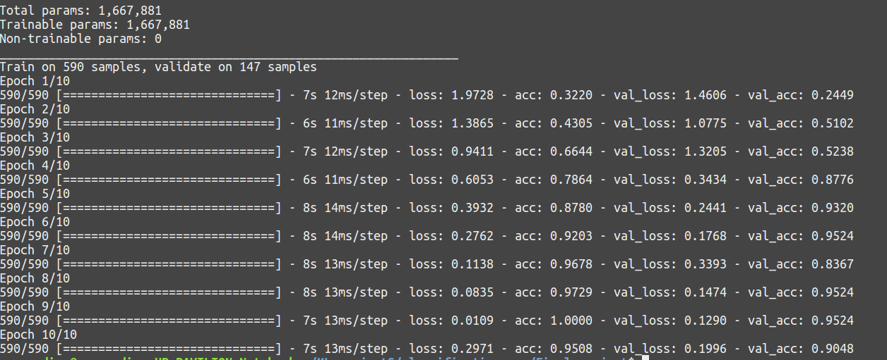
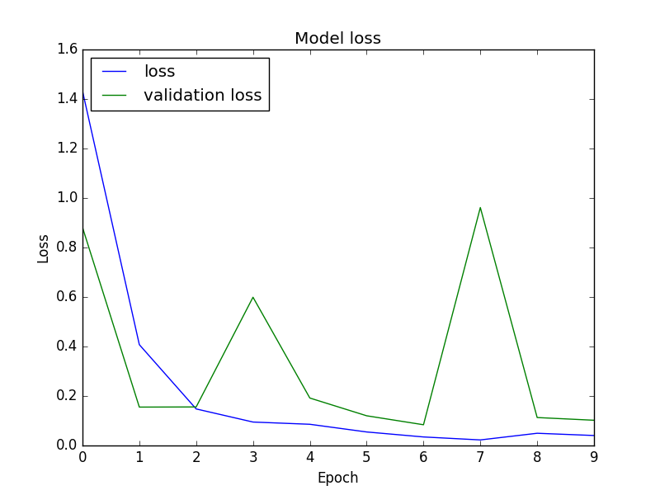
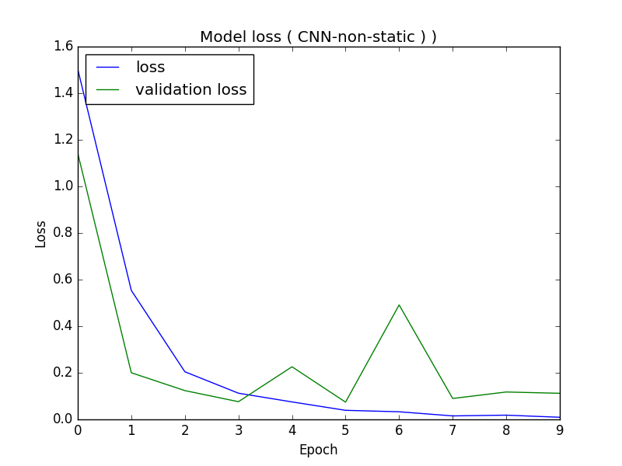
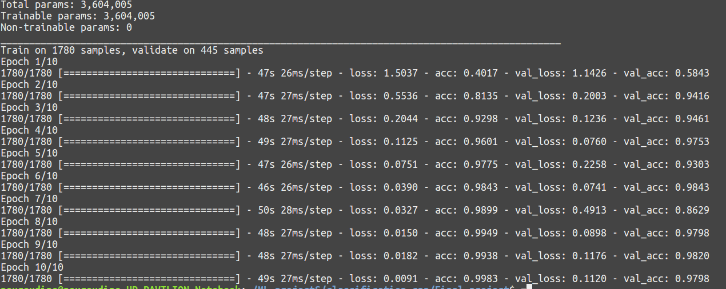
Evaluation for bbcnews dataset With 5 Categories

Slide 14
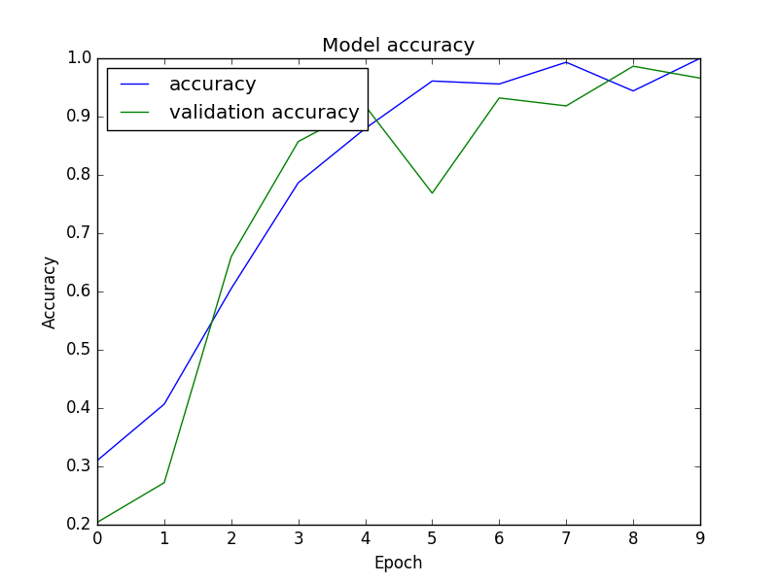
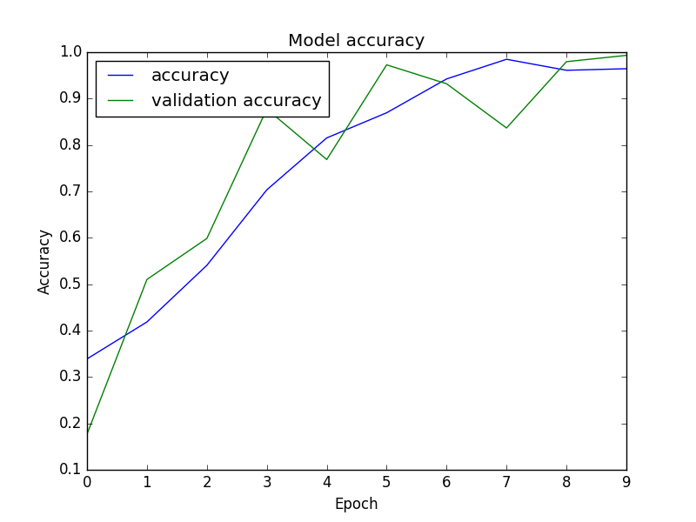
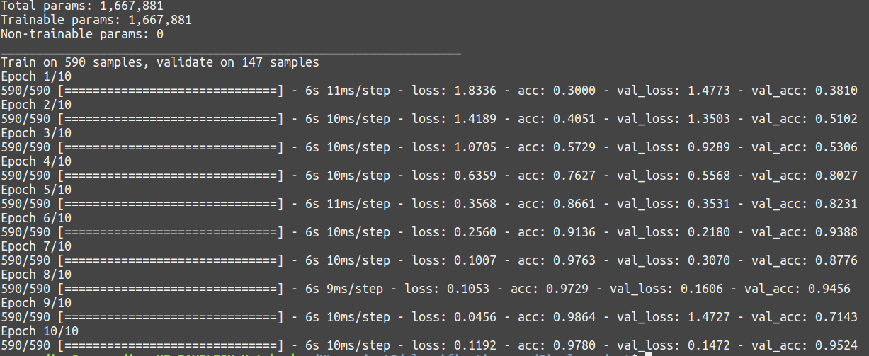
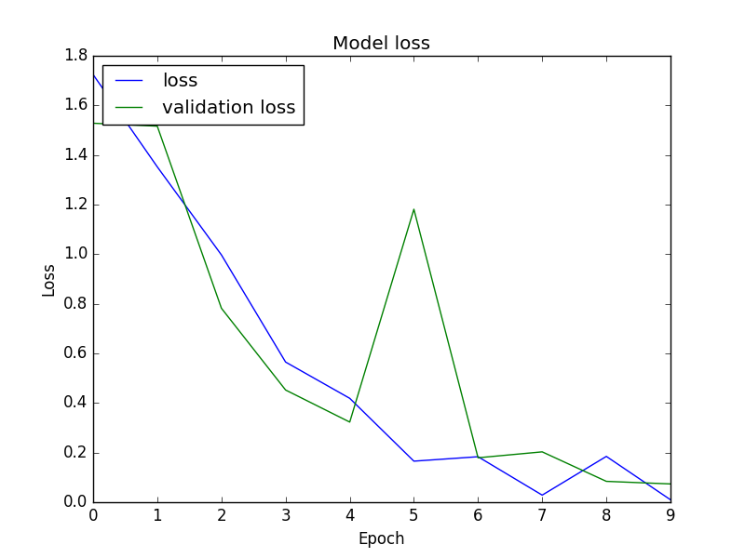
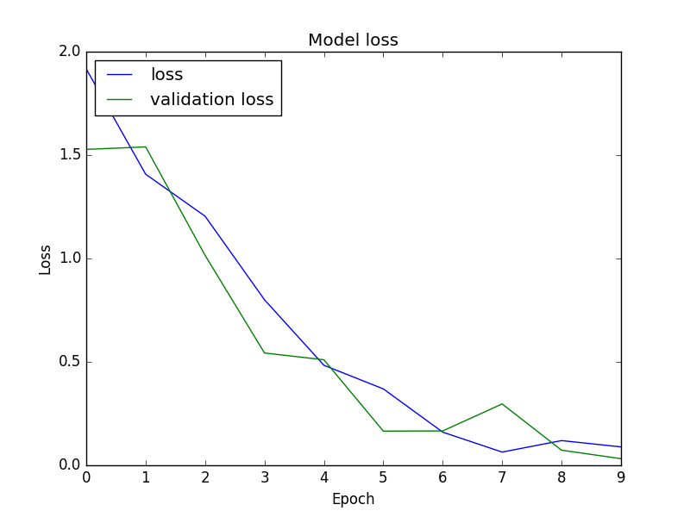
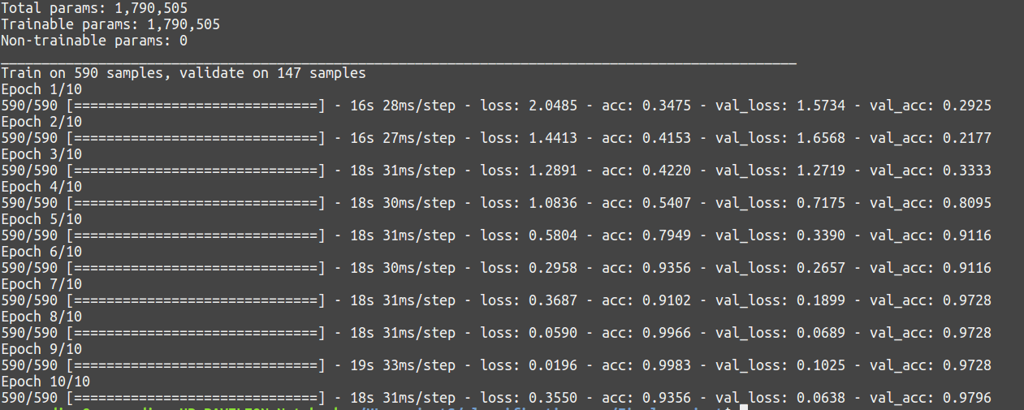
Evaluation for bbcsport dataset With 4 SubCategories

Slide 15
Evaluation Summary
This is a summary of all the results from different evaluations
 | CNN-Static | CNN-non-static
20Newsgroups with 20 Categories | 0.9529 | 0.9840
BbcNews with 5 categories | 0.9910 | 0.9983
bbcSport with 1 category | 0.9780 | 0.9356

Slide 16
Conclusion
We have used different dataset to test the accuracy of CNN models
This research would be extended
To get more understanding on how the platform could be build efficiently
The ressources that could be added to CNN for more results

Slide 17
References
[Kim2014] Yoon Kim. 2014. Convolutional neural networks for sentence classification. arXiv preprint arXiv:1408.5882.
[ Zhang et Wallace2016 ] Ye Zhang and Byron C. Wallace. 2016.. Wallace. 2016. A sensitivity analysis of (and practitioners’ guide to) convolutional neural networks for sentence classification. arXiv preprint arXiv:1510.03820.
D. Greene and P. Cunningham. "Practical Solutions to the Problem of Diagonal Dominance in Kernel Document Clustering", Proc. ICML 2006.

